Slide 1
PRESENTATION TO THE SELECT COMMITTEE POSTBANK AMENDMENT BILL MAY 2023

Slide 2
PRESENTATION OUTLINE
Main objectives of the Postbank Amendment Bill
Rationale for the establishment of the Bank Controlling Company (BCC)
Requirements to qualify for registration as a Bank Controlling Company
Detailed amendments to the South African Postbank SOC Limited Act
Public Comments received during the Portfolio Committee on Communication and Digital Technologies consultations on the Postbank Amendment Bill
Status of the Postbank Act Amendments process
Annexure : Actual Amendments

Slide 3
Objectives of the Postbank AMENDMENTS bill
To mainly amend the South African Postbank SOC Limited Act (Postbank Act) in order to mitigate against the risks associated with the structure envisaged in the Postbank Act, which makes SAPO the sole owner and shareholder of the Postbank:
To amend the shareholding arrangements for the Postbank (transferring shareholding from South African Post Office to the Government through the creation of a new bank controlling company.
Facilitate the establishment and registration of the bank controlling company (BCC) in terms of the Banks Act; and to provide for matters connected therewith.
The Ministry of Communications and Digital Technologies as the shareholder Department to be responsible directly for the Postbank as a stand alone on behalf of the Government:
This to be effected by establishing the BCC between Postbank and the Department in the reporting structure
To amend other sections of the Act impacted by the change in the Postbank reporting structure
Upon the enactment of the Postbank Bill, the BCC for Postbank will be registered in terms of the section 43 of the Banks Act to exercise control over the Postbank. This to conclude the Postbank licence application process

Slide 4
RATIONALE FOR THE ESTABLISHMENT OF THE BCC
A Bank Controlling Company (BCC) is required to be registered in terms of the section 43 of the Banks Act to exercise control over the Postbank:
Shareholder of reference for capital adequacy and in terms of compliance and submission of statutory monthly returns as stipulated in the Banks Act regulations and circulars.
The implication is that the BCC will step in to recapitalise and support its subsidiary bank if it runs into financial difficulties.
One of the key requirements is that the BCC must be in a financially sound position in terms of section 44(2)(e) of the Banks Act.
Meanwhile:
Section 3(2) of the Postbank Act states that, “upon the incorporation of the Postbank Company, SAPO shall be the sole member and shareholder of the Company” implying that SAPO needed to be registered as a BCC for Postbank.
To mitigate:
Appropriate BCC reporting structure had to be determined
Various BCC structure options were considered to determine the optimal option by DCDT & Treasury in consultation with the SARB and SAPO

Slide 5
REQUIREMENTS TO QUALIFY FOR REGISTRATION AS A BANK CONTROLLING COMPANY
BCC must be in a financially sound position in terms of section 44(2)(e) of the Banks Act
SAPO is not in a financial sound position to meet the requirements for registration as a BCC.
Very high capital adequacy requirements if SAPO were to be the direct shareholder of Postbank.
SAPO’s non-banking services posed a threat to the safeguarding of depositors’ funds in that Government will be obliged to provide on-going financial support to SAPO in order to maintain BCC structure position.
As result of the about challenges, the appropriate reporting structure of the BCC had to be determined.
To mitigate against the above risk to the Postbank banking licence application:
Various BCC structure options were considered to determine the optimal option by DCDT & Treasury in consultation with the SARB and SAPO

Slide 6
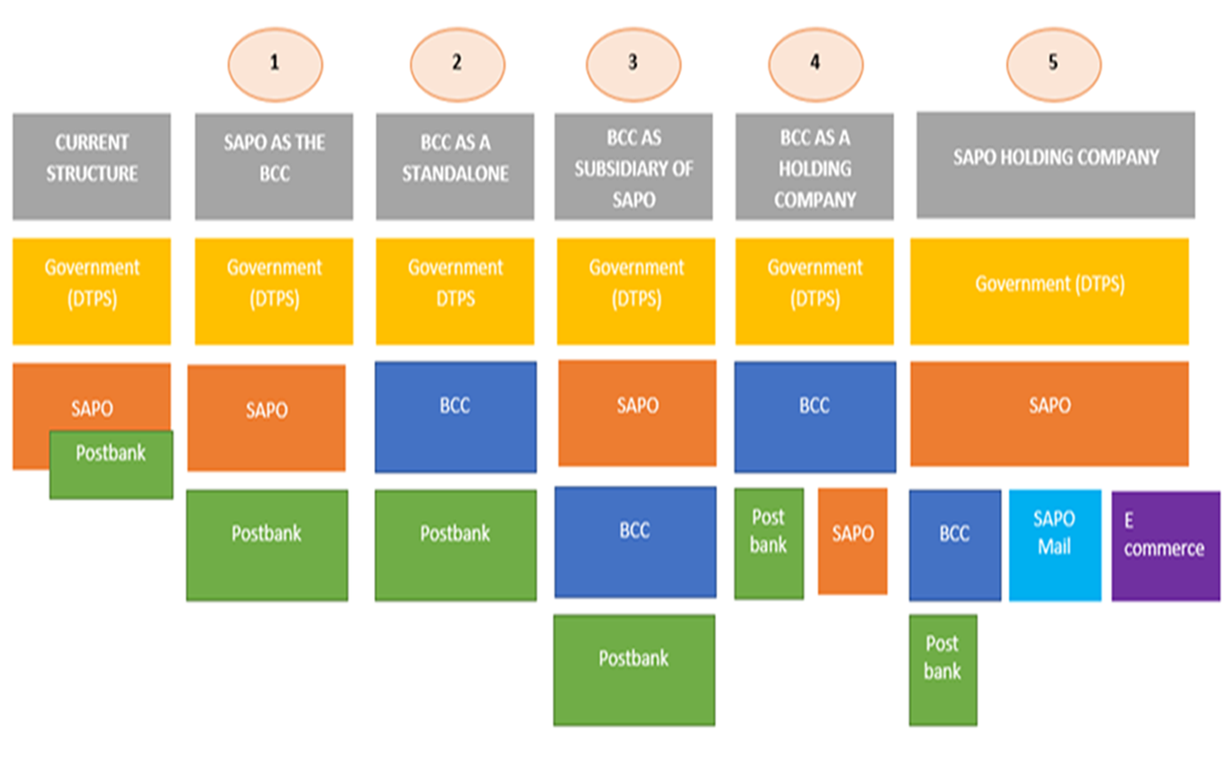
Various bcc structure options considered

Slide 7
bcc structure option CHOSEN
Option 2 (as recommended by the National Treasury which makes the Postbank report directly to the Department of Communications and Digital Technologies through the establishment of the Bank Controlling Company (BCC) between the Department and the Postbank was selected as the optimal reporting structure option:
Least financial implications for the bank based on the results of the financial audits on the capital costing requirements of the various options
SAPO’s financial and liquidity position and the requirements as outlined in the Financial Matters Amendments Act did not allow for the BCC to report to it, it reinforces the selected BCC option
In addition, SARB made it clear that it would be comfortable with the BCC structure endorsed by the National Treasury as it controls the fiscus
To effect the appropriate BCC structure for Postbank
Amendments to Postbank Act have been effected as contained in the Postbank Amendment Bill

Slide 8
status of the Postbank Act Amendments process
The Postbank Amendment Bill was developed by the Department of Communications and Digital Technologies in consultation with key stakeholders :
SAPO, Postbank and National Treasury
Submitted and presented to the Economic Sectors, Investment, Employment and Infrastructure Development (ESIEID) Cluster and Cabinet Committee after certifications by relevant authorities
Office of Chief State Law Advisor (OCSLA) – legal drafting
Department of Monitoring and Evaluation DPME - SEIAS report
The Bill was publicly consulted upon and the ESIEID Cluster supported the Bill for submission to the Ministerial Cluster after its comments were addressed
Cabinet approved the Bill for public comments and the revised Bill incorporating feedback from the public consultation have been presented to the Cabinet Committee on 02 March 2022 requesting approval to introduce the Bill in Parliament. The approval by Cabinet was granted.
The Bill was submitted to the Speaker of the National Assembly and the Chairperson of the National Council of Provinces during April 2022 for further processing in Parliament
The Portfolio Committee on Communications commenced its own processing of the bill and published the Bill for public comments
The Department assisted to respond to the public comments

Slide 9
status of the Postbank Act Amendments process (Public Comments) COMMENTS RELATE TO:
ORGANIZATION
COSATU | COSATU supports the amendments to the Postbank Amendment Bill given the critical mandate of the Postbank
Right2know | Minister of Communications’ role as sole shareholder of the BCC/ approval and power of the Minister to appoint Postbank’s Postbank Board members, CEO and CFO and the concurrence of the Minister of Finance in the board appointments.
Financial Sector Conduct Authority (FSCA) | Board members of the Bank Controlling Company
Banking Association of South Authority (BASA) | Financial services as defined in the FAIS Act
Ombudsman for Banking Services South Africa (OBSSA) | Some insertions/deletion of some definitions
NB. Although the organisations made comments in their submission, all the above organisations supported the Postbank Amendments Bill. The comments were incorporated in the revised Bill during the deliberation at the PCC

Slide 10
status of the Postbank Act Amendments process
The Portfolio Committee completed its deliberations on the Bill and approved the Bill for submission to the National Assembly for a debate and a vote.
The National Assembly has since approved the Bill for noting by the National Council of Provinces and then for President’s approval/signature
Conclusion:
The signing of the Bill into law will enable the completion of the Postbank License Application process
It is vital that the Select Committee supports the Bill for signing into Law

Slide 11
ANNEXURE A
Detailed amendments to the South African Postbank SOC Limited Act

Slide 12
AMENDMENTS TO BE ENACTED ON THE POSTBANK ACT
Section | Amendments
Clause 1 | Seeks to amend section 1 of the Act. It provides that definition contained in the Bill are amended or inserted for better understanding and interpretation relating to additional clauses.
Clause 2 | This clause provides for the amendment of section 2 by removing the words ‘‘legal person’’ and replace it with ‘‘company and bank controlling company’’ and by deleting ‘‘transactional’’ and replacing it with ‘‘financial services and banking services’’. This is to ensure better use of the language and interpretation of the Act. It also seeks to amend section 2(b) of the Act, after the words ‘‘Post Office’’ to insert the words ‘‘any other means of delivery the company may deem appropriate for its operational needs’’. This amendment seeks to give the Postbank operational flexibility in terms of the means of delivery of services to avoid solely depending on the SAPO infrastructure. Postbank shall also be able to take advantage of the Fintech opportunities. It further seeks to amend section 2(f) of the Act to provide for the objective of responsible lending to rural and lower income markets. It further provides for the amendment of section 2 of the Act by the addition of paragraph (g) which provides a further object of the Act for the Postbank Division of the Post Office to act as the delivery arm of government to effectively deliver financial and payment services to citizens. This amendment seeks to expand on the objectives of the Postbank. The insertion of a new paragraph (g) in section 2 of the Act seeks to distinguish the Postbank from the normal banks as the Postbank shall be a state-owned commercial bank conducting ‘‘the business of a bank’’ as defined in the Banks Act. This shall ensure that the Postbank shall act as the delivery arm of government to effectively deliver financial and payment services to citizens.

Slide 13
AMENDMENTS TO BE ENACTED ON THE POSTBANK ACT
Section | Amendments
Clause 3 | Provides for the amendment of section 3 of the Act to ensure the establishment of the BCC in terms of the Banks Act. Further provides for the amendment of section 3 of the Act to allow the Minister to consider and approve any other shareholding with the concurrence with the Minister of Finance and in line with the requirements of the Banks Act, Companies Act and the Financial Sector Regulation Act, 2017 (Act No. 9 of 2017). Further provides for the name of the BCC as the “South African Postbank SOC Limited” and that no other person, other than the Postbank, may carry on any business or be registered with that name. Further provides for the amendment of section 3 of the Act to provide that the BCC will hold 100% shares in the company on behalf of government representing the Minister and that the BCC will exercise oversight over the Postbank and ensures that the company exercises sound risk management and governance practices, in line with the Banks Act and its regulations. It also provides for the Minister to apply to register the BCC in accordance with section 43 of the Banks Act.

Slide 14
AMENDMENTS TO BE ENACTED ON THE POSTBANK ACT
Section | Amendments
Clause 4 | Provides for the amendment of section 9 of the Act by the insertion of paragraph (g) in subsection (1) to provide that the Company may use any infrastructure to render its services where the Post Office is not available or does not cater for its operational needs. Further provides for the substitution of section 9(2)(a) of the Act to provide that the Company, the BCC and the Post Office must, with the concurrence of the Minister conclude an agreement which governs cooperation between the Company, BCC and the Post Office.
Clause 5 | Provides for the amendment of section 10 of the Act to provide that the Minister appoints or reappoints the members of the Board with the concurrence of the Minister of Finance. The concurrence of the Minister of Finance shall be deemed to have been granted should such a response not be forthcoming within 30 days from the receipt of the request. Section 10 of the Act is also amended to provide that the members of the Board of the Company and of the bank controlling company are to be appointed or reappointed by the Minister in the same manner contemplated in section 14 of the Act and in accordance with the requirements of the Banks Act. The Board of the bank controlling company is made up of ten non-executive members, 50 per cent of which are appointed by the Minister from among the Board of the Company.
Clause 6 | Provides for the amendment of section 12 of the Act, which provides for the composition of the Board. This amendment seeks to ensure that when the members of the Board are appointed they are fit and proper persons in terms of the Banks Act. Further provides for the amendment of section 12(1)(c) of the Act by replacing the words “managing director” with the words “chief executive officer and the chief financial officer, who are the executive members of the Board by virtue of office that they hold”.
Clause 7 | Provides for the amendment of section 14 of the Act to delete reference to the Post Office as it will no longer be the controlling company of the Postbank.

Slide 15
AMENDMENTS TO BE ENACTED ON THE POSTBANK ACT
Section | Amendments
Clause 8 | Provides for the insertion of section 15A into the Act to provide for the functions of BCC. In terms of this clause, the BCC will be the controlling company of the Postbank. The provision further provides for the BCC to exercise additional oversight over the Postbank and ensuring that bank operating company exercises sound risk management and governance practices in line with SARB requirements of the Banks Act and its regulations.
Clause 9 | Provides for the amendment of section 18 of the Act to provide for the substitution of the words “managing director” with the words “chief executive officer” and “chief financial officer” respectively. Further amended to provide for the appointment and terms of office of the acting chief executive officer and chief financial officer by the Board.
Clause 10 | Provides for the amendment of section 19 of the Act to provide for the substitution of the words “managing director” with the words chief executive officer and “chief financial officer” in the heading of this section and in the subsections of section 19 of the Act. This is to ensure that the conditions of employment for chief executive officer and the chief financial officer are also catered for. Further amended to ensure the process in the appointment of the chief financial officer, the requirement to conclude performance agreement with the Board, and determination of the chief financial officer’s remuneration by the Board with the concurrence of the Minister.
Clause 11 | Provides for the amendment of section 20 of the Act to provide for the substitution of “managing director” with “chief executive officer” to ensure consistency. The section is amended to further provide for the appointment of the acting chief executive officer and the chief financial officer by the Board.

Slide 16
AMENDMENTS TO BE ENACTED ON THE POSTBANK ACT
Section | Amendments
Clause 12 | Provides for the insertion of section 20A into the Act to provide for the organisational structure and operations of the BCC which shall consist primarily of a compliance, risk management and the governance functions. Also provides for the Board to remain responsible for ensuring that its approved strategy is implemented and that the group’s purpose is fulfilled. The Board shall also accepts responsibility to ensure that risks are adequately identified, measured, managed and monitored and that good governance is maintained and that the board shall discharge its duty through policies and frameworks supported by board committees. The section further provides for the Board Committees to be established in line with the Companies Act, the Banks Act and the Public Finance Management Act.
Clause 13 | Provides for the amendment of section 22 of the Act to include the BCC and to also provide for the funds of the BCC in section 22 of the Act.
Clause 14 | Provides for the amendment of section 23 of the Act to insert the BCC to also furnish to the Minister or to such officer, as the case may be all such information as may reasonably be required.
Clause 15 | Provides for the amendment of section 24 of the Act to ensure that the BCC is also subject to the Public Finance Management Act.
Clause 16 | Provides for the amendment of section 28 of the Act to allow the Minister to request the Minister of Trade and Industry exemption from certain provisions of the Companies Act applicable to the company or the BCC for the purposes of ensuring incorporation of the two companies and conditions under which exemptions to the Company and the controlling company can be granted.

Slide 17
AMENDMENTS TO BE ENACTED ON THE POSTBANK ACT
Section | Amendments
Clause 17 | provides for the amendment to the long title of the Act to include the establishment and shareholding arrangements for the South African Postbank SOC Limited through the creation of a BCC in terms of the Banks Act.
Clause 18 | provides for amendments to the Arrangement of sections in the Act.
Clause 19 | provides for the amendment of the short title of the Act, to include reference to the abbreviation “SOC” as required in terms of the Companies Act.
Clause 20 | provides for the short title and commencement of the South African Postbank Limited Amendment Act, 2022.

