Slide 1
2020/21 ANNUAL REPORT PRESENTATION TO THE PARLIAMENTARY PORTFOLIO COMMITTEE ON SPORT, ARTS AND CULTURE

Slide 2
Vision, Mission & Values
Governance
Performance Overview
Predetermined Objectives
Employment Equity
Financial Overview
Audit Outcomes

Slide 3
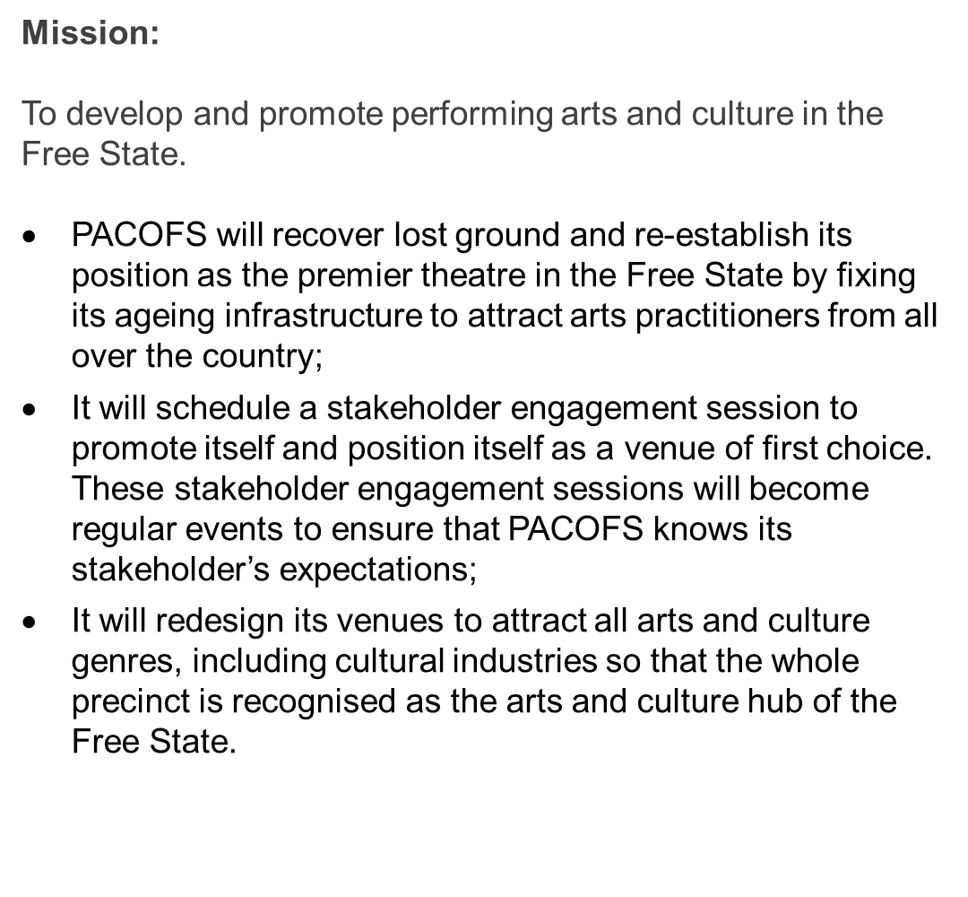
VISION, MISSION & VALUES

Slide 4
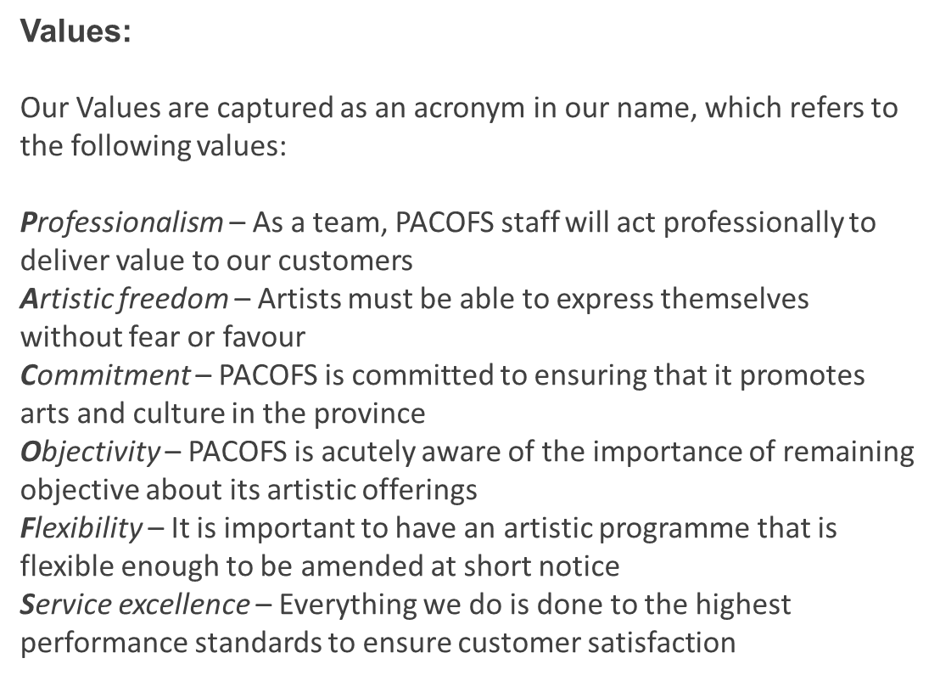
VISION, MISSION & VALUES

Slide 5
GOVERNANCE
Number of Council Committee Meetings | held during the financial year |  | 22
Number of Council Committee Meetings held during the financial year 38
> Audit & Risk Committee |  | 15
> Remuneration, Social & Ethics Committee ( REMSEC) |  | 13
> Core Business Committee |  | 5
> Special Projects ( Fundraising) Committee |  | 5
The following council members' terms ended on 9 December 2020:
Name | Designation | Term period
Mr N Sifumba | Chairman | 01/12/2017 to 08/12/ 2020
Adv. K Thango | Deputy Chairman | 01/12/2017 to 08/12/ 2020
Ms T Nogabe | Member | 01/12/2017 to 08/12/ 2020
Ms T Mnumzana | Member | 01/12/2017 to 08/12/ 2020
Mr D Brijlal | Member | 01/12/2017 to 08/12/ 2020
Ms M Naidoo | Member | 01/12/2017 to 08/12/ 2020
Mr H Matlou | Member | 01/12/2017 to 08/12/ 2020
The following are current council members
Name | Designation | Appointment date
Ms M Kganedi | Member | 09/12/2020
Mr A Latchu | Member | 09/12/2020
Adv T Moeeng | Chairperson | 09/12/2020
Ms. N Mosala | Member | 09/12/2020
Ms. P Maseko | Member | 09/12/2020
Mr. K Thulo | Deputy Chairperson | 09/12/2020
Mr. K Moshounyane | Member | 09/12/2020

Slide 6
PERFORMANCE OVERVIEW
PACOFS theatre operations were severely constrained during the financial period under review, occasioned initially by the hard lockdown, and later by the restrictions and limitations placed on the performing arts practices in general and theatre operations in particular. These restrictions hampered us in the achievement of our performance objectives and had a negative impact on our revenue. PACOFS has put plans in place to address those targets that were either partially achieved or not achieved in the new financial year.
Despite the challenges, we prioritised support to local artists and we are pleased to report that 95 % of the productions staged were presented by artists from the Free State Province.
During the hard lockdown in 2020, PACOFS launched a video streaming service called Live@PACOFS for selected artists as part of the economic relief effort for artists. This enabled their artistic performances to be live streamed via Facebook. A total of 38 videos were selected for streaming on PACOFS’ social media platform.

Slide 7
Below is the detail of the target not achieved:
 | DESCRIPTION | TARGETS | ACHIEVED | PARTIALLY ACHIEVED | NOT ACHIEVED
Programme 1 | Administration | 8 | 3 | 4 | 1
Programme 2 | Business Development | 2 | 0 | 2 | 0
Programme 3 | Public Engagement | 3 | 3 | 0 | 0
 | TOTAL | 13 | 6 | 6 | 1
 | % PERFORMANCE |  | 46% | 46% | 8%
Target | Reason for deviation
Number of infrastructure projects completed on time | Consulting engineers for 3 projects were appointed late in the year due to challenges in procurement and due to lockdown.

Slide 8
Levels | Male
 | African | Coloured | White
Top Management | 2 | 1 | 0
Senior Management | 5 | 0 | 1
Professional qualified | 2 | 0 | 0
Skilled | 5 | 2 | 0
Semi-skilled | 18 | 0 | 0
Unskilled | 2 | 0 | 0
Total | 34 | 3 | 1
Levels | Female
 | African | Coloured | White
Top Management | 0 | 0 | 0
Senior Management | 2 | 1 | 0
Professional qualified | 1 | 0 | 1
Skilled | 4 | 1 | 2
Semi-skilled | 8 | 0 | 1
Unskilled | 2 | 0 | 0
Total | 17 | 2 | 4

Slide 9
 | 2021 | 2020
 | R’000 | R’000
Total Assets | 150 427 | 148 343
Total Liabilities | 98 214 | 96 202
Net Assets | 52 213 | 52 141

Slide 10
Financial Ratios
Current Ratio Current Assets/ Current Liabilities | 1.15
Quick Ratio (Cash and cash equivalent + Accounts receivables) / Current liabilities | 1.14
Creditors Turnover Ratio Net Credit Purchases / Average Accounts Payable | 2.8
Debtors Turnover Ratio Total Sales / Account Receivables | 2.2

Slide 11
 | Budget | Actual | Variance | % Variance
 | R’000 | R’000 | R’000
Total Income | 61 092 | 51 378 | (9 714) | (15.9%)
Total Expenditure | 58 342 | 48 251 | 10 091 | 17.3%
Non-cash expenses | 2 750 | 3 056 | (306) | (11.1)
Surplus/(deficit) | 0 | 71 | (71)

Slide 12
There was an improvement in the audit outcome from a qualified audit opinion in the 2019/20 financial year to an unqualified audit opinion in 2020/21;

