Slide 1

PPP Framework review AND Recommendations
PRESENTED BY:
NATIONAL TREASURY
Presentation
Parliament Portfolio Committee

Slide 2
Structure of presentation
Brief overview
Objectives of the PPP Framework Review
Methodology and Approach
Consultation and Validation process
Key Findings and Recommendations for the PPP Framework Review – PFMA PPPs (national and provincial)
Findings and Recommendations for the Municipal PPP Framework Review
Observations
Way Forward

Slide 3
Brief overview - As THINGS STAND NOW
34 PPPs closed to date; 28 projects closed prior to 2007
Decline in the number of new PPPs since 2007
19 of the 34 closed PPPs projects were closed before NTR 16 was amended and the standardized PPP provisions were issued in 2004
South Africa had an estimated ZAR 10.7 billion in PPP transactions by 2011/12 that declined to ZAR 4.8 billion in 2017/18
The average project size of PPP projects developed during this period was ZAR 1.1 billion (outside of the two large transactions, i.e. Gautrain and Gauteng Freeway)
Factors contributing to early success may have included the political leadership and championing of PPPs from the Minister of Finance; overall global and regional economic factors; and the market’s appetite and capacity for PPPs, including a relatively active project finance market.
Current PPP pipeline includes 22 projects with 9 projects at various stages of procurement.

Slide 4
Brief overview cont. - 4-Stage approval process
Regulation 16 (NTR-16) under the PFMA specifically regulates PPPs through a 4-stage Treasury Approval (TA) and Treasury Views and Recommendations (TVRs):

Slide 5
objectives of thE PPP Framework REVIEW
The objective of the review was to address the concerns, perceptions and criticism raised about PPPs with the hope of increasing PPPs and crowd in private sector funding.
To better understand the challenges, bottlenecks and to provide stakeholders with an opportunity to validate the draft recommendations before they were fully adopted.
The review considered lessons learned from the application of the current PPP framework over the past years and the experience of other select countries.
To present key findings on the current PPP legal, regulatory, and institutional environment and to present targeted recommendations on how to address identified gaps and challenges.
The review of PPPs is part of broader infrastructure reforms meant to increase infrastructure investments by pooling together public and private sector resources. The Fund announced by the President offers an opportunity for increased partnership between government and private sector with the objective of boosting investment and contributing to growth.

Slide 6
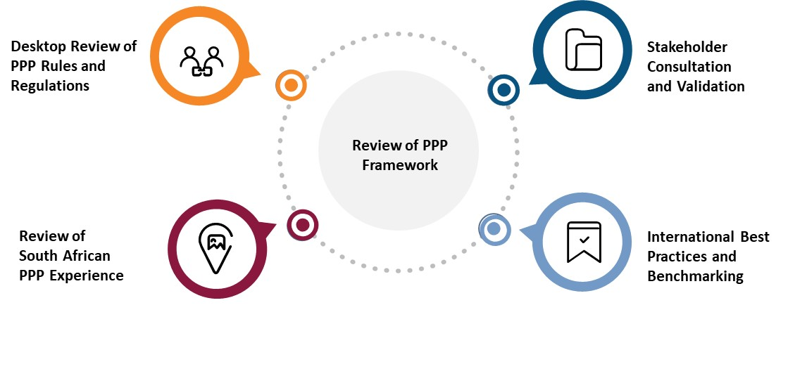
Methodology and approach

Slide 7
Consultation - Reference committee
The National Treasury Budget Office appointed a Reference Committee to act as a sounding board for the PPP framework review.
It comprises public and private sector PPP practitioners, including representatives of:
Government Technical Advisory Centre (GTAC),
Development Bank of Southern Africa (DBSA),
Gauteng Management Agency (GMA),
Independent Power Producers (IPP) Office,
Department of International Relations (DIRCO), and
Representatives of leading financial and legal firms advising on PPP projects in South Africa

Slide 8
Key findings-PPP Framework review (PFMA PPP – National & PROVINCIAL)
Policy Framework: South Africa lacks an overarching infrastructure policy framework that can mainstream PPPs into the overall planning process for public investments in a fiscally prudent manner.
Legal and Regulatory Framework: Multiple approvals and inadequate coverage of important aspects in PPP legal and regulatory framework.
Institutional Arrangements and Accountability: There is a lack of a centralized approach and ‘gateway’ body to screen infrastructure investments for PPP suitability.
PPP Capacity: There is a lack of capacity at various government levels: Within the Regulatory function in National Treasury which does not have sufficient numbers of dedicated staff; the PPP Unit which needs more resources; and Procuring Institutions (PI)s which lack skills and expertise in PPPs.
PPP Process: The existing PPP processes are rigid and cumbersome as they are not calibrated to project size or project type.
Recommendations
Overall, the review findings indicate that there is no need for a complete overhaul of the PPP legal and regulatory framework as there are good aspects that compare well with international benchmarks. However, critical gaps and challenges that need to be addressed and improved. Recommendations include legislative changes to improve the PPP value chain and improved application and practise which is expected to yield more reliable results and generate more confidence in the overall PPP framework.

Slide 9
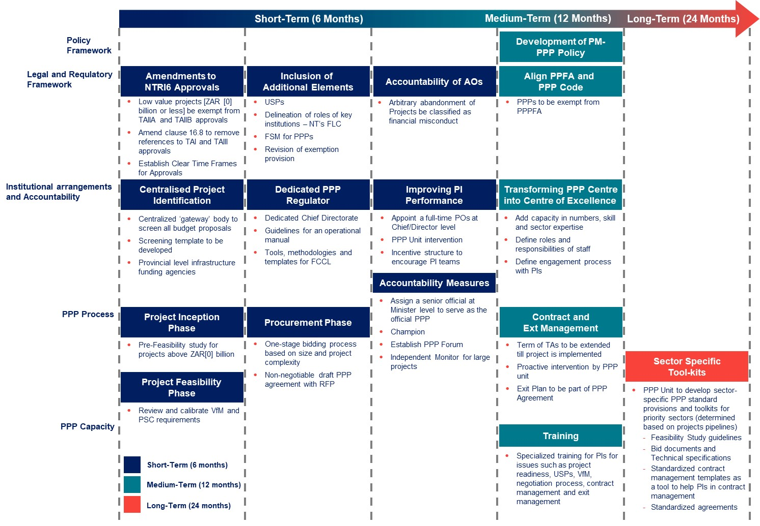
Recommendations for the PPP FRAMEWORK REVIEW (PFMA PPPs)

Slide 10
Key findings-MUNICIPAL ppp FRAMEWORK
Overlaps in Legal Framework for PPPs and public consultation, laborious requirements of TVRs and inadequate coverage of important aspects in PPP framework.
The current institutional arrangements prove inadequate due to lack of capacity at various government levels (regulator, PPP Unit and Procuring Institutions - PIs), which would benefit from training and other technical assistance.
  Delays in the PPP project cycle can be attributed to the following factors: lack of a dedicated full-time on the regulatory side, the absence of operational guidance and the fact that there are no prescribed timeframes within which TVRs must be provided.
  The PPP Unit - unable to catalyse a robust municipal PPP pipeline or proactively support municipalities in PPP identification and preparation.
  Municipalities are ill-equipped to identify, prepare and implement PPPs.
  There is no PPP champion at the highest senior government level to promote and support the use of PPPs as an alternative funding mechanism.
  Despite the fact that there is PPP training conducted for municipalities at the DBSA on a quarterly basis, there still appears to be a significant lack of understanding of PPPs and hence municipalities do not lean towards PPPs as an alternative funding mechanism.
    Additional aspects to facilitate priority municipal programmes

Slide 11
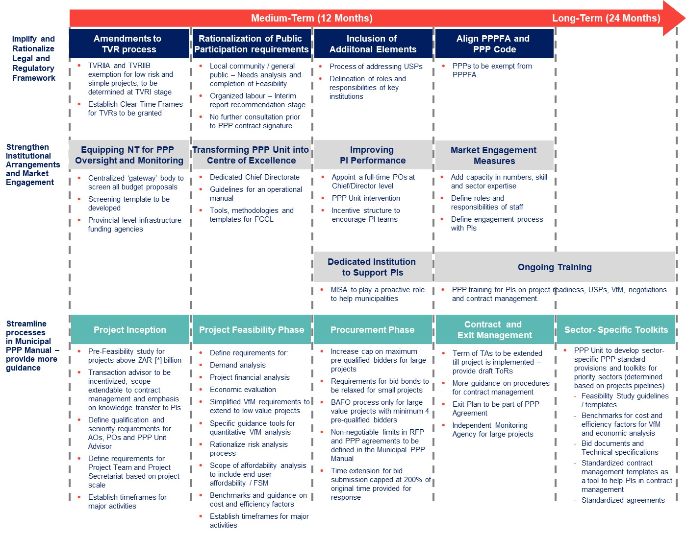
Recommendations for the PPP FRAMEWORK REVIEW (MFMA PPPs)

Slide 12
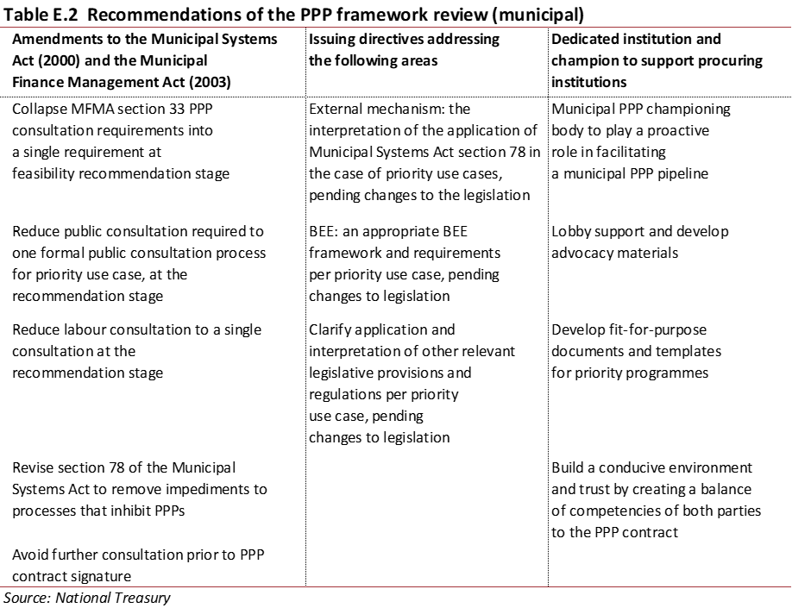
ADDITIONAL RECOMMENDATIONS

Slide 13
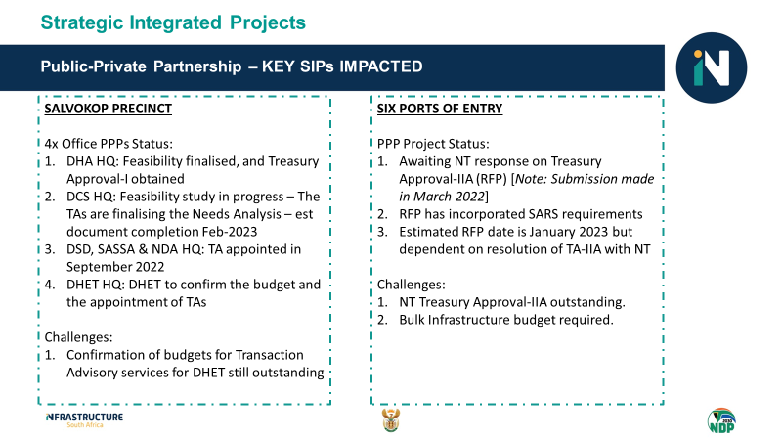
SIP PPP UPDATE

Slide 14
observations
Policy and systematic recommendations strongly supported – PIM-PPP policy;
Institutional and Systematic link to ISA and IF
Mainstreaming PPP in a fiscally prudent manner – fiscal commitments and contingent liability management
Lack of funding for PPPs – Financing support mechanism framework
Self Sustainable Facility for Project Preparation Funding
Project pipeline – skills and institutional capacity and a capable transactional service
Additional requirements needed at the municipal level have been identified.

Slide 15
Way forward
Administrative Processes in NT- Memos signalling intention to change Treasury Regulation 16 governing PPPs and all necessary approvals have been granted.
On-going necessary processes include:
  Alignment with the Public Procurement Bill
  Following the necessary steps in changing regulations with regards to the PFMA and relevant Municipal legislation
  Meeting the requirements for further consultations
  Incorporate all changes
PPP Review Project Document guiding the implementation of work streams and deliverables.

