Slide 1
STATE OF LOCAL GOVERNMENT REPORT
PRESENTATION TO PORTFOLIO COMMITTEE
30 November 2022
COGTA Portfolio Committee 30 November 2022

Slide 2
PRESENTATION OUTLINE
PURPOSE
DEPARTMENT POSITIONING
INTRODUCTION
RUNNING OF AN IDEAL MUNICIPALITY
CABINET RESOLUTIONS – 2 AUGUST 2022
KEY LOCAL GOVERNMENT SUMMIT RESOLUTIONS
SOLG INDICATORS & OVERVIEW
MSIP PROVINCIAL PERSPECTIVE
PROGRESS: MUNICIPAL SUPPORT & INTERVENTION PLANS (MSIPs)
SOLG HIGHLIGHTS
SECTION 139(7) INTERVENTIONS
HOTSPOT MUNICIPALITIES
GENERIC OBSERVATIONS
RECOMMENDATIONS

Slide 3
PURPOSE
The purpose of the presentation is to:
Present the State of Local Government report as at June 2022 as agreed with the Portfolio Committee.

Slide 4

Context: The System of Local Government and Role of CoGTA
Cogta has adopted a new operating model which consist of provincial teams comprising 9 Chief Directors for purposes of strengthening the capacity of Provincial COGTA departments and section 154 support to municipalities.
The system of local government in South Africa is regulated in terms of the Constitution, the White Paper on LG, MSA and other various legislations that are aimed to ensure that services are provided to the citizens of the country.
Section 152(1) of the Constitution, 1996 stipulates that the mandate of local government is to provide democratic and accountable government for local communities; ensure provision of services to the communities in a sustainable manner; promote social and economic development; promote a safe and healthy environment and encourage the involvement of communities and community organizations in the matters of local government.
Section 152(2) of the Constitution stipulates that a municipality must strive, within its financial and administrative capacity, to achieve the mandate as set out in Section 152(1).
Section 153 of the Constitution: Developmental duties of municipalities: A municipality must –“Structure and manage its administration and budgeting and planning processes to give priority to the basic needs of the community, and to promote the social and economic development of the community; and participate in national and provincial development programmes.
Section 154 of the Constitution: “The national government and provincial government, by legislative and other measures, must support and strengthen the capacity of municipalities to manage their own affairs, to exercise their powers and to perform their functions.”

Slide 5
INTRODUCTION
A progress report on the implementation of the recommendations in the State of Local Government report was presented to the Portfolio Committee in June 2021.
The Special Cabinet meeting on Local Government held on 2 August 2022 focused on interventions to support failing municipalities.
A Cabinet Lekgotla meeting on Local Government was held from 5 – 6 September 2022 and focused on an ideal municipality.
A Local Government Summit was held on 27 and 28 September 2022 which resulted in key resolutions to address the challenges facing the local government sphere relating to Governance, Administration and Financial Management, Local Economic Development, Service Delivery, Climate Change and Disaster Management.
The implementation of resolutions from the Cabinet meetings and the Local Government Summit will strengthen support towards implementation of the State of Local Government and efforts to create ideal municipalities.

Slide 6
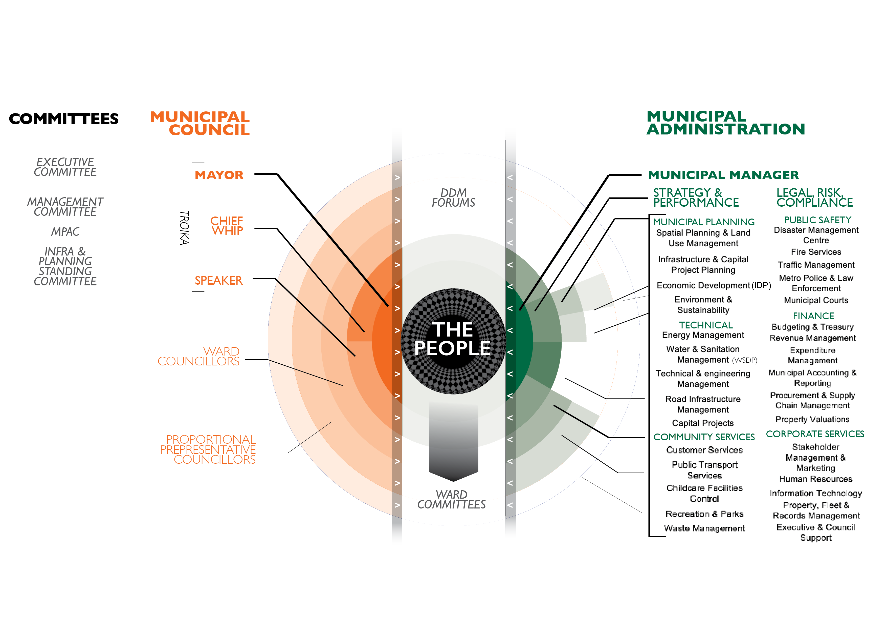
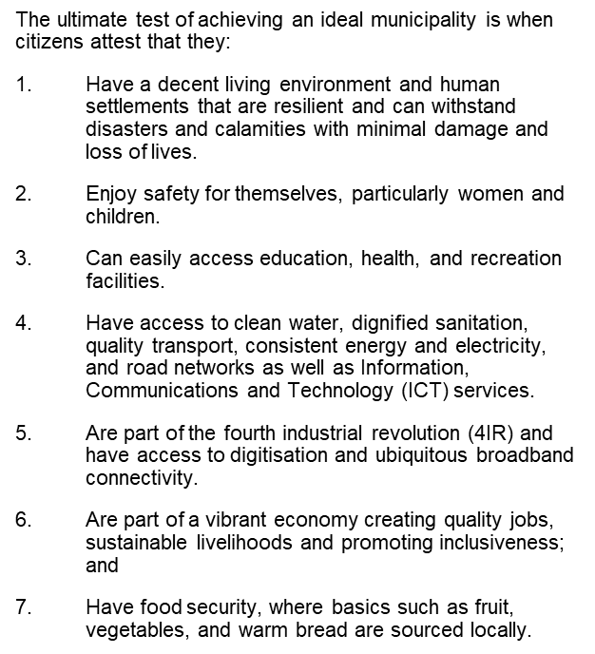
Running an ideal municipality

Slide 7
cabinet resolutions 2 AUGUST 2022
The Special Cabinet meeting on Local Government held on 2 August 2022 focused on interventions to support failing municipalities. The Special Cabinet noted and endorsed the reports on interventions where municipalities are failing and noted the following resolutions:
a) Institutionalising the DDM by making it mandatory for all national and provincial departments as well as State-Owned Entities to participate in the planning, implementation and monitoring support to municipalities Further developing and resourcing the capability and capacity of the Department of Cooperative Governance and Traditional Affairs to support interventions in municipalities
Strengthening the Provincial COGTAs to enable them to fulfil their statuary obligations and the Departments of Public Service and Administration (DPSA) and Planning, Monitoring and Evaluation (DPME) assess the organisational structures as well as the budgets
Promotion of social and economic development by instructing COGTA to collaborate with the Departments of Small Business Development, of Agriculture, Land Reform and Rural Development, of Tourism, of Forestry, Fisheries and the Environment and of Mineral Resources and Energy to establish individual district economic capabilities by exploring endowments to leverage economic development initiatives with biases towards women and youth
e) The Minister of Cooperative Governance Traditional Affairs in collaboration with the Minister of Finance lead the Provincial Local Government Summit to deal with challenges facing local government toward the development of a National Municipal Support Plan for municipalities
f) Provinces to monitor municipalities and submit performance reports to the National Department of COGTA on a quarterly basis. (LGOS)
g) President requested a follow-up Special Cabinet meeting on Local Government be held in the first week of October 2022
h) In preparation for the meeting in October 2022, the Minister of Cooperative Governance and Traditional Affairs (lead), of Finance and in the Presidency must engage with other relevant departments, provinces and SALGA to develop a coherent plan to strengthen local government performance which must be presented to the Cabinet in the form of a memorandum after having been tabled at the President’s Coordinating Council (PCC)
On Municipal Financial Recovery Services and the success of Section 139 Interventions
  DCoG and NT Collaboration to support distressed municipalities by inducting them on the new approach to interventions;
  Stakeholder coordination (within CoGTA and outside) to support implementation of the intervention
j) Minister of Cooperative Governance and Traditional Affairs (lead) in collaboration with Ministers of Finance, in the Presidency, Premiers, SALGA and the Auditor-General have a comprehensive discussion on the financial status of municipalities and the Section 139 Interventions and report to Cabinet by the end of September 2022.

Slide 8
Key Local government summit resolutions
DDM: Ensure greater participation of the other spheres and political champions at Local Government especially in municipalities and provides monthly reports indicating support provided to municipality as per section 154 of the Constitution.
LED: Coordinate a skills revolution workshop which will focus on the creative sector, agriculture (in its full value chain), innovations and ICT, as well as the business and entrepreneurial skills as well as the green and blue economy.
LED: A special summit on LED where all the players should be in attendance to report and account to the district spaces on development initiatives/programs undertaken and those that are underway including those that are planned be convened.
Governance: Consider simplifying, integrating and revising regulation requirement for local government (i.e., review indicators and reduce reporting requirements).
Governance: MPACs to be strengthened through the Municipal Support and Intervention Plan (MSIP). MPACs guidelines be reviewed to include consequence management.
Governance: To ensure understanding of roles and responsibilities and to address the issue of political/administrative interference, workshop session be conducted for political leadership.
Governance: A legislative provision be promulgated to empower investigators to implement the finding/ outcomes of their investigation (such as Section 106 investigations).
Governance: An annual awards platform be established for best performing municipalities, and an incentive system for such municipalities.
Governance: MSIP to include capacity support and guidance on budget process to cater for maintenance, operations and asset management.
Governance: To Improve the efficiency and quality of local government through better funding, Equitable Share formula / financial model be reviewed
Governance: Establish sound financial practices and eliminate corruption in municipalities
12. Governance: Members of Parliament, Members of Provincial Legislatures and Councillors to jointly provide feedback to communities in respect of services provided by each sphere of government such as roads, heath, education, etc.
13. Service Delivery: A framework inclusive of early warning systems to tackle climate change problems faced by communities in rural areas be formulated.
14. Service Delivery: Consider MoU / Structured Functional relationship with Institutions of Higher Learning and Climate Change Agencies with the objective to use technology like Climate GIS mapping analysis to highlight the vulnerability caused by climate changes in high-risk locations and other areas.
15. Service Delivery: A shared services approach be explored, using the DDM and the Private sector to improve delivery capacity.

Slide 9





State of Local Government : Indicators
Political
Governance
Administrative
Financial
Management
Service
Delivery
HIGH RISK DYSFUNCTIONAL | In-fighting in councils Intra-political party divisions in council Divisions in caucuses External political interference in councils Persistent & frequent section 139 interventions (esp. on dissolution of councils) | Council not meeting as regulated Committees of council not meeting Council taking wrongful decisions No oversight by council on administration Poor and weak decision-making by council Councilors unduly interfering in administration No consequence management on corruption, maladministration, nepotism & poor performance Frequent Labour disputes and disruptions Poor public participation processes | Vacancies in key positions Bloated structures Poor performance management and lack of consequence management Non-compliance: legislation, regulations and policies | Unfunded budget Incapacitated and incompetent Budget & Treasury Offices (BTO) Excessive salary bills Non submission or late submission of annual financial statements Disclaimer & adverse audit outcomes High debt to utilities and statutory obligations Flouted SCM processes Poor collection of revenue | High basic services backlogs High number of informal settlements No maintenance of infrastructure resulting in water and electricity supply interruptions and poor water quality No technical capacity Glaring service delivery issues Perennial poor infrastructure grant expenditure Persistent service delivery protests Poor response: service delivery complaints Court actions by interest groups on poor service delivery
Med RISK | Minimal in-fighting in council Elements of factionalism Regular Section 139 interventions | Council meeting as scheduled with some external interruptions Reports on maladministration identified but not acted on by council Oversight conducted not fully effective Public participation not fully effective | Vacancies in some key positions Structure not fully respondent to municipal needs Compliance to applicable legislation, regulations and policies not fully met | BTO not fully capacitated – vacancies in some positions Financial management policies in place, not fully implemented Weak revenue collection Debt owed to utilities & statutory obligations not fully services Annual financial statements late Qualified audit outcomes | Basic services backlogs not fully met Repairs and maintenance not fully executed due to capacity and budget Infrastructure grants not fully spent Frequent service delivery protests Inadequate response to service delivery complaints
LOW RISK | Robust and functional Council No intra-party political divisions | Council meeting as scheduled with no undue external influence Reports on maladministration identified | Vacancies in key positions Structure not respondent to municipal needs Compliance to applicable legislation, regulations and policies not fully met | Weak revenue collection Debt owed to utilities & statutory obligations not fully services Reliance on consultants for Annual financial statements | Repairs and maintenance not fully executed due to capacity and budget Incapacity to response to service delivery complaints
STABLE | Cohesion in council Functional caucus No intra-party political divisions No section 139 interventions over 5 year period | Council meeting regularly, as regulated Council adopts IDP, budget, policies, annual financial statements on an informed and efficient basis Council provides effective oversight over administration | Structure fully respondent to municipal needs No vacancies in key and senior positions (positions occupied by competent individuals) Full compliance with legislation, regulations and policies | Fully funded budget Functional BTO Effective application of credit control and debt collection policies No or minimal outstanding debt to utilities & statutory obligations | Community consultation on service delivery priorities Well capacitated and efficient infrastructure services department Uninterrupted delivery of services due to well maintained infrastructure Quick response and turnaround time to service delivery complaints Infrequent service delivery protests

Slide 10
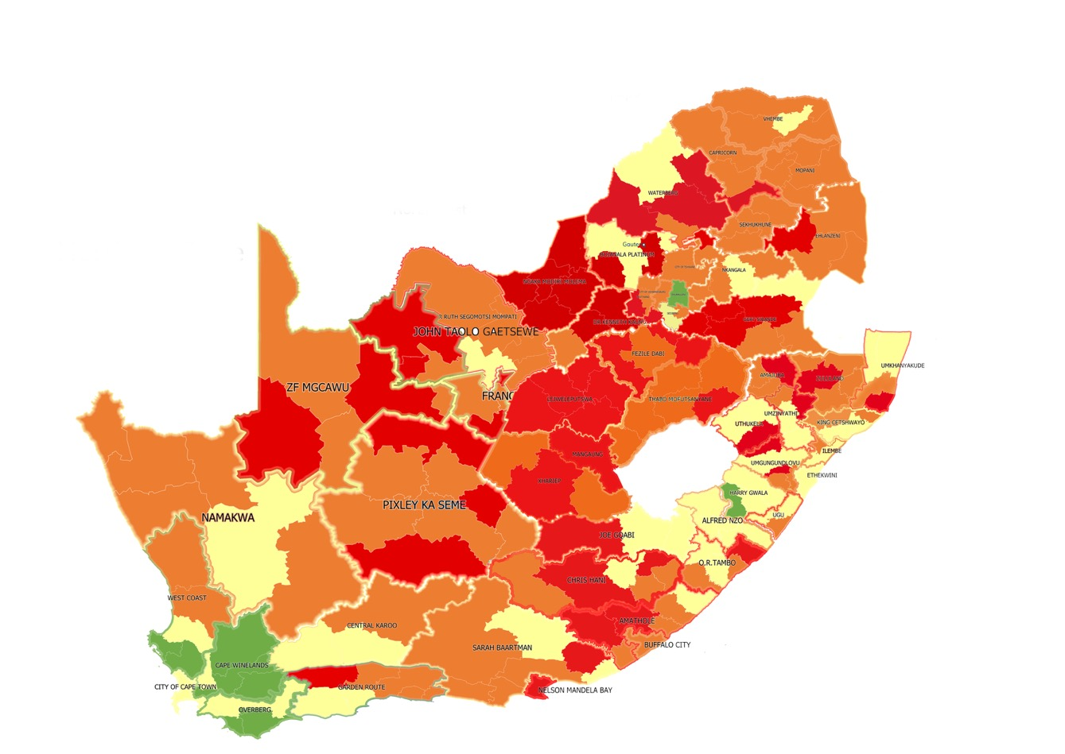
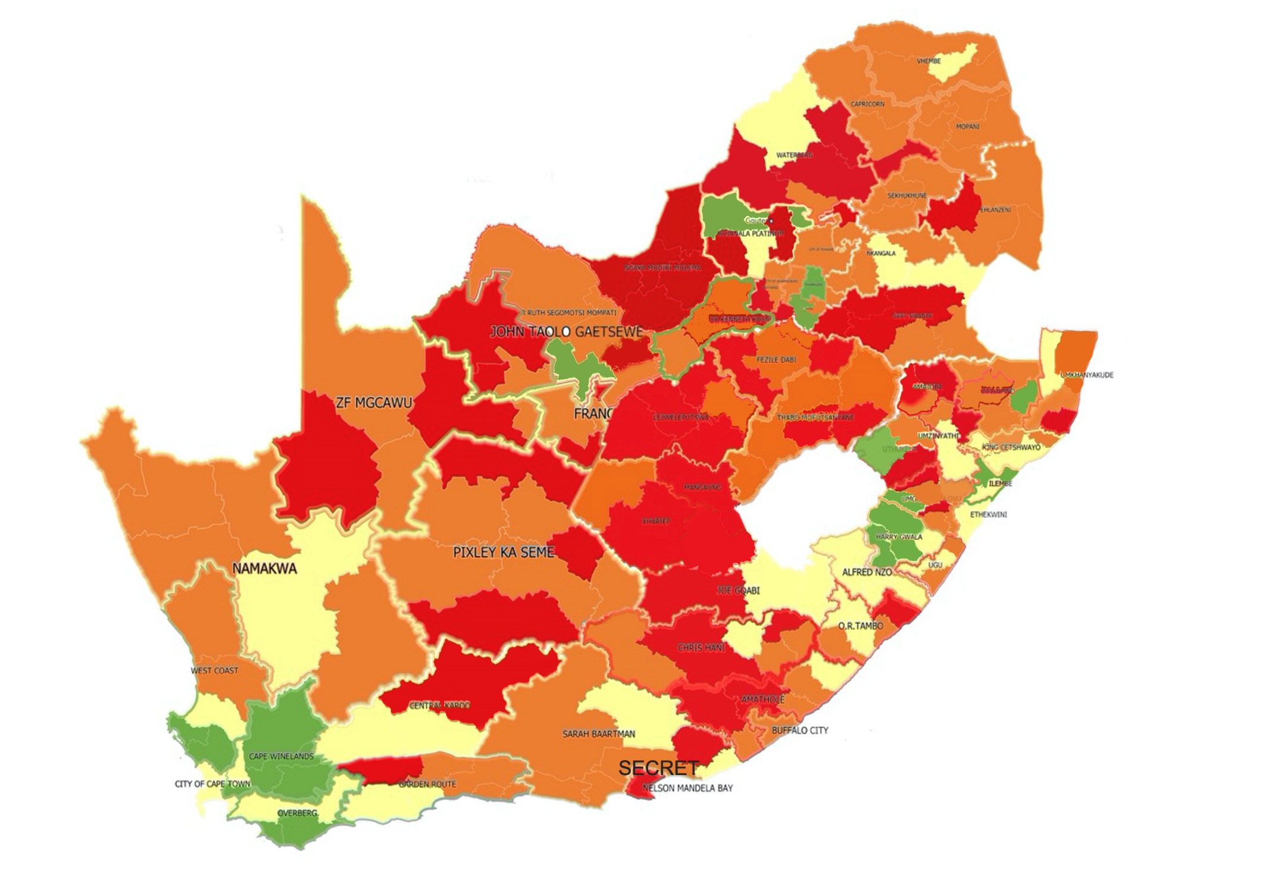
STATE OF LOCAL GOVERNMENT OVERVIEW
2022
2021
Dysfunctional (Red) | Medium Risk (Orange) | Low Risk (Yellow) | Stable (Green)
64 | 111 | 66 | 16
24,90% | 43,19% | 25,68% | 6,22%
Dysfunctional (Red) | Medium Risk (Orange) | Low Risk (Yellow) | Stable (Green)
66 | 107 | 54 | 30
25,68% | 41,63% | 21,01% | 11,67%

Slide 11
Msip : progress
  MSIPs are intergovernmental support plans to address the short and medium-term challenges in the key local government performance areas.
  The Framework on Municipal Support and Intervention Plans (MSIPs) outlines the legislative provisions for support & interventions in terms of Section 154 and 156 of the Constitution and highlights criteria for modes/types of section 139 of the constitutional intervention in line with the COGTA/NT Intervention Collaborative Framework.
  COGTA, in collaboration with relevant stakeholders continues to implement the Framework on MSIPs which was adopted by COGTA MinMEC.
  MSIPs for municipalities have been developed and for municipalities placed under mandatory intervention in terms of Section 139(5), Financial Recovery Plans (FRP’s) have been developed.
  The CoGTA MEC’s tabled quarterly progress reports on the status of implementation of MSIPs to the COGTA MinMEC meeting held on 13 July 2022.
  A joint approach was adopted between NT and CoGTA, provincial COGTAs and Provincial Treasuries to support the 43 distressed municipalities.

Slide 12
Msip: provincial perspective
  Provincial CoGTA departments are at different levels with regards to the implementation of the MSIPs.
  Provinces such as Mpumalanga, KwaZulu-Natal, Western Cape have institutionalised processes for monitoring and reporting MSIP implementation.
  Some provinces established the Rapid Response Teams and Multi-disciplinary teams to deal with municipalities in crisis, supported by the Political Principals e.g. One-on-One engagements.
  Provinces have varying capacities to support municipalities and to implement new national government priorities and policies.
  Political instability, especially in municipalities that have coalitions governments, is impacting negatively on the implementation of MSIPs.
  CoGTA will be embarking on roadshows to conduct bilateral engagements with the provincial Departments and Municipalities to align the operations, support, monitoring and evaluations protocols across the provinces.
  Slow uptake of Circular 88 (Joint Municipal Reporting Reforms by NT/COGTA) by municipalities in some provinces and the required support by provinces as observed by the Auditor-General in the audit outcomes.

Slide 13
Progress on MUNICIPAL SUPPORT & INTERVENTION PLANS – July 2022
Province | Total No. | Stable |  | High Risk |  | Medium Risk |  | Low Risk
 |  | 2021 | 2022 | 2021 | 2022 | 2021 | 2022 | 2021 | 2022
Eastern Cape | 39 | 0 | 0 | 11 | 11 | 14 | 14 | 14 | 14
Free State | 23 | 0 | 0 | 11 | 11 | 11 | 11 | 1 | 1
Gauteng | 11 | 1 | 2 | 2 | 2 | 7 | 7 | 1 | 0
Kwa-Zulu Natal | 54 | 1 | 11 | 11 | 12 | 20 | 17 | 22 | 14
Limpopo | 27 | 0 | 0 | 3 | 3 | 21 | 21 | 3 | 3
Mpumalanga | 20 | 1 | 1 | 6 | 6 | 9 | 9 | 4 | 4
North West | 22 | 0 | 3 | 10 | 10 | 6 | 6 | 6 | 3
Northern Cape | 31 | 1 | 1 | 9 | 9 | 16 | 16 | 5 | 5
Western Cape | 30 | 12 | 12 | 1 | 2 | 7 | 6 | 10 | 10
Total Numbers | 257 | 16 | 30 | 64 | 66 | 111 | 107 | 66 | 54
Stable increased: 16 to 30, Low-risk decreased: 66 to 54 Medium-risk decreased: 111 to 107 Dysfunctional increased: 64 to 66

Slide 14
Solg: highlights
The assessment of the SOLG during June 2022 against the performance of municipalities during July 2021 has shown a marked improvement in performance of municipalities due to the nearly 100% increase of municipalities that moved to the stable category.
KwaZulu-Natal Province was the biggest contributor (10 municipalities) that moved to the stable category due to the development of customised MSIP packages for intense and high priority interventions and support by the provincial CoGTA department to deploy governance and financial experts as well as interventions by Political Champions which yielded the following positive results:
  Political / Administrative stability
  Functional Audit Committees, MPAC training for consideration of UIFW reports; functional Council structures, appointment of competent and qualified Municipal Managers and Section 56 managers
  Financial Management improved due to funded budgets, UIWF expenditure addressed and prevention measures implemented, implementation of audit action plans;
  Service delivery – improved water supply, rehabilitation of landfill sites

Slide 15
Solg: highlights
North West Province has the 2nd largest improvements with 4 municipalities. Three municipalities moved to the stable category (Moretele, Greater Taung and Dr. Kenneth Kaunda) and Bojanala municipality moved to the low-risk category due to national interventions and dedicated focus on support by departments to municipalities.
In Gauteng Province, the Midvaal LM was moved to the stable category through the establishment of a dedicated and interdepartmental intervention team.
In the Free State Province, two municipalities (Matjhabeng and Metsimaholo) improved from dysfunctional to medium risk and two municipalities (Mohokare and Dihlabeng) regressed from medium risk to dysfunctional.
In Western Cape Province, Beaufort West is a coalition municipality and regressed since June 2021 from medium risk to dysfunctional. The municipality is under Section 139(5) intervention and a Financial Recovery Plan is being implemented.
No changes to the categories of municipalities were registered in 2022 vs 2021 for Eastern Cape, Limpopo, Mpumalanga and Northern Cape Provinces.

Slide 16
Section 139(7) - Enoch mgijima local municipality
The Municipal Council is not entirely supportive of the Section 139(7) intervention.
There seems to be exogenous political interference in the operations of the Municipality.
A recent special Council meeting which had been requested by the NCR to present a report on the defiance of the records reconstruction project has been postponed twice without a convincing rationale.
Stakeholders are depending on this national intervention and have pledged support to the NCR Team.
The organizational re-design process will stabilize staff costs once the process is completed.
There is a significant number of employees including labour representatives who are desperate for change and stability.
The Local Bargaining Council is divided on the issue with SAMWU seemingly supportive of the status quo and expressing anti NCR sentiments.
IMATU is seemingly receptive and keen on getting more information on the NCR processes for purposes of briefing their membership.
Efforts to deal with malfeasance and corruption are underway despite push back from management.
The resistance and defiance led by the erstwhile Municipal Manager and the CFO to the records reconstruction process is revealing a bigger threat and risk to the NCR led project.
Support by all to the implementation of the new FRP will lead to service delivery gains.

Slide 17
section 139(7) - Lekwa local municipality
Lekwa LM is currently under the national intervention in terms of S139(7) of the Constitution.
However, the Municipality is no longer under administration, following the election of the municipal council in November 2022.
A National Cabinet Representative (NCR) and financial expert were deployed to the municipality by National Treasury. However, the NCR requested an earlier termination of his contract and was subsequently released on 31 August 2022. The contract of the financial expert expired on 22 September 2022
CoGTA seconded support to the Office of the Municipal Manager and the Mpumalanga COGTA department seconded an acting Director responsible for Corporate Services to the municipality which will be withdrawn once the appointment is completed.
MISA assigned a Professional Civil Engineer, an Electrical Engineer and Chief Engineer to support the Technical Unit with Service delivery
Significant progress has been made by the intervention in turning around the situation at Lekwa LM, especially in the governance and institutional pillars.
  The municipality is politically stable unlike the situation before intervention
  Governance structures are established and functional (Council and Council Committees, Municipal Public Accounts Committee and Disciplinary Board)
  All Section 57 and 56 positions have been filled except the Director: Corporate Service positions which has been advertised. The Municipal Manager assumed duty on 11 July 2022; Director Community Services and Safety assumed duty on 22 September 2022; Director Technical Services assumed duty on 3 October 2022.

Slide 18
Section 139(7) - LEKWA Local municipality
7. Currently, Council is responsible for overseeing the implementation of the FRP by the administration who must continue with the submission of monthly progress reports to National Treasury until the termination of the intervention.
8. The national intervention will only terminate once the conditions as provided for in section 148(2) of the MFMA have been met.
9. Stakeholder commitments, pledges and support to the municipality on financial management and service delivery pillars include:
    Minister of DWS during his visit on the 21st July 2022 committed an amount of R350million to address water and sanitation challenges. High impact short term intervention and processes to appoint service providers have commenced.
    National Treasury approved funding to the value of R45 million for the installation of 7678 smart meters
10. Deteriorated road infrastructure remains one of the key areas where support is required. The municipality identified some of their roads for possible transfer to SANRAL and awaiting approval from the Province.

Slide 19
section 139(7) – MANGAUNG METRO
The Minister of CoGTA sent a Ministerial task team to Mangaung on 11 November 2022 to convene discussions with the South African Municipal Workers Union (SAMWU), Mangaung Service Delivery Forum (MSDF) and Mangaung Concerned Committee (MCC). Several service delivery failures was identified on the part of the municipality on areas of Solid Waste Management, Water and Sanitation, Roads and Stormwater. An implementation plan has been developed to address the concerns raised by the unions and community organisations.
The Minister of Finance introduced the new members of the National Cabinet Representative (NCR) Team during a special Council meeting held on 7 November 2022. Ms Gugu Malazi was appointed as the Lead NCR replacing Mr Paul Maseko and Mr Mxolisi Nkosi as the governance expert replacing Mr Lulamile Mapholoba.
The recruitment process of City Manager is at an advanced stage to finality to be tabled at the next Council meeting. Two candidates were taken for competency assessment, and one candidate will be undergoing competency assessment on 28-29 November 2022.
Macro Organisational Structure was approved by Council on 7 November 2022 with reduction from nine (9) heads of Departments to six (6) heads of departments.
The three (3) Heads of Department (HoD) positions of CFO, Corporate Service and Technical Services were advertised.
The new acting CFO to be replaced by NT will be tabled to next Council meeting and the position of Head of Department Social Services and Metro Police for appointment due to contract of current HoD coming to an end 31 December 2022.

Slide 20
HOTSPOT MUNICIPALITIES
  NORTH WEST PROVINCE: KAGISANO MOLOPO LM
  Since the inauguration of new Municipal Councils in the province after the November 2021 Local Government Elections, the Municipal Council of Kagisano-Molopo Local Municipality has never stabilised and did not concentrate on developing plans to provide service delivery to the constituents of that municipality.
  Provincial EXCO on the 14 September 2022 resolved that the municipality must be placed under section 139(1)(b) of the Constitution sighting the following :
(a) Allegation on contestation of political power between Councillors which has resulted in parallel Municipal Council structures being formed, each with a Mayor and Speaker, leading to councillors taking their contestation to the courts in trying to legitimise their differences by obtaining court interdicts;
(b) Allegation that the Municipal Manager has been identified as the driver of sowing disunity within the Municipal Council, instead of advising Municipal Council, and the Municipal Manager seems to have influenced and perpetuated the divisions in the Municipal Council;
(c) Allegation that the Municipal Manager has even hired bouncers to control access to municipal premises, wherein Speaker, Mayor and other councillors opposed to him are denied access to the municipal premises. In addition, the Speaker has taken his case of being ousted to court.
(d) Persistent infighting within Municipal Council;
(e) Unlawful process of tabling the draft budget as the presiding Accounting Officer was found to be unlawfully appointed, resulting in non-compliance with the Municipal Finance Management Act, No.56 of 2003;
  The Minister approved the intervention in terms of section 139(1)(b) of the Constitution.
  The Administrator is in place and the Municipality has since stabilised after the municipal managers contract was terminated.

Slide 21
hotspot municipalities
NORTH WEST PROVINCE: DITSOBOTLA LM
  Since the inauguration of new Municipal Councils in November 2021, instability in the municipality continue to persist, resulting in the MEC responsible for local government to issue a directive in terms of section 139(1)(a) of the Constitution in Ditsobotla Local Municipality in May 2022, to redress these challenges of infighting and governance paralysis. The instability and defiance continued to prevail in the municipality despite the issued directive.
Along the directive, the provincial government stepped up the support to the municipality which in some instances was rejected.
The state of governance deteriorated further leaving the provincial government with no choice but to dissolve the Municipal Council on the 14 September 2022.
  The Administrator was barred by the municipality not to assume his responsibilities also the municipality took the Provincial EXCO to court resisting the dissolution.
  The matter was held in court on the 4 October 2022 and judgement has been released on the 21 November 2022 which is in favour of provincial EXCO.
  The Administrator and his team got access to municipal offices on the 10 November 2022 with the assistance SAPS.
  Preparations are underway for By-Elections to be held in December 2022

Slide 22
hotspot municipalities
WESTERN CAPE: KANNALAND LM:
The municipality has been dysfunctional and financially distressed for number of years and the support that has been provided for years continue to make no positive impact on the viability of the municipality.
  Prolonged vacancies in respect of critical posts causing instability within the administration.
  The Municipality has four (4) senior manager posts. Three of these critical posts are vacant, including the posts of Municipal Manager, Executive Manager: Financial Services and Executive Manager: Infrastructure Services and Community Services.
LIMPOPO PROVINCE:
Thabazimbi LM is a hung council and experience instability of Council which is characterized by infighting that has resulted in failure to appoint senior managers. There is generally weak oversight by Council. The instability is affecting service delivery.
Lephalale LM is experiencing political instability. The recent appointment of a Mayor has caused serious turmoil at the municipality, requiring urgent intervention at the administrative and political level.
Mogalakwena LM – Governance challenges persist with the Court Case related to the appointment of the Municipal Manager posing a risk to the functionality of the Municipality and the delay by Council. There is unwillingness from the political office bearers to unlock revenue potential at Mahwelereng and Rebone townships despite the deteriorating state of revenue that cause the Municipality to be unable to honor its obligations. Deficit of appetite Council to process the UIFW report.

Slide 23
Hotspot municipalities
MPUMALANGA PROVINCE:
Mkhondo LM is led by a coalition government and six (06) councillors were dismissed by their party in September 2022. The vacancies have been declared with the IEC and still to be filled through by-elections. Signs of administrative instability due to four (04) vacant senior manager positions namely: MM, Director Corporate Services, Director Technical Services and Director Planning. Only two post filled namely: CFO and Director Community Services. COGTA(MP) considering instituting section 106 investigation on allegations maladministration.
Steve Tshwete LM is led by a coalition government and experienced labour unrest due to labour demanding that the municipality to be graded to level 5. Through the intervention by the National CoGTA and the province the illegal strike was ended and employees returned to work on 08 September 2022. The municipality still experience short work stoppages due to worker demands for the Mayor to vacate office.

Slide 24
HOTSPOT MUNICIPALITIES
Kwazulu-natal: UMKHANYAKUDE DM:
Council and its structures remain dysfunctional.
The Section 139(1)(b) and Section 134 interventions have been invoked parallel to each other. Section 139(4) arose as a result of non-approval of the budget by the Municipal Council.
Section 139(1)(b)has been extended to 30 April 2023.
Intervention by Minister of Water and Sanitation also exists alongside the above 2 interventions
The UKDM has spent 0,0% of the WSIG allocation of R60 000 000 as at 30 September 2022 and funding was therefore withheld.
UKDM has been placed under Section 63 of the Water Services Act Ministerial intervention by the Minister of Water and Sanitation and these allocations will not be transferred to the WSA. DWS has appointed Mhlathuze Water to take over water and sanitation projects in the UKDM
The District has only spent 10% of it’s MIG allocation as at 30 October 2022. The municipality has been placed on cost reimbursement verification model, whereby DCOG will not release funds to the DM until invoices that are presented are verified by DCOG and MISA through site inspections. This then delays the payment to contracted service providers.
Experts deployed by COGTA and PT has since been withdrawn as they are under utilized due to instability even at administrative level.

Slide 25
HOTSPOT MUNICIPALITIES
FREE STATE PROVINCE: MOHOKARE LM
The municipality has been stable since the inauguration of the new Council, however challenges arose with the appointment of the municipal manager.
The disgruntled Councilors took the Mayor to court as they were of the view that the MM was appointed illegally and the court issued a court order interdicting the appointment of the municipal manager and barred the newly appointed municipal manager from entering the premises of the municipality. The court instructed the Council to reconvene to approve the appointment of the MM.
The Council subsequently met during September 2022 and took a resolution and the municipal manager resumed duty, however the disgruntled councilors approached the court again on an urgent basis but the court did not grant the urgent application, and rather directed that that matter be brought on merit.
The above caused division with the municipality, and brought administration instability, resulting in the municipality failing to submit Annual Financial Statements, no funding plan approved by Council, and no MSIP approval by Council.
The Provincial CoGTA is unable to support the municipality on development of the MSIP as the municipality are insisting to meet with senior officials to undertake this task. The Provincial CoGTA has intervened and a meeting will be held with the municipality to finalise the MSIP during December 2022.
Provincial department of COGTA is in the process of concluding section 106 investigation.
FREE STATE PROVINCE: DIHLABENG LM is experiencing political instability due intra-political party differences which necessitated intervention of the MEC COGTA w.r.t. secondment of a Municipal Manager to the municipality during November 2022.

Slide 26
Generic observations
The SOLG dysfunctional or high-risk categorisation increased from 64 to 66 municipalities. However, this number is not clear cut as there were regression in some instances but also improvement from the dysfunctional to medium risk category which resulted in the increase of two (2) in the total dysfunctional municipalities. The following seven (7) municipalities FS – Mohakare, Dihlabeng, KZN – Newcastle, Amajuba, NW – Ngaka Modiri Molema, Mamusa, WC – Beaufort West regressed from their precious categorisation due to perennial challenges such as:
  Political Interference has a negative impact on institutional capacity:
      Irregular appointments and without required skills, bloated organograms
      Interference in procurement processes
      Poor service delivery due to delays in approving projects, increased frequency of interruptions
      Long turn-around times to respond to community complaints lead to protests
      Poor financial management e.g. negative audit outcomes, irregular expenditure
  Infrastructure costings and cost of consultants
  Developmental and dynamic communications lacking
  Largely poor oversight and non-compliance with legislation
  Lack of consequence management confirmed by recent Audit Outcomes from AG
  Inadequate implementation S154 of the Constitution resulted in the need for many S139 interventions.

Slide 27
RECOMMENDATIONS
It is recommended that the Portfolio Committee:
Notes the progress made on the implementation of the State of Local Government as at end of June 2022; and
Note that CoGTA is currently in the process of implementing the Cabinet decision with regard to the development of a Coherent Cross Sectoral National Support Plan to strengthen local government performance.

