Slide 1
PRESENTATION TO THE PORTFOLIO COMMITTEE ON COOPERATIVE GOVERNANCE AND TRADITIONAL AFFAIRS
29 NOVEMBER 2022

Slide 2
PRESENTATION OUTLINE
Overview of the Waterberg District
Geographical location
Geographic Maps
Legislative Framework on support to locals
Support to locals (Mogalakwena Local Municipality)
Intergovernmental Relations Forum
Support in provision of services
Administrative Support
Political interventions
Conclusion

Slide 3
Overview of the Waterberg
The Waterberg Region is located within the South Western part of the Limpopo Province.
It is adjacent to the South African border with Botswana to the West and is bordered by the North West, Gauteng and Mpumalanga Provinces to the south.
Limpopo’s Sekhukhune and Capricorn District Municipalities border the WDM to the east.
District Land size 45 110 km2
The district is comprised of the following local municipalities:
Mogalakwena
Lephalale
Bela Bela
Modimolle – Mookgophong
Thabazimbi

Slide 4
GEOGRAPHICAL LOCATION OF WATERBERG DISTRICT MUNICIPALITY
The Waterberg District Municipality is a Category C1 municipality located in the western part of the Limpopo Province.
The district municipality shares its borders with the Capricorn District Municipality in the north and the Sekhukhune District Municipality in the east.
The Southwestern boundary with North West Province, while the Gauteng Province lies on the Southeastern side.
The District shares its five border control points with Botswana, namely Groblersbrug, Stockpoort, Derdepoort, Zanzibar and Platjan.
Five local municipalities - Bela-Bela, Lephalale, Modimolle-Mookgophong, Mogalakwena and Thabazimbi, make up the Waterberg District Municipality, which has a ground surface area of about 45 110km ². (District SDF)
C1 means it is not a Water Service authority
KPA 1. SPATIAL RATIONALE

Slide 5
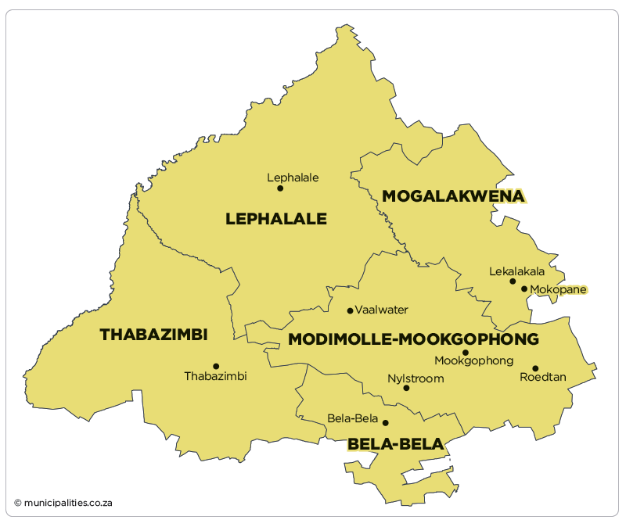
Geographical Map
KPA 1. SPATIAL RATIONALE

Slide 6
LEGISLATIVE FRAMEWORK
Chapter 5 Section 83 (3)(c) of the Municipal Structures Act 117of 1998:
The district municipality must seek to achieve the integrated, sustainable and equitable social and economic development of its area as a whole by-
“ building the capacity to local municipalities in its area to perform their functions and exercise their powers where such capacity is lacking”…
Chapter 5 Section 84 of the Municipal Structures Act- Division of functions and powers of the district and local municipalities
Chapter 7 section 154 (1) (a) of the Constitution of the Republic of South Africa, 1996
“ The national and provincial governments, by legislative and other measures, must support and strengthen the capacity of municipalities to manage their own affairs to exercise their powers and to perform their functions”…
KPA 1. SPATIAL RATIONALE

Slide 7
KPA 1. SPATIAL RATIONALE
SUPPORT TO LOCAL MUNICIPALITIES

Slide 8
SUPPPORT IN THE FORM OF INTERGOVERNMENTAL RELATIONS FORA
The Waterberg District Municipality coordinates and chairs various District Intergovernmental (IGR) Forums established to discuss and advice each other on matters of mutual interest
The established forums include amongst others the following:
Municipal Managers Forum
Mayor`s Forum
CFO`s Forum
District MIG Forum
Speakers Forum and
Chief Whip`s Forum
The above forums complement, support each other and share best practices on the execution of municipalities service delivery mandate
KPA 1. SPATIAL RATIONALE

Slide 9
SERVICE DELIVERY…FIRE FIGHTING
The Waterberg District Municipalities supports Mogalakwena Local Municipality in terms of fire fighting services in line with the Municipal Structures Act, Section 84(1)(j):
The district municipality deployed resources in the form of equipment and personnel to Mogalakwena Local Municipality to assist in the provision of fire fighting services.
Eight vehicles, fire fighting equipment and nine personnel (Fire fighting Officers) are permanently stationed at Mogalakwena Local Municipality Fire Station.
The service is provided to the entire Mokopane Town, Townships and all villages that constitute Mogalakwena Local Municipality.
KPA 1. SPATIAL RATIONALE

Slide 10
SERVICE DELIVERY…ENVIRONMENTAL HEALTH
Environmental Health Services is also one the services that
the Waterberg District is providing in all its local municipalities
including Mogalakwena
Out of 28 Environmental Health Practitioners, 12 have been
deployed to Mogalakwena Local Municipality focusing on the following:
Inspection of landfill sites
Inspection of food outlets
Disposal of the dead
Education and awareness
Compliance with COVID19 Regulations etc.
Addition to the above is two Air Quality Management Officers deployed
to assist with the management of air pollution in industries and
mining companies around the vicinity of Mogalakwena Municipality
KPA 1. SPATIAL RATIONALE

Slide 11
SERVICE DELIVERY…DISASTER MANAGEMENT
The Waterberg District Municipality is the custodian of coordination
of disaster management in the within the district
The district has allocated humanitarian relief material in the form of
tents, mattresses and blankets to Mogalakwena to assist
community members affected by disaster incidents such as rain, fire,
storm etc.
In the absence of disaster management officials in
Mogalakwena Municipality, the district is responsible for the
overall coordination and execution of the function.
KPA 1. SPATIAL RATIONALE

Slide 12
ADMINISTRATIVE SUPPORT
As a result of the instability and an exodus of key personnel
in Mogalakwena, the district provided support by seconding the officials
to the following positions:
Divisional Manager Capital Project - to act as Manager Technical Services
Chief Financial Officer (CFO)- to act as the CFO
Manager Corporate Support and Shared Services - to act on the same position
The secondmends were effected between March 2020 and January 2021
The above were processed as a result of vacancies in the
same positions at Mogalakwena Municipality which hindered
on administrative operations
Engagements are in process to also second one official to the municipality to assist in the position of the CFO
KPA 1. SPATIAL RATIONALE

Slide 13
ADMINISTRATIVE SUPPPORT continues…
The intervention on the secondment of officials to Mogalakwena
was complementing the intervention by the provincial government
through COGHSTA which introduced Section 139 (b) of the
Constitution
The intervention by the district municipality resulted in the following
being achieved:
Compilation and submission of Annual Financial Statements within stipulated
time frame for the financial year in question
Responding to audit queries raised by the Auditor General
Cooperating with the AG during the audit period
Introduction of internal control measures
Improvement of the municipality`s auditoutcome
Continuous administrative support is provided to Mogalakwena
Local Municipality by the district as and when requested
KPA 1. SPATIAL RATIONALE

Slide 14
POLITICAL INTERVENTIONS
The political instability in Mogalakwena Local Municipality tempted the leadership of the governing party to intervene
As a result of the new Mayor was deployed to the municipality after
the recent local government elections to stabilize the municipality
Constant engagements are held coordinated by the Executive Mayor
of the district in an endeavor to settle the political conflicts in
Mogalakwena Local Municipality
KPA 1. SPATIAL RATIONALE

Slide 15
CONCLUSION
The Waterberg District is a category C1 Municipality hence is not a water services or water services authority
The district therefore depend solely on grants for its operations making it difficult to financially support its local municipalities
The district municipality has been supporting and implementing projects on behalf of Thabazimbi and Modimolle –Mookgophong and therefore ready to assist Mogalakwena as well upon request
The full implementation of the District Development Model will therefore be a permanent solution to building the requisite skills and capacity in municipalities.
KPA 1. SPATIAL RATIONALE

Slide 16
THANK YOU
KPA 1. SPATIAL RATIONALE

