Slide 1
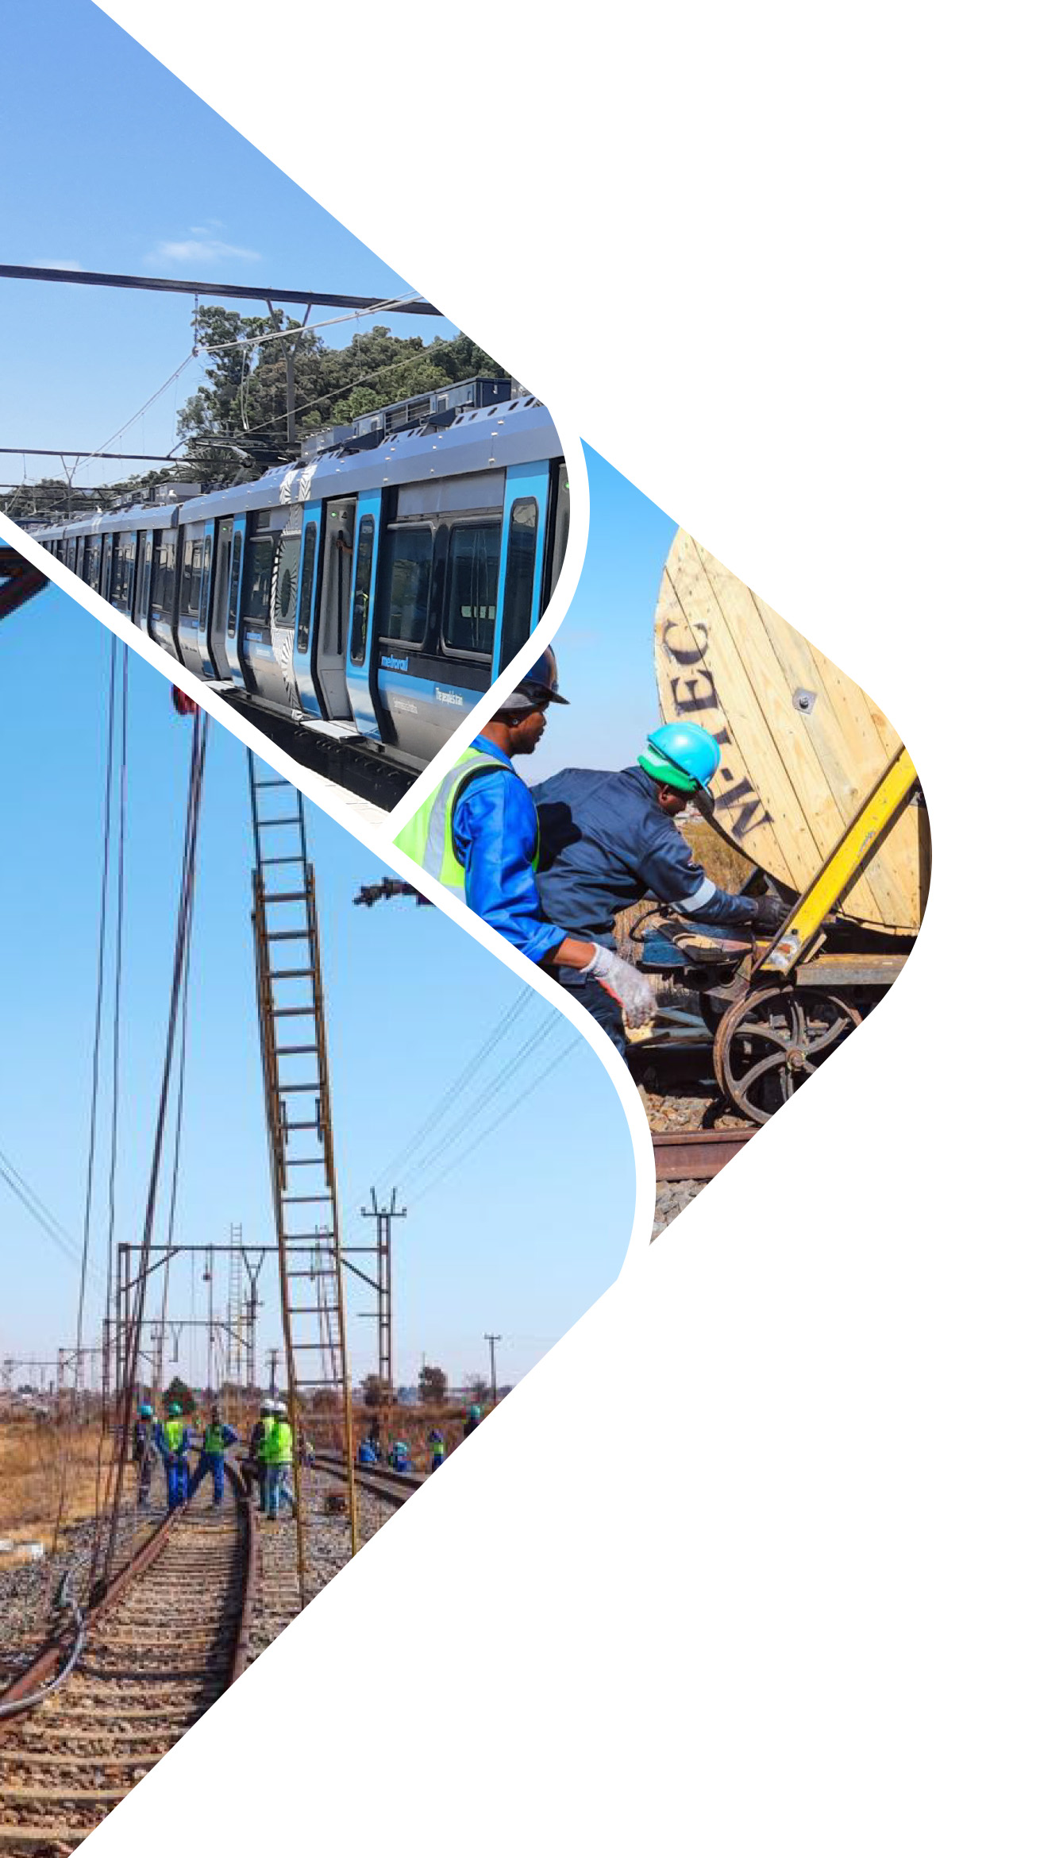
PRESENTATION TO SCOPA ON ANNUAL REPORT 2021/22, IRREGULAR, FRUITLESS
AND WASTEFUL EXPENDITURE
29 NOVEMBER 2022
Presented by: Name & Surname
prasa.com

Slide 2
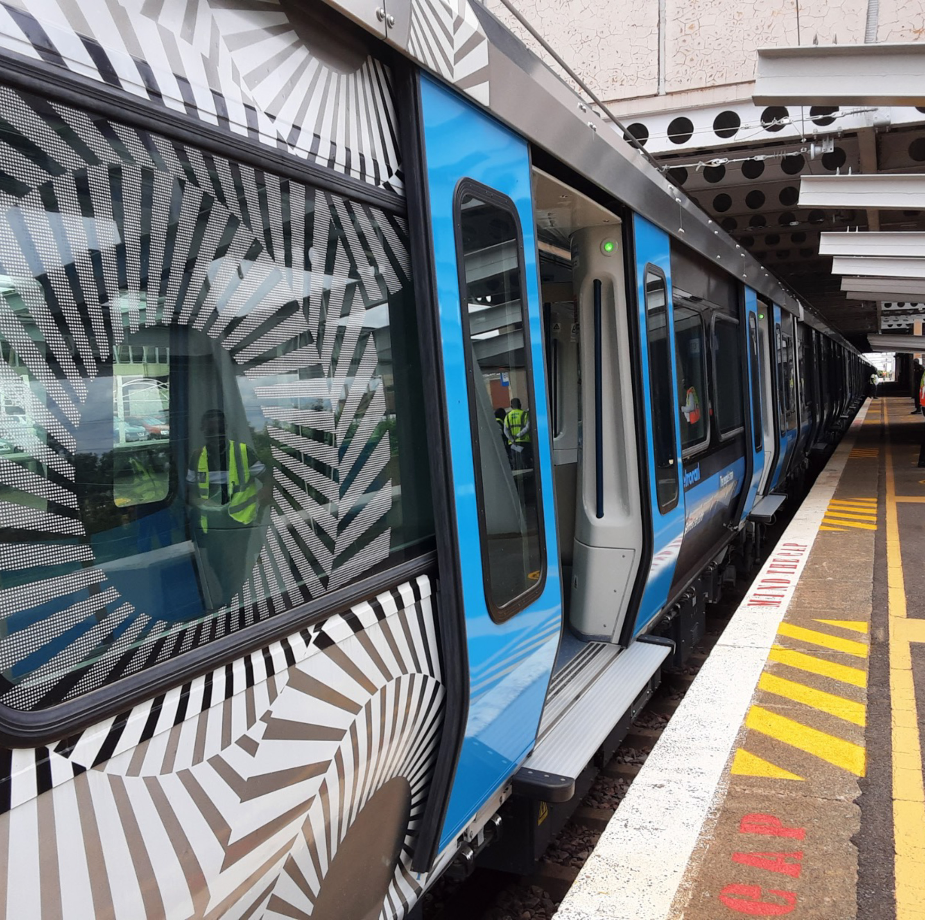
Table of Contents
Overview
Annual Performance 2021/22
Status of performance per pre-determined objective
Post year-end achievements & progress
Irregular Expenditure
Audit Outcomes: 2021/22

Slide 3
2021/22 a year of continued improvement
PRASA on a steady path to recovery.
Process to bring stability, address irregularities and rebuild PRASA on track.
Board made significant strides in addressing irregularities
Condonations of R12bn submitted to NT
SIU investigations concluded and instituted disciplinary hearings for 44 employees
13 cases active
Consolidated subsidiary Intersite with division CRES
CRES taken over all staff functions and Intersite remains a Special Purpose Vehicle
with its own Board
Approved an organisational structure in line with GTAC and World Bank reports.

Slide 4
Annual Performance: 2021/22 Achievements
Five of 10 corridors resumed with electrical services for both peak and off-peak
  Pretoria - Mabopane with new train sets
  Pretoria – Saulsville with new train sets
  Cape Town – Simon’s Town with new train sets
  Cape Town – Retreat with new train sets
  Cape Town – Bellville via Goodwood (End 2022/23 for new train sets)
Presented by: Name & Surname
prasa.com

Slide 5
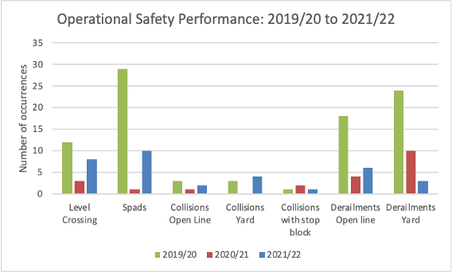
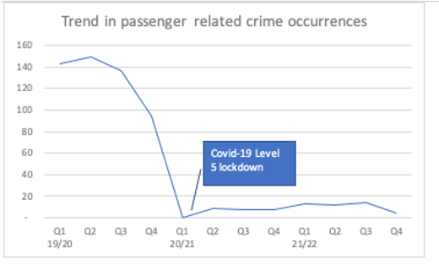
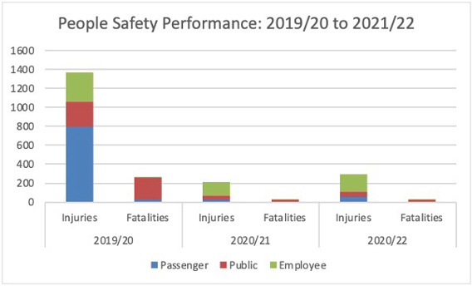
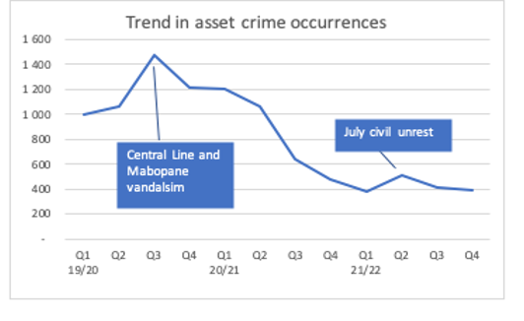
Annual Performance: 2021/22 Achievements
Number of safety occurrences remain very low partially linked to less trains.
Number of security occurrences remain lower than anticipated indicating success of security interventions.

Slide 6
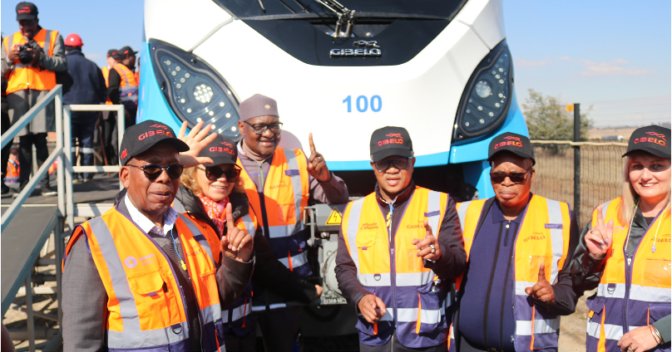
Annual Performance: 2021/22 Achievements
Implementation of integrated security strategy with physical security and technology commenced.
  Security intervention unit in Mabopane over period December 2021 – March 2022 nil incidents
  related to assets
39 new train sets completed
  6 carry over to 2022/23 as final sign off not concluded by 31 March 2022.
Unqualified audit of performance of pre-determined objectives.

Slide 7
Status of performance per pre-determined objective: 2021/22
Pre-determined Objective | Achieved | Not Achieved | Total
Core performance objective
Modernise rail through manufacturing, infrastructure development and maintenance |  | 7 | 7
Recover Rail and Autopax performance | 1 | 4 | 5
Improve Operational Safety & security | 2 | 2 | 2
Restructure and improve performance of secondary mandate |  | 1 | 1
Performance core objectives | 3 (19%) | 14 | 17
Partial achievements
36 out of 44 new EMUs delivered (Excl. 6 carried over)
Signalling of Western Cape completed with exception of Central Line that was halted due to Illegal Settlements removal not completed.
Notes:
Completion of other corridors were not part of the compact.

Slide 8
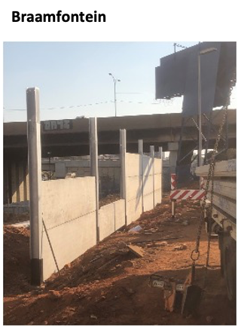
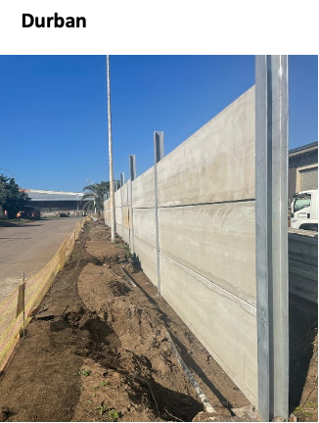
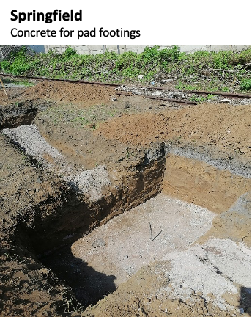
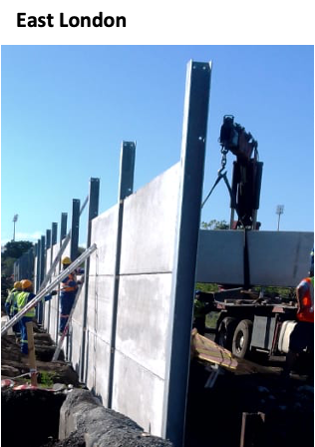
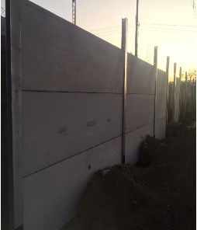
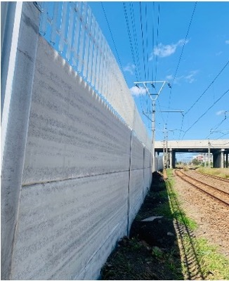
Post year-end achievements & progress: 2021/22
Fencing for 6 depots with concrete walling with high technology in progress with completion by end of 2022/23. Contracts commenced March 2022.
Paarden Eiland
Salt River

Slide 9
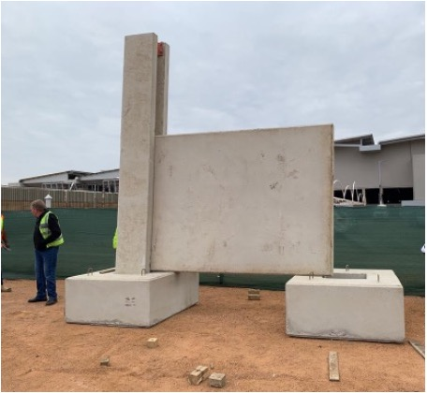
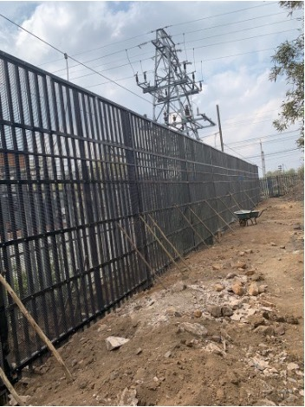
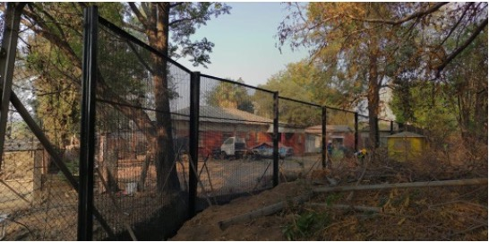
Post year-end achievements: 2021/22
General Overhaul programme endorsed by Shareholder - contracts concluded June 2022.
  Trains from programme will be in PRASA blue
  2000 potential jobs.
  Work accelerated to meet targets for 2022/23 on Metrorail coaches
Fencing and walling of high-risk infrastructure in Mabopane
Mabopane – Prototype Wall
Military grade fencing – Hercules.
Signal Room – below and Substation - right

Slide 10
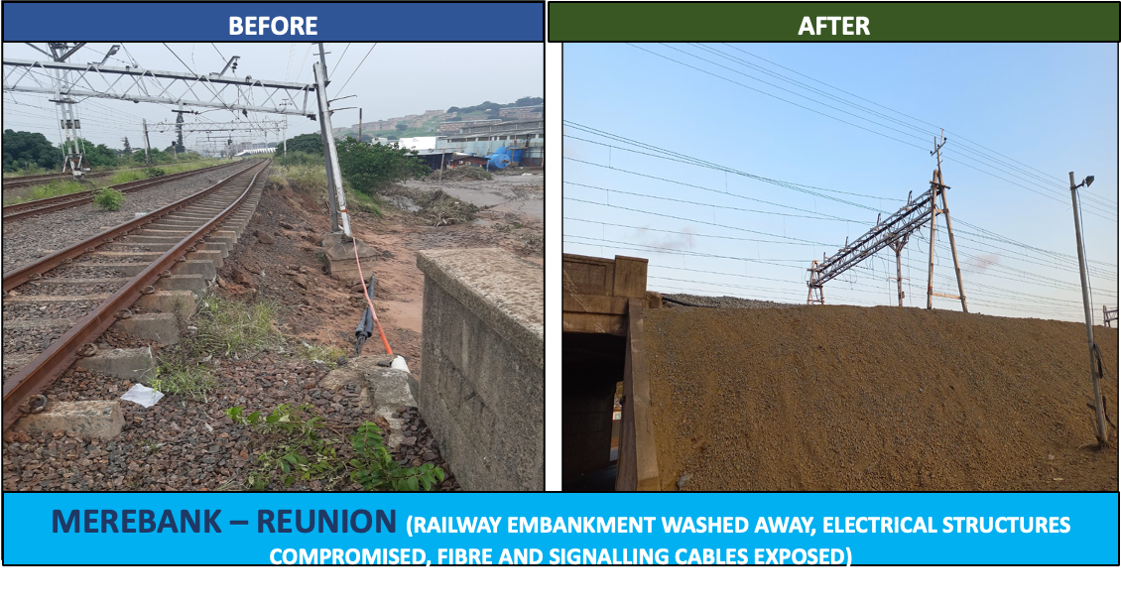
Post year-end achievements: 2021/22
Diesel locomotives released from Gauteng redistributed to KwaZulu-Natal and Eastern Cape.
Clean-up work in KwaZulu-Natal post April 2022 floods completed to run diesel service in June 2022 from Umgeni – KwaMashu; electrical service between Durban and Merebank extended to Umbogintwini

Slide 11
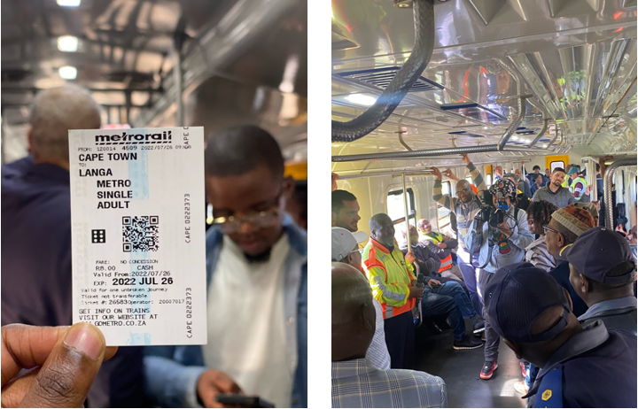
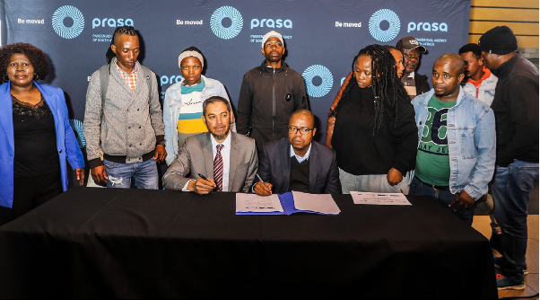
Post year-end achievements: 2021/22
On 26 July 2022, commenced trail services between Langa and Pinelands and Cape Town to Bellville via Sarepta and full service without signalling from 1 August 2022.
An Implementation Protocol between several government levels concluded by end March 2022.
  A National Steering Committee formed with dual leadership by DOT and DHS. DOT leading project management committee on relocations and HDA tasked with relocations.
A social compact with communities were signed on 9 September 2022.

Slide 12
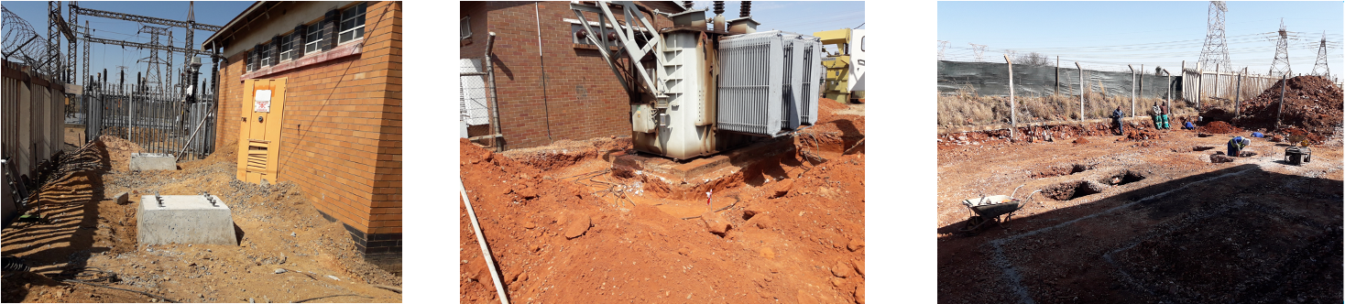
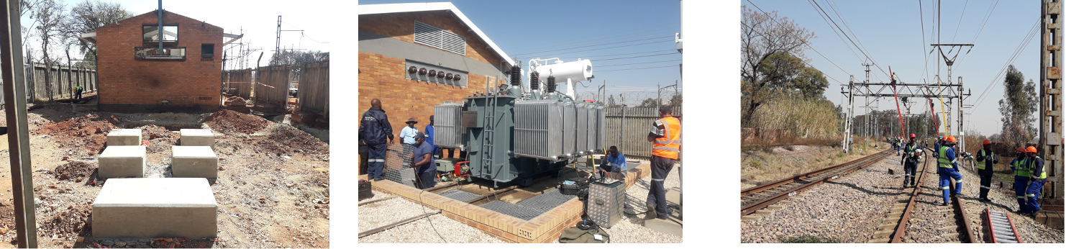
Post year-end achievements: 2021/22
Dube Substation Aerial feeds
& structure foundations
Naledi substation foundation for
Bund wall
Pinedene Substation Excavations
Oakmoor substation
Koedoespoort new transformer
OHTE Work at Pienaarspoort

Slide 13
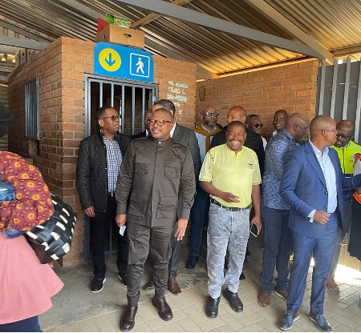
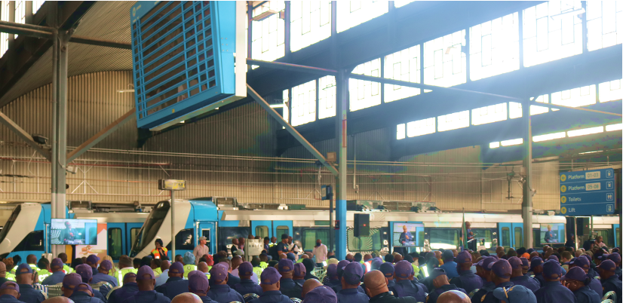
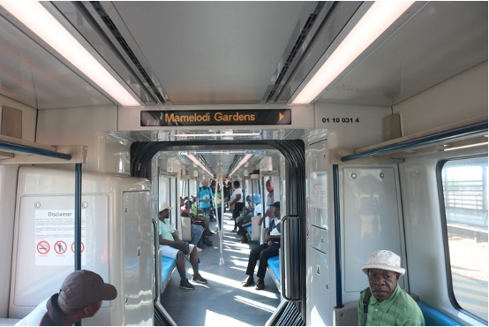
Post year-end achievements: 2021/22
Authorisation of RSR for testing of new trains on DeWildt to Belle Ombre Line at speed of 120km/h obtained
Rebuilding of corridors in Gauteng commenced end May 2022
Pretoria – Pienaarspoort full commercial services as from 3 October 2022 at speed of 60km/h

Slide 14
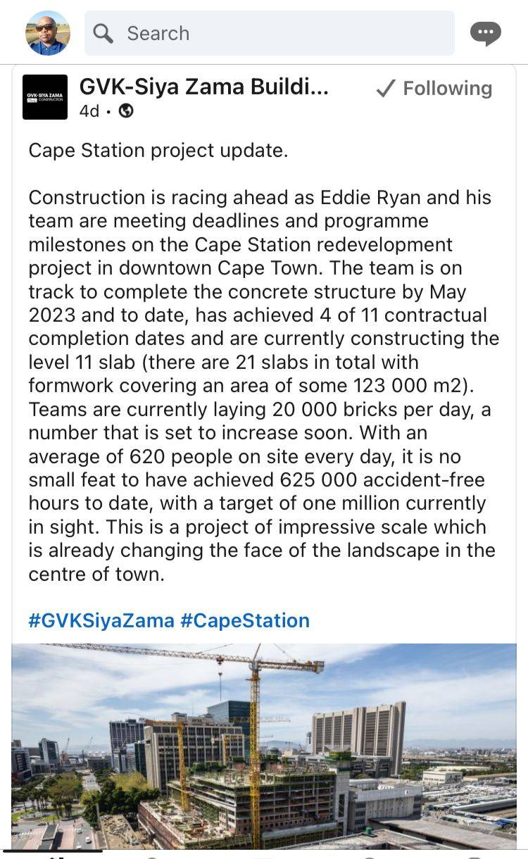
Post year-end achievements: 2021/22
Co-investment in a commercial development for Cape Town Station concluded.
Student accommodation for 3000 beds and 7000m² retail space.
Revenue from co-investment to be realized from January 2024

Slide 15
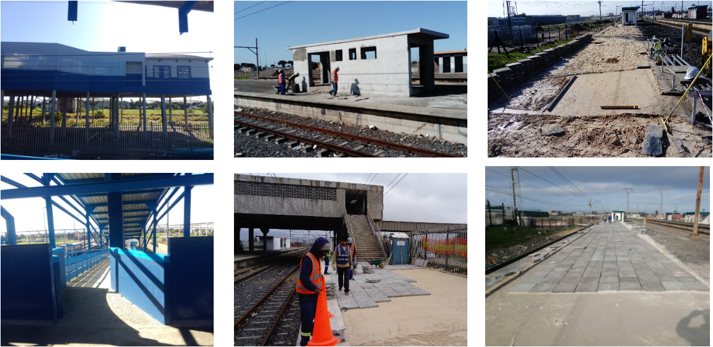
Station Progress: Western Cape
Ysterplaat
Bonteheuwel
Lavis Town

Slide 16
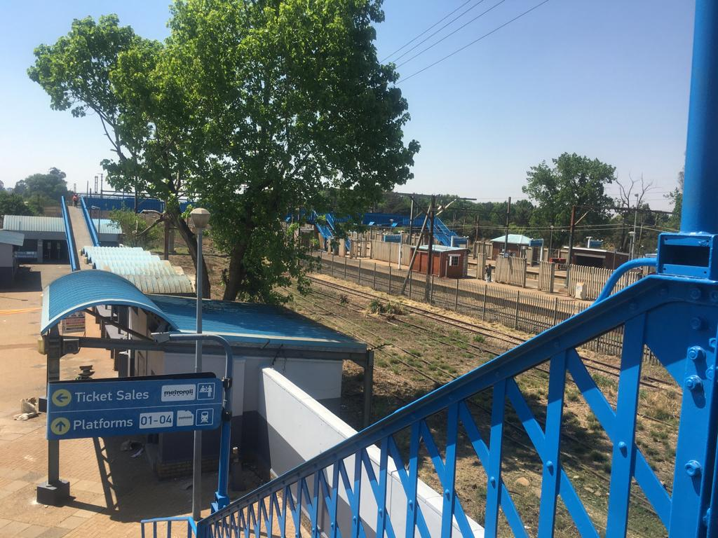
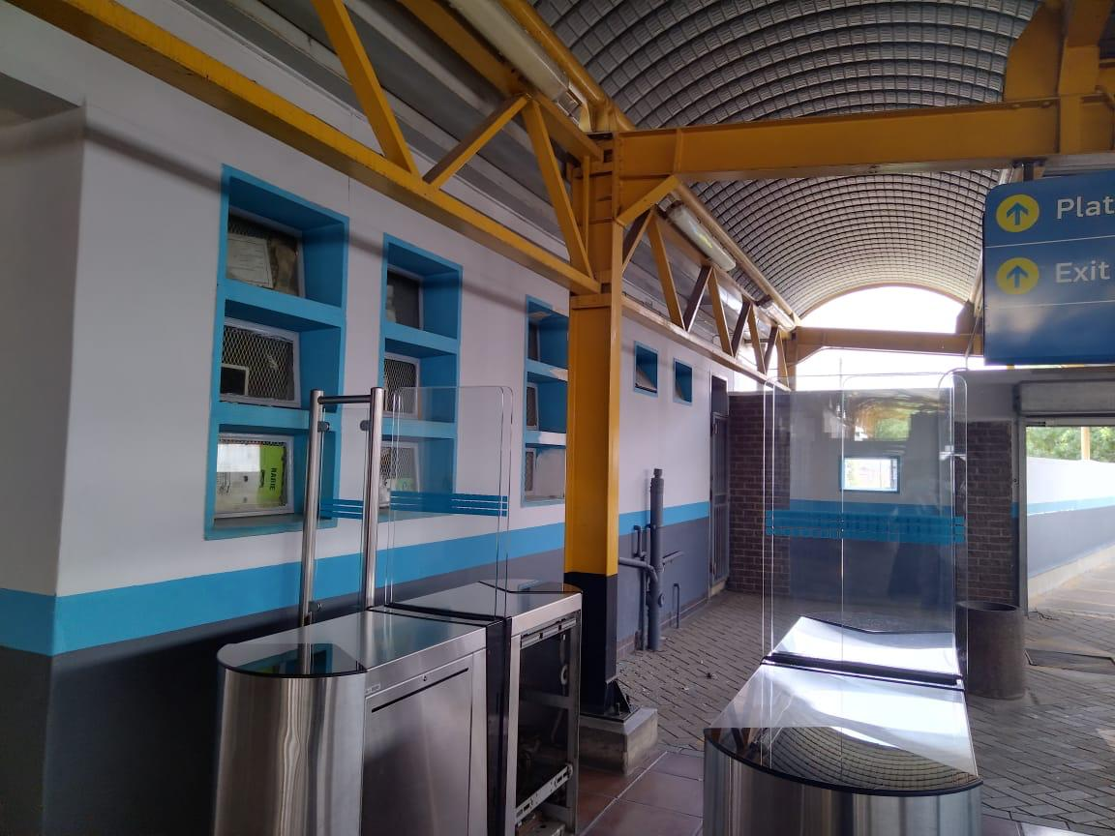
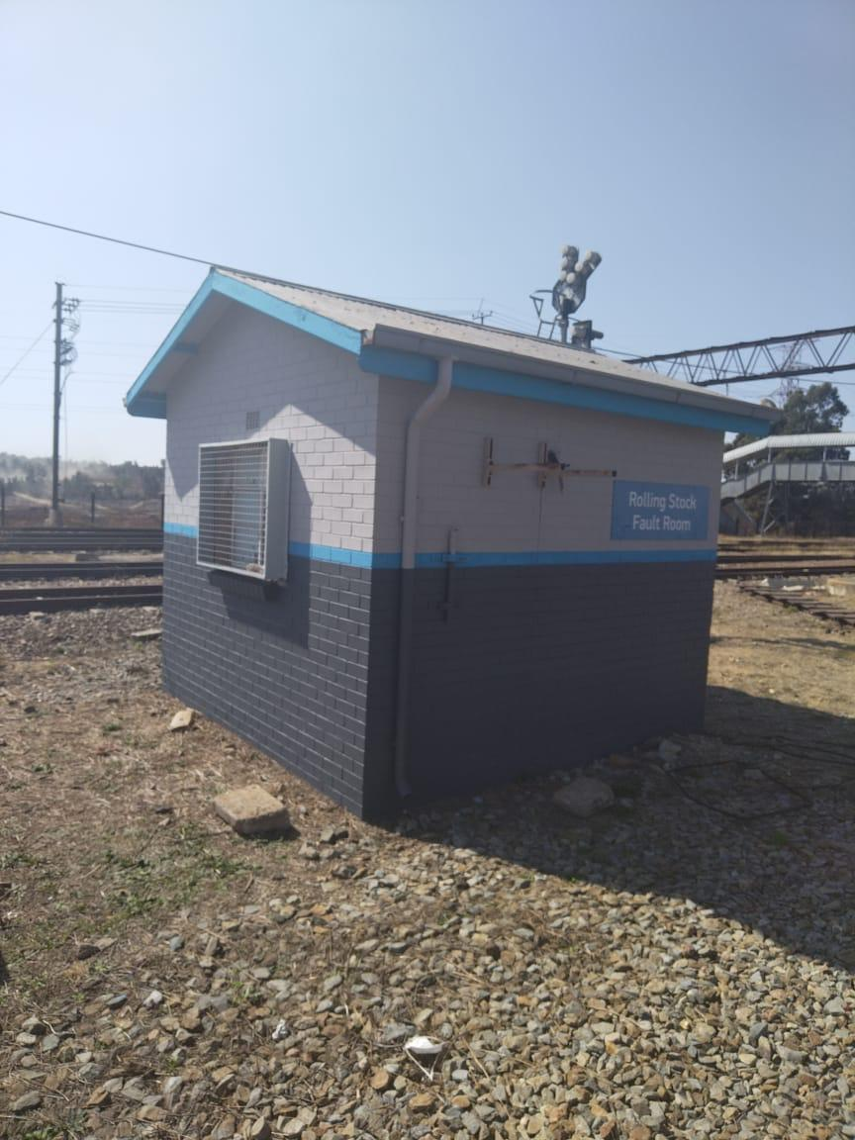
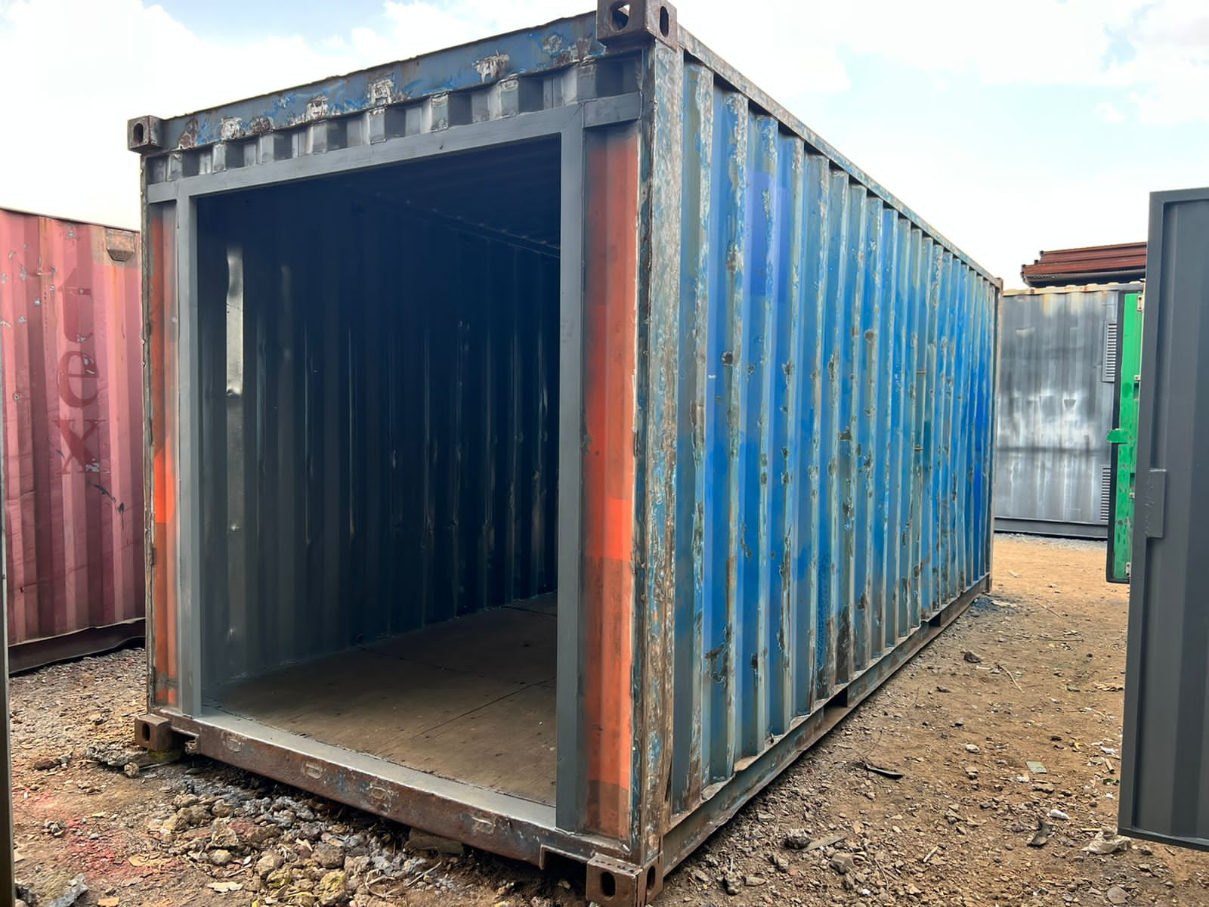
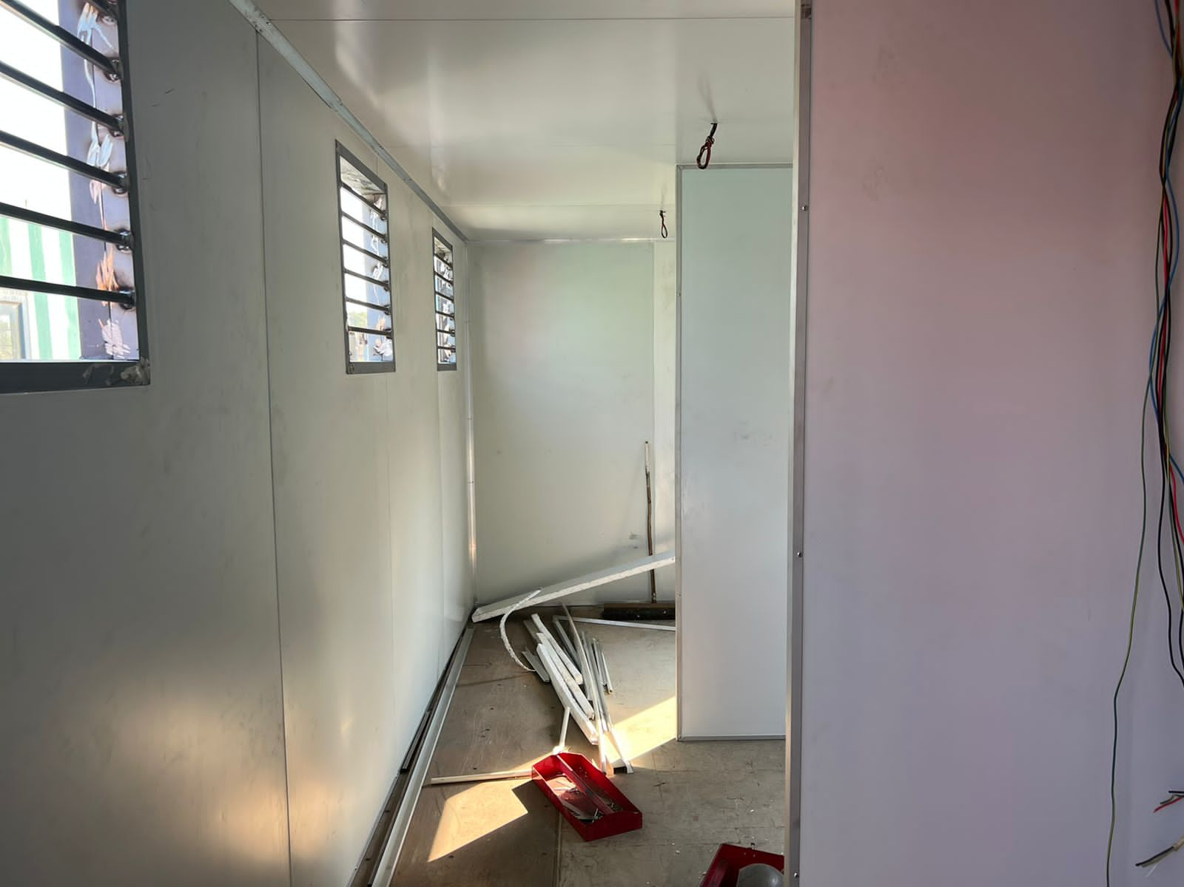
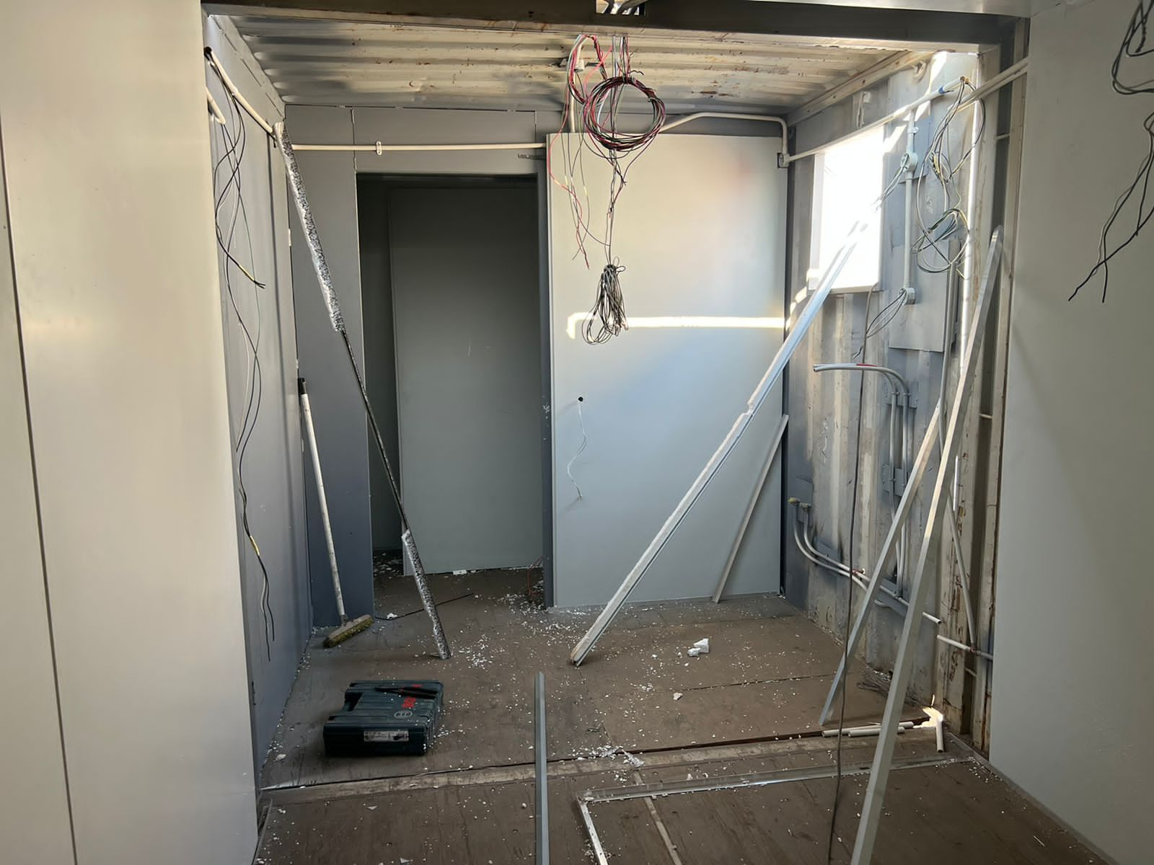
Station Progress: Gauteng
Grosvernor ABT

Slide 17
Financial Year at a Glance: 2021/22
  Stability at Board level.
  Instability in key management positions.
  The rebuild program is under way.
  Limited capacity to implement the capital programme.
  Limited availability of the network severely impacting PRASA’s fare revenue and performance.
  Positive action noted in addressing some audit outcomes.
Presented by: Name & Surname
prasa.com

Slide 18
Irregular Expenditure : 2022/23
IRREGULAR EXPENDITURE AS AT 31 OCTOBER 2022 - PRASA GROUP
Irregular Expenditure Balance
 | R’000
Opening balance @ 01 April 2022 | 29,328,660.38
Add: Irregular Expenditure – current year | 1,590,379.87
Less: Amounts condoned | -
Less: Amounts recoverable (not condoned) | -
Less: Amounts not recoverable (not condoned) | -
Closing Balance @ 31 October 2022 | 30,919,040.25
Condonation Submissions:
Less: Submitted to NT for Approval | (11,663,820.93)
Less: Submitted to IA for Determination test | (13,449,204.00)
Less: Submitted for Investigation | -
Balance to be Condoned | 5,806,015.32
The irregular expenditure has increased by 5% since the beginning of the financial year.
Management has actioned 81% of the expenditure.
Internal Audit is currently conducting a determination test on R 13,4billion
Initiatives to enhance internal control are in progress.
Presented by: Name & Surname
prasa.com

Slide 19
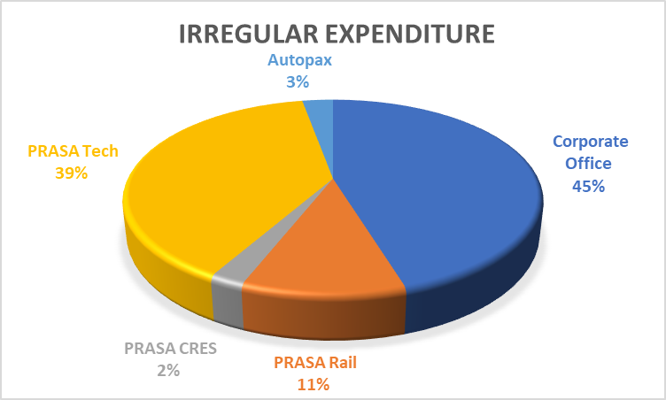
NB: For detail transactions per division, refer to Annexure A
Irregular Expenditure Per Division: 2021/22
Division | Irregular Expenditure
Corporate Office | 13,996,162,784.87
PRASA Rail | 3,314,338,417.68
PRASA CRES | 705,842,260.39
PRASA Tech | 12,018,960,338.73
Autopax | 883,736,446.43
Total | 30,919,040,248.10
Presented by: Name & Surname
prasa.com

Slide 20
Audit Outcomes: 2021/22
The PRASA 2021/2022 audit outcome is a Disclaimer with findings.
The Auditor-General South Africa highlighted the following as root causes:
    No sustainable and comprehensive turnaround plan that will address audit outcomes and performance shortfalls.
    Stability in executive management.
    Critical capacity constraints.
    Insufficient financial processing reconciling controls combined with poor record keeping.
    Inadequate financial reporting processes and review.
    Lack of compliance monitoring and enforcement.
    Poor procurement planning and lack of preventative controls to avoid irregular expenditure.
    Lack of legislatively prescribed consequence management.
Presented by: Name & Surname
prasa.com

Slide 21
Financial Performance: 2021/22
Salient Financial Position
 | 31 March 2022 | 31 March 2021
Group Revenue | R 18.7 bn | R 11.4 bn
Group Expenditure | R 12.8 bn | R 14.5 bn
Group Operating Loss | (R 3.8 bn) | (R 3.8 bn)
Group cash (Loss)/Surplus: (excluding non-cash items) | (R 0.9 bn) | R 1.3 bn
Presented by: Name & Surname
prasa.com

Slide 22
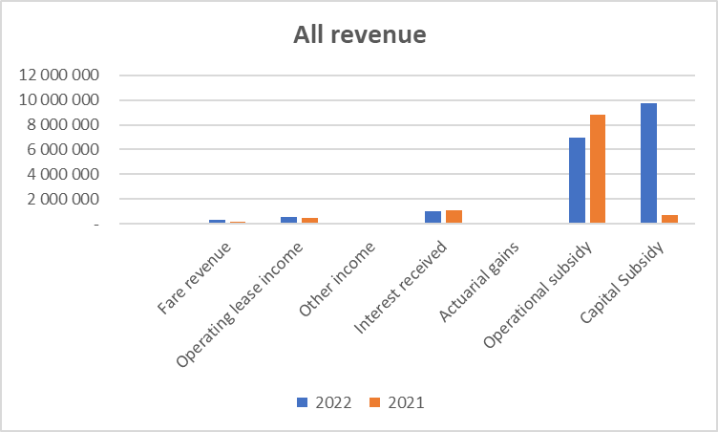
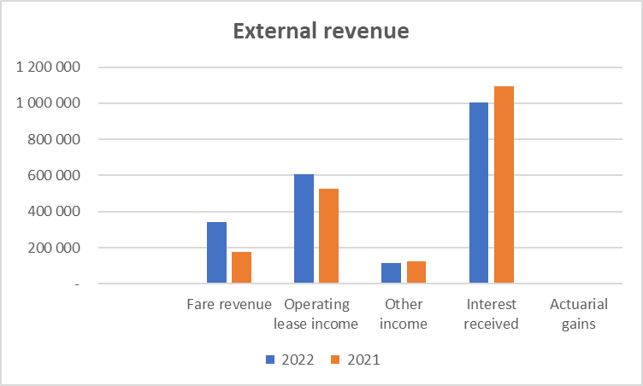
Revenue
Revenue (reflects constrained operation conditions):
Subsidy – Operational subsidy dropped as no further Covid assistance received. Capital subsidy increased as activity resumed.
Increasing fare revenue (R 165 million) – remain impacted by network and train availability
Interest income dependency.

Slide 23
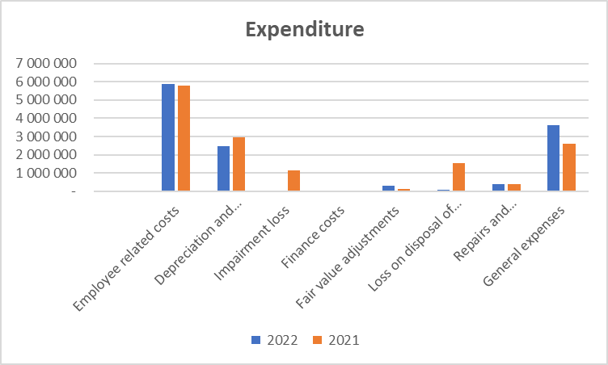
Expenditure
Expenditure (reflects inherent fixed cost structure):
Staff costs – consistent year on year
  General expenditure comprises security, municipal costs, materials, leases (including locomotives), Insurance, Health and Risk (cleaning and SHEQ), ICT costs (including data and communication) and decreased due to less activity and lower consumption

Slide 24
Balance Sheet
 | R-value | Comment
Property, plant and equipment:
Additions (WIP) | R7.2 bn | March 2021 : R 3.7 bn
WIP capitalised | R5.7 bn | March 2021 : R5.5 bn
Prepayment (Gibela) | R7.4 bn | Amortisation of trains
Cash and cash equivalents | R24.6 bn | High deposits due to unspent capex
Capex spend | R5.3 bn/R9.1 bn | March 2021: R3.7 bn/R11.9 bn
Investment property | R4.4 bn | Fair value adjustments

Slide 25
Improvement in Internal Controls and Processes
Asset management (including impairment) – Engineering asset management and Finance
Work in Progress – Project Management and Finance
Group policies and standard processes
Accounting policy matters – Capital Grants
SCM Compliance and Training (Institutionalisation)
Loss control process put in place
Consequence management taking place although slowly
Presented by: Name & Surname
prasa.com

Slide 26
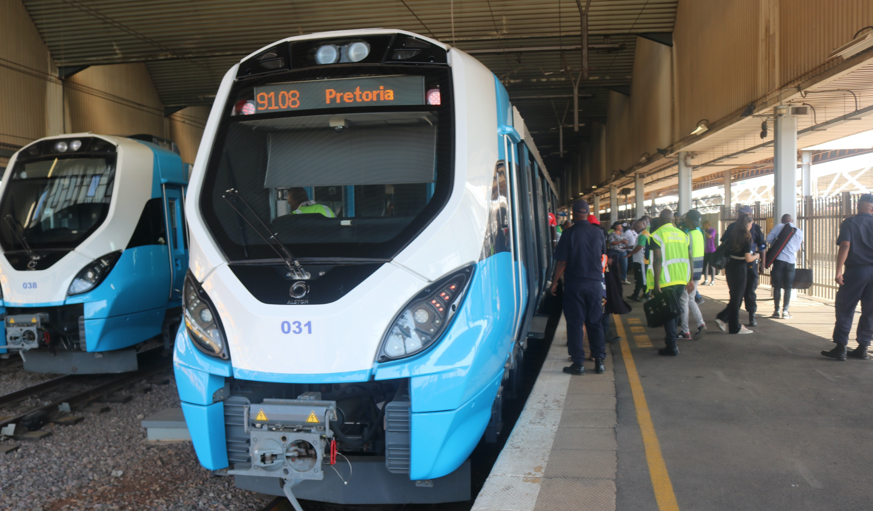
Thank You

