Slide 1
SUPPORT PROVIDED TO MOGALAKWENA LOCAL MUNICIPALITY AND WATERBERG DISTRICT MUNICIPALITY
29 NOVEMBER 2022

Slide 2
CONTENTS
Background and Context
Municipal Finance and Audit Support
Municipal Capabilities and Governance Support
Municipal Infrastructure and Service Delivery Support
Socio-economic Development And Spatial Transformation Support
Conclusion and Recommendations

Slide 3
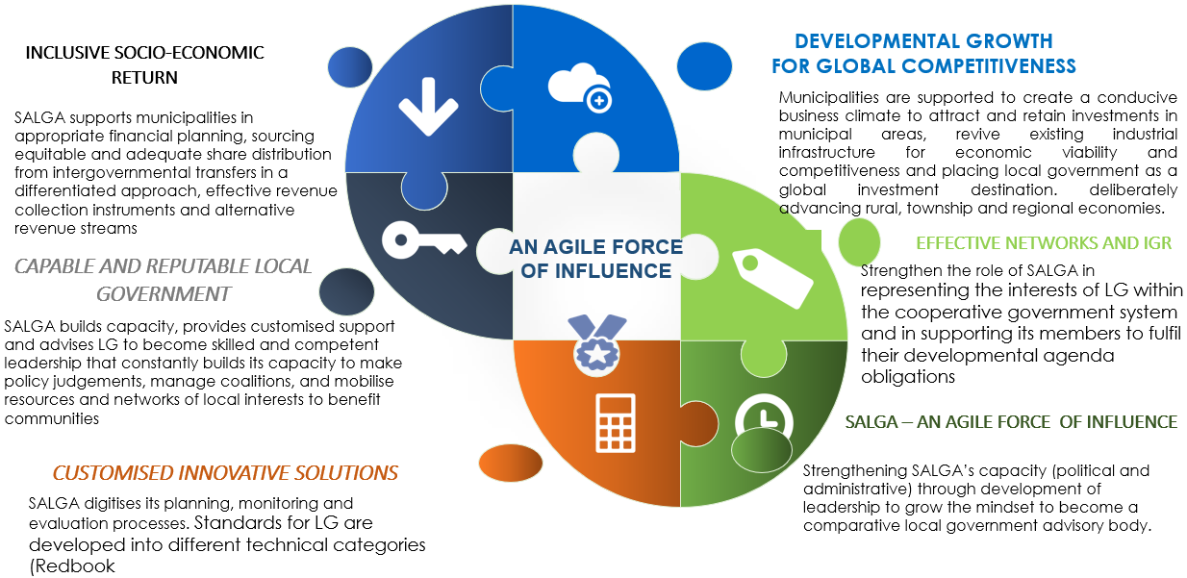
STRATEGIC OUTCOMES

Slide 4
What is the problem?
Poor political leadership capacity and weak administrative management
Ineffective utilisation of financial resources (poor financial administration) & inability to collect revenue and insufficient fiscus allocation
Weakening municipal governance and leadership characterised by poor oversight, limited consequence management, instability at senior management levels, and a lack of skills, deficient PMS, non-standardisation of the recruitment – retirement
Increase of municipalities in financial distress due to many factors like: poor financial planning, inadequate fiscus allocation, ineffective allocation of allocated resources, increase in the cost of services (tariffs), decrease in revenue collection, irregular, fruitless and wasteful expenditure, high levels of unemployment & poverty.
Inefficient and non-integrated LG delivery mechanisms, systems and processes to enable service delivery
Degenerating infrastructure and non-existent or poor services provided to local communities
Unintegrated/silo delivery of services across the 3 spheres of government, deficient integrated planning (IGR structures not functioning adequately across LG role-players and between district and local municipalities), inappropriate allocation of functional roles between district and local municipalities and overregulation, uncoordinated policy and legislation development and outdated assumptions
Increase in coverage of basic services but under pressure from widening funding gap for infrastructure, poor life cycle asset management, maintenance and effective project implementation, as well as lack of technical capabilities, inadequate involvement by communities, weak technical & planning capacity.
THE CORE PROBLEM: LOCAL GOVERNMENT IS INADEQUATELY EQUIPPED/TOOLED TO FULFILL ITS DEVELOPMENTAL AGENDA
Notes:
Auditor-General South Africa. (2018). Consolidated MFMA 2016 – 17. General Report on the Local Government Audit Outcomes.
South African Cities Network (2018). State of City Finances. Johannesburg: SCAN.
National Treasury. (2017). The State of Local Government Finances and Financial Management as at 30 June 2017. Analysis Document. Pretoria: National Treasury.
STATS SA. (2018). Capital expenditure by the public sector. Pretoria: STATS SA
STATS SA. (2018). Non-financial Census of Municipalities 2017. Pretoria: STATS SA
STATS SA. (2018). Financial census of municipalities for the year ended 30 June 2017. Pretoria: STATS SA

Slide 5
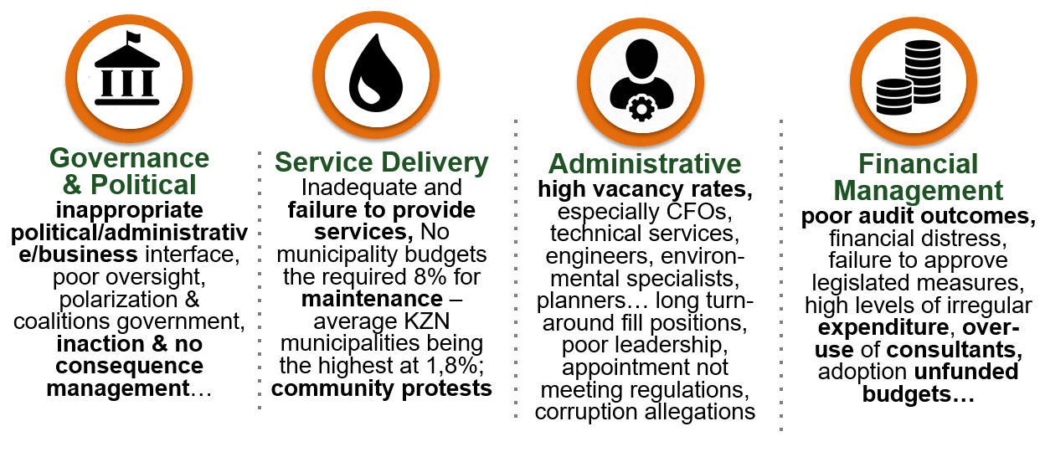
KEY LOCAL GOVERNMENT CHALLENGES THAT
TRIGGER INTERVENTIONS AS PER DCOG
Di

Slide 6
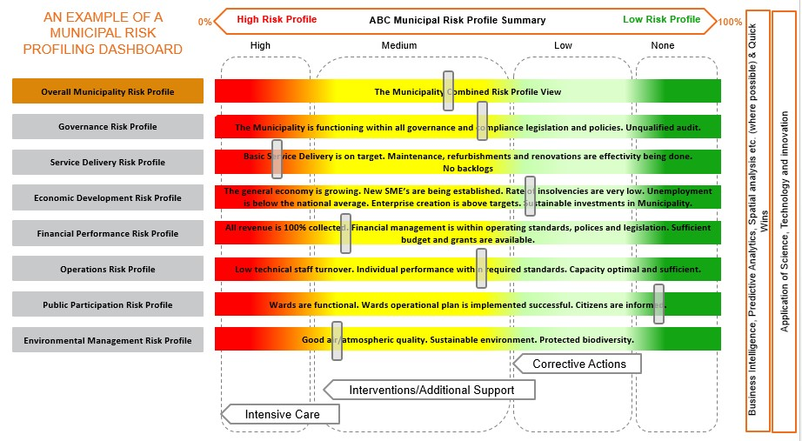
EARLY WARNING SYSTEM

Slide 7
NEWLY ADOPTED SALGA SUPPORT APROACH
DEVELOP EARLY WARNING SYSTEM using Statutory and periodic reports:
AG reports
MFMA Section 71 reports
MFMA Section 72 reports
MFMA Section 73 reports
MSA section 106 reports (where such were evoked)
Quarterly performance reports
2
ONGOING SELF-ASSESSMENT: Identify underperformance and self-correct
1
3
ONGOING MONITORING: Provincial & National Monitoring Support
4a
Contract targeted support
4
IDENTIFY TARGETED SUPPORT: Agreement with municipality on support requirements
4b
Monitoring Support
Monitoring and Support Report (s154 Report)
4c
5
6
7
S46 Quarterly Reports
S47 Report
S48 Report
ONGOING MUNICIPAL SUPPORT

Slide 8
Municipal Finance and Fiscal Policy

Slide 9
AUDIT OUTCOME
“I firmly believe that courageous, ethical, accountable and citizen-centric leadership is needed to turn the tide in local government.”
Tsakani Maluleke,
Auditor-General of South Africa

Slide 10
SALGA MUNICIPAL AUDIT SUPPORT PROGRAMME
SALGAs Municipal Audit Support Program (MASP) follows a Multidisciplinary approach that is based on 4 Pillars.
We believe that all four pillars in a Municipality need to be strong and functioning effectively in order for a Municipality to obtain and sustain unqualified audits and good service delivery
SALGA is confident that the MASP based on the 4 Pillars of Support cover the risk areas and root causes identified by the AGSA as well as the three aspects audited
Institutional Capacity
Financial Management
Leadership
Governance

Slide 11
MUNICIPAL FINANCE -
Current Support Programmes
SECTION/UNIT | MUNICIPAL CHALLENGES | DESCRIPTION OF SUPPORT | WHAT IS NEXT?
Mmunicipal Finance | Unauthorised, Irregular, Fruitless and Wasteful (UIF-W) Expenditure | Workshopped on Provincial UIF_W Reduction Strategy – 75% reduction of UI expenditure by 2024 and 100% FW expenditure by 2024 | Follow Up Workshop scheduled for December 2022
 | Municipal Financial Management & Oversight | Engaged on Unfunded Budget, Financial Health, Liquity Ratios, Revenue Enhancement, support on functionality of Audit Committees and MPACs, Implementation of Audit Plans. | Follow Up Engagements – Generic and Specific to the Municipality
 | Implementation of Municipal Recovery Plans and Recovery of Debt Owed to Municipalities | Engaged in lobbying and advocacy to ensure recovery of debt owed to municipalities through Debt and other IGR Forums. | Expedite implementation of SALGA Asisho Campaign

Slide 12
MUNICIPAL FINANCE –
Previous Support Programmes
No. | Support Programme | Description and Evisaged Impact
1 | Capacity building on Assets Management. | Producing GRAP Compliant Assets Register and Annual Financial Statements.
2 | Record Management Training | Compliance with Records Management standards
3 | Portfolio based training of MMC for finance. | Capacitate councillors to ensure that they discharge their oversight responsibility effectively.
4 | SALGA Limpopo partnered with PriceWaterhouse Coopers, and convened (GRAP) and (AFS) Workshop | The aim of the session, was to provide technical knowledge on preparation of Annual Financial Statement to municipal officials, with the aim of improving the audit outcomes of
5 | Participating in the Audit steering committee meetings of the municipality. | Assisting the municipality in addressing findings raised by AG.
6 | Training Members of MPACs | Regular training of MPACs on how to carry out their roles and responsibilities effectively and efficiently.
 | Revenue, Credit and Debts controls workshop | Assist municipalities with the implementation of best practice framework on revenue, credit and debit.

Slide 13
MUNICIPAL FINANCE –
Previous Support Programmes
No. | Support Programme | Description and Evisaged Impact
1 | Municipal Audit Awards to encourage better performance, peer learning and overall compliance and improvement | More municipalities moved to unqualified audit opinions, and Waterberg to Clean. Mogalakwena improved on previous audit to qualified
2 | Quarterly meeting Chief Internal Auditor and Risk Manager with selected municipalities was convened on the 23 September 2022. | The purpose of the engagement is to discuss and resolve Audit Progress and challenges faced by municipalities.
3 | Annual Financial Statement Review session was convened on the 18 - 19 August 2022. | The objective of the session is to capacitate Chief Audit Executives with practical Annual Financial Statements review processes as assurance providers.

Slide 14
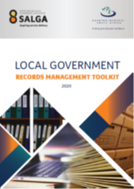
Municipal Audit Support Programme
Records Management Toolkit:
Asset Management Toolkit:
In collaboration with the AGSA developed a Records Management Toolkit. Training to be rolled out in the fourth quarter (January – March 2023)

Slide 15
Municipal Capabilities and Governance

Slide 16
MUNICIPAL GOVERNANCE -
Current Support Programmes
SECTION/UNIT | MUNICIPAL CHALLENGES | DESCRIPTION OF SUPPORT | WHAT IS NEXT?
Mmunicipal Governance | Strengthening and modernising Community Engagement Mechanisms | Workshopped on legislated public participation mechanisms and active citizenry. | Standing matter on Council of Speakers
 | Ethical leadership and anti-corruption | Partnered with Coghsta, the Limpopo Legislature, SIU, NPA, Ethics Institute, Public Service Commission, amongst others, on ethics management. | Follow Up Engagements through Provincial Forum for Rules & Ethics Committees
 | MPAC Support | Support provided on UIFW Investigations and review and development of Annual Oversight Report. | Follow Up through Provincial MPAC Forum
 | Councillor Support and Welfare | Provided support to avoid audit queries in this focal area. | Continue practical councillor tax support

Slide 17
MUNICIPAL GOVERNANCE -
Current Support Programmes
SECTION/UNIT | MUNICIPAL CHALLENGES | DESCRIPTION OF SUPPORT | WHAT IS NEXT?
Mmunicipal Governance | Strengthen compliance and ensure effective governance support- Council of Speakers Peer Learning | Cconsequence Management Procedures Separation of Functions Model Oversight on UIFW Reduction Strategy Review of Council Rules of Orders | Continue promote best practice sharing
 | Strengthen compliance and ensure effective governance support- Provincial Chief Whips Forum Peer Learning | Council and PMT Functionality Whipper Management Development of Coalition Framework for Local Government Oversight on UIFW Reduction Strategy | Continue promote best practice sharing

Slide 18
MUNICIPAL GOVERNANCE –
Previous Support Programmes
No. | Support Programme | Description and Evisaged Impact
1 | Capacity building support for s79 committees | Separation of functions, functionality of rules and ethics committees and MPAC
2 | Engagement with Municipality as part of SALGA National Integrated Municipal Support Framework (IMSF) – National | Follow up on identified areas of support- mobilise resources and networks
3. | Annual SALGA Governance and Performance Management Seminar – National | Follow Up on Municipal PMS Support Needs
4. | Annual SALGA Talent Management Seminar – National | Follow Up on Municipal Support Needs, where and when required.

Slide 19
MUNICIPAL CAPABILITIES -
Current Support Programmes
SECTION/UNIT | MUNICIPAL CHALLENGES | DESCRIPTION OF SUPPORT | WHAT IS NEXT?
Mmunicipal Capabilities | Ensure Human Capability Optimisation: HR Audit Support Activities Municipal Capability Assessment Report Analysis of HR Maturity levels to serve as a baseline | SALGA convened a support session with the two identified municipalities (Musina and Waterberg District) on the 15th of August through MS Teams. Both municipalities identified their needs for support purposes. Waterberg District signed a support plan. | Follow up on municipal needs for support
 | Competency Assessments conducted | SALGA Municipal Leadership Competency Assessment Centre (MLAC), personal credentials verification and integrity checks | Continue to support members on competency assessments
 | Impact of Local Government Municipal Staff Regulations | Conducted a support session | Continue to conduct support session as and when required.

Slide 20
MUNICIPAL CAPABILITIES -
Current Support Programmes
SECTION/UNIT | MUNICIPAL CHALLENGES | DESCRIPTION OF SUPPORT | WHAT IS NEXT?
Mmunicipal Capabilities | Labour Relations related matters: | Circular No. 1- 2022 Limpopo - Extension of Divisional CoS Agreement issued Conducted Labour Relations Practitioners Forum Circular No 9/2022 - RFCA - Temporary Interdict Obtained by MWRF issued Circular No. 6 -2022 - Compensatory Framework issued Issued a circular to monitor compliance Salary and Wage Collective Agreement | Follow up on municipal LR needs for support

Slide 21
TASK JOB EVALUATION
Municipality | Number of Jobs on the Organogram | Number of jobs loaded on the TASK System | Number of evaluated jobs by the DJEU | Number of Jobs submitted to the PAC | Number of jobs audited by the PAC | Completion Percentage at District Level
Sekhukhune District | 238 | 238 | 187 | 135 | 0 | 79%
Makhuduthamaga | 124 | 124 | 124 | 124 | 124 | 100%
Elias Motsoaledi | 215 | 215 | 210 | 210 | 0 | 98%
Ephraim Mogale | 124 | 124 | 123 | 0 | 0 | 99%
Fetakgomo Tubatse | 261 | 261 | 261 | 261 | 261 | 100%
Mopani District | 197 | 292 | 292 | 0 | 0 | 100%
Greater Giyani | 260 | 260 | 260 | 231 | 110 | 100%
Greater Tzaneen | 445 | 445 | 431 | 431 | 17 | 97%
Greater Letaba | 230 | 230 | 65 | 0 | 0 | 28%
Ba- Phalaborwa | 294 | 294 | 286 | 0 | 0 | 97%
Maruleng | 168 | 168 | 168 | 0 | 0 | 100%
Waterberg District | 93 | 93 | 93 | 73 | 73 | 100%
Bela-Bela | 332 | 303 | 283 | 0 | 0 | 91%

Slide 22
TASK JOB EVALUATION
Municipality | Number of Jobs on the Organogram | Number of jobs loaded on the TASK System | Number of evaluated jobs by the DJEU | Number of Jobs submitted to the PAC | Number of jobs audited by the PAC | Completion Percentage at District Level
Lephalale | 267 | 260 | 204 | 0 | 0 | 78%
Thabazimbi | 276 | 276 | 258 | 0 | 0 | 93%
Modimolle-Mookgopong | 176 | 174 | 168 | 168 | 168 | 100%
Mogalakwena | 362 | 362 | 362 | 75 | 75 | 100%
Polokwane | 732 | 580 | 523 | 356 | 356 | 90%
Capricorn District | 242 | 232 | 232 | 150 | 46 | 96%
Lepelle-Nkumpi | 226 | 226 | 78 | 0 | 0 | 34%
Blouberg | 136 | 136 | 136 | 136 | 136 | 100%
Molemole | 160 | 160 | 151 | 0 | 0 | 94%
Vhembe District | 246 | 223 | 120 | 106 | 106 | 53%
Thulamela | 233 | 162 | 68 | 0 | 0 | 42%
Musina | 198 | 177 | 103 | 54 | 54 | 59%
Makhado | 447 | 396 | 255 | 58 | 58 | 65%
Collins Chabane | 169 | 196 | 104 | 0 | 0 | 53%

Slide 23
SUMMARY: PAC PROGRESS
Municipality | No. Jobs Submitted | No. of Audited Jobs | No. of Moderated Jobs
Greater Tzaneen | 17 | 17 | 17
Mogalakwena | 362 | 362 | 75
Waterberg District | 88 | 88 | 0
Modimolle-Mookgopong | 223 | 223 | 223
Blouberg | 136 | 136 | 136
Polokwane | 270 | 230 | 65
Fetakgomo-Tubatse | 235 | 235 | 235
Musina | 14 | 14 | 0
Makhado | 46 | 0 | 0
Ba-Phalaborwa | 1 | 1 | 1
Collins Chabane | 46 | 14 | 0
Greater Tzaneen Development Agency | 15 | 15 | 15
Makhuduthamaga | 124 | 124 | 124
Bela-Bela | 57 | 50 | 0
Waterberg District | 75 | 67 | 0
Greater Giyani | 172 | 146 | 0
Sekhukhune | 100 | 76 | 0

Slide 24
REPORT ON LOCAL LABOUR FORUM FOR EMPLOYER COMPONENT
Summary:
It is recommended that the PEC:
Note the progress on training of the LLF
Induction Date | Total Number of Councillors and Officials Trained | Training Venue | Name of SALGA Facilitator/s | Status
13 - 14 June 2022 | 33 | Sekhukhune District Municipal Council Chambers - Groblersdal | Lead Facilitator Mr. Johan Van Zyl | Completed
22 - 23 June 2022 | 30 | Musina Municipal Council Chambers - Musina | Lead Facilitator Mr. Themba Nxumalo | Completed
7 - 8 July 2022 | 34 | Waterberg District Municipal Council Chambers - Modimolle | Lead Facilitator Mr. Johan Van Zyl | Completed
26 – 27 October 2022 |  | Ba-Phalaborwa Municipal Council Chambers - Phalaborwa | Lead Facilitator Mr. Themba Nxumalo | Postponed due to a strike at Ba-Phalaborwa Municipality
11 - 12 August 2022 | 16 | Peter Mokaba Stadium - Polokwane | Lead Facilitator Mr. Themba Nxumalo | Completed

Slide 25
ITEM 11.7
REPORT ON COORDINATION AND SUPPORT OF CAPACITY BUILDING INITIATIVES FOR COUNCILORS AND OFFICIALS
Summary:
Name of Training | Date | Venue | Number of Councillors Trained | Number of Officials Trained
Occupational Health and Safety – CompEasy Training | 19 – 23 September 2022 | Bela-Bela Municipality – Bela-Bela |  | 54
Local Labour Forum for Employer component- Waterberg District | 7 – 8 July 2022 | Waterberg District Municipal Council Chambers - Modimolle | 11 | 14
Local Labour Forum for Employer component- Capricorn District | 11 – 12 August 2022 | Peter Mokaba Stadium – Polokwane | 4 | 16
Initiating and Chairing Disciplinary Hearing | 21 – 22 September 2022 | Tzaneen Fire Station – Tzaneen |  | 56

Slide 26
PMS AND CHANGE MANAGEMENT SUPPORT
Summary:
Municipality Supported | Date | Summary of Support Provided
Musina Municipality Modimolle-Mookgopong Greater Letaba | 16 August 2021 | PMS workshop and hands-on support in the development, implementation & institutionalisation / cascading of performance management system
All Municipalities Engaged on Professionalisation | 21 November 2022 | SALGA consulting municipalities on Professionalisation Framework for the Sector – including but not limited to affiliation to Professional Bodies, this includes Professionalisation of SCM Practitioners.

Slide 27
Key interventions to undertake in the Professionalisation journey
Invest resources and dedicated effort
- Toward reorientating LG functionaries to embrace the values and practices of professionalization
Link how Institutional Professionalisation is Exhibited
Conduct of functionaries within public organizations
Organizational Design
Customer – Facing Business Process Reengineering Arrangement
Systems – Based Operating Environment
Image . Perception that Customers have about the Professional Standing of the Municipal Sector
Monitor Professionalisation
-through instruments of driving effective leadership, accountability, governance improvement & performance management
Advocate for an Independent Single LG Regulatory Authority
- Modelled along the lines of the PSC to oversee this area of work
Undertake an Empirical Study
- To determine norms and standards for elected leaders and administrative officials and review current mechanism of Institutional Professionalisation
Undertake Further Work
- To align the Perspectives on Institutional Professionalisation at a Transversal Level (Public Sector as a Whole)

Slide 28
Municipal Infrastructure and Service Delivery

Slide 29
MUNICIPAL INFRASTRUCTURE AND SERVICE DELIVERY –
No. | Support Programme | Description and Evisaged Impact
1 | Municipal Infrastructure Grant (MIG) Spending. | Provided support as part of MISA programme
2 | Standard Transfer Specification (STS) Token Identifier (TiD) Rollover Programme – anticipated to stop dispensing electricity on 24 November 2024 - present significant risk in provision of electricity service, sales and revenue collection. | SALGA has established a dashboard where the status of TID rollover meter reset is displayed. SALGA Awareness Campaign underway. The dashboard gives an up-to-date information on progress in resetting the meters. Four municipalities (Thabazimbi, Polokwane, Blouberg and G. Tzaneen) completed online questionnaire to update dashboard. SALGA engaged South African Council for Graduates Cooperative (SACGRA) for graduates to be trained and reset the meters

Slide 30
SALGA PARTNERSHIP WITH ASSOCIATION OF MUNICIPAL ELECTRICITY UTILITIES (AMEU)
SALGA partnered with AMEU to address challenges facing municipalities providing electrification and water projects, in relation to the below:
Capacity provision on INEP.
Rural and Urban cost per connections - urban municipalities have low cost per connection but high improvements in terms of electricity connections and energisation.
Delays in terms of energisation by ESKOM, but if projects are implemented by ESKOM are energised upon completion.
High Mast Connections: High cost of connection and inconsistency in quotations; monthly invoices/bills – fixed, land rate, public lights, all night tariffs and others;
Water Connections – no capacity with no plans
Increasing licence areas –Eskom to be persuaded to come for discussions, and there are high cost to take over.

Slide 31
Socio-economic Development And Spatial Transformation Support

Slide 32
SOCIO-ECONOMIC DEVELOPMENT AND SPATIAL TRANSFORMATION
SECTION/UNIT | MUNICIPAL CHALLENGES | DESCRIPTION OF SUPPORT | WHAT IS NEXT?
Socio-economic development and spatial transformation | Insufficient MHS capacity: Food Control; Waste Management; Water quality monitoring; Health Education and Awareness; Environmental Pollution; Air Quality, permitted landfill sites monitored, EIAs | SALGA Portfolio-based Councillor induction conducted (Environmental Health National Indaba) | Promote MHS awareness. Explore feasibility of identified MHS sources for revenue generation
 | IDP, SDBIP and Budget Assessment | SALGA identified municipalities per province for a review of the IDPs, SDBIPs and Budget in relation to Municipal Health | Mopani and Waterberg District were identified for support

Slide 33
SOCIO-ECONOMIC DEVELOPMENT AND SPATIAL TRANSFORMATION
SECTION/UNIT | MUNICIPAL CHALLENGES | DESCRIPTION OF SUPPORT | WHAT IS NEXT?
Socio-economic development and spatial transformation | Municipal capacity building needs relating to the function of Libraries as Instruments for the preservation of heritage & promotion of social cohesion. | Webinar hosted directed at professionals and politicians to capacitate them on a spectrum of topics which attempt to interlink library service and promotion and preservation of heritage programme towards promoting social cohesion. | Regular capacity building engagement one: role definition, funding for the function, digitalisation o libraries
 | Inclusion of vulnerable groups in local economies | Clustered SALGA Virtual Meeting held on the 23rd September 2022 between Limpopo, North West, Northern Cape and the Western Cape provinces | Continue to promote the involvement of vulnerable groups, that is women, people with disabilities, children and youth, in local economies

Slide 34
ESTABLSIHMENT OF THE MULTI-PARTY WOMEN’S CAUCUS
The Municipal Speakers and the District Commissioner’s established the MPWC in their District in August.
Vhembe District established: all 5 municipalities
Capricorn District established: all 5 municipalities
Mopani District established: all 6 municipalities
Sekhukhune District established: all 5 municipalities
Waterberg District established 4, Bela Bela LM and Mogalakwena LM not yet established- ongoing support provided to establish.

Slide 35
SOCIO-ECONOMIC DEVELOPMENT AND SPATIAL TRANSFORMATION
SECTION/UNIT | MUNICIPAL CHALLENGES | DESCRIPTION OF SUPPORT | WHAT IS NEXT?
Socio-economic development and spatial transformation | Public Safety Plans- Municipal Infrastructure Protection - widespread copper cable theft and vandalism of infrastructure | Launch of Report on the State of Law Enforcement Assessment in Local Government between SALGA and the Institute for Security Studies. SALGA presented on the Role of Local Government in Building Safer communities during the Police MINMEC. | Follow up on report findings and recommendations.
 | Health Regulations Post End Of State Of Disaster And Progress On Health Regulations Amendments | Circulated the health regulations to the members of the National Municipal Health Services Managers Forum for inputs on the 20 February 2022. | Regular engagement of municipalities through NMHSM’s Forum

Slide 36
SOCIO-ECONOMIC DEVELOPMENT AND SPATIAL TRANSFORMATION
SECTION/UNIT | MUNICIPAL CHALLENGES | DESCRIPTION OF SUPPORT | WHAT IS NEXT?
Socio-economic development and spatial transformation | Disaster Management Advocacy & Knowledge Sharing | Engagement held on the 23 September 2022 to support and build required capacity for this function. GIS training workshops conducted. | Continue to assess the quarterly reports on Disaster Management, incl. ability to perform fire services function
 | Current practices for investment, operation and maintenance of Social Infrastructure in Municipalities | SALGA documented practices for investment, operation and maintenance of social infrastructure in municipalities with the aim of publishing and sharing these findings with all municipalities across the country in order to inspire and encourage benchmarking, facilitate peer learning and attract investment. | Further engagement with municipalities on findings.

Slide 37
  Summary findings
  Social infrastructure investment
Investment currently is implemented through municipal grants (MIG & USDG).
There is minimal private sector investment towards social infrastructure.
The funding for the construction is also made available by external stakeholders such as the Department of Public Works, Department of Sport, Arts and Culture etc.
There are however other funding models available to municipalities such as PPPs and revenue enhancement projects to increase municipal fiscus to allow for investment into social infrastructure.
Challenges encountered include
  Poor workmanship by contractors
The duration of the investment is based on the scope of the project and funding available.
Key factors for the success of an infrastructure investment are collaboration with community and stakeholders, sufficient resources to operationalise and manage the facility.
Other respondents noted that one should be realistic about what can be achieved within the budget and provide for multi-faceted usage that the building/ facility can accommodate.

Slide 38
SOCIO-ECONOMIC DEVELOPMENT AND SPATIAL TRANSFORMATION
SECTION/UNIT | MUNICIPAL CHALLENGES | DESCRIPTION OF SUPPORT | WHAT IS NEXT?
Socio-economic development and spatial transformation | Climate Resilience Climate Risk and Vulnerability Assessment GHG Emissions Inventory and Mitigation Potential Analysis | Workshop was held on the 13-14 September 2022 to enhance systems for integrated planning and implementation, sustaining our ecosystems and using natural resources more efficiently and move towards a green economy and Building sustainable communities. | SALGA to continue to provide support to enable municipalities to develop toolkits for implementation and compliance.
 |  | Workshop was held on the 13-14 September 2022 to consider environmental management planning and mitigation matters. | Regular engagement

Slide 39
Thank You

