Slide 1

STATE OF MOGALAKWENA LOCAL MUNICIPALITY
PRESENTATION TO THE PORTFOLIO COMMITTEE
COOPERATIVE GOVERNANCE AND TRADITIONAL AFFAIRS
Presenter: Mr Mpho Mogale - Acting DDG LGOS
Date: 29 November 2022

Slide 2
presentation outline
Purpose
Background
State of Mogalakwena Local Municipality:
- Political Stability
- Governance
- Administration
- Financial Management
- Service Delivery & MISA Technical Support on Infrastructure Development
- Local Economic Development
Challenges
Conclusion
Recommendations

Slide 3
PURPOSE
The purpose of this presentation is to provide briefing to the Portfolio Committee on Cooperative Governance and Traditional Affairs on the State of Mogalakwena Local Municipality.

Slide 4
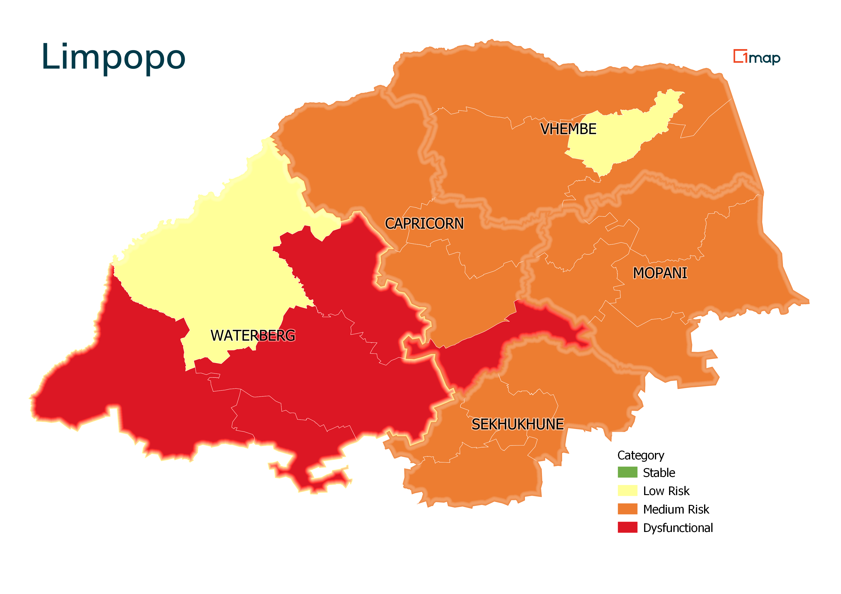
State of Local Government Limpopo

Slide 5
PROVINCE OF LIMPOPO PROVINCE
POST-ASSESSMENT CATEGORIZATION OF LIMPOPO MUNICIPALITIIES
DYSFUNCTIONAL | MEDIUM RISK | LOW RISK | STABLE
1. Lepelle Nkumpi | 1. Capricorn DM | 1. Thulamela
2. Modimolle-Mookgophong | 2. Polowane | 2. Waterberg
3. Mogalakwena | 3. MoleMole | 3. Lephalale
 | 4. Blouberg
 | 5. Mopani
 | 6. Giyani
 | 7. Maruleng
 | 8. Ba-Phalaborwa
 | 9. Tzaneen
 | 10. Letaba
 | 11. Sekhukhune
 | 12. Fetakgomo-Tubatse
 | 13. Makhuduthamaga
 | 14. Ephraim Mogale
 | 15. Elias Motsoaledi
 | 16. Vhembe
 | 17. Musina
 | 18. Collins Chabane
 | 19. Makhado
 | 21. Thabazimbi
 | 22. Bela-Bela

Slide 6
background
The Mogalakwena is a Category B municipality located in the Limpopo Province within the Waterberg District and is one of the 27 in Limpopo Province. The composition of the Council is as follows: ANC 42, EFF 13, DA 5, VF PLUS 2, APC 1, PAC 1 and has 30 wards.
The Limpopo Provincial Executive Council (PEC) resolved to place Mogalakwena Local Municipality under administration in terms of Section 139 (1)(b) of the Constitution of South Africa, 1996, on 04 December 2019
The triggers for Section 139 intervention in Mogalakwena included poor governance, financial mismanagement, and poor service delivery related matters.
On 30 June 2021, the Minister presented to Cabinet the State of Local Government Report that categorised the municipality as dysfunctional .
The provincial PEC subsequently terminated the intervention on 30 June 2022. However, the PEC directed that the intervention team should develop an action plan for stabilization of the municipality, and that the team should continue to assist the municipality on outstanding/critical matters for further six months from 01 July to 31 December 2022

Slide 7
STATE OF MOGALAKWENA lm: political STABILITY
The municipality is fairly stabilized. Council meetings are no longer experiencing disruptions and Council meetings are being held on regular basis.
EXCO members and Mayor are beginning to effectively play their oversight role by visiting projects. Implementation of the council resolutions is monitored on an ongoing basis through resolution register.
Council induction programme was undertaken to capacitate the new councilors.

Slide 8
STATE OF MOGALAKWENA lm: GOVERNANCE
Financial Misconduct Board is currently investigating transgressions as per AG’ s report.
Council committees have been established and are functional.
The council committees are meeting on regular basis to consider reports prior submission to Council.
The reports which were tabled at EXCO without being processed through these committees were rejected and referred to relevant committees.
MPAC is functional, and 2020/21 annual report was tabled to council and currently MPAC is busy with the finalization of Oversight report.
The UIFW report was submitted to the MEC as per MFMA section 32 requirement.

Slide 9
STATE OF MOGALAKWENA lm: ADMINISTRATION
4 out of 7 senior management positions filled, CFO and Directors Technical Services and Community Services vacant.
The Acting Director for Technical is suspended for allegations of misconduct and Acting CFO was also suspended for financial misconduct and dereliction of duties.
Municipal Manager (MM) has been appointed. However, there are 2 litigations against his (MM) appointment that were heard on the 06 September 2022. The judgement was subsequently passed on the 13 September 2022 in favour of the municipality.
The municipality had irregularly appointed and later terminated 400 irregularly appointed employees resulting in the huge salary bill.
MISA Technical Training Courses for Municipal Officials: 3 official from the municipality have been trained.

Slide 10
STATE OF mogalakwena LM: FINANCIAL MANAGEMENT
For the financial years dating back from 2015/16 to 2019/2021 the municipality has been receiving successive adverse audits.
In 2020/ 2021 financial year the municipality received an improved audit outcome (i.e., Qualified)
The Financial Recovery Plan report for July 2022 was submitted and approved by Council.
A debt collector was appointed with effect from June 2022 and has commenced with the service.
Audit action plan was developed and presented to council on the 31 March 2022, as part of the draft annual report.
The UIFW reduction strategy is in place and approved by Council.
Revenue collection rate increased from 56% to 69%.
The Annual Financial Statements were submitted on time (31 August 2022) to AGSA and all relevant stakeholders.
The Provincial Treasury and CoGHSTA regularly attend the audit steering committee meetings of the municipality.

Slide 11
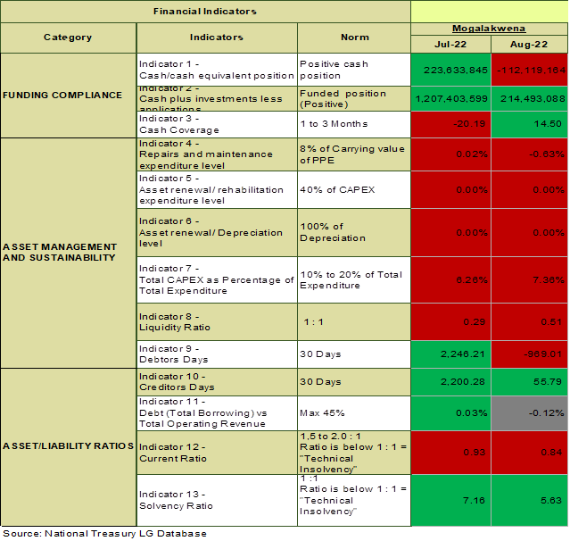
STATE OF MOGALAKWENA LM: FINANCIAL HEALTH
The municipality’s cash plus investments as at 31 August 2022 was –R112.1 million.
The municipality’s repairs and maintenance as a percentage of PPE (Carrying value) was at -0.63per cent and is way below the norm of 8 per cent.
The municipality’s debtors' days is at -969 days. The municipality is taking too long to collect money from debtors. This will have a negative impact on the cash flow
The creditors days is at 56 days. The trend of taking time to settle creditors can result in the municipality incurring interest.
The municipality’s current ratio is at 0.84:1 which is below the norm of 1:1.
The municipality’s liquidity ratio is at 0.61:1 which is below the norm of 1:1.
The municipality’s solvency ratio is 5.63:1 which is above the norm of 1:1.

Slide 12
STATE OF MOGALAKWENA LM: FINANCIAL RECOVERY PLAN
The three phases of the new recovery process is depicted below
Each phase is time-bound with measurable targets and defined reporting formats
Phase 1:
Rescue
(6-8 Months)
Phase 2:
Stabilisation
(6/8-18/24 Months)
Phase 3:
Sustainability
(From depends on phase 2)
Focus is on cash – and short term liquidity
Selected high-level governance and service delivery indicators focused on visible wins
Selection of appropriate strategic financial indicators:
Funded Budget
Cash Flow Management
Cost Containment
Trading Debtors
Creditor Management
Ring-fencing Conditional Grants
Visible service delivery (e.g potholes, streetlights, etc).
“Plugging the holes and fixing the leaks”
Focus is on the areas that are depleting the municipality’s financial resources
Deeper focus on governance, service delivery and institutional pillars
Longer-term liquidity
Focus on preventing a regression in performance
Institutionalisation of progress in Phases 1 and 2
Long-term financing strategy, revenue enhancements, etc.
Technological improvements, innovation, etc.

Slide 13
STATE OF MOGALAKWENA LM: ESKOM DEBT
The municipality owe ESKOM an amount of R19 189 268-00 .
The municipality has entered a payment arrangement with ESKOM until December 2022 and it is adhered to.

Slide 14
State of Mogalakwena lm: service delivery & misa technical support on infrastructure development
The MISA professionals support on the MIG implementation includes the following:
Programme wide and respective projects planning
Development & review of business plans, technical reports & documentation for MIG registration;
Development & review of planning 7 projects documents e.g. MIG implementation Plan, Terms of Reference (ToRs) for service providers, designs, drawings & contract documentation;
Undertaking site inspections & verification of work done;
Providing technical advice at MIG coordinating forums or meetings with all stakeholders
MIG Allocation (‘000) | Expenditure (‘000) End of Sept’22 | Total no. of projects | Projects registered | Design & tender stage | Construction
R 179 727 | R 17 041 (9,48%) | 13 | 13 | 10 | 3

Slide 15
State of Mogalakwena lm: service delivery & misa technical support on infrastructure development
MISA provides technical support during the planning and implementation of all infrastructure grant projects
  Includes the preparation of business plans, Project Implementation plans & project management & monitoring for WSIG & RBIG projects
  Payment and works verification of completed grant funded projects: As of 10 November 2022, out of WSIG allocation of R47 640 000, expenditure was at R20 000 000 (41,98%); As of 10 November 2022, out of RBIG allocation of R80 000 000, expenditure was at R30 148 000 (37,69%)
1 Civil Engineer, 1 Electrical Engineer & 1 Town Planner deployed to improve infrastructure asset management practices.
To support on operations & maintenance related activities (Civil & Electrical) and technical advice is provided to improve performance on Infrastructure Grant Programmes & reduce infrastructure backlogs; improve Town Planning and Urban Development activities; implementation of Innovative Solid Waste Management programme; and Capacity building for municipal officials.

Slide 16
State of Mogalakwena lm: service delivery & misa technical support on infrastructure development (electrical & town planning)
MISA provides technical support during the planning and implementation of all infrastructure grant projects
  Includes the preparation of business plans, Project Implementation plans & project management & monitoring for INEP funded projects
  Payment and works verification of completed grant funded projects
  As of 10 November 2022, out of INEP allocation of R7 000 000, expenditure to-date is at 0% as the municipality is still finalizing appointments of service providers
    Assisting with review of SDF and Land Use Scheme
    Assessing land development applications
    Currently assisting with developing of Telecommunication Mast Policy by end of financial year
    MISA Town Planner is a member of the Mogalakwena SDF project implementation Project Steering Committee (PSC).
    Represents MLM during the sitting at the Municipal Planning Tribal (MPT) at Waterberg District Municipality (where MPT sits)

Slide 17
MISA FUNDED CAPITAL PROJECTS
Project | Budget | Start date | Completion date | Comments
Development and Implementation of Innovative Solid Waste Management Solutions to support the municipality | R9 308 620,12 | 11 May 2022 | 28 November 2022 | 621 work opportunities created, 4 SMMEs appointed Scope: litter picking, separation at source for recycling & enterprise development
Design and management of a labour-intensive construction (LIC) capacity building programme for Mogalakwena Local Municipality and Vhembe District Municipality | R 3 996 480.000 | 01-Apr-2021 | 31-Mar-2022 | 12 officials trained on LIC NQF 7 EPWP policy developed for MLM Proforma tender documents for LIC projects

Slide 18
STATE OF Mogalakwena: local economic development (Community Works Programme
Mogalakwena Municipality has a target of 1 400 participants. The actual participants as of end October 2022 is 1 459. Useful work done by CWP participants in Mogalakwena is divided into 4 categories. These are:
Infrastructure
Education
Community Service
Health and Social.
CWP participants in Mogalakwena are involved amongst other things on;
Cleaning of 16 schools in various wards. Examples of schools cleaned are Mamopi Secondary School, Ntuba High School etc. They also assist in pumping water to villages that has a shortage of water supply like Matjitjileng, Galelia and to Strekwater villages. They assist in eradicating illegal dumping at ward 31 and at Mokopane town as well as cooking and cleaning for 10 vulnerable households in Bavaria, Galelia, Breda, Matjitjileng, GaRamela etc.

Slide 19
challenges
Although the municipality gradually improved in political stability, governance, and administration there are persistent challenges that the municipality must address. This includes:
The court cases that involves the appointment of the current Municipal Manager remains a risk to the Municipality.
The municipality is not attending and reporting on the progress, challenges and action to improve the UIFW expenditure.
Although the Unauthorized, Irregular, Fruitless, and Wasteful (UIFW) strategy has been developed, continued support on implementation is being provided.
The municipality has no budget to fund stalled projects.
The municipality failed to submit a completed “Use of Consultants” template to the Provincial Treasury and has no consultancy fee reduction plan. Plans to address these matters are underway.

Slide 20
conclusion
The ushering in of the new political leadership after the LG elections was the game changer that created a conducive environment for the provincial intervention to yield positive results in terms of impact.
The deployed Provincial Executive Representative Team led by COGHSTA and Provincial Treasury and supported by MISA, DWS and other key stakeholders were able to restore management stability and were able to effect some of the resolutions made by the Portfolio Committee (ensuring that MPAC reports are tabled to Council and also effecting disciplinary actions against officials that committed acts of misconduct).
The Department welcomes the process underway to fill the remaining vacancies of the key middle management positions.
The Masodi Waste Water Treatment Works project is progressing well and is expected to be completed in April 2023.

Slide 21
RECOMMENDATIONS
It is recommended that Portfolio Committee note the State of Mogalakwena Local Municipality and support provided by sector departments (i.e. COGHSTA, Provincial Treasury & DCOG) in dealing with challenges facing the municipality.

