Slide 1
Grassroots Innovation Programme

Slide 2
High-level Impact
139 Projects
approved
Programme
leveraged R20.3m
Projects
raised R13,8m
40 Innovation Products developed
18 Companies
created
15 Products
in the market
22 Jobs created FY2021/22

Slide 3
Background
The Grassroots Innovation Programme (GIP) is a strategic intervention initiated by the Department of Science and Innovation (DSI) mainly to support the needs of grassroots innovators.
The Programme forms part of interventions intended to support development and commercialisation of innovations for tackling unemployment, poverty and inequality through innovation in South Africa.
The programme seeks to fund and support innovative solutions that have a market need or the potential to address challenges in communities.

Slide 4
Programme Objectives
Identify grassroots innovators in South Africa across all the provinces;
Provide access to a range of interventions including funding and business development;
Assist grassroots innovators to enhance their innovations and skills and enable them to progress towards pre-commercialisation;
Profile and showcase their innovations of the participating grassroots innovators;

Slide 5
Support Package
GRANT FUNDING
R260 000
COMPLIANCE Support to adhere to business & industry regulation
1
8
2
IDEA DEVELOPMENT Conceptulisng & IP protection
MENTORSHIP Individualised coaching on technical & business elements
BUSINESS MODEL Product market fit, market feasibility & testing
7
3
TECHNICAL PROTOTYPE DEVELOPMENT
Placement at TIA Technology Stations accessing infrastructure, expertise & support
6
4
BUSINESS AND TECHNICAL SKILLS TRAINING
Capability & needs based blended learning opportunities per innovator
5
NETWORKING Partners that can enhance access to market, incubation, distribution & additional funding. Including peer learning & media profiling

Slide 6
Eligibility Criteria (1)
Who do we fund:
Individual who undertakes innovations to solve local challenges using local resources and capabilities through working outside the realm of formal innovation institutions.
South African citizens above 18 years of age (women, persons with disabilities are encouraged to apply).
Willing to commit time to programme activities and meeting milestones to developing and proving their innovation over a period of 24 months.
Excludes students/researchers at formal Higher Education Institutions and Science Councils that are part of a research group.

Slide 7
Eligibility Criteria (2)
What do we fund:
The proposal must be an innovative idea at early proof of concept stage and addresses a social challenge or potential technology solution to a specific or identified need.
A new or improved innovative product/process/service that addresses a social challenge.
Is at early proof of concept and before pre-revenue stage.
Has high potential to be commercialised into a viable and innovative business.
Innovative idea is technical feasible.

Slide 8
Recruitment
Financial Year | Number of Project Approved
2019 - 2021 | 55
2021 – 2022 | 55
2022 - 2023 | 29
Total | 139

Slide 9
Portfolio Analysis
Contracting Status | Numbers
Contracted Projects | 114
Contracting | 23
On-hold | 2
Total | 139
Status of Contracted Projects
Active | 76
Completed all Milestones | 21
Contracts Extension | 15
On-hold | 2

Slide 10
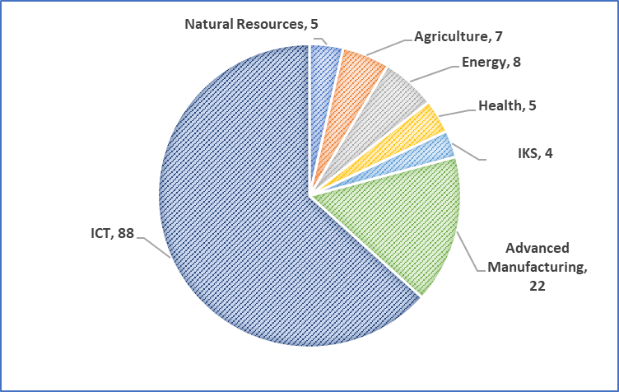
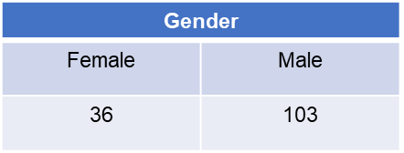
Demographics

Slide 11
Strategic Partners (1)
Insurance Sector Education and Training Authority (INSETA)
Collaboration agreement for the Innovation Challenge Pilot Project in the insurance and related services sector for period of 2 years and 3 months to the valued of R17.5million
The partnership identified 20 innovative solutions addressing challenges faced by the insurance industry and related services sector resulting from the impact of the 4th industrial revolution (4IR) and the COVID-19 pandemic.
Department of Tourism
Collaboration agreement for the Technology Tourism Grassroots Innovation and Incubation Programme (TTGIIP) for a period of 2 years to valued of R9.9million.
The partnership is empowering 20 tourism enterprises, youth owned enterprises (start-ups and existing), in technology and innovation businesses in tourism.
Industrial Development Cooperation
Engagement with the IDC for follow on funding through the Grassroots Innovation Facilitation Scheme of the IDC.

Slide 12
Strategic Partners (2)
SAB Foundation
Collaboration agreement for implementation of the TIA-SABF Industry partnership for a period 3 years to the valued of R18million.
The partnership aims support 22 companies.
UNDP
Collaboration between UNDP, City of Tshwane & Innovation Hub for R800K to support grassroots technologies that will be piloted at the City of Tshwane.
Eskom Expo
Partnership with Eskom Expo for the Grassroots Innovation School Programme.
On an annual basis between 20 and 30 learners who have innovation projects are exposed to a 5 day bootcamp.
Thereafter, learners submit applications for funding.
DDM Initiatives
Partnership with Ugu and Zululand District Municipalities to support youth innovators. Ten innovators will be selected from each District.
Eskom Development Foundation (new)
Eskom Foundation to make a deed of donation to support the deployment of grassroots technologies to communities for socio-economic upliftment and skills development.

Slide 13
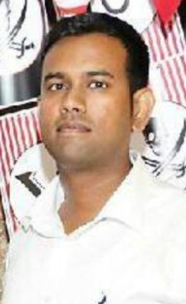
Grassroots Innovation Programme (GIP)
Pramod Penceliah
Financial Inclusion
Alternative Credit Scoring
Underwriting
Achievements since start of GIP
Funding: R910k (TIA), R200K self-funded.
Partnerships:
University of Cape Town
Nedbank
Consumer Profile Bureau
i-solar Energy
MTN
African Bank., Uloans.
Credit Peak is the first mobile wallet in South Africa that will help you build credit, earn rewards points and access greater financial inclusion. No credit checks. Use your existing bank!
Start building or improving your credit with Credit Peak At the end of every month, Credit Peak totals up all your purchases and payments and reports them to a registered credit bureau to build your credit score.
Connect your bank Credit Peak is compatible with all banks in South Africa- keep your money where you want while spending smarter with Credit Peak.
What Next?
The innovation has established an acceptable marketplace for consumers who are otherwise excluded. The marketplace enables banks and financial service providers to tailor products according to a customers risk profile, we aim to grow this marketplace in 2023!
We aim to accelerate research and development in enhancing our methodology of "energy being a driver of financial inclusion".
credit-peak.com

Slide 14
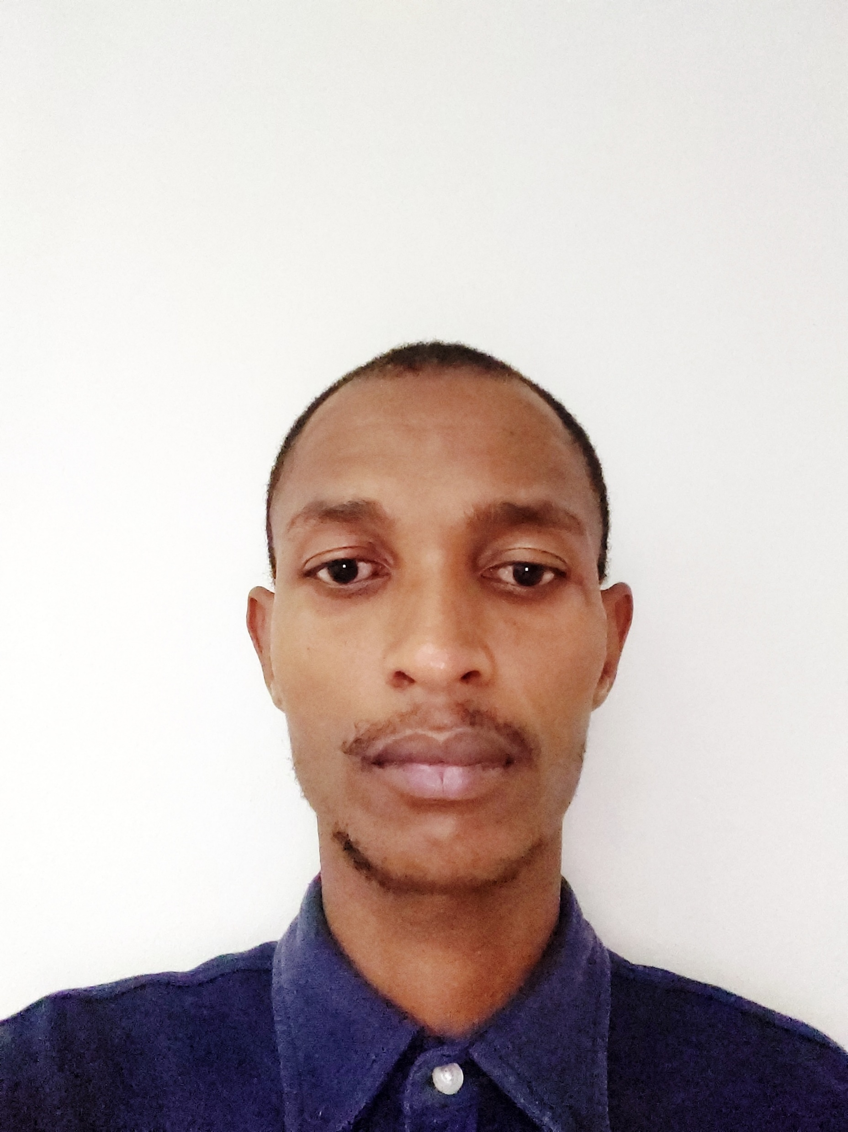
Grassroots Innovation Programme (GIP)
Siphiwo Peace Mjwara
Achievements since start of GIP
Funding: R 260 000 (GIP) / R25 000.00 Innovation support fund. (Innovate Durban)
Partnerships: N/A
Sector: Health Technologies, Internet of Things, Data Analytics, Sanitation.
What is the innovation/project?
Mkazi Concepts (Pty) Ltd has developed the Sensani™ system, an intelligent hand sanitation station that acts as a preventative intervention against the spread of communicable diseases and infectious germs. It is a people management system for high foot traffic environments which grants employees and the public, access to a building based on infection prevention, sanitation and public health and safety standards. User data is logged and propagated in real-time to the building and company-wide management system and centralized dashboard which allows cross-enterprise profile sharing and gives companies intelligent and actionable people movement insights. The solution uses a combination of near field communicators to accurately record unique digital profiles.
What’s next?
The company is seeking collaborative partnerships and is raising capital to help implement market penetration strategies an mobilise the plans for scale. The company will conduct team expansions and continue environmental trials.
Who is involved?
Tshwane University of Technology, Institute for advance tooling and Inovo Systems.

Slide 15
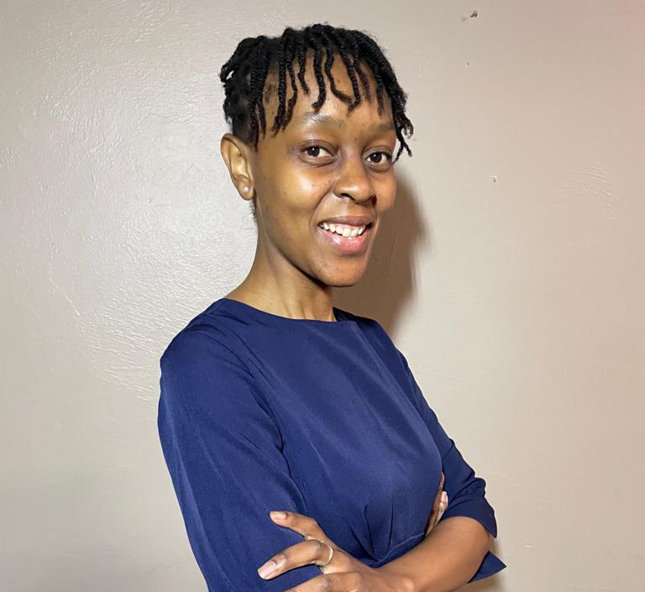
Grassroots Innovation Programme (GIP)
Ntshabo Lehong
Achievements since start of GIP
Funding: R200 000 for technology development received to date, R45 000 in project fees, R22 000 towards piloting, R12 000 towards NVC training, R24 000 towards Incubation
Partnerships:
Timbaktuu (Pty) Ltd for piloting, using their township internet café network partner points for job seeker recruitment and advertising within local township communities..
Sector: Tourism Technology
What is the innovation/project? m-Temp is a Hospitality Staffing Chatbot platform that will be used by two types of users (1) the temporary work job seeker and (2) hospitality business or enterprise client. The Chatbot will be used for job seeker engagement, collection of information and data, whilst the website will be used by the hospitality business or enterprise client to post available work shifts based on their requirements.
What’s next?
We are currently in pre-pilot implementation stage working towards full pilot and commercialization of the product.
Once commercialized we would like to stimulate more short term jobs, particularly to digitize the short term township labour market in the hospitality and tourism industries. We will also investigate the potential of licensing the technology for other industries.
Who is involved?
Makeeda is led by three young hospitality industry black females that hold Hospitality Management qualifications and with operational, training and marketing experience gained over the last 6 years.
www.makeeda.co.za

Slide 16
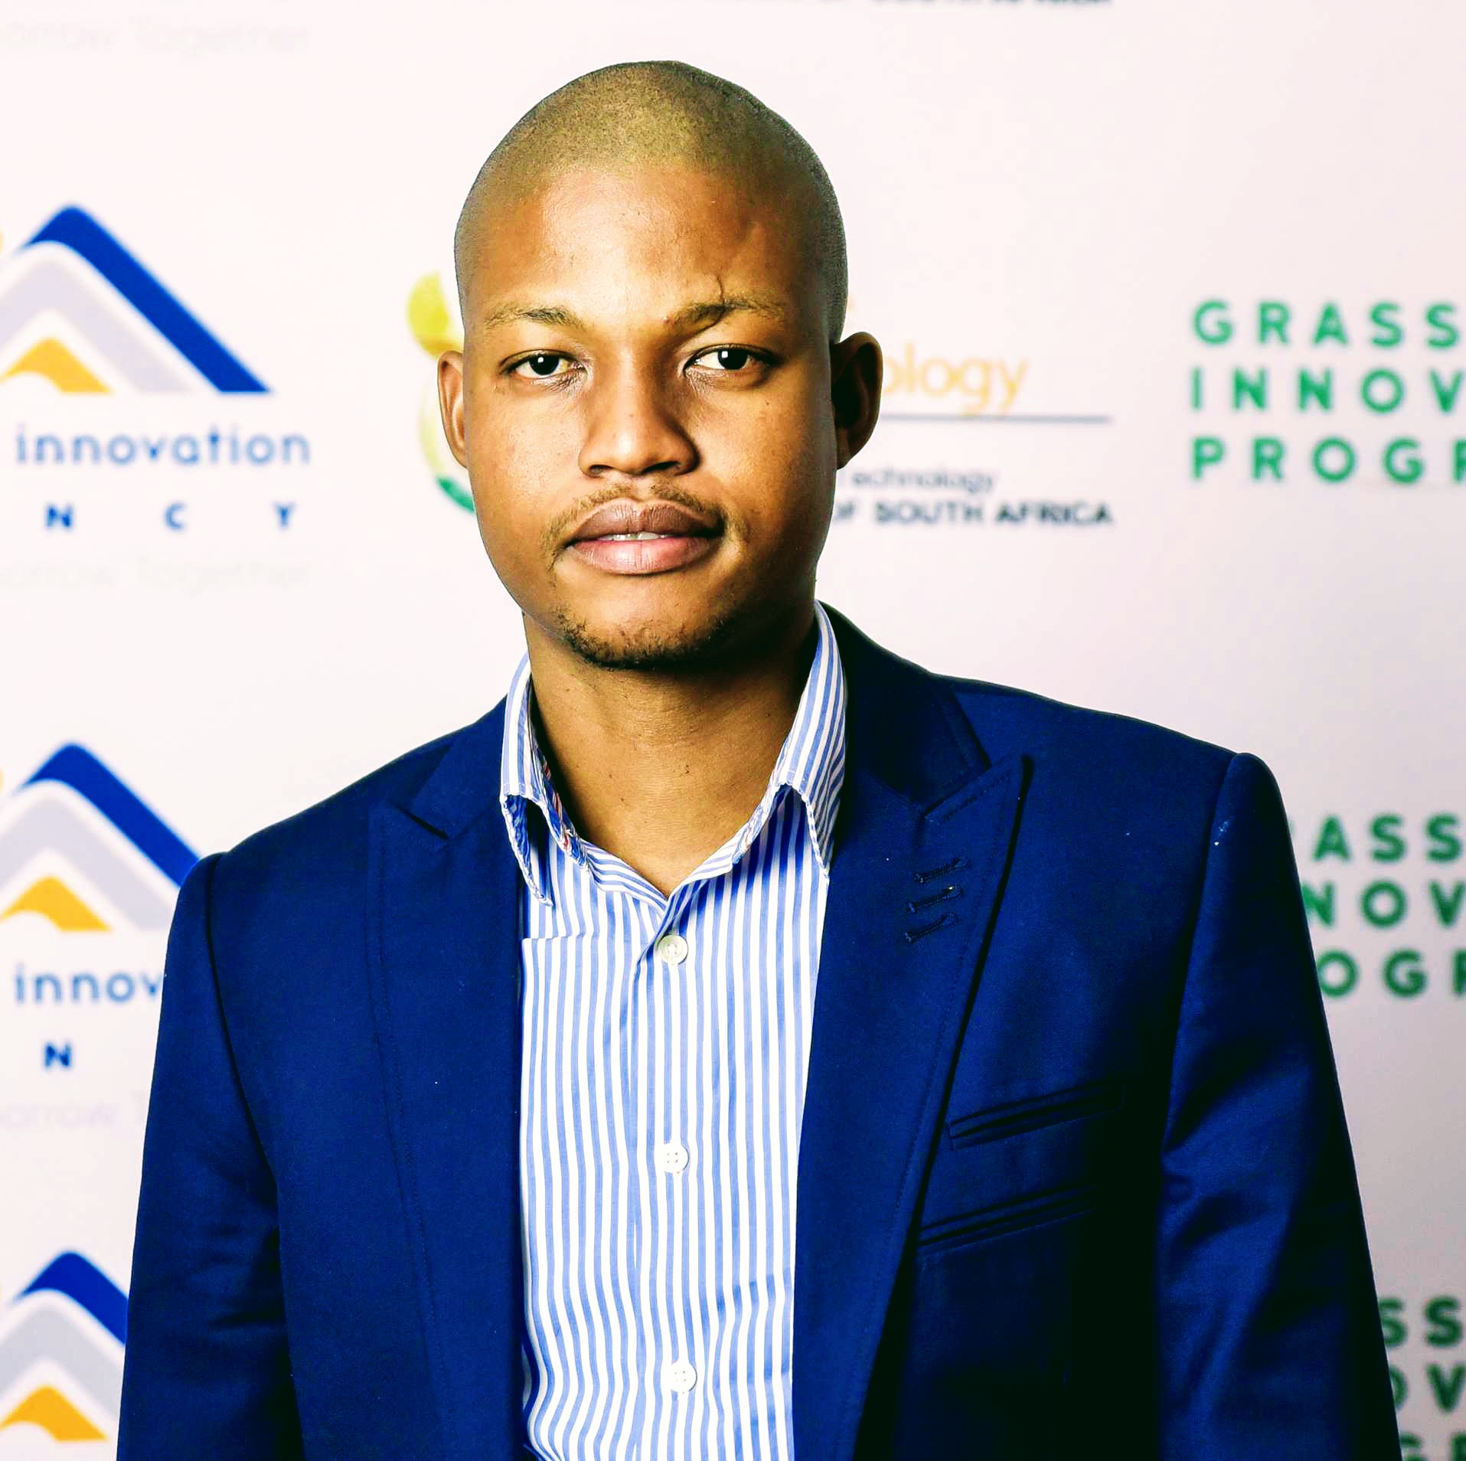
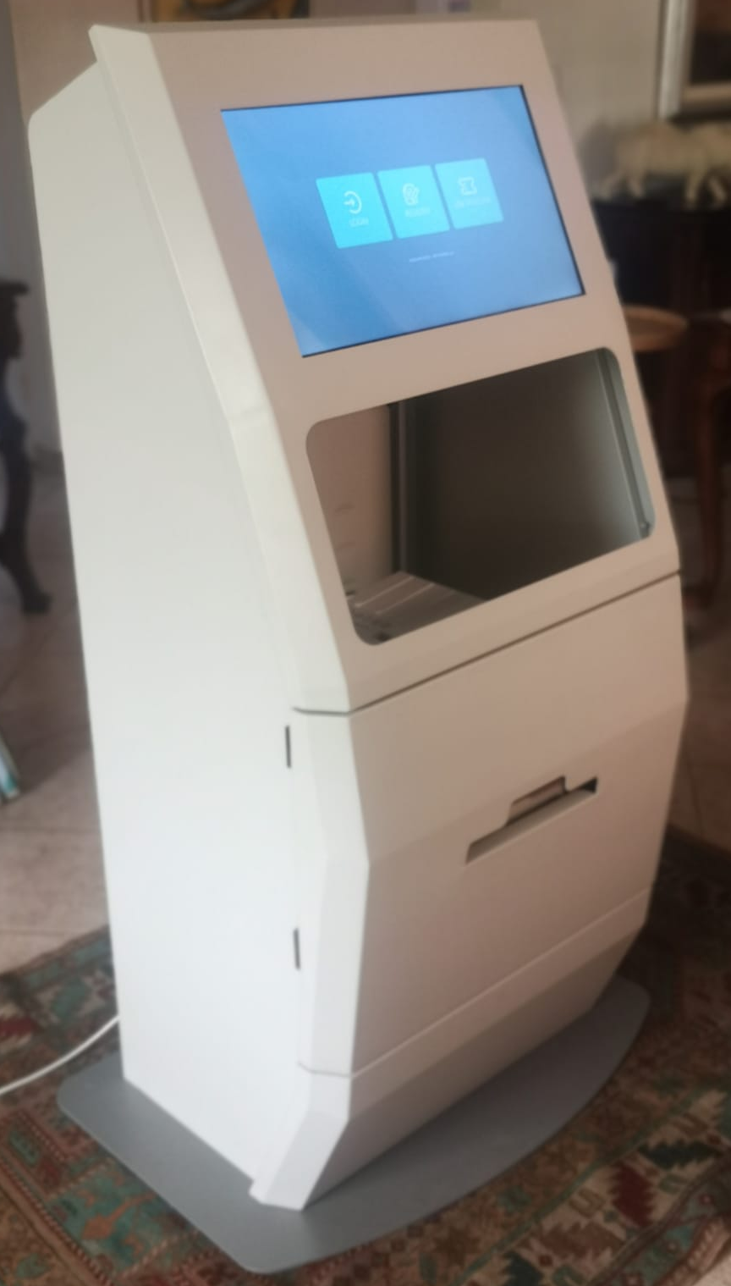
Grassroots Innovation Programme (GIP)
Thabiso Tiro Kegakilwe
Achievements since start of GIP
Funding: R 260 000 (initial funding) and R300 000( follow-up funding)
We managed to develop a proof of concept and a working prototype. We’re busy fine tuning the system for market readiness.
Partnerships: None so far
ICT
What is the innovation/project?
User-friendly and self-serviced print, photocopy, fax, email, scan, mobile typing, cloud storage and internet services paid via a virtual account, vouchers or cash. To be accessible at nearest municipal offices, post offices, police stations, community centres, libraries, schools, and shopping centres.
What’s next?
To finalize fine tuning the project and get funding early next year for piloting the project in Ngaka Modiri Molema District municipality police stations and local municipality offices (Mahikeng local municipality and Ramotshere Moiloa local municipality)
Who is involved?
ALPHA LAB TECHNOLOGIES (owned by two computer science students from the University of North West, Mafikeng) is assisting us with application development and Wafrika Technologies (owned by Mr Thabiso Tiro Kegakilwe) is doing oversight. Initially we used Black Ice Digital which assisted with prototype.
Snap media Presentation of the project
To view click here : https://1drv.ms/v/s!AiDcfuIg3LXK22S2C_FUJHRZLZPL?e=qemJz0
www.wafrikatech.co.za

Slide 17
Grassroots Innovation Programme (GIP)
Lisa Von Benecke
Achievements since start of GIP
TotalEnergies Startupper Challenge- Best Female Entrepreneur Award
Mail & Guardian 200 Young South Africans- Business & Entrepreneurship
Funding:
R 360 000.00 (GIP/INSETA) Prototype and technology development
R250 000.00 (GIP/INSETA) Commercialisation funding
Sector: Energy
What is the innovation/project?
LC Dynamics is a technology startup aiming to improve access to clean alternative energy solutions. Our first product is a mobile solar window blind which aims to make solar PV technology accessible for tenants and sectional title schemes where customers often lack the freedom, space or ownership of their properties to install a traditional solar system. We are also developing an online platform to help connect clients find the most suitable product.
What’s next?
Pilot the solar blind product
Develop online platform
Grow team and scale business for investment-readiness
Who is involved?
LC Dynamics is a 100% female, youth-owned company currently based in Matatiele, Eastern Cape.
www.lcdynamics.co.za

Slide 18
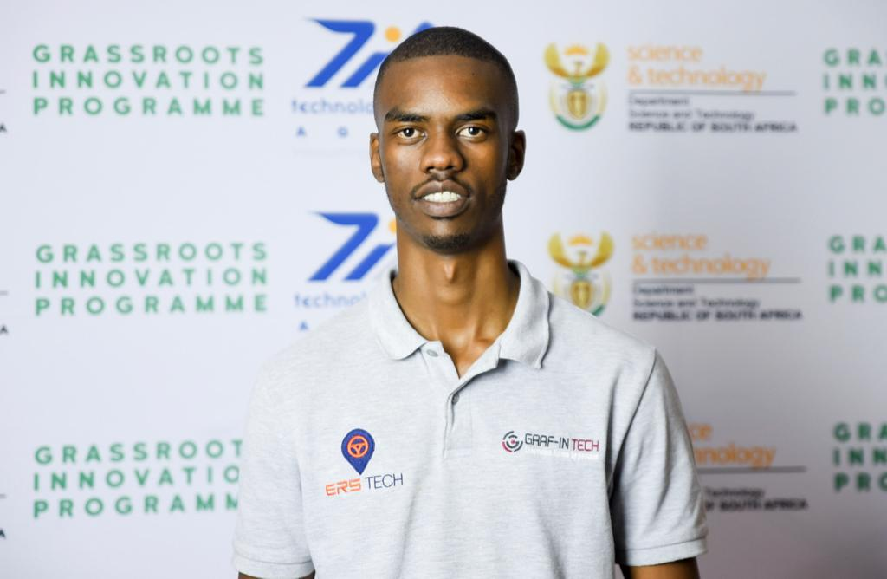
Grassroots Innovation Programme (GIP)
Brendan Fernandez (26)
Graf-in Tech Founder & Chief Executive Officer
Achievements since start of GIP
Funding: R 560 000.00 from TIA (+ additional R500k grant committed by COJ)
Partnerships:
Sector:
Artificial Intelligence (Big Data and Analytics)
What is the innovation/project?
ERS Tech is an end-to-end Business Intelligence (BI) driven Fleet Management Solution. This solution connects multiple Internet-of-Things enabled devices and sensors (incl. GPS tracking devices, fuel sensors, temperature sensors, on-board video cameras etc.) to collect data of interest from vehicles, thereafter, the solution uses AI and Machine Learning algorithms to analyse data and produce actionable insights to inform decision making in real-time. The core solution features include driver behaviour and safety management, fuel management, route optimization, predictive and prescriptive maintenance planning and live BI reporting dashboards. ERS Tech leverages data to help fleet managers improve operational efficiencies while reducing costs, among other benefits.
What’s next?
ERS Tech is a fully functional solution that has been successfully deployed for multiple private bus operators around Gauteng province. A successful pilot roll-out for Pikitup will be followed by a full solution implementation that will deliver clear Returns-on-Investment (ROI) for the entity. Moreover, Graf-in Tech is actively pursuing new opportunities to scale ERS Tech to other municipalities, government departments, and private sector clients across multiple industries such as logistics, agriculture, manufacturing and mining.
Graf-in Tech is a Level 1 BBBEE contributor company and a registered member of MEMSA – through this partnership, we are now implementing ERS Tech to create live visibility for Key Performance Indicators, predict equipment failure, and optimise the performance of underground mining drills and rock bolter autonomous machines manufactured in SA – thus reducing machine downtime and saving significant costs for clients.
Who is involved?
Graf-in Tech was recently awarded as a winner of the City of Johannesburg (COJ) Smart City Innovation Challenge 2021/2022 and has secured an opportunity to pilot the ERS Tech solution for Pikitup’s fleet – which collects waste from over 3 million households and 17 thousand businesses around the City of Johannesburg.
Social Media: https://www.linkedin.com/company/graf-in-tech-pty-ltd/

Slide 19
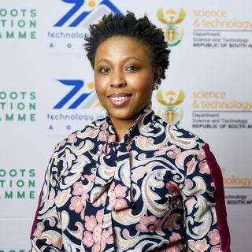
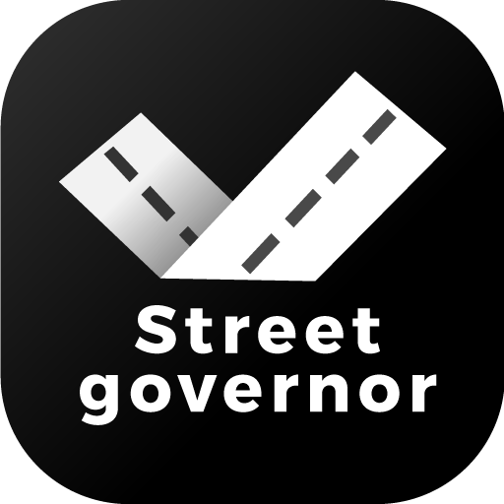
Grassroots Innovation Programme (GIP)
Busisiwe Ndabana
Achievements since the start of GIP
Funding: R 260k GIP grant, R300k GIP grant, Fem in Tech Investment Readiness Program, Patent, trademarks and a partnership with Santaco through an equity deal transaction.
Partnerships:
ICT Sector
What’s next?
An equity transaction between SmartVein and Santaco will be concluded by the end of November 2022.
By October 2023, all biometrics and general information of all taxi industry members (taxi drivers, operators, queue Marshalls, squad patrols, admin staff, rank managers, and rank informal traders) would have been captured onto Street Governor.
Regulatory compliance monitoring, analytics and Regulatory reporting framework will be concluded, and the reporting tools will go live by November 2023 on Street Governor.
Data backed policy formulation framework will go live by March 2024
What is the innovation/project?
Street Governor is a transport intelligence system designed to help stabilise the minibus taxi industry. This is achieved by providing a set of decision-support tools to various stakeholders that make the business of the taxi industry work. The system will narrow the trust deficit by improving transparency, accountability and profitability.
Who is involved?
SmartVein and Santaco have partnered on the Street Governor project. All public transport formations affiliated with Santaco will be part of Street Governor.
www.smartvein.africa

