Slide 1
Provincial Treasury
2022/23
MUNICIPAL ECONOMIC REVIEW AND OUTLOOK
Western Cape Provincial Parliament
Budget Committee
24 November 2022

Slide 2
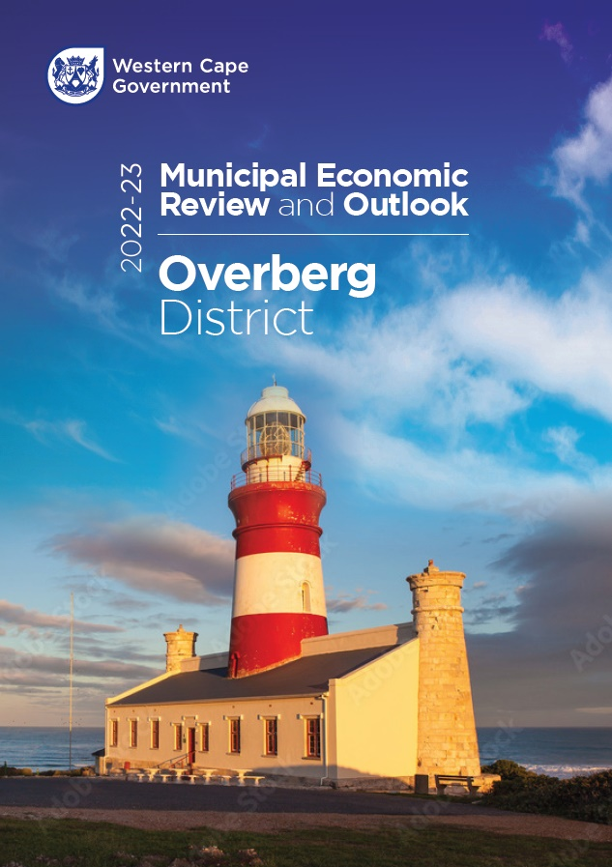

  MERO 2022- 23
  Governing for Growth
  Key Messages
  Post-lockdown rebound: business retention initiatives as key differentiator
  Lagged recovery of jobs: Recognition of informality in urban labour markets a contextual necessity
  Energy/ port & other enabling infrastructure challenges: Agility & innovation in service delivery no longer nice-to-haves but now pre-determinants of survival
  Potential 2023 recession: importance of tailored enterprise support
  Inequality: Increasing as wealth accumulation is only in a small percentage of the population

Slide 3
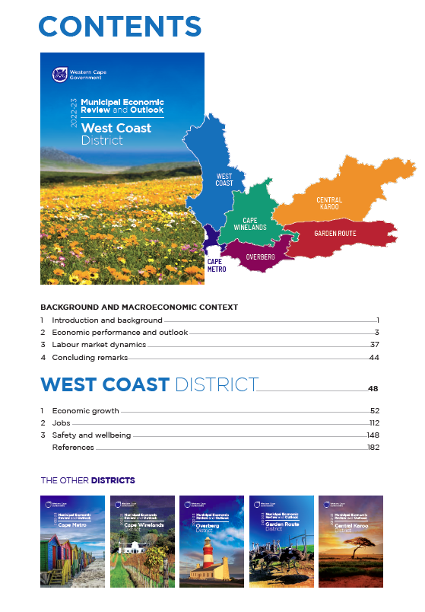
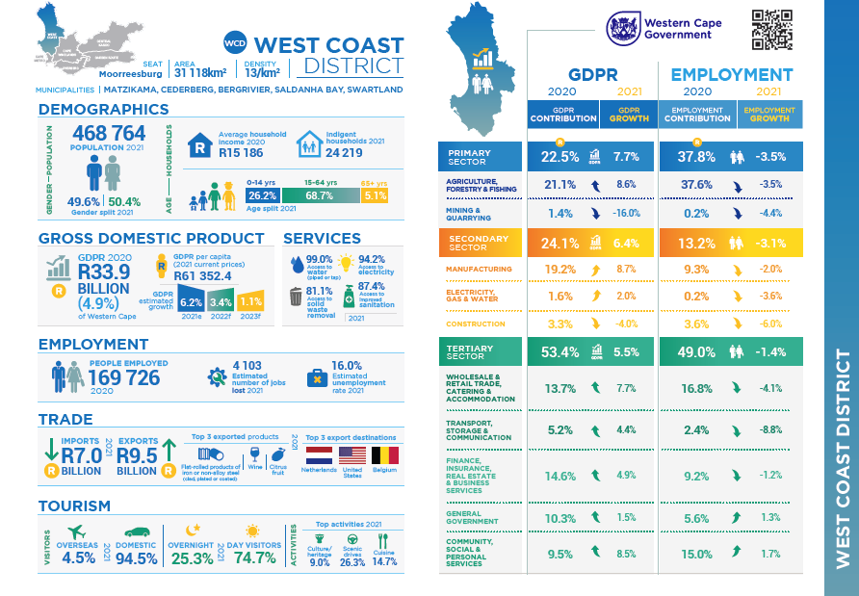
What’s in the 2022 MERO?

Slide 4
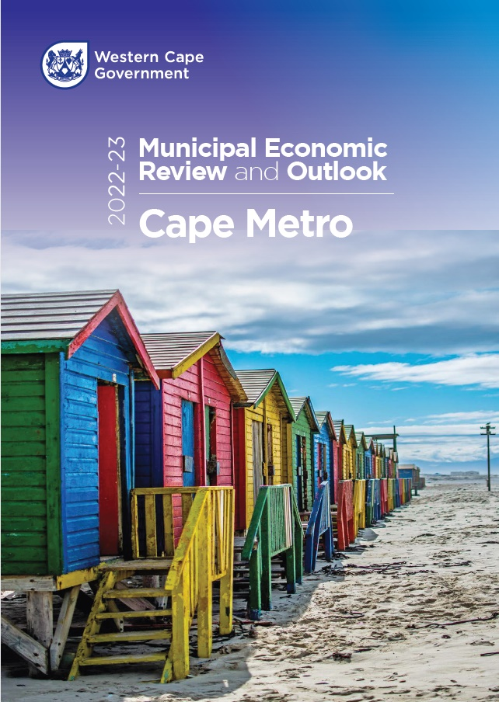
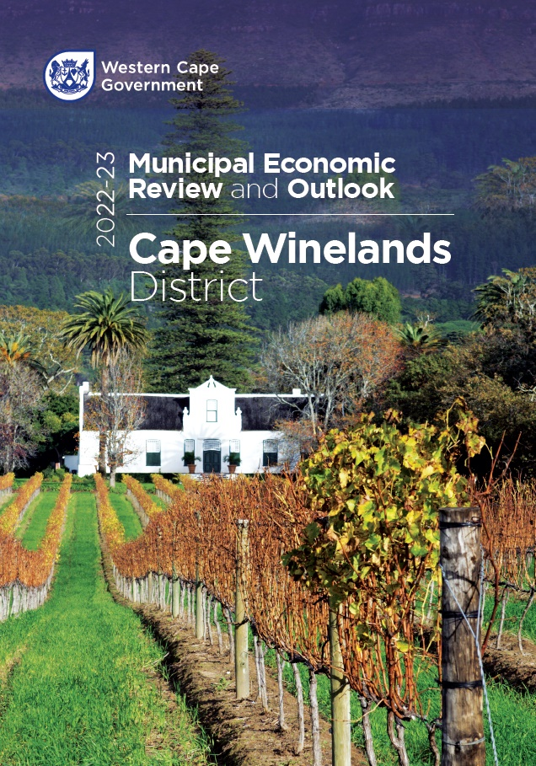
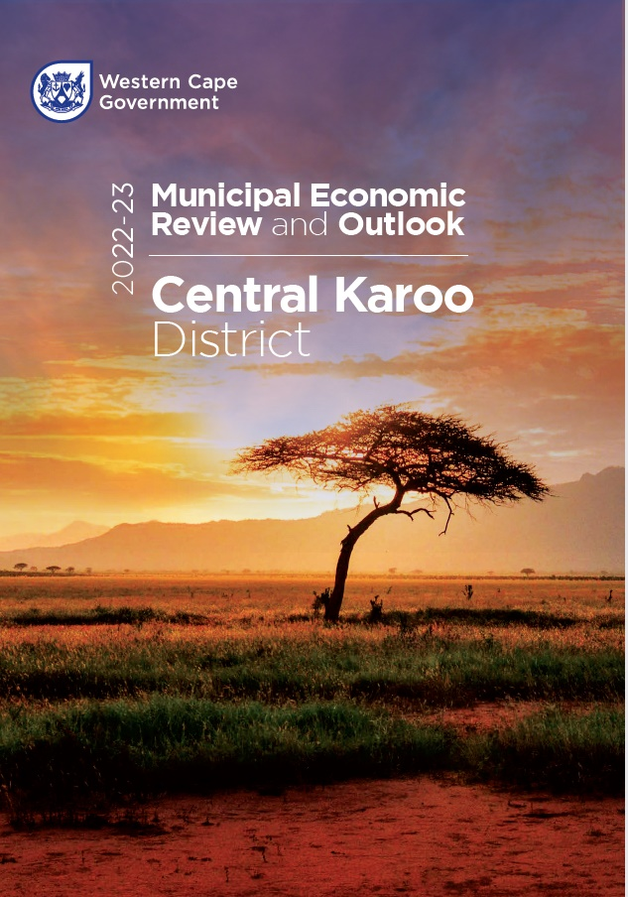
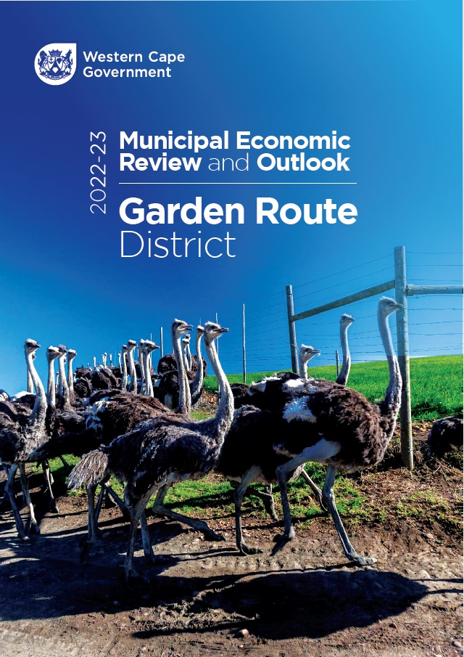
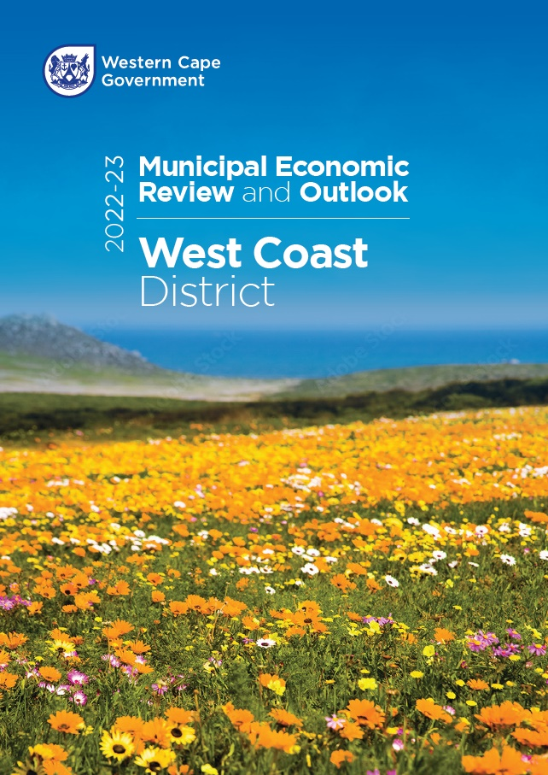
2022 MERO Innovations
  Format
    ‘Pull-out’ book per district
    Chapter structure aligned to Provincial Strategic Implementation Plan
  New data:
    WESGRO tourism app (Ch 1)
    CAHF/ DEA&DP housing market studies (Ch 3)
    Public Sector Expenditure on designated groups (Ch 1)
    Gross fixed capital formation
    Covid vaccinations (Ch 3)
    Number of taxpayers (Ch 3)

Slide 5
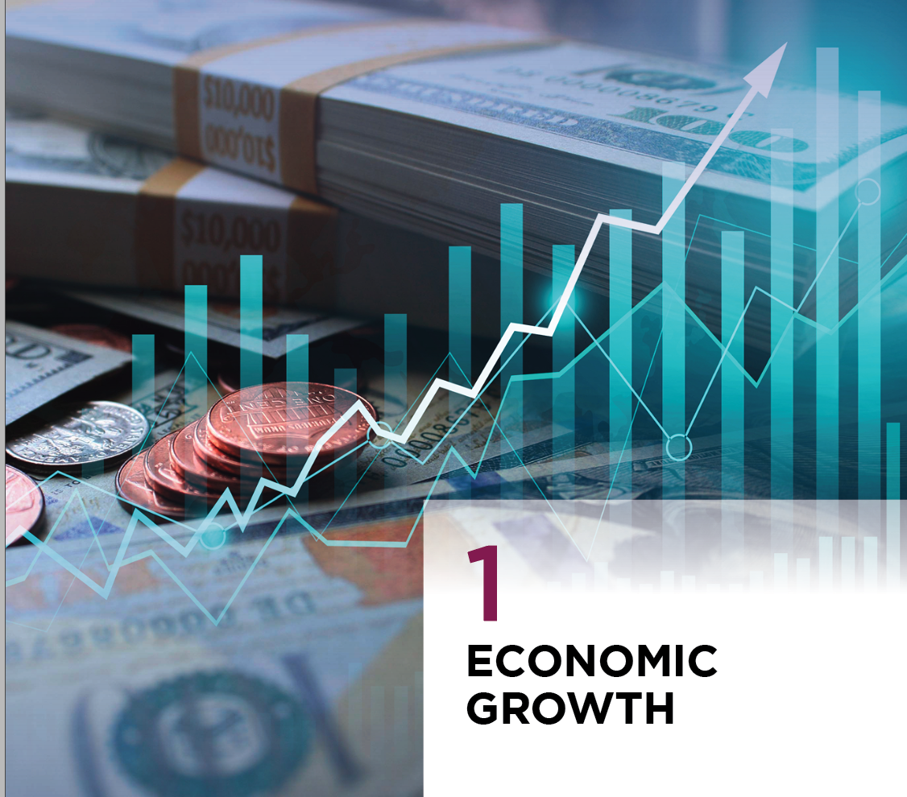

Slide 6
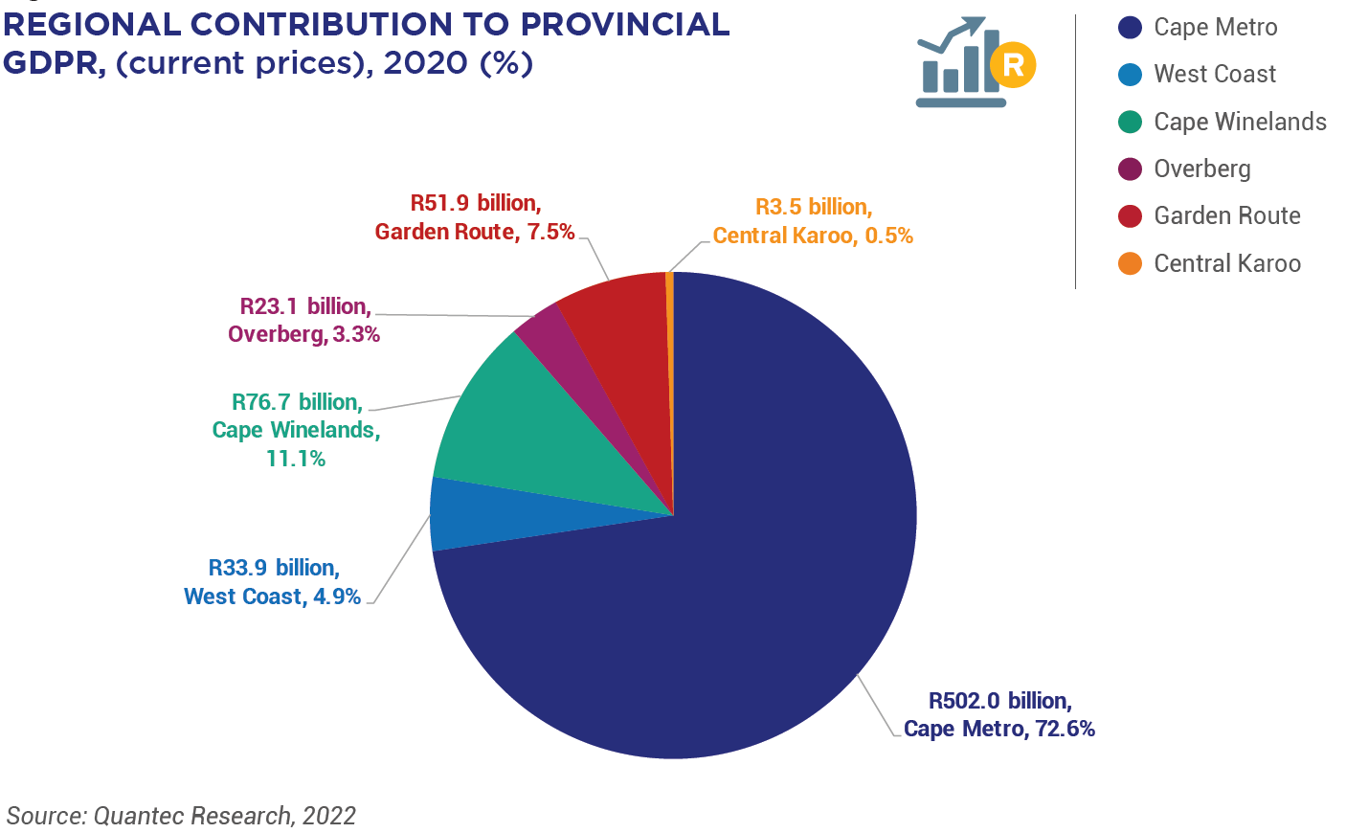
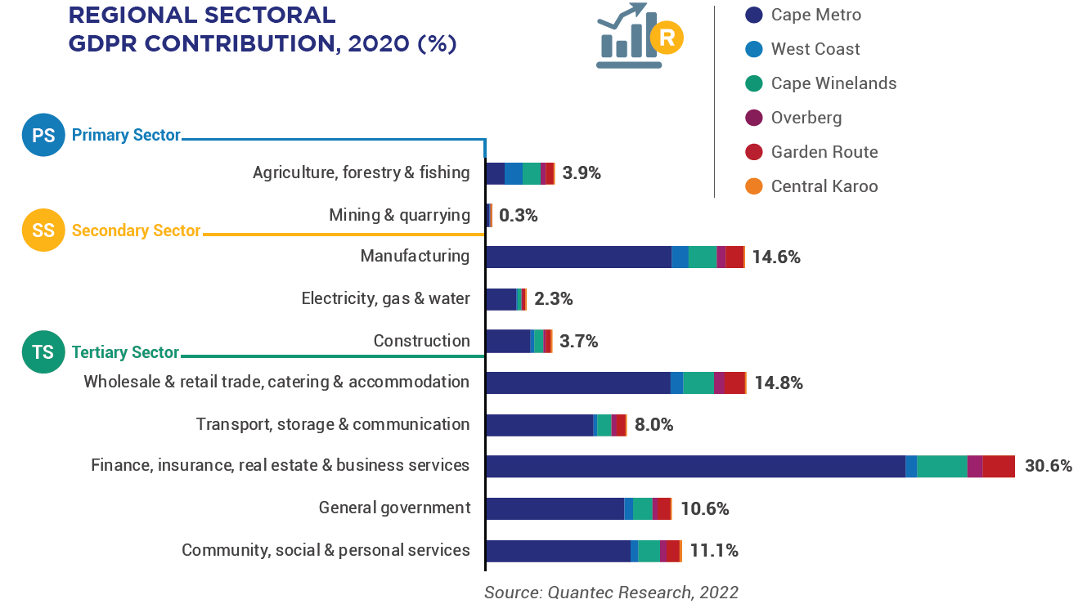
Regional GDPR Performance and Sectoral GDPR Contribution
  Key take-away: Largest year-on-year decline in contribution of trade sector

Slide 7
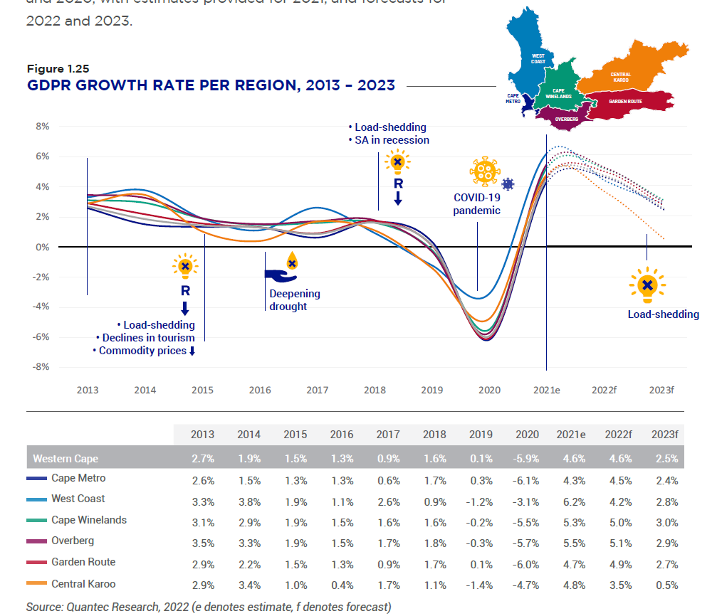
GDPR Growth per District

Slide 8
Regional Real GDPR growth trend (2016-2020)
AVERAGE REAL GDPR GROWTH BY SECTOR AND REGION (%)
Sector | Cape Metro Area | West Coast | Cape Winelands | Overberg | Garden Route | Central Karoo
Primary Sector | 2.4 | 2.2 | 1.0 | 0.5 | 0.7 | 1.4
Agriculture, forestry & fishing | 2.5 | 2.4 | 0.9 | 0.5 | 0.7 | 1.4
Mining & quarrying | 1.3 | -0.7 | 1.3 | 2.6 | 1.5 | 2.1
Secondary Sector | -3.1 | -1.7 | -3.3 | -2.0 | -3.2 | -4.0
Manufacturing | -2.2 | -0.5 | -3.0 | -0.1 | -1.5 | -1.1
Electricity, gas & water | -2.8 | -3.8 | -1.6 | -2.7 | -3.1 | -1.8
Construction | -5.8 | -6.4 | -4.5 | -5.6 | -7.4 | -7.6
Tertiary Sector | 0.2 | 0.2 | 0.8 | 0.4 | 0.4 | -0.4
Wholesale & retail trade, catering & accommodation | -2.5 | -1.9 | -1.5 | -1.7 | -2.9 | -4.7
Transport, storage & communication | -2.3 | -4.1 | -2.0 | -2.0 | -2.0 | -4.4
Finance, insurance, real estate & business services | 1.8 | 2.6 | 3.4 | 2.6 | 2.9 | 2.5
General government | 1.6 | 1.5 | 1.0 | 0.6 | 0.5 | 2.0
Community, social & personal services | 0.3 | 1.2 | 0.2 | 0.6 | 0.0 | 0.9
Total | -0.4 | 0.1 | -0.2 | -0.2 | -0.4 | -0.6
  Key take-away: Post-2010 construction sector slump continued into 2nd part of the decade

Slide 9
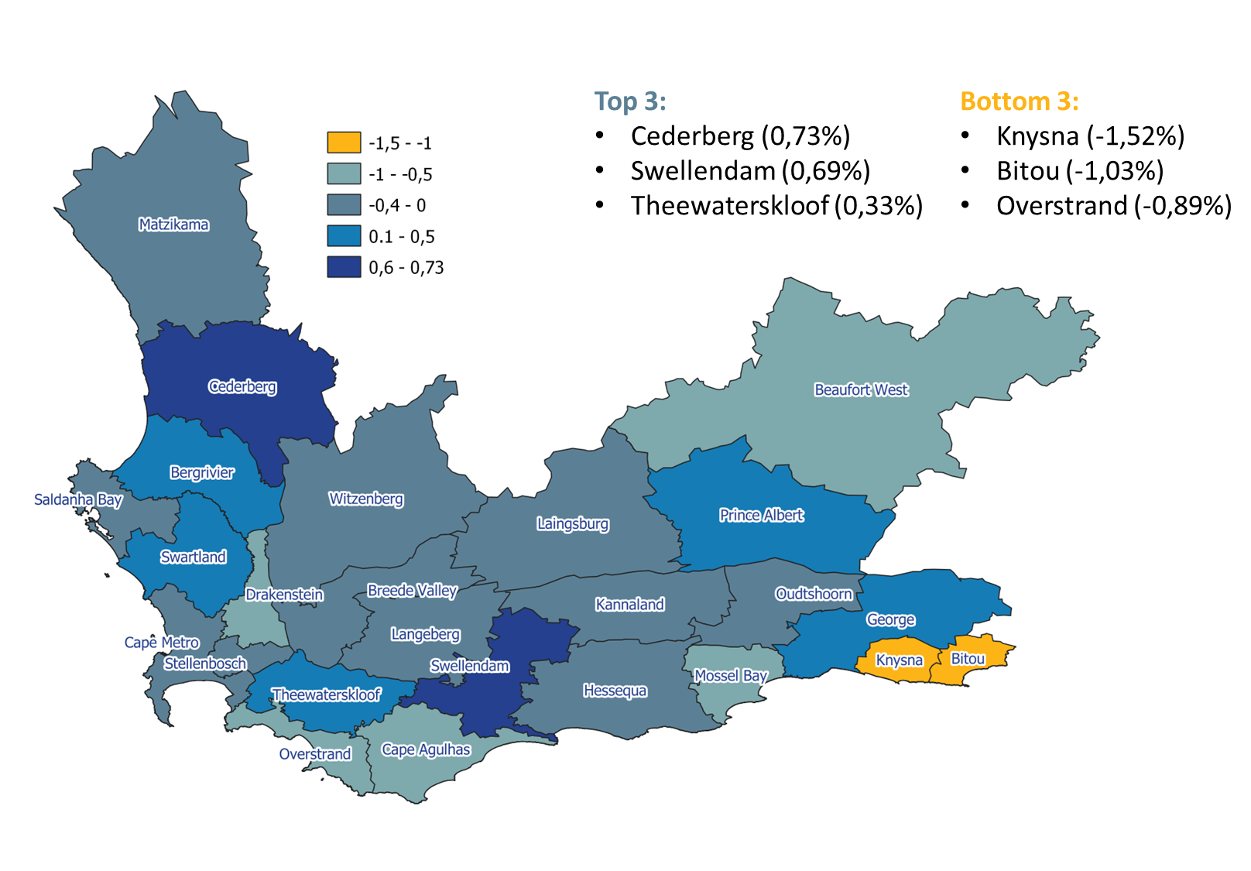
Local Real GDPR growth trend (2016-2020)

Slide 10
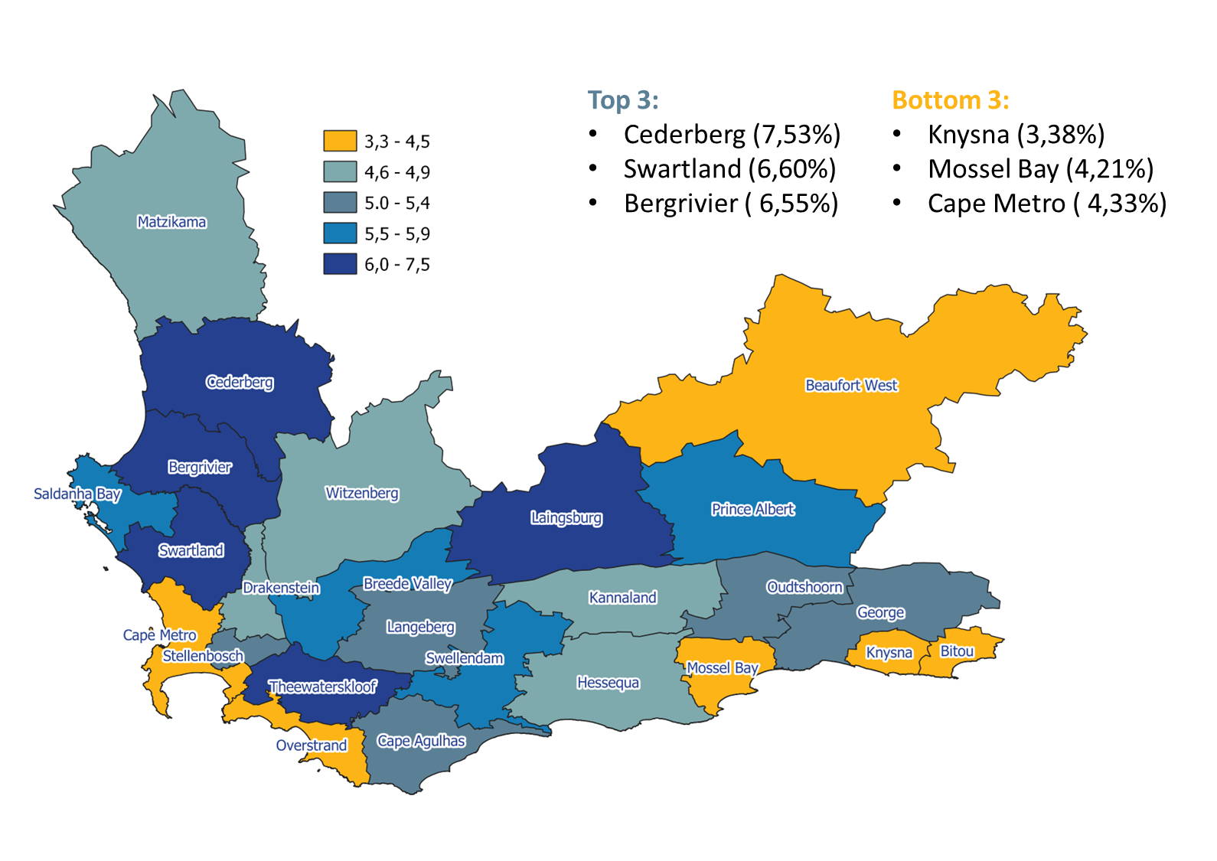
Local Real GDPR growth trend (2021e)

Slide 11


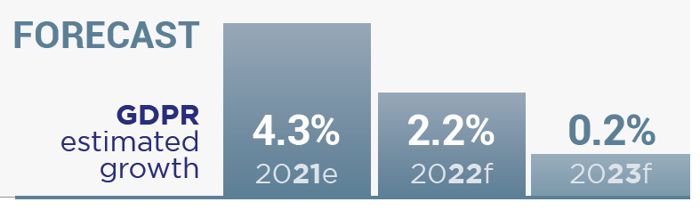
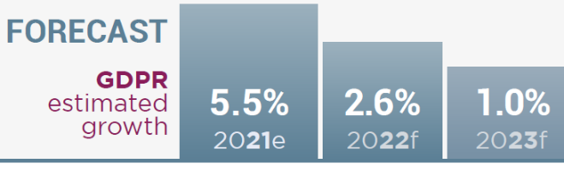


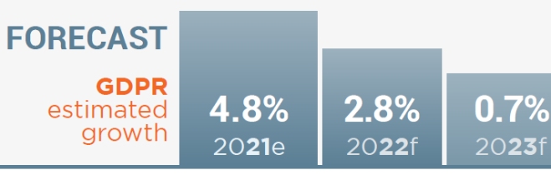
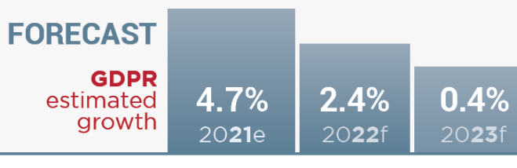


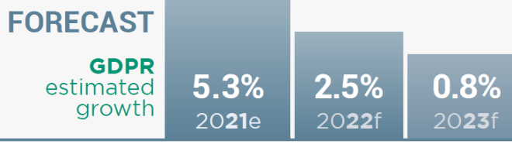
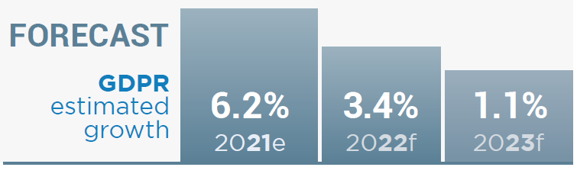
GDPR forecast
Cape Metro
Overberg
Central Karoo
Garden Route
Cape Winelands
West Coast

Slide 12














International trade: top export products & destinations (2021)
Cape Metro
Petroleum:
R10.4bn
10.2% of exports
Central
Karoo
Milk & cream
R19.6m
17.2% of exports
West Coast
Iron & Steel products
R3.4bn
36.3% of exports
India
United States
Namibia
Cape
Winelands
Citrus fruit:
R8.4bn
18.4% of exports
Garden Route
Apples, pears & quinces
R1.4bn
25.0% of exports
Overberg
Apples, pears & quinces
R695.5m
20.3% of exports
Netherlands
United Kingdom
Netherlands
  Important to note that data represents where headquarters of an exporting entity is registered and may not always align with actual location of operations. Trade data originates from StatsSA

Slide 13




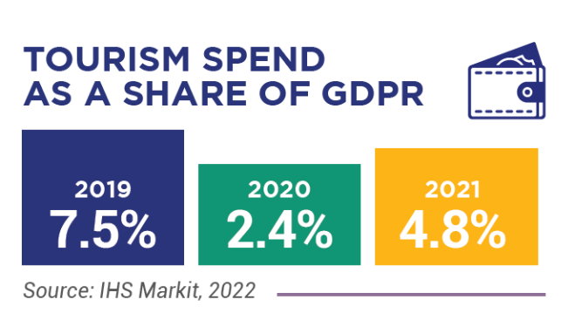
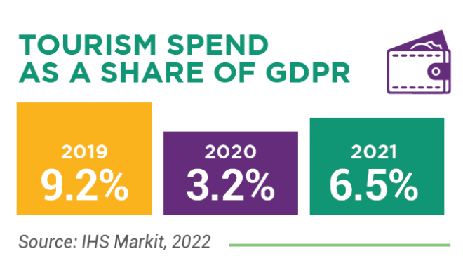
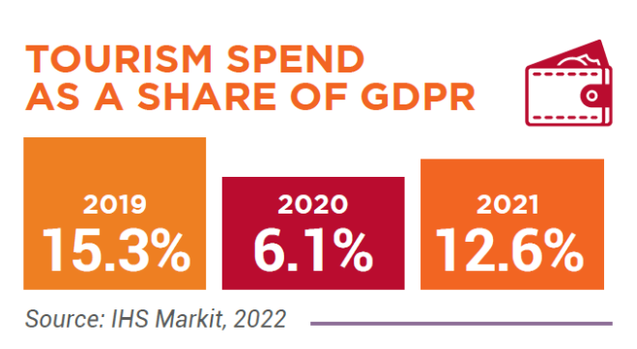
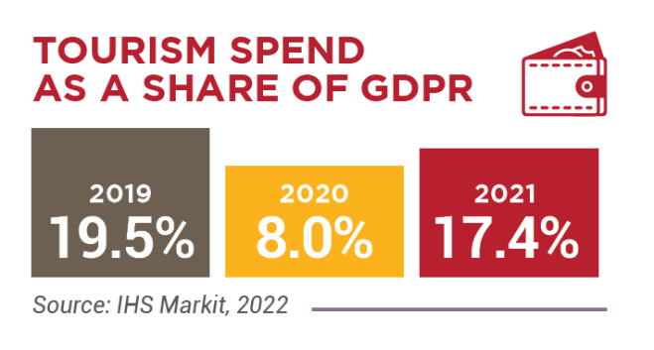
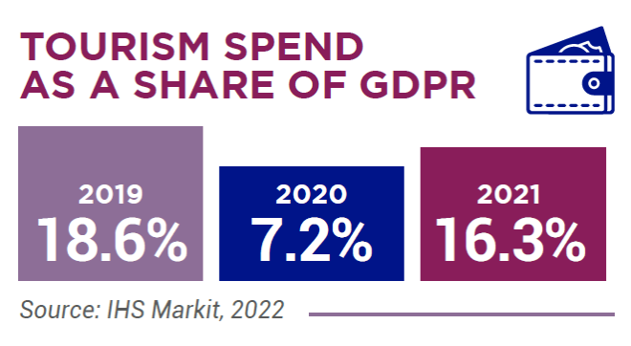
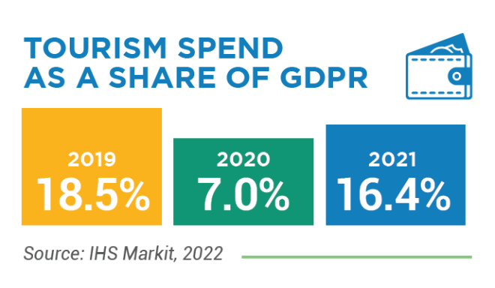
Tourism
Cape Metro
Cape
Winelands
Central
Karoo
Garden Route
Overberg
West Coast
  Bed nights up 12.8%
  United States as main international source market
  Bed nights up 12.7%
  Germany as main international source market
  Bed nights up 12%
  Germany as main international source market
  Bed nights up 12.7%
  United States as main international source market
  Bed nights up 15.3%
  Germany as main international source market
  Bed nights up 13.5%
  United Kingdom as main international source market
2021

Slide 14
Economic Opportunities
Cape Metro
Cape
Winelands
Central
Karoo
Garden Route
Overberg
West Coast
  Airport & Seaport as areas of economic risk & opportunity
  Key investment announcements in events, property & municipal energy
  Agro-processing under pressure (Fruit canning, wine, etc.)
  Stellenbosch University as investment catalyst (bio-tech & student accommodation)
  Emergent post-drought recovery of agriculture & tourism
  Key investment progress in renewables (REI4P)
  Port, Oil & Gas as areas of risk & opportunity
  GRDM investment prospectus as means of leveraging Semigration
  Bottom-up LED exemplified by Kleinbegint business incubation hub, Project Lungisa partnership & Overstand investment conference
  Battery Energy Storage System (BESS) & Green hydrogen pilots as positive developments towards net-zero just transition in natural-resource-dependent region

Slide 15


Slide 16
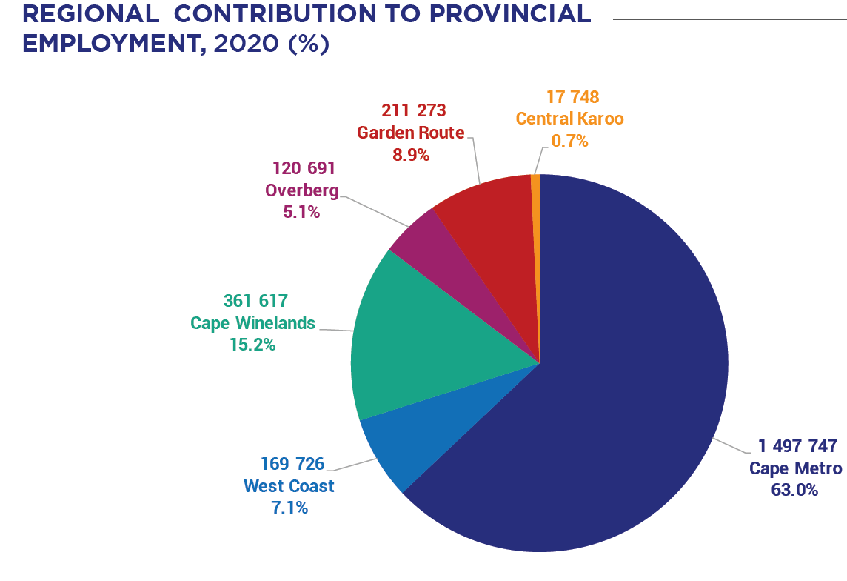
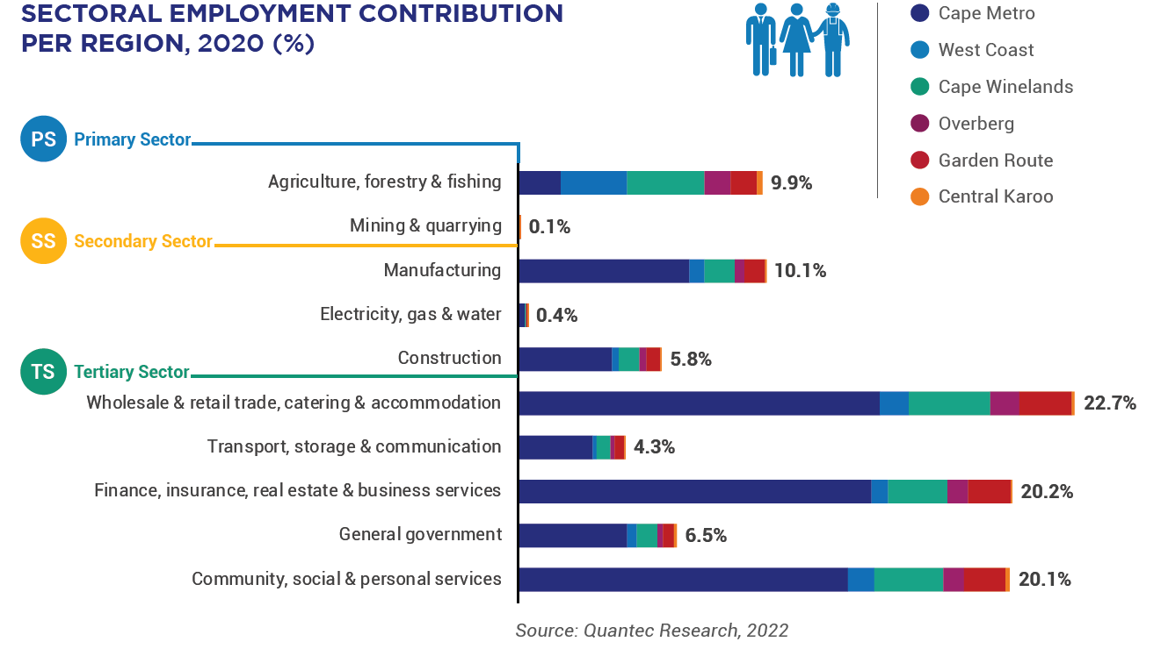
Employment contribution
  Key take-away:
  Labour intensity of employment in non-metro areas highlights importance of agriculture value chain (primary production, manufacturing, logistics, etc.) in provincial job creation

Slide 17
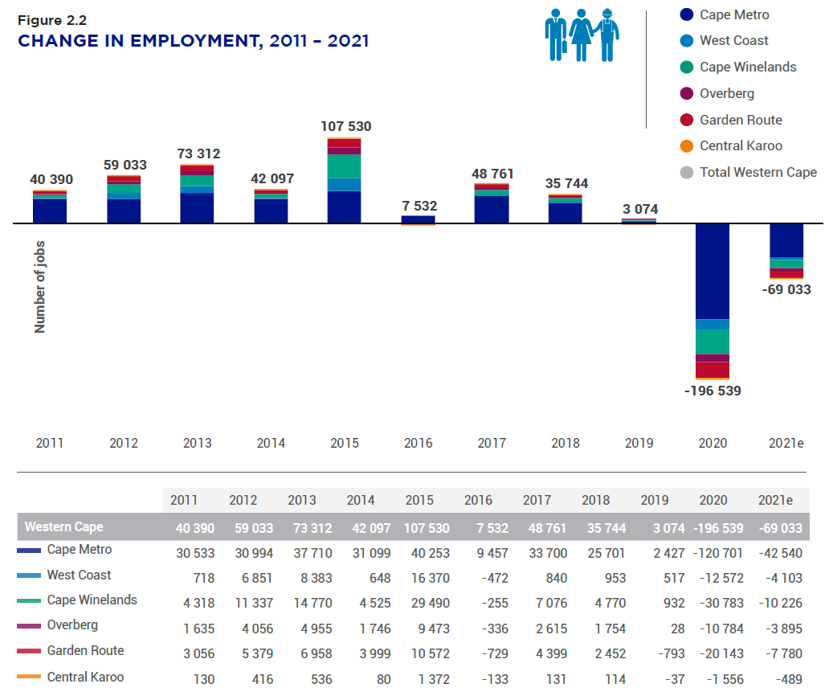
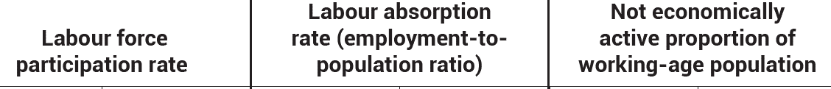
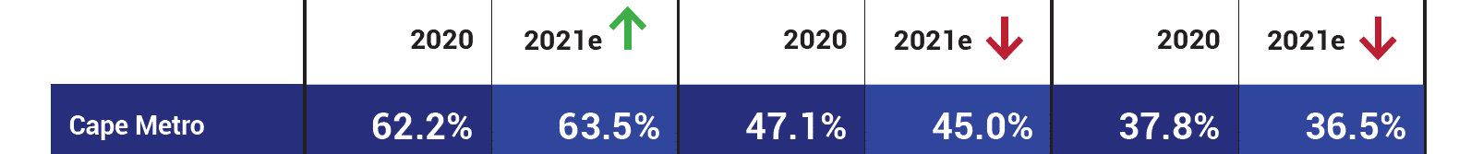
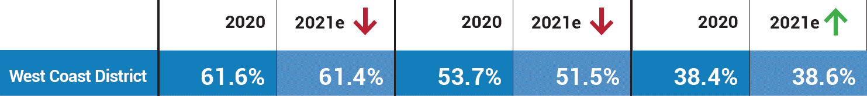
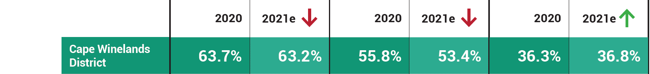
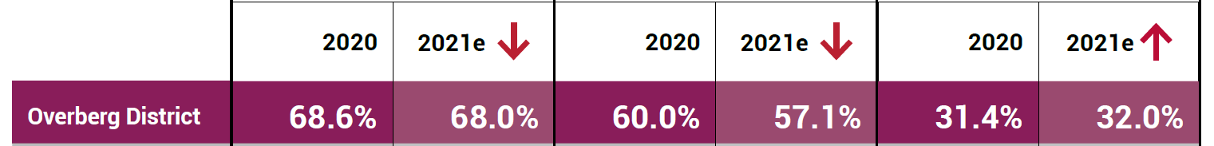
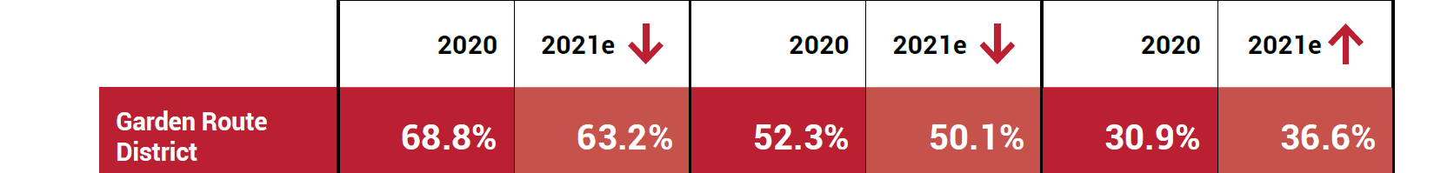
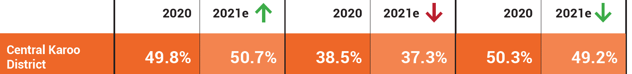
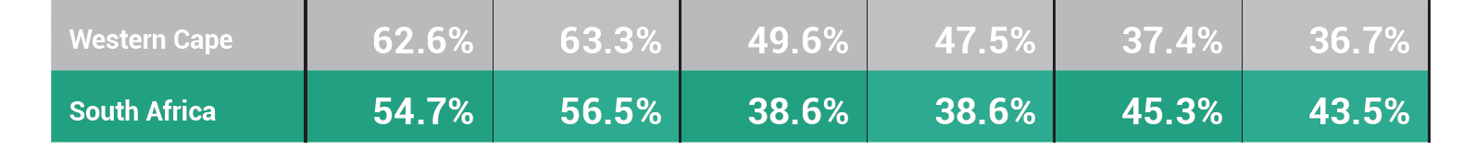
Unemployment profile
Unemployment Rate 2021
29.0%
16.0%
15.4%
15.9%
21.1%
26.4%
25.1%

Slide 18
Comparative advantage
  Location quotient (LQ) : Used to identify the comparative advantage and level of specialization of various economic sectors in each District. LQ > 1 indicates comparative advantage in the specific sector when compared to the national economy.
LOCATION QUOTIENT IN TERMS OF EMPLOYMENT, 2021
Sector | Cape Metro Area | West Coast | Cape Winelands | Overberg | Garden Route | Central Karoo
Primary Sector | 0.27 | 3.67 | 2.03 | 2.03 | 1.19 | 2.34
Agriculture, forestry & fishing | 0.39 | 5.33 | 2.96 | 2.96 | 1.73 | 3.42
Mining & quarrying | 0.02 | 0.07 | 0.01 | 0.01 | 0.02 | 0.0
Secondary Sector | 1.12 | 0.84 | 0.89 | 0.93 | 1.01 | 0.42
Manufacturing | 1.17 | 0.98 | 0.86 | 0.84 | 0.95 | 0.16
Electricity, gas & water | 0.88 | 0.53 | 0.62 | 0.65 | 0.87 | 1.31
Construction | 1.06 | 0.64 | 0.96 | 1.11 | 1.10 | 0.78
Tertiary Sector | 1.07 | 0.66 | 0.88 | 0.87 | 0.97 | 0.93
Wholesale & retail trade, catering & accommodation | 1.07 | 0.77 | 1.01 | 1.03 | 1.11 | 0.97
Transport, storage & communication | 1.12 | 0.56 | 0.80 | 0.90 | 0.96 | 0.96
Finance, insurance, real estate & business services | 1.24 | 0.50 | 0.87 | 0.93 | 1.04 | 0.49
General government | 1.09 | 0.87 | 0.83 | 0.68 | 0.85 | 1.65
Community, social & personal services | 0.93 | 0.65 | 0.80 | 0.72 | 0.83 | 1.05

Slide 19


Slide 20
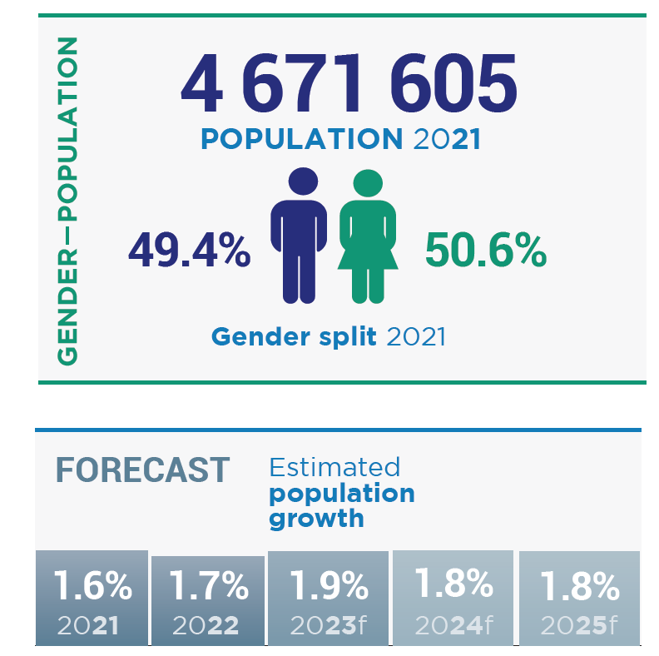
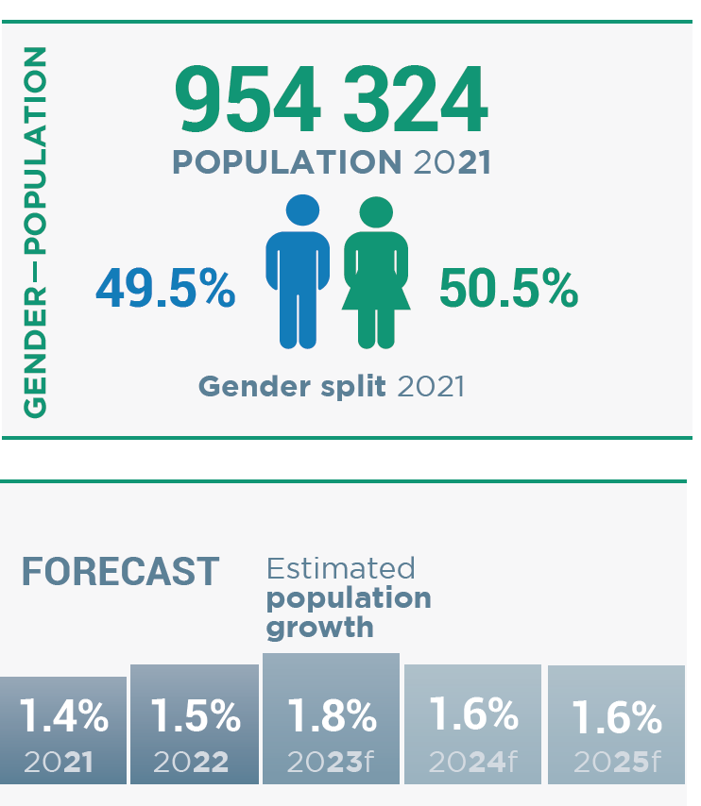
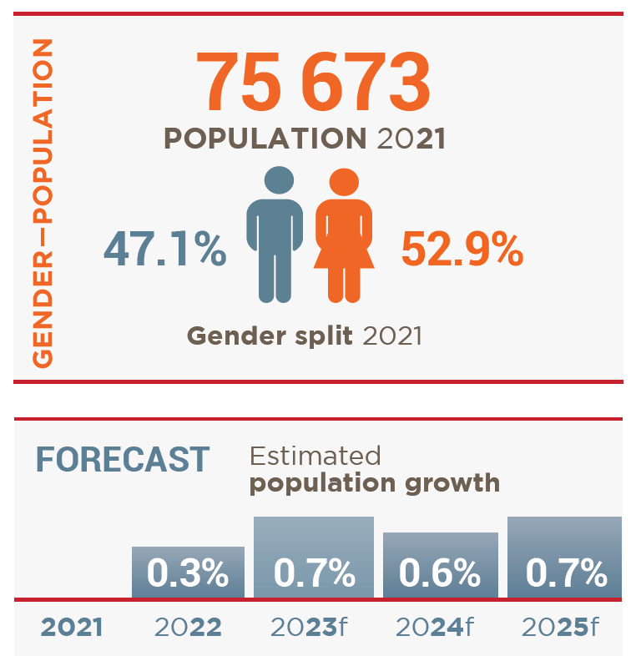
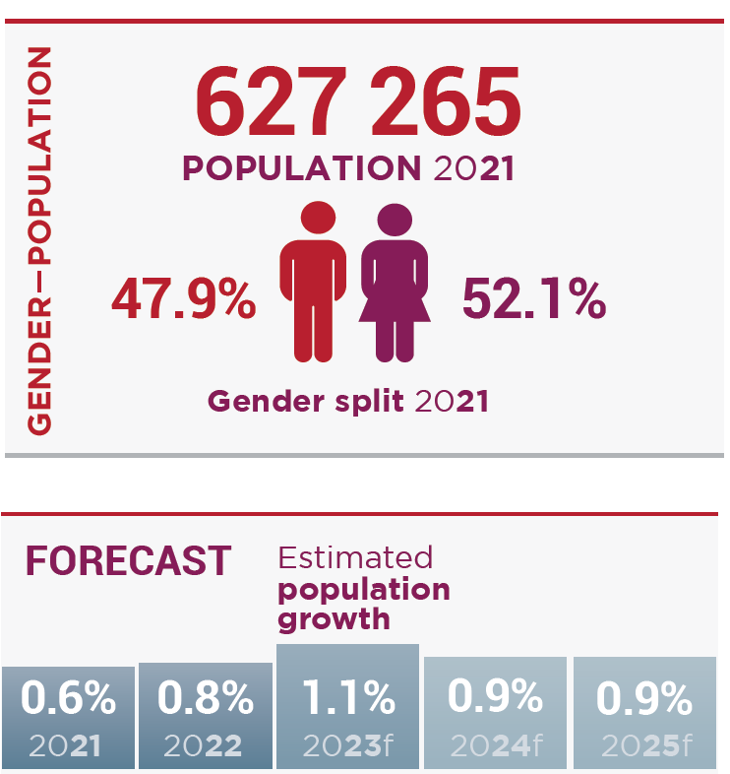
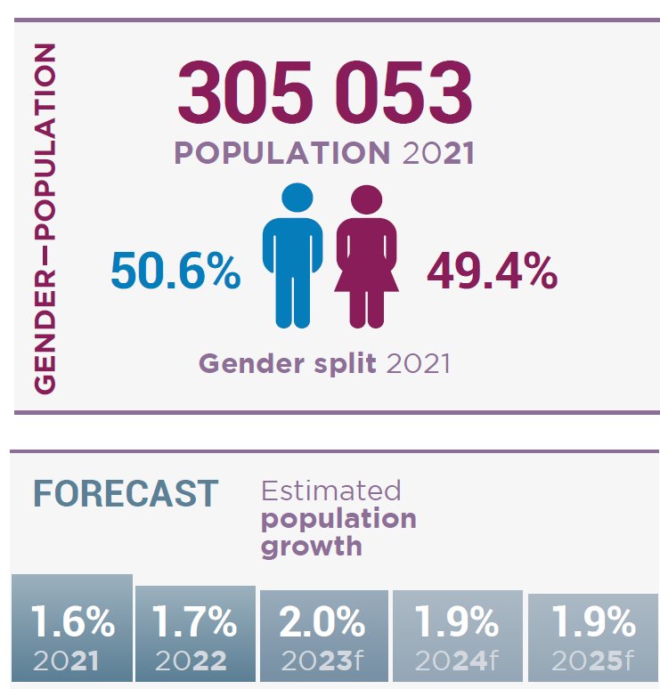
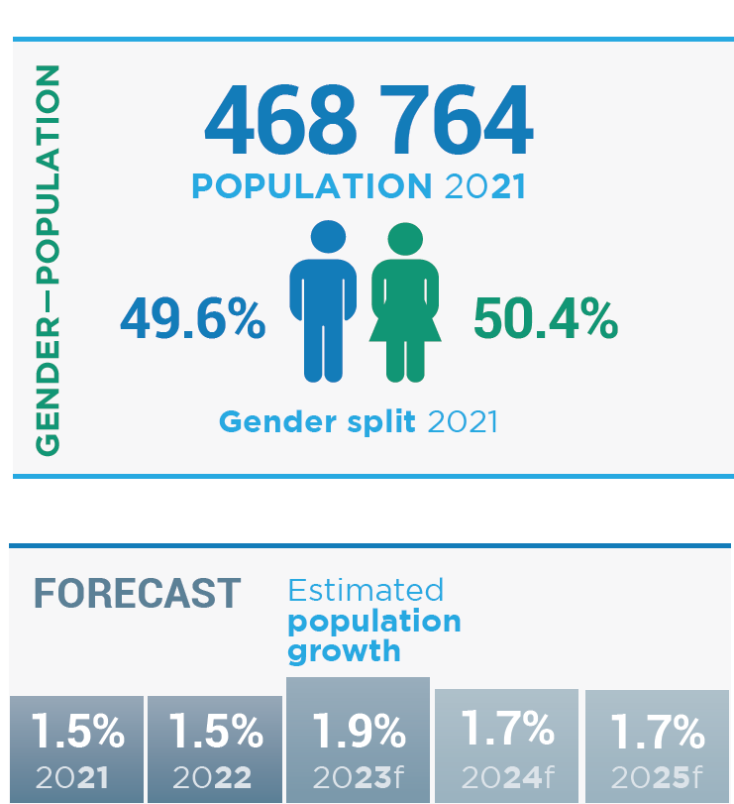
Population size & growth
Cape Metro
Cape Winelands
Central Karoo
Garden Route
Overberg
West Coast

Slide 21
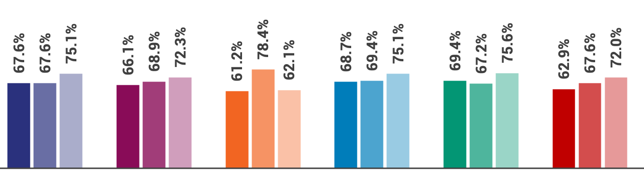
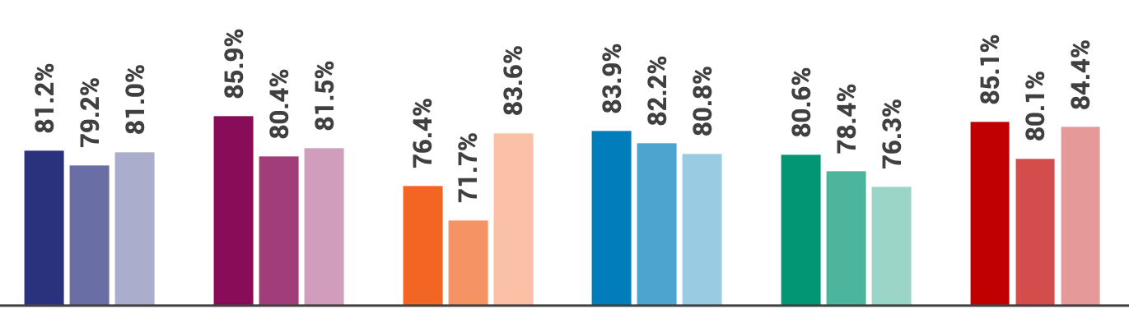


Education
2019
2020
2021
2019
2020
2021
2019
2020
2021
2019
2020
2021
2019
2020
2021
2019
2020
2021
Grade 10-12
retention rate
Cape Metro
Central Karoo
West Coast
Cape Winelands
Garden Route
Overberg
2019
2020
2021
2019
2020
2021
2019
2020
2021
2019
2020
2021
2019
2020
2021
2019
2020
2021
Matric
pass rate

Slide 22
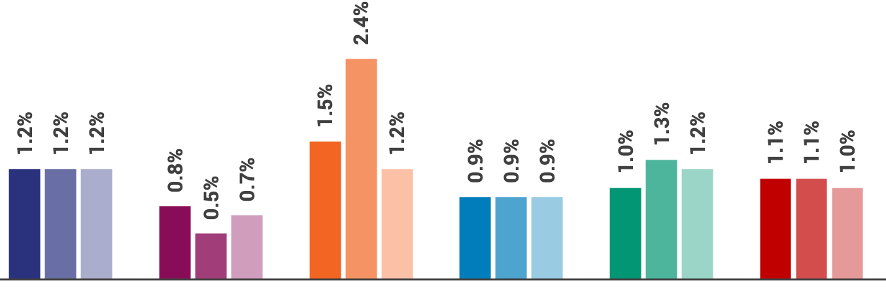
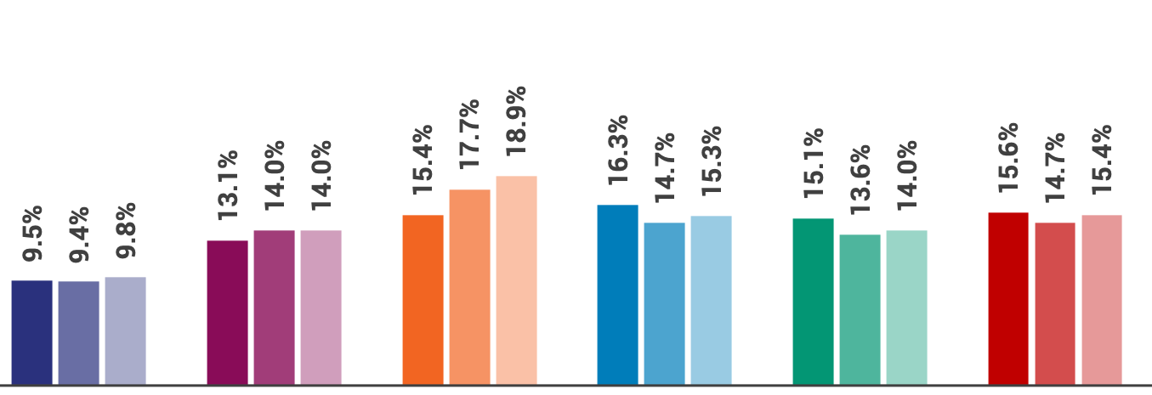


Well-being: Health (Maternal and infant outcomes)
2019
2020
2021
2019
‘20
‘21
2019
2020
2021
2019
2020
2021
2019
2020
2021
2019
2020
2021
Infant deaths
Cape Metro
Central Karoo
West Coast
Cape Winelands
Garden Route
Overberg
2019
2020
2021
2019
2020
2021
2019
2020
2021
2019
2020
2021
2019
2020
2021
2019
2020
2021
Delivery
to teenagers

Slide 23
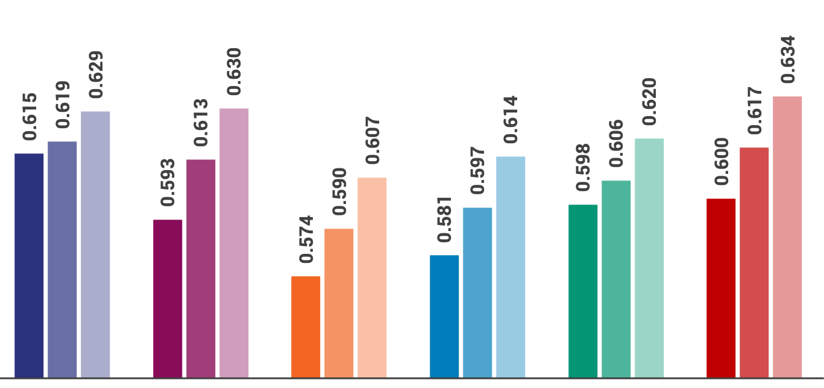
Well-being: Inequality (Gini coefficient)
2015
2018
2021
2015
2018
2021
2015
2018
2021
2015
2018
2021
2015
2018
2021
2015
2018
2021
Cape Metro
Central Karoo
West Coast
Cape Winelands
Garden Route
Overberg
  Key take-away: Pandemic job-losses accelerated inequality

Slide 24
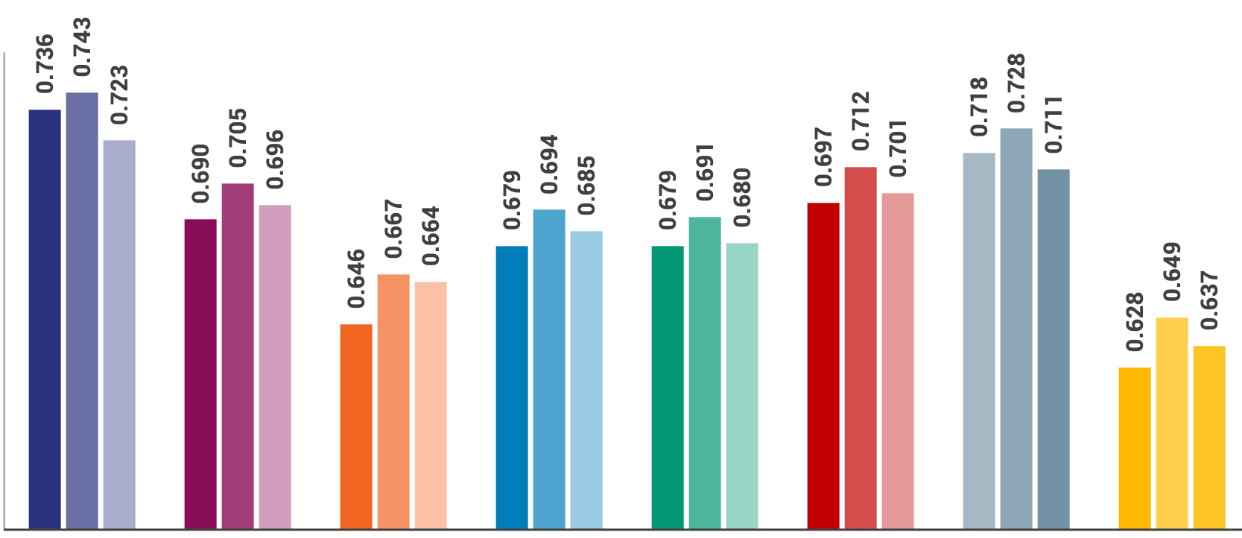
Human Development Index (HDI)
2015
2018
2021
2015
2018
2021
2015
2018
2021
2015
2018
2021
2015
2018
2021
2015
2018
2021
Cape Metro
Central Karoo
West Coast
Cape Winelands
Garden Route
Western Cape
South Africa
Overberg
  Key take-away: HDI has declined across all regions, largely due to lower incomes per capita

Slide 25





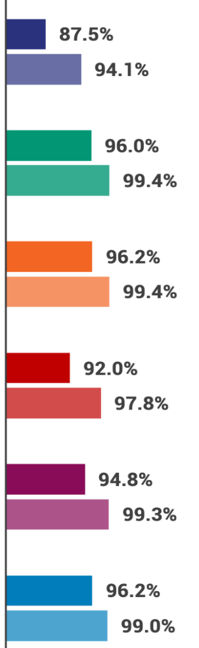




Access to basic services 1994 & 2021
Access
to water
Access
to electricity
Access to
improved
sanitation
Access to
solid waste
removal
Access to
formal
housing
Cape Metro
Cape Winelands
1994
2021
1994
2021
1994
2021
1994
2021
2021
Central Karoo
Garden Route
Overberg
West Coast

Slide 26


Safety: Crime per 100 000 people
  Occurrences & instances of reported crime in the Province higher than national rates
  It is acknowledged that nationally, some crimes may be under-reported
  2021 values represent post-covid adjustment (e.g., higher levels of unemployment, deprivation & load shedding contributing towards increased burglaries

Slide 27





NEW DATA
Notes:
To display only a few examples of the new data

Slide 28


Housing Market Study
  Key take-away: Significant excess demand for affordable & entry-market housing

Slide 29








Public sector spending on designated groups
PAYMENTS TO SUPPLIERS PER DESIGNATED CATEGORY IN THE PPPFR, 2021/22
 | Cape Metro | West Coast | Cape Winelands | Overberg | Garden Route | Central Karoo
Military Veterans | 6% | 3.6% | 42.8% | 0.9% | 5.8% | 0%
Disabled | 2.2% | 3.9% | 6.5% | 19.5% | 0.3% | 0%
Youth | 91.7% | 92.5% | 50.7% | 76.9% | 94.9% | 100%
Total spend on designated groups | R 2.4b | R 16.7m | R 35.3m | R 5.7m | R 64.6m | R 6.6m

Slide 30

POLICY
IMPLICATIONS

Slide 31
Key implications for policy, planning and budgeting (1)
Increased population growth: Growth to be factored into planning and budgeting given its impact on service delivery demands
Deteriorating economic conditions, job losses and loadshedding: Negative impact on household income and ability to afford municipal trading services. Places strain on already limited municipal finances
Increased need for self-financing of capital expansions: National fiscus remains under pressure. Greater need to seek alternative funding for infrastructure developments. Municipalities’ revenue generating capacity is constrained. Funding models to be reviewed.
Energy supply constraints and above-inflationary electricity price increases: Need to drive energy sustainability and supply. Implement and promote renewable energy initiatives.
Enhanced infrastructure investment remains an enabler of broad-based growth: Need to secure funding and investment pipelines. Address backlogs to implementation and completion of main projects. Utilize spatial data and planning.

Slide 32
Key implications for policy, planning and budgeting (2)
International trade and tourism to increase local growth and employment prospects: Destination marketing
Increase in the demand for skilled labour: Greater need for upskilling initiatives. Education and learner support as strategic priorities.
Rising socio-economic vulnerability: Increased teenage pregnancies and high levels of crime. Integrated provincial and municipal action and targeted intervention needed.
Consequences of COVID-19 pandemic: MERO reflects challenges of job losses, safety, and wellbeing. Need to prioritise and implement interventions in Western Cape Recovery Plan.
MERO as key input for evidence-based decision making: MERO to feed into municipal integrated development plans; spatial development frameworks, local economic development strategies and budgets.

