Slide 1

Seda 2022/23 Quarter 2 Performance
Meeting: Portfolio Committee
Date:
Presenter:
Date: 23 November 2022
Presenter: Mr. Nkosikhona Mbatha

Slide 2
PRESENTATION OUTLINE
1 | Introduction
2 | Performance Overview
3 | Performance Information
4 | Human Resource Report
5 | Financial Report
6 | Governance and Compliance
7 | Marketing and Communication
8 | Key Projects

Slide 3



1. INTRODUCTION
Notes:
As At 30 September 2022, the portfolio had a total balance of R3.9bn (Including funds).
The total portfolio is made up of R1.4bn WL representing 36% and R2.5bn in DL representing 64%.
The WL book increased by 5% (R71.2m) quarter on quarter as a result of the net effect of repayments and disbursements.
DL book grew by 10% (R233m) quarter on quarter as a result of new disbursements and repayments.

Slide 4
Introduction
The report highlights the organisation's performance for the second quarter of the 2022/23 Financial Year.
A total number of 17 indicators were measured in quarter 2, The organisation achieved 100% or more on 13 indicators and underperformed on 4 indicators. This amounts to 76% performance achievement.
One indicator was under achieved between 80% to 99%: Number of SMMEs & Co-operatives supported in the priority sectors (Scale-Up / High Growth Potential).
Three indicators were under achieved below 50%: Number of new Seda access point. Number of new Incubation Centres established Number of SMMEs & Cooperatives assisted through the Technology Transfer Assistance Programme
Notes:
As At 30 September 2022, the portfolio had a total balance of R3.9bn (Including funds).
The total portfolio is made up of R1.4bn WL representing 36% and R2.5bn in DL representing 64%.
The WL book increased by 5% (R71.2m) quarter on quarter as a result of the net effect of repayments and disbursements.
DL book grew by 10% (R233m) quarter on quarter as a result of new disbursements and repayments.

Slide 5
2. PERFORMANCE OVERVIEW
Notes:
As At 30 September 2022, the portfolio had a total balance of R3.9bn (Including funds).
The total portfolio is made up of R1.4bn WL representing 36% and R2.5bn in DL representing 64%.
The WL book increased by 5% (R71.2m) quarter on quarter as a result of the net effect of repayments and disbursements.
DL book grew by 10% (R233m) quarter on quarter as a result of new disbursements and repayments.

Slide 6
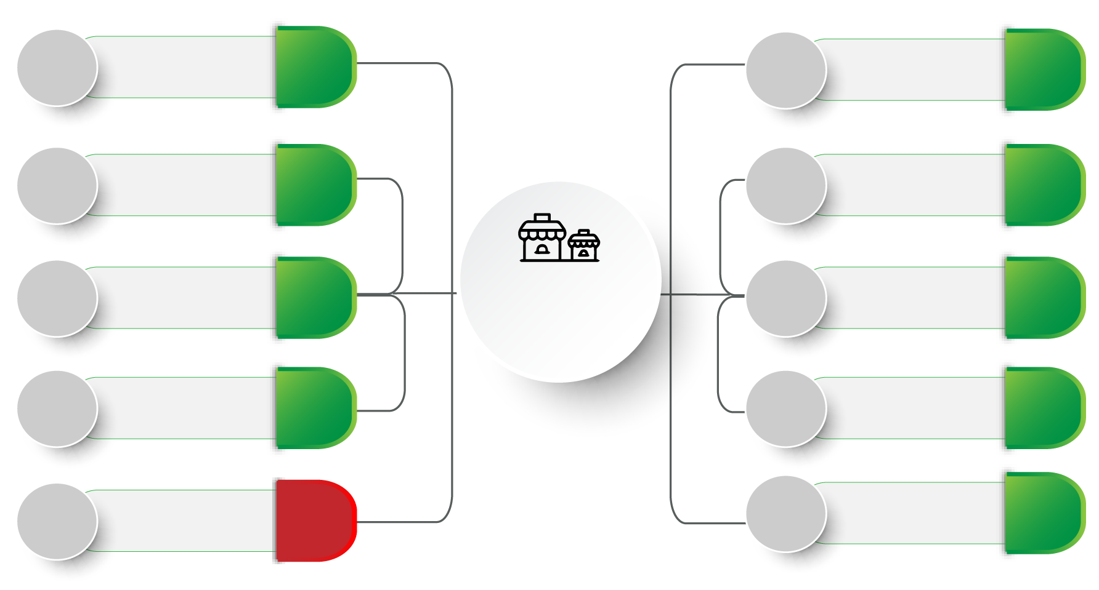
Performance Overview
7 000
Entrepreneurship
Awareness
24 087
1 000
Incubation
Programme
1 588
5 000
Township & Rural
based clients
6 241
500
Productivity
Improvement
521
20
Seda Access
Points
4
Total SMMEs &
Cooperatives
Supported
42 319
750
Quality
Improvement
1 182
Access to
Local
Markets
1 119
Priority Sectors
26
600
30
26
300
Access to
International
Markets
476
6 000
Training, Mentorship
& Coaching
7 075
Notes:
As At 30 September 2022, the portfolio had a total balance of R3.9bn (Including funds).
The total portfolio is made up of R1.4bn WL representing 36% and R2.5bn in DL representing 64%.
The WL book increased by 5% (R71.2m) quarter on quarter as a result of the net effect of repayments and disbursements.
DL book grew by 10% (R233m) quarter on quarter as a result of new disbursements and repayments.

Slide 7
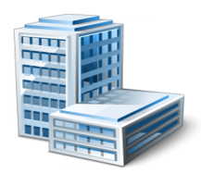
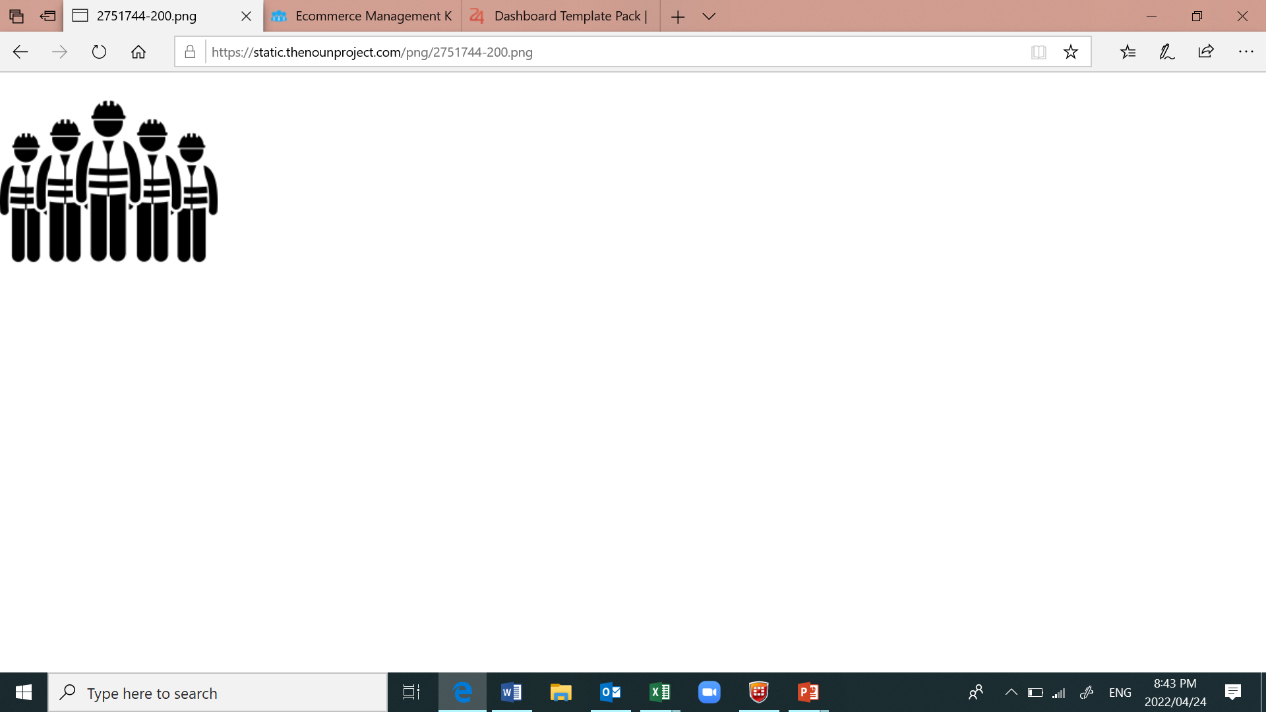
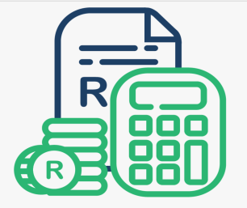
Performance Overview
Jobs Created & Sustained
Seda Branches - 54
Quarter 2 Spend– 107%
Incubation Centres - 122
Seda Access Points - 4
5511
R253 Million
Seda Colocation Points - 57
Notes:
As At 30 September 2022, the portfolio had a total balance of R3.9bn (Including funds).
The total portfolio is made up of R1.4bn WL representing 36% and R2.5bn in DL representing 64%.
The WL book increased by 5% (R71.2m) quarter on quarter as a result of the net effect of repayments and disbursements.
DL book grew by 10% (R233m) quarter on quarter as a result of new disbursements and repayments.

Slide 8
Seda Quarter 2 Performance Comparison
Notes:
As At 30 September 2022, the portfolio had a total balance of R3.9bn (Including funds).
The total portfolio is made up of R1.4bn WL representing 36% and R2.5bn in DL representing 64%.
The WL book increased by 5% (R71.2m) quarter on quarter as a result of the net effect of repayments and disbursements.
DL book grew by 10% (R233m) quarter on quarter as a result of new disbursements and repayments.

Slide 9
3. PERFORMANCE INFORMATION
Notes:
As At 30 September 2022, the portfolio had a total balance of R3.9bn (Including funds).
The total portfolio is made up of R1.4bn WL representing 36% and R2.5bn in DL representing 64%.
The WL book increased by 5% (R71.2m) quarter on quarter as a result of the net effect of repayments and disbursements.
DL book grew by 10% (R233m) quarter on quarter as a result of new disbursements and repayments.

Slide 10
PROGRAMME 1: Township, Rural and Informal Business
NO. | Output Indicator | Annual Targets | Q2 Target | Q2 Achievement | Q2 Variance | Reason for Variance | Corrective Measures | YTD Target | YTD Achieve ment
1.1 | Number of SMMEs & Cooperatives reached through entrepreneurship awareness sessions | 20 000 | 7 000 | 24 087 | 17 087 | Overachievement is due to awareness events, briefing sessions on how to start your own business, CIPC registrations, SARS & workshops on the art of pitching. | None | 10 000 | 52 128
1.2 | Number of township & rural business supported | 16 000 | 5 000 | 6 241 | 1 241 | The target was achieved due to an increased number of leads that were generated in the previous quarter. | None | 8 000 | 10 282
1.3 | Number of new Incubation Centres established | 11 | 3 | 0 | -3 | A Call for new Incubators was made on the 01st June 2022. Committee. Adjudication was put on hold due to review of the Policy, elevation of the Adjudication Committee as well as review of the Terms of Reference. | Adjudication will resume in November post the reworked/ amended policy being approved by the Board. | 3 | 0
1.4 | Number of new Seda access point | 80 | 20 | 4 | -16 | 7 Provinces issued calls for proposals. The remaining 2 will do so in October. 3 Provinces are at contracting stage. Others are conducting site verifications as part of the evaluation 4 contracts were signed in Moretele Municipality | The organisation is aiming to finalise all contracts by the end of the 3rd quarter | 40 | 4
1.5 | Ecosystem Development Plan implementation | 40% | - | - | - | Not due | None | - | -
Notes:
As At 30 September 2022, the portfolio had a total balance of R3.9bn (Including funds).
The total portfolio is made up of R1.4bn WL representing 36% and R2.5bn in DL representing 64%.
The WL book increased by 5% (R71.2m) quarter on quarter as a result of the net effect of repayments and disbursements.
DL book grew by 10% (R233m) quarter on quarter as a result of new disbursements and repayments.

Slide 11
PROGRAMME 2: Business Competitiveness and Viability
No. | Output indicator | Annual Targets | Q2 Target | Q2 Achievement | Q2 Variance | Reason for Variance | Corrective Measures | YTD Target | YTD Achieve- ment
2.1 | Number of SMMEs & Cooperatives exposed to Local markets | 2 000 | 600 | 1 119 | 519 | Access to Local market interventions like mall activation, pop-up markets & enterprise and supplier development contributed to this performance. | None | 1 000 | 1 575
2.2 | Number of SMMEs & Cooperatives supported to participate in the international markets | 1 000 | 300 | 476 | 176 | Seda was able to support a significant number of clients to participate in many tradeshows. | None | 500 | 690
2.3 | Number of SMMEs & Cooperatives assisted through Incubation programme | 2 500 | 1 000 | 1 588 | 588 | A higher number of clients were enrolled into the incubation programme. | None | 1 000 | 1 356
2.4 | Number of SMMEs & Cooperatives assisted with Productivity improvement | 2 000 | 500 | 521 | 21 | The increase in performance was due to the increased demand of productivity improvement trainings. | None | 1 000 | 1 428
2.5 | Number of SMMEs & Cooperatives assisted through the Technology Transfer Assistance Programme | 70 | 20 | 0 | -20 | The Technical Committee Meetings and Adjudication Committee Meetings was put on hold due to the review of the TTA Policy, elevation of the Adjudication Committee to EXCO as well as review of the Terms of Reference and SOPs. | The Technical Committee and Adjudication Committee Meetings will resume in November | 30 | 32
Notes:
As At 30 September 2022, the portfolio had a total balance of R3.9bn (Including funds).
The total portfolio is made up of R1.4bn WL representing 36% and R2.5bn in DL representing 64%.
The WL book increased by 5% (R71.2m) quarter on quarter as a result of the net effect of repayments and disbursements.
DL book grew by 10% (R233m) quarter on quarter as a result of new disbursements and repayments.

Slide 12
PROGRAMME 2: Business Competitiveness and Viability
No. | Output indicator | Annual Targets | Q2 Target | Q2 Achievement | Q2 Variance | Reason for Variance | Corrective Measures | YTD Target | YTD Achieve- ment
2.6 | Number of SMMEs & Cooperatives assisted with Quality improvements | 2 500 | 750 | 1 182 | 432 | Performance was due to the increased demand of quality improvement interventions. | None | 1 250 | 2 261
2.7 | Number of SMMEs & Cooperatives whose turnover has increased by 5% per annum | 450 | 150 | 930 | 780 | Businesses assessed in the second quarter highlights a positive change in turnover. | None | 250 | 1 193
2.8 | Number of jobs created | 4 000 | 1 200 | 1 616 | 416 | Businesses assessed in the second quarter highlights a positive change in jobs creation. Majority of the supported businesses were large scale with high potential for jobs creation. | None | 2 000 | 2 256
2.9 | Number of jobs sustained | 6 000 | 2 000 | 3 895 | 1 895 | The high number of jobs sustained is a result of the number of interventions conducted with most of the assessed businesses focusing on retaining jobs due to the economic climate. | None | 3 000 | 6 525
Notes:
As At 30 September 2022, the portfolio had a total balance of R3.9bn (Including funds).
The total portfolio is made up of R1.4bn WL representing 36% and R2.5bn in DL representing 64%.
The WL book increased by 5% (R71.2m) quarter on quarter as a result of the net effect of repayments and disbursements.
DL book grew by 10% (R233m) quarter on quarter as a result of new disbursements and repayments.

Slide 13
PROGRAMME 2: Business Competitiveness and Viability
No. | Output indicator | Annual Targets | Q2 Target | Q2 Achievement | Q2 Variance | Reason for Variance | Corrective Measures | YTD Target | YTD Achieve- ment
2.10 | Number of SMMEs & Co-operatives supported in the priority sectors (Scale-Up / High Growth Potential) | 100 | 30 | 26 | -4 | Branches couldn’t award high-value interventions due to budget constraints | Provinces were allocated additional budget, which should assist enable them to implement high end interventions. | 50 | 77
2.11 | Number of SMMEs & Co-operatives supported with training, mentorship & coaching | 20 000 | 6 000 | 7 075 | 1 075 | The organisation conducted several training interventions such as Empretec, HACCP, business management, OHS and financial training. | None | 10 000 | 11 277
Notes:
As At 30 September 2022, the portfolio had a total balance of R3.9bn (Including funds).
The total portfolio is made up of R1.4bn WL representing 36% and R2.5bn in DL representing 64%.
The WL book increased by 5% (R71.2m) quarter on quarter as a result of the net effect of repayments and disbursements.
DL book grew by 10% (R233m) quarter on quarter as a result of new disbursements and repayments.

Slide 14
PROGRAMME 3: Administration
No. | Output indicator | Annual Targets | Q2 Target | Q2 Achievement | Q2 Variance | Reason for Variance | Corrective Measures | YTD Target | YTD Achieve- ment
3.1 | Percentage of innovative ideas implemented | 35% | - | - | - | Not due | None | - | -
3.2 | Percentage of staff who performed at 311 & above in the performance evaluation recognized for excellence | 60% | - | - | - | Not due | None | - | -
3.3 | Percentage of staff satisfaction | 50% | - | - | - | Not due | None | - | -
3.4 | Percentage of customer satisfaction | 80% | 80% | 97% | 17% | The target was exceeded due to positive feedback received from clients | None | 80% | 97%
3.5 | Percentage of vacancy rate | 10% | 10% | 4.8% | 5.2% | Continuous engagements and follow-ups made to accelerate the filling of vacant positions | None | 10% | 7%
3.6 | Number of priority systems digitized | 2 | - | - | - | Not due | None | - | -
Notes:
As At 30 September 2022, the portfolio had a total balance of R3.9bn (Including funds).
The total portfolio is made up of R1.4bn WL representing 36% and R2.5bn in DL representing 64%.
The WL book increased by 5% (R71.2m) quarter on quarter as a result of the net effect of repayments and disbursements.
DL book grew by 10% (R233m) quarter on quarter as a result of new disbursements and repayments.

Slide 15
4. HUMAN RESOURCE REPORT
Notes:
As At 30 September 2022, the portfolio had a total balance of R3.9bn (Including funds).
The total portfolio is made up of R1.4bn WL representing 36% and R2.5bn in DL representing 64%.
The WL book increased by 5% (R71.2m) quarter on quarter as a result of the net effect of repayments and disbursements.
DL book grew by 10% (R233m) quarter on quarter as a result of new disbursements and repayments.

Slide 16
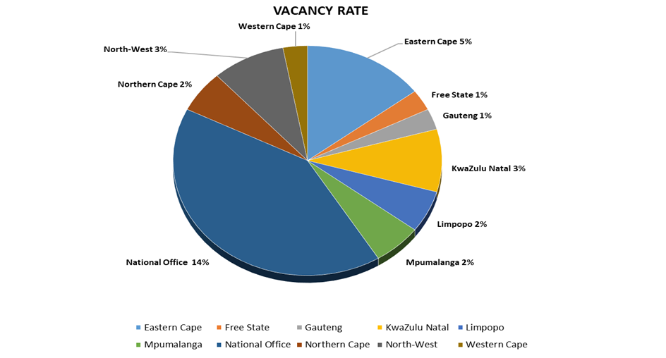
Human Resource Vacancies
Total number employees as per approved structure -713
Number of staff as at end September 2022 was 679
The vacancy rate as end September 2022 : 4,8%
Notes:
As At 30 September 2022, the portfolio had a total balance of R3.9bn (Including funds).
The total portfolio is made up of R1.4bn WL representing 36% and R2.5bn in DL representing 64%.
The WL book increased by 5% (R71.2m) quarter on quarter as a result of the net effect of repayments and disbursements.
DL book grew by 10% (R233m) quarter on quarter as a result of new disbursements and repayments.

Slide 17
5. FINANCIAL REPORT
Notes:
As At 30 September 2022, the portfolio had a total balance of R3.9bn (Including funds).
The total portfolio is made up of R1.4bn WL representing 36% and R2.5bn in DL representing 64%.
The WL book increased by 5% (R71.2m) quarter on quarter as a result of the net effect of repayments and disbursements.
DL book grew by 10% (R233m) quarter on quarter as a result of new disbursements and repayments.

Slide 18
BUDGET 2022/2023
Budget for 2022/23
The total revenue budget for Seda for the 2022/23 financial year amounts to R947,46 million and, the total expenditure budget amounts to R947,46 million (including capital). The total include R60 million for special Flood Relief project.
Notes:
As At 30 September 2022, the portfolio had a total balance of R3.9bn (Including funds).
The total portfolio is made up of R1.4bn WL representing 36% and R2.5bn in DL representing 64%.
The WL book increased by 5% (R71.2m) quarter on quarter as a result of the net effect of repayments and disbursements.
DL book grew by 10% (R233m) quarter on quarter as a result of new disbursements and repayments.

Slide 19

EXPENDITURE SPLIT OF CORE VS SUPPORT
Actual expenditure
Core:
R231,05 million
Support:
R22,02 million
Target
Core:
75%
Support:
25%
Achieved
Core:
91%
Support:
9%
Seda’s target is to allocate 75% and above on the core and 25% to support.
Notes:
As At 30 September 2022, the portfolio had a total balance of R3.9bn (Including funds).
The total portfolio is made up of R1.4bn WL representing 36% and R2.5bn in DL representing 64%.
The WL book increased by 5% (R71.2m) quarter on quarter as a result of the net effect of repayments and disbursements.
DL book grew by 10% (R233m) quarter on quarter as a result of new disbursements and repayments.

Slide 20
FINANCIAL REPORT end of Quarter 2
Notes:
As At 30 September 2022, the portfolio had a total balance of R3.9bn (Including funds).
The total portfolio is made up of R1.4bn WL representing 36% and R2.5bn in DL representing 64%.
The WL book increased by 5% (R71.2m) quarter on quarter as a result of the net effect of repayments and disbursements.
DL book grew by 10% (R233m) quarter on quarter as a result of new disbursements and repayments.

Slide 21
SPENDING OF QUARTER 2
The expenditure for the quarter amounted to R253,0 million against the budget of R235,4 million, resulting in overspending of R17,6 million (7,49%).
The second quarter has improved from first quarter whereby the underspending was R25,6 million (9.43%). More interventions were delivered in the second quarter to catch-up from the first quarter.
99,8% of the invoices were paid within 30 days.
Notes:
As At 30 September 2022, the portfolio had a total balance of R3.9bn (Including funds).
The total portfolio is made up of R1.4bn WL representing 36% and R2.5bn in DL representing 64%.
The WL book increased by 5% (R71.2m) quarter on quarter as a result of the net effect of repayments and disbursements.
DL book grew by 10% (R233m) quarter on quarter as a result of new disbursements and repayments.

Slide 22
FINANCIAL REPORT END OF QUARTER 2
Explanation of variances:
Personnel costs – minor underspending of 0.42% (R397 976) is due to vacancies, mainly caused by the upcoming merger. Recruitment processes are at various stages.
Administration, Project and Programme – overspending of 13,69% (R18,8 million). Spending in quarter 2 include the catching-up from quarter 1 whereby the underspending was R25,6 million. The year-to-date underspending is 1,57%.
Depreciation – underspending of 12,76% (R313 755) is due to delays in the delivery and capitalizing of assets that were under-construction.
Capital expenditure – underspending of 34,40% (R428 282) is relating to a vehicle purchased and not yet delivered. Payment and delivery will be in October 2022.
Notes:
As At 30 September 2022, the portfolio had a total balance of R3.9bn (Including funds).
The total portfolio is made up of R1.4bn WL representing 36% and R2.5bn in DL representing 64%.
The WL book increased by 5% (R71.2m) quarter on quarter as a result of the net effect of repayments and disbursements.
DL book grew by 10% (R233m) quarter on quarter as a result of new disbursements and repayments.

Slide 23
SPLIT PER PROVINCE & NATIONAL OFFICE (July – Sep 2022)
The Provinces total budget is R227,99 m and the expenditure is R260,29 m. Provinces spend more in the quarter, mainly KZN due to the Flood relief projects.
Notes:
As At 30 September 2022, the portfolio had a total balance of R3.9bn (Including funds).
The total portfolio is made up of R1.4bn WL representing 36% and R2.5bn in DL representing 64%.
The WL book increased by 5% (R71.2m) quarter on quarter as a result of the net effect of repayments and disbursements.
DL book grew by 10% (R233m) quarter on quarter as a result of new disbursements and repayments.

Slide 24
6. GOVERNANCE & COMPLIANCE
Notes:
As At 30 September 2022, the portfolio had a total balance of R3.9bn (Including funds).
The total portfolio is made up of R1.4bn WL representing 36% and R2.5bn in DL representing 64%.
The WL book increased by 5% (R71.2m) quarter on quarter as a result of the net effect of repayments and disbursements.
DL book grew by 10% (R233m) quarter on quarter as a result of new disbursements and repayments.

Slide 25
Board and Committee Meetings
FINANCIAL REPORT END OF QUARTER 2
Committee | No of Scheduled Meetings | Dates
Board Meetings | 2 | 29 July 2022 31 August 2022
Strategy and Organisational Performance Committee (SOPC) | 3 | 19 July 2022 Special on 27 July 2022 Special on 25 August 2022
Audit And Risk Committee (ARC) | 1 | 27 July 2022
Human Resources and Remuneration Committee | 2 | Special 21 July 2022 24 August 2022
Social and Ethics Committee | 1 | 21 July 2022
Amalgamation Committee | 1 | 12 September 2022
Ad Hoc Nomination Committee | 3 | 15 August 2022 29 August 2022 27 September 2022
Notes:
As At 30 September 2022, the portfolio had a total balance of R3.9bn (Including funds).
The total portfolio is made up of R1.4bn WL representing 36% and R2.5bn in DL representing 64%.
The WL book increased by 5% (R71.2m) quarter on quarter as a result of the net effect of repayments and disbursements.
DL book grew by 10% (R233m) quarter on quarter as a result of new disbursements and repayments.

Slide 26
Board Priorities (July – September 2022)
The Board attended to the following priorities during this quarter:
The following key matters were deliberated on and were approved:
The 4.5% cost of living adjustment and 1% pay progression for the bargaining Unit (A3 -C5) and for employees within the non-bargaining group (D1 -D4).
Microsoft Enterprise License Agreement Renewal
Seda Draft and Audited Annual Financial Statement ending March 2022
Performance Information for the year ended 31 March 2022
Management Letter and Audit Report
Mock-up of Annual Report 2021/2022
The following additional matters were deliberated on and approved:
Constituted new board committees, Amalgamation, Incubation and Nomination Committees to enhance Board oversight and approved the terms of reference of these committees and aligned the Delegation of Authority (DOA) thereto.
WAN – MPLS Internet Services tender
2022/23 Strategic Risk Register
Extension of the National Office Lease
Notes:
As At 30 September 2022, the portfolio had a total balance of R3.9bn (Including funds).
The total portfolio is made up of R1.4bn WL representing 36% and R2.5bn in DL representing 64%.
The WL book increased by 5% (R71.2m) quarter on quarter as a result of the net effect of repayments and disbursements.
DL book grew by 10% (R233m) quarter on quarter as a result of new disbursements and repayments.

Slide 27
Board Priorities (July – September 2022)
The following key matters were deliberated on and the board approved the following:
The Board approved funding for the following Incubators:
Furntech Funding approval
NCI Funding approval
The Board approved the following policies to enhance operational efficiency:
Review of Asset Management Policy
Review of Investment Policy
Review of Supply Chain Management Policy
Review of the Recruitment and Selection Policy
Review of the Disciplinary Policy
Review of the Human Resource Development Policy
Reviewed Restructuring and Retrenchment Policy
Notes:
As At 30 September 2022, the portfolio had a total balance of R3.9bn (Including funds).
The total portfolio is made up of R1.4bn WL representing 36% and R2.5bn in DL representing 64%.
The WL book increased by 5% (R71.2m) quarter on quarter as a result of the net effect of repayments and disbursements.
DL book grew by 10% (R233m) quarter on quarter as a result of new disbursements and repayments.

Slide 28
Board Priorities (July – September 2022)
The following key matters were deliberated on, and the board approved the following:
Special Initiatives
Company Secretariat Tender
The tender was advertised to capacitate secretariat and the closing date is 31 October 2022 whereafter evaluations will be done
Strategic sessions
The Board held strategic session on 17 and 18 October 2022 wherein strategic direction were given to management to ensure the APP and strategy aligns to portfolio and board strategic thinking.
Provincial Visits
The Board will conduct site visits to all provinces to engage with the provinces to interrogate the operating model, challenges experienced in an effort to move the organisation forward noting the pending amalgamation.
Notes:
As At 30 September 2022, the portfolio had a total balance of R3.9bn (Including funds).
The total portfolio is made up of R1.4bn WL representing 36% and R2.5bn in DL representing 64%.
The WL book increased by 5% (R71.2m) quarter on quarter as a result of the net effect of repayments and disbursements.
DL book grew by 10% (R233m) quarter on quarter as a result of new disbursements and repayments.

Slide 29
7. MARKETING & COMMUNICATION
Notes:
As At 30 September 2022, the portfolio had a total balance of R3.9bn (Including funds).
The total portfolio is made up of R1.4bn WL representing 36% and R2.5bn in DL representing 64%.
The WL book increased by 5% (R71.2m) quarter on quarter as a result of the net effect of repayments and disbursements.
DL book grew by 10% (R233m) quarter on quarter as a result of new disbursements and repayments.

Slide 30

Marketing and Communication
Events support provided to Seda divisions and the DSBD
Audiovisual Communication
Brand Management & Website and Intranet
Core Divisions’ events supported
6 x Marketing support provided core divisional events(i.e. branding, photography, videography, graphic design, webinar hosting support, and social media and mainstream were required)
Portfolio events supported
5 x DSBD events were supported through branding, photography, and videography
Pop-Up Markets
3 x Pop-Up Markets were supported Q2
Events initiated by the CCM unit
4 x rural/township-focused events and 5 generic events were conducted.
Graphic Design Creatives
142 x creatives were designed for divisions and the DSBD.
Audiovisual Communication and Publications
Seda Profile updated and individualised for each province, printed and distributed.
The 3rd Edition of Seda E-NEWS( Staff News video) is in the production phase.
12 x Seda events/activities were video graphed/photographed for posting on YouTube and other social media platforms.
Seda Profile Brail booklet developed and distributed to all branches.
Brand Management
The launch of the Internal Brand Marketing Campaign and Brand Advocacy Programme took place on 21 September 2022.
Website & Intranet
New website landing page developed and being tested – to go live in December 2022.
Work on the Ipapatse SMME Portal is in progress – the BIS unit is assisting with network integration.
The launch date of the portal is anticipated for the next financial year.
Notes:
As At 30 September 2022, the portfolio had a total balance of R3.9bn (Including funds).
The total portfolio is made up of R1.4bn WL representing 36% and R2.5bn in DL representing 64%.
The WL book increased by 5% (R71.2m) quarter on quarter as a result of the net effect of repayments and disbursements.
DL book grew by 10% (R233m) quarter on quarter as a result of new disbursements and repayments.

Slide 31
8. KEY PROJECTS
Notes:
As At 30 September 2022, the portfolio had a total balance of R3.9bn (Including funds).
The total portfolio is made up of R1.4bn WL representing 36% and R2.5bn in DL representing 64%.
The WL book increased by 5% (R71.2m) quarter on quarter as a result of the net effect of repayments and disbursements.
DL book grew by 10% (R233m) quarter on quarter as a result of new disbursements and repayments.

Slide 32
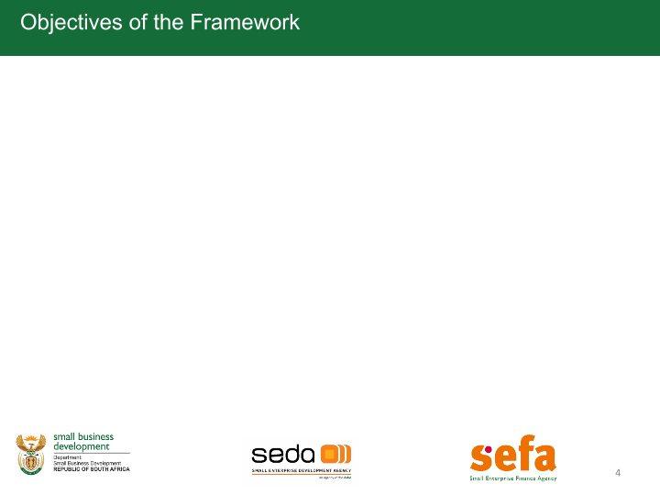
High Impact Projects
Project/targeted support | Project Focus/ Outcomes
Lebombo Secondary Cooperative | Cooperative members were capacitated on cooperative governance during the period under review. Seda appointed a Service Provider to determine further interventions for improvement, growth, and sustainability. The Department of Agriculture provided them with a grant of R3.5 million for the acquisition of seedlings and implements. Cotton SA continues with the provision of technical support.
Merseta | Seda will train Small Enterprise in the Automotive Trade Sector as well as facilitate Artisan Recognition of Prior Learning (ARPL). Merseta to provide the budget
Export Credit Insurance Corporation (ECIC) | The MOA between ECIC and Seda, TTA will send a proposal with potential clients to ECIC. TTA will receive an amount R1, 6 Million for the current financial year for clients approved under ECIC. The amount remaining in ECIC budget is only R 294 520. Seda awaits a payment to procure/adjudicate for ECIC for 2022/2023 to cover the shortfall.
British High Commission – Digital Access Programme | The British High Commission has partnered with the Global Cyber Alliance to develop the Digital Access Programme(DAP). Officials from Incubators supported by STP have been partaking in a train the trainer programme on cyber security. The training was attended by over 50 participants from the different hubs. These participants were trained on cyber security including the POPIA Act. The training ended with a certificate handover function at the CSIR Convention Centre. The occasion was graced by HE, the British High Commissioner SA.

Slide 33
High Impact Projects
Project/targeted support | Project Focus/ Outcomes
Cherrie Blair Foundation | This is a partnership with Cherrie Blair Foundation and GIBBS. Seda will train 2500 women-owned businesses on HerVenture App, an e-learning platform. Seda, through its network, will be responsible for the recruitment of the participants, assisting women owned businesses to download and utilize the HerVenture APP.

Slide 34

Thank You!
Thank You!

Slide 35
