Slide 1
Western Cape Government and Kannaland Municipality
PORTFOLIO COMMITTEE BRIEFING
Kannaland Municipality: Status Update and Support Going Forward
Adv G Birch
23 November 2022

Slide 2
Index
Part A: Historic Overview: Support, Interventions and Involvement (DLG & PT)
Part B: Current Status Quo (Municipality, PT and DLG perspectives)
Part C: Way forward: Support Package (including financial stability – DLG & PT)

Slide 3
PART A
Historic Overview: Support, Interventions and Involvement (DLG and PT)

Slide 4
Timeline: Support and Intervention
Year | Support Initiative | Status
2004 | Project Consolidate – Recovery Plan | Support Plan in place Functional committee driving implementation of plan R1.6 m
2005 | Project Consolidate –Recovery Plan: | Support Plan in place Functional committee driving implementation of plan R21.3 m
2006 | Project Consolidate – Recovery Plan | Support Plan in place Functional committee driving implementation of plan R2.5 m
2007 | Project Consolidate – Recovery Plan | Support Plan in place Functional committee driving implementation of plan R4.9 m
2008 | Project Consolidate – Recovery Plan | Support Plan in place Functional committee driving implementation of plan R2 m
2004- 2008 | R33 941 960 - was provided to Kannaland by both National and Provincial Sector Departments in support of projects identified under the Project Consolidate Programme.

Slide 5
Timeline: Support and Intervention (2)
Year | Support Initiative
2010 | Kannaland was nominated to form part of the LGTAS (Local Government Turn Around Strategy) programme
2011 | 2011 Local Government Elections - Mr Morne’ Hoogbaard was appointed as Municipal Manager and Mr Nigel Delo as Chief Financial Officer. DLG supported by Provincial Treasury developed a support plan for this purpose (LGTAS). Projects included amongst others: Rehabilitation of Schoongezicht road; Development of a Spatial Development Framework; Development of a Human Settlements Strategy; Securing land for Zoar Cemetery; Mediation with Eskom regarding the arrear Eskom Account; and Other projects

Slide 6
Timeline: Support and Intervention (3)
Year | Support Initiative
2014 | COGTA, DLG, PT and various Provincial Sector Departments reviewed the LGTAS with a view to bring it in line with the principles of the Back-2-Basics programme. In support of this plan, the Provincial Government allocated both resources in the form of funding and human resources to support identified projects. The Back-2-Basics programme – activated and functional A number of critical projects were implemented, but the completion of individual projects did not contribute to improved governance, stability and service delivery in the Municipality. A lack of ownership and entrenched mismanagement and fraud plagued the Municipality during this period.

Slide 7
Timeline: Support and Intervention (4)
Year | Support Initiative
2016 (First Intervention) | Local Government Elections: Change in political leadership - coalition of the Democratic Alliance and African National Congress. New Council inherited a Municipality facing serious governance, financial and service delivery challenges. Outstanding debts of over R75 mill and creditors amounting to R69 million. DLG supported by the PT, undertook a diagnostic process with a view to re-visit and refine the Municipal Support Plan, B-2-B support plans. On 7 December 2016, the Provincial Executive decided to intervene in the Municipality in terms of section 139(5) of the Constitution, read with sections 139(1) and 141 to 142 of the MFMA. Actions included: Preparing a financial recovery plan for the Municipality and; DLG and PT with support from all relevant national and provincial departments to develop and implement a targeted support package to address the immediate governance, operational and technical challenges.

Slide 8
Timeline: Support and Intervention (5)
Year | Support Initiative
2017 | The financial recovery plan for the Municipality was finalised following the consultation and public participation processes, and the criteria set out in the MFMA. On 8 March 2017, the Provincial Executive resolved to impose the financial recovery plan on the Municipality, subject to the approval of the Provincial Minister: Finance, in accordance with the requirements of section 139(5) of the Constitution, read with the relevant provisions of the MFMA. The DLG and PT, together with other national and provincial departments and stakeholders, provided extensive support in implementing and reviewing the plan on an ongoing basis, in line with the changing needs of the Municipality. During such a session the Municipality indicated (i) limited progress had been made in giving proper effect to the said plan to date; (ii) is not in a position to take executive measures necessary to give effect to such plan; and (iii) the Provincial Executive needs to take certain actions to ensure the proper implementation of the said plan.

Slide 9
Timeline: Support and Intervention (6)
Year | Support Initiative
2018 | On 5 December 2018, the Provincial Executive resolved to assume responsibility, in terms of section 139(5)(c) of the Constitution, for the implementation of the financial recovery plan, given that the Municipality was unable to properly implement the FRP.
2019 | Significant gains were made in achieving the aims of the approved financial recovery plan after the appointment of an Administrator (Financial Recovery).
2020 | At a Special Council Meeting, the Municipal Council resolves to lift/terminate the section 139(5)(c) intervention, and the FRP (November 2020) The Acting Deputy Executive Mayor notifies the Administrator (FR) that his services have been terminated, and demands that the Administrator (FR) vacates the offices of the Municipality (December 2020) The Municipal Council, at an intended Special Meeting, sets out to re-instate a number of dismissed employees The Minister: Local Government urges the Municipal Council to refrain from and immediately cease unlawful conduct (December 2020) PT initiated process to review and amend FRP – National Treasury’s Municipal Financial Recovery Service led process to develop amended FRP

Slide 10
Timeline: Support and Intervention (7)
Year | Support Initiative
2021 | WCG launches application to interdict unlawful conduct by the Municipal Council. Interdict granted by Western Cape High Court to prevent Municipality from taking unlawful action. FRP set aside and declared unlawful due to process followed to develop the plan not complying with legislated process. Local Government Elections held and new Municipal Council appointed
2022 | PT and DLG monitoring status of Municipality. Provincial Government diagnostic assessment oversight visit 16 to 17 August 2022. Based on the outcome of this diagnostic assessment, targeted support to be provided by various organs of state to the Municipality.

Slide 11
Timeline: Support and Intervention (8)
Year | Intervention
2021-2022 | Throughout this period, Municipal governance and financial management deteriorated and regressed. The Municipality has experienced significant political instability since the November 2021 local government elections. The Municipality has been governed by various unstable coalitions which has destabilised the administration in the Municipality which, in turn, has adversely impacted the Municipality’s finances and ability to deliver services.

Slide 12
PREVIOUSLY INSTITUTED SUPPORT (2016 – 2020)
S154 Support Package Financial and other Resources allocated Financial Recovery Plan (FRP)

Slide 13
Reviewed Support Plans: Post 2016 LG Elections
Post the 2016 Local Government Elections, Kannaland Municipality saw a change in political leadership.
The new Council requested the Department of Local Government and Provincial Treasury to conduct a Diagnostic Assessment which revealed a number of critical financial, service delivery and governance failures.
A Financial Recovery Plan(FRP) and targeted support plan was developed to strengthen the implementation of the financial recovery plan and to address governance and service delivery failures.
Examples (not comprehensive) of the progress made is captured in the slides to follow – this indicates that where leadership drives support packages a turn around is possible.

Slide 14
Support Progress: Projects Completed
GOVERNANCE
Reporting and Compliance: The tabling of the Draft Budget for the 2019/20 MTREF and the adoption of the Final Budget for the 2019/20 MTREF
Oversight and Governance Training for Councilors on Code of Conduct, Rules of Order, Roles & Responsibilities, Ethics and MPAC. Updated Municipal Code comprising of all its By-Laws. Provision of a Draft Standard Rules of Order Review of Delegations.
ADMINISTRATION
Shared Services Arrangements with Garden Route DM: Internal Audit Risk Management Fire Fighting Services ICT Services
Specific HR matters: Contract appointment and terminations were reviewed. Disciplinary matters were attended to.
Stability in the Administration Processes put in place to fill vacant Senior Management positions
FINANCIAL MANAGEMENT
Weekly monitoring of the Financial Recovery Plan and reporting on progress. SIME and TIME process for budgeting. Municipal visits for budgeting process assisting the municipality in identifying revenue streams and expenditure line items budget cuts and revenue optimization opportunities. AFS and SCM Expert, FRP Implementation Manager. Capacity building of staff through transversal training.

Slide 15
Support Progress: Projects Completed (2)
PUBLIC PARTICIPATION
Development and monitoring of Citizen/ Client Service Charters. Ward Committee Functionality: Training, Know Your Ward Committee Campaigns. Development and review of Ward Committee Operational Plans. Development and review of Public Participation and Ward Committee Policies. Design a new municipal Corporate Identity. Various other communication initiatives were supported to ensure community awareness, e.g., drought.
SERVICE DELIVERY
Storm Water and Roads Master Plans. Electricity Master Plan. Infrastructure Growth Plan. Repair and maintenance Framework. Human Settlements Plan Refuse is removed on a daily basis as per Municipal Schedule Landfill site is maintained on a daily basis and refuse is covered. Refuse is removed on a daily basis as per Municipal Schedule Landfill site is maintained on a daily basis and refuse is covered.
DRAP: Water Security Programme: Kannaland has been supported through this initiate by making a drought engineer, geo-hydrologist and additional funding available to ensure water security.

Slide 16
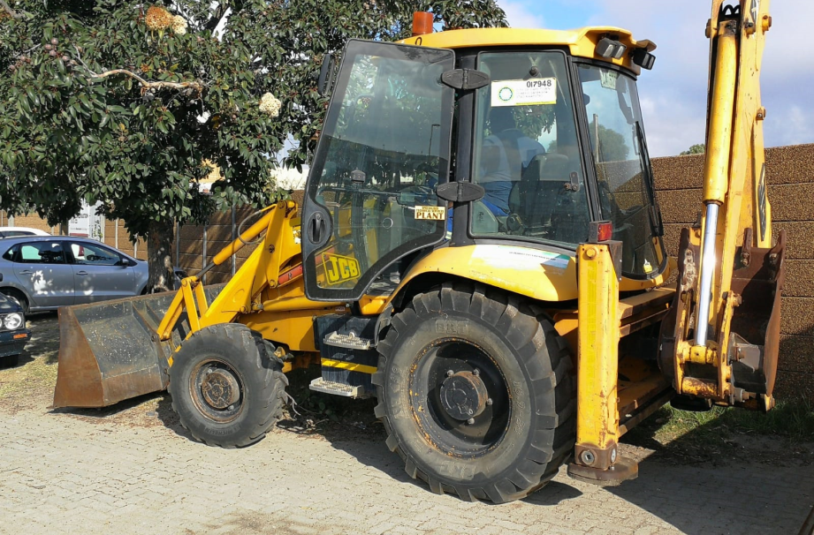
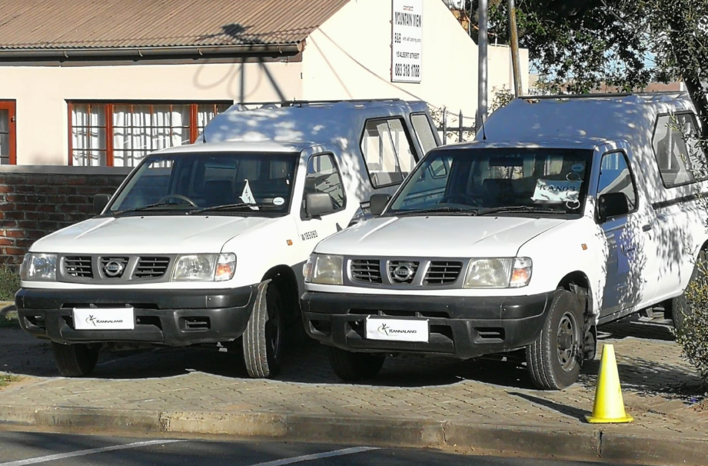
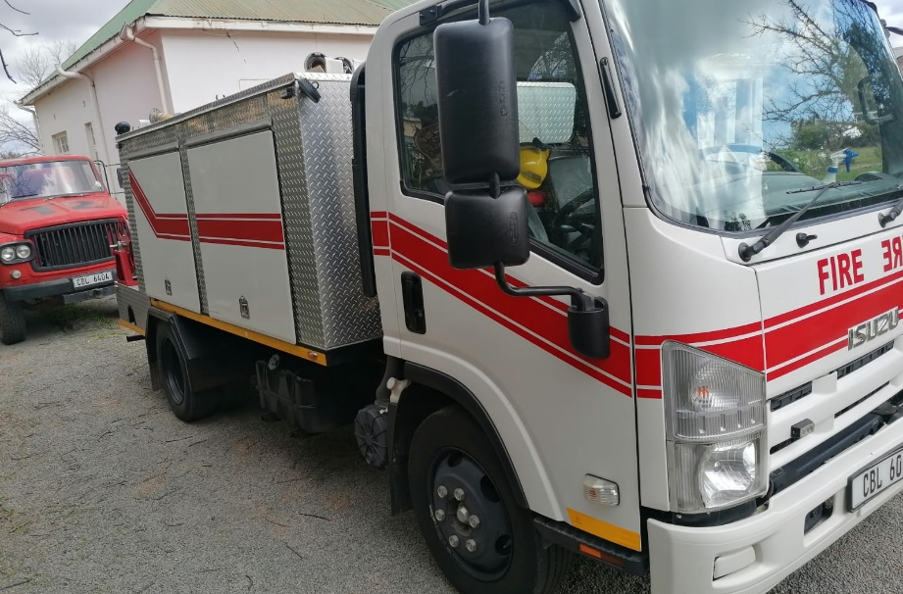
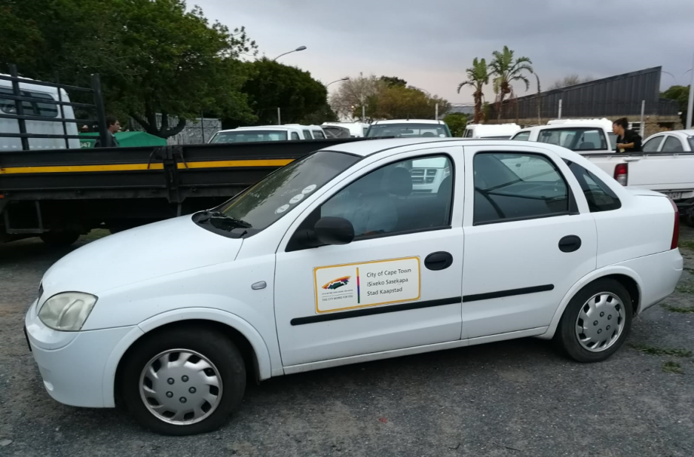
Special Support: Service Delivery
DLG aided with financial and logistical support to purchase, 10 vehicles and 1 fire truck to the value of R494 320.00 and R730 000.00 respectively.

Slide 17
Additional Resources Allocated (2016 – 2020)

Slide 18
Financial Resources Allocated
DEPARTMENT OF LOCAL GOVERNMENT
Financial Year | Grant | Amount
2016/17 | Capacity Building Grant | R 1 745 000
2017/18 | Capacity Building Grant | R 550 000
2018/19 | Capacity Building Grant | R 1 300 000
2019/20 | Intervention Grant | R4 821 000
2019/20 | Capacity Building Grant | R495 000
DEPARTMENT OF PROVINCIAL TREASURY
Financial Year | Grant | Amount
2018/19 | Intervention Grant | R1 730 000
2019/20 | Intervention Grant | R4 821 000

Slide 19
Human Resource Support Allocated
RESOURCE ALLOCATED | STAKEHOLDER
Recovery Plan Implementation Manager: Feb – May 2017 Acting Municipal Manager: March – May 2017 Recovery Plan Implementation Manager: June – Sept 2017 Acting CFO: June – Aug 2018 Technical Service Manager: June – Nov 2018 Human Resources Support: Jan – June 2017 | Department of Local Government
Garden Route District Risk Officer’s x 2: Ongoing MISA Programme Manager Western Cape: Ongoing Engineer: MISA: Ongoing Director: Development Planning: Hessequa Municipality: Ongoing Director: Corporate Services: Mossel Bay Municipality appointed Administrator FRP: Kannaland Municipality: March – Aug 2019 Manager NCCS: Statistics SA: Ongoing LG Budget Coordinator: National Treasury (NT): Ongoing MFIP Support (NT): Ongoing | Partners

Slide 20
PART B – KANNALAND MUNICIPALITY
Current Status Quo: Municipal Perspective
Presenter: Mr K Jordaan
Acting Municipal Manager

Slide 21
Historic Institutional Arrangements
The following towns are within the municipal area;
Ladismith
Calitzdorp
Zoar
Van Wyksdorp
Established with Executive Mayor and Ward Committee System (2000);
Currently has seven (7) councillors;
The Municipality was placed under administration from 2 Dec 2016 to 1 March 2021;
The municipality is a Grade 2 authority, in terms of the Office Bearers Act; and
Population within municipal boundary – 22 244.

Slide 22
Our own listed Management Action Plan
Cashflow Position (Eskom Debt Agreement)
Service Delivery Issues
Organisational Structure
Legal action instigated by municipality as applicant
Appointment of Staff from 1 January 2022
Adjustment Budget (Payment Rate)
Strategic Management
Office accommodation
Staff discipline
Land Audit
Credit Control and Debt Collection

Slide 23
The Biggest Institutional Challenges
Current Cash Position
Total Creditors (31October) - R69M
Cash in Bank (4 Nov) - R852k
EPWP funds - R464k
Chief Financial Officer post vacant (Head Hunting);
Auditor- General is finalising the 2021/2022 audit;
Councillor litigation costs still unknown (To be investigated); and
Annual bonus payment paid end November.

Slide 24
What needs to be done…
Debt Collection needs to improve effectively.
Stability must be established within the administration.
Consequence management is needed.
Policies and procedures need to be reviewed and amended (not business as usual).
Cost Containment measures.
Mentorship and In-service training.
Review Operating Procedures vs Job Tasks.
Review current Service Delivery Mechanisms.
Work on Image of the Municipality (quick wins).
Teamwork / Partnerships (Business Sector - Inclusive).
Town Planning assistance promote development (cut red tape).

Slide 25
Council Strategic Session
Revision of the Macro Structure in terms of Staff Regulations:
Financial Services Directorate
Community Services Directorate
Infrastructure Directorate
Corporate Services Directorate
Office Accommodation
The internal management action plan revision.
Challenges and Quick wins
Technical Services
Corporate Services
Community Services
Human Resource Management

Slide 26
PART B – WESTERN CAPE GOVERNMENT (PT)
Current Status Quo: Financial Governance
Presenter: Steven Kenyon

Slide 27
Financial Management Challenges
The Municipality still faces significant financial challenges, including:
Adoption of an unfunded budget for 2022/23
Small revenue base, weak collections and high staff costs and losses on services mean the municipality struggles to build cash reserves. Hence facing liquidity challenges.
Weak cash position has led to non-payment of creditors such as Eskom, AGSA (resulting in the build-up of large debts on which interest must be paid.
Weaknesses in financial management mean there is a poor link between budgeted and actual spending.
A lack of oversight, SCM risks and non-compliance resulting in opportunity for non-value for money spending and excessive occurrences of irregular, fruitless and wasteful and unauthorised expenditure. The amount and volume of supply chain management (SCM) deviations remains a critical concern.
Qualified audit opinion from the Auditor-General for the 2020/21 financial year with emphasis on financial affairs of the municipality which were not in order.

Slide 28
Unfunded Budgets
The Municipality has adopted unfunded budgets since 2018/19 and for the 2022/23 financial year the budget is still unfunded.
Municipality has not implemented the measures needed to balance revenue and expenditure and achieve a funded budget.
The Municipality has adopted a Budget Funding Plan and reports regularly on its implementation.
However, Implementation of the Budget Funding Plan has been too slow and targets have been missed – hence the failure to move to a funded position.

Slide 29
Financial Management - Capacity Constraints
The finance unit in Kannaland is facing severe capacity constraints:
Resignation of key management in the finance unit (BTO Manager and Accountant) has left the municipality without the necessary skills or proper direction for sound financial management.
The current SCM structure does not meet the policy requirements and does not provide for an adequate number of officials necessary to maintain an effective system of SCM.
The Municipality struggles with compliance with legislation in terms of completion, approval, submission and publishing of strategic documents such as the SDBIP, Annual Report and MFMA Section 52(d) reports.
Provincial Treasury is also concerned with the credibility of non-financial performance information which was raised as material finding during the 2020/21 audit by AG.

Slide 30
Support for Financial Management
Accountability for financial management capability rests with the municipality.
Provincial Treasury has tried several different ways to provide capacity to the Municipality including:
Grant funding (including funding positions in the municipality);
Support through expertise deployed to the Municipality (funded by National Treasury); and
Meetings, advice and support.
Current approach to support includes:
Engaging new management on establishing a formal “cashflow committee” to prioritize revenue and spending decisions and oversee implementation;
Capacity support deployed to support Kannaland on part-time basis; and
Continued advice and close monitoring of Budget Funding Plan.

Slide 31
PART B – WESTERN CAPE GOVERNMENT (DLG)
Current Status Quo:
Governance, Administration and Service Delivery
Presenter: Adv G Birch

Slide 32
Governance
The composition of the Municipal Council of Kannaland Municipality is seven (7) Councillors.
The current political composition of Council is as follows: 3 ICOSA, 2 ANC, 1 DA and 1 KIP.
Coalition arrangements in the Municipality are unstable, with coalition partnership changing constantly-
Post-election coalition partnership between ICOSA & ANC;
19 January 2022: Motions of No Confidence: Political Control by way of a coalition between ANC, KIP and DA;
21 October 2022: Motions of No Confidence: political control by way of coalition between ICOSA and KIP; and
This led to Council being unstable and dysfunctional for intermittent periods. An internal political dispute furthermore caused ongoing litigation between political factions within the Council and legal proceedings against the Electoral Commission, the MEC for Local Government & Others.

Slide 33
Governance (2)
The Municipality’s Rules of Order is required to be reviewed; Province has provided all Municipalities with a Draft Standard Rules of Order, including Kannaland Municipality and has offered the Municipality support in adapting the Draft Standard Rules of Order to meet its needs.
The Department of Local Government will furthermore assist the Municipality with the development and review of its By-laws and Policies.
It was identified that the Municipality did not review its System of Delegations after the election of the new Council; the Department will furthermore support the Municipality in relation to the review of the System of Delegations.
Training and capacitation will furthermore be provided to the Municipality on inter alia, Roles and Responsibilities, Code of Conduct for Councillors, capacitation of MPAC, the recruitment process in terms of the Appointment Regulations for Senior Managers.

Slide 34
Administration
There has been a pattern of poor governance within the Municipality over a long period, which includes the following:
Prolonged vacancies in respect of critical posts causing instability within the administration.
The Municipality has four (4) senior manager posts. Three of these critical posts are vacant, including the posts of Municipal Manager, Executive Manager: Financial Services and Executive Manager: Infrastructure Services and Community Services.
There was a prolonged suspension of the former MM (Mr Reynold Stevens), which culminated in a termination of his employment by settlement. During this period of suspension and subsequently, the post has been occupied by various Acting incumbents.

Slide 35
Administration (2)
On 21 October 2022, Council appointed Mr Keith Jordaan as Acting MM and Mr Morne Hoogbaard as Executive Manager: Infrastructure Services and Community Services. Mr Jordaan was previously dismissed by George Municipality for financial misconduct. The Department has sought a senior counsel opinion on enforcing Regulation 18 of the Appointment Regulations, which prohibits the re-employment of a dismissed person for a prescribed period.
Correspondence has furthermore been sent to the Municipality, informing it that Mr Hoogbaard does not meet the qualifications to be appointed as Executive Manager: Infrastructure Services, and affording it an opportunity to take remedial action, failing which the MEC will institute legal proceedings as to the invalidity of the appointment.
The post of Executive Manager: Financial Services is currently vacant, with the Municipality attempting to source an acting incumbent.

Slide 36
Service Delivery
Critical posts are vacant including Director Technical Services and Manager Electrical & Mechanical services.
Streamlined and formalized complaints procedure system required.
High level of standby and overtime claims in the municipality.
Procurement remains a stumbling block with regards to service delivery, due to delayed processes and lack of communication.
The majority of fleet in the municipality is in a poor and unroadworthy condition.
Pothole repairs, general road maintenance, tools, plant, and equipment are all matters to be addressed in the roads and stormwater division.
Ageing of water infrastructure leading to pressure problems in the networks, leaks and pipe bursts, water losses, faulty pumps, valves, meters and fittings.
Raw water and potable water storage capacity required, disinfectants, water monitoring and testing to be carried out in compliance with Blue Drop.

Slide 37
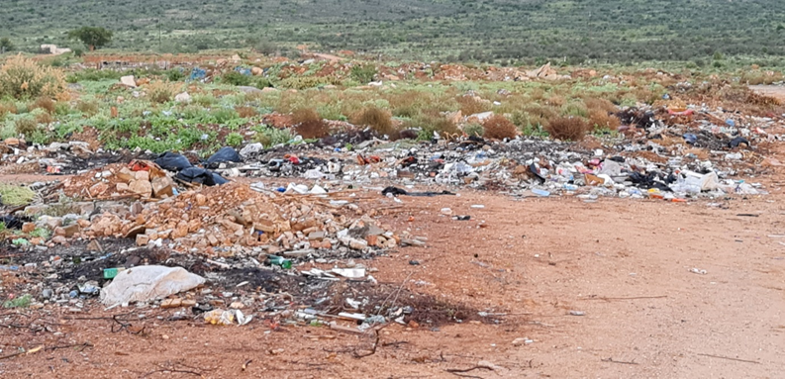
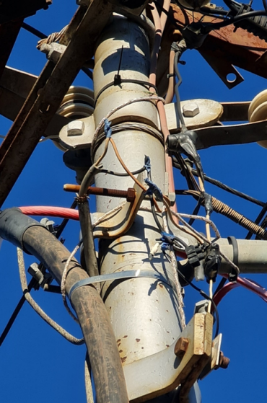
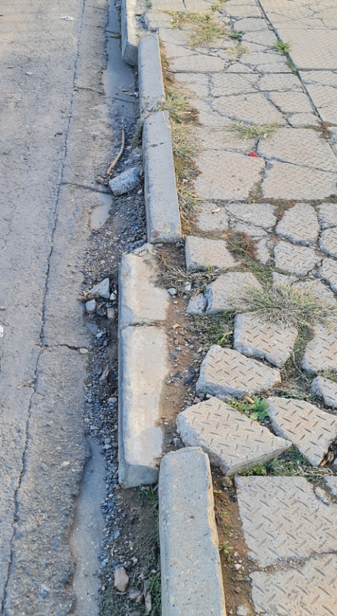
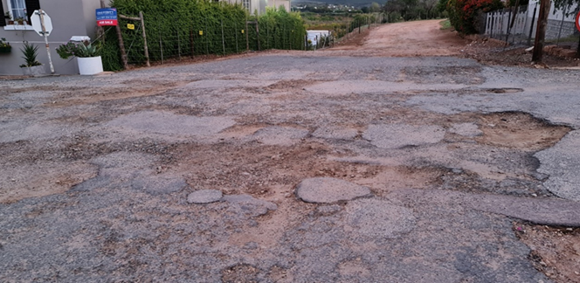
Service Delivery (2)
Attend to the challenge of intermittent water supply, ensuring continuous supply of potable water.
Directives and non-compliances of WWTWs, such as pollution of water course through sewer spillages, lack of required qualified process controllers, and water quality monitoring programme in accordance with Green Drop requirements.
Water and Sanitation Masterplans, O&M manuals, tools and equipment, preventative maintenance planning are required.
Upgrading of the electrical supply grid, reinforcing of electrical network to ensure supply reliability.
Vandalism of infrastructure is a major challenge in the municipality, as well as the lack of proper record keeping and administration within the technical services directorate.

Slide 38
Service Delivery (3)
Lack of electrical spares such as transformers, surge arrestors etc. as well as a general lack of generators at critical infrastructure to ensure operations continue during power outages.
THREE (3) KEY RECOMMENDATIONS
Appointment of technical director and other critical posts as well as capacitation of personnel as discussed above: Kannaland Municipality (KLM) responsible.
Investigate other sources of funding for infrastructure maintenance: KLM/PT/DLG.
Provide coordinated technical support from other government entities to enhance service delivery and capacitate personnel: Coordination by DLG.

Slide 39
PART C – WAY FORWARD
Support Package
(Including Financial Stability - DLG, PT, SALGA)
Presenter: Dr S Greyling

Slide 40
Draft Section 154 Support Plan aligned to Acting Municipal Manager’s Findings
A Support Plan has been developed to address the Diagnostic Assessment’s key findings, as follows: DLG: initiatives to support KLM:
Development of several By-Laws;
Councillor training on Rules of Order, Code of Conduct, MPAC etc.;
Organisational Structure and Performance Management Systems;
Appointment of staff;
New staff regulations;
Service Delivery issues in Van Wyksdorp;
Fleet Management;
Repairs and Maintenance of roads in Ladismith;
Reduce High water losses (water conservation and demand management); and
Replacement of Water and Electricity meters in Ladismith

Slide 41
Draft Section 154 Support Plan aligned to Acting Municipal Manager’s Findings (2)
DLG: initiatives to support KLM (2):
Review of ICT Policies;
Development of IT Strategy, IT Steering Committee;
Data Back-up and Disaster Recovery;
Public participation strategies;
Municipal Communication Strategies; and
MPRA
Other Departments: initiatives to support KLM:
In Year Monitoring of PT;
Land Audit – New Burial spaces – DRDLR;
Waste Management Strategies – DEADP; and
Assist with management of Sport fields - DCAS

Slide 42
Draft Section 154 Support Plan aligned to Acting Municipal Manager’s Findings (3)
The next step in the process is to allow Council to adopt the Diagnostic Report findings and Draft Support Plan.
The Support Plan will then be finalised and implemented.
A Steercom consisting of all relevant stakeholders will be set up to manage progress on projects and / or address challenges and report back to municipal and provincial structures.

Slide 43
Adv G Birch
DEPARTMENT OF LOCAL GOVERNMENT
Tel: +27 21 438 3113
Gary.Birch@westerncape.gov.za
www.westerncape.gov.za

