Slide 1
AUDIT ACTION PLAN
Frik Nieman
Fnieman@dcdt.gov.za

Slide 2
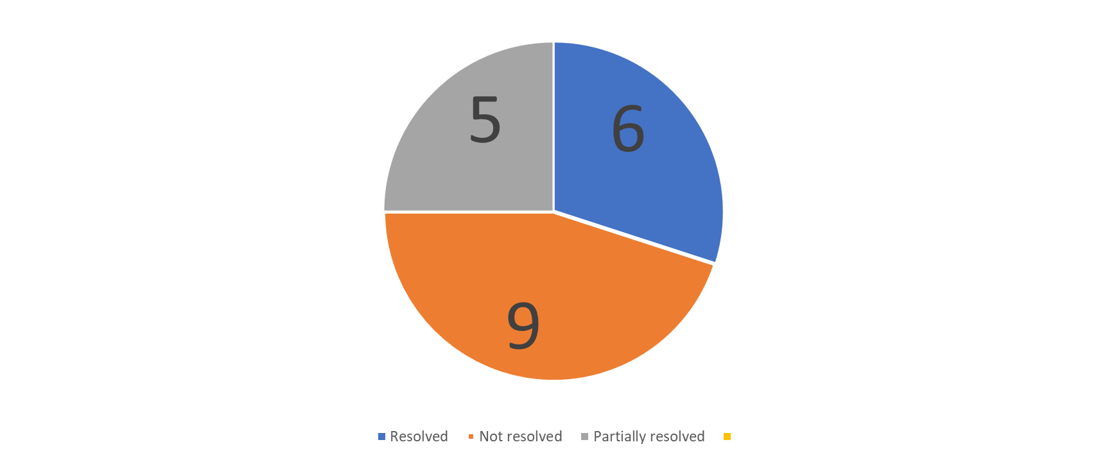
Breakdown of findings for 2021/22
AUDIT FINDINGS 2021/22

Slide 3
Breakdown of findings for 2021/22
AUDIT FINDINGS 2021/22
Unit | Risk Category | Number of Findings | Resolved | Unresolved | Partially Resolved
Finance | Consequence management | 2 |  | 2
 | Related Parties | 1 | 1
 | Compliance | 1 |  | 1
 | Loans | 1 | - |  | 1
 | BBBEE | 1 | 1
 | Contingent liability | 1 | 1
 | Procurement and contract management | 1 | 1
Total |  | 8 | 4 | 3 | 1
Human Resource | Human Resource | 2 |  | 2
 | Human Resource/Dev & Training | 1 |  |  | 1
 | Fruitless Expenditure | 1 |  | 1
Total |  | 4 | - | 3 | 1
Broadcast Digital Migration | Performance Information | 2 |  |  | 2
Information Technology | Information Technology | 3 | 2 |  | 1
Performance Management | Performance Information | 3 |  | 3
GRAND TOTAL |  | 20 | 6 | 9 | 5

Slide 4
Breakdownfff of findings for distribution of audit findings -2021/22 financial year

Slide 5
Action Plan - Finance
Finding | Root Cause | Action Plan | Due date
IRREGULAR EXPENDITURE Non-compliance with the National Treasury Irregular expenditure Framework No evidence that determination assessments conducted Consequence management not implemented SABC LOAN National Treasury requested on 25 July 2022 to repeal Section 30 of the Exchequer Act. It is hopeful that it be resolved before 31 March 2022. | Non-alignment with NT Irregular Expenditure framework Inadequate oversight mechanism/process that monitors progress of the assessment of irregular expenditure No dedicated resource Unavailability of records The Exchequer Act no 66 of 1975 was repealed in its entirety by section 87 of the PFMA (Act 1 of 1999) except for section 28 to 30 Unfamiliarity with the act | Terms of reference amended. Training arranged for all the Loss Control Committee members on 3 & 4 November 2022. Labour Relations assisting with consequence management. 2 Dedicated resources appointed to deal with cases. New Chairperson appointed The Financials were updated accordingly. A letter was sent to National Treasury on the 25th July 2022 requesting section 28 to 30 of the Exchequer act to be repealed, | Resolving Irregular Expenditure is ongoing. Awaiting response from NT regarding repealing of section 28 to 30 .

Slide 6
Action Plan – Performance Management
Finding | Root Cause | Action Plan | Due date
Reported achievement not supported by accurate and complete listing Indicators not well-defined and targets not specific and measurable Nonalignment of prioritised indicators as per the ENE and APP. | Inaccurate and unreliable listing Inadequate processes and procedures for the collection, collation and verification of information Inadequate quality checks Inadequate quality checks on Indicators & Targets Constant revision of the APP without considering the final ENE | Addressing the findings are ongoing. Will be resolved by year end. APP being amended and reporting will be realigned accordingly. Department is currently developing APP and will ensure that APP indicators are well defined through engagement with relevant stakeholders including Internal Audit Unit and DPME official. SPM has worked closely with DCDT Finance Office in engaging National Treasury to ensure that APP indicators are aligned with ENE indicators. The last engagement with National Treasury was on 07 October 2022. | Findings should be addressed by 31 March 2023 Annually Annually

Slide 7
Action Plan – Human Resource
Finding | Root Cause | Action Plan | Due date
Delays in developing and implementing Departmental Human Resource Plan. The procurement of training is not in compliant with the National Treasury Instruction. Fruitless and Wasteful Expenditure disclosure note understated on the AFS | Delays in finalisation of the funded and approved Organizational Structure. Late approval of the amended Strategic Plan. Departmental policy not in line with NT Supply Chain Management laws and regulations | DCDT draft structure was presented to EXCO on 31 October. Work in progress. Letter was forwarded to Treasury on 26 September to request exemption. Circular was issued to inform all staff to follow 3 quotation rule with all short courses. Irregular referred to Labour Relations to investigate and suggest consequence. Finding on fruitless and wasteful expenditure iro recruitment still to be resolved. | Dependent on approved structure 31 December 2022 31 March 2022

Slide 8
Action Plan – Information Technology
Finding | Root Cause | Action Plan | Due date
Inadequate monitoring of IT Admin activities Inadequate password configurations on the active directory and firewall The IT steering committee did not meet quarterly to discharge its duties | Lack of documented procedures for administrator's activities. Non adherence to Password Policy Working remotely No IT steering committee in place to discharge its roles and responsibilities. | The Standard Operating Procedure (SOP) for reviewing the administrators activities has been developed and an independent person has been identified to review administrators activities The password remembrance parameters on the firewall has been reconfigured to align with the AD Standards. The screensaver settings on the AD has been set to 300 seconds (5 minutes) The IT Committee is in place and meeting quarterly | 31 December 2022 Implemented Implemented

Slide 9
Action Plan – Broadcast Digital Migration
Finding | Root Cause | Action Plan | Due date
Management does not have adequate internal control process in place for the collecting, collating and verifying the data related to the Broadcasting Digital Migration(BDM) indicator and related target Reported achievement not supported by accurate and complete listing – Analogue Switch-Off | Inadequate monitoring and evaluation emanating from insufficient human capital in the project management office Lack of automated systems regarding the STB life-cycle, from assignment to a beneficiary triggered by registration until actual installation Inadequate monitoring and evaluation emanating from insufficient human capital in the project management office | The APP is being amended for both findings so that DCDT report on progress, Sentech on physical installations and USAASA on the funding. This will prevent repetition of the finding. | 30 September 2022 30 September 2022

Slide 10
Action Plan
Finance | Performance | HR | IT | BDM
3 unresolved findings relate to Irregular Expenditure. TOR amended. Training arranged for all the Loss Control Committee members on 3 & 4 November 2022. Labour Relations assisting with consequence management. 2 Dedicated resources appointed to deal with cases. New Chairperson appointed. Resolving Irregular Expenditure is ongoing. National Treasury requested on 25 July 2022 to repeal Section 30 of the Exchequer Act. It is hopeful that it be resolved before 31 March 2022. | Addressing the findings are ongoing. Will be resolved by year end. APP being amended and reporting will be realigned accordingly. Findings should be addressed by 31 March 2023.. | DCDT draft structure was presented to EXCO on 31 October. Work in progress. Letter was forwarded to Treasury on 26 September to request exemption. Circular was issued to inform all staff to follow 3 quotation rule with all short courses. Irregular referred to Labour Relations to investigate and suggest consequence. Finding on fruitless and wasteful expenditure iro recruitment still to be resolved. | SOP for reviewing administrator activities was done and routed for approval. | Quarter 1 and 2 will be reported on APP and on numbers of installations. However, the APP is being amended to that DCDT report on progress, Sentech on physical installations and USAASA on the funding. This will prevent repetition of the finding. APP will be presented to Cabinet in Quarter 3.

Slide 11
AUDIT FINDINGS 2020/21

Slide 12
Breakdown of findings for 2020/21

Slide 13
Action Plan
Finance | Governance | HR
The unresolved finding relates to Irregular Expenditure. TOR amended. Training arranged for all the Loss Control Committee members on 3 & 4 November 2022. Labour Relations assisting with consequence management. 2 Dedicated resources assigned to deal with cases. New Chairperson appointed. Resolving Irregular Expenditure is ongoing. | Finding on policies in progress. Progress on Quarter 1 and 2 of 2022/23 financial year as follows: 60 Policies approved 6 Policies partially concluded 6 Policies still outstanding 2 Policies were put on hold | DCDT draft structure was presented to EXCO on 31 October. Work in progress. Filling of vacancies depending the approval of the new structure. Vacancies in Administration in the process to be filled in line with DPSA directive on Programme 1 Generic structure

Slide 14
Material Irregularities
DEFINITION:
Non-compliance with, or contravention of, legislation, fraud, theft or a breach of fiduciary duty identified during an audit that resulted in or is likely to result in a material financial loss, the misuse or loss of a material public resource, or substantial harm to a public sector institution or the general public.
IRREGULAR EXPENDITURE
Total Irregular amount to R233 million. R78 million is awaiting court action,R58 million is under investigation and R133 million submitted to NT for condonation.
CHALLENGES
Availability of documentation
Loss of institutional memory
Misclassification of irregular expenditure
WAY FORWARD
Due to urgency, dedicated unit be created to address outstanding matters
ACFO will meet with Treasury to discuss lack of documentation and information
Seek guidance from Treasury on the above
Register of irregular expenditure will be reclassified for purposes of accurate reporting

Slide 15
Fruitless and Wasteful Expenditure
Transaction Number | Date reported to AO/AA | Details of the transaction/ incident | Amount confirmed of Fruitless and Wasteful Expenditure
1 | 24/06/2010 | Termination of 112 ECC: Security Services and Accommodation Charges | R 7 562 519,71
2 | 26/06/2010 | 112 ECC: sub-letting to Plan B | R 1 042 559,00
3 | 16/08/2022 | Cancellation fee of venue | R 55 683,34
TOTAL |  |  | R 8 660 762,05

