Slide 1
PORTFOLIO COMMITTEE ON COGTA
STATE OF AMATHOLE DISTRICT MUNICIPALITY
DATE: 22 NOVEMBER 2022
1

Slide 2
TABLE OF CONTENT
Part 1
INTRODUCTION
Part 2
PILLARS OF LOCAL GOVERNMENT SUSTAINABILITY & GOVERNANCE
Part 3
KEY ACHIEVEMENTS & RISKS
PROGRESS ON THE IMPLEMENTATION OF FINANCIAL RECOVERY PLAN
Part 4
Part 5
Part 6
RECOMMENDATIONS
SUPPORT BY PROVINCIAL TREASURY

Slide 3
Part 1: INTRODUCTION
3

Slide 4
INTRODUCTION
Amathole District Municipality - Category C situated in the central part of the Province. It stretches along the Sunshine Coast from the Fish River Mouth and along the Eastern Seaboard to just south of Hole in the Wall along the Wild Coast. It is bordered to the north by the Amathole Mountain Range. It is comprised of six local municipalities: Mbhashe, Mnquma, Great Kei, Amahlathi, Ngqushwa & Raymond Mhlaba.
Provincial Executive has instituted an intervention in terms of Section 139(5) (a) of the Constitution. The intervention occurred in response to many challenges including difficulties in providing basic services, long term financial sustainability, the risk of not having sufficient funds to pay its staff due to the above average staff complement. Given the above and the urgency to ensure service delivery to communities and financial viability and sustainability, the development and the implementation of a Financial Recovery Plan (FRP) has been seen as a critical way forward.
The presentation provide an overview on the State of Performance of ADM; Compliance with MFMA, Achievements, Key Risks & Support by Provincial Treasury.
4

Slide 5
Part 2: PILLARS OF LOCAL GOVERNMENT SUSTAINABILITY & GOVERNANCE
5

Slide 6
PILLARS OF LOCAL GOVERNMENT SUSTAINABILITY AND GOVERNANCE
BACK TO BASICS PREMISED AROUND
Putting People First
Delivering Basic Services;
Good Governance;
Sound Financial Management; and
Capacity Building
National Treasury institutionalised:
  Local Government Accountability Cycle; and
  Pillars of Local Government Sustainability.
Above are at the core of strengthening Local Government Back to Basics primarily on:
  Good Governance;
  Sound Financial Management; and
  Capacity building to deliver Services.
The Pillars of sustainability is crucial for overall ideal municipality’s functional machinery;
Political and Administrative protocols inline with separation of responsibilities is centre to municipal good corporate image; and
Sustainable local government is central to satisfactory Service Delivery and stakeholder good relations.

Slide 7
Part 2: FINANCIAL HEALTH
7

Slide 8
FINANCIAL HEALTH
BUDGET
ADM has been adopting unfunded budgets for the past 5 years, the municipality experienced a decline in the reserves which initially triggered the unfunded position.
The 2022/2023 budget is currently unfunded as a result of the payables from exchange transactions which have been growing over the years, mainly attributed to the decrease in the cash and cash equivalents as well as a low collection rate for water and sanitation services:
8

Slide 9
FINANCIAL HEALTH
ASSESSMENT OF THE BUDGET:
The municipality has a low collection rate below 30 per cent which is way below the prescribed norm of 95 per cent as guided by MFMA Circular 71;
There is a concern pattern of high wage bill, showing signs of failure to manage human resources which will not be sustainable in the long run;
The trading services of Water & Sanitation are operating at a deficit meaning that the current tariffs are not cost reflective hence a funding gap exists on the budget of the municipality;
The employee related costs and remuneration of councillors are the largest cost drivers of the operational expenditure of the municipality at 49.9 per cent of the 2022/23 MTREF budget operational expenditure (as per the budget of the municipality);
The municipality has been implementing cost containment measures over the years as guided by MFMA Circular 96, however it has not resulted in a funded budget as it has other high operational expenditure cost drivers such as: security services, office accommodation rentals and the financial system;
The decline in the reserves of the municipality led to a decrease in the cash and cash equivalents;
The creditors balances have been growing over the years as the municipality could not afford to service them this is attributed to the growth in the operational expenditure
9

Slide 10
FINANCIAL HEALTH
TOTAL CREDITORS:
The payables from exchange transactions increased from R442.7 million (2019/2020) to R 563 million (2020/2021) Audited AFS;
The municipality owes the following major creditors (Water Board R 132.6 million , DWS, R18.4 million, Tech Mahindra R 23.5 million)
2018/19 - 30%
2019/20 - 23%
2020/21 - 25%
The COVID-19 pandemic had a significant impact on the affordability of municipal services which resulted in ADM writing off R1 billion of the outstanding debtors balances.
The municipality as a result of the drought incurred additional costs for water carting which also affected the collection rate as ADM could not billed for the form of delivery of the service.
DEBTORS COLLECTION:
10

Slide 11
FINANCIAL HEALTH
FINANCIAL RATIOS
The purpose of the assessment is to determine the financial health of the municipality taking into consideration the socio-economic conditions of the municipal area. The results of the financial ratios and norms are used to support financial decisions and to identify factors which may influence the financial sustainability of the municipality. It is also to enable timely corrective action where service delivery may be at risk.
Table above, reflect that ADM has not accounted for any impairment which is indicative of minimum assessments at year of indications of impairment, due to physical verification of assets not conducted promptly. With the low percentage of 1% on repairs and maintenance the municipality should have depleting assets that are not maintained with serious impact on distribution losses as well as service delivery.
11

Slide 12
FINANCIAL HEALTH
12
FINANCIAL RATIOS
In the table above, the collection rate is at a poor state, even though it has been improving, it is yet far from the required norm of 95%. The cash flow of the municipality is negatively impacted by this.
Noticeably, the debt write offs are at a soaring high as a percentage of the provision for bad debts. This may be due to data cleansing that needs to be done within the revenue system of the municipality. Net debtors days are improving and yet still vey high as compared to the required 30 days.
12

Slide 13
FINANCIAL HEALTH
FINANCIAL RATIOS
The monthly cash to cost have coverage has reduced to zero as a result of the financial strain that the municipality has been facing which includes low collection of revenue, increase of contracted services. Noticeably the current ratio has been depleting and is now at 0.42, far from the minimum requirement of 1.5.
13

Slide 14
FINANCIAL HEALTH
FINANCIAL RATIOS
In the table above, the creditors days have not improved looking at the three year analysis, it has remained at 212 days which is far above the norm of 30 days.
Salary bill has remained within the norm. Contracted services are within the norm, but a notable increase from R69 million in 2020 to R93 million in 2021 as been noted. The municipality is consistently increasing the use of consultants.
14

Slide 15
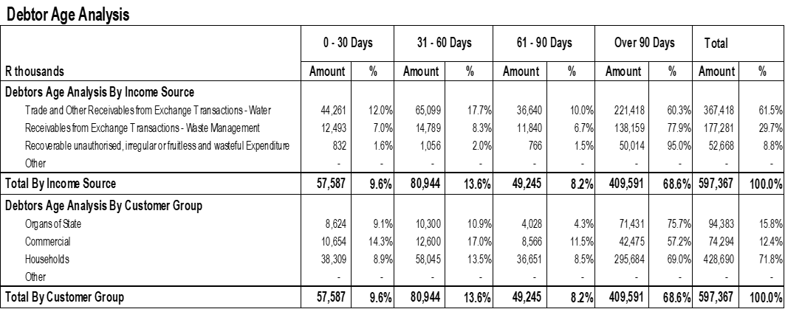
FINANCIAL HEALTH – IYM : SEPTEMBER 2022
Organs of the state are currently sitting at R94,383 million to date, which is equals to 15.8 per cent of the total debt. Commercial debtors are currently sitting at R74,294 million or equals to 12.4 per cent of the total debt.
It is important for the municipality to fully implement its credit control policy.
Households are sitting at R428,690 million or equals to 71.8 per cent of the debt. The demographic profile is rural in nature affecting the collection rate of the municipality and these are the highest consumers of the water and sanitation services.
ADM reported R409,591 million over 90 days which is equivalent to 68.6 per cent of the total debt, and this means that the municipality collection rate is low which also affects negatively the cash flow of the municipality.
15

Slide 16
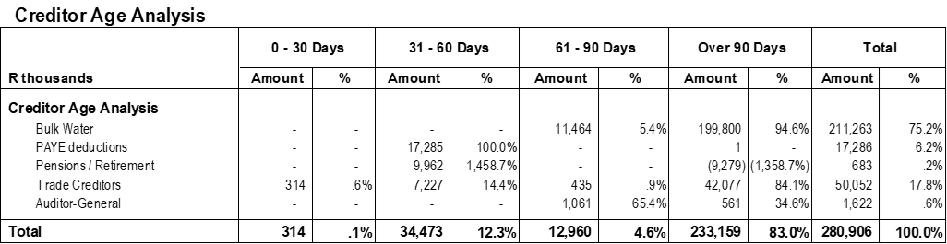
FINANCIAL HEALTH – IYM : SEPTEMBER 2022
As at 30 September 2022 the municipality has reported R280,906 million. It is noted that 83 per cent is sitting over 90 day’s period, which is in contravention of S65(e) of the MFMA.
Bulk water is major contributor to the of the municipal creditors currently sitting at 75 per cent of the total creditors’ balances.
ADM is advised to adhere to section 65 of the MFMA and strive to pay its creditors within 30 days of receiving an invoice or statement.
The creditors balances of the municipality could be understated taking into consideration the possible opening balances since the municipality has not submitted its 2021/2022 pre-audited financial statements.
16

Slide 17
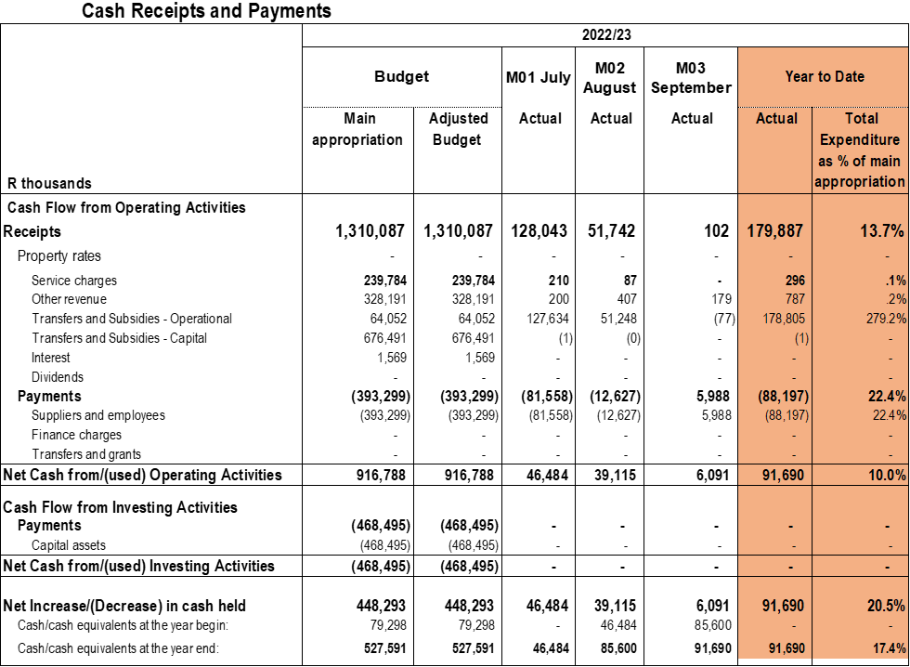
FINANCIAL HEALTH – IYM : SEPTEMBER 2022
ADM reported balance of R 91.690 million, mainly due to government grants received, this cash position cannot be relied on based on the following findings:
The municipality has not accounted for the cash opening balance as at the beginning of the financial year;
The expenditure disclosed above on the statement of financial performance relating to supplies and employees does not reconcile as these expenditure items are direct cash outflows as salaries are paid monthly; and
The municipality has billed revenue for water and sanitation, however the receipts or cash inflows are understated which gives the impression of a low collection rate.
17

Slide 18
Part 2: GOVERNANCE
18

Slide 19
GOVERNANCE
19
AUDIT OUTCOMES – FIVE YEAR TREND
There is a clear financial governance failure with audit outcomes, recording serious weaknesses and failures and yet there is no consequence management to enforce accountability and this could be attributed to the failure of oversight responsibilities by the Council.
ADM received an adverse audit opinion for the 2020/21 financial year. The adverse was as a result of the significance of the matters described in the basis for disclaimer of opinion section of the auditor’s report, the Auditor-General was unable to obtain sufficient appropriate audit evidence to provide a basis for an audit opinion on the financial statements of ADM.
In order for the municipality to achieve a clean audit, it must obtain an unqualified audit opinion, with no items identified within the Emphasis of Matter paragraphs and no findings on non-compliance with laws and regulations. In addition, the municipality should ensure that there are no significant weaknesses in internal controls
19

Slide 20
GOVERNANCE
AUDIT OUTCOMES 2020/21
The municipality had an adverse opinion as a result of the following findings: -
Property, Plant and Equipment
Receivables from non-exchange transactions
Payables from exchange transactions
Operational Costs
Inventory Consumed
Statement of Comparison of Budget vs Actual
Commitments
Cash Flow Statement
Reportable Segments
20

Slide 21
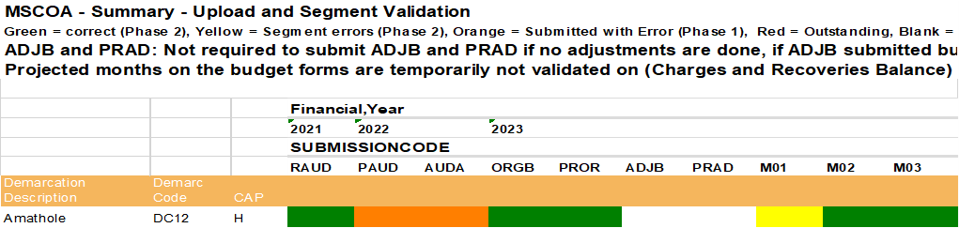
GOVERNANCE
mSCOA IMPLEMENTATION
Provincial Treasury has been assisting ADM in complying with the mSCOA requirements by having regular sessions with the municipality and the financial system vendor appointed to maintain the financial system.
ADM has made tremendous strides in submitting monthly data strings as required, however some challenges still exist with the credibility of information reported as noted above with the cash flow statement.
Finally, ADM need to work towards ensuring that all modules in the financial system are functional and integrated and also gradually eradicate use of more than one sub-system. The ultimate goal should be to maximize use of the SAP system and eliminate costs of paying maintenance and license fees for more than one system.
21

Slide 22
GOVERNANCE
mSCOA IMPLEMENTATION
Provincial Treasury engages with municipalities to discuss ICU assessment criteria as reflected in the table below that with these results there is a need for targeted support to municipalities.
The status above reflects improvements on all municipalities when compared to the previous quarter in the Amathole District. However, there are still challenges on the development of Road Map and reporting progress on the implementation of this Road Map.
22

Slide 23
GOVERNANCE
UNAUTHORISED, IRREGULAR, FRUITLESS & WASTEFULL EXPENDITURE (UIFWE)
ADM has been treating Irregular Expenditure on regular basis. As illustrated on the table below, the municipality has a closing balance of R39 232 551.00 (2020/21) which demonstrate a reduction form the opening balance of R103 819 538.00 (2019/20)
Fruitless and Wasteful expenditure has increased by R6 960 460.00 although a council recommended a write-off amounting to R3 266 636.00. The municipality continued incurring interest on late payment of service providers.
Unauthorized expenditure has remain unchanged over the past two year with no treatment made by the municipality on this line item
23

Slide 24
Part 2: INSTITUTIONAL
24

Slide 25
INSTITUTIONAL
The position of the Municipal Manager has been vacant for more than five months and that of the Chief Financial Officer (current on suspension) have been filled including Directors with the exception of Director Strategic Management and Planning and Director Community Services (contracts ended) reporting to the Municipal Manager.
The municipality had labour unrest affecting the operations of the municipality as a result of the employees demanding salary increases of 6.25%.
The work on reducing Employee Related Costs is moving slow as a result the Makanda High Court has not been implemented by ADM, making employee related costs the largest cost driver of the operating budget
TROIKA of the municipality was appointed on the 11th of August 2022 and council had not been sitting and only commenced with its meetings from 7th of October 2022. This resulted in non-compliance with the MFMA, for the tabling of the IDP Budget Process Plan and the Draft Annual report
25

Slide 26
Part 2: SERVICE DELIVERY
26

Slide 27
SERVICE DELIVERY
27
Over the past few years, ADM has experienced significant challenges in so far as service delivery is concerned. As the IDP shows service delivery backlogs when it comes to the provision of water and sanitation services.
The municipality has experienced service delivery bottlenecks as it has not been making adequate provision for the repairs and maintenance of its service delivery assets.
This poor performance on service delivery is mainly due to the slow spending on capital expenditure budget, the municipality has a backlog to provide water and sanitation services while the drought condition is also contributing to the water crisis.
ADM applied for budget roll-over of unspent MIG funding to the value of R92 million which was rejected by National Treasury and subsequently amended to R158 million as the municipality has not submitted the 2021/2022 pre-audited financial statements.
The unspent R158 million was sourced from the MFMA Section 71 30 June 2022 report.
Poor maintenance of the ADM’s ageing infrastructure underlies the high volume of water losses.
Water leaks due to pipe burst leads to escalation of overtime costs, which is a major contributing factor to the high wage bill of the Municipality.
National government has allocated significant amounts of resources through various conditional grants mainly for Municipal Infrastructure Grant (MIG), Water Services Infrastructure Grant (WSIG).
27

Slide 28
SERVICE DELIVERY
28
The municipality is operating the water and sanitation services at a deficit and has not implemented cost reflective tariffs to accommodate the depreciation costs of the infrastructure.
The municipality is not adequately budgeting for the renewal and upgrading of service delivery assets which will affect the sustainability of the assets in operating at optimal capacity.
The municipality is not spending well when it comes to the pivotal expenditure conditional grants
The Municipal Infrastructure Grant had spent 1.7 per cent as at 30 September which is significantly low as the municipality is expected to have spent 45 per cent of its total annual allocation as at 31 December 2022.
The municipality is at risk of having their annual allocation reduced as a result of low expenditure, which has a direct impact on the service delivery capacity
28

Slide 29
Part 3: KEY ACHIEVEMENTS & RISKS
29

Slide 30
KEY ACHIEVEMENTS
ADM’S meter readers provide a monthly report on the faulty meters, which is sent to Engineering Services, the May 2022 report uploaded as evidence the faulty meters have been identified. ADM is in the process of appointing a service provider to provide 20 000 meters.
The SCM unit have reviewed all 2020/21 contracts to ensure completeness of Irregular Expenditure and review of the 2021/22 contracts has commenced.
ADM has developed and implementing UIFW expenditure reduction plan, the performance is reported in S52(d) report, the full investigation on UIFWE is to be submitted in the next Council Meeting before the end of July 2022.
Appointed the Internal Audit co-sourced as part of their responsibilities is to Audit the Risk Registers and progress thereof.
The 2022/2023 adopted budget has a surplus of about R60 million on the statement of financial /capital performance but still unfunded.
Tariff calculation done using DWS model, ADM increased 2022/23 tariffs by 15% in alignment with the 13.5% increase in bulk purchases - Council approved 15% tariff increase in adopted budget.
30

Slide 31
KEY ACHIEVEMENTS
An amount of R23 million was collected, representing a 46% collection rate for the month of May.
Disconnection intention is communicated to consumers within 14-day response time. Businesses are being disconnected and households restricted. Those businesses not coming forward after disconnection are handed over to ADM attorneys for collection.
SOP's have been reviewed and the revenue enhancement strategy policies have been approved with an implementation date being 1 July 2022.
All conditional grants have separate bank accounts. Grants are maintained at fund level in the general ledger so that the report will reflect spending and income per grant. Monthly recon of grants received and payments.
Disciplinary Board established, cases referred to the Board and there is sitting as part of consequence management
31

Slide 32
KEY RISKS
The position of the Municipal Manager has been vacant since 28th June 2022 which affects the criteria used in the approval of budget roll overs.
The municipality has not submitted the 2021/2022 pre-audited financial statements
The above resulted in the rejection of the R 92 million roll over application, ADM has to source additional funding for the implementation of the capital projects affected
Chief Financial Officer is on suspension and this resulted to delays in the sitting of the finance work stream and consequently delays on the progress of the implementation of the mandatory Financial Recovery Plan.
The process of ensuring that all employees are on the correct grade will be addressed in line with the Makhanda Court judgement which has set aside the illegal Grade 7 and moving at a slow pace.
The council approval of salary increases above 4.9% stated in the Bargaining council resolution will further strain the unfunded budget position.
32

Slide 33
Part 4: PROGRESS ON IMPLEMENTATION OF FRP
33

Slide 34
PROGRESS ON IMPLEMENTATION OF FINANCIAL RECOVERY PLAN
ADM has been placed under Provincial Administration in terms of Section 139 (5)(a) of the Constitution of the Republic of South Africa. As a consequence of the intervention, a Financial Recovery Plan with a detailed Implementation Plan has been developed and the plan is being implemented by ADM.
The Finance Work Stream meetings are convened monthly and composed of officials from the National Treasury, Municipal Financial Recovery Services (MFRS), Municipal officials, SALGA, ECCOGTA & Provincial Treasury. To date, 11 meetings have been held (23 April 2021, 20 May 2021, 12 August 2021, 23 September 2021, 14 October 2021, 17 December 2021, 28 February 2022 , 04 March 2022, 12 April 2022 , 27 May 2022, 28 July 2022, 22 August’22 & 22 September’22) where progress on the draft FRP Implementation Plan has been monitored and discussed with the municipality.
The municipality is making progress on some of the activities of the FRP, however it is noted that the municipality’s collection rate is still below the acceptable norm. Furthermore, municipality’s trading services are operating at a deficit as the municipality is not recovering the total cost of the service and has not implemented cost reflective tariffs to determine the funding gap of the service.
ADM is not moving with speed to address the Makhanda High Court judgement and as of to date, the municipality has not yet implemented the judgement and the non-implementation of this court order has negative impact on the progress of focus areas under the financial management pillar.
34

Slide 35
PROGRESS ON IMPLEMENTATION OF FINANCIAL RECOVERY PLAN
Below are high level activities to be completed:
The budget funding plan of the municipality is work in progress as it will determine the alignment of FRP activities to the 2022/2023 MTREF Budget
The municipality is still calculating cost reflective tariffs to identify the costs of rendering the services
Reconciliation of Eskom accounts has begun, the reconciliation report on the billing points (Amatola Water and ESKOM) is done on a regular bases to ensure the correctness of the bills submitted.
Potable Water Supply - The tender for the appointment of the WCDM service provider is currently at procurement stage (BEC/BAC), with appointment expected to be finalised in June 2022 with a contract duration of 36 months. Service Provider has started and to be concluded by the end of June 2022., the strategy is being developed and implemented weekly meetings in the form of the FRP were held in which the cash situation was discussed. Meetings chaired by the MM and attended by the HoD's..
Installation of billing meters in rural areas has commenced - 100 billing meters installed. A separate debtor category for Rural yard connection has been created - 244 stands and accounts created, billing taking place monthly.
RISKS:
The process of ensuring that all employees are on the correct grade will be addressed in line with the Makhanda Court judgement which has set aside the illegal Grade 7.
The decision on the salary increases will affect the funding of the 2023 MTREF.
With regard to Contingent Liabilities, while progress reports and comments are noted, ADM is still required to report on the investigation of contingent liabilities and meetings with claimants to be held where legal action can be suspended to resolve claims amicably. Cases are dealt with by ADM Legal Services. Total contingent liabilities R186 million
  ADM does not have a robust cash management tool.
  Instability in the Political & Administration of ADM this negatively affects the reporting and sitting as scheduled.
  Labour unrest disrupts delivery of basic services and the implementation of FRP.
  Slow spending on conditional grants present a risk to service delivery and potential financial losses due to stopping
  Non-submission of 2021/22 AFS resulted to non-approval of roll –over grants amounting approximately to R92 080 million.
  Instability in leadership (political and administration) has an impact of performance and delivery of services to the community.
35

Slide 36
Part 5: SUPPORT BY PROVINCIAL TREASURY
36

Slide 37
SUPPORT BY PROVINCIAL TREASURY
Assess and review budget process plans and provide feedback to ADM
Provide training on the latest budget reforms and circulars and provide working session on the budget funding tool
Assess and review municipality’s draft budgets provide feedback through assessment report
Coordinate and participate during budget engagement sessions & Review and assess mid-year reports(S72) and provide feedback
Monitor implementation of audit action plans and key internal controls monthly and quarterly.
Roll –out workshop on the AFS review to BTO & Internal Audit unit and provided tools on review of AFS.
Assess and review municipality’s monthly in-year reports (S71) draft budgets provide feedback through assessment report
PT has been monitoring the implementation of the payment plans as part of the oversight role
Provide help desk on SCM queries and roll out training on members of MPAC & DC Board.
NT deployed MFIP – Technical Advisor to provide hands on support to three municipalities in the district including ADM for 24 months.
37

Slide 38
Part 6: RECOMMENDATIONS
38

Slide 39
RECOMMENDATIONS
It is crucial that the leadership set a tone of zero tolerance for non-compliance and non-performance.
ADM must ensure stability at Political and Administrative to create conducive environment for municipal performance and service delivery.
Develop & Monitor register to track resolutions made by Council and decisions made by Management to assess the impact on the functionality of ADM.
Implementation of the Long Term Financial Plan to improve the funding of the budget
Management to ensure implementation of FRP & Councillors monitor progress on the implementation of FRP.
ADM to conduct Public Participation to restore public image of the ADM and address issues of the low collection rate and service delivery.
39

Slide 40
END OF PRESENTATION
40

