Slide 1
BRIEFING BY THE DEPARTMENT OF COMMUNICATIONS AND DIGITAL TECHNOLOGY ON MATERIAL IRREGULARITIES AND ACTION PLANS TO ADDRESS THE AGSA CONCERNS
22 November 2022

Slide 2
PRESENTATION OULTINE
South African Post Office (SAPO)
State Information Technology Agency (SITA)
Universal Service and Access Agency of South Africa (USAASA)
South African Broadcasting Corporation of South Africa (SABC

Slide 3
SAPO

Slide 4
SAPO – 2021/2022
Audit Opinion - Disclaimer Audit opinion
Significant matters – 13 (2021: 18)
Category A findings – 39 (2021: 50)
Significant Matters
Going concern
Right of use of asset and lease liability
Funds collected on behalf of third parties
Noncurrent assets held for sale
Trade and other receivables
Trade and other payables
Financial services revenue
Other operating expenses
Accumulated loss
Cash and equivalents
Related parties
Comparative figures
Fruitless and wasteful expenditure

Slide 5
SAPO – 2021/2022
Category A findings – 39
Category A Audit Findings | 27
Going concern | 1
Non current assets held for sale | 4
Right of use of assets Finance lease liability Lease payments | 3
Trade and other receivables | 9
Trade and other payables | 3
Cash and equivalents Statement of changes in equity Funds collected Related parties Expenses | 7
Category A Audit Findings | 12
Supply chain management | 2
Strategic planning and performance management | 9
Fruitless and wasteful expenditure | 1

Slide 6
SAPO – 2021/2022
Going concern – SAPO liquidity challenges
Losses of R2.4 billion for the 2021/2022 FY and R2.2 billion for the 2022/2023 FY.
Implementation of the SAPO strategy will improve the financial performance.
Financial assistance is required to settle to the historical debt and implement the strategy.
Liquidity challenges results in late payment and interest being incurred.
Right of use of asset and lease liability
Contractual payments was used instead of the lease payments.
Nonpayment of creditors results in delay payments resulting in the differences.
Large number of leases.
Investment in system to automate the process (cost implications).
IFRS schedules (Property rentals, lease vehicles and network equipment) are required to be recalculated for the 2021/2022 FY and 2020/2021 FY.
Schedules are required to be updated for the 2022/2023 FY.
In progress - target to have the updated preliminary schedules to be completed by 28 February 2023.
Final schedules to be updated to be completed by 30 April 2023.

Slide 7
SAPO – 2021/2022
Funds collected on behalf of third parties and Financial services revenue
Third Party Management System (TPMS) .
System was not restored / disaster recovery challenges.
Resulted in limitation of scope on the audit of revenue from financial services and Agency services revenue.
Investment in IT Infrastructure is required.
Finance is constant discussions with IT department ensure the transactions are processed.
Noncurrent assets held for sale
Difference in the approval schedule for the sale of properties and schedule provided to AGSA.
Properties have prepared submission to Board to approve the revised schedule.
Properties in process of expediting the transfer of the properties to the purchasers.
Related parties
Target to have the updated preliminary schedules to be completed by 28 February 2023.
Final schedules to be updated to be completed by 30 April 2023.

Slide 8
SAPO – 2021/2022
Trade and other receivables
Reconciliations not timeously cleared.
Unacknowledged receipts by branches.
Documentation requested not provided within the three days.
All reconciliations are being attended to.
SASWITCH process for branches for over the counter (OTC) transactions implemented from October 2022 – will improve the processes and control environment.
In progress to address all audit findings
Trade and other payables
In progress to have the required documentation to support the balances for audits for the 2021/22 FY and 2022/2023 financial year by 31 January 2023.
Documentation to support the balances for the 2022/2023 FY to be completed by 30 April 2023.
In progress to address all audit findings
Cash and equivalents
Cash transferred to vendor was disclosed as receivables.
Auditors' opinion that funds should be disclosed as cash & cash equivalents.
To be corrected when the 2022/2023 FY AFS are prepared.

Slide 9
SAPO – 2021/2022
Supply chain management
Dignity services contracts for SASSA grant payments where procurement was done regionally.
Dignity services contracts expired 30 September 2022 and ceded to Postbank with effect from 01 October 2022.No further work will be performed.
Continuous engagement with Finance to submit all fruitless and wasteful transactions to SCM for the registering of these transactions.
Values have been included and/ or amended in the register and subsequently included in the AFS.
Strategic planning and performance management
Findings relate to reliability and measurability of reported performance.
Findings in process of correction.
Matters of subsidiaries have been included in the Corporate Plan for 2022/23 FY.
Fruitless and wasteful expenditure
Write-off policy in process of approval by the Board of Directors.
Identification of fruitless & wasteful expenditure ongoing.
Investigations into fruitless & wasteful expenditure ongoing.
Where required, consequence management has been recommended for implementation.

Slide 10
SAPO – 2021/2022
Action plans to address AGSA Concerns
Company | Number Reported | Number Resolved | Percentage Resolved | Work in Progress | Items Failed | Details
SAPO | 160 | 38 | 24% | 120 | 2 | Items Failed 91. Internal control deficiencies identified on the internal audit function. A vacancy rate of 22.4% including that of Chief Audit Executive There were no external trainings were conducted in the internal audit function and no external quality assurance review was done in the last 5 years, however, there is internal quality assurance standard and internal trainings. 97. Planning: Internal Control Deficiencies: South African Post Office does not have an approved annual procurement plan for 2021/22 financial year SAPO did not submit the annual procurement plan to the National Treasury for the year ended 2021/22 by 31 March 2021.
Docex | 41 | 2 | 5% | 39 | 0
Property Companies | 23 | 0 | 0% | 23 | 0
CFG | 48 | 1 | 2% | 48 | 0

Slide 11
SAPO – 2021/2022
SAPO – 2022/23 FY State of Readiness
In the 2022 FY a framework for digitally managing communications with the AGSA was implemented and will continue to improve this process for the 2023 FY.
Activity tracked under this framework includes:
The audit file - Documentation provided to the AGSA at commencement of the audit.
RFIs - Request for information issued by the auditors, responses from SAPO, and acceptance thereof by the audit team.
COAFs - Communications of audit findings as above, including auditors’ conclusions.
The information gathered to improve our internal processes and prepare for the 2022/2023 FY audit.
IT system challenges – age of infrastructure, hardware and software.
Finance section – resource challenges in critical areas (skills and capacity).
Despite challenges, focus is being given to all critical areas to resolve the audit findings to improve the audit outcome for the 2022/23 FY.
Audit action plans developed for resolution of findings and will be assisted by Internal Audit to monitor progress.

Slide 12
SITA

Slide 13
SITA – 2021/2022
Specific Qualification Areas
Qualifications relating to Property, Plant and Equipment (PPE) and Intangible Assets
A lot of work has taken place during the last year that creates the basis for addressing the current year qualification.
National Treasury have been consulted where necessary to assess technical application of complex accounting standard requirements and to provide technical opinions and assistance to the audit.
Write-ups and assessments will be improved and any input from National Treasury will be incorporated into the assessments.
Manual reconciliations between Loss on disposal of assets and impairment have been performed to ensure that the two amounts are disclosed accurately.
Revenue, Cost of Sales and Operational Expenditure
Record keeping of documentation has been centralized.
Cut-off for revenue and operating expenditure are being reviewed and controls have been implemented to address this.
Incorrect Calculation of Commitment Balances
System reports have been reviewed for accuracy and where necessary are being refined.

Slide 14
SITA – 2021/2022
Specific Qualification Areas
Trade Receivables
Differences were identified between the debtors confirmation send to the AG directly to customers and the balance as per SITA’s records. Many customers also did not respond to debtors confirmations.
Customers work on cash basis of accounting and many customers only confirmed balances captured in their system for payment and in many instances signed off on the billing subsequent to year-end and also paid undisputed amounts.
Management will confirm balances with customers at year-end and reconcile any balances using support for services delivered.
Cash Flow Statement
System cash flow reports have been refined to support amounts included in the cash flow statement and these reports are reviewed monthly.
Income Tax
Mostly related to the qualification on assets.

Slide 15
Irregular Expenditure
SITA – 2021/2022
During the 2021/22 financial year, Irregular Expenditure decreased from R820million incurred during the 2020/21 financial year to R282million incurred in the 2021/22 financial year. Of this amount R247million was continuing irregular expenditure identified in the prior year, mainly relating to access links.
SITA implemented the following remedial actions to address the controls deficiencies highlighted during the clean-up process and noted by PP:
Restructured SITA and filled all critical positions including capacitating the SCM division;
Restructured the then Bid Committees and allocated most senior employees on the various Bid Adjudication Committees (BAC);
Bid specifications are now approved by the BAC before publication to eliminate instances of bid cancellations and cases of corruption;
All bid above R10 million are subject to probity audit by SITA’s Internal Audit and external audit service providers;
All SCM employees and SCM role players are receiving on-going training pertaining to SCM critical prescripts;
Implemented SCM documents management system (SharePoint) where all bids documents and Tender Masterfiles are stored to circumvent limitation of scope audit findings and unnecessary delays in the investigations (if any);
Improved Loss Control Committee (LCC) operations to ensure that proper consequence management is implemented against any employees who are impacted on Irregular, Fruitless and Wasteful expenditure (IFWE);
Implemented strategies to curb cases of continuing Irregular expenditure, especially Data Links contracts, which is a main contributor to the Irregular expenditure book.

Slide 16
Material Audit findings
SITA – 2021/2022
Blue Turtle
SITA and Blue Turtle are waiting for an arbitration award.
Blue Turtle is claiming an amount of approximately R9m being for the remaining amount of the 99000 licences.
SITA defended the matter as if of the view that according the agreement it will only pay licence per user. In addition SITA issued a counter claim in an amount of R13m for licences that were paid for but not used.
SITA to charge employees that were responsible.
Tradezone
SITA issued an application to recover fruitless and wasteful expenditures incurred as a result of monies paid and advanced to Trade zone for SMME conference which never materialized.
Tradezone is currently defending the matter, but have failed to file answering affidavit. SITA is considering applying for a default judgment against Tradezone.
SITA through its attorneys, appointed a tracing agent to trace the whereabout of former SITA employees with a view of serving the application.

Slide 17
Background on audit action plan
SITA – 2021/2022
SITA received a financially qualified audit report with findings on compliance with applicable legislation The following issues contributed to the qualification areas:
Late finalization of the previous audit had a ripple effect on the preparation of financial statements as well as the possibility of an interim audit
Time was the biggest challenge given the nature of the different findings.
The time challenges relate to both the preparation for and submission of the financial statements as well as the short time available to the Auditor-General of South Africa (AG) to audit voluminous information as an interim audit was not possible. This limited discussions between Management and the AG.
As the audit was finalized earlier, the timing of activities has been normalized and is likely to have a positive impact on the audit outcome going forward.
Staff training
Only a very small compliment in Finance is up to date with Generally Recognised Accounting Practice standards (GRAP).
Training will be rolled out to all finance staff on key GRAP standards.
With the recent interactions with the Finance management team it became apparent there is a need to engage further on the assertions made to audit when presenting the financial statements for audit. A session was held with the Finance management team to take them through the requirements of focusing on key controls and assertions.
System challenges
System needs to be enhanced to ensure that it is aligned to GRAP requirements and to new developments in GRAP.
For the 2022/23 financial year system related risks will be mitigated by manual controls.

Slide 18
Background on audit action plan
SITA – 2021/2022
Standard Operating Procedures
It should be noted that the basic standard operating procedures for the initiation of Requisitions, Purchase Orders, processing of invoices etc. are in place and is part of the system controls. However, the documentation of Standard Operating Procedures (SOPs) are not sufficient for AG audit purposes .
The documentation and revision of SOPs have been included in the performance contract of managers.
Engagement with the AG needs to improve – to be discussed, the following items should be considered
Mechanisms to reach consensus/agreements on technical issues as well as disagreements on documentation submitted needs to be established.
More engagement through discussions is necessary as written communications are always subject to the readers interpretation;
A workshop focusing on the way forward was held with the AG and this proofed to be very constructive.
Interim audit to address opening balances will be discussed with the AG and this will take the pressure off the final audit. The dates for this will be agreed to when the AG strategic plan is compiled in November 2022.
Internal Audit
Provide assurance on the plan itself.
Provide assurance on the results of the action plan before it is submitted to the AG

Slide 19
USAASA

Slide 20
Material Irregularities
USAASA & USAf – 2021/2022

Slide 21
Irregular Expenditure (IE) 2020/21 and 2021/22
USAASA & USAf – 2021/2022
USAASA Cum/22 FY: R 16 778 000
Root cause: Majority (96%) due to contracts that have lapsed. USAASA was not able to extend beyond 31/03/2022 due to disestablishment.
Mitigation/progress: 2022/23 FY:
Entering into short-term contracts ending 31/03/2023. Office rent – Landlord not entertaining short-term contract. Vodacom – considering RT contract from NT.
IE under investigations = Majority are matters dating back to 2015/16.
R 5 570 130
IE Submitted to National Treasury for condonation = R 30 383 253
IE submitted and written-off by Board = R 20 405 530
Investigations completed by SIU or NPA and court ruled matters;
In line with the current IE Framework; and
USAASA Cumulative balance up to 31/03/2021: R 35 336 000
Incurred during 2021/22 FY: R 16 778 000
Root cause: Majority (96%) due to contracts that have lapsed. USAASA was not able to extend beyond 31/03/2022 due to disestablishment.
Mitigation/progress: 2022/23 FY:
Entering into short-term contracts ending 31/03/2023. Office rent – Landlord not entertaining short-term contract. Vodacom – considering RT contract from NT.
IE under investigations = R 5 570 130
IE Submitted to National Treasury for condonation = R 30 383 253
IE submitted and written-off by Board = R 20 405 530
Investigations completed by SIU or NPA and court ruled matters;
In line with the current IE Framework; and
Majority are matters dating back to 2015/16.

Slide 22
Irregular, Fruitless and Wasteful Expenditure (IFWE) 2020/21 and 2021/22
USAASA & USAf – 2021/2022
A. Irregular Expenditure (IE):
USAF Cumulative balance up to 31/03/2021: R 63 250 000
Incurred during 2021/22 FY: R 0
B. Fruitless and Wasteful Expenditure (FWE):
USAF Cumulative balance up to 31/03/2021: R 4 009 000
Incurred during 2021/22 FY: R 2 707 000
Root cause: All current year made up of interest charged on litigations and through court orders.
Mitigation/progress: 2022/23 FY
Appointing sister entities to implement our projects;
IFWE under investigations = R 8 721 849
IFWE Submitted to National Treasury for condonation = R 0.
IFWE submitted and written-off by Board = R 56 934 991
Investigations completed by SIU or NPA and court ruled matters);
In line with the current IE Framework; and
Majority are matters dating back to 2015/16.
USAASA Cum/22 FY: R 16 778 000
Root cause: Majority (96%) due to contracts that have lapsed. USAASA was not able to extend beyond 31/03/2022 due to disestablishment.
Mitigation/progress: 2022/23 FY:
Entering into short-term contracts ending 31/03/2023. Office rent – Landlord not entertaining short-term contract. Vodacom – considering RT contract from NT.
IE under investigations = Majority are matters dating back to 2015/16.
R 5 570 130
IE Submitted to National Treasury for condonation = R 30 383 253
IE submitted and written-off by Board = R 20 405 530
Investigations completed by SIU or NPA and court ruled matters;
In line with the current IE Framework; and

Slide 23
AGSA Findings & Action Plans
USAASA & USAf – 2021/2022
USAASA Cum/22 FY: R 16 778 000
Root cause: Majority (96%) due to contracts that have lapsed. USAASA was not able to extend beyond 31/03/2022 due to disestablishment.
Mitigation/progress: 2022/23 FY:
Entering into short-term contracts ending 31/03/2023. Office rent – Landlord not entertaining short-term contract. Vodacom – considering RT contract from NT.
IE under investigations = Majority are matters dating back to 2015/16.
R 5 570 130
IE Submitted to National Treasury for condonation = R 30 383 253
IE submitted and written-off by Board = R 20 405 530
Investigations completed by SIU or NPA and court ruled matters;
In line with the current IE Framework; and
 | USAASA | USAF | Both
Status on 2021/20 Audit Action Plans:
Total findings affecting the audit report | 7 | 14 | 21
Relating to compliance | 3 | 1 | 4
Relating to operating expenses | 1 | 3 | 4
Relating to provisions | 1 | 3 | 4
Relating to receivables (staff debtors) | 2 | 0 | 2
Related to inventory | 0 | 2 | 2
Related to contingent liabilities | 0 | 1 | 1
Related to accruals | 0 | 1 | 1
Related to predetermined objectives | 0 | 1 | 1
Related to related parties | 0 | 1 | 1
Related to prior-year errors | 0 | 1 | 1

Slide 24
USAASA & USAf – 2021/2022
Main root causes for the AGSA findings:
SAP System errors that required SAP technicians to resolve. The errors were due to the following:
Balances not carried over from the previous financial years into the opening balances. This led to the differences between amounts in the General Ledger and the Trial Balance.
Solution: Appointment of a technical SAP specialist to diagnose the problem, i.e. whether it is due to lack of patching/updates OR due to configuration errors. This will be implemented immediately when the retention of funds is approved by the National Treasury.
2. Using excel to prepare financial statement (manual). This led to unnecessary errors and audit findings. The use of excel was due to the Entity not renewing the financial statement system license.
Solution: Renewing the financial statement system license. Attending technical training on using the system. This will be implemented immediately when the retention of funds is approved by the National Treasury.
3. Not applying proper GRAP (accrual) basis of accounting.
Solution: Finance team to attend GRAP training. Conducting detailed analysis and review of financials to ensure GRAP accounting compliance.
4. Poor records management.
Solution: Enforced proper records keeping including preparing audit files and ensuring all required records are properly filed for ease of access during audits (internal or external).
USAASA Cum/22 FY: R 16 778 000
Root cause: Majority (96%) due to contracts that have lapsed. USAASA was not able to extend beyond 31/03/2022 due to disestablishment.
Mitigation/progress: 2022/23 FY:
Entering into short-term contracts ending 31/03/2023. Office rent – Landlord not entertaining short-term contract. Vodacom – considering RT contract from NT.
IE under investigations = Majority are matters dating back to 2015/16.
R 5 570 130
IE Submitted to National Treasury for condonation = R 30 383 253
IE submitted and written-off by Board = R 20 405 530
Investigations completed by SIU or NPA and court ruled matters;
In line with the current IE Framework; and

Slide 25
USAASA & USAf – 2021/2022
Main root causes for the AGSA findings:
Inadequate Portfolio of evidence. This affected multiple transactions and accounting line items as well, e.g. inventory opening and closing balances, accounts payable, accruals, related party disclosures, commitments and project costs.
Solution: Appointed a team in operations division working together with Sentech to verify POE in line with the relevant contracts. Continuous verifications are now conducted on a monthly basis.
6. Capacity constraints in key positions. This is also affected by the number of employees in key positions that were placed on suspension.
Solution: Appointed contract employees with requisite competencies in these critical positions to assist in the areas of concern. We are currently finalise the disciplinary proceedings.
7. Lack of consequence management for transgressors
Solution: Implement consequence management in line with the relevant principles. Starting with accountability letters to be send to all the executives to account for the issues identified within their respective areas.
8. Poor internal controls systems and processes
Solution: Review and enforce adherence to internal control policies and procedures. Regular review/audit of internal controls, and development and implementation of internal improvement plans.
USAASA Cum/22 FY: R 16 778 000
Root cause: Majority (96%) due to contracts that have lapsed. USAASA was not able to extend beyond 31/03/2022 due to disestablishment.
Mitigation/progress: 2022/23 FY:
Entering into short-term contracts ending 31/03/2023. Office rent – Landlord not entertaining short-term contract. Vodacom – considering RT contract from NT.
IE under investigations = Majority are matters dating back to 2015/16.
R 5 570 130
IE Submitted to National Treasury for condonation = R 30 383 253
IE submitted and written-off by Board = R 20 405 530
Investigations completed by SIU or NPA and court ruled matters;
In line with the current IE Framework; and

Slide 26
SABC

Slide 27
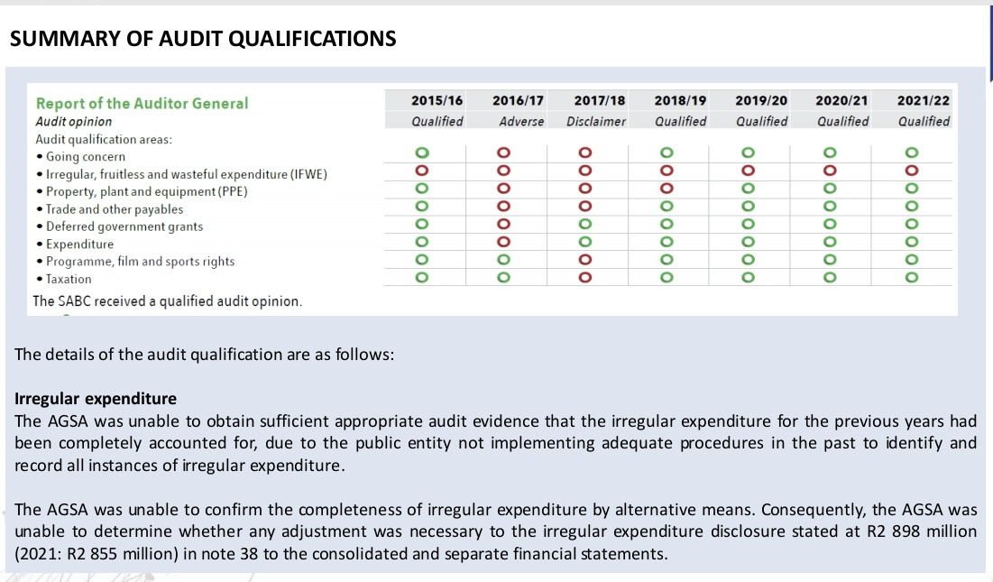
SABC – 2021/2022
USAASA Cum/22 FY: R 16 778 000
Root cause: Majority (96%) due to contracts that have lapsed. USAASA was not able to extend beyond 31/03/2022 due to disestablishment.
Mitigation/progress: 2022/23 FY:
Entering into short-term contracts ending 31/03/2023. Office rent – Landlord not entertaining short-term contract. Vodacom – considering RT contract from NT.
IE under investigations = Majority are matters dating back to 2015/16.
R 5 570 130
IE Submitted to National Treasury for condonation = R 30 383 253
IE submitted and written-off by Board = R 20 405 530
Investigations completed by SIU or NPA and court ruled matters;
In line with the current IE Framework; and

Slide 28
SABC – 2021/2022
USAASA Cum/22 FY: R 16 778 000
Root cause: Majority (96%) due to contracts that have lapsed. USAASA was not able to extend beyond 31/03/2022 due to disestablishment.
Mitigation/progress: 2022/23 FY:
Entering into short-term contracts ending 31/03/2023. Office rent – Landlord not entertaining short-term contract. Vodacom – considering RT contract from NT.
IE under investigations = Majority are matters dating back to 2015/16.
R 5 570 130
IE Submitted to National Treasury for condonation = R 30 383 253
IE submitted and written-off by Board = R 20 405 530
Investigations completed by SIU or NPA and court ruled matters;
In line with the current IE Framework; and

Slide 29
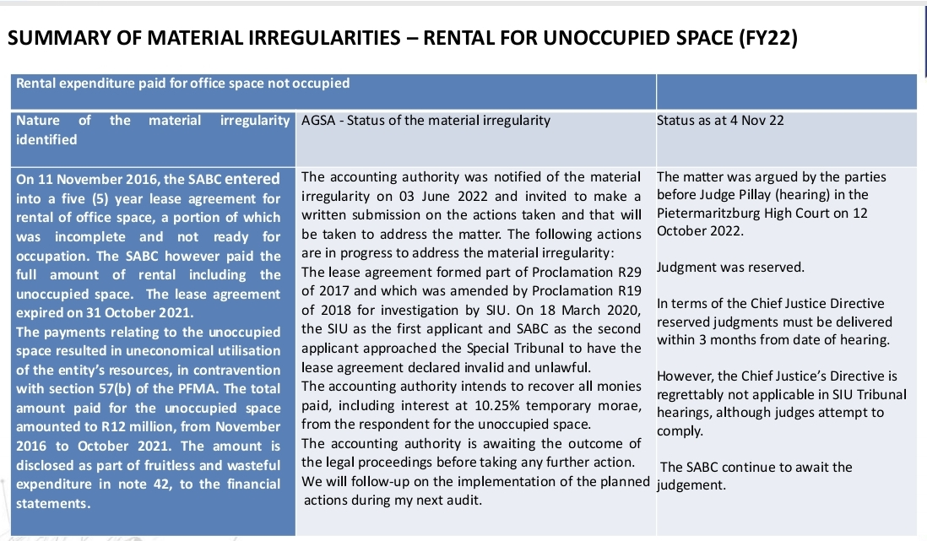
SABC – 2021/2022
USAASA Cum/22 FY: R 16 778 000
Root cause: Majority (96%) due to contracts that have lapsed. USAASA was not able to extend beyond 31/03/2022 due to disestablishment.
Mitigation/progress: 2022/23 FY:
Entering into short-term contracts ending 31/03/2023. Office rent – Landlord not entertaining short-term contract. Vodacom – considering RT contract from NT.
IE under investigations = Majority are matters dating back to 2015/16.
R 5 570 130
IE Submitted to National Treasury for condonation = R 30 383 253
IE submitted and written-off by Board = R 20 405 530
Investigations completed by SIU or NPA and court ruled matters;
In line with the current IE Framework; and

Slide 30
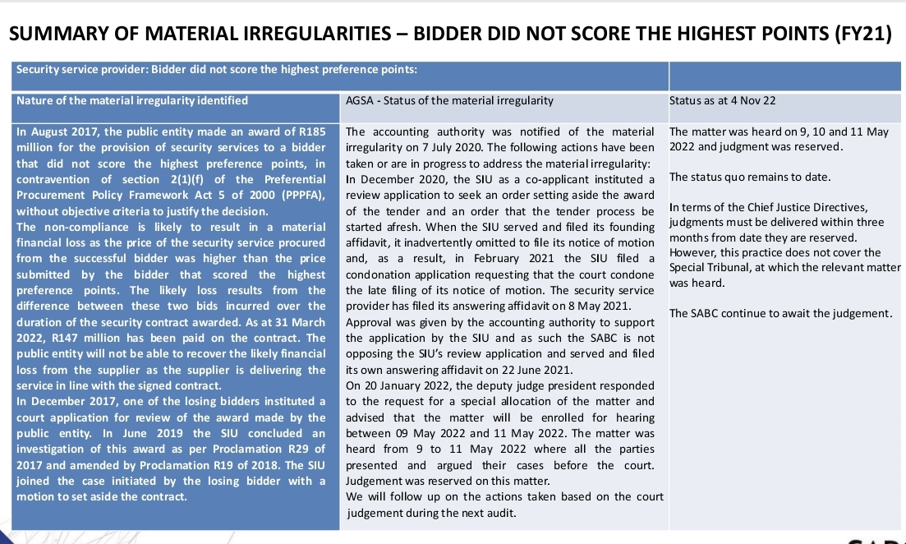
SABC – 2021/2022
USAASA Cum/22 FY: R 16 778 000
Root cause: Majority (96%) due to contracts that have lapsed. USAASA was not able to extend beyond 31/03/2022 due to disestablishment.
Mitigation/progress: 2022/23 FY:
Entering into short-term contracts ending 31/03/2023. Office rent – Landlord not entertaining short-term contract. Vodacom – considering RT contract from NT.
IE under investigations = Majority are matters dating back to 2015/16.
R 5 570 130
IE Submitted to National Treasury for condonation = R 30 383 253
IE submitted and written-off by Board = R 20 405 530
Investigations completed by SIU or NPA and court ruled matters;
In line with the current IE Framework; and

Slide 31
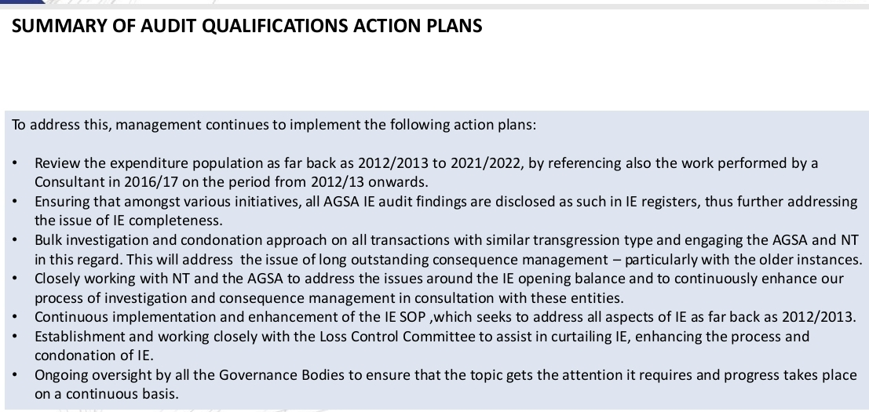
SABC – 2021/2022
USAASA Cum/22 FY: R 16 778 000
Root cause: Majority (96%) due to contracts that have lapsed. USAASA was not able to extend beyond 31/03/2022 due to disestablishment.
Mitigation/progress: 2022/23 FY:
Entering into short-term contracts ending 31/03/2023. Office rent – Landlord not entertaining short-term contract. Vodacom – considering RT contract from NT.
IE under investigations = Majority are matters dating back to 2015/16.
R 5 570 130
IE Submitted to National Treasury for condonation = R 30 383 253
IE submitted and written-off by Board = R 20 405 530
Investigations completed by SIU or NPA and court ruled matters;
In line with the current IE Framework; and

