Slide 1
COGTA-PT meeting with the National Portfolio Committee on the ADM intervention
18 November 2022

Slide 2
PURPOSE OF THE PRESENTATION
The purpose of the presentation is to present an update on the Amathole District intervention. The report covers the period up to October 2022.

Slide 3
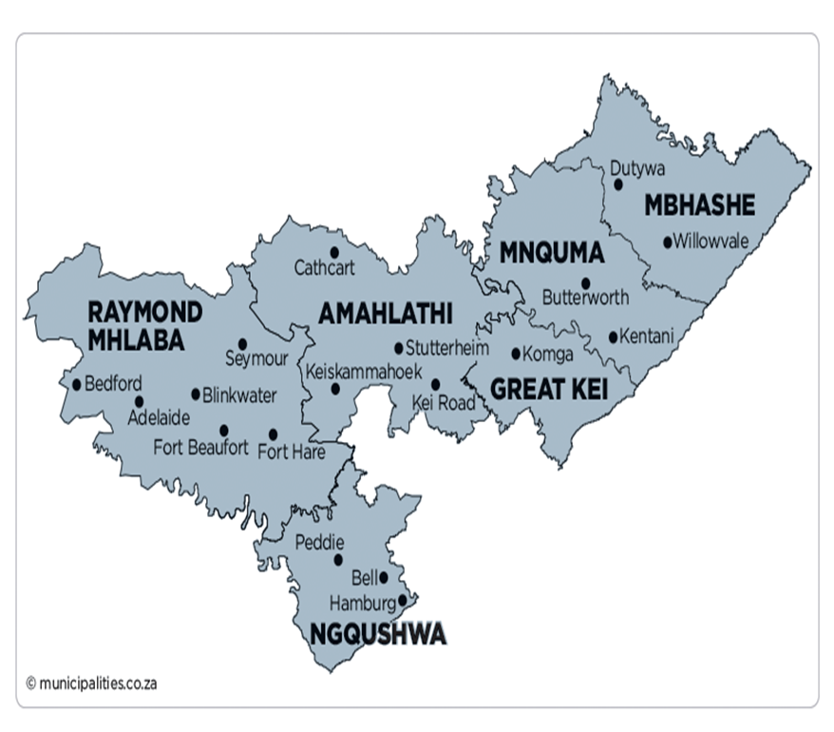
AMATHOLE DISTRICT AREA
MDB code: DC12
Description: The Amathole District Municipality is a Category C municipality situated in the central part of the Eastern Cape. It stretches along the Sunshine Coast from the Fish River Mouth and along the Eastern Seaboard to just south of Hole in the Wall along the Wild Coast. It is bordered to the north by the Amathole Mountain Range. The municipality is comprised of six local municipalities: Mbhashe, Mnquma, Great Kei, Amahlathi, Ngqushwa and Raymond Mhlaba.
Four heritage routes have been developed that are named after Xhosa kings and heroes. They are the Maqoma Route, the Makana Route, the Sandile Route and the Phalo Route. These intertwine with the other tourism routes located within the district, namely the Sunshine Coast Route, the Wild Coast Route, the Amathole Mountain Escape Route and the Friendly N6 Route.
Area: 21 114km²
Cities/Towns: Adelaide, Alice, Amatola Coastal, Bedford, Butterworth, Cathcart, Dutywa, Elliotdale, Fort Beaufort, Hamburg, Hogsback, Kei Mouth, Kei Road, Keiskammahoek, Kentani, Komga, Middeldrift, Morgan Bay, Ngqamakhwe, Peddie, Seymore, Stutterheim, Willowvale
Main Economic Sectors: Community services (44%), finance (19%), manufacturing (14%), trade (13%), transport (4%), agriculture (3%), construction (2%)

Slide 4
BACKGROUND
Amathole District Municipality is currently on the Financial Recovery Plan intervention as per section 139(5)(a)of the South African Constitution. This intervention mandates the National Treasury, COGTA, Provincial Treasury and COGTA to be part of the workstreams in assisting the municipality to recover from the financial difficulties in finds itself in.
The environment at the District has also been compounded by the High Court Judgement that ordered for the invalidation of the decisions to change the grade of the District from 6 to 7, thereby having serious implications on the compensation of employees as against the legislated equitable share.
The Labour Unions established a task team to engage the District political and executive management on the matter of salary increases. It should be noted that staff had not received any salary increase since 2019.
The Labour Unions representatives then approached the High Court for that resolution to be reversed and the appointment of Mr Mnyimba be declared invalid. The court case NO: EL841/2022 was heard on the 28 June 2022 and ordered that Mr Mnyimba’s appointment should be declared invalid and set aside, therefore he should vacate the offices forthwith.

Slide 5
BACKGROUND
The Department of Cooperative Governance and Traditional Affairs, in executing its oversight on the appointment of municipal ;senior managers, had noted that the appointment of Mr Mnyimba could not be confirmed because of 5 areas by which the process was not compliant with the Local Government Regulations of 2014;
The vetting process failed to confirm Mr Mnyimba as having a grade 12 (Senior Certificate) certificate.
Mr Mnyimba’s qualifications do not meet the legislated minimum requirements and qualifications in terms of the Local Government Regulations of 2014.
ADM used an unaccredited service provider for competency assessment. This is in contravention of National Government circular 27 of 2017.
An anomaly was identified as he was the signatory of the Council Resolutions confirming his appointment.
Mr Mnyimba misrepresented facts in his CV, claiming that he is a member of the Institute of Financial Managers, a statement disputed by the vetting process.
Mr Mnyimba is currently appealing the judgement.

Slide 6
BACKGROUND
RISKS IDENTIFIED AS PER ADM FRP
Industrial actions owing to communications and resistance to the changes due to any organizational restructuring.
The high costs of employment which have been caused by the approval of unrealistic and unaffordable HR Allowances, Policies, bloated Organization Structure, and the illegal categorization of ADM from a category 6 to a 7, if not urgently addressed, poses a very serious at threat to the financial recovery and long-term sustainability of the municipality.
Slow progress in the finalization of disciplinary matters.
Loss of grant funding due to non-compliance with grant conditions.
Continued non-collection of revenue and increase in the debtors’ book.
Failure to reverse the trend of under-maintenance.
Non-commitment to stringent expenditure controls and non-implementation of the revenue enhancement initiatives.
Non-implementation of the approved systems of delegation that impact on governance, administration and operational efficiency.
High level of litigation issues and financial impact related thereto.
Inadequate implementation of internal controls.
The financial management system is not yet fully functional.

Slide 7
BACKGROUND
COGTA provides monitoring and oversight of the intervention and the FRP through the Technical FRP Intervention Coordinating Team and 4 Workstreams arranged in accordance with the Pillars of Governance, Institutional Stability & Capability, Financial Health and Service Delivery.
Workstreams are guided by the activities of the strategies contained in the FRP.
Workstreams meet monthly and consider performance progress reports on the FRP implementation.
Workstream Conveners prepare and submit consolidated progress reports monthly for consideration by the Technical FRP Intervention Coordinating Team; LG Working Group, G&A Cluster.

Slide 8
Labour Relations Overview
Following a Court Order (19 Aug 2021) that declared the Standardisation and Re-categorization of ADM as illegal, the ADM Council took it upon themselves to consult Organised labour on the Court Ruling.
The Judgement was tabled in the Local Labour Forum on the 14th of October 2021 for consultation and the matter was not conclusively dealt with on that meeting.
The Judgement was again tabled in the LLF on the 15th of September 2022 for further consultation and therein, the decision was that the Makhanda Judgement must be tabled with all relevant calculations, However there was a delay in compiling such calculations due to ADM having insufficient funds to appoint a Service Provider with relevant expertise.
Eventually the calculations were done by a co-sourced internal Audit function (ARM’s Audit) that was to be presented in the next LLF on the 26 September 2022.
ADM Management hopes that after the work has been tabled in the LLF, there would be engagement and a clear wayforward on how to recoup such funds from the individual employees who are liable and also a plan on how to reimburse where refunds are due

Slide 9
Labour Relations Overview
Local Labour Forum at ADM is functional and convenes every quarter with special LLF meetings in between.
EC COGTA has had 2 engagements with the ADM LLF on the issue of the Staff Regulations and Staff establishment. The latest engagement was on the 8 November 2022 and the follow up session is scheduled for the 2 December 2022.
Under microscope will be the issue of the Organogram that was reviewed in 2021 which is yet to be processed by the LLF and the delayed processing of reviewed HR Policies.
ADM currently is using the organogram that was approved in 2014, with some elements of the organogram approved in 2021. The Institutional workstream recognized that the District is wholy not compliant with the provisions of the Staff Regulations of September 2021.
The Troika, Management and the Labour Union established Task Team resolved to unsuspend the 14 employees that were suspended by the previous Municipal Manager. All 14 of the affected employees reported for duty on the 10th October 2022.
- It was agreed that their respective offences and disciplinary processes would continue whilst they are at work.

Slide 10
Re-Categorization of ADM
ADM was categorised by the SALGBC as a Grade 6 Municipality.
However, the grading of the municipality was changed in 2013/14 to a grade 7 through an illegal process.
The Court has since declared that action to be illegal and directed the municipality to correct such in consultation with Organised Labour particularly on matters that affect employees.
ADM has prepared a letter to SALGA and the SALGBC to confirm that the official grade of the municipality is a Grade 6 and has never been changed,

Slide 11
Re-Categorization of ADM
ADM Management has been engaged in a process of establishing individual liability of all employees arising from the incorrect re-grading of the municipality,
To stablish liability, professional services were engaged to determine the individual cost and such a report is now ready however, it will first be presented in the Local Labour Forum and thereafter the Workstream,
The exercise also includes the cost of Standardisation of salaries which was also declared as an illegal practice.

Slide 12
HUMAN RESOURCE PLAN AND STAFF ESTABLISHMENT
The reviewal of the HR Policies was been initiated in 2020/2021 and approval was secured through Council.
However, the 2020/2021 reviewal was never implemented by the ADM management due to a Court interdict that was brought about by the affected employees.
The employer then embarked on a fresh review of the policies in 2021/2022 which took into consideration the Court ruling on the matter.
The Court ruling had specifically stated that the implementation of the reviewed polices would constitute a breach of employment contracts for the employees who were enjoying benefits such as Travel allowance, Cellphone allowance and Essential User scheme
Having taken note of the Court Judgement, ADM embarked on a fresh review and ensured that a clause was inserted in all the policies.
The clause inserted stated that the revised monthly allowances would not affect the employees that were already participating in the schemes.
The condition was inserted to ensure that the municipality was not found to be in contravention of the Court Order which categorically stated that employee benefits could not be tempered with as that would constitute a breach of contract on the side of the employer

Slide 13
AMATHOLE DISTRICT MUNICIPALITY POSITIONS PER DIRECTORATE [%]
Department | Number of Positions | Percentage
Office of the Municipal Manager | 77 | 3.68
Strategic Planning & Development | 66 | 3.15
Budget & Treasury Office | 253 | 12.09
Corporate Services | 130 | 6.21
Engineering & Infrastructure Services | 1272 | 60.8
Community Services | 240 | 11.47
Spatial Planning & Economic Development | 54 | 2.58
TOTAL = | 2092 | 100%

Slide 14
MUTUAL SEPARATION AGREEMENT (MSA) UPDATE
The MSA process was first opened for applications in 2019 and only managers from Task Grade 14 to Task Grade 20 were eligible to apply.
Total number of targeted group of employees was 135 and to-date, only 13 applied and only 11 applications were approved and 1 is no longer an employee of ADM since end July 2022.
Thus, a total of 10 applicants will be processed for MSA.
Calculations are updated continuously to reflect current salary package to be paid in respect of MSA.
A third party has been engaged to audit figures payable to qualifying MSA applicants
The report on audited figures has been submitted by the third party.
The potential cost of 10 applicants as at September 2022 is estimated at plus/minus R9 731 698.58
Third party report has been submitted to Internal Audit for verification.

Slide 15
ADM JOB EVALUATION UPDATE AS OF 20 SEPTEMBER 2022
To-date, a total of 2028 (97%) positions have been graded by the DJEC,
Out of 2028 positions 1733 (83%) have been audited and confirmed by the PAC.

Slide 16
CHANGE MANAGEMENT PROCESS
Part of the Process Plan developed to implement the Makhanda Court Judgement is to activate Change Management as part of the broader intervention.
There is already an existing Change Management Committee at ADM chaired by the Strategic Planning Dept however, that committee has not been functioning optimally.
The programme will entail all aspects of change management that are necessary to transform ADM as there are many changes unfolding simultaneously
In the main, the change management intervention is intended to build relations between the employer and employees as the relations are at an all time low due to various changes that have and still unfold at ADM.
It is our hope and belief that the programme will assist to change the mindset of employee to work towards a common goal and uplift ADM

Slide 17
CHANGE MANAGEMENT PROCESS
Part of the Process Plan developed to implement the Makhanda Court Judgement is to activate Change Management as part of the broader intervention.
There is already an existing Change Management Committee at ADM chaired by the Strategic Planning Dept however, that committee has not been functioning optimally.
The programme will entail all aspects of change management that are necessary to transform ADM as there are many changes unfolding simultaneously
In the main, the change management intervention is intended to build relations between the employer and employees as the relations are at an all time low due to various changes that have and still unfold at ADM.
It is our hope and belief that the programme will assist to change the mindset of employee to work towards a common goal and uplift ADM

Slide 18
PROGRESS ON THE RFP MANDATE
ADM developed a tool for identifying critical positions and such a tool is currently utilised when vacancies arise.
Generally, ADM does not fill vacancies unless a positions is extremely critical and the tool is utilised accordingly to ensure that there is objectivity in identifying such posts.
The ADM conducted a Head-Count in April 2022 to eliminate any ghost workers and the final report was presented to the Executive Management Committee on 19 April 2022 having identified zero ghost workers
The MFRP also calls for the verification of all employee qualifications and the municipalities lack the financial resources to conduct such an exercise
A letter was prepared to be dispatched to National Treasury requesting such funding however, the letter is yet to be signed for delivery to the National Treasury.
Currently the letter is in the Acting Municipal Managers office for final signature

Slide 19
PROGRESS ON THE RFP MANDATE
PROPERTIES OFFICE ACCOMMODATION [40 CAMBRIDGE STREET & WHELAN DEPOT]
On a long-term basis ADM is preparing to move out of BCMM and build offices in Chintsa within its own jurisdiction.
Currently ADM is renting office space in Chiselhurst at an amount of R 3.5m a month for staff based in East London and the lease expires end of Feb 2023.
Due to its financial constraints ADM took a resolution not to renew the contract and utilise its two properties,namely,40 Cambridge Street and Whelan Depot.
A contractor has been appointed through SCM processes on a Turnkey based contract with a value of R13 785 000(direct and indirect costs inclusive)
The contractor commenced its work at 40 Cambridge Street in August 2022.
As of end October 2022, there were contractual disputes with the contractor and the alterations in the Cambridge building have come to the standstill. The Acting Municipal Manager is engaging the contractor to resolve the impasse.

Slide 20
PROGRESS ON THE RFP MANDATE
The construction is anticipated to be completed by end of November and the relocation process should be completed by February 2023 when the current contract ends.
At Whelan a Social Facilitation has started (Pre-construction process).
Work to be done at Whelan include rehabilitation of the current workshop due to financial constraints.
Further budget will be requested through the adjustment budget.
The Project period is 4 months for both sites and anticipated to be finished by end November 2022.

Slide 21
PROGRESS ON THE RFP MANDATE
FLEET MANAGEMENT
As per National Treasury’s Mandatory Financial Recovery Plan, Fleet was identified as one of the cost drivers for the institution. Among issues identified was that ADM has old fleet that costs ADM a lot and recommendations were made that the obsolete and redundant vehicles be identified and auctioned.
A cost benefit analysis is also underway to consider the best option between leasing and purchasing own vehicles.
Fleet management conducts meetings with WesBank on a quarterly basis to discuss fleet maintenance issues.
Monthly cost analysis reports are emailed to Snr Managers in Satellite Offices to investigate high fuel costs emanating from generators and vehicles.
It is worth noting that in 2021/2022 financial year fuel costs were high in certain months and decreased in some as marked red and blue in the table below respectively.

Slide 22
PROGRESS ON THE RFP MANDATE
For the period 2021/22 financial year, there was a number of Council Committees that did not sit owing to non-availability of quorum and sometimes due to clashes resulting to other institutional commitments, the table below depicts the percentage with respect to the sitting of ADM Council Committee Meetings:

Slide 23
ADM STATUS UPDATE SUMMARY
POLITICAL | GOVERNANCE | ADMINISTRATIVE | FINANCIAL MANAGEMENT | SERVICE DELIVERY
The newly elected TROIKA (Political Office Bearers) is in place and the municipality is politically stable. The new Executive Mayor has since appointed a new Mayoral committee and is functional. Chairpersons of both Section 79/79A & 80 Committees were elected, and Committees established. The municipality is still under section 139(5)(a) intervention and there is slow progress in the implementation of the FRP. | The municipality has developed and adopted the Schedule of Meetings. Council and Committees meetings are sitting as per adopted schedule The Department currently monitors the functionality of Councils and its structures on a quarterly basis. The municipal Council noted and adopted both the Rules of Order and Delegation of Powers during the Inauguration Council meeting. All Councillors have signed the Code of Conduct and declared their financial interests. Public participation is actively supportive to the local municipalities. There is a fully fledged public participation unit. There is no policy on public participation IDP framework and process plan not yet adopted due to political instability The municipality was assessed on the 22 August 2022 | MM position is vacant and COGTA has sent one of its senior managers to go and act as MM with effect from the 1st of November 2022 Position of a Strategic Director came to an end this end of October. | Adverse 2020/21 opinion Poor revenue collection at 32% The municipality is financially distressed Unfunded budget for 2022/23 MTREF Huge irregular expenditure No systems in place to accurately record and disclose Salary Bill remains above the norm Material uncertainty relating financial stability Inability to meet its financial obligations | The Municipality did not report for July and in August, a total of R73 588 917.00 was planned to be spent in July and August as per PIP. However, after re-instating of the 5 Service Delivery Managers, the Municipality have spent R8, 4million which is 1.7% at the end of October 2022. The Municipality had a balance of R38m in 2021/22 FY allocation, a rollover application was submitted to NT Treasury on the 31st of August 2022. Unfortunately, the rollover application was rejected by the NT. The District assisted with FBS policy review The ADM has a functional FBS District Forum for integration of Indigent with its local municipalities. The district is also assisting its local municipalities to conduct indigent registration COGTA in collaboration with NBI is assisting ADM with Professional Engineers to assisting them to unlock any bottleneck that will impede service Delivery expenditure. The Engineers will render service not limited to Project Management . Technical Report Writing, Project Designs, Development of Scope of Works and any other area of expertise that may need..

Slide 24
DDM Reflections on the Review Process
EC-COGTA and OTP facilitates the process and content review process.
The ADM DDM Technical Structure has been established in line with Circular 10 of 2022 on review of One Plans.
ADM DDM Technical Structure was convened on the 25 October 2022 and 3rd November 2022.
Information gathering tools to close the One Plan Gap were distributed to all sector departments in all three spheres of government including the District and the local municipalities.
Finalization of DDM One Plan review is earmarked for 30th November 2022.
On the 7th November 2022, the National DDM National Political Champion Nkosi Phathekile Holomisa conducted a DDM oversight visit and raised the concern of instabilities in the District that result in non-sitting of the DDM meetings.
The purpose of the National Champion oversight meeting was to support the One Plan review.

Slide 25
DDM Reflections on the Review Process
On Service Delivery Matters raised during the National Political Champion DDM oversight visit, Deputy Minister committed to engage National Department of Transport to respond to roads.
The National Champions committed to engage the National Sphere of government to cooperate and support the review of Amathole District One Plan and other service delivery challenges highlighted during the visit.
Department of Justice and Correctional Services committed to support Amathole District in the context of DDM.
COGTA-EC and OTP plans to facilitate and convene a District Political IGR Structure Session (all Political Champions) for endorsement of the One Plans.
The District committed to give the Province a date for the District Political IGR Structure Session

Slide 26
THANK YOU

