Slide 1
FESTIVE SEASON OPERATIONAL PLAN- 2022/23: BMA:
PRESENTED BY: MAJOR-GENERAL (Rtd) CHILEMBE
Secure Borders for Development
NOV/DEC 2022

Slide 2
PURPOSE OF THE PRESENTATION
The purpose of this presentation is to provide the Portfolio Committee of Home Affairs on the:
update regarding the preparations made towards the 2022/23 safer festive season operations at all declared ports of entry and the vulnerable segments of the borderline and further to:
Show the direction and guidance provided to ports structures for the Operational Planning of the sound execution of the Festive Plan
Slide 2 of 34
Secure Borders for Development

Slide 3
CONTENTS OF THE PRESENTATION
KEY PRINCIPLES FOR THE OPERATIONAL PLANNING
OPERATIONAL CONCEPT
THREAT & RISK ASSESSMENT
PHASE 1: PLANNING (1 OCTOBER - 6 DECEMBER 2022)
PHASE 2: EXECUTION (7 DECEMBER – 11 JANUARY 2023)
PHASE 3: DEMOBILIZATION (12 JANUARY 2023)
RECOMMENDATION
Secure Borders for Development

Slide 4
KEY PRINCIPLES FOR THE OPERATIONAL PLANNING
Ensure sound collaboration with all stakeholders in the operational area including Authorities of neighboring countries; SANDF along the borderline and Customs.
Enforcement of all RSA legislative and regulatory frameworks within the border environment.
Prevent and intercept all security threats posed to the State including any corrupt activities by border officials and travelers in the Ports and borderline.
Secure Borders for Development

Slide 5
OPERATIONAL CONCEPT
Facilitate the movement of legitimate traders and travellers by interdicting all potential violators in the border law enforcement area.
Ensure that trade facilitation is not affected by the increase in passenger and light vehicle volumes and intercept all inadmissible goods and conveyances.
Ensure that commercial vehicles do not create an obstacle to passenger movement.
Control the movement of all travelers entering and leaving South Africa.
Ensure all illegal movements across the borderline are intercepted by ensuring the interdiction of people, goods and animal movement
Secure Borders for Development

Slide 6
THREAT AND RISK ASSESSMENT
Slide 6 of 34
Secure Borders for Development

Slide 7
THREAT AND RISKS:
The threat and risks were compiled by the combination of Intelligence Agencies under Border Intelligence that included SSA, CI and Defense Intelligence.
There have been frequent incidents reported during peak periods that impacted on the integrity of border security.
These risks and vulnerabilities do not only have an effect on port operations, but also have a potential impact on national security as the porousness of the borders allow for uncontrolled movement of people, some of whom may be wanted fugitives and prohibited goods. It should be noted that the assessment includes both the Ports of Entry as well as the Borderline and include the following:
Public Health Risks- importation of communicable diseases
Personnel Integrity challenges-insider threats and collusion
Smuggling, cross border transportation, clearing Agents etcetera.
Full document is attached as Annexure A
Secure Borders for Development

Slide 8
PHASE 1: PLANNING
Slide 8 of 34
Secure Borders for Development

Slide 9
ACTIVITIES DURING PLANNING:
The Planning phase started as early as 1 October 2022 and will end on the 6th of December 2022.
Salient issues were:
Finalization, completion and consolidation of all ports plans into a national plan
Request and approval of the ports extension of operational hours (Minister Home Affairs)
Approval of needs for infrastructural requirements National Department of Public Works and Infrastructure.
Request and approval of extra HR and overtime budgets
Briefing of relevant structures for the approval of plans
Dissemination of Operational Plans to accounting authorities
Secure Borders for Development

Slide 10
EXTENSION OF OPERATIONAL HOURS
CONTRY | PORTS OF ENTRY | CURRENT HOURS | EXTENDED HOURS | PERIODS/DATES
MOZAMBIQUE | KOSIBAY | 08:00 – 17:00 | 06:00 – 18:00 | 15 DEC 2022 – 08 JAN 2023
eSWATINI | MAHAMBA | 07:00 – 22:00 | 07:00 – 00:00 | 15 DEC 2022 23 DEC 2022 24 DEC 2022
LESOTHO | SANIPASS | 06:00 – 18:00 | 06:00 – 20:00 | 15 – 16 DEC 2022 23 – 24 DEC 2022
LESOTHO | CALEDONSPOORT | 06:00 – 22:00 | 06:00 – 00:00 | 15 – 16BDEC 2022 24 DEC 2022 8 JAN 2023
 |  | 06:00 – 22:00 | 24 HOURS | 23 DEC 2022 2 JAN 2023
LESOTHO | PEKABRIDGE | 08:00 – 16:00 | 08:00-18:00 | 15 – 16 DEC DEC 2022 23 – 24 DEC 2022 02 JAN 2023
LESETHO | VAN ROOYENSGATE | 06:00 – 22:00 | 06:00 – 00:00 | 15 – 16 DEC DEC 2022 24 DEC 2022 08 JAN 2023
 |  | 06:00 – 22:00 | 24 HOURS | 23 DEC 2022 02 JAN 2023
Secure Borders for Development

Slide 11
OPERATIONAL SUPPORT – DHA HR
Port of Entry | Additional Capacity | Comments
Beitbridge | 75 | Overtime to be provided
Lebombo | 60 | Overtime to be provided
Oshoek | 15 | Overtime to be provided
Maserubridge | 30 | Overtime to be provided
Ficksburg | 25 | Overtime to be provided
Golela | 6 | Overtime to be provided
Caledonspoort | 10 | Overtime to be provided
Kopfontein | 10 | Overtime to be provided
Stockpoort | 2 | Overtime to be provided
Tellebridge | 8 | Overtime to be provided
Gorblersbridge | 10 | Overtime to be provided
Kosibay | 8 | Overtime to be provided
Qachasnek | 6 | Overtime to be provided
Sanipass | 6 | Overtime to be provided
.
Secure Borders for Development

Slide 12
SOUTH AFRICAN POLICE SERVICE
Port of Entry | Additional Capacity | Comments
Beit bridge | 30 Public Order Police | Overtime to be provided
Lebombo | 88 Public Order Police | Overtime to be provided
Oshoek | No additional police | Overtime to be provided
Maserubridge | 16 Public Order Police | Overtime to be provided
Ficksburg | 16 Public Order Police | Overtime to be provided
Groblersbridge | 14 additional police | Overtime to be provided
Secure Borders for Development

Slide 13
SARS-CUSTOMS
Port of Entry | Additional security personnel
Lebombo | 8
Beit bridge | 4
Maseru Bridge | 6
Ficksburg | 4
Oshoek | 4
Kopfontein | 4
Secure Borders for Development

Slide 14
SOUTH AFRICAN NATIONAL DEFENCE FORCE
Borderline | Deployments | Comments
Limpopo | 1 x Battalion (4 x Companies) 3 x Company – RSA/Zimbabwe 1 x Company – RSA/Botswana | Battalion Hq based in Musina.
Mpumalanga | 1 x Battalion (4 x Companies) 1 x Company - RSA/Mozambique. 1 x Company – RSA/eSwatini 1 x Company – Kruger National Park | Battalion HQ based in Makhadamia.
KwaZulu Natal | 1 x Battalion (3 x Companies) 1 x Company RSA/Mozambique 1 x Company – RSA/eSwatini 1 x Company – RSA/Lesotho | Battalion HQ based in Pongola.
Freestate | 1 x Battalion (2 x Companies) 2 x Company RSA/Lesotho Special infantry capability | Battalion HQ based in Ladybrandt.
Northern Cape | 1 x Company RSA/Namibia (Rotated – 31st Oct 2022) | Company HQ based in Upington
North West | 1 x Company RSA/Botswana | Company HQ based at NW Joint Tactical HQ.
Eastern Cape | 1 x Company RSA/Lesotho
Secure Borders for Development

Slide 15
BORDER MANAGEMENT AUTHORITY BORDER GUARDS
Borderline Segment | Force levels | Comments
Limpopo | Beitbridge – 40 Giriyondo – 22 | Due to lower operational activities in the Giriyondo area, the Border Guard will be redeployed for the festive season to Beitbridge segement
Mpumalanga | Lebombo – 39 Oshoek - 33 | The current Border Guard deployments remain as currently with the intention to secure the RSA/Mozambiqan border segment from Lebombo. Another grouping is to secure the RSA/eSwatini borderline from Oshoek.
KwaZulu Natal | Kosibay – 33 Sanipass - 11 | The current capacity based in Kosibay will continue with securing the RSA/Mozambican. The appointment of new recruits should be finalised and be ready for deployment in the Sanipass are on the RSA/Lesotho segment.
Freestate | Maserubridge & Ficksburg - 33 | The current deployments of the Border Guards remain as current with the intention to secure the RSA/Lesotho borderline segment from Maserubridge & Ficksburg.
Eastern Cape | Matatielle & Qachasnek - 10 | The appointment of new recruits should be finalised and be ready for deployment in the Matatiele area.
Secure Borders for Development

Slide 16
DALRRD AND DoH (Port Health)
The Department of Agriculture Land Reform and Rural Development and the Department of Health (Port Health) are both deployed selected Commercial Ports of Entry
No additional staff will be deployed however they have catered for and planned for overtime to be used should there be extra demand for their services.
Secure Borders for Development

Slide 17
Department of Forestry, Fisheries, and the Environment. The department is the custodian of the environment as mandated in Section 24 of the Constitution of South Africa. Accordingly, under the framework the National Environment Management Act (NEMA), Section 24 is enforceable. NEMA gives rise to the various Specific Environmental Management Acts and of particular relevance in the border space is the National Environmental Management: Biodiversity Act, 2004 (NEMBA) and its associated Regulations. The Environmental Management Inspectors (EMIs) then monitor compliance with the aforementioned legislation and where non-compliance is detected, enforcement action is taken against the perpetrators. The Department will be at selected ports during and post the Festive season that includes Kopfontein (14-18th November 2022), Tele Bridge (23rd-27th January 2023) and Mahamba & Golela (13th-17th February 2023). No additional staff will be deployed but overtime has been provided for.
DEPT OF FORESTRY AND FISHERIES AND ENVIRONMENT:
Secure Borders for Development

Slide 18
MARITIME / COASTAL OPERATIONS
Secure Borders for Development

Slide 19
TEMPORARY INFRASTRUCTURE REQUESTED
Province | Port of Entry | Infrastructure Improvements/Requirements
Limpopo | Beitbridge | 900m x crowd management barricades 20 x Plastic chairs 12 x Insect trappers 9 x tents (4m x 4m) 28 x Chemical toilets 6 x Portable water tanks 42 Additional cleaners 3 x Standby generators for the park homes. 100L Diesel for standby generators Sunscreen x 100 units x 523 officials 36 x 750ml Sanitisers 8000 x 1.5L additional water 523 x 3L bottled water x 35 days (officials)
 | Groblersbridge | 4 x chemical toilets
Mpumalanga | Lebombo | 700L Diesel for backup generator 6 x Medium Tents 400L Diesel 8 x VIP ablution facilities 900m crowd management fence/barricades Concrete barricades/cones (truck bypass facility) 8 x Army tents 8 x Flood lights 6 x Generators for tents 10 x Chemical toilets 12 x Additional cleaning staff (cover 24hrs should the port be authorised to operate 24 hrs) 2 x Additional water points
Secure Borders for Development

Slide 20
TEMPORARY INFRASTRUCTURE REQUESTED
 | Oshoek | 4 x Chemical toilets
Freestate | Maseru Bridge | 3 x VIP Mobile toilets 15 x 4m speed fence 2 x 6m high mast mobile lighting tower 1 x tent (4mx4m) 4 x Gazebos (2.5m x2.5m) 6 x steel folding tables (189x76cm) 20 x Plastic chairs 12 x COVID-19 desk shields (W600mm x H800mm) 8 X 250L of portable water points 2 x 5000L water tanks 8 x Chemical toilets 12 x waste bins 8 x Additional cleaners 500L Diesel (standby) 8 x Foldable and Extendable Barricades (1.6m x 3.2m)
Secure Borders for Development

Slide 21
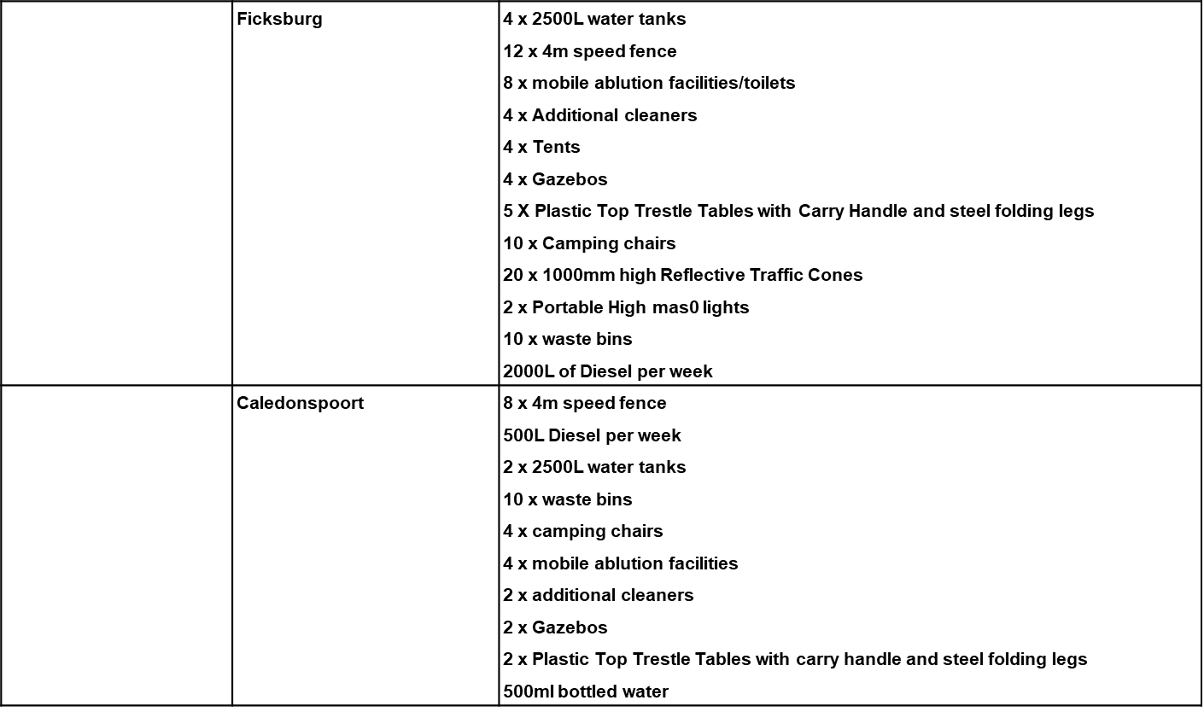

Slide 22
TEMPORARY INFRASTRUCTURE REQUESTED
 |  | 2 x additional cleaners 2 x Gazebos 2 x Plastic Top Trestle Tables with carry handle and steel folding legs 500ml bottled water
 | Van Rooyen’s Gate | 4 x Foldable tables 2 x Gazebos (2.5m x 2.5m) 2 x Chemical toilets 1 x Tent (4m x 4m) 8 x Plastic Chairs 2 x 500L water tanks 200L Diesel 3 x additional cleaners
KwaZulu Natal | Kosi Bay | 2 x VIP Mobile toilets 25 panels of Temporary foldable and extendable barricade fencing (1.9m x 2m wide) 2 x 6m High Mast Mobile lighting Tower 1 x Tent (4m x 4m) 2 x Gazebos (2.5m x 2.5m) 2 x Steel folding tables (189 x 76cm) 4 x COVID-19 desk shields (W600mm x H800mm) 10 x Plastic chairs 8 x 250L Portable water points 1.6-foot operated sanitizer machines and 25L sanitisers 2 x screening booths with shields 2 x Chemical toilets 2 x 5000L Water tanks 3 x Waste bins 2 x Additional cleaners
Secure Borders for Development

Slide 23
PHASE 2: EXECUTION
Slide 23 of 34
Secure Borders for Development

Slide 24
PHASE 2 THE EXECUTION PHASE
The execution phase will start on 7th of December 2022 until the 11th of January 2023 and will include the following:
Daily operations as approved per the category of the port
Ensure the sound collaboration with all stakeholders charged with border control to include authorities of the neighboring country and in the borderline to coordinate functions with the SANDF, SARS and the SAPS.
Enforcement of Legislative and regulatory frameworks within the port of entry
Prevent and intercept all potential security threats including any corrupt activities.
Facilitate the legitimate movement of people and goods
Ensure that the port is without challenges of congestion by involving the counterparts.
Secure Borders for Development

Slide 25
EXECUTION PHASE Cont….
Factors Affecting Execution
Managing of the corridors en route to the ports by enforcing the traffic regulations in conjunction with the traffic departments, the local police and the SANDF
Managing of the traffic contingences for seamless traffic flow especially in the main commercial ports such as Beit Bridge, Lebombo and Maseru Brigde
Engage with all agencies responsible for traffic management and cross border movements
Improved process flow by designating and segregation of vehicle flows
Introducing of proper signage, barricades and marshals
Secure Borders for Development

Slide 26
EXECUTION PHASE factors affecting Cont…
Separation of incoming and outgoing passengers
Dedicated counters for certain travelers for example those from mines and contract workers
Conducting of the daily Joint Operations through the Venue Operational Centre (VOC) for efficient governance to monitor the implementation of the plan.
Ensure the support services on the ICT, for system management
Engage the trucking business on options to have lesser truck movement during peak hours.
Secure Borders for Development

Slide 27
MEDIA AND COMMUNICATION PROTOCOL
Secure Borders for Development

Slide 28
COMMAND AND CONTROL
Overall command and control of all border operations will remain with the Deputy Commissioner Operations on behalf of the Commissioner BMA
PORT Managers are responsible for the coordination of activities at the port of entry and segments of the borderline, such coordination should also be done in the cascading Provincial Joint Structures
Any intervention required by the departments not represented at the port committee, must be communicated via the NBMCC
Secure Borders for Development

Slide 29
ESCALATION PROTOCOL
To streamline and ensuring proper operational management and information flow from the POE to the NBMCC, BMA and supporting government structures.
It is imperative that individual departments are responsive to matters related to their respective mandates. This will ensure that operations management across the spectrum is seamless and services are delivered efficiently and effectively.
The escalating protocol is in line with the recognized and approved structures to manage the border environment as illustrated below:
Secure Borders for Development

Slide 30
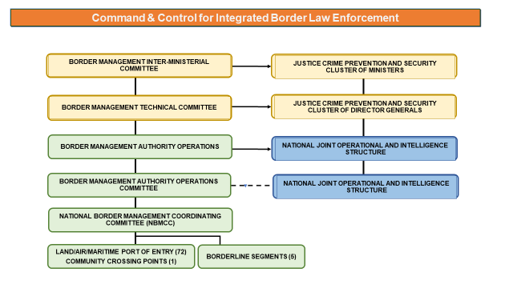
ESCALATION PROTOCOL CONT…
Secure Borders for Development

Slide 31
PHASE 3: DEMOBILIZATION
Slide 31 of 34
Secure Borders for Development

Slide 32
PHASE 3- WITHDRAWAL OF STAFF & WRAPPING UP OF OPERATIONS
Demobilization & withdrawal
This phase of the operations commences on 12 January 2023 and includes the wrapping of operations. Debriefing of the 2022/23 Festive Season periods and withdrawal from deployments where applicable.
By this time all travelers would have entered and operations at ports turned to normal.
Secure Borders for Development

Slide 33
RECOMMENDATION:
It is recommended that the Portfolio Committee should:
note and support the 2022/23 festive Season plan in the Border environment.
Secure Borders for Development

Slide 34
THANK YOU!
Slide 34 of 34
Secure Borders for Development

