Slide 1
PORTFOLIO COMMITTEE ON COOPERATIVE GOVERNANCE AND TRADITIONAL AFFAIRS
PRESENTED BY: EXECUTIVE MAYOR: CLLR MOTSEOKAE SENSE MAJE
14 NOVEMBER 2022

Slide 2
Outline
Background
Current Status Quo: Political & Administrative
Service Delivery Challenges
Support to Kagisano-Molopo LM
Planned Projects
Conclusion

Slide 3
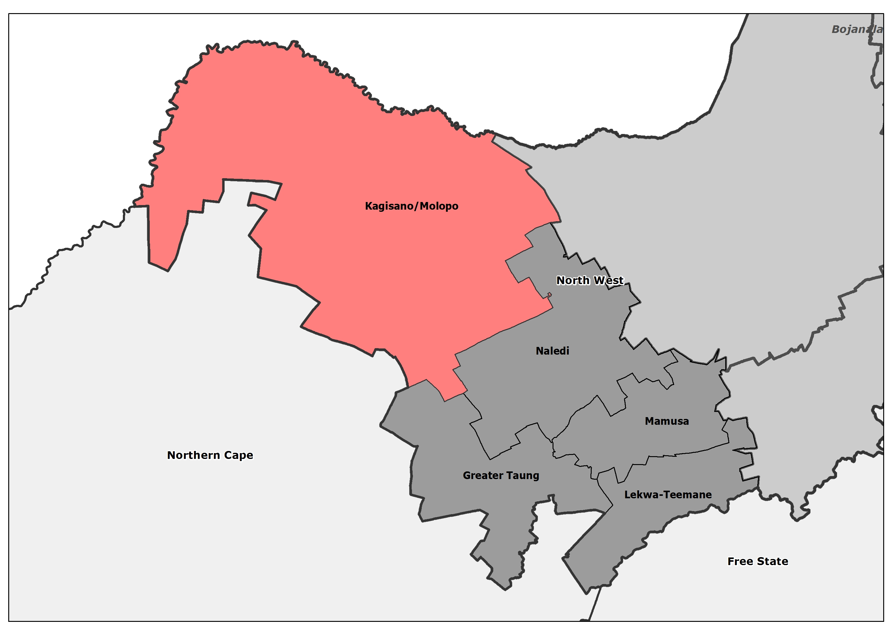
Background
Kagisano-Molopo Local Municipality (NW 397), is a Category B Municipality within Dr Ruth Segomotsi Mompati District Municipality (DRRSMDM)
Is 23 827 km² in extent in the north-western corner of the North West Province.
It borders on the Kgalagadi District of the Republic of Botswana to the north, Joe Morolong Local Municipality in the Northern Cape Province to the south-west , Naledi Local Municipality to the south-east, and Ratlou Local Municipality to the east.
The second largest local municipality within district as with 15 wards and over 72 Villages the administrative centre is in Ganyesa.
It has population of about 102703 (Census 2016)
About 46% of household have access to piped tap water (Kagisano-Molopo IDP, 2022).
84% of households access to sanitation, i.e. use VIPs (Kagisano-Molopo IDP, 2022).
74% of household in Kagisano Molopo use prepaid meter electricity (Kagisano-Molopo IDP, 2022).
92% of households in the municipality use own refuse dumps (Kagisano-Molopo IDP, 2022).
Has about 28 274 household (Census 2016)
Has 29 Councillors, ANC= 20, EFF+4, AICM=2, DA=2, UCDP=1

Slide 4
Current Status Quo: Political & Administrative
Since the November 2021, the municipality has been beset with political and administrative challenges,
The Municipal Manager (MM) was central to the instability of the municipality, however his contracted ended and has taken municipality to court.
Municipality placed under Section 139(b) of the Constitution
Administrator appointed, together with Acting Municipal Manager (AMM)
Currently since the former MM left and intervention ensued, there has been stability in the municipality e.g. council had meeting without hinderance, Administrator and AMM hit the ground run by ensuring administration does its work, nor more work stoppages.

Slide 5
Service Delivery Challenges
Provision of water, eg. Uninterrupted water supply to all the areas
Provision of sanitation services to all the wards not covered, e.g. VIP toilets
Currently no SLA with KMLM
Upgrading of roads
Unlawful Waste Water Disposal
No landfill Site
Staff turnover, e.g. there are critical vacant positions in the Engineering & Technical Services

Slide 6
Support to Kagisano-Molopo LM
The DRRSMDM is the Water Service Authority (WSA) and has mandate to provide uninterrupted water and sanitation to the municipality as a whole.
For the 2022/23 MTREF Budget the DRRSMDM has set aside allocations across various grants
There has been delays with the Implementation Readiness Study (IRS) approvals from the Dept Water Sanitation (DWS), however both District and DWS are solving the issues, eg. IRS are currently being resolved.
The KMLM has sent a letter on 04th November 2022 requesting to be assisted with water shortages at Bona-Bona
District supported with extinguishing veld fires that ravaged the area recently.
The District is prepared to provide administrative, financial and technical support ito of Section 88 of the Structures Act as when required, already there is a request to provide ICT support to the municipality and is being considered.
Extensively consulted with KMLM on the District Development Model (DDM) to identify key catalytic projects to be implemented and supported e.g. smart village concept to alleviate water challenges, landfill site development, job creation projects (Motlopi Coffee, Devil’s Claw) etc.

Slide 7
PLANNED PROJECTS FOR KMLM
MIG CAPITAL PROJECTS
Local Municipality | Project Description | Project Number | Type | Adjustment Budget 21/22 | Budget 22/23 | Budget 23/24 | Budget 24/25
Kagisano Molopo | Dr RSM DM Rural Sanitation | MIG/NW2266/S/15/23 | New | R40,000,000 | R25,000,000 | R30,000,000 | R40,000,000

Slide 8
PLANNED PROJECTS FOR KMLM
WSIG CAPITAL PROJECTS
Local Municipality | Project Description | Project Number | Type | Adjustment Budget 21/22 | Budget 22/23 | Budget 23/24 | Budget 24/25
Kagisano Molopo | Rural Water Programme 2020/2023 - Mabone |  | New | - | R18,000,000 | R11,000,000 | -
 | Rural Water Programme 2020/2023 - Bray |  | New | R16,000,000 | R10,000,000 | - | -
 | Rural Water Programme 2020/2023 - Dipudi |  | Upgrading | R13,000,000 | R15,000,000 | - | -
 | Rural Water Programme 2020/2023 - Tlakgameng |  | New | - | - | R26,000,000 | -
 | Rural Water Programme 2020/2023 - Piet Plessis - Phase 2 |  | New | - | R6,522,000 | - | -
 | Rural Water Programme 2020/2023 - Matlhabetlhabe |  | New | - | - | R16,000,000 | -
Total |  |  |  | R29,000,000 | R49,522,000 | R53,000,000 | 0

Slide 9
PLANNED PROJECTS FOR KMLM
RBIG CAPITAL PROJECTS
Local Municipality | Project Description | Project Number | Type | Adjustment Budget 21/22 | Budget 22/23 | Budget 23/24 | Budget 24/25
Kagisano Molopo | Bulk Water Implementation: Bona Bona Cluster |  | New | R75,000,000 | R10,000,000 | - | -
 | Bulk Water Implementation: Tlapeng Cluster |  | New | R50,000,000 | R33,861,000 | R20,038,000 | -
 | Upgrading of bulk water to Ganyesa Cluster |  | New | R5,000,000 | R35,000,000 | R80,000,000 | R15,000,000
 | Upgrading of bulk water to Tseoge Cluster |  | New | R2,000,000 | R15,000,000 | R30,000,000 | R70,000,000
 | Upgrading of bulk water to Tlakgameng Cluster |  | New | R3,000,000 | R20,000,000 | R75,000,000 | R35,000,000
 | Upgrading of bulk water to Morokweng Cluster |  | New | R3,000,000 | R20,000,000 | R20,000,000 | R80,000,000
 | Upgrading of bulk water to Bray & Tosca Cluster |  | New | R7,000,000 | R20,000,000 | R87,000,000 | R33,911,000
Total |  |  |  | R145,000,000 | R156,861,000 | R312,038,000 | R233,911,000

Slide 10
CONCLUSION
On the 8th November 2022 Council has resolved to sign off the Service Delivery Agreement with Magalies Water Board (MWB). This will ensure that the services previously performed by Sedibeng WB will be carried out by MWB without haste.
Fast-track resolving the approval of the IRS with DWS to unblock the Bona-Bona Cluster which is experiencing water shortages
Address the water shortages in the Bray/Pomfret area, drilling and equipping of boreholes
Appointed substantive Municipal Manager with effect from 1st December 2022
Advertised the position of Senior Manager: Technical Appointing closing 21 November 2022.
Support with administrative, financial and technical as a when needed by KMLM
Continue with engagements on the DDM, to realize planned interventions and projects included in the District One Plan.

