Slide 1
Tobacco Tax Make it work
Parliament
15 November 2022
© Copyright exists in entire presentation ©
Prepared by peter@peterucko.com +27 82 454 9889
Notes:
Tax is a tool

Slide 2
The Constitution of the
Republic of South Africa Act 108 / 1996
There is
NO right
to smoke
Notes:
Must be clear about this. Not anywhere. Not any time.
Choice – then No choice – Addiction. But must protect other’s right to Clean Air (Sect 24 Const)

Slide 3
Recommendations:
Increase the current excise by
at least 20%
Aim for a result of increasing the
RSP by Inflation plus 15%
Illicit Trade is serious. Tax will NOT
increase it. Illicit trade is a CRIMINAL
act.
Notes:
Better to make it 25%. But changing the way things have been done at 20% is at least a start. RSP up by

Slide 4
Tax as a successful tool
Must be applied
CONSISTENTLY
so that cigarettes become
PROGRESSIVELY
more expensive and less affordable

Slide 5
Make HEALTH tax
Benefit
HEALTH

Slide 6
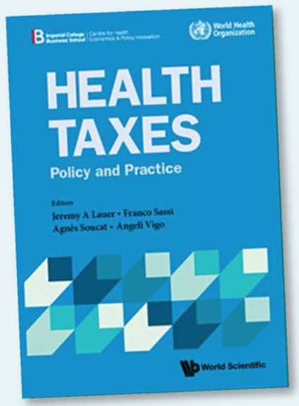
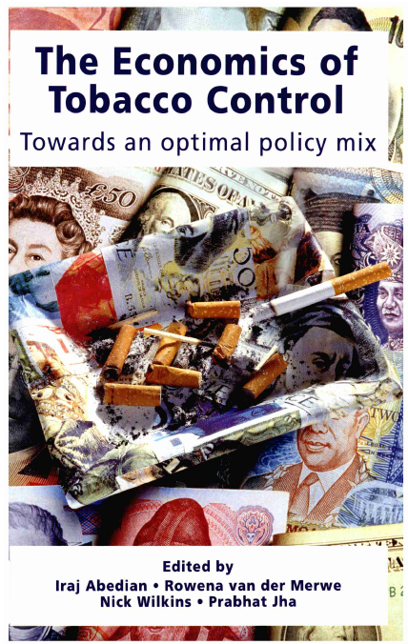
Notes:
1998 Iraj Abedian et al. 2022 WHO – Health Taxes. NOT Sin tax. Tax is a tool that, when used correctly, can save the country money. Apply Consistently to make tobacco products Progressively less affordable. Not increase only tax component above inflation. Negligible effect on affordability. Net effect less than Half of inflation.
Recent: Economic Cost of Smoking in SA. 2021 Boachie, Roussow L & Ross H.

Slide 7
What is lost if everyone stopped smoking today?
NOTHING
Money spent on tobacco and tax
doesn’t vanish
Notes:
Money spent on tobacco doesn’t disappear. Spent on other goods yielding VAT and other taxes. Creating jobs.
Spent on important things. Clothing, housing - shelter, books, nutrition, Education.

Slide 8
What is gained if everyone stops smoking
EVERYTHING
Lives. Breadwinners. Teachers. MPs. Public healthcare costs. Less cleaning chemical pollutants.
The youth. Less deforestation

Slide 9
IMPORTANT NO Job losses
Cigarettes are made by machines.
Not PEOPLE
No jobs will be lost. More jobs created in other industries
Notes:
Industry will tell you that millions. Billions, GaZillions (they do tend to exaggerate) of jobs depend on tobacco. But a supermarket won’t close if cigarettes are not sold. Or any single item.
Create jobs in other people intensive industries

Slide 10
Pollution reduced
24 billion cigarettes = 1.2 billion packs
57 m X 900 m X 0.26 m
heap of discarded packs
10 soccer fields knee deep in trash - EVERY year
Notes:
Ignore cartons and containers in which pack are delivered. Almost 30 km circum.
Pack about 5.7 X 9 X 2.2 cm.
10 000 in a line X 10 000 lines X 12 high Equal to 10 soccer fields.
Imagine that
Plus Thousand or tree destroyed for curing. Just to kill people

Slide 11
Pollution. Rivers and oceans.
Animals and fish die
Cigarette butts. Single use plastic
24 000 000 000
Twenty Four BILLION butts
120 MILLION kg of waste
Notes:
Almost not biodegradable. Gets into the sea and everywhere. And they hold tar etcetera. Poisons. 400 butts for every person in SA every year.
120 Million kg of butts
400 butts for every person in SA every year. 120 Million kg of butts 24 Billion X 5 g = unpronounceable quantity divide by 1000 = 120 Million kg. Car about 2000 kg. This waste equals the mass of 60 000 cars.

Slide 12
Environment
FIRES
Remember Table Mountain?
A HUGE Disaster and one person died
Notes:
About 5% of fires are caused by “discarded smoking material“.
There’s an economic component. COST

Slide 13
The KILLER product
CIGARETTE
The ONLY consumer product that, if used as directed by the manufacturer, will kill half its users prematurely
Notes:
NPA - - the manufacturers and importers and all their executives know that the products KILLS people. Key word – KILL. Why not prosecute them for Murder?
What about a Class Action?

Slide 14
Public Healthcare costs?
R200 Billion ?
How much of this spend is caused by the Dreaded Terrible Triple D?
Notes:
Finance can tell us.

Slide 15
What we Lose
R14.48 Billion lost on tobacco related public health costs. 7.24% LOST
Diseases
Disabilities and
Deaths
Notes:
Treatment before death. Operations like laryngectomy. Chemotherapy.
Ventilators. How many doctors and nurses can be directed to much more meaningful medical duties than those caused by a killer product.

Slide 16
Why is what you do so IMPORTANT?
The aim is L I F E
Save Lives.
Save Individuals.
Save Families.
Save the Environment.
Notes:
Life has a value. An economic advantage

Slide 17
And for ECONOMICS - Finance
The aim is M O N E Y
Save Many Lives.
Save Ordinary people.
Save our Nation.
Save the Environment.
Save the YOURSELF.
Notes:
Save someone you love. Bonus. Save someone you don’t know. Triple bonus.
Every time you save someone you save the world.
It’s Money. Hard Cash. Tobacco Tax a MUST do - - must do well.

Slide 18
Do the Right thing
Make our tax system WORK so that
\\HEALTH Tax
Works for HEALTH
Notes:
Repeat. Increase the tax by 25%. Work towards an annual increase in the RSP of Inflation Plus 15%

