Slide 1
Health Risks associated with the use of Electronic Delivery Systems
Dr Catherine O. Egbe
Specialist Scientist: Tobacco Control
Alcohol, Tobacco and Other Drug Research Unit, SAMRC
(Public hearing on 2022 Rates and TLAB: NCOP Select Finance committee)
15 Nov. 2022

Slide 2
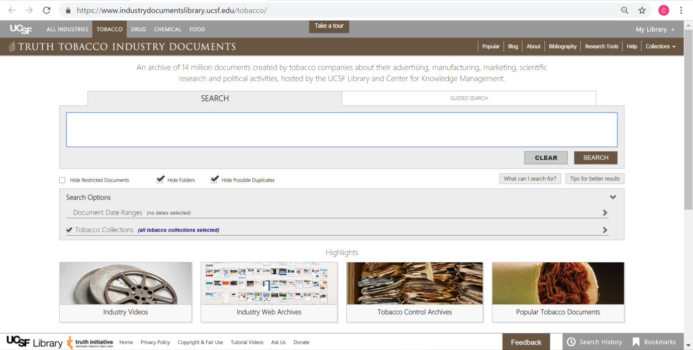
e-cigarette: the origin
The TI’s search for an alternative and less controversial product to replace cigarettes
“Any work undertaken must be with a commercial or political motive as well as a scientific motive. The object is for the company to be able to say that, in the light of all available knowledge, it "... is doing its best to supply a 'safer' smoke."
(Letter from BAT to B&W’s president Ed Finch, 1964)

Slide 3
Harmful effects of nicotine
90 animal and human studies
Investigated only the role of nicotine on organ systems
Excluded studies evaluating tobacco use and smoking
Conclusion: “The use of nicotine needs regulation. The sale of nicotine should be under supervision of trained medical personnel.”
Notes:
https://www.ncbi.nlm.nih.gov/pmc/articles/PMC4363846/
90 relevant articles were included in the review. All the animal and human studies that investigated the role of nicotine on organ systems were analyzed. Studies that evaluated tobacco use and smoking were excluded.

Slide 4
Nicotine has been found to be harmful to the developing brain
Younger users are more likely to become addicted, have more difficulty quitting, and may be at a higher risk for addiction to other substances in the future

Slide 5
Tobacco and lung cancer: The history
Cigarettes were recognised as the cause of the lung cancer epidemic starting from the 1930s based on 4 types of scientific evidence
Confluence of studies
1.
Epidemiology
2.
Animal experiments
3.
Cellular pathology
4.
Chemical analytics

Slide 6
Evidence of the health effects of e-cigs
Confluence
of studies
1.
Epidemiology
2.
Animal experiments
3.
Cellular pathology
4.
Chemical analytics

Slide 7
Evidence of the health effects of e-cigs
1.
Epidemiology
Population studies (2021)
132 papers

Slide 8
Evidence of the health effects of e-cigs
2.
Animal experiments
Published March 2021
Synthesized evidence from 106 papers
Animal and human studies

Slide 9
Evidence of the health effects of e-cigs
3.
Cellular pathology
Published March 2021
Synthesized evidence from 106 papers
Animal and human studies

Slide 10
Evidence of the health effects of e-cigs
3.
Cellular pathology

Slide 11
Evidence of the health effects of e-cigs
4.
Chemical analytics
Electronic cigarettes contain:
Ultrafine particles that can be inhaled deep into the lungs
Flavorants such as diacetyl, a chemical linked to serious lung disease
Volatile organic compounds
Heavy metals, such as nickel, tin, arsenic, cadmium, and lead
Injury as a result of battery explosion

Slide 12
What are other health bodies saying?
Careful and precautionary approach
Effective regulation is needed to reduce harm to users and non-users
WHO: "Switching from conventional tobacco products to e-cigarettes is not quitting" ... "e-cigarettes are not proven cessation aids“
EU Scientific Committee on Health, Environmental and Emerging Risks: “the evidence basis for potential harms from e-cigarette use (respiratory and cardiovascular systems, increased smoking by young people, etc) was stronger than the evidence basis for potential benefits (helping smokers quit or cut down)

Slide 13
E-cigarettes taxation (TLAB 2022): we recommend
Imposition of a flat tax of at least R5/mil of e-liquids regardless of nicotine concentration
Because even a R5/mil tax would only make little impact on the price of these products to deter adolescents from purchasing them. We also recommend a base tax of R50 per unit
Apply an ad valorem tax on the devices and other accessories like batteries
That this new tax be used to aid the costs of implementation of regulations for electronic cigarettes and other tobacco control measures as well as cessation programmes for those who would need assistance to quite nicotine addiction

Slide 14
GATS: Tobacco use in South Africa versus other African countries

Slide 15
cigarettes taxation in the 2022 rates bill
The WHO outlines the advantages of taxes of tobacco products as follows:
“Tobacco taxes save lives, mobilize resources, address health inequities, reduce health system burdens and costs, and target noncommunicable risk factors for the achievement of Sustainable Development Goals (SDGs)”
All of the above are important for the success of the National Health Insurance Scheme
We call for an increase that is based above inflation which is currently at 7.5% (September 2022 )
A tax of at least 10% is more feasible to achieve the purpose of imposing these tobacco taxes which is to prevent youth initiation and encourage cessation.

