Slide 1
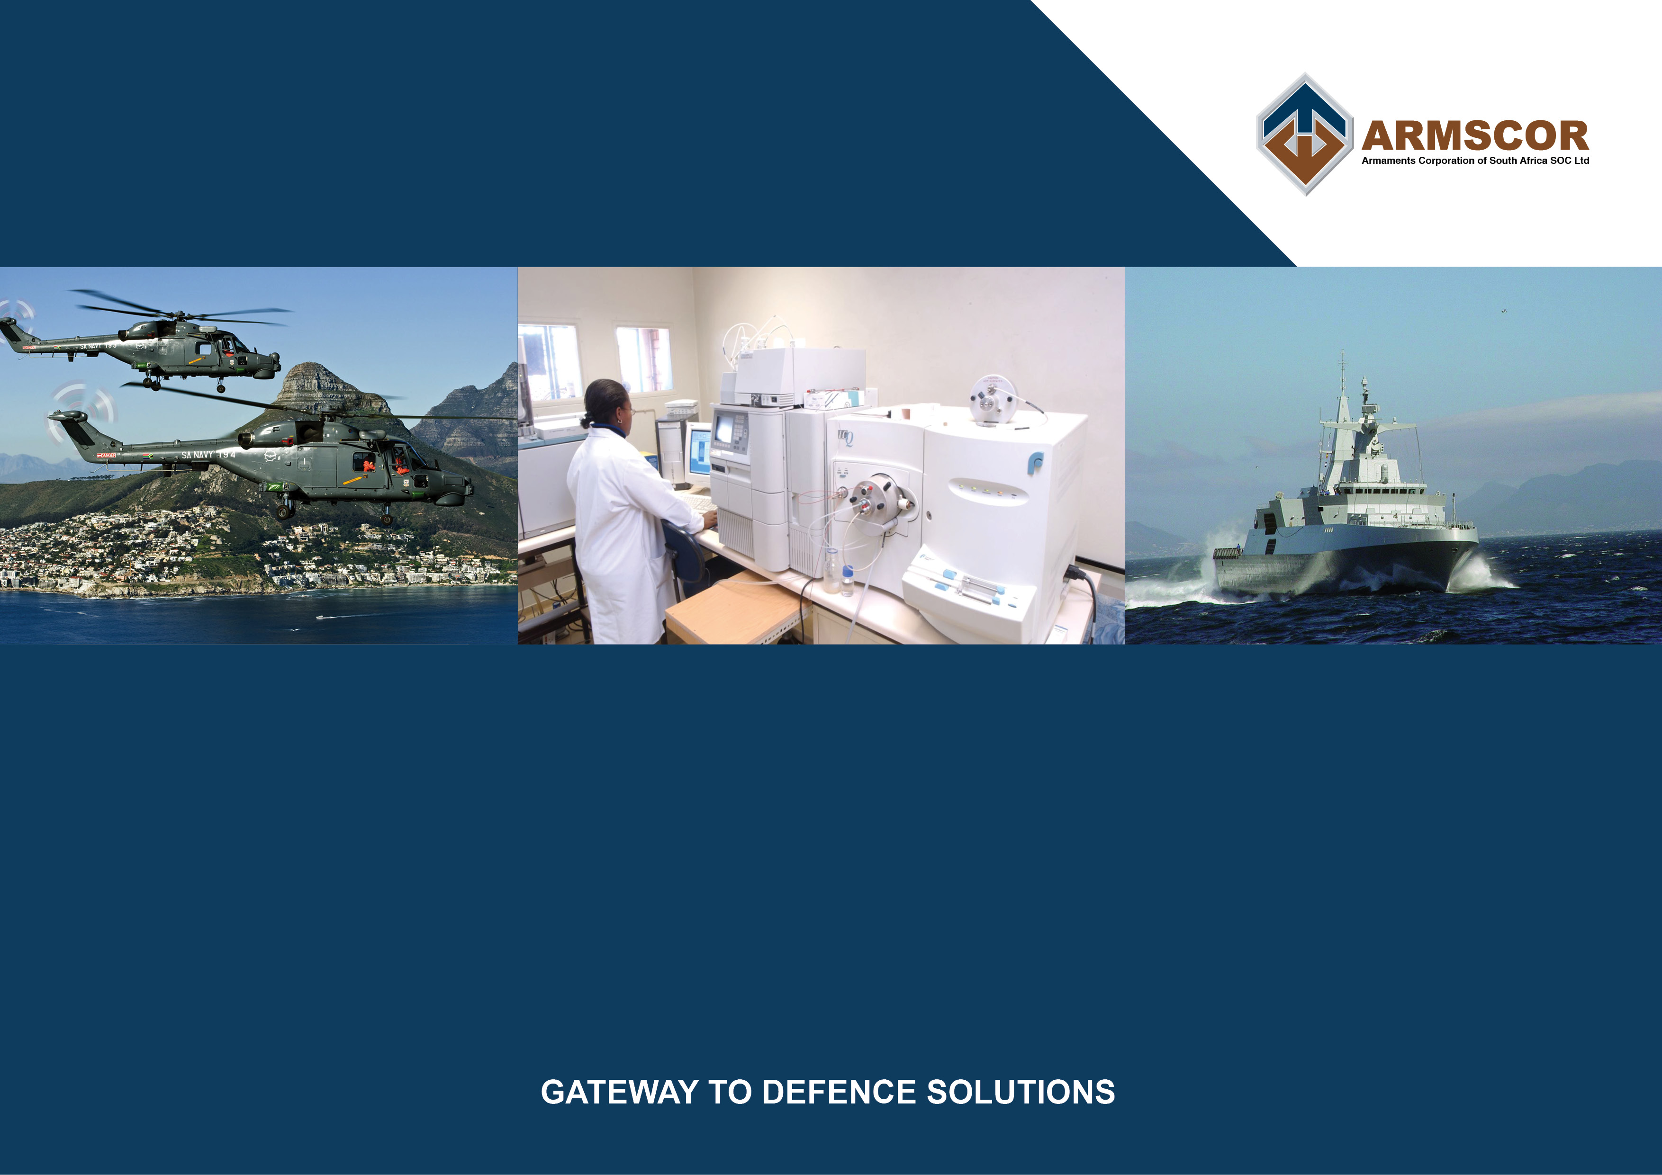
ARMSCOR/DOD SERVICE LEVEL AGREEMENT
Armscor Performance Against Agreed Goals

Slide 2
Introduction
The services provided by Armscor to the DOD, are in accordance with the Armscor Act.
The Service Level Agreement (SLA) between Armscor and the DOD reflects the scope of services to be provided by Armscor, based on the legislated role and functions of Armscor.
The SLA is valid for a four year period and is reviewed and updated during the last year of the contracted period, or whenever circumstances so require.
The current SLA, signed between the Secretary for Defence and the CEO of Armscor, was concluded on 26 March 2022, and is valid from 1 April 2022 to 31 March 2025.
In addition the detailing the scope of services to be provided by Armscor, the SLA contains a number of Key Performance Indicators (KPI’s) that have been agreed between Armscor and the DOD, and Armscor is measured against those KPI’s on a quarterly basis.

Slide 3
Key Performance Indicators
The following KPI’s have been agreed for Armscor in the current SLA :
Percentage of Capital requirements converted into orders placed – 95% objective.
Execution of Capital contracts as measured through actual cash flow (adjusted for factors beyond Armscor’s control) on DOD orders placed – 95% objective.
Percentage of System Support and Procurement requirements converted into orders placed – 95% objective.
Execution of System Support and Procurement contracts as measured through actual cash flow (adjusted for factors beyond Armscor’s control) on DOD orders placed – 95% objective.
Average time taken to convert DOD requirements into orders – from receipt of requirement to placement of orders, excluding time taken for FA approval :
  For GDA-funded COTS procurement using shortened tender process – 90 days objective
  For GDA-funded non-COTS procurement and Product Support – 120 days objective
  For SDA-funded Capital acquisition programs – 140 days objective
Value of Defence Industrial Participation credits granted (measured against planned value) – 100% objective.
Percentage execution of technology requirements, measured against contractual milestones/deliveries as per agreed MOA – 95% objective.
Armscor to obtain unqualified audit report from the Auditor General.

Slide 4
Dockyard-Related Key Performance Indicators
Percentage of project tasking and job cards executed – 90% objective.
Percentage of compliance to project finance (measured against approved financial authorities and cash-flow plan) – 90% objective.
Percentage of ancillary services executed (measured against Dockyard Business Plan) – 95% objective.
Percentage of training requests executed (measured against requirements submitted by the SA Navy) – 100% objective.
Percentage compliance with quarterly report timelines (measured against reporting timeline schedule) – 100% objective

Slide 5
Armscor Performance Against SLA –
At 31 October 2022
Nº | KPI Description | Objective | Actual Performance | Notes
1 | Percentage of Capital requirements converted into orders placed | 95% | 136.10% | Target exceeded
2 | Capital contracts cash flow | 95% | 93.67% | Target not met due to delays in 2 projects where contractors are experiencing financial difficulties.
3 | Percentage of System Support and Procurement requirements converted into orders placed | 95% | 102.03% | Target exceeded
4 | System Support and Procurement contracts cash flow | 95% | 104.96% | Target exceeded
5 | Average time taken to convert DOD requirements into orders COTS procurement Non-COTS and Support Capital Projects | 90 days 120 days 140 days | 103 days 86 days 113 days | Not met due to repeated no-bids Target exceeded Target exceeded

Slide 6
Armscor Performance Against SLA –
At 31 October 2022 (2)
Nº | KPI Description | Objective | Actual Performance | Notes
6 | Value of Defence Industrial Participation credits granted | RM111.31 until 31/3/23 | RM8.13 to date | Expected underperformance due to planned Project Biro credits already claimed during 21/22
7 | Execution of technology requirements | RM28.78 | RM19.74 | Target not met due to delays in the procurement and delivery of required specialised equipment.
8 | Armscor to obtain unqualified audit report from the Auditor General |  |  | To be assessed after the end of the financial year.

Slide 7
Dockyard Performance Against SLA –
At 31 October 2022
Nº | KPI Description | Objective | Actual Performance | Notes
1 | Percentage of project tasking and job cards executed | 90% | 80% | Critical enablers still major issue in the execution of projects and ad-hoc activities: Most activities were deferred until enablers are available.
2 | Percentage of compliance to project finance | 90% | 46.72% | Projected achievement of target by financial year-end
3 | Percentage of ancillary services executed | 95% | 99.1% | Target exceeded
4 | Percentage of training requests executed | 100% | 100% | Target achieved
5 | Percentage compliance with quarterly report timelines | 100% | 100% | Target achieved

Slide 8
SAAF Aircraft Support Contracts
Introduction
Support contracts for SAAF Aircraft support is funded from the limited SAAF operating budget.
Funds have to be prioritised for allocation to the respective aircraft fleets.
Funding challenges inevitably result in under-funded support contracts as well as delays in receiving funding allocations to facilitate the placement of support contracts.
Funding limitations are resulting in challenges with negotiating support contracts with OEM’s that meet all SAAF requirements – this leads to delays in contract placement as well as periods with no support contracts for affected aircraft.

Slide 9
Status of SAAF Aircraft Support Contracts
Transport aircraft
Product System | Support Contract Status
Boeing Business Jet | Current contract expires on 30/11/22. Placement of new contract in process and is anticipated to run from 1/12/22
Falcon Aircraft Fleet | Contract expired 1/7/22. New contract placement planned for 1/12/22
Hercules C130BZ | Contract extended to 31/12/22. New contract in process for placement by 1/1/23
Casa Fleet | New contract in place since 1/08/22
Dakota C47-TP | No contract since 31/3/17. New contract planned for placement from 1/12/22
Beechcraft King Air | Current contract in place until 15/02/23. New contract offer solicitation in process.
Cessna C 208 | Current contract valid till 15/12/22. New contract placement in process.

Slide 10
Status of SAAF Aircraft Support Contracts
Helicopters
Product System | Support Contract Status
Oryx Medium Transport Helicopter | Contract valid until September 2023.
Rooivalk Combat Support Helicopter | Contract valid until September 2023
BK117 Helicopter | Contract expired on 31/3/22. Armscor still awaiting Requirement from the SAAF
A109 Light Utility Helicopter | Contract valid until 30/11/22. New contract in process for placement by 1/12/22
Lynx Maritime Helicopter | Contract valid until 1/9/23. Armscor is in process of contracting for long lead spares.

Slide 11
Status of SAAF Aircraft Support Contracts
Fighter aircraft
Product System | Support Contract Status
SAAB Gripen Advanced Light Fighter | Contract for airframe support in place since 1/9/22. Contract for GKN engine in process for placement by 1/12/22
BAE Hawk 120 | Support contracts valid until 30/06/24
Pilatus PC7 MkII | Contract on OEM valid until 15/3/23. Contact for local support in process

Slide 12
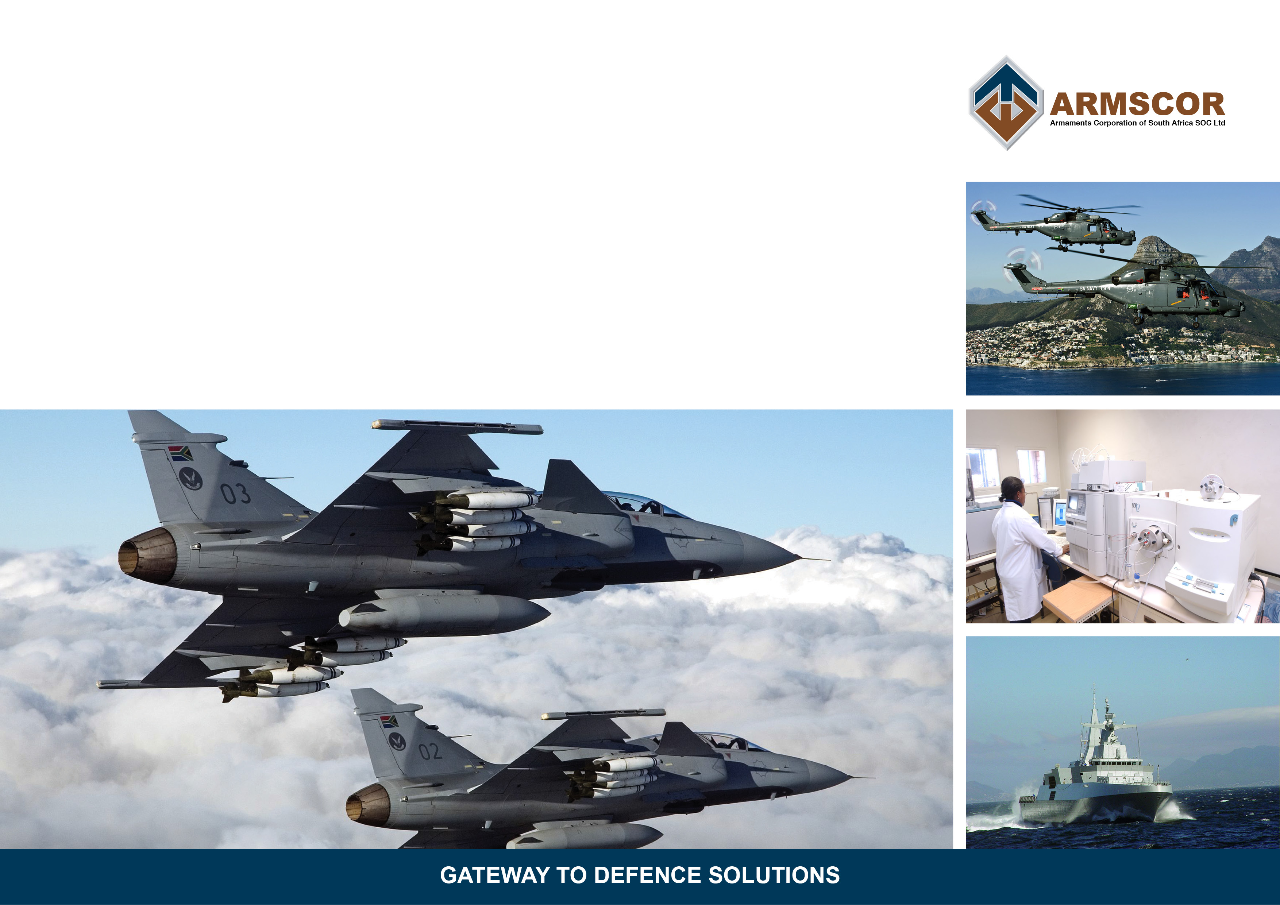
Questions ?

