Slide 1
SRC Presentation Portfolio Committee
T.B Mofokeng ISRC President

Slide 3
Table of contents
Introduction.
Role and Composition of the SRC
ISRC Program of action.
State affairs of the College.
Challenges and Recommendations.
SRC support to the students.
Conclusion.

Slide 4
Introduction
“The beautiful thing about learning is that no one can take it away from you.”
-B.B. King

Slide 5
Role and Composition of SRC.
A Student Representative Council (SRC) is a group of students elected by their peers to represent all students within the Institution. SRC works democratically to represent the student body in college decision-making and organize ways for students to participate in and have a fruitful academic year.
Motheo TVET College hosts its SRC Elections on an annual bases during the first quarter of the year, this process happens during the month of February or early March.
SRC of Motheo TVET College is composed of two bodies namely; Institutional SRC and Campus SRC. The institution has in total 7 Campuses across Free State and each campus has SRC members that are represented on campus level and ISRC represented in the institutional level.

Slide 6
SRC Structure
INSTITUTIONAL SRC | Campus SRC
President General | 1. Campus Chairperson
2. Deputy President | 2. Secretary
3. Secretary General | 3. Academic Officer
4. Deputy Secretary General | 4. Sports Officer
5. Treasure General | 5. Disability Officer
6. Sports arts and recreation Officer
7. Gender and disability Officer 8. Media and Publicity Officer 9. Academic Officer

Slide 7
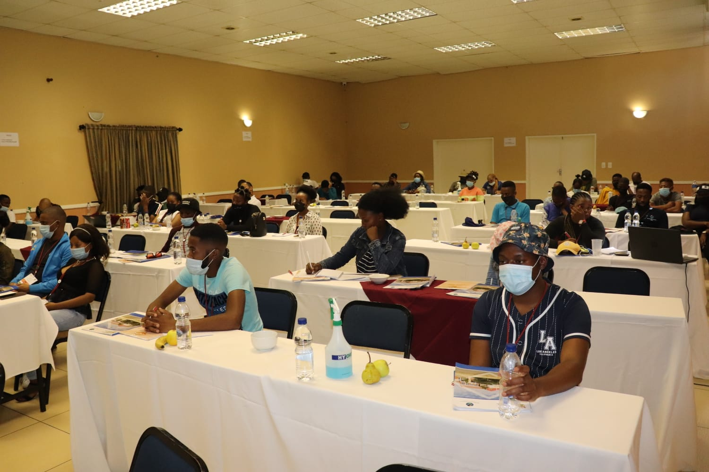
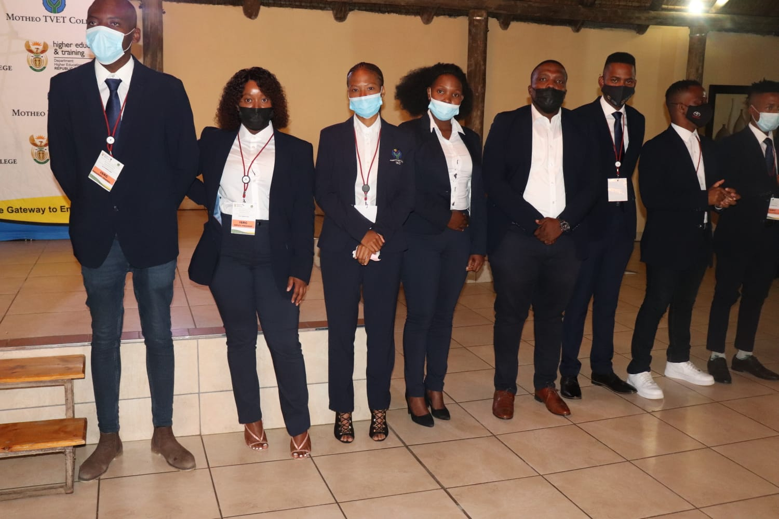
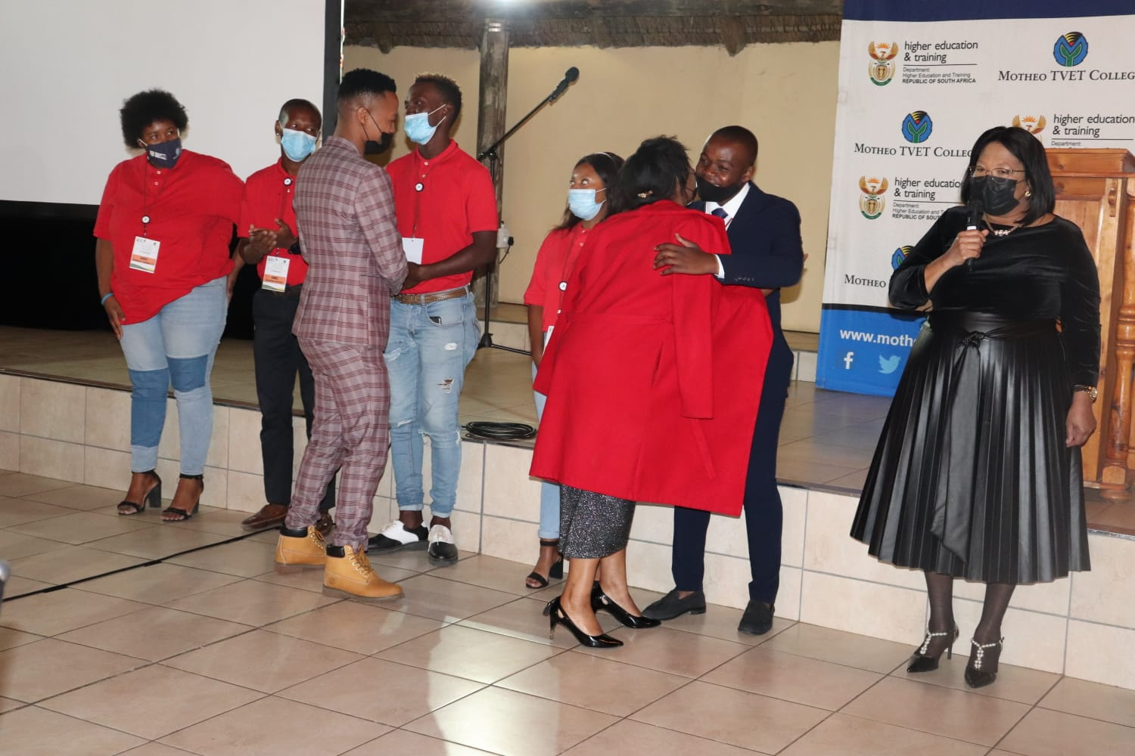
INAUGURATION OF THE SRC
The main purpose of the inauguration is to officially welcome the newly elected SRC members into their positions and induct them about student governance.

Slide 8
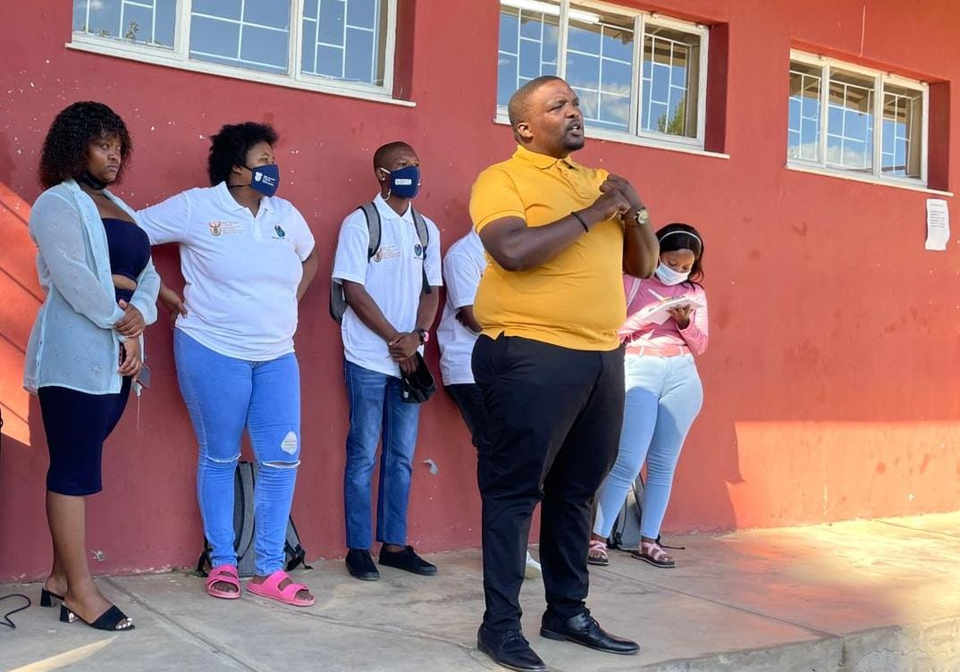
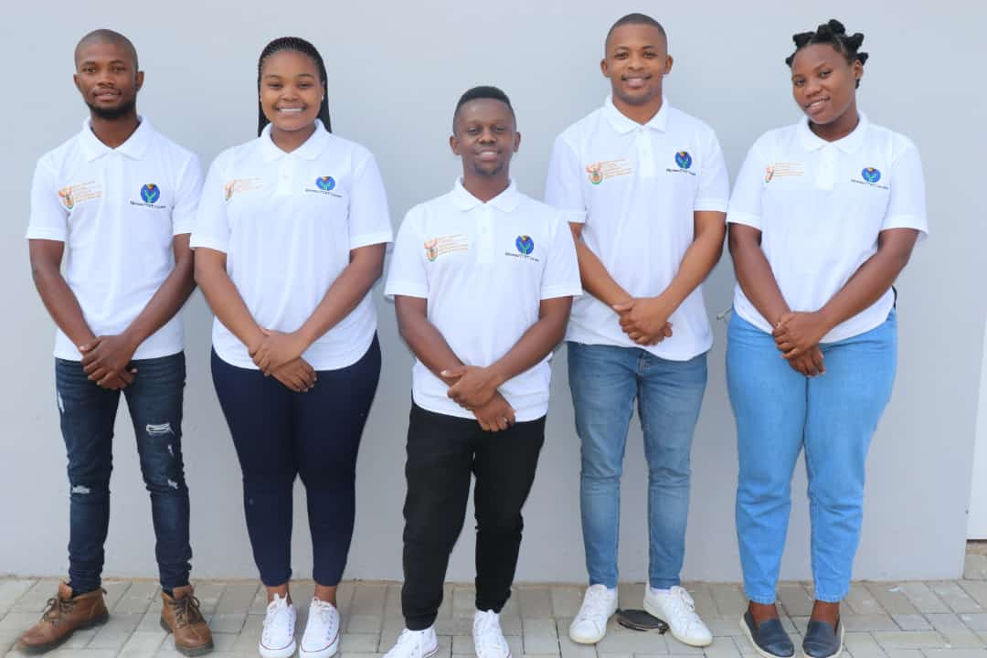
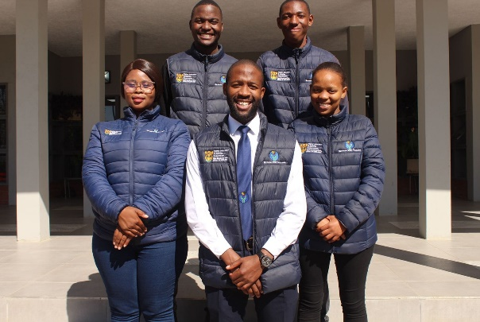
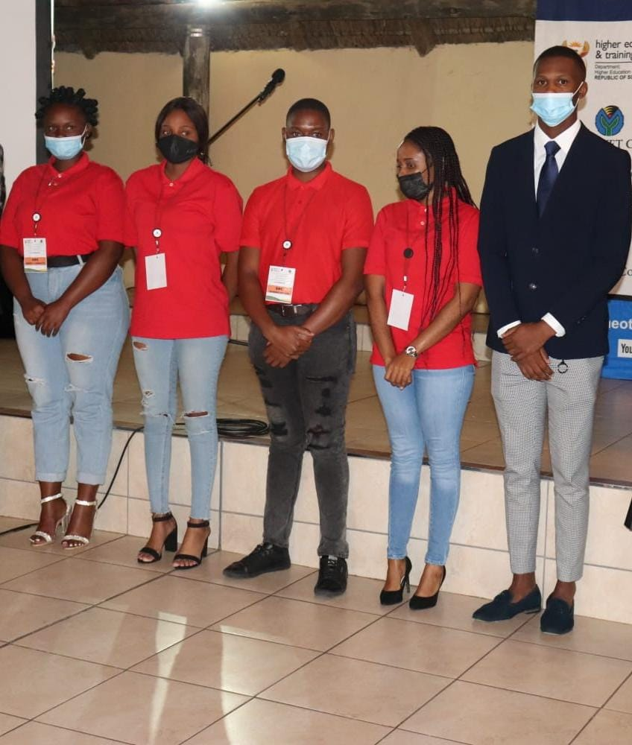
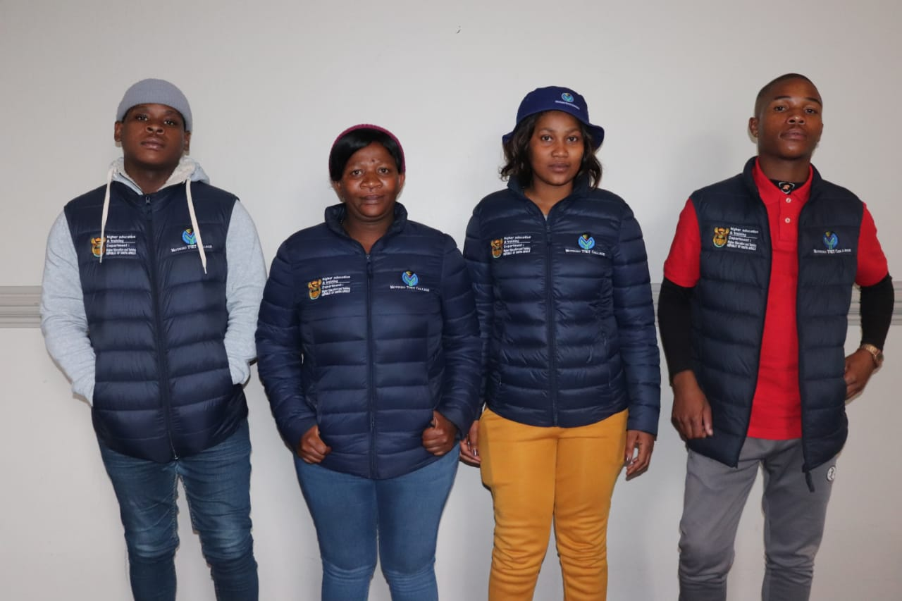
SRC Photos

Slide 9
ISRC PROGRAMS of Action progress
PROGRAMME | DATE | DONE | PENDING | PROGRESS
Academic Conference | 12th – 14th August | x
NSFAS & Workshop | 2nd of July | x
Health awareness | July |  |  | Not done
Casual day | September
Inter-campus tournament | August
Heritage day | September

Slide 10
Continuation
PROGRAM | DATE | DONE | PENDING | PROGRESS
Mr & Ms Motheo | October
Policy Summit | October
Student Parliament | Nov/Dec

Slide 11
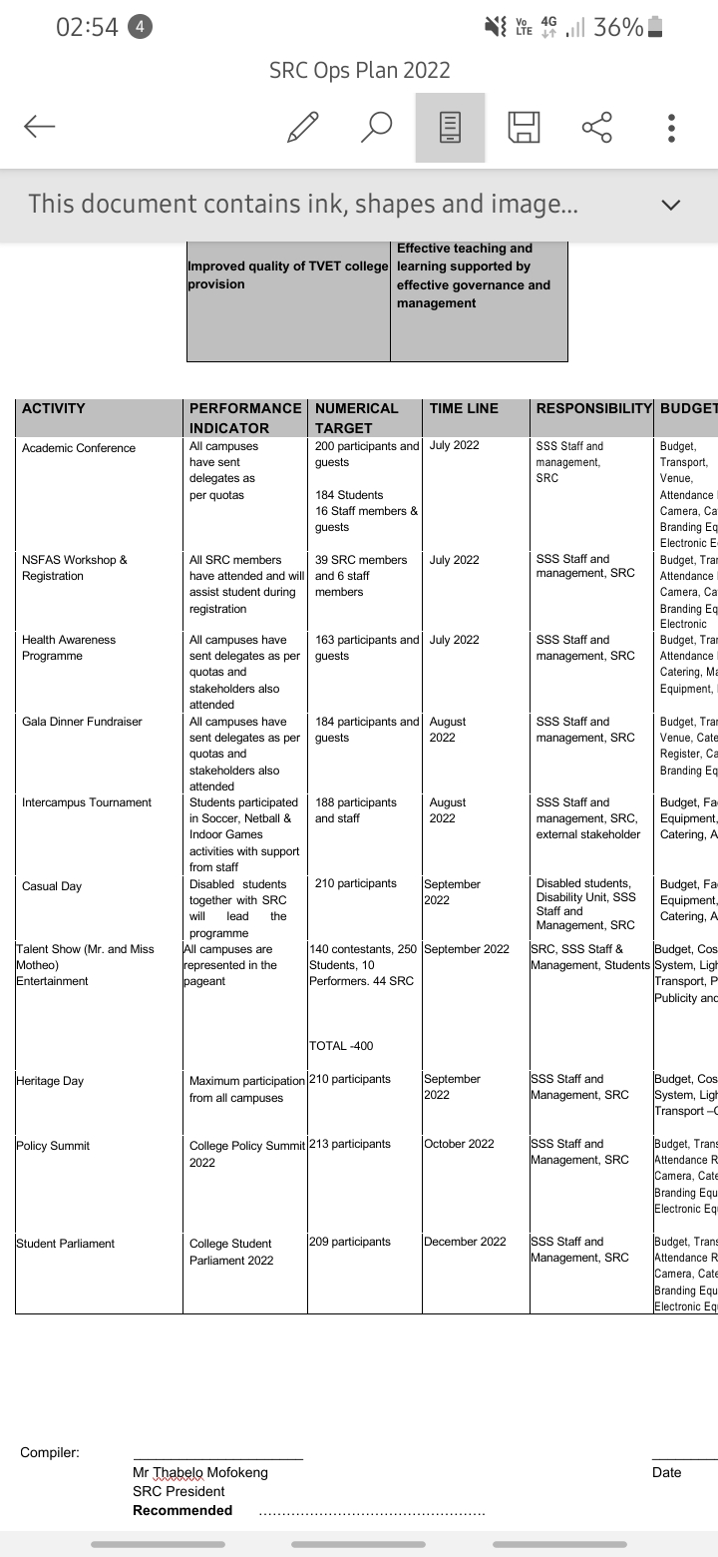
ISRC POA 2022 STRUCTURE

Slide 12
ISRC ACHIEVED PROGRAMS

Slide 13
11th Academic conference
The 11th Academic Conference of Motheo TVET College commenced on the 12th to the 14th of August 2022 under the theme: “Inspiration is the starting point of our journey to success” to advocate for Academic Excellence which will improve the capacity of teaching and learning and a steering wheel to the Gateway to Employability.
The expected number of delegates was 184 from all seven campuses and 179 delegates were present.
Expected guests were 15, present guests were 8.
The conference curated, able to proceed and was efficient as per expectations.

Slide 14
11th Academic conference cont…
The goal of the Academic Conference is to ensure that academic related processes in the institution are developed to the best interest of the stakeholders (students), policies that are academic binding are reviewed and implemented for the greater good of the students.
The expected outcome of the 11th Academic conference was that the resolutions of this conference should be implemented in different campuses. The academic and transformation officer is expected to present these resolutions to the academic board and the Secretary to include these resolutions in her report to be presented in the college council for adoption and approval.
The Campus SRC is expected to take the direction of the resolutions made in the implementation of their programme of action. The present delegation is expected to report back to their fellow students.

Slide 15
There were five commissions discussed under the following topics which include all student challenges and the resolutions to move forward as a college.
Commission 1 – How to improve student life at campus.
Commission 2 – Should peer tutoring be formalized.
Commission 3 – Associating student wellbeing with academic performance.
Commission 4 – impact of the late NSFAS payment to academics.
Commission 5 – Academic exclusion.

Slide 16
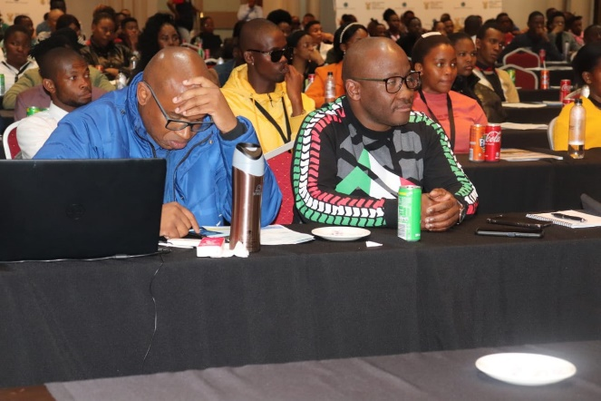
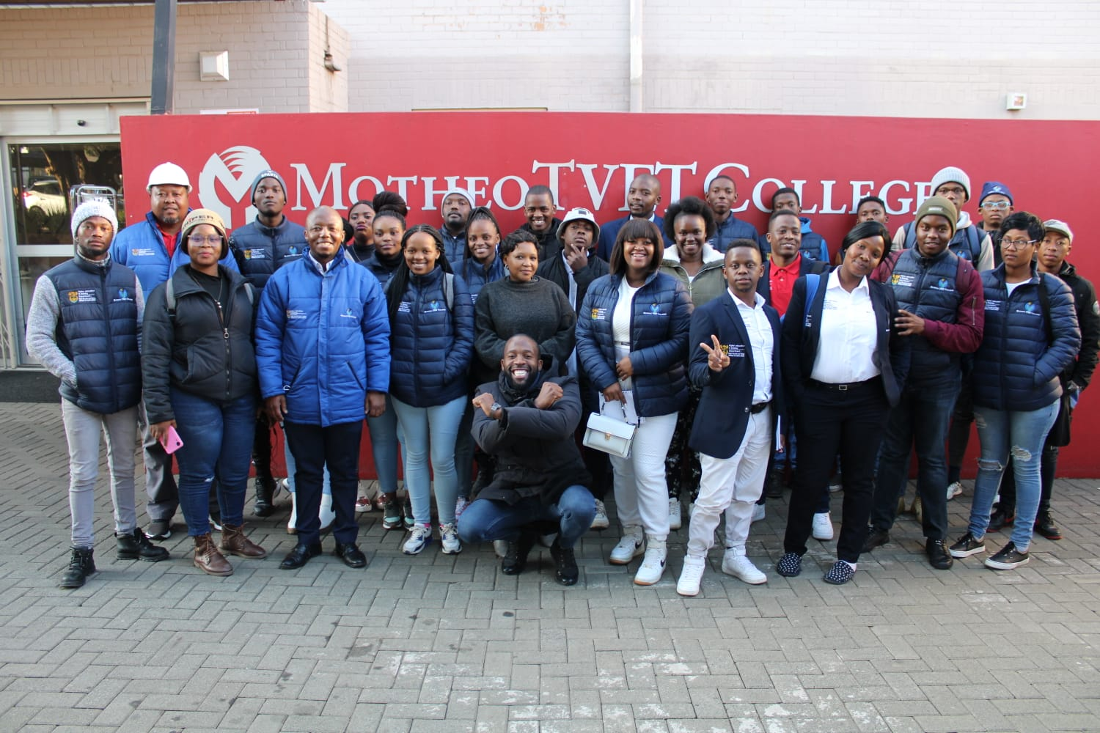
The Academic Conference
OCCUPATIONAL HEALTH & SAFETY WORKSHOP

Slide 17
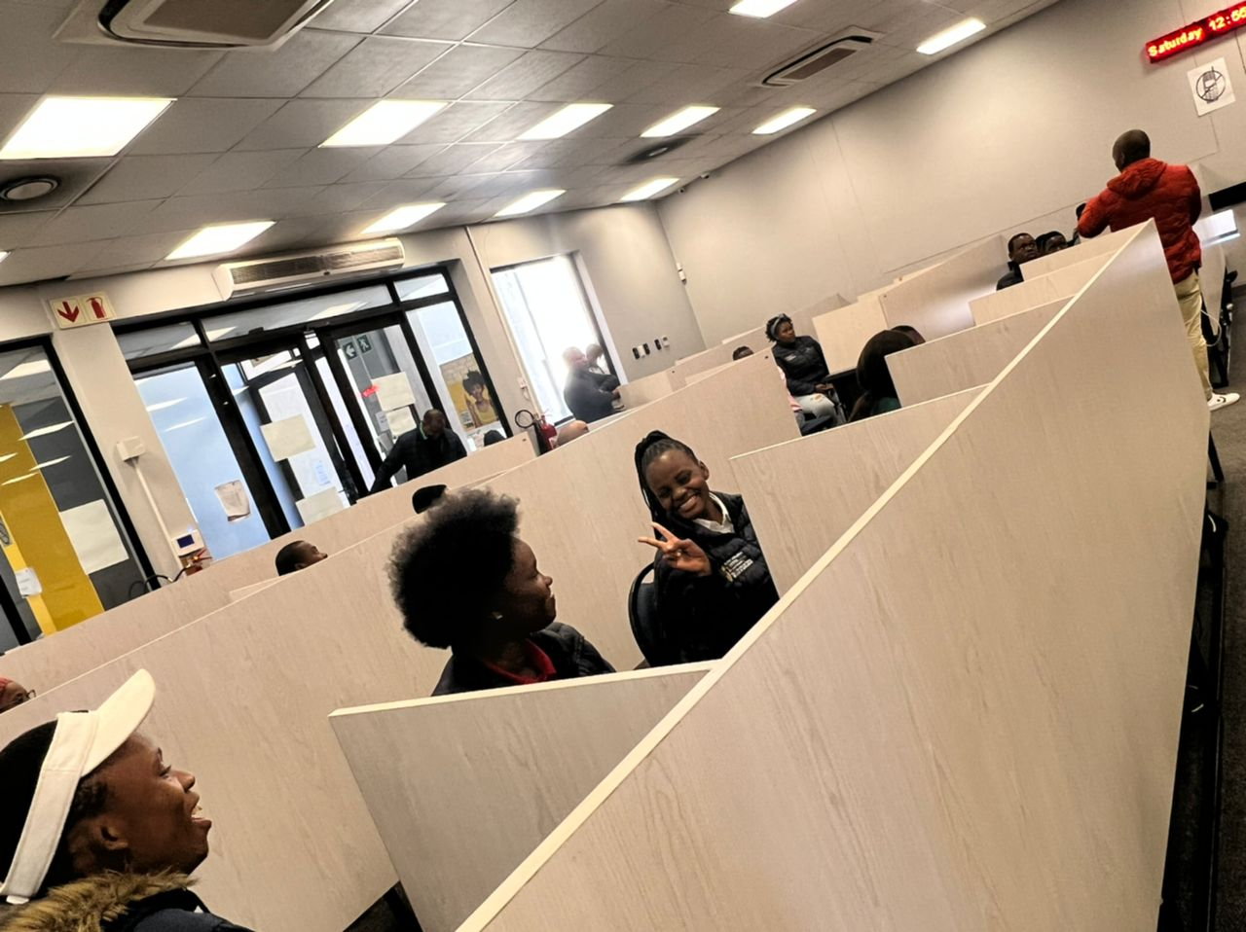
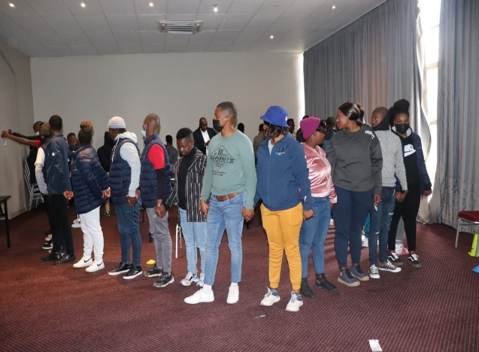
NSFAS WORKSHOP
CAPACITY BUILDING WORKSHOP

Slide 18
STUDENT PARLIAMENT
Student parliament is an annual event that was established in 2013, since the establishment we have managed to have 10 successful student parliament events that allowed students to interact directly with all stakeholders, management and council of the college on the development and effectiveness of Motheo TVET College in their academics
Furthermore, it serves as a platform where the ISRC and the campus SRC report back to students on their term of office as student leaders.
Moreover, it is a platform where students related policies of the institution are reviewed by students themselves and amendments are done to make sure that students are governed by policies that are relevant in their academic year.

Slide 19
Election Process of Student Parliament Committee
The student parliament is conducted by a committee called the parliament committee that is led by registered students of the institution and the committee has five positions in total that are elected.
Speaker
Deputy speaker
Secretary
Deputy Secretary
Chief Whip
This committee is elected at the academic conference by delegates and will serve until the SRC elections take place.
Each elected member is guided by Student parliament constitution that stipulates responsibilities of each elected member of the parliament committee.

Slide 20
Invites and delegates
As the current Parliament Committee, we held the 10th student parliament under the theme : To Strengthen Participatory governance in parliament functions ) and we set at Bloem Spa Hotel from the 24th – 26th of February 2022.
We had invited the following departments to the event :
Management of the institution
SSS Unite
17 Students From each campus
NSFAS Official
Electoral House of Africa
Student Hub
Development progress of the institution
Higher Health
SAVETSA
AST
And all SRC members

Slide 21
Invites and delegates cont…
We had presentations from all invited departments, and they are all minted in the office of the Secretary of the parliament committee
We expected a total of 213 attendance.
We were expecting 119 students and 105 where present and 14 absent.
We were also expecting 50 guests inclusive of staff, Management and SSS all present
We expected 44 SRC members and 35 were present.
In total we had 199 attendance during the event.

Slide 22
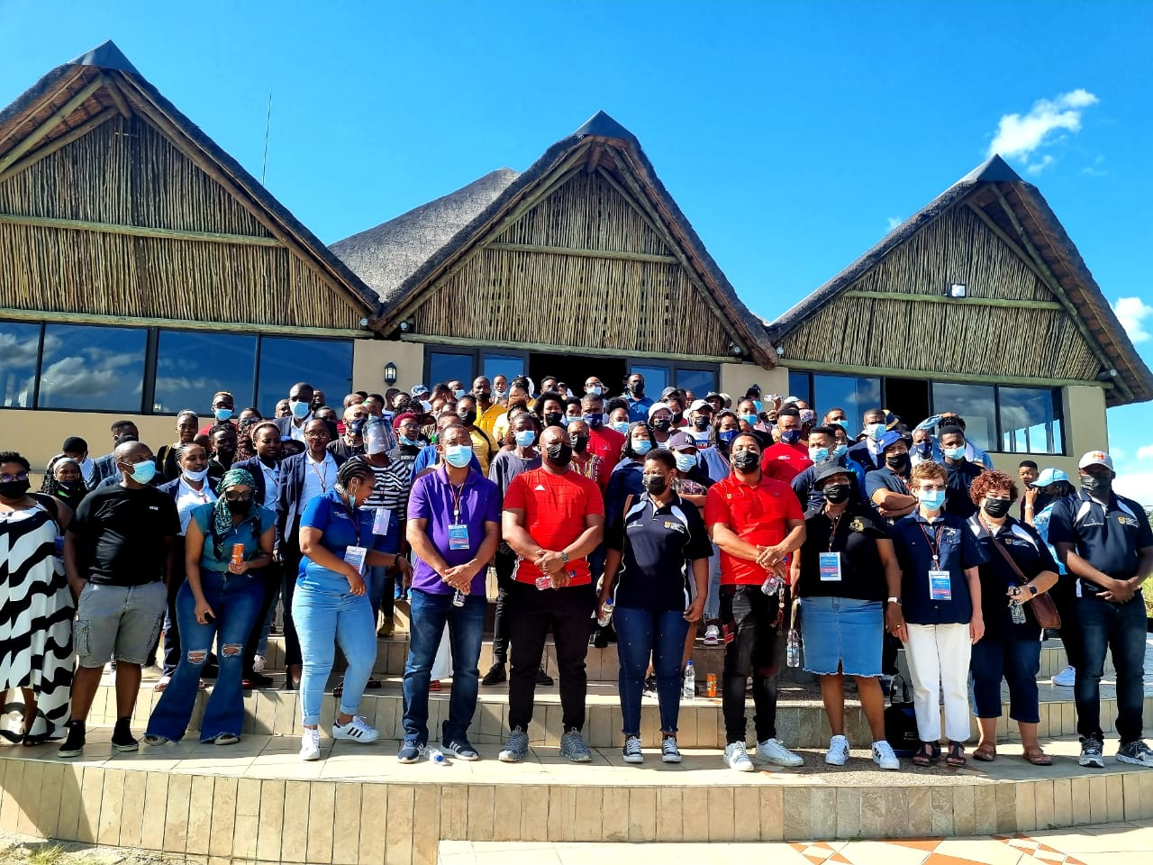
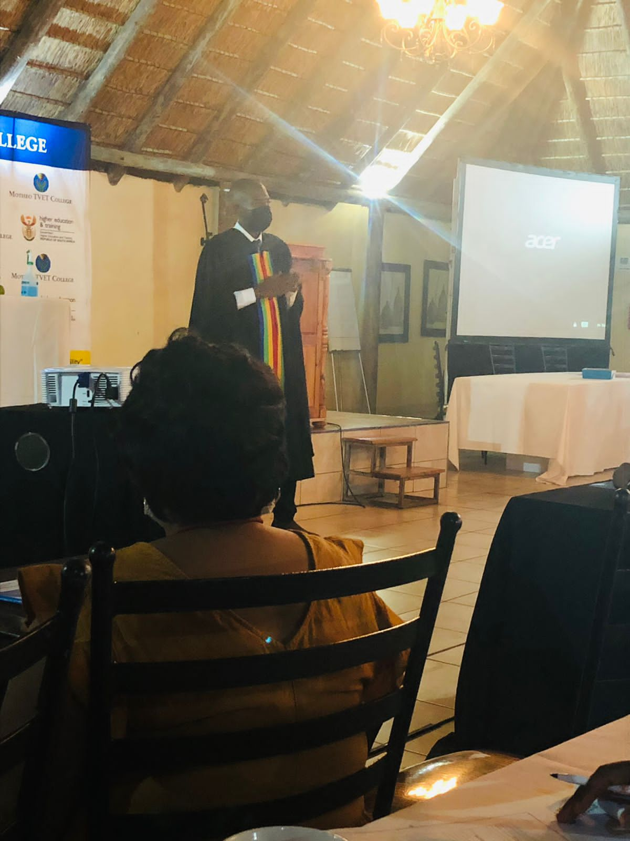
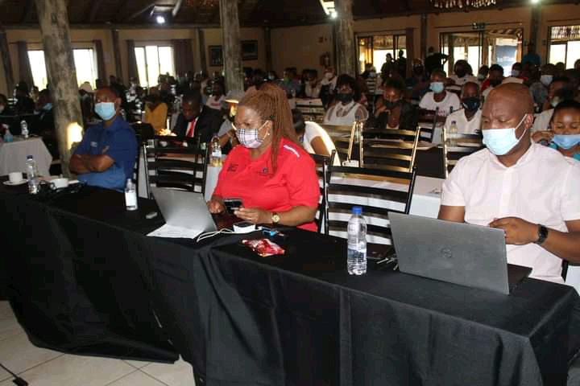

Slide 23
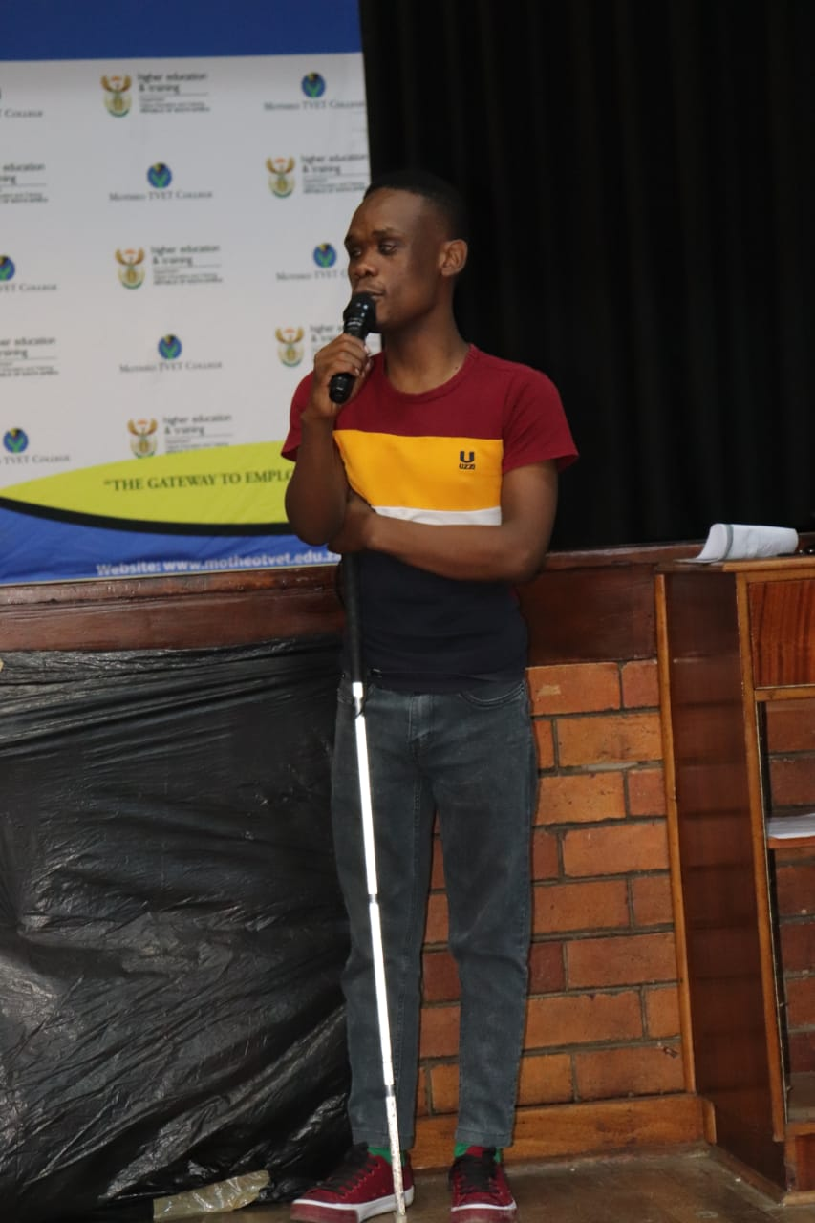
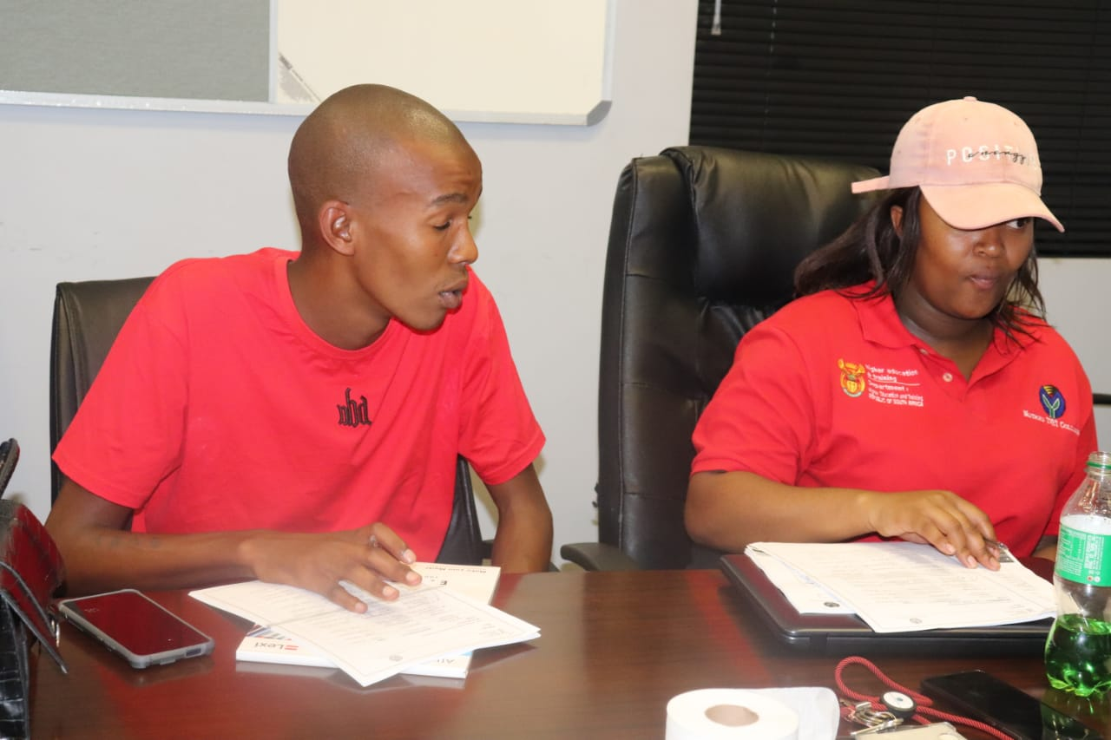
CASUAL DAY EVENT
STUDENT PARLIAMENT INDUCTION

Slide 24
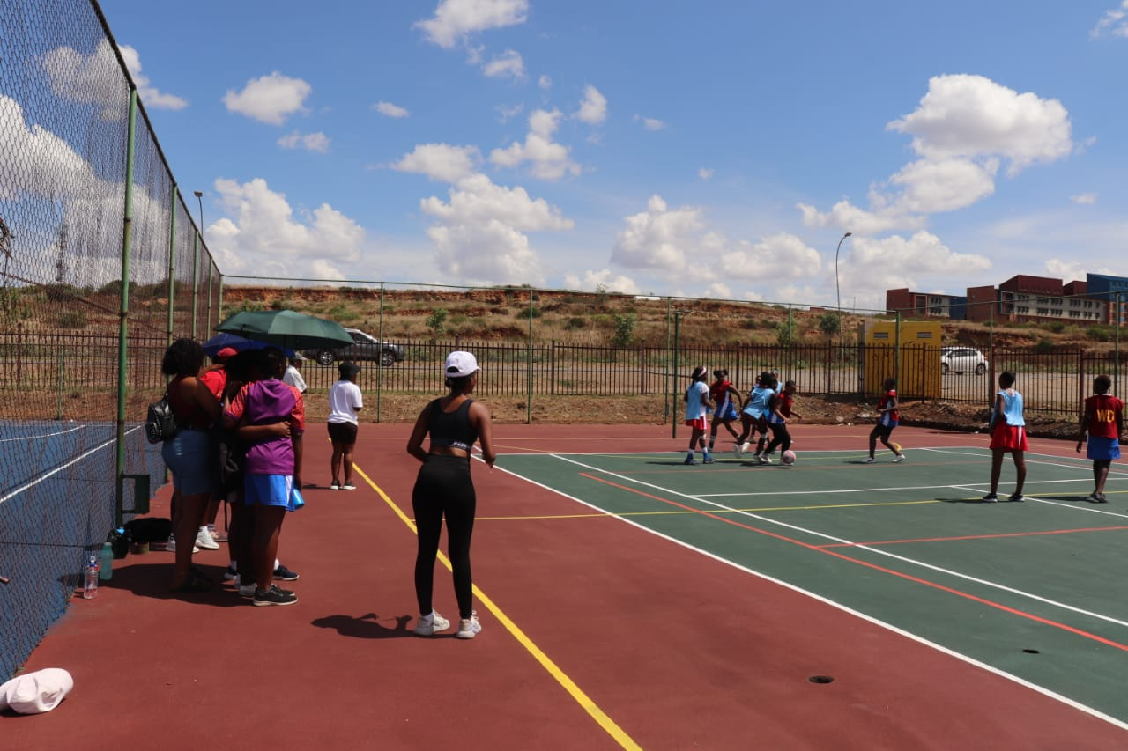
Heritage Day event
SPORTS TOURNAMENT

Slide 25
Campus SRC Programs
Bloemfontein Campus: GBV Awareness
Zastron Campus: Academic Awards

Slide 26
Botshabelo Campus: Open day event
Plot 32: Women's Quiz

Slide 27
HillSide view: Men's dialogue
Thaba - Nchu: ‘Motivational Talk for underperforming students

Slide 28
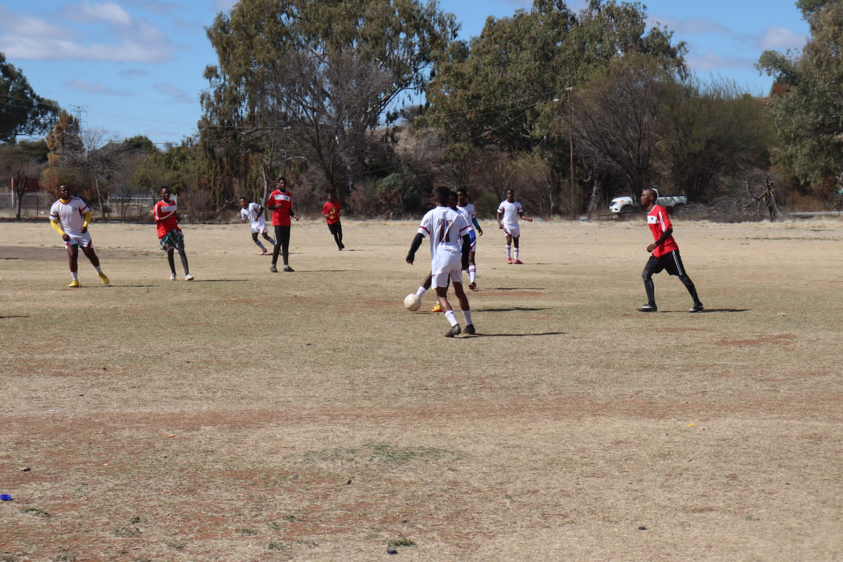
Koffiefontein Campus; Soccer tournament

Slide 29
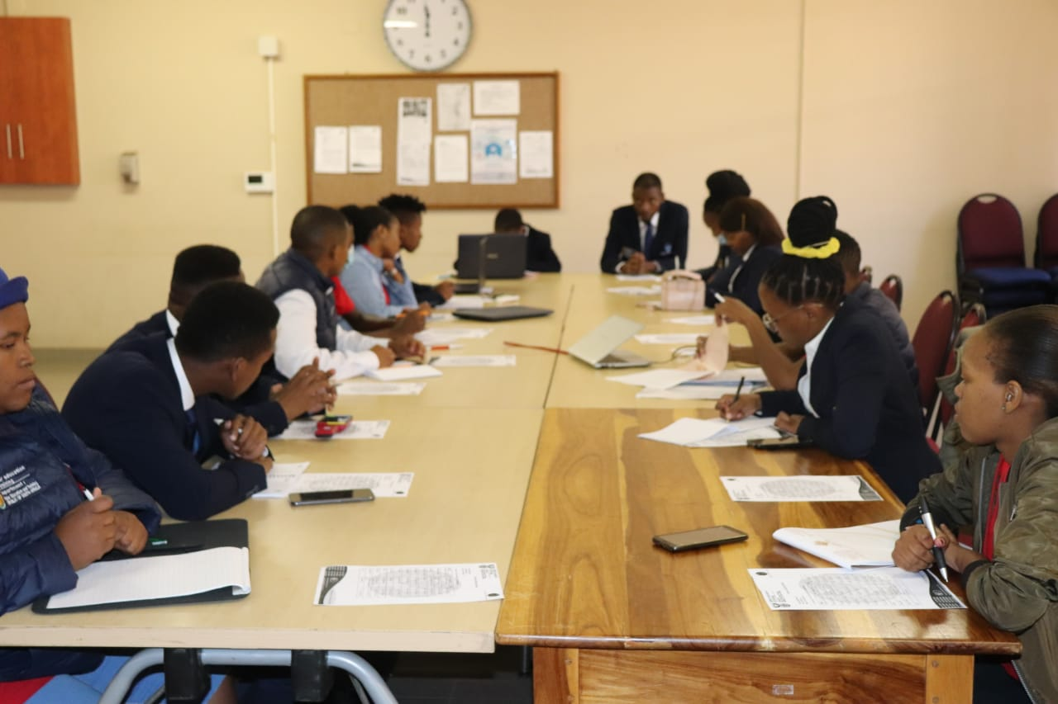
To ensure that all the programs are achieved and there is adequate academic support in the institution, the ISRC Council hold’s their monthly meetings. CSRC also holds their weekly meetings to ensure the interests of the students are well attended to.

Slide 30
Student Challenges and recommendations
Challenges
Recommendations
Funding for Skills Students.
NSFAS Late payments and unstable systems.
Safety of students off campus.
Lack of placement, industries and exposure in the economic sector.
Low support of the 4IR education implementation and support.
Support for the differently abled students.
Late issuing of Certificates and pending results.
CETA’s or any other funding aid be established through the NSF for both tuition and allowances.
The financial year of NSFAS be at the first month of each academic year not in march
Student residences be established.
Priorities TVET graduates in the government space as interns or employees.
Support the introduction of 4IR related Modules and Fields of study with necessary equipment and requirements.
Assist with refurnishing and improving the Disability Unite to accommodate all disabled students.
Create an online system for colleges and students to apply and access their certificates

Slide 31
SRC Support to Students
Academic support
Social Support
Establishment of Peer tutoring classes and styles.
Implementation of online learning.
Availability of resource center and information e.g. old question papers for referrals to exams.
Availability of academic societies.
Establishment of Programs that will improve student life at campus.
Availability of access to SSS, CDO and other college statues that are impactful to students.
Availability of non – academic Societies.
Advocating for sourcing resources for those who have challenges.

Slide 32
Conclusion
“If you think education is expensive wait till you ignore it and see the bill of not being educated”
Thank you

