Slide 1
IMMIGRATION SERVICES
PRESENTATION TO THE STANDING COMMITTEE ON FINANCE, ECONOMIC OPPORTUNITIES AND TOURISM
09 November 2022

Slide 2
PURPOSE
Briefing by the Department of Home Affairs on the processing of skills visas, remote working visas and tourism visas in preparation for the 2022/23 tourism season in the Western Cape

Slide 3
MANDATE
To facilitate and regulate the secure movement of people through the ports of entry into and out of the Republic of South Africa, determine the status of asylum seekers and regulate refugee affairs, confirm and provide enabling documents to foreign visitors legally residing within the Republic, enforce immigration legislation and effect deportations.
The core immigration mandate is to:
Legal Enablement
Facilitate and regulate the secure movement of people through the ports of entry into and out of the Republic of South Africa;
Confirm and provide enabling documents to foreign visitors legally residing within RSA;
Enforce immigration legislation and effect deportations;
Determine the status of asylum seekers and regulate refugee affairs; and
Contribute towards realising a positive skills migration trend into the RSA.
IMMIGRATION ACT No. 13 of 2002
The Immigration Amendment Act 13 of 2002 (as amended 2004, 2007 and 2011) as well as Regulations promulgated in terms thereof which came into effect on 26 May 2014.
REFUGEES ACT No. 130 of 1998
Determination of refugee status and the issuance of refugee enabling documents

Slide 4
CRITICAL SKILLS LIST 2022
The Department of Home Affairs entered into a memorandum of agreement in 2020 with the Department of Higher Education and Training, for the drafting of the new Critical Skills List based on a scientific research methodology.
The Directorate: System Monitoring and Economic Analysis of DHET provided DHA with a draft preliminary technical report on the critical skills in November 2020.
The Minister of Home Affairs published the technical report for public comments on the 18th of February with a closing date of the 31st of March 2021.
The first Critical Skills List 2022 was published on the 2nd of February 2022.
The second publication, updated with Health Professionals was published on the 02nd of August 2022 and is the current version.
To date, in the current 2022/23 performance year, the Department has processed approximately 3 182 critical skills work visa applications and close to 1 013 permanent residence applications based on critical skills

Slide 5
REMOTE WORKING VISA
In his 2022 State of the Nation Address (SONA) President Cyril Ramaphosa made the announcement that the South African government will be reviewing South Africa's work visas with the view of exploring the possibility of new visa categories, including a remote-working visa.
A comprehensive report on the review of the work visa system was recently completed by the Operation Vulindlela Team led by former Director-General of Home Affairs, Mr Mavuso Msimang.
The Report makes recommendations with regards to the possibility of new visa categories that could enable economic growth, such as a start-up visa and a remote working visa.
The introduction of new visa categories will most certainly require a review and amendment of the Immigration Act as all current visa categories are legislated.

Slide 6
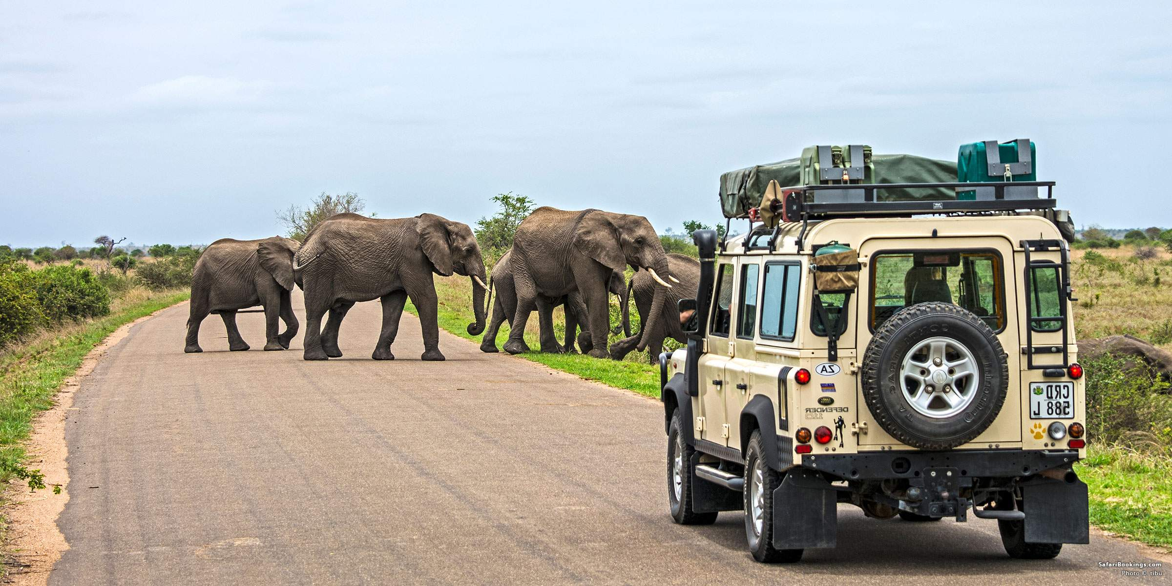
HOME AFFAIRS’ CONTRIBUTION TO TOURISM

Slide 7
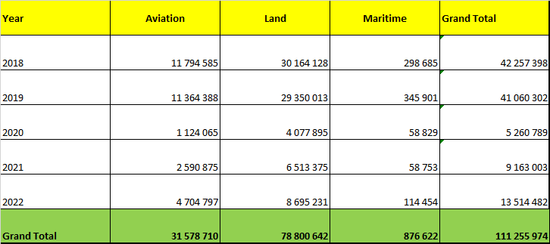
HOME AFFAIRS’ CONTRIBUTION TO TOURISM
The below is the statistics of travelers into SA per year. It is evident that there has been a significant increase in people coming into SA.

Slide 8
HOME AFFAIRS’ CONTRIBUTION TO TOURISM
Inclusive tourism:- This is about reducing uncertainty around what to expect from a destination and offer a positive travel experience. Widening the participation in tourism decision making. The Department is on a regular basis increasing its visa exemption list. We now have 148 countries that we have a visa agreement with.
These countries can enter SA between 30-90 days without obtaining visa.
The rollout out of the e-Visa system is also part of Government’s plans to streamline and modernize the visa application process to make it easier to travel to South Africa for tourism, business and work.

Slide 9
VISA EXEMPTION STATUS
Green: Visa Not required to visit RSA
Red: Visa required to visit RSA
Amber: Negotiations started to waive visas

Slide 10
HOME AFFAIRS’ CONTRIBUTION TO TOURISM
E-VISA
The e-Visa system has to date been launched and piloted in 14 countries, including China, India, Kenya and Nigeria, according to government’s commitment.
The rollout out of the eVisa system is also part of Government’s plans to streamline and modernize the visa application process to make it easier to travel to South Africa for tourism, business and work.
The South Africa e-visa application is aimed at making the immigration process more fluid and to amplify the border security checks. It allows eligible foreigners with a trusted traveler history to enter the country without going to an embassy.
The e-Visa enables the prospective visitor to apply for a Visa from his/her home country online without visiting the Mission. It also allows for the online and secure payment of the visa fee.

Slide 11
HOME AFFAIRS’ CONTRIBUTION TO TOURISM
E-VISA
On arrival, the visitor presents the authorisation to the immigration authorities who would then stamp the entry into the country.
The South Africa online visa is aimed at being available to a larger number of nationalities once the system has been stabilized for the 14 Countries

Slide 12


