Slide 1
Department of Economic Development and Tourism
Tourism Season Readiness 2022/23
9 November 2022

Slide 2
Contents
Projections for the upcoming Season
Destination Readiness
Destination Accessibility
Workforce readiness
Activations and communications

Slide 3
Projections for the upcoming season
Projections for the upcoming tourism summer season…

Slide 4
Forward bookings to South Africa
Bookings for the rest of the year are well ahead of 2021 levels, almost 3x greater.
Over 75% of the bookings are from Northern and Western Europe, and North America.
50% of all bookings are from the UK, USA, Germany and The Netherlands.
The key African markets are Kenya, Zimbabwe, Zambia and Malawi.

Slide 5
CPT two-way capacity
200 000
115%
180 000
109%
110%
105%
105%
160 000
105%
140 000
100%
Seat Capacity
95%
95%
120 000
95%
100 000
%
90%
80 000
60 000
85%
40 000
80%
20 000
75%
0
70%
November
December
January Month
February
March
2019/2020
2022/2023
% Recovery
Source: OAG Schedules Analyser, own calculations

Slide 6
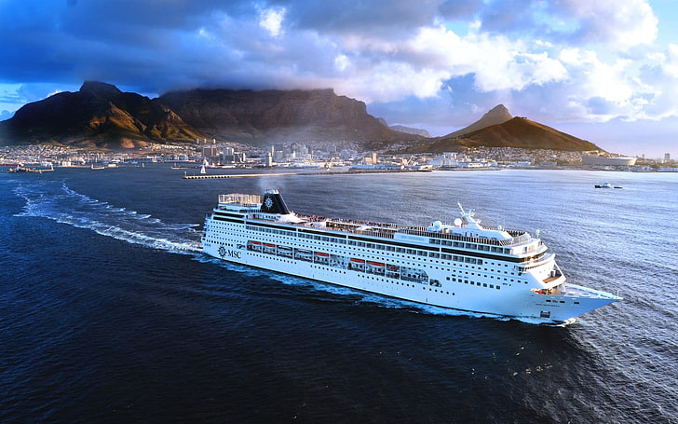
Western Cape Cruise season 2022/23
Cruise season has 5 new ships added to the booking schedule.
Preliminary bookings for the 2022/23 season already indicates 75 ship visits into Cape Town.
Season currently at 132% of Cruise Cape Town target for arriving passengers.
Cruise season was launched on the 19th October 2021 with the official arrival of the Hanseatic Spirit to the Port of Cape Town.

Slide 7
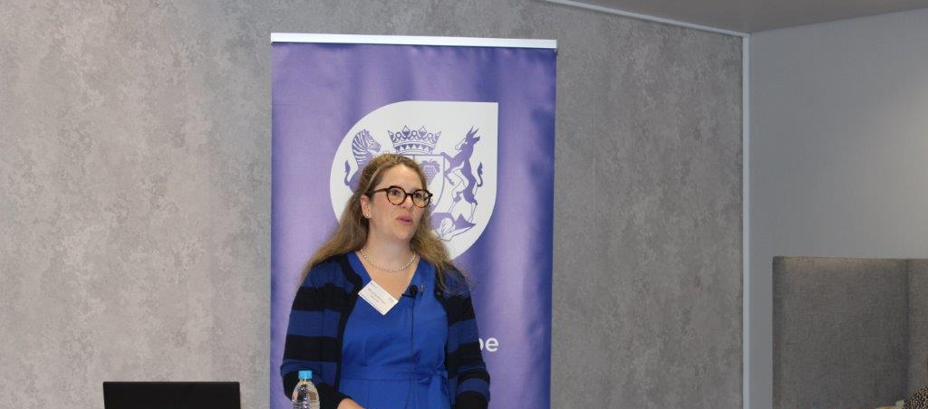
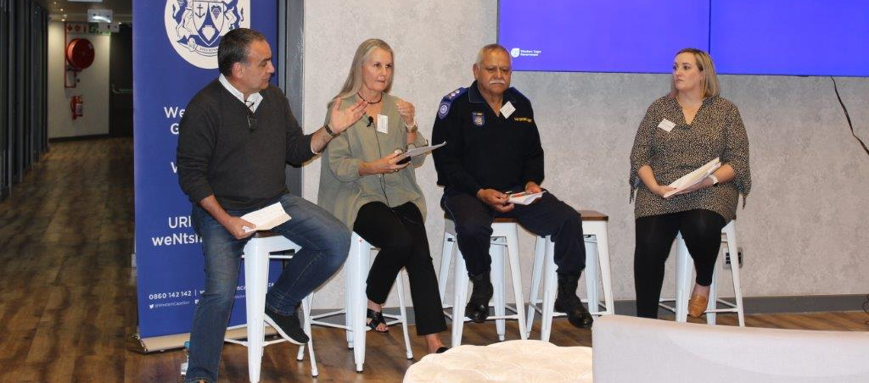
Summer readiness dialogue
10 October 2022
Minister Wenger hosted a summer readiness dialogue in October 2022 to discuss key issues facing the industry in anticipation of a busy tourism season.
50 representatives from the industry attended the event.
Panel discussions looked at what is needed from destination readiness, air and cruise accessibility and skills perspectives.

Slide 8
Destination Readiness

Slide 9
Tourism Safety
The National Department of Tourism implements the National Tourism Safety Strategy in collaboration with provinces.
300 tourism monitors were deployed in 2022. The current phase of the programme comes to an end in November and it is hoped that the next phase will commence in February 2023.
The Department of Tourism has however secured the commitment from SAPS that police reservists will be available during the summer season to assist with tourism safety. DEDAT is engaging the Department and SAPS on this.

Slide 10
Tourism Safety
Law Enforcement & SAPS victim support include:
The Tourism Law Enforcement unit in the CoCT will be funded and overseen by the Department of Community Safety and implemented by the City of Cape Town.
The CBD, Table Mountain, Signal Hill, V&A Waterfront and the Bo-Kaap areas will continue to be patrolled daily.
Law enforcement will be boosted by e-bikes to broaden the unit’s patrol footprint and more importantly they will help improve their response time to any incidents that may occur.
SAPS will have 6 victim support centres set up in the Western Cape in preparation for the festive season that can also be used by tourists. The centres are in George, Belville, Khayelitsha, Mannenburg, Worcester and Atlantis.

Slide 11
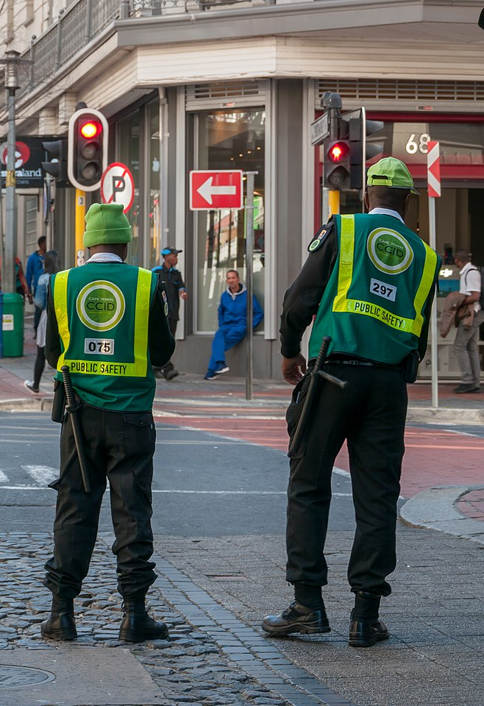
Tourism Safety
The CCID has introduced new urban management projects in the CDB such as the state-of-the art street sweeper machines to keep the streets clean.
Security personnel patrolling the CBD and V&A Waterfront will be equipped with front facing body cameras.
The CCID have increased the number of their security personnel and they have new patrol vehicles to make sure that they improve their response to incidents.

Slide 12
Tourism Safety
Western Cape Tourism Safety Response Unit support includes:
The tourism safety support unit will be operational
during the summer season.
Support available includes:
Medical/emotional trauma, visiting hospitals.
Advise on short-term temporary accommodation.
Help with basic necessities, where possible.
Help with contacting family or friends.
Facilitate counseling.
Advise on with short-term transport arrangements.
Contacts embassies in case of lost passports and visas
The Tourism Safety Support Programme will be reintroduced to Consulates and industry to increase awareness of services on offer to tourists in distress.
In collaboration with

Slide 13
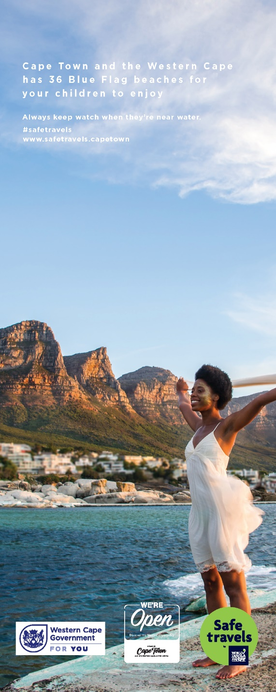
Tourism Safety
DEDAT is currently in the process of procuring new safety brochures that will be distributed to accommodation establishments, major tourism attractions, airports, tourism offices, hospitals and police stations across the province.
White label tourism safety collateral is also being produced.
In addition, https://safetravels.capetown/ is being updated to ensure that content is up to date.

Slide 14
Destination Accessibility

Slide 15
Visas
DEDAT has conducted a survey on tourists visa constraints to identify possible pain points and areas which will drive efforts to improving the visa regime. This has to be done with other partners and mandate owners i.e., DoHA & NDT.
The Western Cape’s key source markets do not need visas (limited to 90 days or less).
According to the Department of Home Affairs, the eVisa system is being extended to more countries.
There have been some challenges with the eVisa system particularly in Africa and seems to affect business travellers in particular. In Nigeria there is also a challenge as applications must be made in Abuja as opposed to Lagos. According to the Department of Home Affairs, these challenges are being addressed.
There is no clarity at present regarding timelines for the implementation of a remote work visa. Extensive lobbying work has been done with a formal submission on amendments to the immigration Act regulations which will enable a remote work visa for 12 months stay in South Africa.

Slide 16
Upcoming International IATA Winter Season for CPT, 2022/23
4 new routes
Atlanta, USA
Washington DC, USA
Brussels, Belgium Maputo, Mozambique
Two-way seat capacity for CPT
93% recovery compared to the same period in 2019, with
>1.5 mln. seats available between Nov 2022 and Mar 2023
International air cargo capacity for CPT
81% recovery compared to the same period in 2019, with
86500 tonnes in two-way capacity.
3 new airlines
Source: Seabury Air Cargo

Slide 17
CPT route and airline update – October 2022
Asia and Middle East
Europe
Emirates operates daily, DXB-CPT. Will operate double daily from Jan 2023
Lufthansa, Frankfurt, five times a week, reducing to three times per week from end Oct
Munich seasonal service will return 28 Oct with a daily flight
Qatar Airways, operates 10 times a week, DOH-CPT
British Airways, London Heathrow, daily service. Twice daily from 13 Nov plus adding a seasonal London Gatwick service three times per week from 13 Dec
Singapore Airlines operates daily service, SIN-JNB-CPT-JNB-SIN
KLM, Amsterdam, daily service increasing to 10 times per week from 27 Oct
Rest of Africa
Turkish Airlines, Istanbul, four times per week, daily flight from 31 Oct
Air Botswana, Gaborone, three times per week
Edelweiss, Zurich, resumed 26 September, three times a week
Ethiopian Airlines, Addis Ababa, daily flight
Air Belgium, Brussels, new service, twice per week, started 14 September
FlyNamibia, Windhoek, six time per week
Condor, Frankfurt seasonal service restarted 4 October, three times a
week.
Kenya Airways, Nairobi direct, twice per week, Nairobi – Livingstone, twice per week and Nairobi - Victoria Falls, twice per week
North America
TAAG, Luanda, six times per week
United Airlines, Newark, year-round service, three times per week.
Washington D.C. direct service from 18 Nov 2022, three times per week
RwandAir, Kigali-Harare, three times per week
Delta Air Lines, Atlanta direct service from 19 Dec, three times a week.
Triangular route between ATL-JNB-CPT-ATL starts 2 Dec, four times a week
Airlink, Windhoek, three times a day
Walvis Bay, daily
Harare, daily
Victoria Falls, six times per week Maun, daily
Maputo, three times per week
Planned Routes
Virgin Atlantic, London Heathrow restarting 5 November, daily seasonal service
Air Mauritius, Mauritius, twice per week, restarting 16 November
Air France, Paris, returning 30 Oct, three times per week

Slide 18
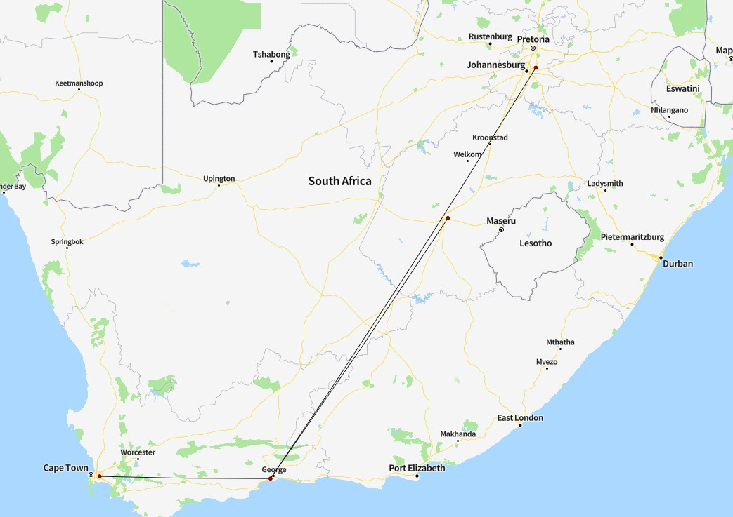
Air Access – George Regional Airport
2022
Year/Month | 2019 | 2020 | 2021 |  | Mar | Apr | May | Jun | Jul | Aug |  | Jan-Aug
Two-way passengers | 832 981 | 340 438 | 536 886 |  | 70 528 | 72 678 | 61 290 | 56 116 | 62 926 | 60 240 |  | 493 361
Passenger recovery* | 100% | 41% | 64% |  | 97% | 109% | 97% | 86% | 103% | 92% |  | 94%
* Passenger recovery compared to same period in 2019
Operating carriers
Source: OAG Schedules Analyser

Slide 19
Air and cruise accessibility & season readiness
Steps have been taken by ACSA to ensure that jet fuel stocks are maintained and closely monitored. An additional tank has been made available.
The Air Access and Cruise Cape Town teams have planned a series of events and activations to support airlines and cruise ships returning to the province this season.
42 learners funded by DEDAT will be placed at Cape Town International Airport (CTIA) to assist with general tasks in and around the airport. Furthermore, the Artisan Development Programme is also working with ACSA to place apprenticeship candidates at CTIA within the next 2 months to provide workplace experience to these beneficiaries.

Slide 20
Workforce Readiness

Slide 21
Skills challenges
COVID-19 has worsened skills constraints in some sub-industries e.g. hospitality and events. This is as a result of the fact that some workers now regard these industries as risky. There are also longstanding perceptions regarding poor pay and long and inconvenient working hours.
Skills constraints cover a range of ‘hard’ and ‘soft’ skills.
Digital disruption has added to the skills needs given that the tourism and travel industries have been early adopters of tech. COVID-19 accelerated this trend.

Slide 22
Tourism Skills Update
The DEDAT Skills Unit has been focusing on skills initiatives that will assist youth with training and experiential learning opportunities and ensure work placement readiness. 245 learners have already been placed including at the Cape Town International Airport, through CapeNature and various members of Fedhasa in the hotel and restaurant industry.
There will also be a focus on soft skills and other competencies such as problem-solving, adaptability and professionalism to assist the youth with workplace readiness.
A focus on improving communication and awareness between industry and academia on the opportunities for work placements.
Inputs from industry will be key to determine the type of skills & preferred training modalities to better respond to industry needs and a skills survey is being conducted.
In partnership with SA Tourism, workshops on customer care will be conducted in November for frontline staff at key tourism facilities.

Slide 23
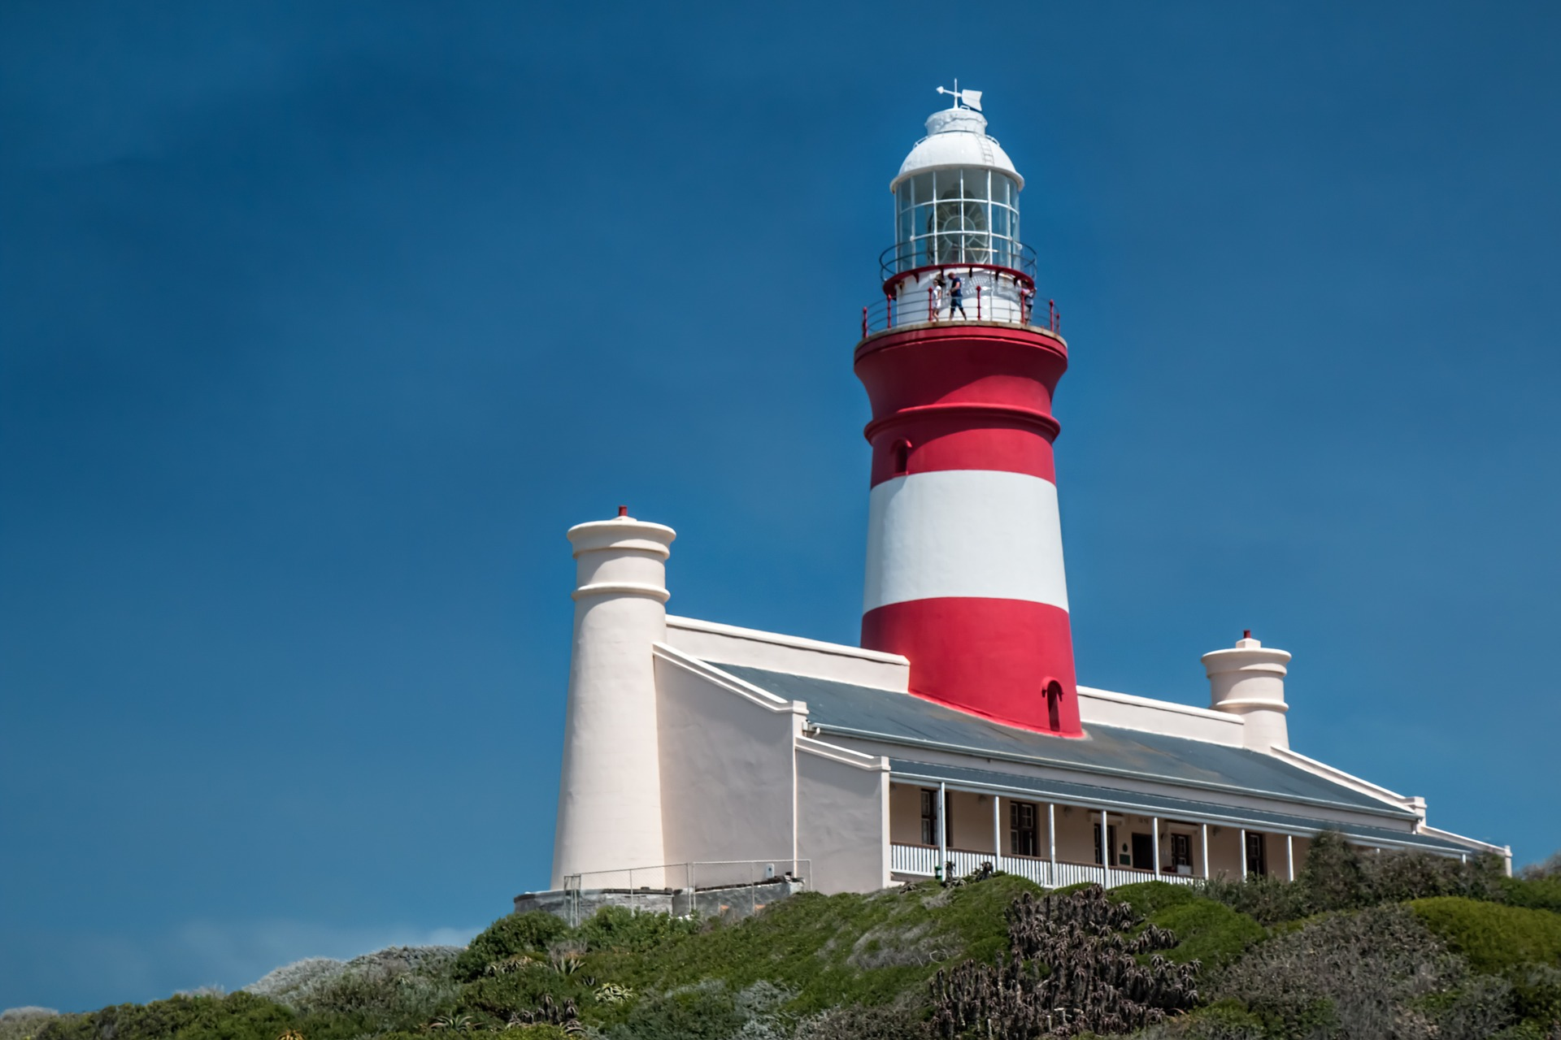
Activations and communications

Slide 24
Activations & communications for summer season
A consolidated schedule of district summer season activations will be finalized in November and support will be provided to districts in terms of the distribution of visitor safety information. White label safety collateral will also be shared with the industry.
In addition, WCG social media will be used to encourage domestic markets to explore the province while communicating safety tips.

