Slide 1
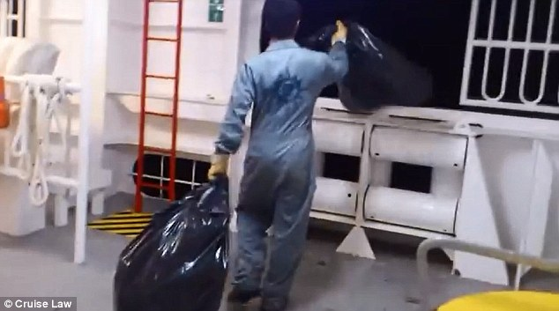
WESSA Submission
Contributing to Parliamentary Bill B5-2022: Marine Pollution (Prevention of Pollution from Ships) Amendment Bill
Morgan Griffiths
Strategic Lead: Advocacy
People Caring For The Earth
Notes:
On Bill B5-2022, to the Portfolio Committee on Transport 8 November 2022

Slide 2
Introduction to WESSA
WESSA is a 96-year youthful NGO which aims to initiate and support high impact environmental and conservation projects to promote public participation in caring for the Earth.
We ACT.EDUCATE.ADVOCATE for conserving the Earth’s vitality and diversity by:
Securing the protection & wise use of natural resources
Acting as an environmental watchdog
Influencing policy and decision-making
Promoting sound environmental values & sustainable lifestyles
Integrating conservation & development
Encouraging individual & community action
Enabling & growing a vibrant & active broad-based membership
Fostering collaborative partnerships

Slide 3
WESSA’s Locus Standi
Contributed to the development of National Parks Act, NEMA, NEM:BA, NEM:AQA, NEM:WA
14-year participation in EIA & EMC of the Port of Ngqura and Coega IDZ
Founder member of CoastWatch
Contributor to the Operation Phakisa: Marine & Coastal Tourism Plan
SA Implementor of the Blue Flag Beaches, Marinas & Tourism Boat Programme for 21 years
Member of the Sustaining the Wild Coast Coalition that interdicted Shell seismic testing
Called for and supported the development of the system of Marine Protected Areas
Member of coalition that successful opposed the proposed Algoa Bay fish cages off tourism beach front
Personal:
Algoa Bay yacht sailor/Vice-Commodore 2006-2022
Worked on scientific research vessels and tall-ship

Slide 4
South Africa’s Exceptional Biodiversity
Notes:
136 marine habitats
13 000 species of marine organisms recorded. Endemism is estimated between 26-33%, third highest
45 Pas, but only 5% EEZ protected (10% target)

Slide 5
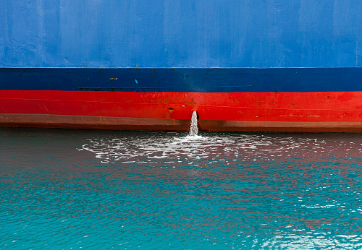
General Comments on the Bill
WESSA supports this Bill, aimed at significantly improving the safe and appropriate management of sewage, waste and air emissions from marine vessels.
We note the crucial improvement to Section 3 (b) with the additions of sub-clauses (e)-(m) which provides for the creation of regulations pertaining to preventing pollution from ships.

Slide 6
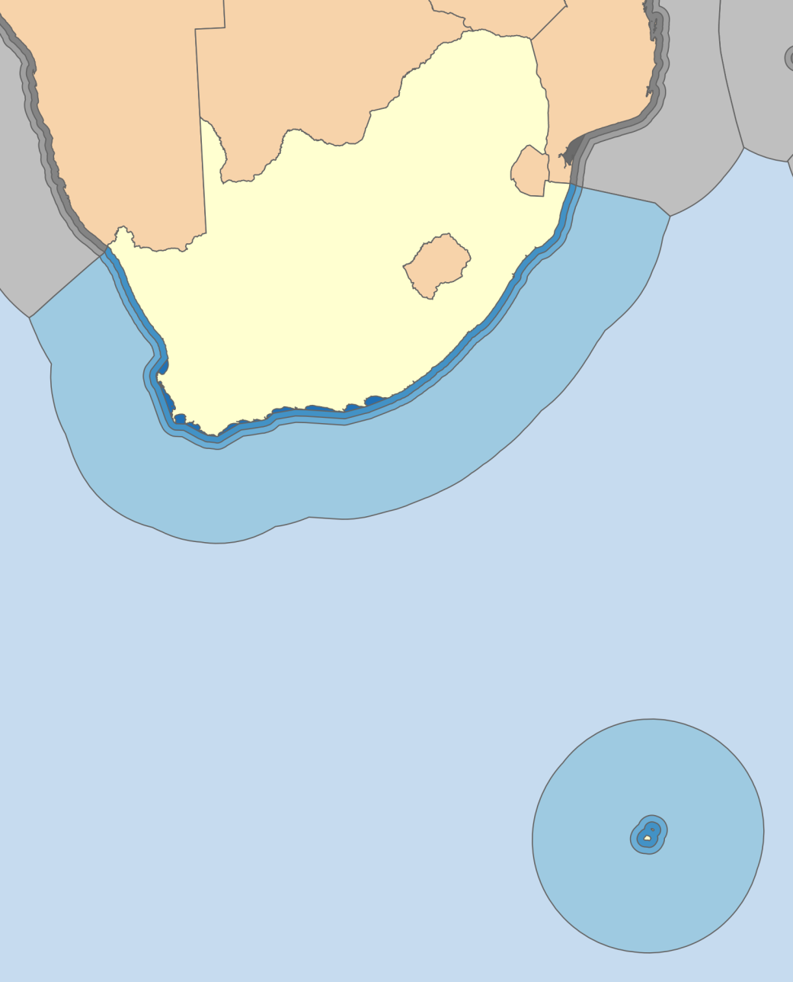
Comments on Annex IV: Regulations for the Prevention of Pollution by Sewage from Ships
Regulation 2.1: provisions of Annex IV will apply to ships engaged only in international voyages.
CONCERN 1: Does not cover ships moving within SA territorial waters, nor between these waters and high seas
PROPOSED REMEDY: Extend Reg.2.1 to include ships engaged in voyages within and between SA territorial waters and the high seas.

Slide 7
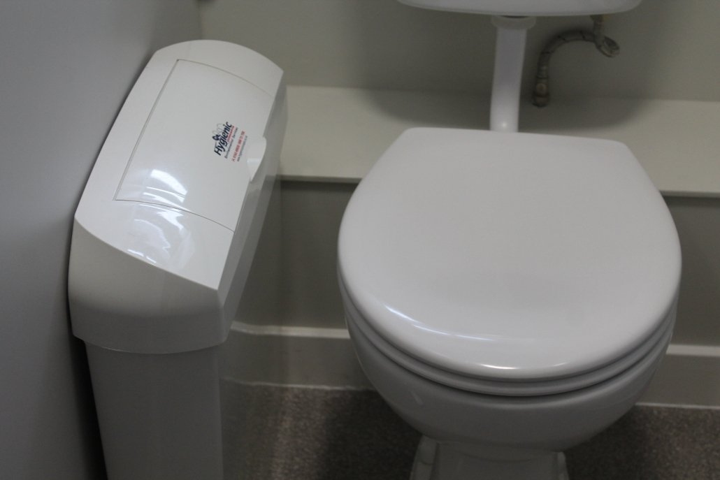
CONCERN 2: The threshold of these regulations only applies to ships above 400 gross tonnage.
PROPOSED REMEDY: that they should extend to all ships above 100 gross tonnage.
CONCERN 3: That inorganics and solids in sewage will continue to be discharged overboard.
PROPOSED REMEDY: Add regulation to require ships to separate out inorganics and solids from sewage, for disposal on land; additionally that sewage be macerated before being disposed of into the sea.

Slide 8
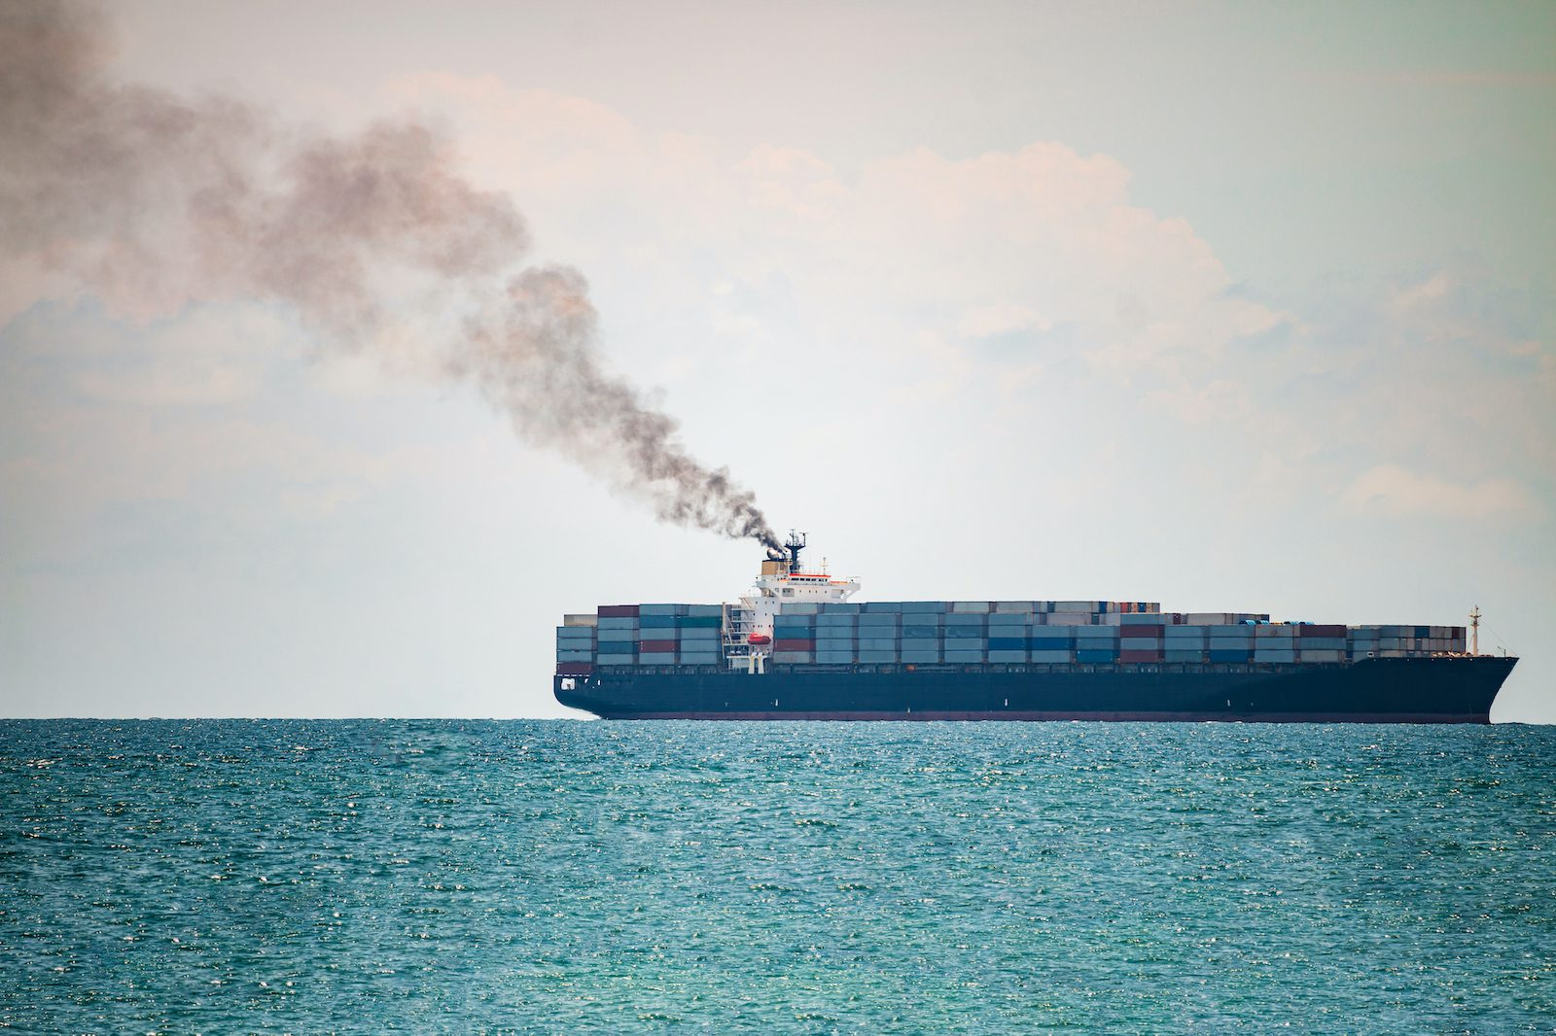
Annex VI: Regulations for the Prevention of Air Pollution from Ships
Air pollution from ships = 2.89% of global Green House Gases (ref: IMO). These emissions are growing and not aligned to keeping within the Paris Agreement’s 1.5ºC target. The regulations proposed by this Bill are crucial to curbing shipping GHGs.
CONCERN 4: The threshold of these regulations only applies to ships above 400 gross tonnage.
PROPOSED REMEDY: Set threshold to all ships above 100 gross tonnage. (Regulation 5.2 provides the space setting regulations for ships below 400 gross tonnage.)
Notes:
IMO = International Maritime Organization

Slide 9
Call for Inclusion of Shipping Noise Pollution
Whereas:
Aim of this Bill is to give effect to Annex IV of the International Convention for the Prevention of Pollution from Ships, and to provide for matters connected therewith.
SA Constitution provides that everyone has the right to
(a) to an environment that is not harmful to their health or well-being;
(b) to have the environment protected, for the benefit of present and future generations, through reasonable legislative and other measures
National Environmental Management Act (NEMA) 107 of 1998, Section 2(4)(e)): everyone has a duty of care towards the environment.
Anthropogenic undersea noise is a growing threat to marine life.
Ocean noise regulation is currently non-existent in both environmental legislation and in maritime legislation in South Africa.

Slide 10
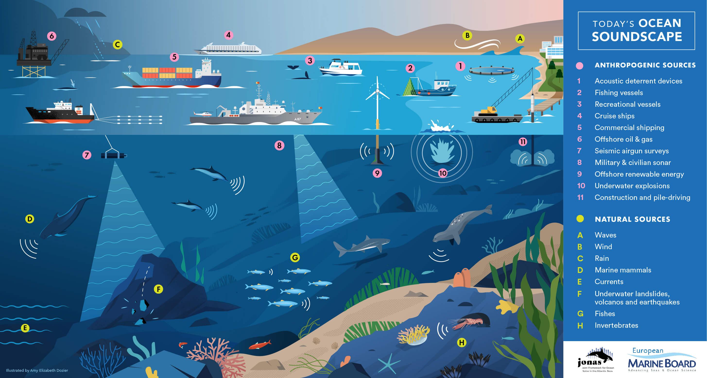
Sources of Marine Noise

Slide 11
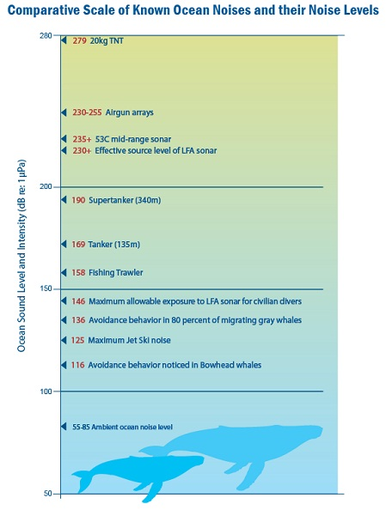
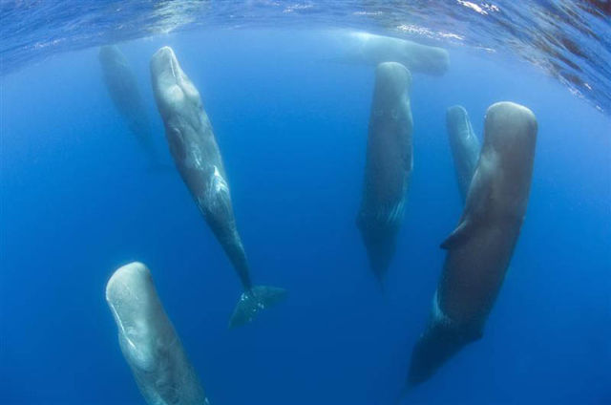
Many marine organisms use sound for:
navigating
catching prey
territorial defense
socializing & attracting mates
Frequency
Notes:
SEISMIC testing has significant impact
Sperm whales use sonar to navigate, hunt and stun prey, use song to navigate, socialise and attract and defend breeding rights

Slide 12
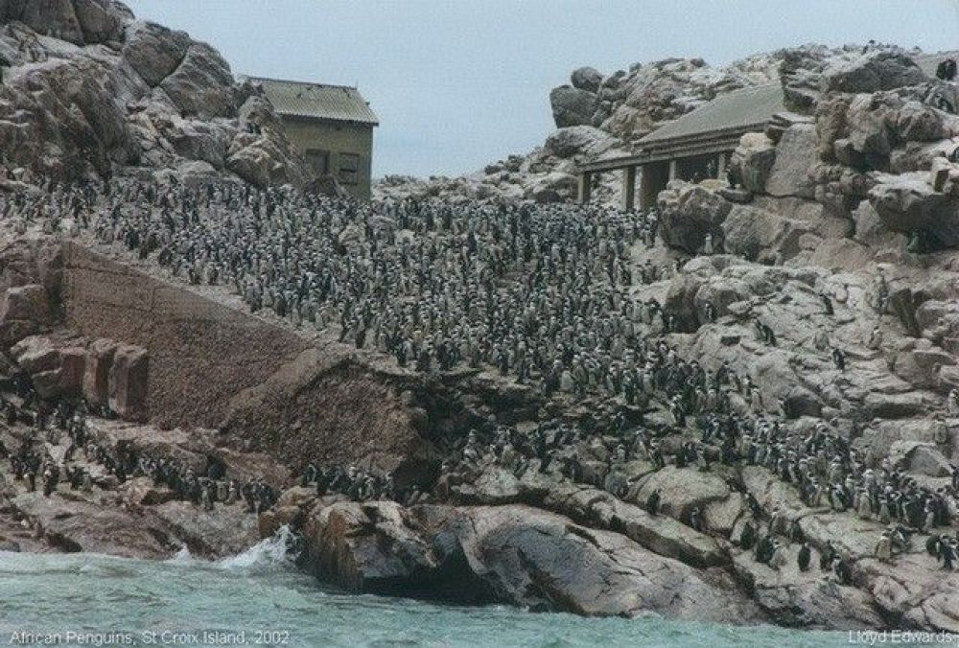
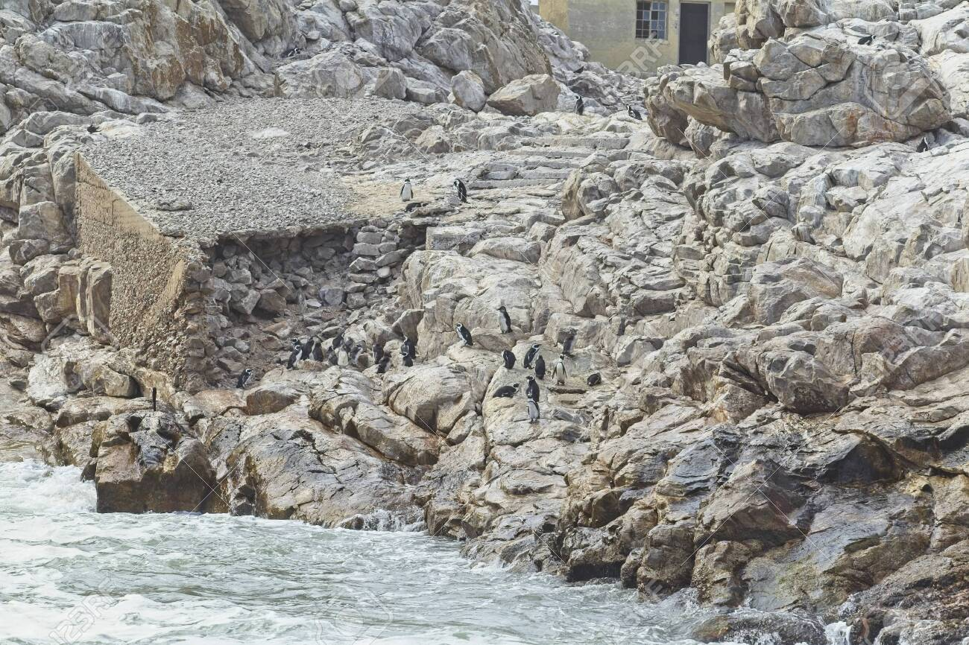
Impacts of Anthropogenic Noise
Stress
Injuries to ear and air/fluid spaces (barotrauma)
Death (barotrauma)
Prevents communications and normal activities
Displacement from feeding grounds and territories
Change of fish stocks distribution
Malnutrition & starvation
Notes:
Fog of noise clouds out natural noise
St Croix penguin colony: 2006 an 2021 (Research by Lorien Pichegru et al 2022)

Slide 13
Suggested New Noise Regulations
REMEDY: Applying the Precautionary Approach to ensure that ocean noise levels are not harmful for marine life and humans, by:
Developing effective noise regulations to mitigate or eliminate intense noise producing activities, including sonar;
Requiring that use of military sonar (outside of imminent or active conflict) be subject to the above noise regulations;
Require that seismic surveys are also subject to the above noise regulations; and
In consultation with marine biology/ecology experts, designate critical marine habitats (biosphere reserves, UNESCO Marine World Heritage Sites and Marine Protected Areas) as low noise areas; wherein these areas shipping noise may not exceed determined decibel levels.

Slide 14
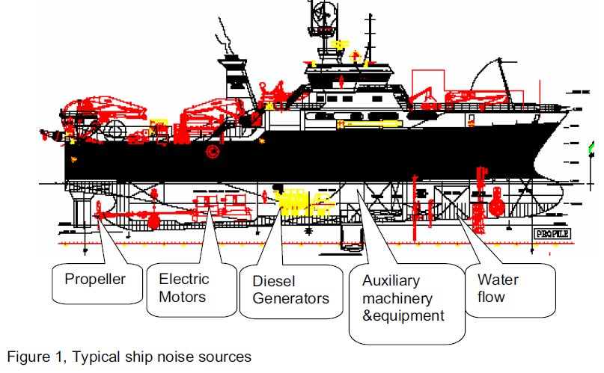
Noise Mitigation Measures
The IMO has been researching and promoting noise reduction solutions.
Their current guidelines are on a trajectory to become international requirements.
Opportune to use this Bill to align our shipping requirements to incrementally address noise pollution.
The IMO promotes achieving this through 1) ship design:
– Design solutions at propulsion level
– Reduction of machinery noise
– Reduction of propeller noise
– Structural & other solutions to reduce underwater radiated noise

Slide 15
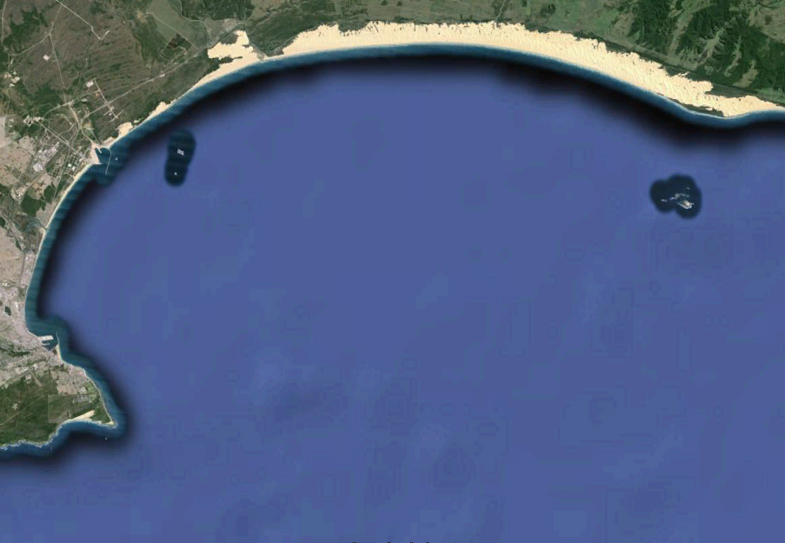
And 2) mitigation measures related to traffic control:
– Mitigation solutions applied to a particular ship (e.g. speed reduction)
– Mitigation solutions applied at ship traffic control level, such as low-noise areas.

Slide 16
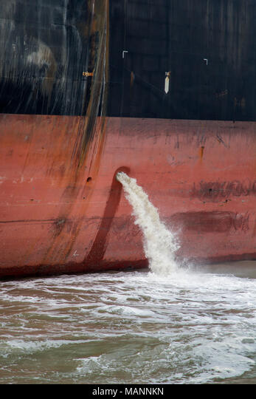
Concluding Comments
Despite plethora of waste management and pollution control legislation, our coastline is experiencing declining water quality.
For this Bill to contribute towards stemming this decline, it needs effective compliance monitoring and enforcement.
This Bill requires that defined ships report periodically on their compliance with the regulations of this Bill.
WESSA proposes additional clause that requires this compliance status information be made publicly accessible through a website portal.

Slide 17
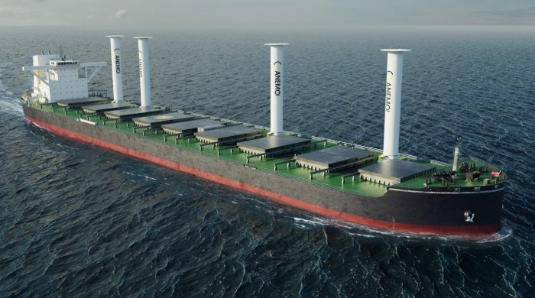
THANK YOU
Morgan Griffiths
WESSA Tourism Blue Flag Project Manager
+27 724175793 / +27 312013126
www.wessa.org.za
morgan.griffiths@wessa.co.za
Notes:
Technology is moving forward

