Slide 1
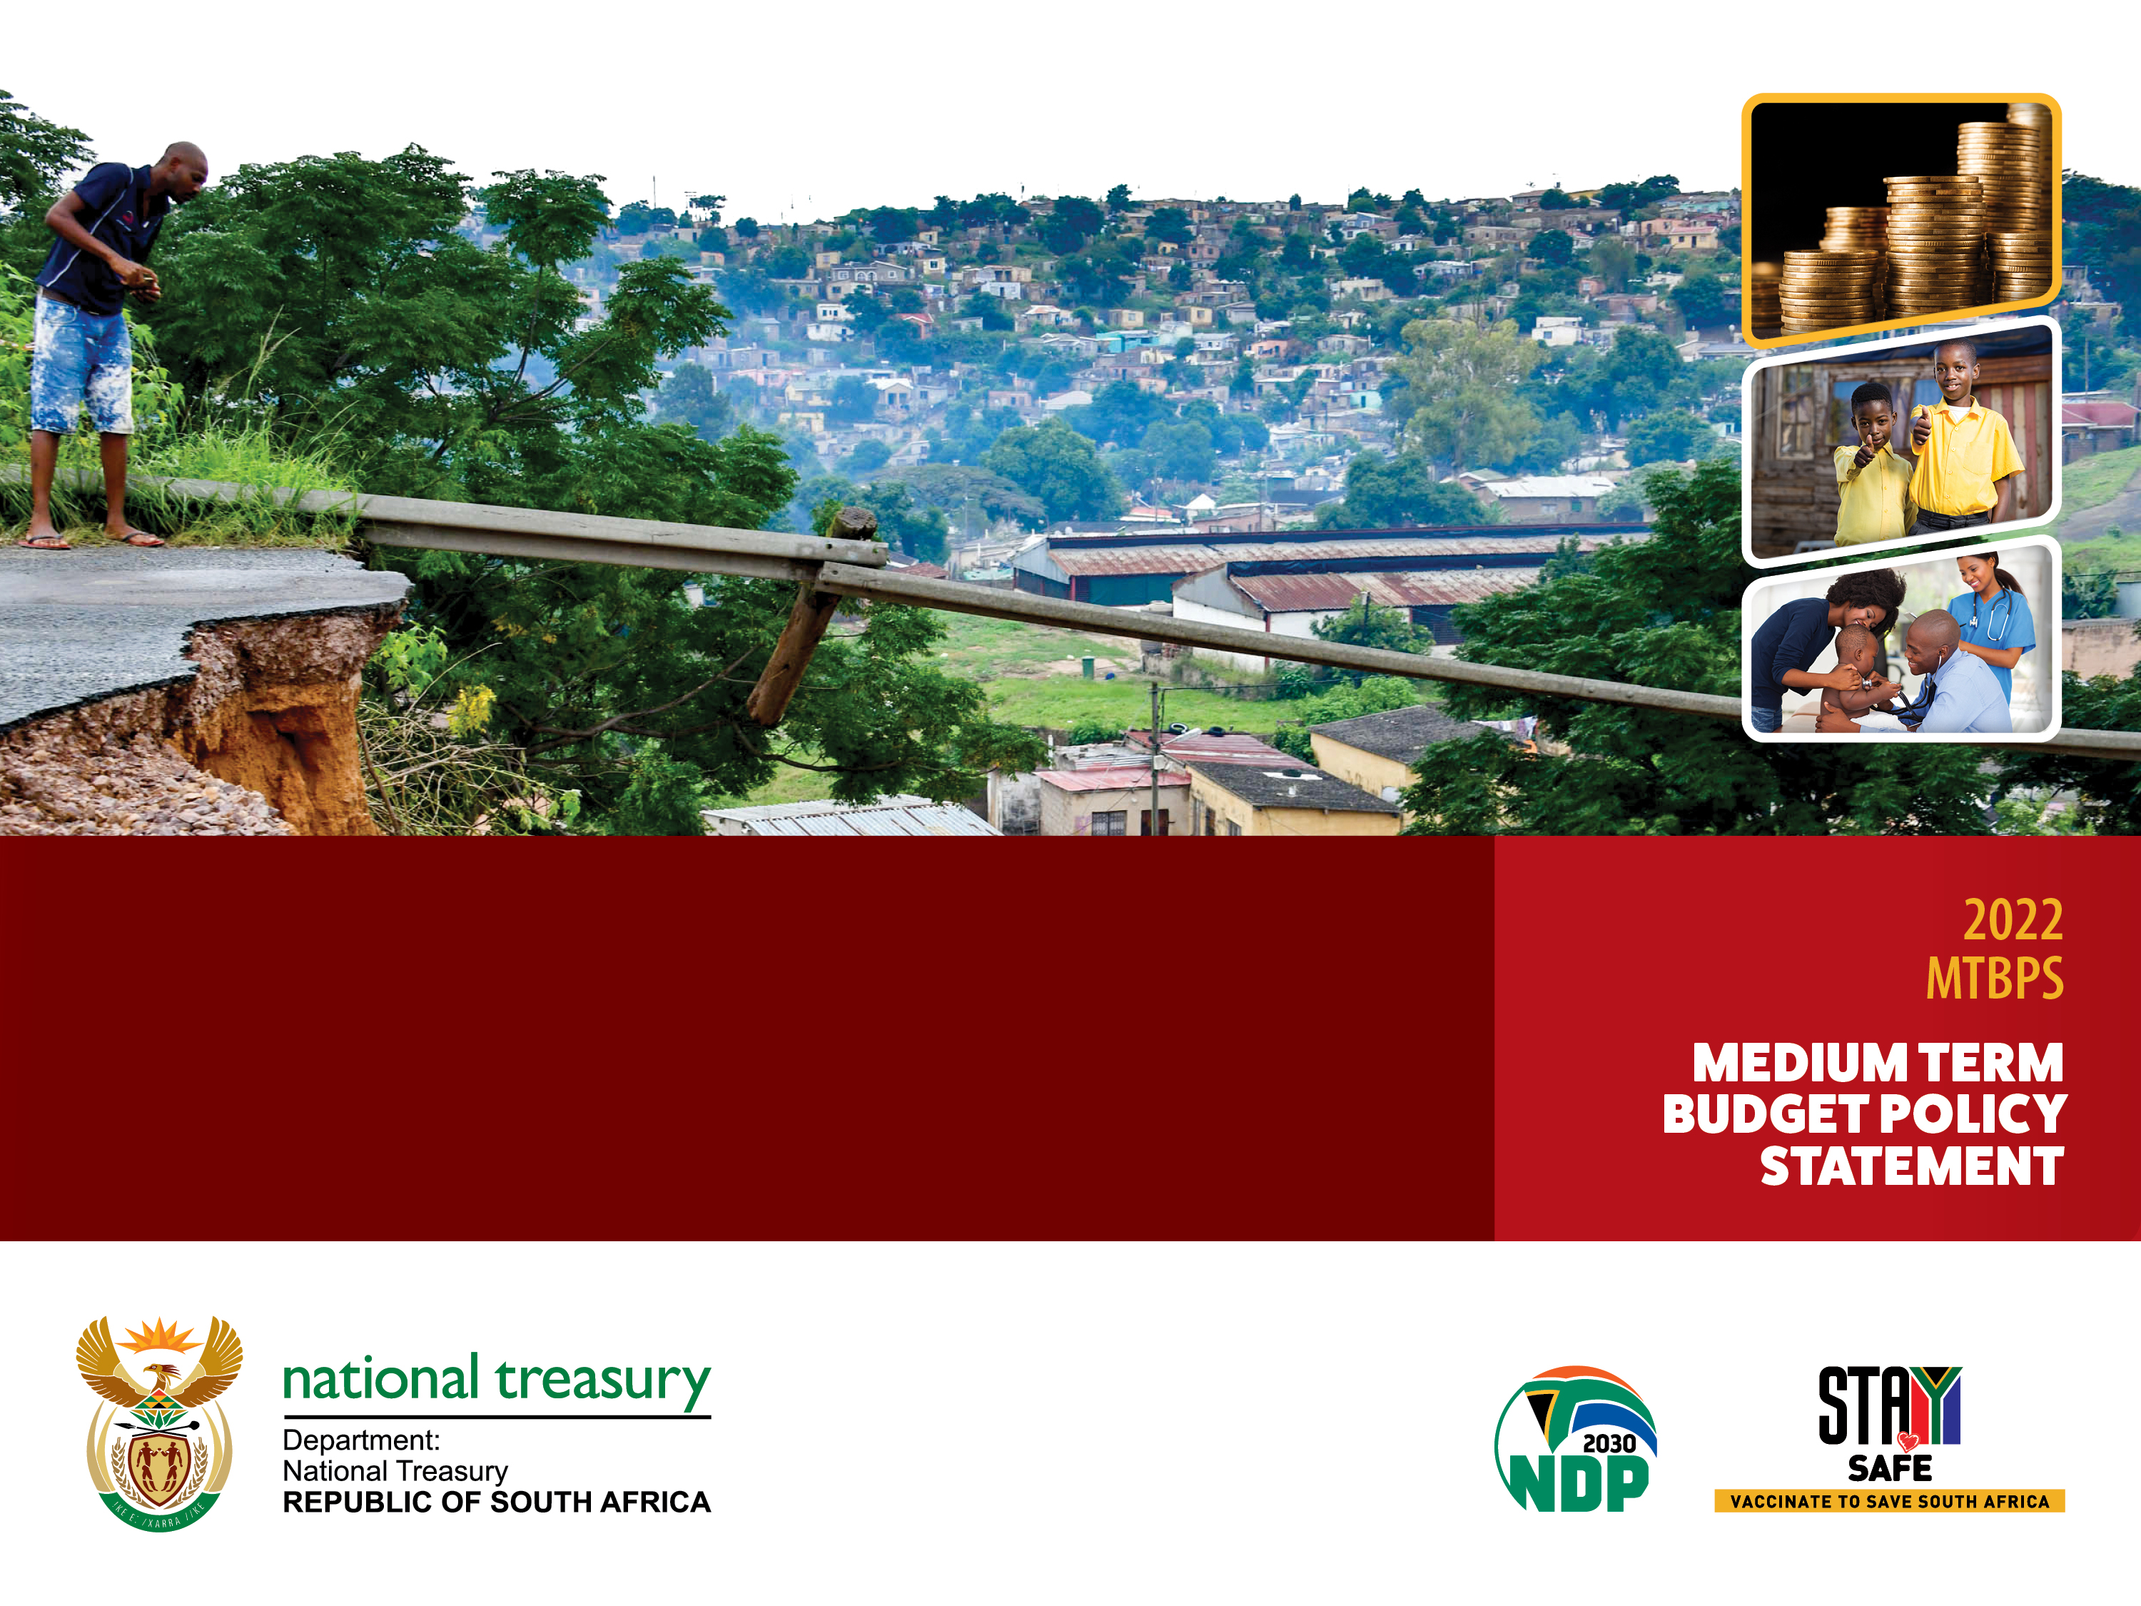
National Treasury response – 2022 MTBPS public hearings
November 2022

Slide 2
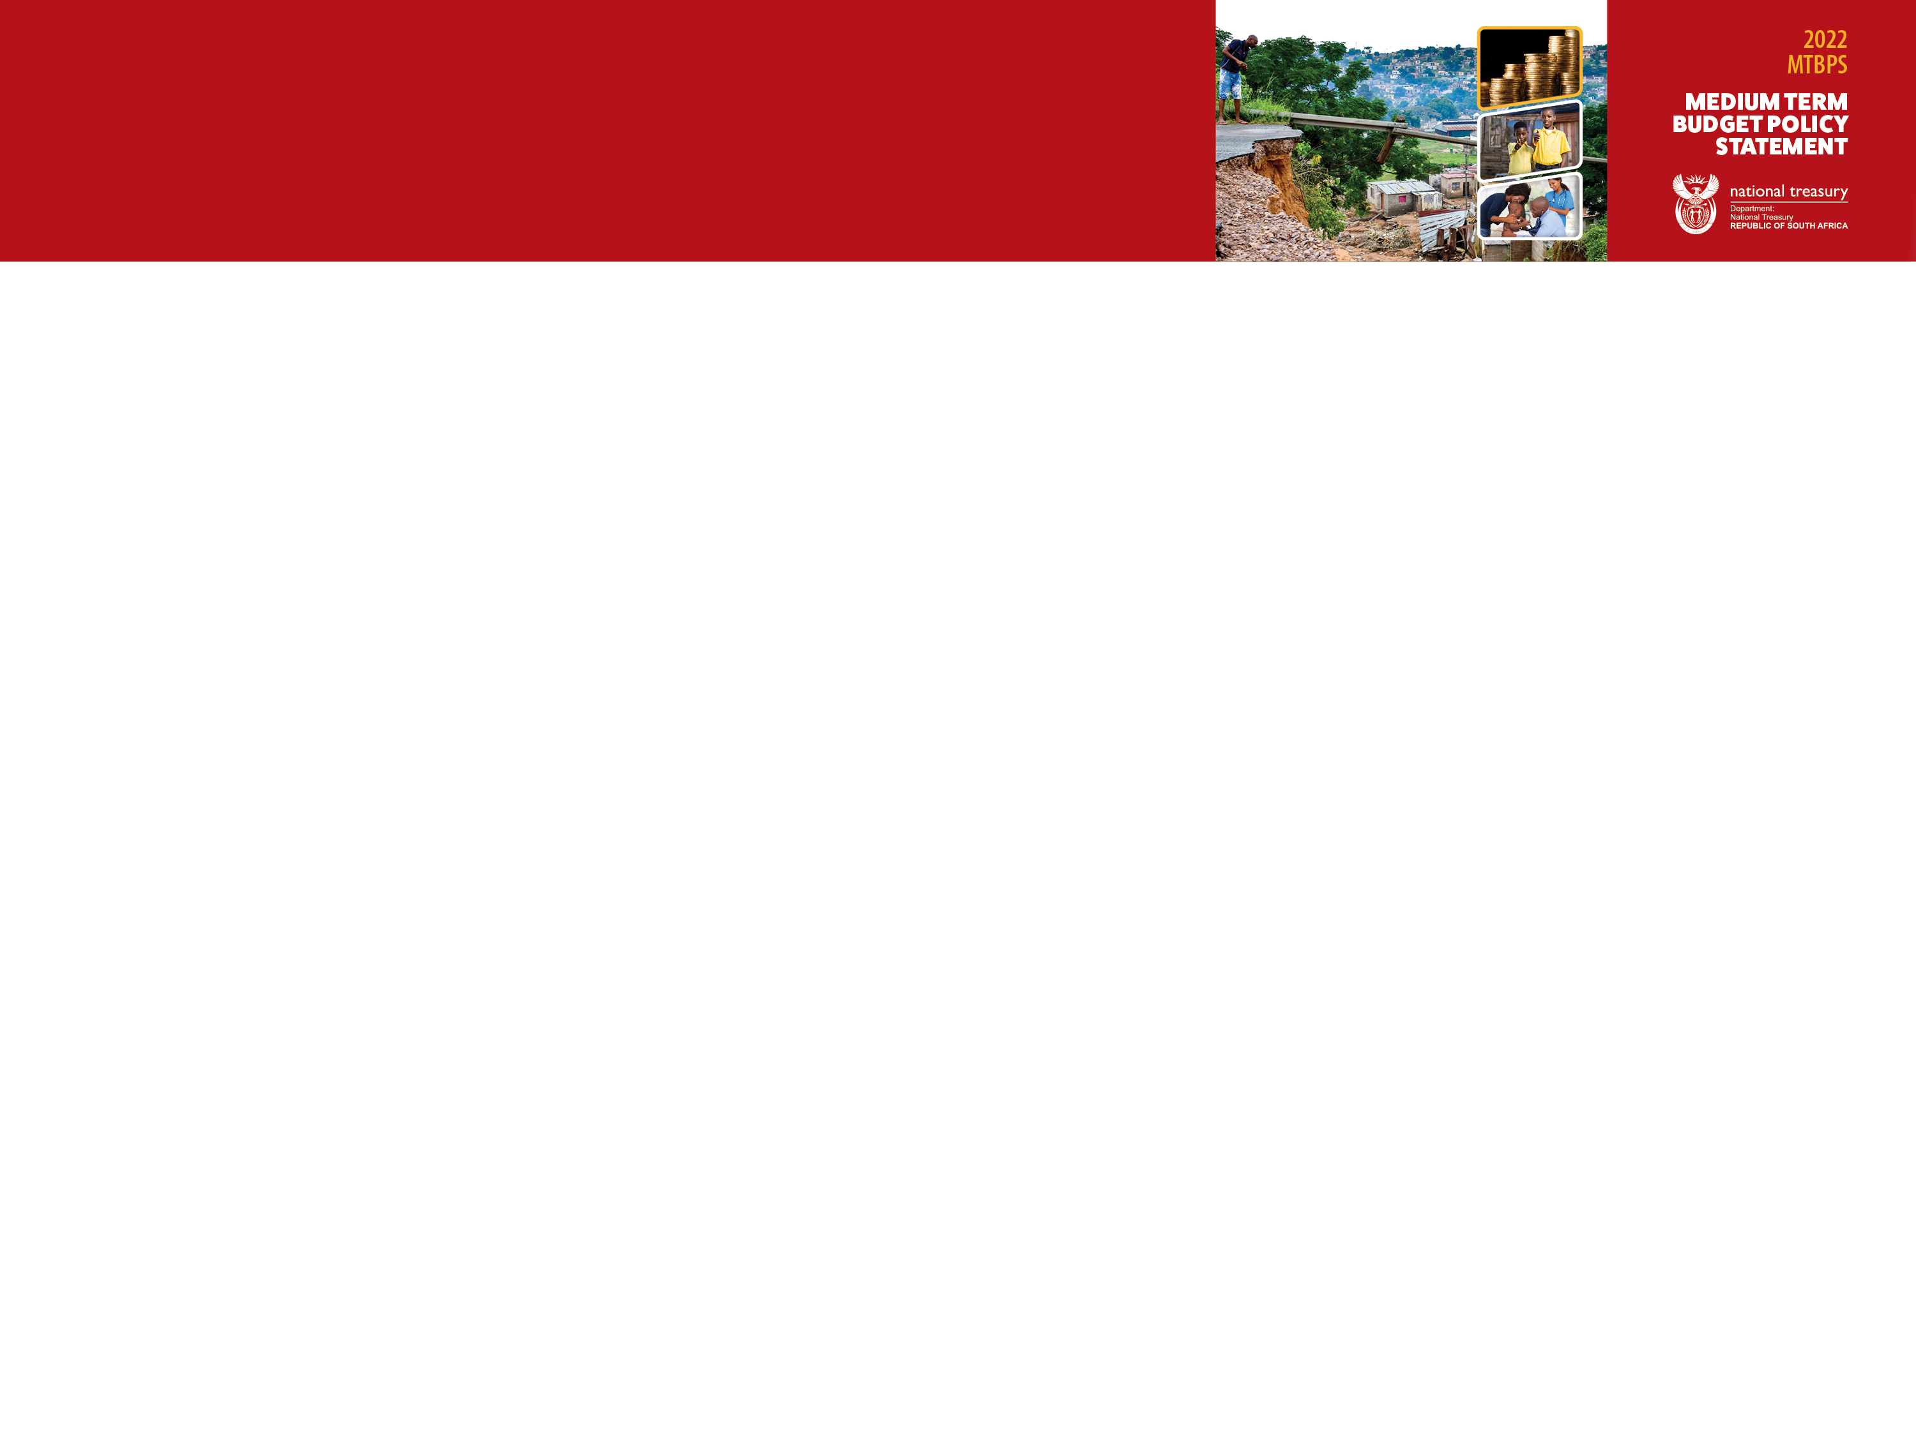
Submissions received
Parliamentary Budget Office (PBO)
Financial and Fiscal Commission (FFC)
South African Institute of Chartered Accountants (SAICA)
Congress of South African Trade Unions (COSATU)
Healthy Living Alliance (HEALA)
Institute for Economic Justice (IEJ)
Public Economy Project (PEP)
Budget Justice Coalition (BJC)

Slide 3
Main responses
Clarifying government’s fiscal position and strategy
Government’s proposed fiscal policy stance
South Africa’s structural growth problem
Revenue and tax proposals
Expenditure
Financing and debt management strategy
State-owned companies (SOCs)
Other matters raised
Public participation strategy

Slide 4
Clarifying government's fiscal position
The MTBPS does not announce new policy proposals such as tax measures or detailed expenditure allocations. This is only done in the February budget.
The fiscal strategy is not exclusively focused on debt reduction, but on strengthening public finances for sustainable growth and service delivery
In order to ensure sustainable public finances to achieve long-term intergenerational equity, it is crucial to carefully balance revenue, expenditure and borrowing. Financing and debt management also plays an important role
Government plans to implement its strategy as presented in the 2022 MTBPS in the following way:
  On average over the 2022 MTEF, government will use 49 per cent of windfall revenue to improve the primary balance and 51 per cent to increase non-interest expenditure.
  Government will not rely on transitory revenue gains to fund permanent spending increases but will instead use these funds to reduce some of the risks and contingent liabilities.
  As the gross debt burden declines, government will repair the broader public-sector balance sheet by reducing risks posed by public entities.
The 2022 MTBPS is not austere
  No further budget reductions were announced in the 2022 MTBPS. Instead, additional spending in critical spending areas are made using a portion of revenue improvements.
  Despite projections to reach a primary surplus by 2023/24, debt is high. Each year, a budget deficit adds to debt, increasing debt-service costs, limiting our capacity to spend more – this cannot continue indefinitely.
  Over the MTEF, an allocation of R3.56 trillion, or 59.2 per cent of total non‐interest spending is dedicated to the social wage. This aims to alleviate poverty, reduce unemployment and accelerate growth.
  Despite measures aimed at controlling expenditure growth, the funding for the social wage has been protected to ensure that necessary goods and services are provided to those who are in need.

Slide 5
Fiscal policy stance and strategy
The fiscal strategy in the 2022 MTBPS reduces fiscal risks in the short term, narrows the budget deficit and stabilises debt, while proposing measures to enhance economic growth and restore funding for infrastructure and service delivery programmes.
Why are we pursuing this strategy?
  Since 2007/08, South Africa’s public debt has risen sevenfold, from R577 billion to over R4 trillion in 2021/22. As a result, payments on the interest for this debt now exceed spending on essential services like health and security.
  A narrowing budget deficit reduces the need to issue new debt and allows government to better manage the spike in debt redemptions, reduce growth in debt-service costs and gradually restore growth in the baselines of key service delivery and infrastructure programmes.
  The country’s stock of debt remains high, and prudent public financial management remains essential to reduce the proportion of revenue dedicated to servicing debt over time.
  Stable public finances will underpin economic growth, maintain government’s commitment to support vulnerable households and help reduce overall risks to the fiscal outlook. This approach avoids the pitfalls of risky fiscal action that has led to currency depreciation and economic instability in several countries.
  South Africa’s economy is highly dependent on international capital flows and the rand is sensitive to changes in market conditions. High and persistent government debt and deficits can raise lending rates across the economy, make it difficult to attract investors, and raise the cost of machinery and fuel imports.
  The fiscal strategy also supports sustainable provision of essential services to low-income households. As the primary balance improves, the real baselines of critical public services can be strengthened.
  Sustainable macro-fiscal economic policy, attracts investment. Fiscal policy contributes indirectly to stimulate the economy.

Slide 6
Proposed use of revenue improvement
Split of revenue improvement since 2022 Budget
In the current year, government will use 65 per cent of the projected additional revenue to improve its primary balance, followed by 45 per cent in 2023/24 and 37 per cent in 2024/25.
On average over the 2022 MTEF, government will use 49 per cent to improve the primary balance and 51 per cent to increase non-interest expenditure.

Slide 7
This is not an austerity budget
National Treasury disagrees with the view that “this is an austerity budget” as:
More resources are added to health, education, local government free basic services, infrastructure, and safety and security.
No new spending reductions are proposed in 2022 MTBPS
Excluding once-off payments in in-year (2022/23) adjustments, main budget non-interest expenditure grows, on average, in line with CPI inflation over the 2023 MTEF.

Slide 8
Medium-term spending plans
  The 2023/24 financial year is the final year of the fiscal consolidation announced in the 2020 MTBPS.
  The 2022 MTBPS does not include any new budget reductions. From 2024/25 main budget non-interest expenditure grows above CPI inflation.
Main budget non-interest expenditure will increase by a net R52.4 billion in 2023/24 and R58.5 billion in 2024/25 compared with the 2022 Budget. This includes the following proposed additions over the next two years:
R66.9 billion for health, education and provision of free basic services by local government, and a one-year extension of the COVID-19 social relief of distress grant.
R8.9 billion for safety and security.
R11.3 billion for infrastructure investment, including rehabilitating damaged municipal infrastructure and refurbishing provincial roads.
Social wage is protected over the MTEF, increasing from R1.13 trillion in 2022/23 to R1.21 trillion in 2025/26.
Spending on payments for capital assets is the fastest-growing item by economic classification, at an average of 15.2 per cent over the three-year period, mainly due to the additional funding allocated for infrastructure investment in municipalities and provincial transport.
Notes:
.

Slide 9
Government supports the social wage
Social wage as a proportion of consolidated non-interest spending
Over the medium term, R3.56 trillion or 59.2 per cent of consolidated non-interest spending goes to the social wage – combined public spending on health, education, housing, social protection, transport, employment and local amenities.
Components of the social wage

Slide 10
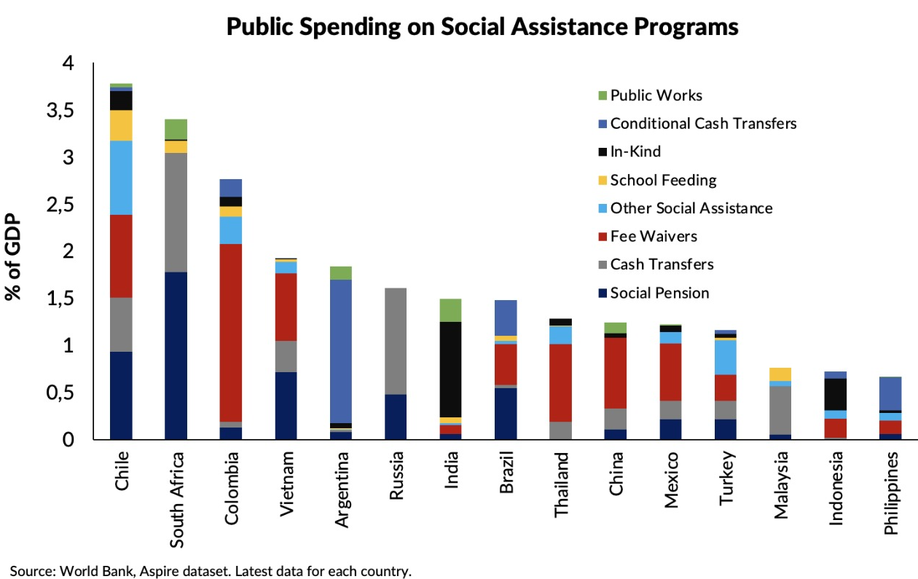
South Africa’s social spending compared to other countries
South Africa estimates exclude spending on student financial aid, therefore, social assistance spending in the broadest terms may be under-estimated

Slide 11
South Africa has a structural growth problem
South Africa has a structural growth problem
  SA's growth is limited by structural challenges related to the ability to combine capital and labour in a dynamic and integrated manner that would drive sustainable long- term growth.
  This is reflected by low potential growth of the economy - potential growth is below 2 per cent.
Low potential growth limits the scope for stimulation
  This suggests that it is unlikely that additional spending will stimulate growth without increasing inflation further in the prevailing environment of low trend growth, high inflation and high debt levels
  The gap between growth outcomes and potential is expected to narrow significantly over the medium term despite persistently low growth
It is in this context that we propose 3 elements that combined can put the economy on a higher and more sustainable growth path:
A clear and stable macroeconomic framework lays a foundation for a growing economy
  Sound macroeconomic policy provides critical buffers against external shocks (e.g. COVID-19).
  Low and stable inflation and a more sustainable fiscal trajectory reduce uncertainty, lower borrowing costs across the economy, anchor returns expectations for investments, and increases business confidence—all of which boost productivity.
Rapid implementation of economic reforms is required to boost economic growth
  Our structural weaknesses (i.e., unreliable electricity supply, high levels of concentration, excessive red tape, high cost of doing business) limit the rate at which the economy can grow and create jobs.
  Making progress on our structural reform agenda, as outlined in the Economic Recovery and Reconstruction Plan (ERRP) and Operation Vulindlela, can make a big difference in both the short and longer term
  Since the 2022 Budget Review, progress has been made on important reforms that are expected to support investment and job creation
Government plays an important role in ensuring an enabling environment for economic activity
This includes the overarching regulatory environment, and the provision of critical public goods and services are supportive of inclusive and sustainable growth
  The state must boost its capacity to prioritise sequence and coordinate interventions through adaptable policymaking and institutions that are accountable and capable, with the ability to make choices where trade-offs arise
  Over the next three years, spending increases will support economic growth and the delivery of health, education and local government free basic services.

Slide 12
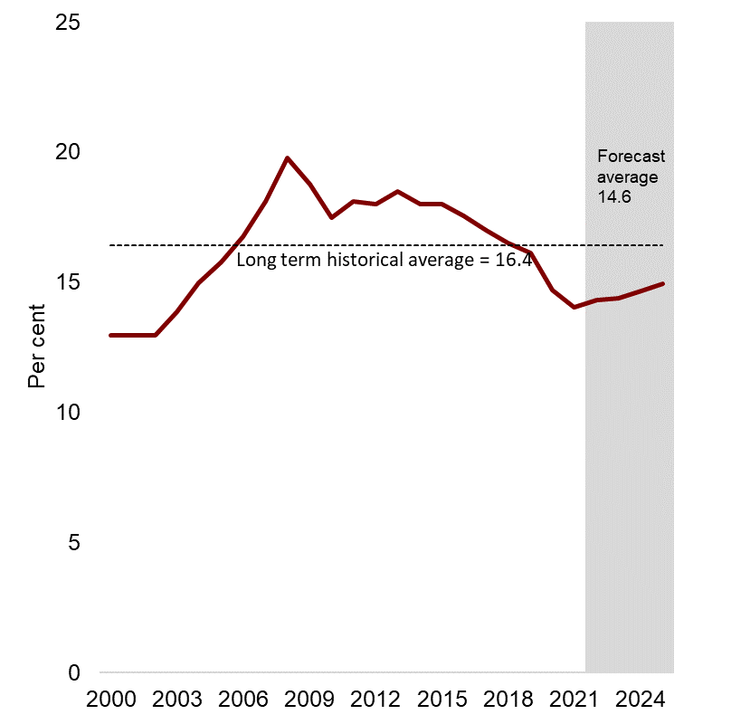
Growth and investment remain constrained by structural impediments
Gross fixed capital formation as a share of GDP
GDP growth has been lowered from 2.1% to 1.9% in 2022 and averages 1.6% in the following 3 years.
The downward revision reflects the scarring impact of the pandemic, the materialisation of global and domestic risks and the emergence of shocks.
Inflation has been upwardly revised to 6.7% in 2022, driven by higher fuel and food prices, with pressures broadening to core inflation.
As a result of higher inflation, nominal GDP has been upwardly revised.
Domestic demand will be a key driver of growth over the medium term, as the external environment softens.
The slow recovery in employment and investment, are particularly concerning in light of this.
Over the medium term, household consumption accounts for around 64% of total GDP.
Gross fixed capital formation is projected to average 14.6% over the same period, and is lower than the historical average of 16.4% (and well below the NDP target of 30% by 2030).
Total investment is forecast to remain below pre-pandemic levels by 2025.
It is, therefore, imperative that we implement the three elements that support growth to boost investment and employment, which will lift long-term GDP.

Slide 13
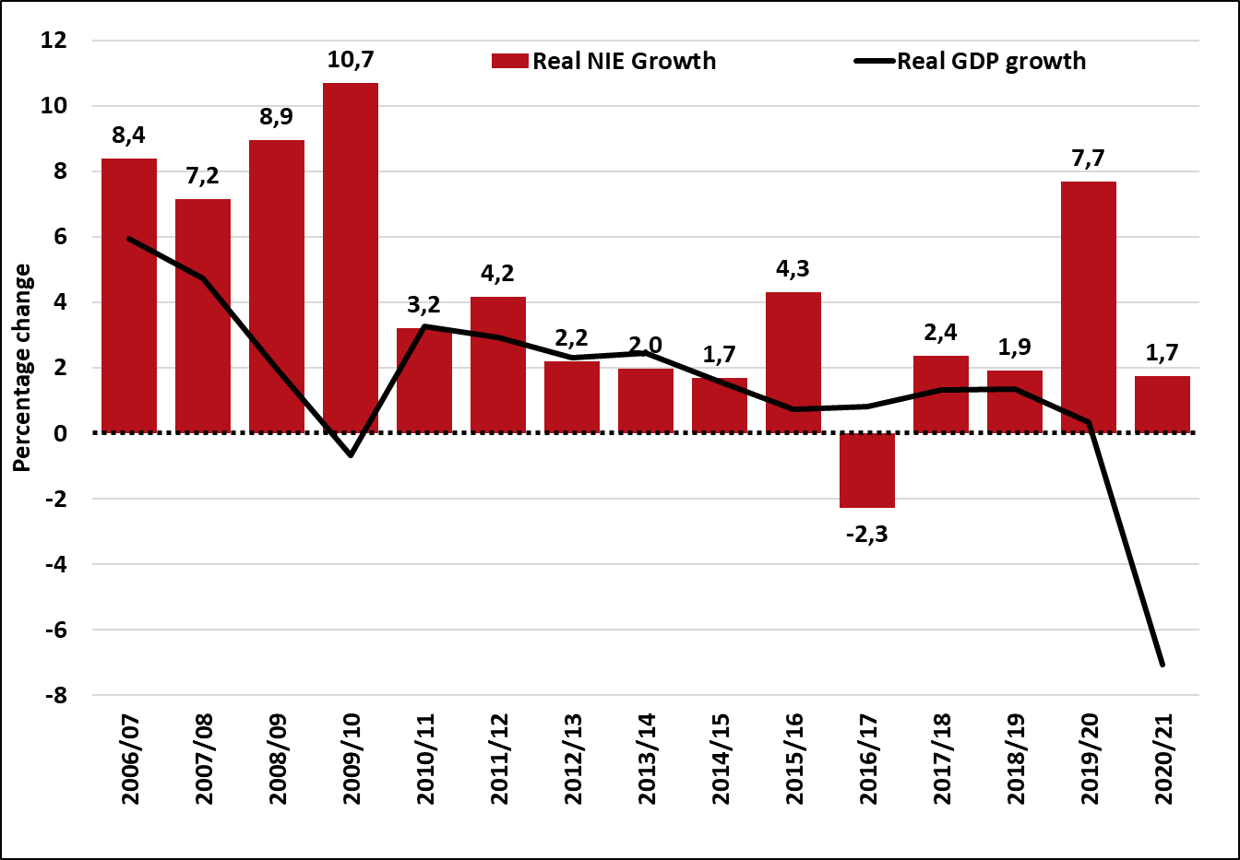
Fiscal policy alone cannot solve the growth problem
Real main budget non-interest expenditure growth vs real GDP growth
Increases in government spending have generally not translated to higher growth
Historical data suggests that prioritization and quality of spending, rather than the amount, have a greater potential impact on growth
Fiscal policy should focus on quality rather than quantity of spend

Slide 14
Revenue forecasts
Commentators suggested that revenue forecast is too optimistic.
Strong collections again this year due to corporate income tax, but this time for improvements in finance and manufacturing sector, not just mining.
Fuel levy relief and elevated VAT refunds in 2022/23 mask higher in-year revenue across most major tax categories.
The 2022 MTBPS revenue estimates align with the baseline macroeconomic projections. Higher inflation leads to higher tax bases and nominal GDP, improving expected revenue.
Medium-term tax elasticity assumptions from the 2022 Budget are maintained for the 2022 MTBPS estimates.
Majority of assumed revenue gains from high commodity prices are excluded from the corporate income tax forecasts over the next two years (assumed buoyancy of corporate income tax is 0 for 2023/24).
No additional revenue measures beyond those proposed in the 2022 Budget - tax policy focused on broadening the tax base and improving tax administration.
The rebuilding of SARS is evident in improved revenue collection and compliance trends. Additional revenue gains from SARS efficiency improvements represent an upside risk to the revenue estimates.
However, NT recognises that there are downside risks if commodity prices fall below forecasted values or if a global recession materialises

Slide 15
Tax policy comments
The MTBPS did not include announcements on tax policy, as these are generally reserved for the Budget in February each year.
Yet comments were received on tax policy issues, such as:
  That there should be an increase in taxes for those on higher incomes, that taxes on luxury imports should be raised and that the corporate income tax rate decrease should be reversed.
  That government should introduce a net wealth tax and reduce medical tax credits and retirement fund deductions. Should also impose a new resource rent tax and a social security tax to implement a BIG.
  That taxes on fuel should be reduced to lower the cost for households
  To improve revenue collections, SARS should be provided additional funding
These proposals will be considered for the 2022 Budget, after assessing the state of the economy, the fiscal position and required expenditure commitments.
HEALA stated that National Treasury had not responded to their PAIA request on minutes of meetings NT and sugar cane industry on the delay to the Health Promotion Levy increase.
  National Treasury formally responded to the request on 26 October 2022 indicating that there were no records of meetings taking place.
Comments that South Africa should not go above the 25% tax to GDP ratio
  There is no government policy stating that the tax-to-GDP ratio cannot go above 25%. Many countries have both higher tax-to-GDP ratios and higher economic growth rates.

Slide 16
Expenditure
The credibility of expenditure ceiling
  The spending ceiling was introduced in the 2013 Budget. However, its effectiveness has been limited and fiscal imbalances continued to grow through the rest of the decade. South Africa was consequently ill‐prepared to deal with the crisis induced by the COVID‐19 pandemic.
  While this measured path of fiscal consolidation achieved some success, debt continued to rise as a share of GDP as new spending pressures emerged and economic growth declined.
  Government is considering additional options to protect fiscal sustainability. National Treasury tested the appropriateness of fiscal rules such as a debt ceiling, expenditure or revenue rule, which may limit excessive deficits.
Spending risks are not allocated in the 2022 MTBPS baseline.
  The Eskom debt take-over still needs to be quantified and will only be included in the baseline when it materializes.
  Public sector wage bill is still under negotiation
  The unallocated reserve cushions the fiscal framework from fiscal risks that may materialise over the medium term. These funds are not earmarked.
  A permanent extension of the SRD grant, or any replacement thereof, needs to be matched by a corresponding permanent increase in revenue, decrease in spending or combination of the two.
  The findings of some spending reviews are being implemented in the peace and security and general public services functions. In most cases, review findings remain under discussion or will take longer to implement because they require legislative amendments and political conversations.
  While it is regrettable that some policy decisions with financial implications have not been finalised, the inclusion of reserves is meant to protect the integrity of the overall fiscal framework. This strategy has already improve clarity and decision-making during the 2023 budget process.

Slide 17
Public sector wage bill uncertain
Most of the unions rejected the 3 per cent facilitated offer by the state, which meant the funding allocations for 2022/23 cost-of-living adjustment (COLA) could not be included in the 2022 Adjusted Estimates of National Expenditure (AENE). No resolution was reached in conciliation process. Unions now have a certificate to embark on an industrial action. Nevertheless, the proposed fiscal framework assumes a broad-based increase in 2022/23 and its carry-through effects over the MTEF. This helps to safeguard the credibilty of the fiscal balances.
  Over the past 15 years, the consolidated wage bill grew significantly. In the context of slow economic growth, the growing wage bill began crowding out spending in other critical areas, including service delivery. Between the 2020 Budget and the 2021 Budget, government reduced the medium-term compensation of employees’ baselines by more than R300 billion to stabilise the public finances.
  To avoid pre-empting the wage negotiation process, no provisions have been made for wage increases in 2023/24 although increases will need to remain within the available fiscal resources so as not to compromise other spending priorities.
  Remuneration practices have become misaligned because of a fragmented system – also seen in collective bargaining process in the public sector – resulting in significant differences between the remuneration of senior managers in the public service and those in municipalities and public entities. A review of the remuneration policies across government aims for the public sector (excluding SOCs) to move towards a single remuneration framework in line with the principles of fair, equitable and sustainable remuneration. This will reduce current remuneration inequality for employees performing similar tasks in different spheres of government.
  Future wage negotiations will aim to strike a balance between remuneration increases and the need for additional staff in services such as education, health and police.
Notes:
Both acting Minister of Public Service and Administration’s (MPSA) decision to implement the final tabled offer unilaterally for public service employees and the Minister of Finance to allocate the available funding to national departments and provinces ensured that public servants are not negatively impacted while safeguarding the credibility of the budget process.
South Africa’s public-sector wage bill is about 5 percentage points greater than the Organisation for Economic Co-operation and Development (OECD) average as a share of GDP.
Educators remain the single largest occupation category in the public service, both in terms of expenditure and headcount. About 52 per cent of the wage bill is spent on educators, nursing personnel and police officers.

Slide 18
Financing and debt management strategy
Government focus on the stabilisation of gross loan debt as a per cent of GDP. As long as government run budget deficits debt will continue to increase. Lowering the budget deficits and running primary budget surpluses will slow down the annual increase in the growth of debt and debt-service costs.
When government starts running budget surpluses it will enable government to reduce its debt.
Gross loan debt will stabilises at 71.4 per cent of GDP in 2022/23 - two years earlier and at a lower level than projected in the 2022 Budget. This is mainly driven by higher nominal GDP projections given significantly higher GDP inflation especially in the current year, and the improvement in the primary balance, given the better-than-expected revenue estimates. These factors outweigh the negative impact of the upward revisions in interest and exchange rates. Net loan debt – which is gross loan debt less cash balances – will stabilise at 69 per cent of GDP in 2024/25.
Gross loan debt is expected to increase from R4.75 trillion in 2022/23 to R5.61 trillion in 2025/26, driven mainly by the budget balance and fluctuations in the interest, inflation, and exchange rates.
Government continues to finance the borrowing requirement in a prudent and sustainable manner. A portion of the higher-than-expected revenue since the 2022 Budget will be used to reduce government’s gross borrowing requirement and subsequently its debt stock.
Higher than expected tax revenue in 2022/23 increased government’s cash balances. This cash will be used to cover expenditure in the last quarter of 2022/23 and to redeem R250 billion of debt in 2023/24 and 2024/25.

Slide 19
SOCs
Eskom debt relief programme
To ensure Eskom’s long-term financial viability, government plans to take over a portion of its debt. This will allow Eskom to implement planned capital investment and critical maintenance and ensure that the company no longer relies on government bailouts.
Debt relief alone will not solve Eskom’s problems. A comprehensive approach, addressing various underlying challenges is considered. The National Treasury is leading a process to finalise a debt relief programme designed to restore Eskom to efficiency and financial sustainability.
The specifics of the programme, including the selection of the relevant debt instruments and the method of effecting the relief, are still being finalised.
The conditions related to the debt take over will be informed by an independent review of Eskom’s operations and will apply before and during the debt transfer, addressing:
  Eskom’s structural challenges by managing its costs,
  arrears due to the utility, and
  providing greater clarity and transparency in tariff pricing.
The announcement had a positive impact on Eskom Bond yields and subsequently Moody’s lifted Eskom Outlook to positive for the first time in 15 years
Further details of the programme will be announced in the 2023 Budget

Slide 20
Preliminary conditions
DENEL (R3.4 billion)
Pre-conditions:
Shareholder confirmation of support of the turnaround plan.
Disposal of all identified non-core assets.
Submission of a strategic equity partnership strategy.
Surplus funds from the section 189 to be utilised to reduce government guaranteed debt.
Funds for legacy obligations should be ring-fenced.
The Denel monitoring committee must be re-established.
Post-conditions:
  DPE must finalise Memorandum of Co-operation with the DoD, within six months.
  The DPE to withdraw specified government guarantees.
  Denel to continue submitting its quarterly performance reports to the DPE and National Treasury.
  No bonuses may be paid, following receipt of recapitalisation and period of the turnaround plan implementation.
  TRANSNET (R2.9 billion)
  Conditions
    Independent review of all freight rail corridors and associated port operations.
    Monthly report on the progress made in the rehabilitation of locomotives and the impact on volumes.
    Monthly report on progress made in addressing the operational challenges.
    Monthly update on the status of the Transnet debt.
    PFMA section 54(2) applications to be approved by the Minister of Public Enterprises and the Minister of Finance.
    DPE to include NT in the PFMA section 54(2) pre-notification process.
    DPE to consult NT prior to the conclusion of the Transnet Shareholder Compact.
  SANRAL (R23.736 billion)
    Funds to be used to repay SANRAL debt and debt obligations.
    SANRAL government guarantees will reduce in line with the allocated funds.
    SANRAL cannot raise or refinance debt until the Minister of Finance communicates otherwise.
    Allocation will be split into two tranches of R8.98billion and R14.76 billion subject to meeting the following conditions:
    The Department of Transport to submit the draft Road Funding Policy to the National Treasury by 31 January 2023 for comments, prior to submitting the policy to Cabinet for public comment by 1 April 2023.
    Independent review of the SANRAL supply chain management policy and related procurement processes.
    Independent review of the performance of the SANRAL Board.
    National and Provincial Government to sign an agreement on a solution for the Gauteng Freeway Improvement road network.

Slide 21
Other issues
Grey listing
  Maintaining the integrity of South Africa's financial system is critical to long-term growth.
  Government is addressing deficiencies in the anti-money laundering framework identified by the Financial Action Task Force.
  These changes are intended to reduce the risk and incidence of financial crime and corruption, and to avoid grey listing.
  Over the 2023 MTEF period, functions critical to the anti-money laundering regime, particularly in the law enforcement agencies and the Financial Intelligence Centre, will receive additional resources to carry out this work.
Climate change
  In line with South Africa’s global commitments, fiscal policy will continue playing its part to shift economic incentives towards cleaner forms of energy.
  As announced in the 2022 Budget, the carbon tax rates will be increased significantly from 2023 onwards.
  A paper on the design options for tax-free allowances under the carbon tax will be published in 2023 for public comment and consultation.
  Support for climate change mitigation and adaptation measures will increasingly feature in budget policy in the period ahead.

Slide 22
Public participation
South Africa remains among the top 2 countries with the most transparent budget processes in the world. We still maintain a reputation as a global leader while strengthening our commitment to a transparent budget system. The global transparency average is 45 out of 100, while South Africa scores the second best with 86 out of 100, a score which reflects South Africa’s commitment to transparency.
Pre-budget public participation :
    MTEF Budget guidelines are made publicly available
    Budget tips (dozens of tips received for 2022 MTBPS)
    Public consultations session on the 2023 MTEF issued 28 July 2022 - South Africa is one of five pilot countries that are participating in the Fiscal Openness Accelerator Project (FOA) that was launched in 2019 by the International Budget Partnership (IBP) and the Global Initiative for Fiscal Transparency (GIFT)
    Nedlac engagements
  Post-budget public participation:
  People’s Guide to the Budget – presented in 7 languages and circulated in communities
  Community radio stations engagements – about 21 radio stations across different provinces
  Budget Outreach Programme
  Other public participation
  National Treasury Website – All budget information including data sets
  Vulekamali - an easily accessible online budget data portal
  Fiscal Openness Accelerator - to support innovation to deepen participation by members of the public in fiscal policy. The initiative aims to improve public participation in the budget process.
  NT is continuously looking at more inclusive public participation mechanisms

Slide 23
Conclusion
The MTBPS does not announce new policy proposals such as tax measures or detailed expenditure allocations. This is only done in the February budget.
The fiscal strategy is not exclusively focused on debt reduction, but on strengthening public finances for sustainable growth and service delivery
In order to ensure sustainable public finances to achieve long-term intergenerational equity, it is crucial to carefully balance revenue, expenditure and borrowing. Financing and debt management also plays an important role
Stable public finances will underpin economic growth, maintain government’s commitment to support vulnerable households and help reduce overall risks to the fiscal outlook. This approach avoids the pitfalls of risky fiscal action that has led to currency depreciation and economic instability in several countries.
Government is allocating funds to reduce fiscal and economic risks posed by Denel, SANRAL and Transnet, and plans to take over a portion of Eskom’s debt. These actions will help secure the gains of fiscal consolidation by improving economic growth and associated revenue collection and reducing contingent liabilities.
Government continues to assess trends in employment and compensation across the public sector to ensure sufficient capacity and a fair, equitable and sustainable remuneration policy. Over the MTEF, government will focus on increasing capacity in services such as education, health and police and develop a single remuneration policy to guide remuneration decisions across different spheres and entities.
Government is addressing deficiencies identified by the FATF. Over the 2023 MTEF period, functions critical to the anti-money laundering regime (i.e law enforcement agencies and the FIC), will receive additional resources to carry out this work.
NT is continuously looking at more inclusive public participation mechanisms

Slide 24
Annexure

Slide 25
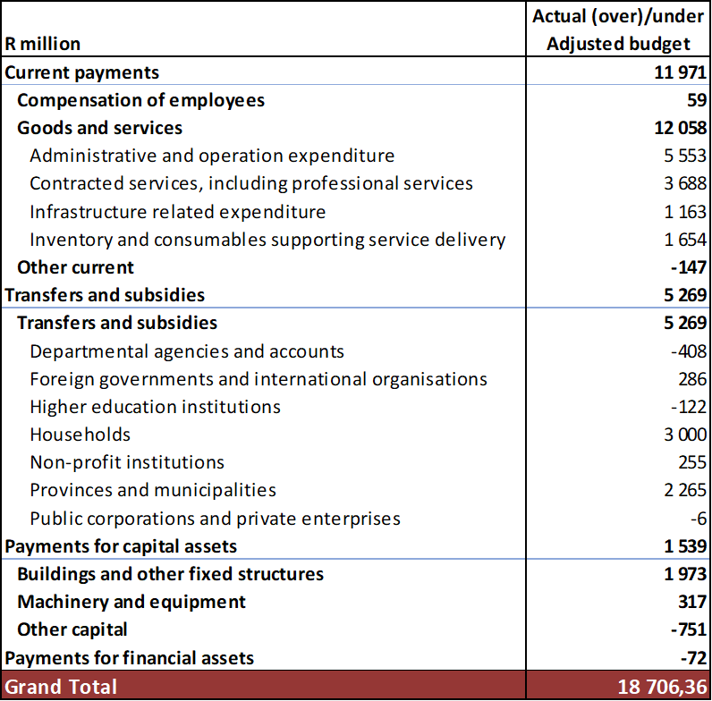
Underspending in 2021/22 per economic classification

Slide 26
Debt sensitivity
Government mitigates against the impact of higher interest rates on borrowing costs:
  Due to rising interest rates, borrowing costs remain higher than pre-pandemic levels. To limit the additional cost of borrowing, 71 per cent of the total long-term fixed-rate bond issuance is concentrated in the three- to 15-year maturity area. The introduction of variable interest rate debt helped reduce the aggregate weighted cost of funding from 10.33 in April 2022 to 9.48 per cent in September 2022.
The debt portfolio is sensitive to changes in the interest-rate, exchange-rate and inflation assumptions
  The debt portfolio is sensitive to the changes in interest-rate, exchange-rate and inflation assumptions. In the case of a 10 per cent increase in any category, government would continue to finance its borrowing requirement, but at greater cost.
  Similarly, favourable movements in any of these categories would reduce borrowing costs. A one percentage point change in headline inflation results in a R0.3 billion increase in debt-service costs while gross loan debt increases by R8.9 billion. (See figure 9 below)
  A R1 depreciation in the Rand/US Dollar exchange results in a R0.5 billion increase in debt-service costs and an increase of R30.7 billion in gross loan debt. A one percentage point change in short- and long-term interest rates result in a R5.8 billion increase in debt-service costs while gross loan debt increases by
  R15.4 billion.

Slide 27
Debt outlook
Gross and net loan debt
Gross loan debt is now expected to stabilise at 71.4 per cent of GDP in 2022/23.
This is mainly driven by higher nominal GDP projections, resulting from higher inflation, and an improved primary balance given better-than-expected revenue estimates.
These factors outweigh the adverse impact of higher interest rates and a weaker exchange rate.
Net loan debt – which is gross loan debt less cash balances – will stabilise at 69 per cent of GDP in 2024/25.

Slide 28
EXPENDITURE PRIORITIES
Consolidated government expenditure, 2023/24 - 2025/26 | Consolidated government expenditure average annual growth, 2023/24 – 2025/26
Consolidated government spending is projected to increase from R2.21 trillion in 2022/23 to R2.48 trillion in 2025/26, growing at an annual rate of 4 per cent.
Learning and culture, which is allocated R1.43 trillion over the period, accounts for the largest share of the total consolidated government MTEF expenditure.
Spending in the economic development function grows at the fastest rate, averaging 8 per cent per year, followed closely by debt-service costs (7.3 per cent).
Spending in the social development function will contract by an average of 2.4 per cent as the COVID-19 social relief of distress grant will end on 31 March 2024.

Slide 29
SOCIAL WAGE SPENDING
The social wage refers to the combined public spending on health, education, housing, social protection, transport, employment and local amenities.
The social wage, totalling R3.56 trillion over the next three years, will continue to take up the biggest share of the budget in support of poor households. The largest allocations are directed to the education, health and social development sectors.

Slide 30
INFRASTRUCTURE SPENDING TO SUPPORT
ECONOMIC GROWTH
Consolidated expenditure on buildings and fixed structures
Government will increase infrastructure budgets over the MTEF period to support economic growth and development.
Spending on building and other fixed structures is projected to increase from R66.7 billion in 2022/23 to R112.5 billion by 2025/26, at an annual average of 19 per cent over the medium term.
The projects recommended through the Budget Facility for Infrastructure at the national and provincial level amount to R4.8 billion in 2023/24, R5.8 billion in 2024/25 and R6.4 billion in 2025/26.
Public entities plan to invest R145.8 billion in infrastructure over the MTEF period, including R85.3 billion in the transport sector and R33.3 billion in the water sector.
The Development Bank of Southern Africa, Infrastructure South Africa and the Government Technical Advisory Centre are scaling up efforts to build a viable project pipeline. These efforts are being strengthened by providing resources for project preparation.

Slide 31
RISKS TO THE FISCAL OUTLOOK
Some previously anticipated fiscal risks have started to materialise and are worse than anticipated at the time of the 2022 Budget Review, although the fiscal position is expected to improve over the medium term.
Major short- to medium-term risks to the outlook include:
  A slowdown in global economic growth, which would negatively affect domestic growth and revenue collection, worsening the fiscal position.
  Continuous electricity supply constraints, which would decelerate economic growth.
  Higher-than-budgeted public-service wage costs would strain fiscal resources. Additional fiscal measures or reductions in headcounts would be required to contain overall compensation spending.
  The materialisation of contingent liabilities and the weak financial position of several state‐owned companies that rely on government support to operate might require additional fiscal resources.
  New, unfunded spending pressures could result in a faster accumulation of debt and negatively affect the public finances. Any large permanent increases in spending must be matched by permanent increases in revenue or reductions in spending elsewhere, including suspending or terminating programmes.

