Slide 1


SRC:
KwaZulu-Natal Community Education and Training College
Presentation Portfolio Committee
4 November 2022

Slide 2
Presentation Outline
Background
Objectives of the SRC
SRC Election
Portfolios
Structures supporting SRC
2022 SRC
2022 Programme of Action
Role of Higher Health
Capacity Building – DHET
Sports Activities
Closure

Slide 3
1. BACKGROUND
The Student Representative Council (SRC) is a structure which represents the interests of the students of KZN CET College as envisaged in Section 14 of the CET Act of 2006 as amended and the Statute of the College. The Student Representative Council has governing responsibilities in respect of student affairs and may advise the College Authorities on all issues including institutional policies affecting students.
It is significant to have a Student Representative Council as it serves as a bridge between the students and the management of the college. In the event students need to address matters of concern, a legitimate governance structure would have to represent them. The SRC advises students on critical matters that might bring the College into disrepute.

Slide 4
The statutory objectives of the SRC are:
• To promote the mission and vision of the KZN CET College
• To align program of action with NP-SET outcomes
• To provide leadership to the student body and promote unity-in-diversity among students
• To represent students of the college in matters that may affect them
• To serve the interests of students without partiality, bias, prejudice discrimination or preference, by promoting excellence in leadership and student governance

Slide 5
3. SRC Elections
The 2022 SRC was elected in terms of the SRC Constitution of the KZN CET College of 2019. The SRC at the KZN CET College acknowledges that the student population is from disadvantaged communities. Its strategic goal is to ensure that graduates that are produced at the college are not only of high academic stature but also have the necessary skills to lead in various spheres of governance.

Slide 6
KZN CENTRAL/ PROVINCIAL 2022 SRC PORTFOLIOS
 | 4. PORTFOLIOS | STUDENT NAME & SURNAME | DISTRICT
1. | PRESIDENT | Ngcobo Lungani | uMgungundlovu
2. | DEPUTY PRESIDENT | Mbatha Sphelele | King Cetshwayo
3. | SECRETARY GENERAL | Tylah Beck | eThekwini Metro Pinetown
4. | DEPUTY SECRETARY GENERAL | Mafuleka Nombuso | eThekwini Municipality Umlazi
5. | TREASURER GENERAL | Cassim Nazeerah | Amajuba
6. | INFORMATION, MEDIA & PUBLICITY OFFICER | Ngidi Snempilo Purity | iLembe
7. | EDUCATION & ACADEMIC SUPPORT OFFICER | Bhengu Ntombikayise | Ugu
8. | WELFARE, GENDER AND DISABILITY | Zungula Zizipho | Harry Gwala
9. | PARTNERSHIP & COMMUNITY LIASON OFFICER | Ngcobo Nokwanda | uThukela
10. | SPORT, ART & CULTURE | Khanyi Philani | uMkhanyakude
11. | MORALS & ETHICS OFFICER | Sishi Nduduzo | Zululand
12. | HEALTH, WELFARE, GENDER & DISABILITY | Buthelezi Sphelele | uMzinyathi

Slide 7
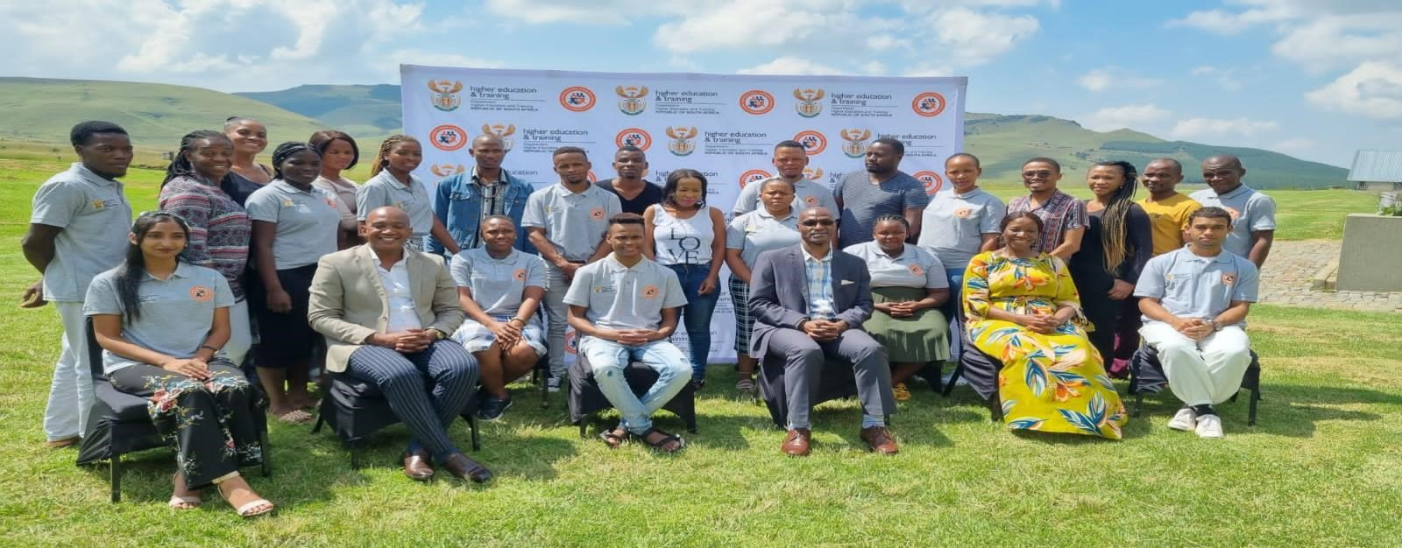
5. 2022 KZN CET College SRC; Provincial Co-ordinator, District Co-ordinators and College Officials.

Slide 8
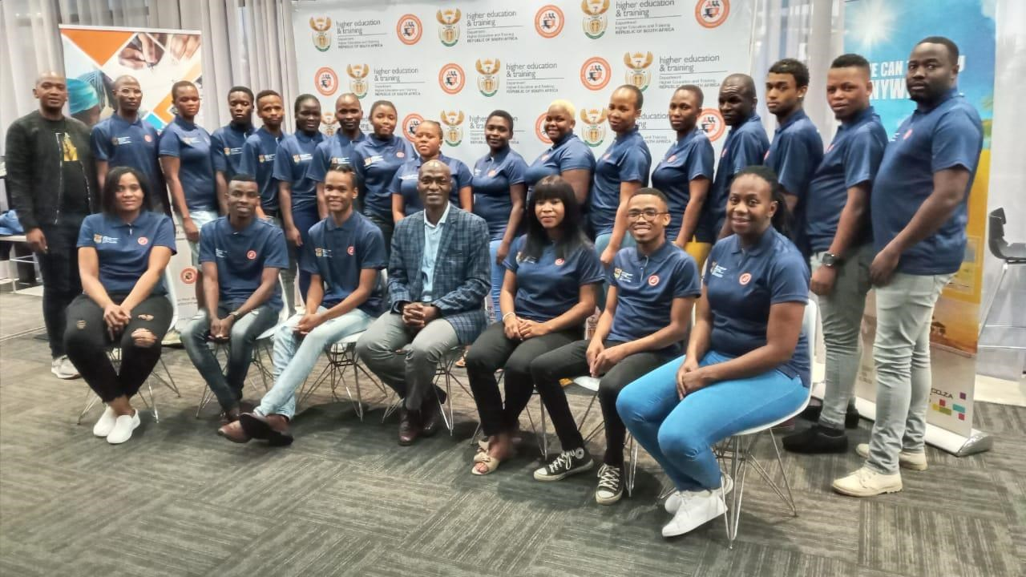
6. 2022 KZN CET College SRC; Provincial Co-ordinator, District Co-ordinators and College Officials

Slide 9
7. 2022 Programme of Action
TERM
TERM 1 17 JANUARY 2022- 25 March 2022
TERM
TERM 2 05 April 2022- 24 June 2022
TERM
TERM 3 19 July 2022 – 30 September 2022
TERM
TERM 4 11 October 2022- 15 December 2022 (see below)

Slide 10
 | TERM 4 11 October 2022- 15 December 2022
TIME FRAME | ACTIVITY | RESPONSIBILITY | INDICATOR
01 – 07 October 2022 | Read-a-thon/ Road show | CSRC, DSRC, CLC SRC & Organisers | Reports
01 November 2022 | LEADERSHIP TRAINING | External Facilitator SRC | Reports
14 October 2022 | Career guidance & Motivation | External Facilitator DSRC & CLC SRC | Reports
25 October 2022 | Submission of the reports by District Secretaries to CSRC secretary in preparation for the | District Secretary Central SRC Secretary CSRC President | Reports Presentation
 | Academic Board Meeting and Council | Provincial Coordinator
01 December 2022 | GBV AWARENESS; DISABILITY AWARENESS AND WORLD- AIDS DAY | CSRC PRESIDENT | Circular
01 – 03 DECEMBER 2022 | REVIEW & REFLECT ON YEAR 2022 CSRC CLOSING FUNCTION | CSRC Coordinators | Function

Slide 11
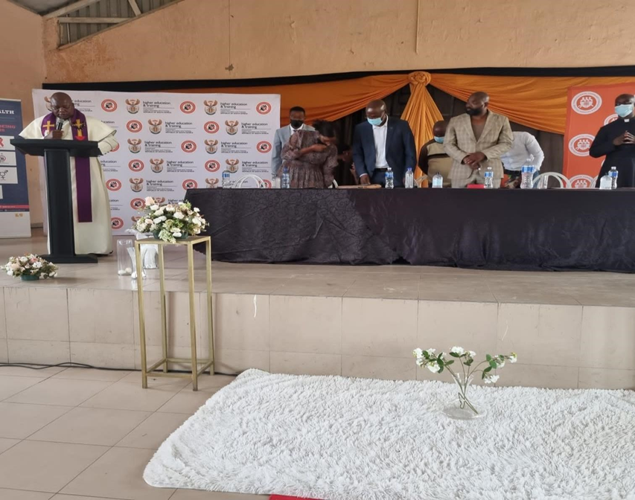
Highlights Of The Events Held As Per The Programme of Action
(Memorial Service of 2 college students that passed away due to floods, eThekwini Metro Pinetown)

Slide 12
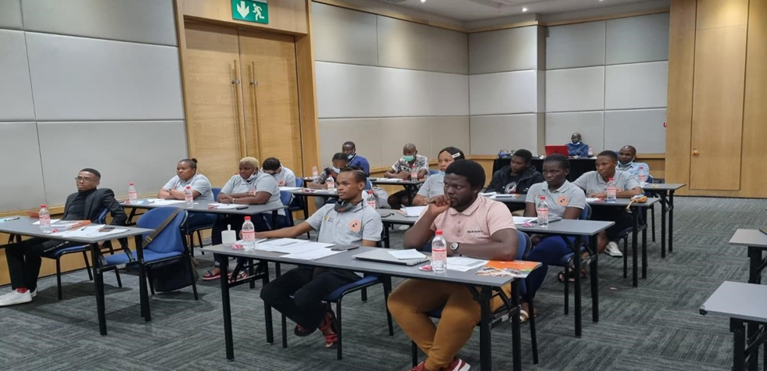
8. 2022 KZN CET College SRC; District Co-ordinators and Higher Health Official

Slide 13
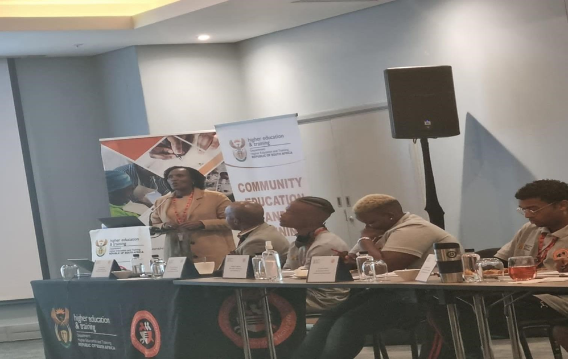
9. SRC Capacity Building Facilitated by DHET -DDG Ms Futshane and Director Ms E Kodisang

Slide 14
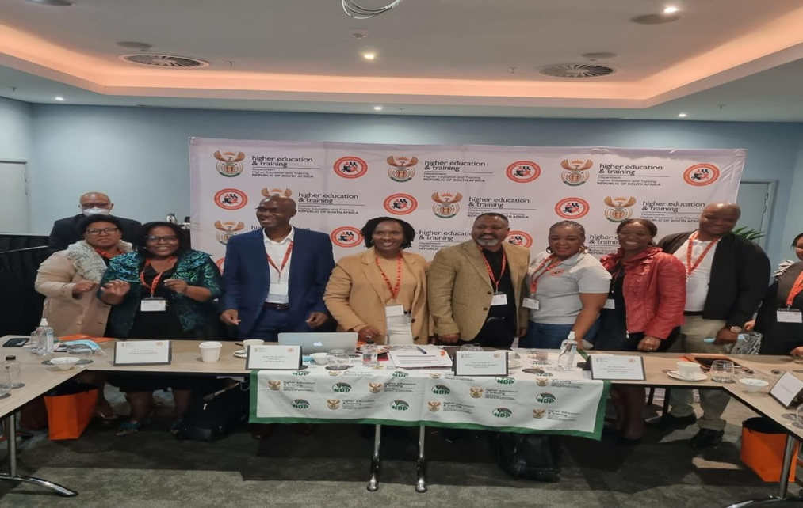

Slide 15
10. Sports Activities
The KZN CET College Central SRC arranged a sports day in commemoration of Youth Day. The sports day was hosted on the 16th of June 2022. The Central SRC wanted this day to be celebrated by all students from different districts, to come together and participate in different sports codes as part of the extra mural activity and wellness of students.
The sports day included the following codes:
▪ Soccer/ Football
▪ Net Ball
▪ Chess
▪ Morabaraba
▪ Indigenous - Games
Central SRC wish to encourage students to participate sports activities by availing themselves to play at least one sports code. Students living with disabilities were also encouraged to participate in any of the sports.

Slide 16
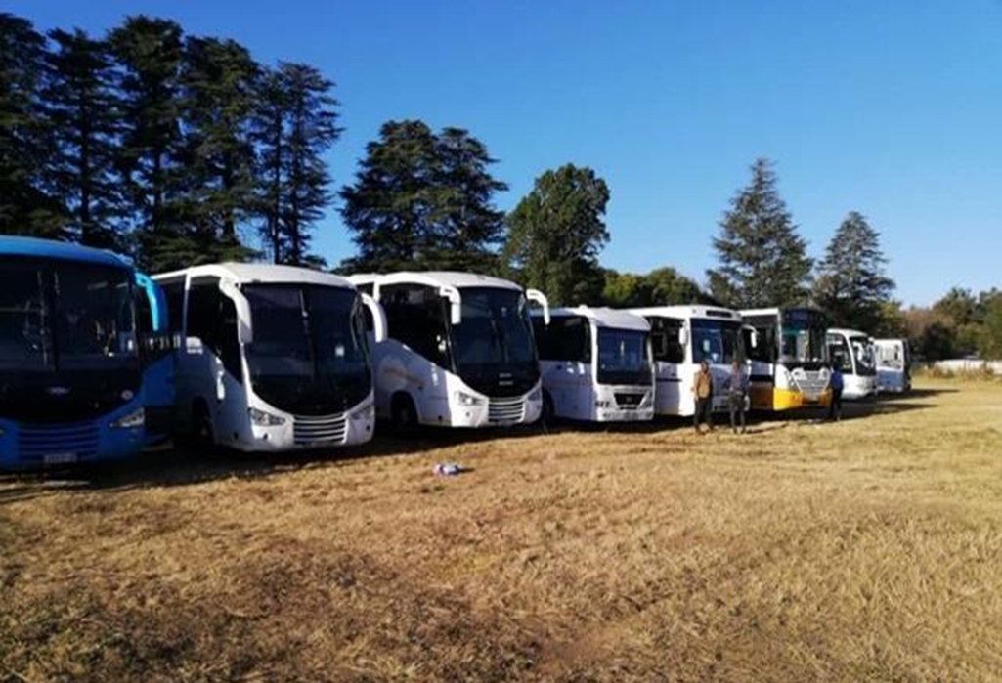

Slide 17
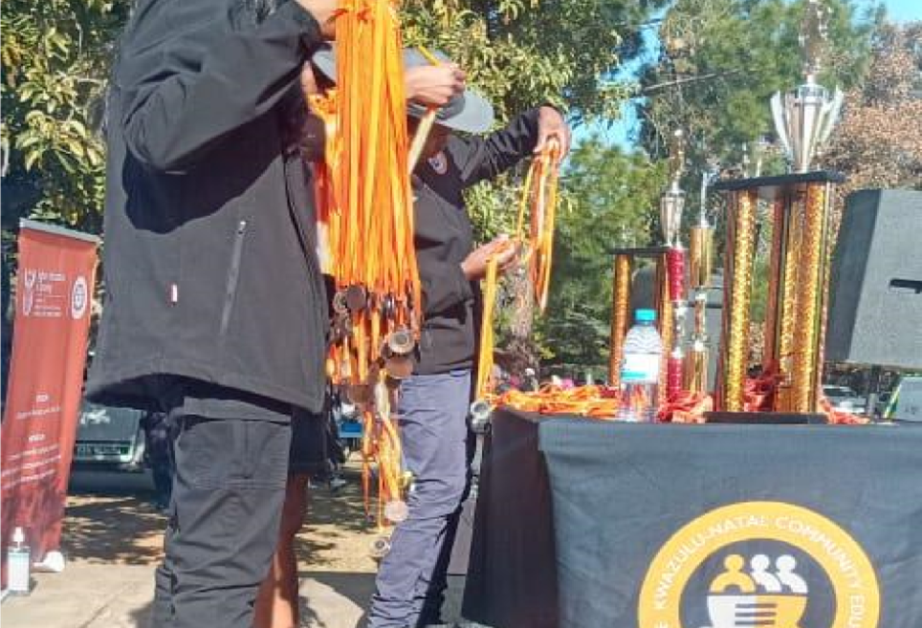

Slide 18
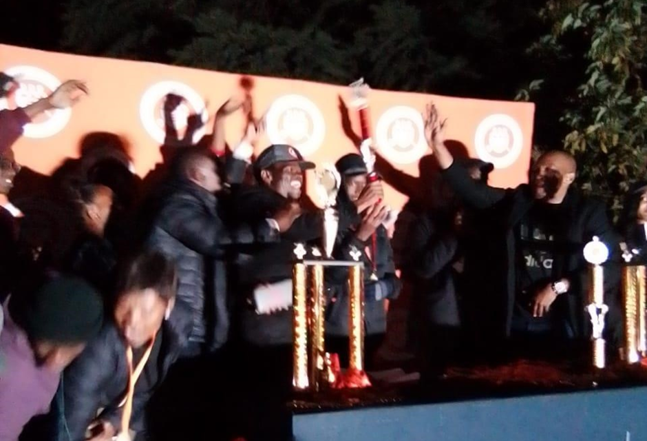

Slide 20
11. Conclusion
“The year has had its ups and downs but we are positive of the future of the college. We wish to recruit more students in the years to come and change the mindset of our communities towards CET Colleges.”

Slide 21

Thank you

