Slide 1
INCLUSIVE EDUCATION
STANDING COMMITTEE PRESENTATION
3 NOVEMBER 2022

Slide 2
The Context for Inclusive Education
International
National
Provincial

Slide 3
The International Context

Slide 5
Education White Paper 6: Developing an Inclusive Education System (2001)
Move from focus only on “Special Needs” (within child/deficit) to focus also on “Barriers to Learning and Development” (Systems Change/Social Rights)
Continuum of Provision – from Mainstream/Ordinary Schools with Support (Low Intensity Support ) to Full-Service (Medium Intensity) to Special Schools (High Intensity Support)
Actions in the short to medium term were intended to provide models and clarity on capital, material and human resource development requirements for system wide application

Slide 6
Starting with Full-service/InclusiveSchools…
White Paper 6 envisaged that:
All schools would over time become inclusive centres of learning, care and support.
There would be provision of specialised support services throughout the system ranging from low or moderate to high levels of provision.
The scope of personnel would range from full-time staff to co-ordinate support at the school, teaching assistants, as well as access to visits by outreach teams from the districts or from the special school resource centres.

Slide 7
Full-service/Inclusive Schools…
White Paper 6 further envisaged that:
Full-service schools would be ordinary schools resourced at a moderate level of support to cater for learners with additional support needs or disabilities.
The first full-service schools would be flagship schools and models of good practice in inclusion to be emulated by other ordinary schools.

Slide 8
Inclusive Education in South Africa
Inclusive Education in South Africa, is arguably not something which has to happen in addition to education reform, but one of the means through which social and education transformation can be achieved…
“

Slide 9
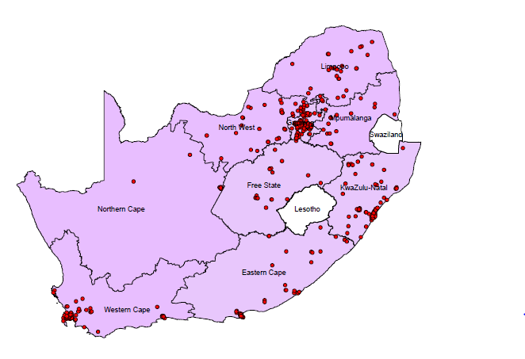
DISTRIBUTION OF SPECIAL SCHOOLS NATIONALLY

Slide 10
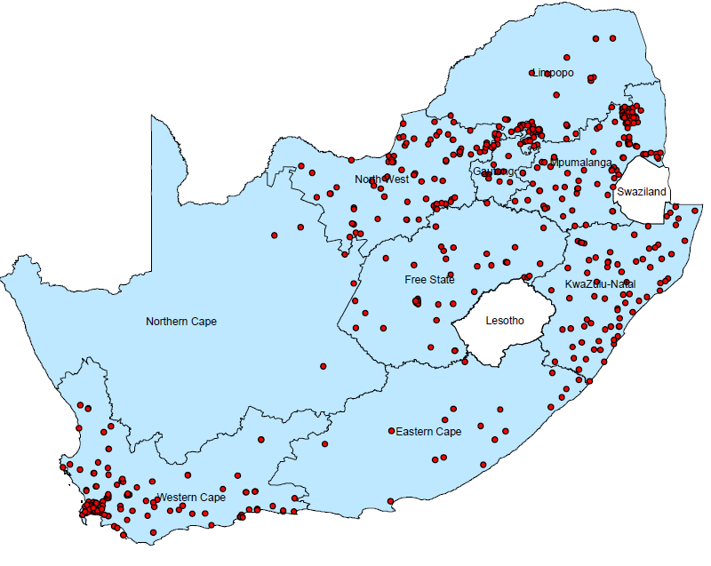
DISTRIBUTION OF FULL-SERVICE SCHOOLS NATIONALLY

Slide 14
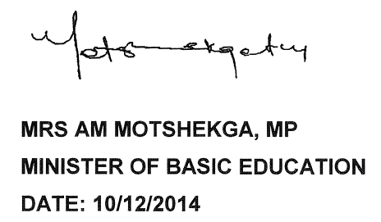
SIAS Promulgated

Slide 15
Oversight visit on the implementation of Inclusive Education
Visit to two districts, one rural and one metro district by DBE oversight team in September 2022
The intention of the expansion of inclusive education is to support learners who experience barriers to learning in public ordinary schools, beginning with those schools which have been identified for conversion into Full-service Schools and to strengthen the outreach of Special Schools. Special Schools which have been identified to be transformed into Resource Centres will offer support programmes to the identified Full-service Schools and learners with moderate support needs in other public ordinary schools.
Outcome of the provincial visits to inform the expansion

Slide 16
Guidelines for resourcing Inclusive Education_Draft_2018
The resourcing proposals incorporate Public Special Schools and Public Ordinary Schools (Full Service Schools)
The resourcing proposals include Compensation of Employees (CoE) and the Non-Personnel Non-Capital (NPNC) mainly in the form of transfers to schools
Provincial Education Departments requested to do a costing for
HEDCOM Sub-Committee on Finance meeting September 2022
The costed guidelines to be subjected to the sector’s approval process

Slide 17
PROFILE OF IE IN THE PROVINCE
POST ESTABLISHMENTS
District Level
ISLES Management Teams = 8
Circuit Support Teams = 64
Inclusive Education Outreach Teams = 22
PED Level
Chief Director: IE & Special Projects
Director: Inclusive &
Specialised Education Support
CES: Specialised Support Services + 6 Programme Managers
CES: Special Schools + 6 Programme Managers
CES: HIV TB Lifeskills & Care and Support
Districts = 8
Circuits = 64
Full-service Schools
Phase 1 = 64
Phase 11 = 64
Public Special Schools = 74

Slide 18
INCLUSIVE EDUCATION: CONTINUUM OF SUPPORT(WCED)
Special Schools
Special School Resource Centres
+
outreach teams
HIGH
Learning Support/
Remedial
Teachers
(full-time)
MODERATE
Learning Support/Remedial Teachers
(itinerant)
LOW
Ordinary /Mainstream schools
Model of Inclusion
Full Service / Inclusive schools
Special Schools
School Based Support Team (SBST)
SBST
SBST
DISTRICT-BASED SUPPORT TEAMS
64 x 3 ISLES Support Teams
(64 Psychologists, 64 Learning Support Advisors, 64 Social Workers)
+ Circuit Managers, Subject Advisors, etc.

Slide 19
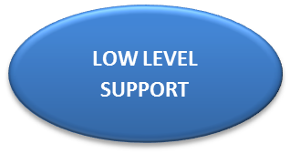
KEY
SNA: Support Needs Assessment
ISP: Individual Support Plan
GSP: Group Support Plan
IE: Inclusive Education Outreach Team
WCED SUPPORT PATHWAY
(incorporating SIAS)
HEALTH PRACTITIONER
DBE 126: Health & Disability Form
TEACHER/ PARENT/ GUARDIAN/HEALTH PRACTITIONER (DBE 126)
IDENTIFIES LEARNER AS EXPERIENCING A BARRIER TO LEARNING - HAVING A SPECIAL EDUCATIONAL NEED/NEEDING PSYCH0-SOCIAL SUPPORT, ETC.
SERIOUS CASES ARE REFERRED TO HIGH LEVEL SUPPORT IMMEDIATELY
CLASSROOM INTERVENTION (SIAS SNA1 & ISP/GSP)
INVOLVE THE PARENT/
GUARDIAN
SCHOOL-BASED SUPPORT TEAM (SNA2 & ISP+/GSP+)
LEARNING SUPPORT
Diagnostic scholastic assessment/withdrawal for learning support /differentiation of the curriculum (DBE 124 &125)
ADDITIONAL CLASS TEACHER INTERVENTION
OTHER
e.g. School Nurse/ Community services
PROVINCIAL- BASED SUPPORT TEAM (PBST)
CIRCUIT/CLUSTER-BASED/IE SUPPORT TEAM (DBE 120)
DISTRICT-BASED SUPPORT TEAM (SNA3, DBE 121 &122)
INTER-SECTORAL PARTNERS
LOW LEVEL SUPPORT
MODERATE LEVEL SUPPORT
HIGH LEVEL SUPPORT (DBE 123a & b)

Slide 21
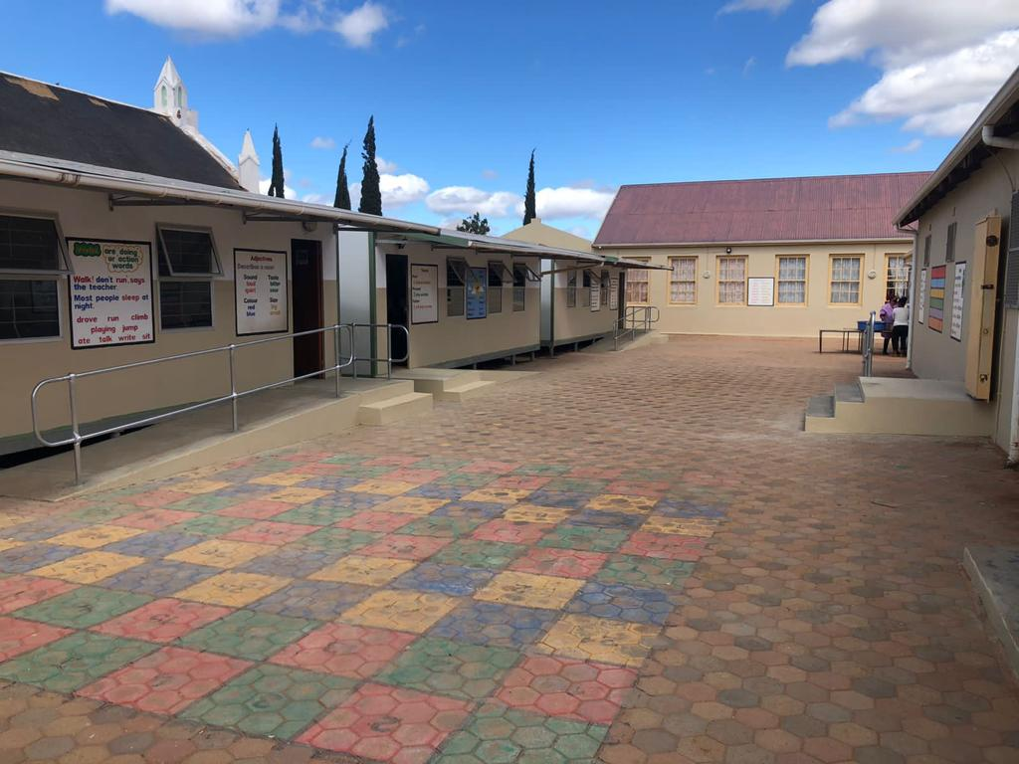
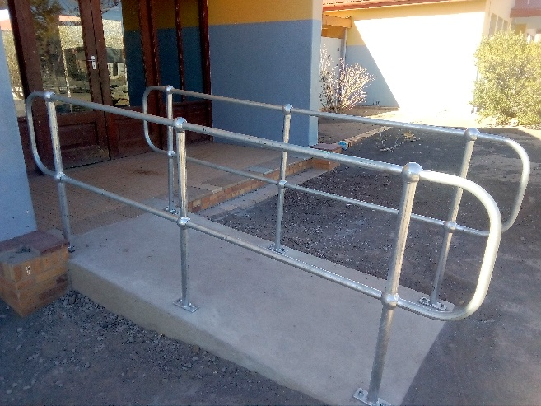
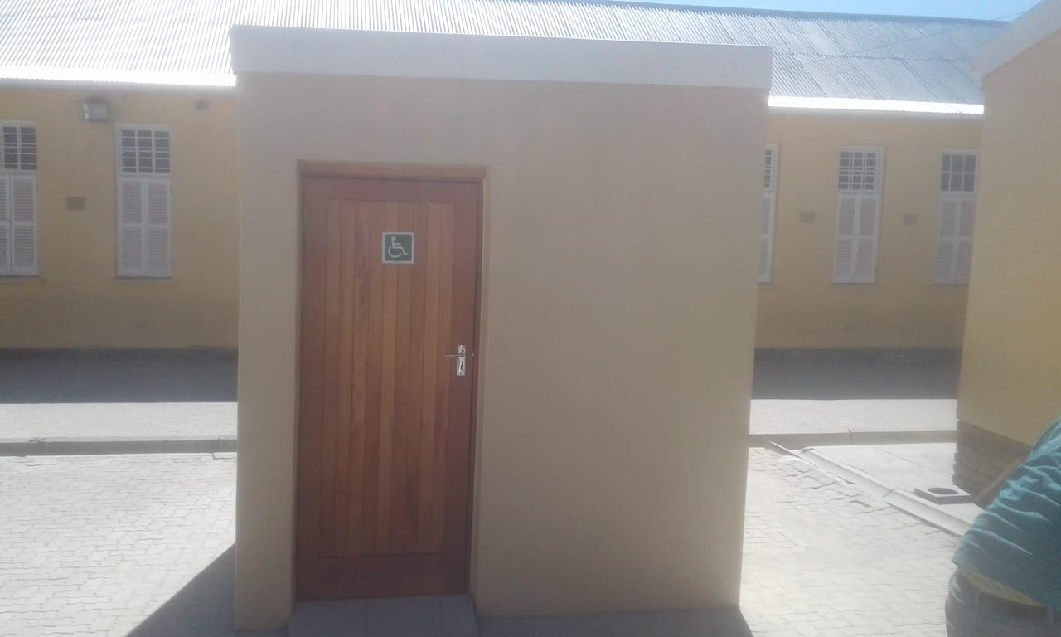
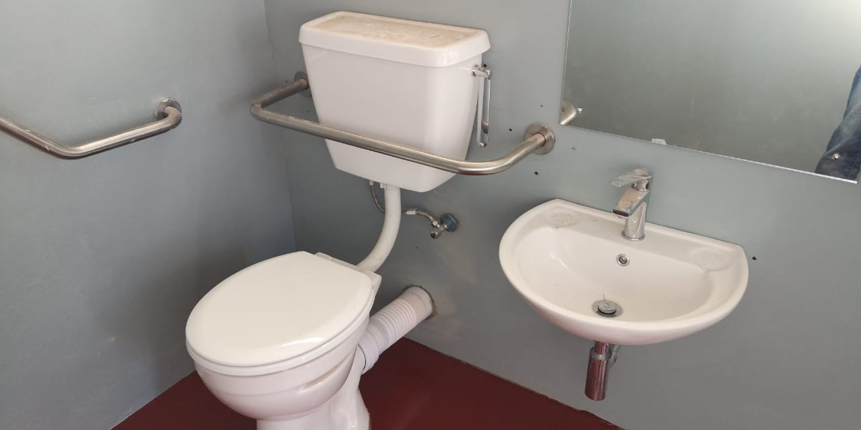

Slide 22
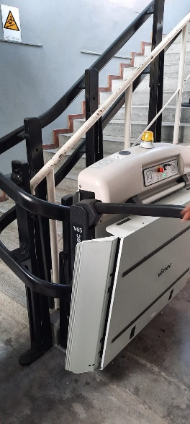
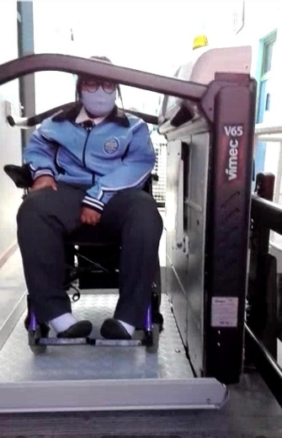
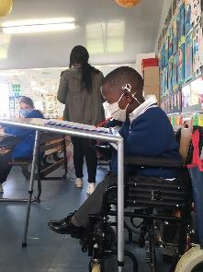

Slide 24
MODULES
UNIT 1: INCLUSIVITY IN EDUCATION
SO1: The context of exclusion and the development of policies of inclusion
SO2: Overarching principles and values of inclusion in South Africa
SO3: Theories and models of Inclusive Education
UNIT 2 LEARNER DIVERSITY
SO1: Learner diversity, intersectionality and equity
SO2: Language, culture and learning
SO3: Non-visible differences

Slide 25
MODULES (CONTD.)
UNIT 3: INCLUSIVE SCHOOL COMMUNITIES
SO1: The South African framework and tool for building inclusive schools
SO2: Teacher agency and social justice
SO3: Practices that promote collaboration
UNIT 4: INCLUSIVE TEACHING AND LEARNING
SO1: Principles of inclusive pedagogy
SO2: Strategies to support learning for all

Slide 26
ROLL-OUT OF TEACHING FOR ALL
Demo/
Flagship
FSS
(Phase1)
2022
Full-service schools
(Phase 2)
2023
Roll-out to all schools

Slide 28
CARE AND SUPPORT FOR TEACHING AND LEARNING
The Education Department is the lead agency in addressing school-level barriers
The Education Department creates an enabling environment for other stakeholders to act in and through schools

Slide 29
Quality Education for All
Covid-19 has forced the world to review and reset…
Inclusive Education in South Africa, is not something which has to happen in addition to education reform, but one of the means through which social and education transformation can be achieved in the ‘new normal’…

Slide 30
DIRECTORATE INCLUSIVE AND
SPECIALISED EDUCATION SUPPORT
THANK YOU

