Slide 1
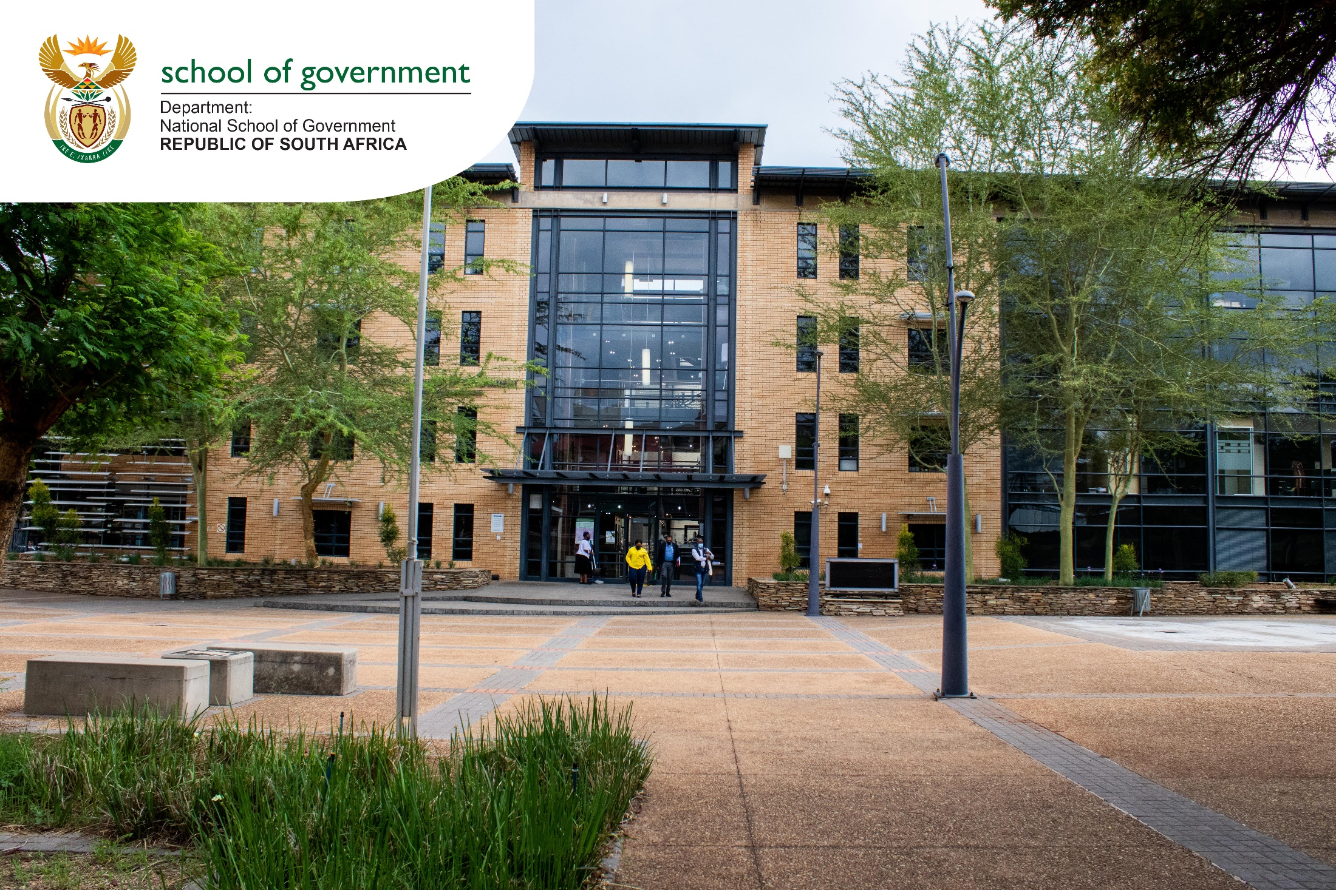
NATIONAL FRAMEWORK TOWARDS THE PROFESSIONALISATION OF THE PUBLIC SECTOR
PORTFOLIO COMMITTEE ON PSA
02 NOVEMBER 2022

Slide 2
Purpose of the Framework
To create a clear vision as to where the next
generation of public servants will emanate from
To establish a career system based on meritocracy
and an ethical disposition
To determine how specialist/
professional
skills will be reproduced
To devise mechanisms to
address skills deficit and
inappropriate staffing
To institutionalise the public
sector as a career of
choice
C
B
D
A
E
AS PART OF STATE REFORM TO STRENGTHEN STATE CAPACITY

Slide 3
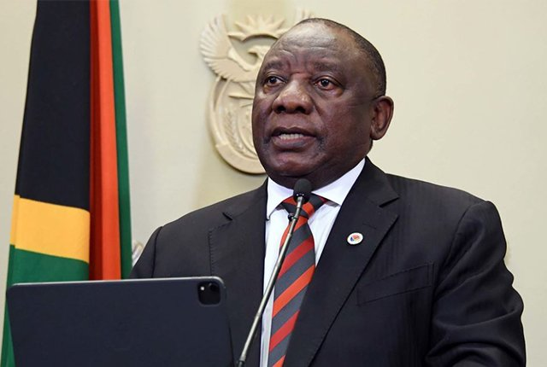
Statement of Support
“When I was elected to the position of President of South Africa, I said that building an efficient, capable and ethical state free from corruption was among my foremost priorities.
Only a capable, efficient, ethical and development-oriented state can deliver on the commitment to improve the lives of the people of this country.
This means that the public service must be staffed by men and women who are professional, skilled, selfless and honest” – President Cyril Ramaphosa, 1st March 2021

Slide 4
Context: Priority 1 of the 6th Administration
CAPABLE STATE
ETHICAL STATE
DEVELOPMENTAL
STATE
A capable state has the
required human capabilities,
institutional capacity, service processes and technological platforms
An ethical state is driven by the constitutional values and principles of public administration and the rule of law, focused on the progressive realisation of socio-economic rights and social justice as outlined in the Bill of Rights.
Meet people’s needs through interventionist, developmental, participatory public administration.

Slide 5
Introduction
National Development
Plan
Meritocratic, Professional Public Sector
Building a meritocratic and professional public sector that serves the government of the day in a loyal manner but has sufficient institutional autonomy to build and retain skills and be protected against political patronage.
At its 54th conference in December 2017
the ruling party identified four areas where targeted action is critical:
The political administrative interface and the clear separation of roles and responsibilities between the political executives and the administration.
Inter governmental systems
The intergovernmental systems and the articulation of roles between national, provincial and local government.
.
Develop technical and specialist professional skills appropriate career path for technical specialists.
The Constitution
For sustainable and inclusive development, emphasizes the key developmental interventions: creating jobs and enhancing livelihoods, which includes improving education and training; building a capable state; fighting corruption and enhancing accountability.
Section 195 prescribes basic values and principles governing public administration – all spheres of government, organs of state & public enterprises.
Framework also applies to Institutions of Traditional Leaders, Military, Police, State Security & Correctional Services .

Slide 6
Roadmap – Progress to date
^{October 2022 - Date}
^{Cabinet}
^{Approval 19 October}
^{Released by MPSA}
^{25 October}
^{Portfolio Committee}
^{2 November}
Lead Departments and Institutions should finalise the implementation plans before the January / February 2023 Cabinet Lekgotla
²⁰²¹
^{JANUARY TO MAY}
^{Media Statements by MPSA}
^{Public Consultations} (HEIs, PBs, PD Academies, Civil Society, Labour)
^{Advisory Panel} ^{Appointed}
²⁰²¹
^{SEPTEMBER TO DECEMBER}
Extension for submission of framework
Consultation PSTF, NSG Conference
Workshop with the Advisory Panel
²⁰²⁰
^{APRIL TO DECEMBER}
Mandate from MPSA (NSG, DPSA & OPC)
Draft Framework Presentation to Cluster and Cabinet
Draft Framework Gazetted for Public Comment
²⁰²¹
^{JUNE TO AUGUST}
Inauguration of the Advisory Panel;
Advisory Panel Consultations with DGs: (NSG, DPSA, OPSC)
^{Advisory Panel Workshop}
²⁰²²
^{JANUARY – JULY}
Report and recommendations presented to MPSA
Presentation to: FOSAD, GSCID cluster, Joint Cabinet Committee

Slide 7
^{Problem Statement}
Improve skills of public servants & erosion of State's role in producing skilled professionals
Past practices of engaging professional institutes in the training, selection and development of senior managers have largely been unsuccessful.
Diagnostic
Overview
(2011)
Diagnostic Overview (2011)
Looming crisis in the reproduction of professional expertise as the ageing cohorts with expertise and knowledge continue to leave the system.
Shortage of technical and managerial skills & the outsourcing of professional and technical services.
25 Year
Review
Report
(2019)
At executive management levels, reporting and recruitment structures have allowed too much political interference which resulted unnecessary turbulence in senior positions.
At junior levels, there has been insufficient focus on providing stimulating career paths that ensure the reproduction of skills.
After 27 years, lack of decisive interventions in the professionalisation of the Public Sector.
Resulted in detrimental consequences such as fruitless expenditure and service delivery protests characterised by violence and fatalities.
25 Year
Review
(2019)

Slide 8
Objectives of the Framework
Entrench a dynamic system of professionalisation in the Public Sector
Strengthen and enable legal and policy instruments to professionalise categories of occupations in the Public Sector
Enhance and build partnerships and relationships with higher education institutions and professional bodies
Ensure meritocracy in public servants' recruitment, selection, and career management in line with the NDP and the MTSF
Initiate consequence management for material irregularities through the transgression mechanisms and various pieces of legislation

Slide 9
Contextualisation of Professionalising the Public Sector
To be professional means to work and project yourself in a way that demonstrates superior levels of acquired knowledge, skills, and competence as well as exemplary conduct, commitment to the profession & its code of conduct.
Professionalisation (Sector)
Profession (Discipline)
Professionalism (Individual)
Professionalism entails a high work ethic and adherence to standards and principles of specific work discipline and context; including qualifications, skills, competencies and values.
Professionalisation subject all employees to a single dispensation of professional registration and regulation. Recognition of the various professional categories within the sector, and subject them to registration with external regulated external professional bodies.

Slide 10
Proposals for the Implementation of Professionalisation
Continuing Learning & Professional Development
Career Progression, Succession Planning & Management of Career Incidence of Heads of Department
Recruitment & Selection
Induction & Onboarding
Planning & Performance Management
Pillar 1
Pillar 2
Pillar 3
Pillar 4
Pillar 5

Slide 11
1. Merit-based recruitment and appointments shall apply at pre-entry, progression and promotion.
5. Recruitment of DGs and DDGs:
EAs remain responsible for the recruitment & Selection
HOPA should form part of the interview panel.
PSC should create a pool of technical experts to augment selection panels for DGs & DDGs.
President & Premiers retain the powers to appoint the Directors-Generals/HoDs.
2. Review the Pre-entry SMS (Nyukela) course: compulsory to all levels in the public sector; including Military, State Security, Correctional Services, Police, Staff appointed into Political Office & Advisors.
6. Recruitment of the Commissioners to the PSC:
Use external experts from academia, professional associations, or bodies to be part of a selection committee.
3. Introduce compulsory occupation-based competency assessments, and integrity assessment for SMS
7. Recruitment of Municipal Managers:
Municipal Councils remain responsible for the recruitment & selection.
Representative from Provincial Treasury should be included in the selection panels
PSC will create a pool of technical experts to augment selection panels for Municipal Managers.
4. By 2025, review the academic entry requirements into SMS level 14-16 to NQF Level 8; with NQF Level 9 highly recommended for Levels 15-16, (including CEOs of SOEs & Municipal Managers).
8. Collaborate with higher education institutions (HEIs), professional bodies, industry experts and departments to undertake curricular development.
Pillar 1: Pre-Entry, Recruitment & Selection

Slide 12
Pillar 2: Induction & On-Boarding
Participation in Compulsory Induction Programme by Prospective Public Servants:
Commence with induction immediately after appointment or within 90 days of appointment
2. Compulsory reorientation programme for serving public servants.
Who must Participate?
Public Servants:
National, Provincial, Local Government & State Owned Entities,
Including Institutions of Traditional Leadership
Military, Police, State Security, Correctional Services,
Staff appointed into Political Office & Advisors.

Slide 13
Pillar 3: Performance Planning & Management
1.
DPSA review performance management system at all levels for tabling to Cabinet before end of November 2022.
2.
Align performance management with professional bodies’ registration.
3.
The new system should provide objective mechanisms to:
Link performance of HODs and DDGs to that of the Institution.
Introduce independent triggers for exit of non-performing HoDs.
Improve the competency of politicians to manage performance.
Address the systemic challenges that result in instability and poor relations between Executive Authorities and HoDs.
4.
Cabinet resolved that the PSC should play a role in performance evaluation of HoDs to strengthen objectivity & introduce an approach that will link the performance of the individual to the institution they lead.

Slide 14
Pillar 4: Continuing Learning & Professional Development
DPSA &
DCOGTA
NATIONAL
TREASURY
DPME
DoJ &CD
AGSA
DPW & CBE
to professionalise
Professionalise ARCHITECTURAL
CONSTRUCTION MANAGEMENT, ENGINEERS, QUANTITY SURVEYORS, etc.
Reform SCM (Cabinet
Resolution 2014)
Establish SCM Council
PLANNING OCCUPATION
Establish a Council (similar SCM)
LEGAL PROFESSION
AUDIT PROFESSION
ICT &
HRMD
Minister of HE Science & Technology & SAQA to assess the Professional Bodies for representativity

Slide 15
Pillar 5: Career Progression & Career Incidents
Political Administrative Interface:
Cabinet resolved DG in the Presidency will be designated as Head of Public Administration.
In Provinces this function is designated to Directors General in the Office of the Premiers.
The HOPA will assist the President & Premiers to manage career incidents of HoDs and serve as mediation mechanism.
Tenure of DGs & HODs
Tenure of HoDs be increased to ten years, subject to rigorous process of recruitment, selection, training and development and performance management reviews and consequence management for non-compliance.
A revised performance management framework for HODs will be presented by the MPSA to Cabinet by the end of November 2022.
Revolving door Policy
To provide for the movement of identified public servants between private sector, academia
Consider external candidates for the positions of DDGs and DGs.
Manage conflicts of interests - highlight those Departments that might create conflict of interest.
Review RPL Policy (DHET and SAQA)
Explore possibility of recruitment for optimum use in public sector (recognition of experience)
MPSA must determine need for an RPL assessment centre

Slide 16
Local Government & State Owned Entities
Tenure of Municipal Managers:
Should be delinked from political term for continuity in administration and improved service delivery.
DCOGTA will work on measures to ensure that there is uniformity to the Service of Conditions for HoDs and Municipal Managers and introduce a rigorous process for recruitment, selection, training, development and consequence management for non performance.
Appointment of Boards of SOEs:
Robust merit based appointment of Boards of SOEs.
Executives to have autonomous powers to make tough decisions
All newly appointed Board members should undergo Induction Programmes for Boards of Public Entities through the NSG.

Slide 17
Adoption of the Professionalisation Framework
STATE OWNED ENTITIES
through shareholder ministers, must adopt the framework for implementation through shareholder compacts
LEAD DEPARTMENTS & INSTITUTIONS
should finalise the implementation plans before the January/Feb 2023 Cabinet Lekgotla
SALGA
must adopt the framework for implementation in local government
LEGISLATIVE SECTOR must adopt the framework for implementation by all 10 legislatures
NOTE:
Implementation Plans must indicate short term, medium term & long term goals.
Recommendations requiring legislative amendments will be catered for in the current PAMA and PSA Bills.

Slide 18
Conclusion
“As part of realising a capable state, we are on a drive to rebuild the public service through promoting lifelong learning, improving skills, and providing the necessary orientation to entrants to the public service. This is happening across government departments, in every municipality, state-owned enterprise and every organ of our state. The National School of Government is rolling out a range of courses for the executive, accounting officers, senior managers, mayors, state entity board members and others on a range of disciplines from economic governance to long-term planning
In the State of the Nation Address, I said we would finalise the National Framework towards the Implementation of Professionalisation of the Public Sector. The revised Framework proposes fundamental reforms, including a stronger emphasis on merit-based recruitment and appointments, integrity testing before any individual joins the public sector, revising the tenure of heads of departments, and curriculum development for ongoing learning of public servants. We expect this framework to be fully implemented across departments and state entities within the next year.”
- The Presidency Budget Vote 2022/23, June 2022

