Slide 1
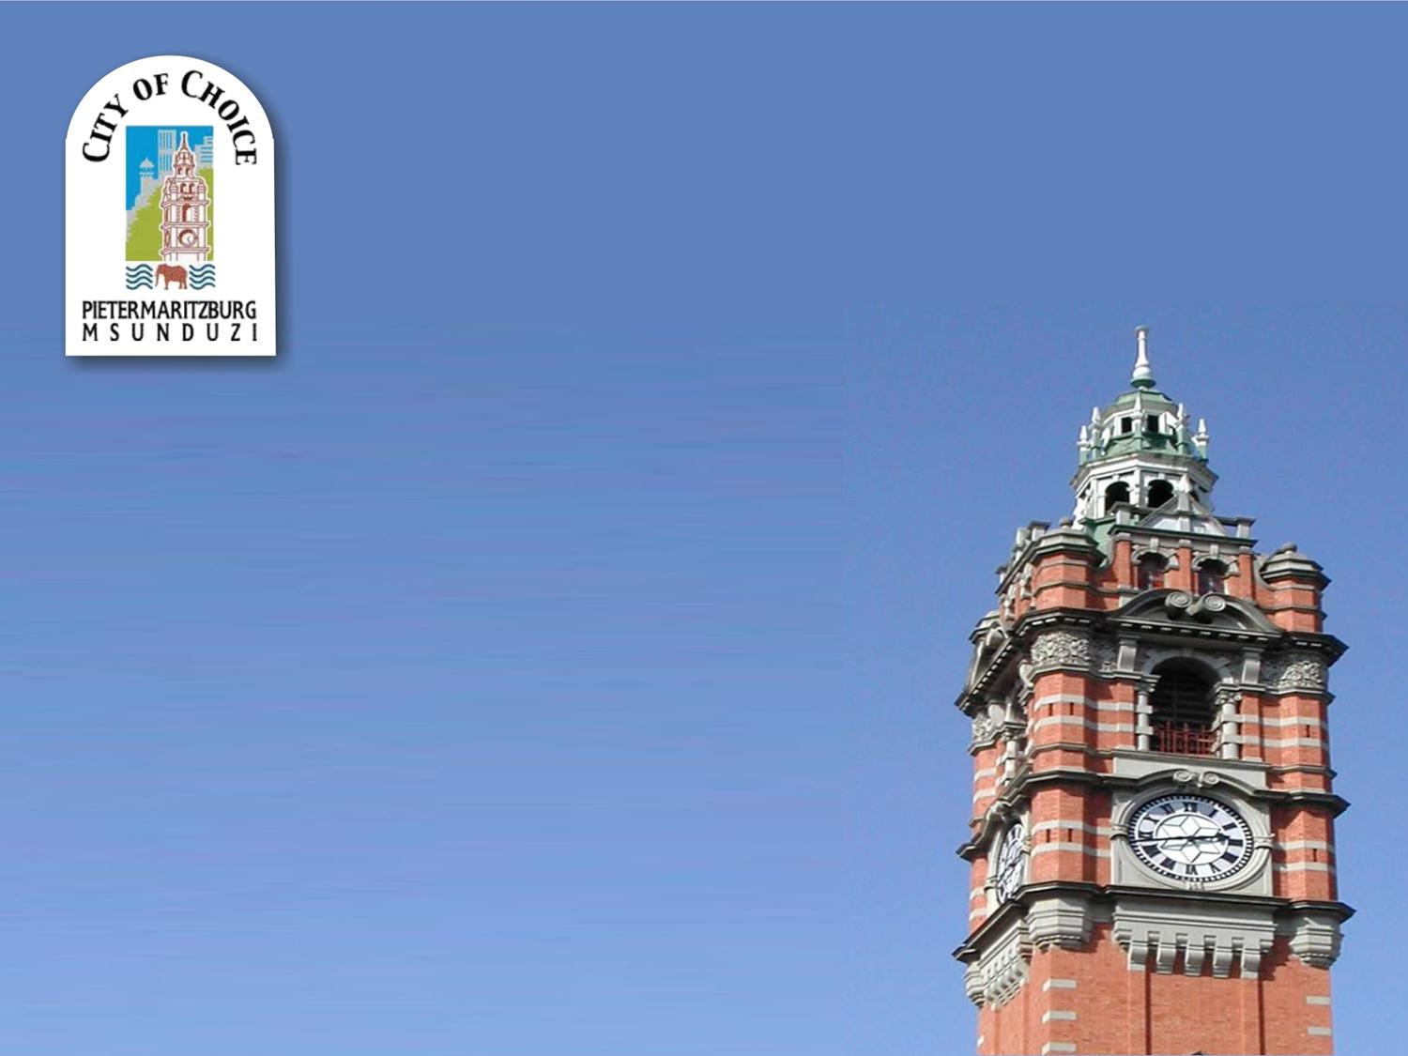

MSUNDUZI MUNICIPALITY
PRESENTATION ON THE STATUS OF THE MUNICIPALITY
PRESENTED BY CLLR M THEBOLLA
THE MAYOR: MSUNDUZI MUNICIPALITY
28TH OCTOBER 2022

Slide 2
INTRODUCTION
VISION OF MSUNDUZI MUNICIPALITY
“By 2040 Msunduzi will be a safe, vibrant, sustainable and smart metropolis.”
MISSION STATEMENT
To ensure that the Municipality functions efficiently to deliver basic, social, economic and environmental services to build better Communities.

Slide 3
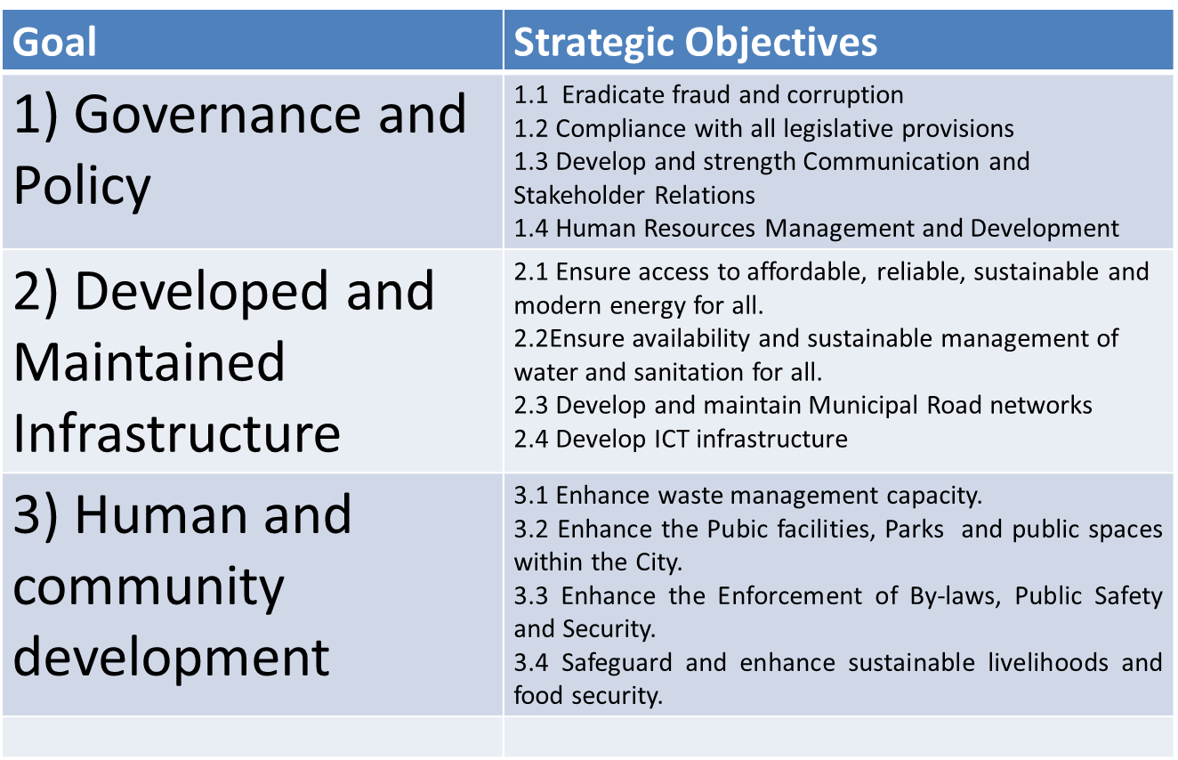
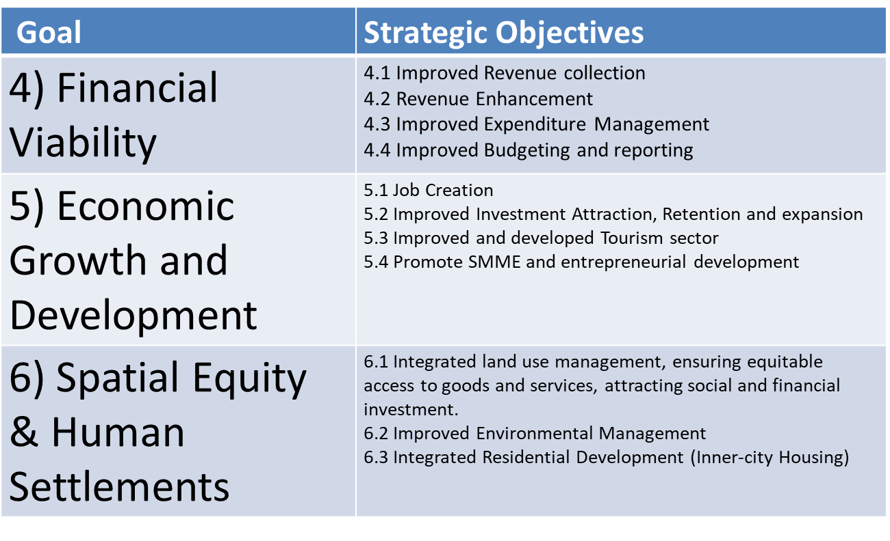
INTRODUCTION
STRATEGIC GOALS AND OBJECTIVES

Slide 4
INTRODUCTION
Msunduzi Local Municipality is the core urban and economic centre of the Umgungundlovu District Municipality. As the coalface of service delivery, municipalities are among the hardest hit at a time when the demands on them are increasing.
The municipality was placed under administration in terms of S 139 (1) (b) due to challenges which are outlined below.
Failure of key infrastructure, such as electricity and water due to poor/inadequate maintenance, age and vandalism
Failure to attend to the repair of potholes, street lights and storm water drains
Failure to clean the city and surrounding nodal and residential areas including irregular collection of solid waste and challenges associated with the processing and disposal of solid waste
Failure to collect revenue – increasing Debtors Book
The following slides will show progress made towards dealing with the above-mentioned challenges.

Slide 5
OVERVIEW REPORT ON SECTION 139 INTERVENTIONS
IMMEDIATE INTERVENTIONS - (MECs DIRECTIVES) – INDICATORS OF IMPROVEMENT IN THE NEXT SIX MONTHS
 | MUNIC | KEY INDICATORS
 |  | Target | Time Frame | Responsible | Progress
1. | Audit Outcome (2021/2022) | Unqualified | 30 Nov 2022 | BTO, All GMs, CM and MR | Financial Year still under audit and AG is still on site)
2. | Budget (2022/23) | Funded Budget | Jan 2023 | MM | Budget Funded.
3. | Filling of Senior Management | All 3 Vacant Senior Manager positions filled | 31 Dec 2022 | Corporate Services/ MR | City Manager Post filled. GM: Infrastructure Services Post - interviews were held on 12 Oct 2022 and GM: Electricity Supply Services – waiting for MECs Concurrence.
4. | MIG / WSIG / INEP | Expend - 60% of allocation | 07 Dec 2022 | Infrastructure /Electricity /MR | MIG – 25.8% (56,396 million) of R217 980 090 allocation i.e. 89% of R65 million tranched) WSIG – 24% (R9,6Million) ofR40 m Allocation, which is 80% of the R12 million tranched. INEP – 7% (R2,3 Million) of RR29m Allocation. A further 56,2% (R16,7 million) is committed for October payments
5. | Sec 106 Investigations | 100% Implementation of recommendations | 31 Dec 2022 | CM/ MR | On the Santosh Manilal Report: There are 19 recommendations of which 6 are implemented and 13 are still a work in progress. On the Morar Report: There are 17 recommendations of which 15 are implemented and 2 are still a work in progress. Progress is tracked regularly on quarterly basis.
6. | Consequence Management | 100% | 31 Dec 2022 | Corp. Services/ MR | 50 cases are still on the roll with 48 cases finalized. There is 257 new cases being added as a result of the illegal unprotected strike by staff from Waste and Parks sections and they have been issued with Letters of Intention to Suspend. 16 Employees in Finance + 1 in Comm. Services have recently been suspended. A Consequence Management Acceleration Plan has been developed and monitored by Corporate Services and MR
7. | Landfill compliance notices cleared | 100% compliant | 30 June 2023 | Comm. Services/ MR | There is compliance action plan which is being implemented and monitored regularly Reports and reports are submitted to EDTEA as per Court Order. Currently in 43% compliant and to achieve 100% in 30 June 2023 as per the approved Action Plan. The balance of the compliances is directly linked to the compliance emergency contract that has since closed and is awaiting bid evaluation and onward transmission to bid evaluation committee which is speaking to the balance compliance of the action plan.
8. | Filling of Potholes | 4000 square meters | per month | Infrastructure/ MR | 19,803,325 square metres from 1st July to 30th of September 2022

Slide 6
OVERVIEW REPORT ON SECTION 139 INTERVENTIONS
IMMEDIATE INTERVENTIONS - (MECs DIRECTIVES) – INDICATORS OF IMPROVEMENT IN THE NEXT SIX MONTHS
 | MUNIC | KEY INDICATORS
 |  | TARGET | TIME FRAME | RESPONSIBLE | PROGRESS
9. | Waste Collection | Visible impact in all 4 Zones of the Mun. | Monitor Monthly | GM: Community Services | Waste gets collected as per schedule in all 4 zones of the Municipality. There was an illegal strike which caused a backlog during the week of 7 October 2022, this has since been resolved.
10. | Revenue Collection | (norm 95%) | Monthly | Finance/ MR | 88% (August 2022), 110% (September)
11. | Cash Coverage | (1-3 months) | Monthly | Finance/ MR | 0.41 Months (August 2022), 0.33 Months (September 2022)
12. | Employee Related costs | 25-40% | Monthly | Finance/ MR | 22% (September 2022)
13. | Sec 32 Investigations (UIFW) completed | Quarterly | Monthly | MMs Office/ MR | The Internal Audit is currently conducting an investigation of 2020/21 and 2021/22 and is anticipated to be completed by 15 December 2022.

Slide 7
OVERVIEW REPORT ON SECTION 139 INTERVENTIONS
IMMEDIATE INTERVENTIONS - (MECs DIRECTIVES) – INDICATORS OF IMPROVEMENT IN THE NEXT SIX MONTHS
 | MUNIC | KEY INDICATORS
 |  | TARGET | TIME FRAME | RESPONSIBLE | PROGRESS
14. | Functional Oversight Structures | 100% functionality | 31 Dec 2022 | Speaker/ Chief Whip/MR | Functional
15. | Reduce Water Outages (Water tanker reduction) | Piped Water& No water tanks | 31 Dec 2022 | Infrastructure/ MR | Ongoing, Upgrade of 2.2km of 160mm diameter pipe to reservoir 12 and associated works in Ward 6 (Vulindlela), anticipated completion date 31st of Oct 2022.
16. | Reduce Electricity Outages | Less Outages | 31 Dec 2022 | Electricity/ MR | Ongoing, the Electricity Dept. has now been made a stand-alone .
17. | Reduce or eliminate Water Board Debt | R0 Old Debt | 31 Dec 2022 | Finance/ MR | Payment plan in place. See Slide 5, Currently, anticipated settlement date for Umngeni is January 2024
18. | Reduce or eliminate Eskom Debt | R0 Old Debt | 31 Dec 2022 | Finance/ MR | Payment plan in place. See Slide 5, Currently, anticipated settlement date for Eskom is January 2023
19. | Cost Containment | Positive Cash Flow | 31 Dec 2022 | Finance/ MR | IFC sits weekly to track and monitor Cost Containment in each Business Unit.

Slide 8
OVERVIEW REPORT ON SECTION 139 INTERVENTIONS
IMMEDIATE INTERVENTIONS - (MECs DIRECTIVES) – INDICATORS OF IMPROVEMENT IN THE NEXT SIX MONTHS
Eskom Payment Plan :
Umngeni Payment Plan:
8

Slide 9
OVERVIEW REPORT ON SECTION 139 INTERVENTIONS
IMMEDIATE INTERVENTIONS - (MECs DIRECTIVES) – INDICATORS OF IMPROVEMENT IN THE NEXT SIX MONTHS
 | MUNIC | KEY INDICATORS
 |  | TARGET | TIME FRAME | RESPONSIBLE | PROGRESS
20. | Implementation of the Financial Recovery Plan | Positive Cash Position | Sep 2024 | Finance/CM/ MR | FRP currently being reviewed by National Treasury (NT process is 24 months)
21. | Implementation of the SDBIP | Measurable Performance | Dec 2022 | MMs Office/ MR | SDBIP on target, 65.48% achievement on Operational Indicators and 14.45 % on Capital Indicators
22. | Functionality of Ward Committees | 100% | Dec 2022 | Speaker’s Office/ MR | Ward Committees Trained, Q1 none submission of POEs. Q2 is at 98%
23. | Reduce / Eliminate Water Losses | Reduced Water Losses | Dec 2022 | Infrastructure/ MR | Ongoing, there is a 5year Non-Revenue Water Master Plan which aims at decreasing Water Losses whilst simultaneously increasing accuracy of metering.
24. | Reduce / Eliminate Electricity Losses | Reduced Electricity Losses | Dec 2022 | Electricity/ MR | Ongoing, Meter Audit Project underway - (Detection Technology).
25. | Adjust Repairs and Maintenance Budget | 8% | Feb 2023 | Finance/ MR | 7% currently. To be considered during the adjustment budget

Slide 10
OVERVIEW REPORT ON SECTION 139 INTERVENTIONS
IMMEDIATE INTERVENTIONS - (MECs DIRECTIVES) – INDICATORS OF IMPROVEMENT IN THE NEXT SIX MONTHS
In progress | 18 | 72%
Complete | 6 | 24%
Not Resolved | 1 | 4%
Total | 25 | 100%

Slide 11
PROGRESS ON GOVERNANCE
All oversight structures (Council & Committees) are functional and optimally executing their allocated responsibilities.
The municipality participates in the following DDM Structures - Political Hub: Technical Hub, Governance Cluster, Economic Cluster, Justice Cluster & Social Cluster.
The Ward Committee elections were held and finalised. Ward Committees Induction & Training has been completed and Ward Committees are 98% functional.
Traditional leaders participate in Council Structures
The municipality participates in all IGR Structures
The Municipal Rapid Response Team (MRT) was established on 25 February 2022. A Workshop was also facilitated by CoGTA.
TROIKA established a war room on service delivery (infrastructure & community services) as well as other critical areas. Meetings take place Monday to Friday at 06:00am
Vacant Section 54/56 posts
  Municipal Manager – Post is filled by Mr L H Mapholoba with effect from 1 October 2022.
  General Manager Electricity Supply Services is a new post. Interviews were conducted on 20 July 2022. Concurrence application in progress via MEC: COGTA. Mr N Mpisi, Senior Manager: Electricity is Acting GM: ESS.
  GM: Infrastructure Services was vacated on 31 July 2022. Interviews were conducted on 25 October 2022. Mr S Hlela, External Contractor is acting GM: IS.

Slide 12
PROGRESS ON GOVERNANCE
  Consequence Management - As of 30th September 2022, there were 50 cases on the roll and 48 completed. Presiding Officers and Prosecutors were appointed on all matters.
    An Acceleration Plan has been developed and is being monitored by the City Manager and Ministerial Representative.
    (257) Letters of Intention to Suspend were issued to staff at Waste (244) & Parks (13) workers who embarked on unprotected industrial action.
    (182) Letters of Intention to Suspend for Waste issued successfully as at 21/10/22 (71%). Respondents have 48 hours within which to respond for MM's consideration of their representations and representations are still awaited.
    (0) Nil Employees are suspended of the (247) at Waste originally issued with Letters of Intention to Suspend. 14 employees were suspended.
    (50) cases are still on the roll with 48 cases remaining to be finalized.
    (16) Employees in Finance + (1) in Community Services have recently been suspended and the suspension period will not exceed the regulated 90 days and disciplinary processes are already in place.

Slide 13
INVESTIGATIONS BY MPAC AND IMPLEMENTATION OF THE RECOMMENDATIONS BY COUNCIL
UNAUTHORISED, FRUITELESS AND WASTEFUL EXPENDITURE
Type of Expenditure | Description | Total Value | Action | Outcome
Irregular | 16/S36 of 17/18 | 100 093.84 | Investigation | Pending
Irregular | SCM28-17/18 | 22 261 833.38 | Investigation | Pending
Irregular | Contour | 3 331 253.26 | Investigation | Pending
Irregular | Write off (21/22)FY | 3 982 703.41 | Investigation | Pending
Irregular | Write off (21/22)FY | 4 000 745,40 | Investigation | Pending
Irregular | Write off (21/22)FY | 31 455.96 | Investigation | Pending
Irregular | Write off (21/22)FY | 48.04 | Investigation | Pending
Irregular | Write off (21/22)FY | 20.75 | Investigation | Pending
The above is a summary of the UIFW items that the MPAC requested investigations on in this term covering 2020/2021 and 2021/2022 financial year. Additional resources will be allocated to MPAC to expedite this process.

Slide 14
INVESTIGATIONS BY MPAC AND IMPLEMENTATION OF THE RECOMMENDATIONS BY COUNCIL
The Council has an approved UFIW recovery plan which was presented to National Treasury and it is being implemented and being monitored.
The recovery plan also includes historical amounts that need to be processed and closed off.
The MPAC uses a resolution tracker to monitor the progress of the resolution implementation and the City Manager is actively involved in this process.

Slide 15
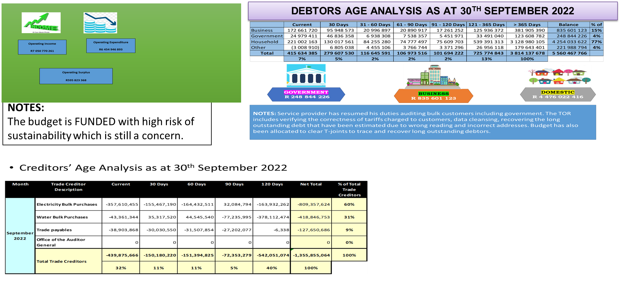
PROGRESS ON FINANCIAL MATTERS
REVENUE ENHANCEMENT
Meter audits
Eradication of T Joints
Street Naming Project
Weekly monitoring meeting that sits every Wednesday

Slide 16
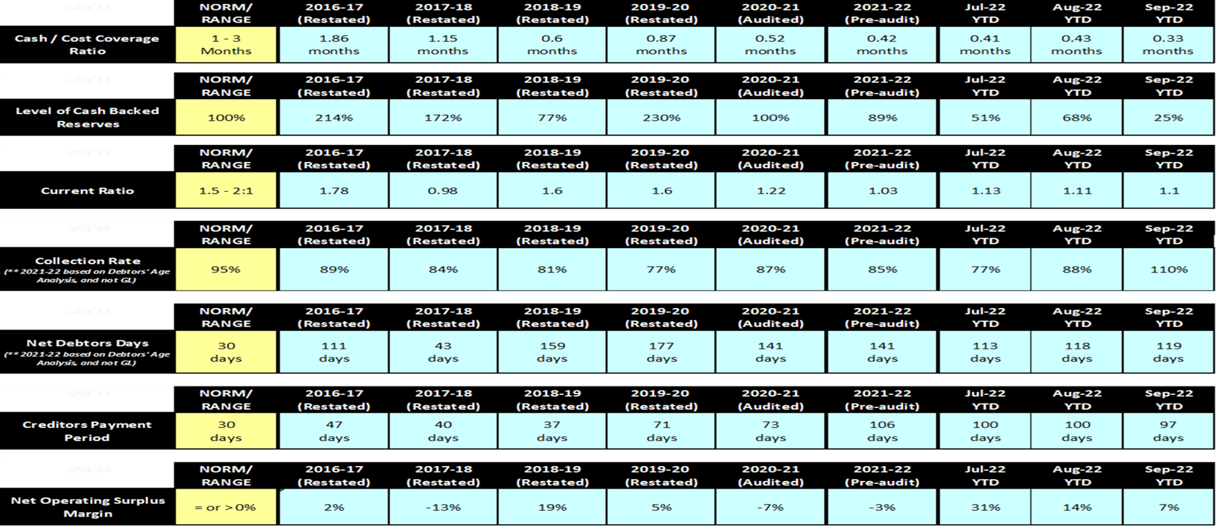
FINANCIAL VIABILITY RATIOS

Slide 17
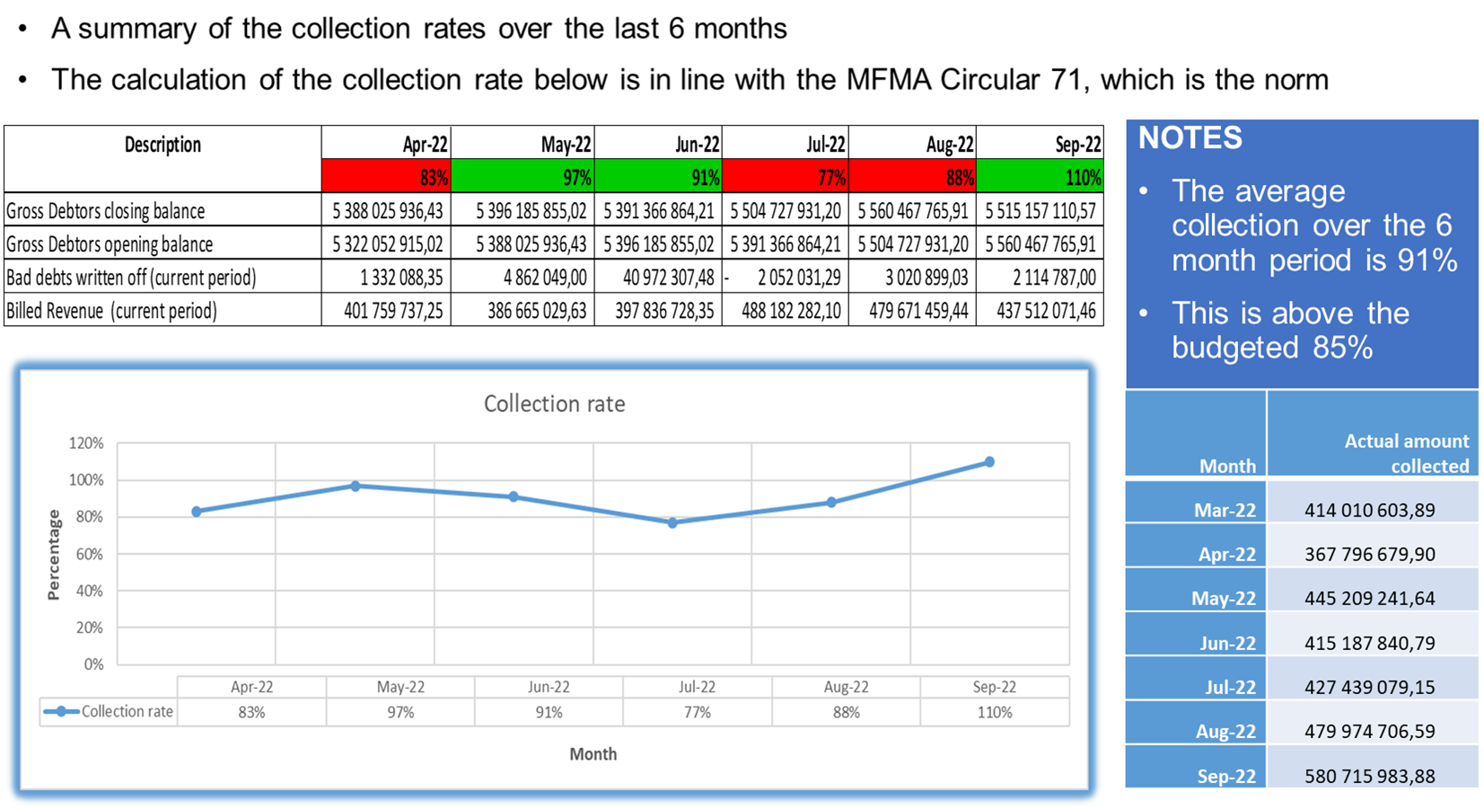
BILLING AND COLLECTION CHALLENGES

Slide 18
DEBT OWED TO THE MUNICIPALITY
The consolidation of accounts (Rates and Services Accounts) is currently under way.
Legal steps to recover debt due to Council – letter of demands, summons, default judgements and warrants of executions have been issued for defaulting debtors.
Meter reading task team formed to reduce the number of estimated meters to improve the accuracy of customer bills.
Improved turnaround time in resolving customer queries and disputes.
Comprehensive review of revenue billing completeness to confirm that customers are billed for all services rendered.
Street naming committee

Slide 19
DEBT OWED TO THE MUNICIPALITY
Implementing credit control procedures on deceased debtors. i.e name changes to surviving spouses
Improved turnaround times for processing name changes after the properties are transferred.
Monitoring the account activities for high priority debtors and reviewing deposits.
A comprehensive reconciliation of Government accounts and meetings with the departments.
Bulk emailing of bills to customers currently working on also sending statements via whatsapp messenger.
Currently addressing the capacity issues at revenue, including the vacancies.

Slide 20
DEBT OWED BY THE MUNICIPALITY
Creditors Age Analysis as at 19 October 2022

Slide 21

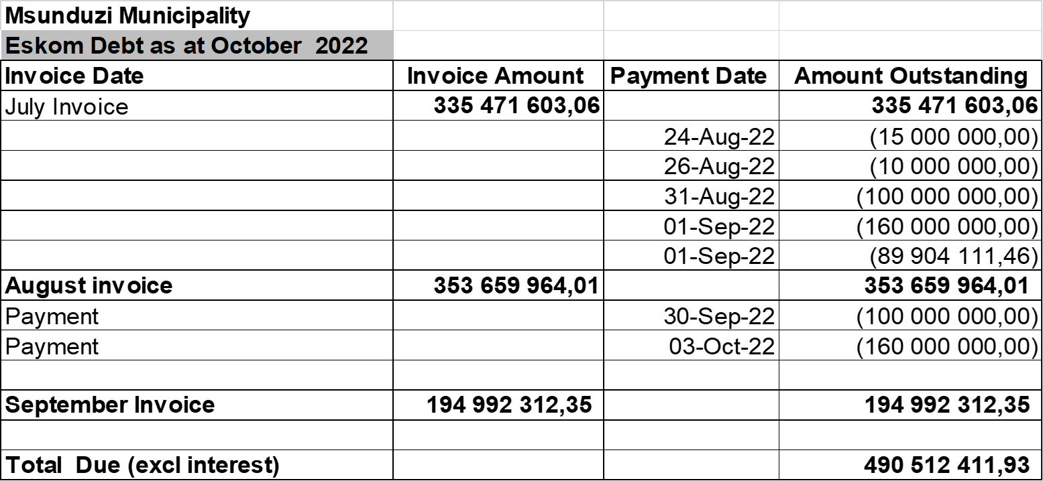
DEBT OWED BY THE MUNICIPALITY

Slide 22

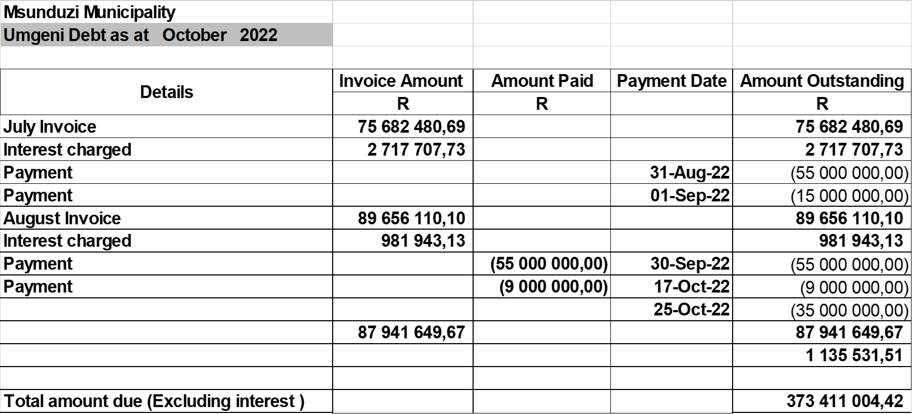
DEBT OWED BY THE MUNICIPALITY

Slide 23
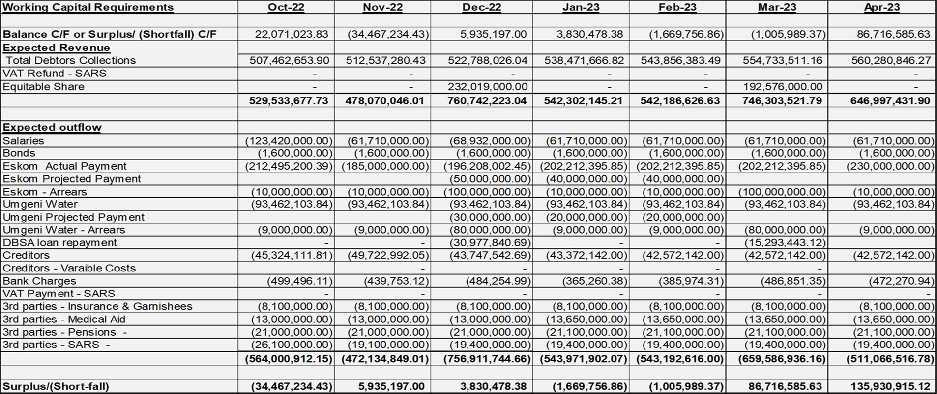
CASH FLOW PROJECTIONS TO APRIL 2023

Slide 24
UIFW EXPENDITURE BY THE MUNICIPALITY
UNAUTHORISED EXPENDITURE
No unauthorised expenditure incur since July 2022 to 27th October 2022
IRREGULAR EXPENDITURE AS AT 30TH SEPTEMBER 2022
Description | Amount
Historic Opening Balance as at the beginning 21/22 FY | R 492 251 429,72
Incurred in 21/22 FY | R 25 599 290,14
Opening Balance as at the beginning 22/23 FY | R 517 850 719,86
Incurred in July 2022 | R 351 441,37
Incurred in August 2022 | R 1 578 542,85
Incurred in September 2022 | R 316 773,10
Total Irregular Expenditure incurred in the Current FY | R 2 246 757,32
Accumulated Irregular Expenditure as at 30 September 2022 | R520 097 477,18

Slide 25
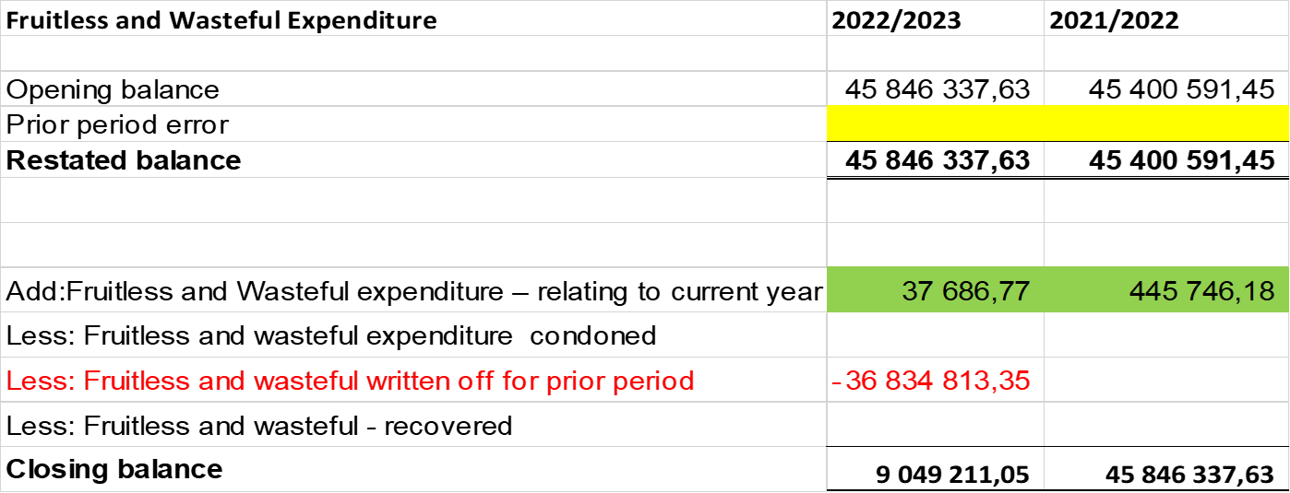
UIFW EXPENDITURE BY THE MUNICIPALITY
FRUITLESS AND WASTEFUL EXPENDITURE

Slide 26
CONSEQUENCE MANAGEMENT FOR UIFW EXPENDITURE
Unauthorised Expenditure
Historical unauthorized incurred is mainly as a results of debt impairment and write-off
Internal Audit has since investigated and recommended to Council to condone R1 122 190 818
Balance of historical unauthorized up to 2020/21 about R 1 302 759 371 is under investigation by Internal Audit
Regarding consequence management Internal Audit report did not recommend any since amount was entirely for Council benefit

Slide 27
CONSEQUENCE MANAGEMENT FOR UIFW EXPENDITURE
Irregular, Fruitless and Wasteful Expenditure
Report are submitted to SMC and Council on quarterly bases in terms of section 32 of the MFMA;
In the main there are three contracts that are affected by the current Irregular expenditure;
Namely , SAP support provided by Nambithi and Issuing of revenue statements provided by Contour;
All of these contracts has either been terminated or the contract came to an end;
Looking ahead the Municipality should not incurred these Irregular expenditures unless its payment for previous months
Investigations are conducted by forensic section within Internal Audit unit.
In line with UIFW reduction strategy adopted by Council the irregular expenditure has reduced

Slide 28
CHALLENGES FACED BY THE MUNICIPALITY THAT IMPACTS SERVICE DELIVERY
Failure of key infrastructure, such as electricity and water due to poor/inadequate maintenance, age and vandalism
Failure to attend to the repair of potholes, street lights and storm water drains
Failure to clean the city and surrounding nodal and residential areas including irregular collection of solid waste and challenges associated with the processing and disposal of solid waste
The electricity infrastructure in Msunduzi is in a bad state resulting in frequent and prolonged outages. These outages have “disastrous" impact on the revenue of the city, the economy and the well-being of residents. The following illustrates some of the impacts:
  Business are affected impacting negatively on the economic activities
  Critical load such as Hospitals, Oxygen producers, Water Reservoir & Water treatment plants are affected triggering environmental issues and threats to life.
  Residents of the City are affected negatively e.g. loosing their groceries, unable to work and study from home

Slide 29
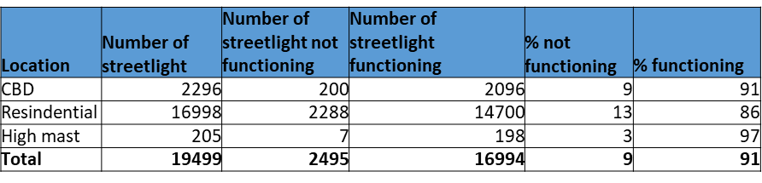
PROGRESS ON SERVICE DELIVERY
ELECTRICITY
PROGRESS AS AT 25 OCTOBER 2022 continued…
Engagement with Business/Industry for implementation of Load Curtailment to minimize load shedding impact are underway and load curtailment is done for customers supplied from Riverside Substation for stage 1 and 2
1101 connections were achieved in 2021/22 and 400 connections are planned in 2022/23 financial year. 138 Connections are complete.
Repair of Cables and Normalize Electricity Network. 60 0ut of 265 cable fault repaired in 2022/23 as at 30 September 2022.
Normalize Electricity Network, 32 RMU and 15 Minisubstation installed in 2021/22 and 56 Secondary substations planned to be normalized in 2022/23 financial year. Awaiting the purchase of new RMUs and minisubs.
Construction of 11kV outdoor structures in Retief and Crossways Primary Substations and currently constructing 11kV outdoor structures in Northdale Primary Substation which is aimed at mitigate the impact in the event where there is fire incident is scheduled to be completed in November 2022 by Eskom. Construction of Eastwood 132kV Transmission Lines is currently in progress through Cogta funding scheduled for completion in October 2022.
44KM of servitude out of 300km maintained.
The pole change in a planning stage and the replacement to commence in November 2022.
Total of 162 Medium Voltages Outages 2022/23 to 520 in 2021/22 financial year
91% and 86% in CBD and Residential areas respectively have been repaired.
The Municipality is in a process of also taking over the maintenance of streetlight in Eskom area of supply during the current financial year. The audit of streetlight is in progress.
The Msunduzi Municipality is working on a plan to separate the residential load of 7MVA from Water Plant Groenekloof Reservoir through INEP funded project, this will require Umgeni to compliment by having standby generator in place on their 2MVA load where load curtailment will be possible during stage 1.
THE MUNICIPALITY HAS PUT IN PLACE THE FOLLOWING STRATEGIES IN PLACE WHICH ARE BEING IMPLEMENTED IN LINE WITH AVAILABLE RESOURCES.
Network Development Plan is in place to address the ageing and overloading infrastructure subject to funding.
Strategy to Minimise Electricity Losses is in place and implemented in line with resources available.
Maintenance Plans in place and implemented in line with resources available.
Meter Audit Plan in place and implemented in line with resources available.
A report detailing the Theft and Vandalism Hotspots is in place and implemented in line with resources available.
The Municipality is working in collaboration with Eskom, MISA and Businesses to address the Electricity issues.
Priority Vacancy List and New Organogram being finalised.
Cost of Supply Study for the Electricity Cost Reflective Tariffs submitted to NERSA for consideration and approval.
Embedded Generation Policy and Tariffs have been developed.
Currently the Municipality is also engaging DBSA and Department of Minerals and Energy (DMRE) for funding of infrastructure and electrification projects.
The revenue initiatives are also being implemented in an effort to improve revenue of the municipality to fund the infrastructure projects.
Municipality has engaged the National Treasury through the BFI program in order to source funding to fund the infrastructure projects and assist in stimulating the economy of the City.
The Municipality is currently allocated repairs and operations/maintenance budget of 7%.
STREETLIGHTS
The maintenance of streetlight program is on an ongoing basis the maintenance and repairs of streetlights is currently underway in various Msunduzi electricity area supply
Below is the update of streetlights maintenance to date. The statistics are based on the equipment that have been inspected and attended. It should be noted that the statistics vary based on the failures experienced on daily basis mainly as a result of theft and vandalism.
The Municipality installed 20 new high mast both in Eskom and Msunduzi area of supply, the energizing of the high mast in Eskom area of supply will be completed during the 2022/23 financial year. Also 20 new high mast planned for installation during the current 2022/23 financial year and 12 out of 20 High Masts Erected.
PROGRESS AS AT 25 OCTOBER 2022
The meter audit appointments have been finalised, inception meetings with appointed services providers and implementation plan completed. A total of 3580 meters out of 8000 meters have been audited.
Roof Repairs are in progress at Electricity Buildings.
The priority vacancy list for 2022/23 has been submitted for advertisement for a budget allocation of R10m.
Report on development in UMshwathi served at IS Portfolio on 28 July 2022. (Claridge)
Electricity Maintenance Plan served at IS Portfolio Committee on 28 July 2022 and is being implemented already.
Load Shedding Schedule covering Stage 1 to 8 is in place and being implemented as per request from Eskom.

Slide 30
PROGRESS ON SERVICE DELIVERY
WATER & SANITATION
Interventions for Loss Reduction; (Revised Non- Revenue Water Master Plan will be Completed and be presented to SMC on the SMC by the in September 2022, and we still have an overpayment issue with Umgeni Water)
1. Meter Replacement Contract
SCM 9 19/20, to be surpassed by SCM 57 20/21 which is awarded, and contractor commenced. The program is to replace approximately 4000 water meters based on the exception list submitted by Revenue.
Nett effect is an increase in Billed Metered Consumption and a reduction in Unbilled Metered Consumption. Currently we have replaced approximately 1288 meters accumulatively in the 2021/2022 financial year. (This will Further address the root cause i.r.o of illegal connections). There is adequate domestic meters in stock, approximately 3000. (Contract completed)
2. Real Loss Reduction
Leak Detection Tender:
Currently the contract had been awarded to 3 contractors who will assist with leak detection and repairs. The CBD has will be prioritised, following high water leakage areas as identified by flow logging. The nett effect will result results in identification and repair of all visible and non-visible leakage, which once detected and repaired will reduce real losses.
High Water Loss areas have been identified to dispatch contractors. The 3 contractors for Leak Detection and Repair commenced in mid-August and following is a summary as of the 3rd week of October 2022. There was a total of 284,7 km that leak detection in wards 2,10,32,33, 17, 18, 27 whereby accumulatively 498 leaks where located.

Slide 31
PROGRESS ON SERVICE DELIVERY
WATER & SANITATION
Pressure Management:
Thirty- seven (39) pressure management zones have been designed and simulated, awaiting the Civils Tender for implementation (currently at Bid specification level) Nett effect will result in reduction of real/Physical losses.
Global Interventions:
To date 80% of existing Pressure Management Zones have been reinstated to their optimal functionality. On-going monitoring and adjustments are undertaken within these systems, as to mitigate the burst frequency and prevent leakage within the defined pressure managed zones.
An apparent loss policy is currently at draft stage which will assist with a standard Operation Procedure to deal with illegal connections. (This will deal with root cause as identified by AG). 4 Additional Plumbers have been employed including the shortlisting Foreman/Charge hands/Supervisors which will assist in the operational responses to reduce water losses. The 4 additional plumbers have commenced on the 1st of August 2021. The Superintendent Water and Foremen: Metering both commenced on the 1st of January 2022.
We are in the process of shortlisting Water Foreman positions including Plumbers/Fitters/Welder and in the advertisement of shortlisting. An additional 10 vans have further been ordered which will assist plumbers with reducing losses. 10 additional plumbers are going to acting whilst these positions are advertised.
The Operations and Maintenance draft budget submission for the 2022/2023 financial year has significantly increased which will be used to repair leaks and burst pipes. In relation to ageing infrastructure, only a limited budget in relation to Capex of R 1 000 000 has been made available in the 2021/2022 financial year. The Water Losses in relation to the 2020/2021 financial year closed at 29,8% which is below the 30% in line with MFMA Circular 2022.
This is above the norm of 30% in terms of circular 72. The rand value will increase due to the increase in tariffs.
Replacement of water pipes in the northern areas is currently ongoing (Contractor and consultant). A total of 1,4km of pipes have been replaced.
The War of leaks programs will commence in has commenced with 44 Apprentice plumber been inducted by HR and was introduced to the Municipal team on 17 October 2022. These apprentice plumbers will be dedicated into wards and assisting with soft leaks both within in low cost housing developments. We have further changed approximately 467 meters have been changed this financial year.

Slide 32
PROGRESS ON SERVICE DELIVERY
ROADS & TRANSPORTATION
Cleaning of catchpits and stormwater pipes is attended on daily bases by different teams.
Based on the RAMP document that was developed in 2015, the total backlog of roads that needs to be rehabilitated was 8 036 687 square meters by 2015. To date total of 299 500 square meters of roads have been resurface since 2015, therefore the backlog has been reduced to 7 687 187 square meters of roads that still require urgent rehabilitation, in order to improve quality of the city’s roads and to solve the potholes problem.
The following roads are being rehabilitated in the current financial year:
IPTN
The road infrastructure component of the project has been completed. Although the road infrastructure has been completed, the Municipality is not ready to operate the system as operational readiness services were affected by suspension.
NDOT has indicated that the criteria that will be used for readmission of suspended cities into the grant has been finalized. A meeting was held with NDOT and NT to discuss the City’s readiness. The feedback was that the City needs to work on its credible and financial sustainable Operation plan and Business plan.
  Procurement process to appoint the service provider to assist with refinement of the Operational plan and business plan is underway and the process will commence during the first week of November.
ROAD NAME | SQUARE METERS
Morcom Road | 27 000
Zwartkop | 38 000
Cleland | 15 250
Lincoln meade | 26 100
Church Street | 9 360

Slide 33
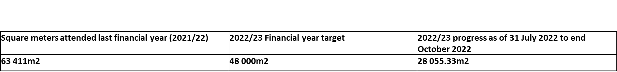
PROGRESS ON SERVICE DELIVERY
POTHOLE REPAIRS
Potholes repairs is part of reactive maintenance which occur as a result of Insufficient budget for routine, periodic or preventative maintenance.
Due to financial constraints our roads have not been maintained as per the recommendations of the Road Asset Management Plan, as a result potholes are now mushrooming in most of our roads, and it has been a challenge for the City to catchup with potholes backlog as it keeps on growing.
Over the years this has led to the Municipality focusing more on reactive maintenance which does not correct the root problem but the symptoms of the problem.
With limited funding that has been provided over the years, resurfacing program has been implemented on critical sections along number of roads and surface patching in other sections – although this approach is mitigating the situation, but it is not a permanent solution as potholes still develop on sections that resurfacing has not been implemented, still on the same road
In the past few month lot of work has been done in order to reduce pothole backlog, however even though potholes are repaired but this is not a proper solution as we are not resolving the root cause of the problem.
Therefore, due to the rate of poor condition of our surface roads pothole backlog is a moving target. The sustainable and long-term solution is to spend more money in roads rehabilitation than for pothole repairs.

Slide 34
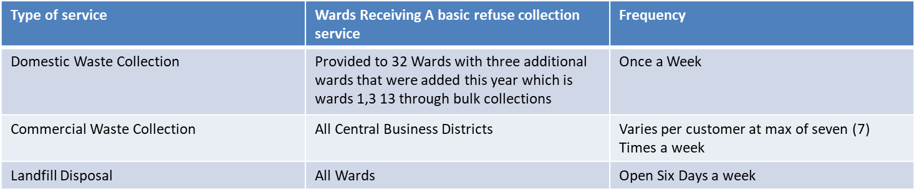
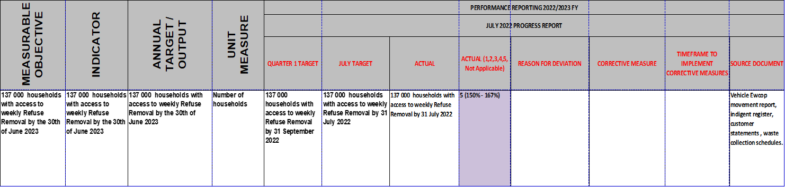
PROGRESS ON SERVICE DELIVERY
WASTE MANAGEMENT

Slide 35
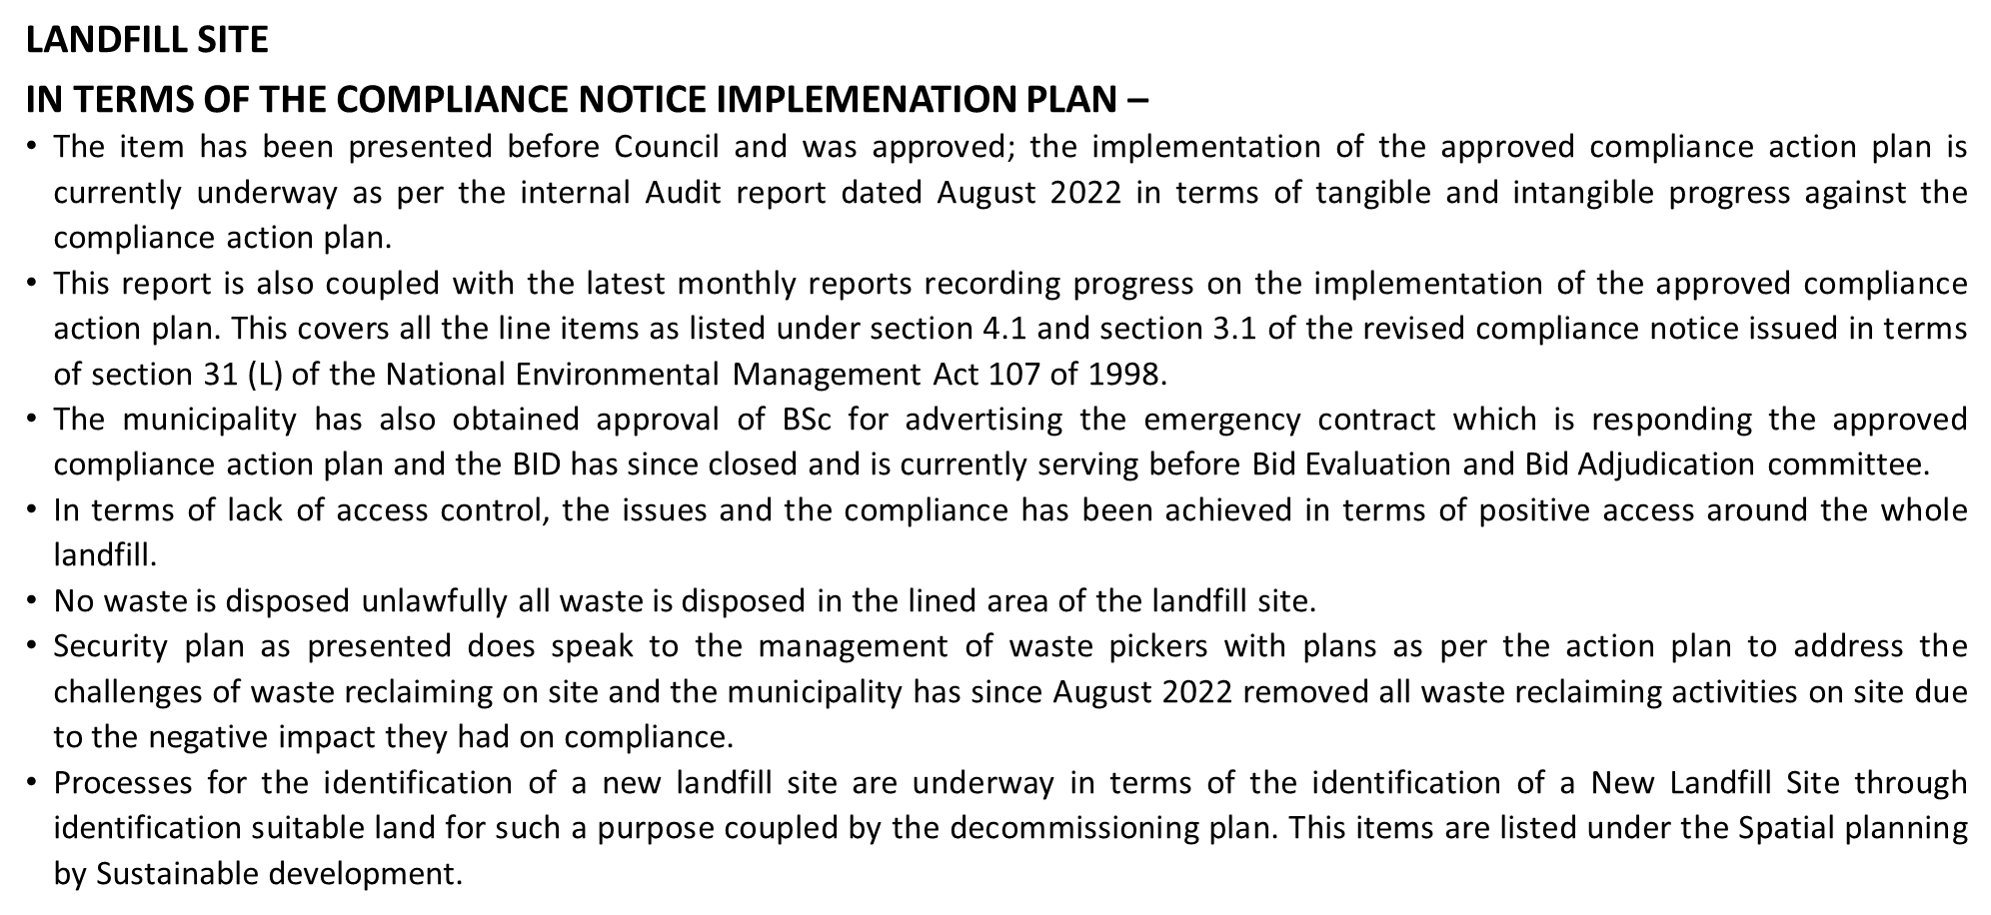
PROGRESS ON SERVICE DELIVERY

Slide 36
LOCAL ECONOMIC DEVELOPMENT INITIATIVES
The Municipality has reviewed its Local Economic Development Strategy. This Strategy has already been adopted by council.
Msunduzi Municipal council has also adopted a Business Retention and Expansion Strategy. The objective is to ensure that we retail the businesses that are already invested in the Municipality. The Strategy also provide incentives for business expansion.
The Municipality has embarked on assisting informal traders operating within the CBD with the market stalls and ablution facilities. The intention is to create conducive environment for the informal traders to conduct their businesses.
The Municipality has developed a land disposal strategy (disposal of strategic land) to attract businesses to the City.
To ensure the inclusion of Youth into the mainstream economy, the Municipality has constructed the Youth Enterprise park in Imbali Township. This park accommodates several youth owned businesses.
As part of tourism development, the Municipality has renovated Manaye Hall, that hosted all Africa Conference in 1961. This is where Dr Nelson Mandela delivered his last speech, before he was incarcerated.

Slide 37
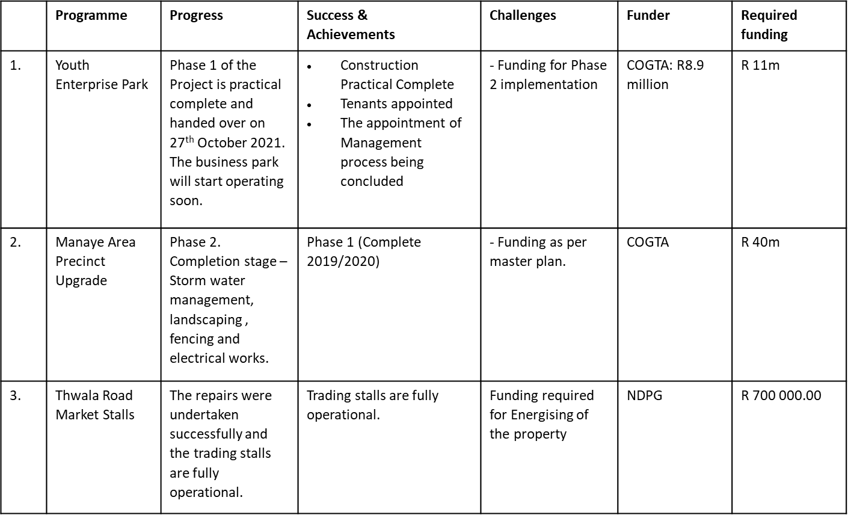
LOCAL ECONOMIC DEVELOPMENT INITIATIVES

Slide 38
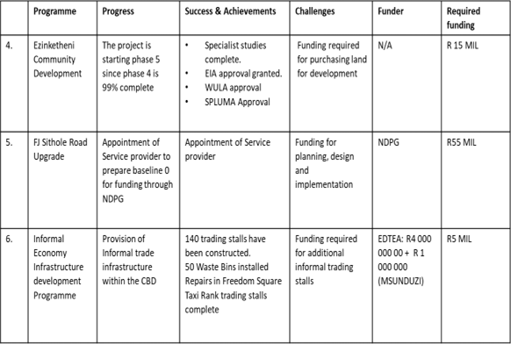
LOCAL ECONOMIC DEVELOPMENT INITIATIVES

Slide 39
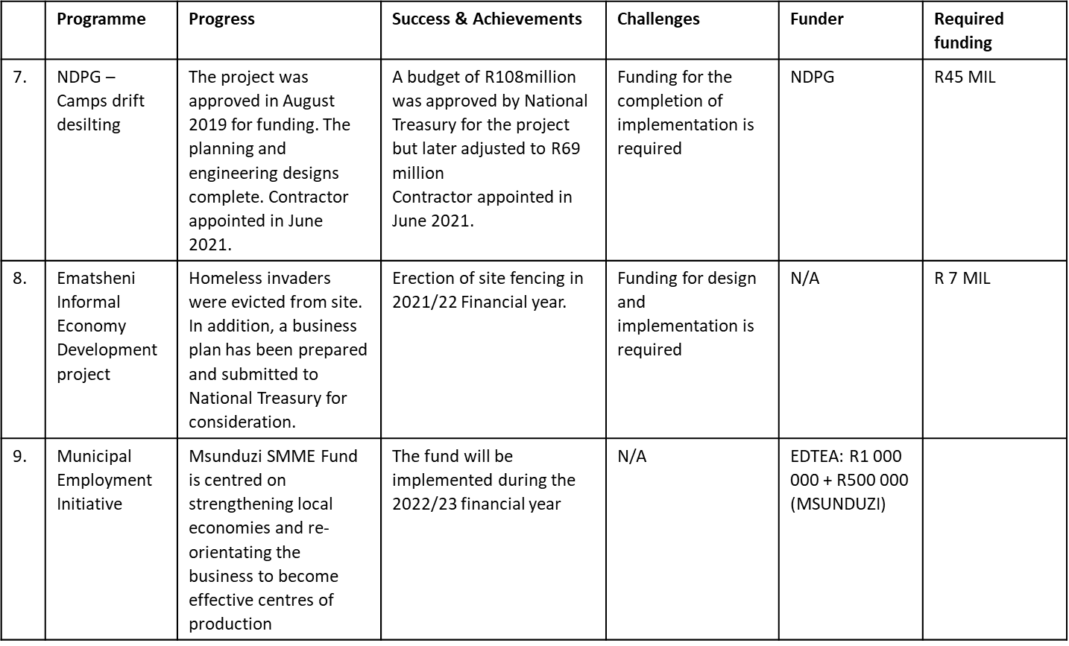
LOCAL ECONOMIC DEVELOPMENT INITIATIVES

Slide 40
SUCCESSES OF THE MUNICIPALITY
Invitation to attend the Provincial Members Assembly (PMA) SALGA Networking to receive the SALGA KZN Award 2022 for the outstanding performance in Credit Control: ‘Operation QoqiMali.
In the 2021/2022 Financial year Msunduzi Municipality advertised a tender calling for service providers to assist with fundraising for the municipality for various projects including but not limited to Infrastructure projects and Economic Development projects.
Completion of the Imbali Youth Enterprise Park which was officially opened by the MEC for CoGTA
100% expenditure of the NDPG Grant for the 21/22 financial year
The Electricity Supply Services business unit has already achieved 60% expenditure on the MIG allocation for electricity projects for the 22/23 financial year.
Establishment of the IPTN Steering Task Team to revive the IPTN project
Establishment of workstreams for the Financial Recovery Plan (Voluntary)
Reviving the ICT Steering Committee
Implementing a Dress, Appearance and Name Badge policy
The municipality received an unqualified audit opinion from the Auditor General during the 2020 /2021 financial year. An audit action plan was devised to address all the audit findings and further, to improve the municipality’s audit outcome.

Slide 41
RECOMMENDATIONS
Msunduzi has made great strides with implementing the Msunduzi Turn Around Strategy and Implementation Plan as well as the Financial Recovery Plan.
The Municipality is on its way to recovery and is unstoppable in it’s efforts to improve service delivery. Furthermore, the Municipality has appointed the City Manager and is in the process of finalising the appointment of the General Manager: Infrastructure and the General Manager: Electricity Supply Services; therefore the municipality has gained administrative stability.
We are therefore recommending that Msunduzi Municipality be removed from the S139 (1)(b) Administration.

Slide 42
CONCLUSIONS
The Municipality made submissions to the National Treasury, and Development Bank of South Africa (DBSA) with the intention of sourcing funding in order to implement the Capital Projects.
The Municipality is engaging Local Business Community in order to find a suitable funding and implementation model that may not compromise the constitutional mandate of the municipality.
The Municipality is also requesting the Provincial Intervention in mobilising and providing resources to assist in addressing the electricity outages experienced by Msunduzi Municipality.
The intervention of experts to prevent theft and vandalism of infrastructure before it occurs. In this regard the municipality has entered strategic partnership with Eskom to provide services that cannot be sourced as a matter urgency.
The daily disconnections and restrictions are being undertaken in terms of implementation of the credit control policy.
Legal steps to recover debt due to council - letters of demand, summons, default judgments and warrant of executions have been issued for defaulting debtors.
Electricity Meter Audit is currently underway for all Council Wide properties.
Town Planning will be part of the teams that are disconnecting to ensure fines and notices are issued
Focus on executing property to ensure Council recovers debt due timeously.
DBSA is finalizing the tender process to do data cleansing since the first contract was terminated due none performance

Slide 43
CONCLUSIONS
Given the decline of the financial status of the municipality a request was made to National Treasury to review the Financial Recovery Plan .
Assessment has been completed , NT is presenting the draft plan to all council structures including the rates payer's association, the MEC for Cogta and the Public at large.
The revised FRP will be used as an instrument to guide the municipality in addressing the financial crisis and to ensure that the municipality regains its financial health within the shortest timeframe while ensuring that all issues which adversely affect the financial health of the municipality are comprehensively addressed
FRP adopts a strategic, focused approach which is time-bound yet comprehensive enough to ensure that the underlying causes of the crisis are adequately addressed. To achieve this objective, the draft financial recovery plan presents a phased approach to recovery, differentiating between issues to be addressed in the short, medium, and long term. The FRP is divided into three distinct but interdependent phases. These include:
Rescue Phase (Phase 1) which focuses primarily on cash and restoring the cash position of the municipality
Stabilization Phase (Phase 2) which expands on the financial indicators to be monitored and emphasizes key governance and institutional issues which must simultaneously be addressed
Sustainability Phase (Phase 3) to ensure that indicators are developed that will give effect to the long-term financial sustainability of the municipality.
Cogta is also proving support in terms of revenue collection, cost containment and all strategies that will improve cash reserves. An Interim Finance Committee sits every Wednesday to monitor these strategies.
CoGTA has also provided hands on support to deal with the government debt and improving capital expenditure on grants

