Slide 1

2021/22 Annual Report
Presentation to the
Portfolio Committtee on Higher Education, Science and Innovation
31 October 2022

Slide 2
PRESENTATION LAYOUT
TOPICS COVERED:
CETA Vision, Mission, Values and Tag-line
Mandate of the CETA
Human Resource Management and Development Overview
CETA Performance against 2021/22 APP Overview
Core Business (ETQA and Projects) Overview
Financial Overview
Auditor-General’s Audit Outcomes
Action Plan to Address 2021/22 AGSA’s Audit Matters
Conclusion

Slide 3

CETA Vision, Mission and Values
Value Proposition Statement
“To implement the objectives of the National Skills Development Plan (NSDP 2030); to increase number of people that obtain critical or scarce skills needed, and to build the capacity of the construction sector to be economically sustainable and globally competitive”
Vision
“To be a pillar for skills development and nation-building”
Mission
“To position skills as a foundation for economic development and empowerment”
Values
Agile
Results-oriented
Integrity
Respect
Professionalism

Slide 4
MANDATE OF THE CETA
Facilitation of skills development in the construction sector
The CETA facilitates and funds skills development through:
Research and development of the Sector Skills Plan
Allocation of Mandatory and Discretionary Grants
The development of qualifications
Accreditation of training providers
Quality assurance of all accredited training in the sector
Implementation and monitoring of Projects
Certification of learners enrolled onto CETA programmes

Slide 5
2021/22 Annual Report Overview

Slide 6
Annual Report Legislative Requirements
Preparation of Public Entities’ Annual Reports
Section 55((1)(d) of the PFMA, 01 of 1999 requires that “the accounting authority for a public entity must submit within five months of the end of a financial year to the relevant treasury, to the executive authority responsible for that public entity an annual report on its activities, the financial statements for that financial year after the statements have been audited; and the report of the auditors on those…”
Section 55(2)(i) of the PFMA, 01 of 1999 further states that “the annual report and financial statements must include particulars of—
  (i) any material losses…and any irregular expenditure and fruitless and wasteful expenditure that occurred…,
  (ii) any criminal or disciplinary steps taken as a consequence of such losses or irregular expenditure or fruitless and wasteful expenditure;
  (iii) any losses recovered or written off;
  (iv) any financial assistance received …and made by the state…; and
  (v) any other matters that may be prescribed”.
Section 14(5)(a) and (b) of the Skills Development Act, 97 of 1998 require that “every SETA must, in accordance with the standards of GRAP— keep proper record of all its financial transactions, assets and liabilities; and within six months after the end of each financial year, prepare accounts reflecting income and expenditure and a balance sheet showing its assets, liabilities and financial position as at the end of that financial year”.

Slide 7
Annual Report Legislative Requirements
CETA 2021/22 Annual Reports Compliance
The CETA prepared in its 2021/22 Annual Report (AR) as per the requirements of the PFMA, SDA and the NT annual report guidelines applicable
Draft AR was internally reviewed by our Monitoring and Evaluation unit and the submitted to AG on 31 May 2022
The AR was then finally submitted to all authorities within prescribed timelines of 31 August 2022
The AR contains in the main:
  Overview sections (AA and CEO’s)
  Governance section (Internal controls, Internal Audit function and ARC’s report, etc.)
  Core Business and Report against 2021/22 Predetermined Objectives as per the APP and SP
  Human Resource Management and Development section
  Financial Statements section with accompanying Audit Report of the AGSA

Slide 8
Human Resource Management and Development Overview

Slide 9
HUMAN RESOURCES (HRM&D)
Organisational Redesign and Development (OD) and Administration
CETA was under Administration from February 2020 to 02 February 2022
An organizational redesign and development process (OD) was undertaken during this period, with the following deliverables as related to HRM & HRD at CETA:
  Redesigned organisational structure (consulted on with Labour and use for staff placement)
  Talent and leadership development framework and toolkit
  Competency framework developed
  CETA Performance Management Review report
  Skills audit conducted, job evaluation and job grading with Skills Audit report used in placement
  Salary and Employee Benefits Benchmark report
  New salary scales on 50 percentile anchor of the Patterson grading adopted
  CETA Staff Remuneration and Incentives Strategy
  Updated HR&D policies and procedures
  Change Management and Culture Audit report

Slide 10
HUMAN RESOURCES (HRM&D) (CONTD)
2021/22 Employment Status
Job Level | Appointments | Terminations | Employment at end of period
Top Management | 4 | 1 | 4
Senior Management | 1 | 0 | 1
Professionally Qualified | 0 | 3 | 23
Skilled | 0 | 0 | 42
Semi-skilled | 0 | 0 | 30
Unskilled | 0 | 1 | 6
TOTAL | 5 | 5 | 106

Slide 11
HUMAN RESOURCES (HRM&D) (CONTD)
Labour Relations (Misconduct and Disciplinary Actions)
and Reasons Terminations
Reason | Number
Death | 1
Resignation | 1
Dismissal | 3
Retirement | 0
Ill Health | 0
Expiry of contract | 0
Other | 0
TOTAL | 5
Type of disciplinary action | Terminations
Verbal warning | 0
Written warning | 0
Final written warning | 0
Dismissal | 3

Slide 12
HUMAN RESOURCES (HRM&D) (CONTD)
Employment Equity Statistics for 2021/22 Period
The CETA has 3 disabled employees at unskilled level, i.e., 1 AM and 2 AF
JOB LEVEL | AFRICAN |  | COLOURED |  | INDIAN |  | WHITE |  | TOTAL
 | M | F | M | F | M | F | M | F | ALL
Top Management | 3 | 1 | 0 | 0 | 0 | 0 | 0 | 0 | 4
Senior Management | 0 | 0 | 0 | 0 | 0 | 0 | 0 | 0 | 0
Professionally qualified | 8 | 12 | 0 | 1 | 0 | 1 | 0 | 0 | 22
Skilled | 19 | 18 | 1 | 1 | 0 | 1 | 0 | 1 | 41
Semi-skilled | 5 | 24 | 1 | 1 | 0 | 0 | 0 | 0 | 31
Unskilled | 3 | 5 | 0 | 0 | 0 | 0 | 0 | 0 | 8
TOTAL | 38 | 60 | 2 | 3 | 0 | 2 | 0 | 1 | 106

Slide 13
Overview of CETA Performance Against 2021/22 APP

Slide 14
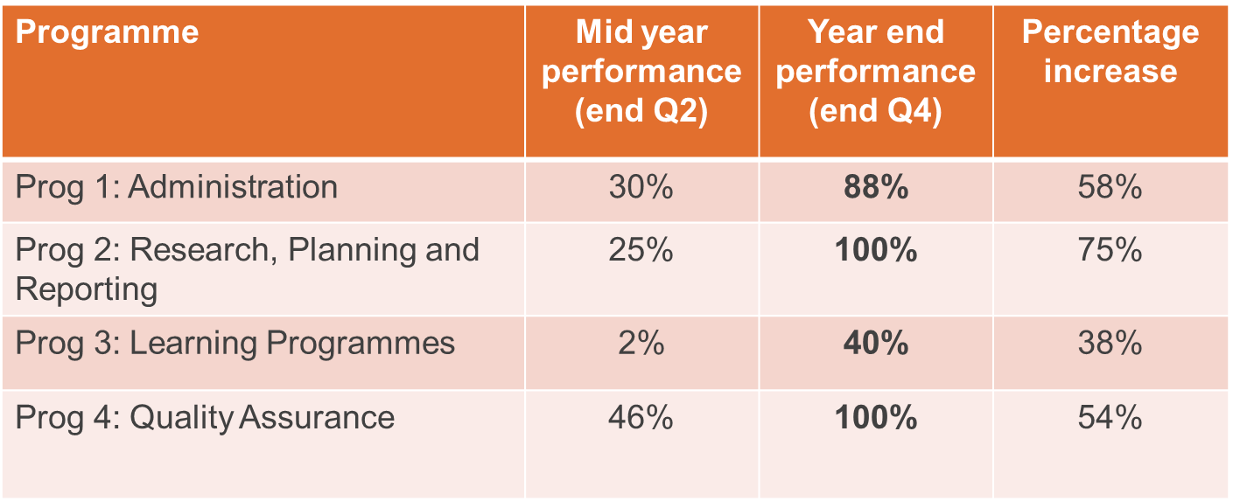
2021/22 SUMMARY PERFORMANCE ACHIEVEMENTS
Performance Against 2021/22 APP
The overall performance for the 2021/22 period is at 62% vs. 22% overall performance achieved in 2020/21

Slide 15
MEASURES TO IMPROVE PERFORMANCE FOR 2022/23 YEAR
Equity Statistics
In summary the KPIs per programme that have not been met:
Programme 1: Administration stands at 88% (22/25) with the majority of targets not met associated with the governance structures not in place due to Administration period
Programme 2: Research, planning and reporting targets have been met at 100% (5/5)
Programme 3: Learning programmes and projects had achievement under per SLA targets is 40% (25/62). Targets not achieved are broadly related to unfunded (industry related) targets plus others specifically related to artisans and learnerships and funded graduate development programmes (employed bursaries, candidacy, etc). Some of TVET college related targets that are not achieved will form part of the MOUs in the new FY
Programme 4: Quality assurance targets are met at 100% (12/12)

Slide 16
MEASURES TO IMPROVE PERFORMANCE
Performance Improvement Actions
Tracking projects roll-out from Q1 and DG window advertised by 31 August 2022
Take-on of stipends payments (biometric and stipends payment system launched on 01 June 2022). Digitisation and automation project for DGs and MGs
Quality Assurance service provider assisting in various areas as per CETA/QCTO SLA requirements
Verification of PDO information throughout performance year
Continuous application of system rules for accurate reporting (Indicium vs SETMIS).
Ensuring all units declare accuracy and completeness of data quarterly. Managerial sign-off and declaration of accuracy on all QMR reports
Enforce contractual obligations by Employers and Training providers for projects to start on time
Stakeholder engagement with employers on best practice for reporting learning programmes
Implementation plans for Special Projects, incl. TVET and CET support; small business and co-operative support, Skills partnerships and research activities (research chairs)
Performance agreements signed all CETA employees
Implement the Annual Operational Plan and monitor and report progress on monthly basis against BSC
Monthly performance reports submitted to M&E Unit for organisational performance regular tracking

Slide 17
OTHER PERFORMANCE STATISTICS
Mandatory and Discretionary Grants and ERRP Performance
Economic Recovery and Reconstruction Programme (ERRP)
CETA implemented short skills programme in contribution to the ERRP in the following:
  Roadworks
  Community house-building
  Construction contractor
ERRP projects took place in EC, KZN, Mpumalanga, Limpopo, NC and WC
Total of 6 132 enrolled with a budget of R92 million, with total of R18,9 million paid in stipends
+- 4 500 learners graduated from 2021/22 ERRP roll-out (74% completion as at 31/03/2022)
Mandatory and Discretionary Grants
CETA received R586 million in skills levies revenue (51% improvement from PY)
Paid out R72 million on MG vs R42 million in the previous year (71% upward improvement)
Paid out R511 million in DG vs R543 million in the previous year (6% decline)

Slide 18
Core Business Overview

Slide 19
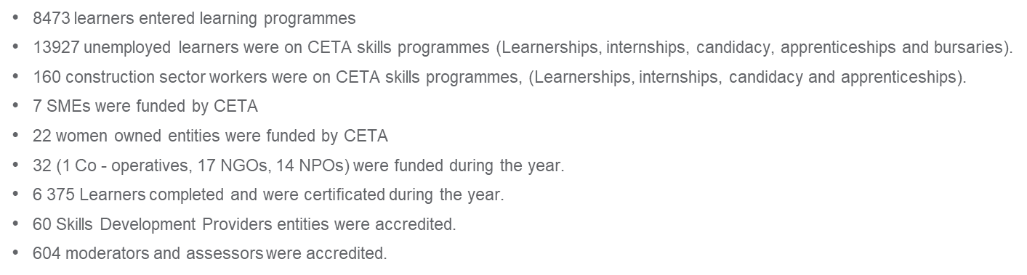
PROJECTS AND ETQA PERFORMANCE
PERFORMANCE HIGHLIGHTS

Slide 20
Achievements of the Annual Performance Objectives – Programme 3
SUB-PROGRAMME 3.1 and 3.6, Learning Programmes and Projects: to address skills priorities within the Construction Sector
Performance Indicators | PLANNED TARGET | ACTUAL ACHIEVEMENT | Variance
Learnerships Entered
Unemployed learners per year | 873 | 414 | -459
Employed learners per year | 89 | 39 | -58
Learnerships Completed
Unemployed learners per year | 1 640 | 1672 | 31
Employed learners per year | 103 | 0 | -103
Skills Programmes Entered
Unemployed learners per year | 227 | 5359 | 5132
Employed learners per year | 0 | 0 | 0
Skills Programmes Completed
Unemployed learners per year | 800 | 157 | -643
Employed learners per year | 0 | 0 | 0
Artisan Entered - Unemployed | 2050 | 1788 | 262
Artisan Completed - Unemployed | 1824 | 2782 | 958

Slide 21
Achievements of the Annual Performance Objectives – Programme 3
SUB-PROGRAMME 3.1 and 3.6, Learning Programmes and Projects: to address skills priorities within the Construction Sector
Performance Indicators | PLANNED TARGET | ACTUAL ACHIEVEMENT | Variance
Number of bursaries entered
Unemployed learners per year | 42 | 112 | 70
Employed learners per year | 45 | 15 | -30
Number of bursaries completed
Bursaries Completed - Unemployed learners per year | 131 | 216 | 85
Number of internships entered - Unemployed | 148 | 112 | 36
Number of internships completed - Unemployed | 104 | 1 | -103
Number of University Student Placement entered per year | 114 | 63 | -49
Student Placement completed at Universities | 60 | 4 | -56
Student/Graduate Placements entered at TVET Colleges | 227 | 226 | -1
Number of TVET Student/Graduate Placements completed - TVET | 60 | 34 | -26
Candidacy programmes Entered | 227 | 128 | -99
Candidacy programmes completed | 58 | 0 | -58
Learners RPLed | 1460 | 129 | -1331

Slide 22
Achievements of the Annual Performance Objectives – Programme 3
SUB-PROGRAMME 3.2 PARTNERSHIPS – University, TVET and CET
SUB- PROGRAMME 3.3 DEVELOPMENT AND Growth of Public College System
Performance Indicators | PLANNED TARGET | ACTUAL ACHIEVEMENT | Variance
CET partnerships established | 9 | 9 | 0
Number of partnerships with private institutions improve service delivery through skills development | 7 | 29 | 22
Number of TVET Lecturers exposed to the industry | 10 | 270 | 260
Number of TVET colleges lecturers awarded bursaries | 5 | 5 | 0
Number of TVET colleges infrastructure development support (equipment/workshops) | 9 | 9 | 0
Number of CET colleges lecturers awarded bursaries | 9 | 9 | 0
Number of CET colleges infrastructure development support (equipment/workshops/Connectivity/ICT) | 4 | 4 | 0
Number of Managers receiving training on curriculum related studies. | 12 | 0 | -12

Slide 23
Achievements of the Annual Performance Objectives – Programme 3
SUB-PROGRAMME 3.5 : Partnerships
PERFORMANCE INDICATORS | PLANNED TARGET | ACTUAL ACHIEVEMENT | VARIANCE
Number of SETA/University partnerships funded by the CETA | 10 | 0 | -10
Number of SETA/TVET College partnerships supported and signed MOUs with CETA to deliver and implement skills development programmes in the construction sector | 35 | 13 | -22
Number of CETA Offices opened in TVET Colleges | 2 | 3 | 1
Partnerships entered with public institutions to improve service delivery through skills development | 13 | 19 | 6
Number of public sector projects in rural areas planned for delivery of skills development programmes in the construction sector | 20 | 22 | 2
Conduct one workshop with each of the 6 councils within the built environment sector | 6 | 0 | -6

Slide 24
Achievements of the Annual Performance Objectives – Programme 3
SUB-PROGRAMME 3.4 Development and support of SMME’S, COOP’S, NGO’S, CBO’S and NPO’S
Performance Indicators | PLANNED TARGET | ACTUAL ACHIEVEMENT | VARIANCE
Number of SMMEs in the construction sector supported through funding and/or accreditation | 21 | 7 | -14
Number of capacity building workshops in Skills Development for Trade Union support | 2 | 2 | 0
Partnership projects to provide training and development support to cooperatives | 9 | 1 | -8
Number of NGOs supported with skills development interventions/programmes within the construction sector. | 12 | 31 | 19

Slide 25
Achievements of the Annual Performance Objectives – Programme 3
SUB-PROGRAMME 3.7 : Career and Vocational Guidance
PERFORMANCE INDICATORS | PLANNED TARGET | ACTUAL ACHIEVEMENT | VARIANCE
Number of career guidance events held in urban areas | 22 | 23 | 1
Number of career guidance events held in rural areas | 12 | 14 | 2
Number of career guidance booklets updated for the construction sector | 1 | 0 | -1

Slide 26
Achievements of the Annual Performance Objectives – Programme 4
Goal 4.1 & 4.2 & 4.3 Implementation of quality assurance that will enhance and ensure quality provision of training
PERFORMANCE INDICATORS | PLANNED TARGET | ACTUAL ACHIEVEMENT | VARIANCE
Number of new accredited training providers for short skills programmes | 60 | 60 | 0
Maintain a database of CETA accredited training providers | 1 | 1 | 0
Maintain a database of QCTO registered construction qualifications | 1 | 1 | 0
Number of accredited TVET Colleges with the CETA | 6 | 6 | 0
Support TVET College lecturers:Number of lecturers trained at TVET colleges | 40 | 40 | 0

Slide 27
Achievements of the Annual Performance Objectives – Programme 4
NSDP GOAL: Goal 4.1 & 4.2 & 4.3 Implementation of quality assurance that will enhance and ensure quality provision of training
Performance Indicators | PLANNED TARGET | ACTUAL ACHIEVEMENT | VARIANCE
Signed SLA with QCTO for the CETA to be the DQP | 1 | 1 | 0
Number of DQP Projects approved | 6 | 7 | 1
Design, develop and register new occupational qualifications and curriculum | 6 | 16 | 10
Number of registered learnerships maintained with DHET | 1 | 1 | 0
Monitoring and Evaluation Policy is reviewed and approved by Accounting Authority annually | 1 | 1 | 0
External Moderation Visits Schedule for CETA programmes is compiled and approved. | 4 | 4 | 0
Quarterly site visit audits for all accredited training providers to verify if they are still compliant | 4 | 4 | 0

Slide 28
Financial Overview

Slide 29
Financial Performance
Year-on-year Comparison

Slide 30
Financial Performance
Actuals and Budget Comparison

Slide 31
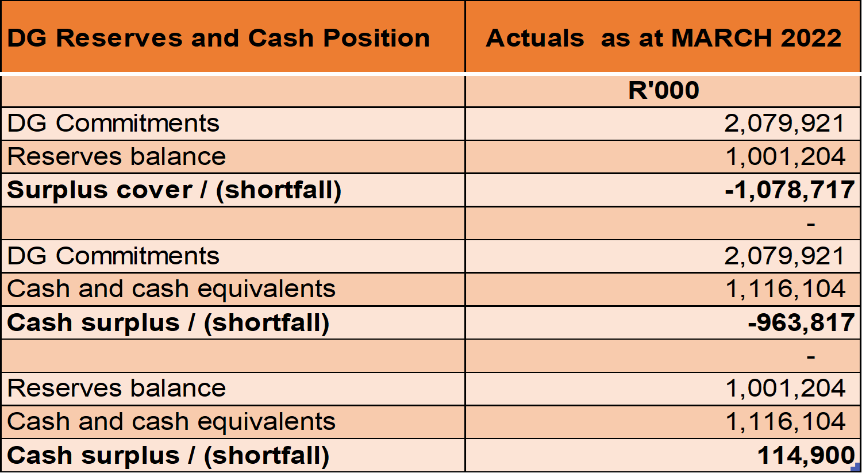
DG RESERVES AND CASH POSITION
Discretionary Grant Reserves Analysis

Slide 32
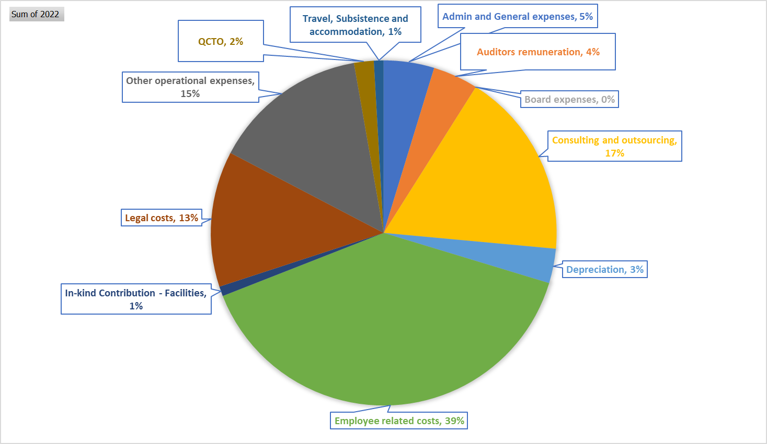
Administration Expenditure
Administration expenditure spread for the 2021/22 FY

Slide 33
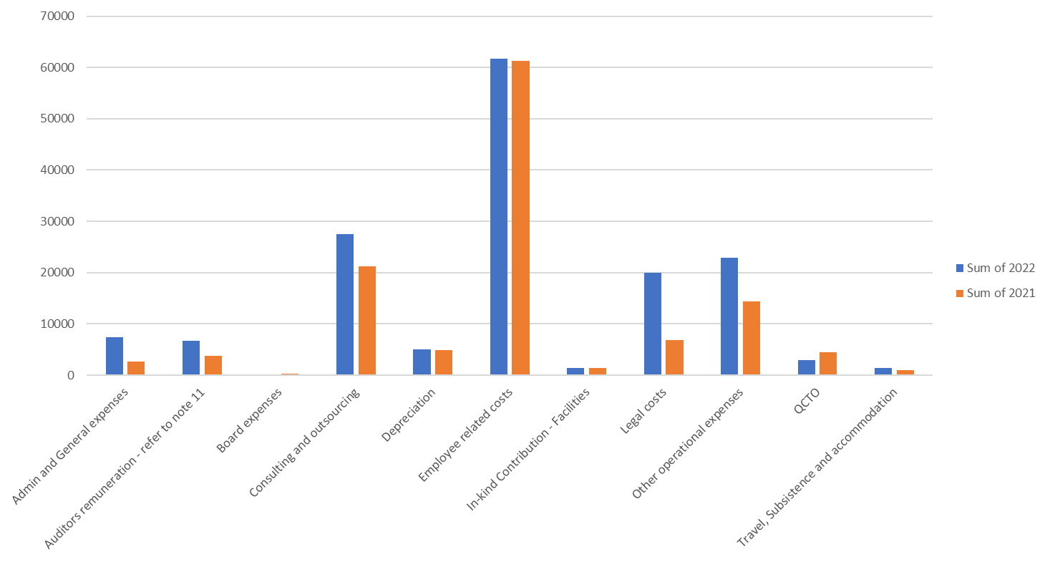
Administration Expenditure
Administration expenditure spread: 2020/21 vs 2021/22 FY

Slide 34
Administration Expenditure
Administration expenditure spread for the 2021/22 FY
Overall administration expenditure went up by 28% and over the budget by 8%. The request to exceed 10.5% administration costs threshold was endorsed by the Minister to National Treasury.
The increment was mainly due to the legal costs relating to litigation cases that arose during the administration process, office rental, audit fees and professional services
Irregular expenditure was incurred to the tune of R70,458 million relating to procurement processes and legislated cap on the project administration expenditure. The R5,562 million relate to the cumulative personnel costs of an official whose qualifications were fraudulent – the employee was dismissed.

Slide 35
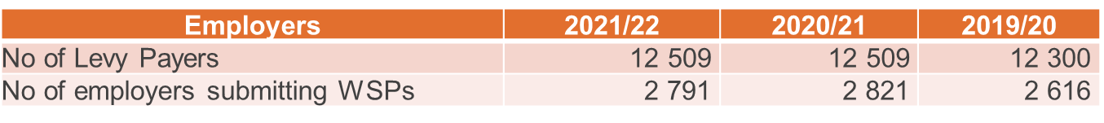
Mandatory Grants Expenditure
Employer grant expenditure
Employer grant expenditure went up by 72% compared to the prior year, which was hugely impacted by Covid-19 lockdown. The expenditure was however 2% below the budget.
The employer grant expenditure increased in the 2021/22 FY despite the to delay in submission of WSP/ATR as it was anticipated and some the employers moving from construction sphere.
The dwindling construction sector has a direct impact on the number of employees employed in the sector negatively impacting in the skills development levy contributions

Slide 36
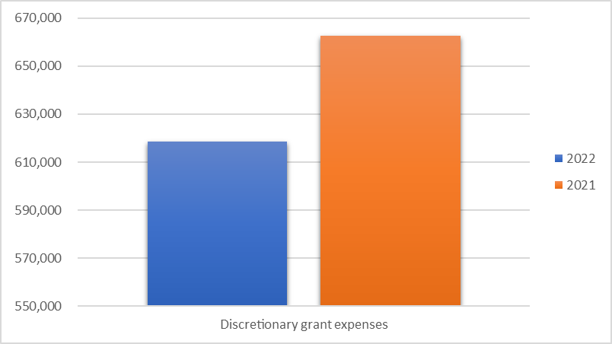
Discretionary Grants Expenditure
Year-on-year Discretionary Grant expenditure
The DG expenditure went down by R43.9 million representing a 7% reduction compared to the prior year
The discretionary grants expenditure for the 2020/21 was higher due the payment of stipends even though classes were suspended due to Covid-19 lockdown. Verification of DG claims resumed in the 2021/22 financial year

Slide 37
CETA EXPENDITURE VS. PERFORMANCE
AGAINST 2021/22 APP
Relationship between Expenditure and Performance
​The CETA spend for 2021/22 FY increase by 3% against its improved revenue at 42%
The above is underpinned by improvement in overall organisational performance by 182% to 62% from 22% in the previous year

Slide 38
UIFW AND ACTIONS TO ADDRESS
Irregular expenditure analysis and actions

Slide 39
UIFW AND ACTIONS TO ADDRESS
Fruitless and wasteful expenditure analysis and actions

Slide 40
2021/22 AGSA’S AUDIT OUTCOME AND ACTION PLAN

Slide 41
2021/22 AGSA’S AUDIT OUTCOMES
Audit Outcome and Background
The AGSA issued a Qualified audit opinion
The qualification was on the following area:
  Discretionary Grants Commitments disclosure note
  Matter disputed by ARC and AA as application and basis of Qualification not in line with Audit Standards
  Accounting treatment dispute still with the Accountant-General
  *Based on legacy awards which were treated in line with prevailing DHET issued SETA DG Grant Regulations guide
  Clean audit opinion on the same evidence was obtained and only in 2021/22, AG demanded SLAs
New Material Irregularity (MI) under assessment, from expenditure incurred and completed in 2020 FY
Even though no opinion was expressed on the performance information, the following observations were made by the AGSA with regards to Programme three:
  Challenges with supporting evidence retrieval
  Verification of learner IDs on the DHA system need to be undertaken

Slide 42
ACTION PLAN FOR 2021/22 AUDIT MATTERS
ACTION PLAN
AG Risk Unit is currently investigation conduct of the Audit Team who signed-off 2021/22 audit
Accountant-General to advise on the accounting treatment conclusion under dispute
Project management improvements to be implemented and tracked throughout the period, reported at Management EXCO, Audit Improvement team and to the ARC on quarterly basis
Digitisation of records and automation of key processes has been started to deal with documents retrievals
Engagement with SARS, and DHA for programme beneficiaries IDs verification to be undertaken by Q3
Monthly and Quarterly sign-offs by Managers of QPR achievements and shared folder in place to load supporting evidence for achievements claimed
CETA M&E to verifies and reports to Management EXCO monthly on performance tracking and needed improvements
Loss Control Committee considers and advise oversight Committees re: UIFW
Investigations into UIFW items to be completed by 30 November 2022, and recommendations implemented by 15 December 2022
Probity audits and probity advisory on all tenders estimated above R20 million, lowered to R5 million for 2022/23

Slide 43
Thank You
E-mail: cetagovernance@ceta.co.za
Tel: 011 265 5958

