Slide 1
Virtual Public Hearings on the AGRICULTURAL PRODUCTS STANDARDS AMENDMENT BILL [B15-2021] 1 November, 2022

Slide 2
Short history of SAOSO (The South African NOAM)
SAOSO was formed in 2009 and still functions as a voluntary association and recently registered as a not for profit company (NPC). SAOSO is the official organic sector body in South Africa
Our mandate by four government departments is to develop and promote the organic sector and its associated value chain in South Africa through the FRIDGE Study of 2008
SAOSO has been a member of IFOAM Organics International since 2016
SAOSO is the custodian of the South African Organic Sector Organisation (SAOSO) Standard for Organic Production And Processing – a standard included in the IFOAM family of standards in December, 2017 which went live in 2020 with certification services through Control Union.
In 2019, SAOSO became the country implementing partner of the Knowledge Hub for Organic Agriculture in Southern Africa (KHSA)

Slide 3
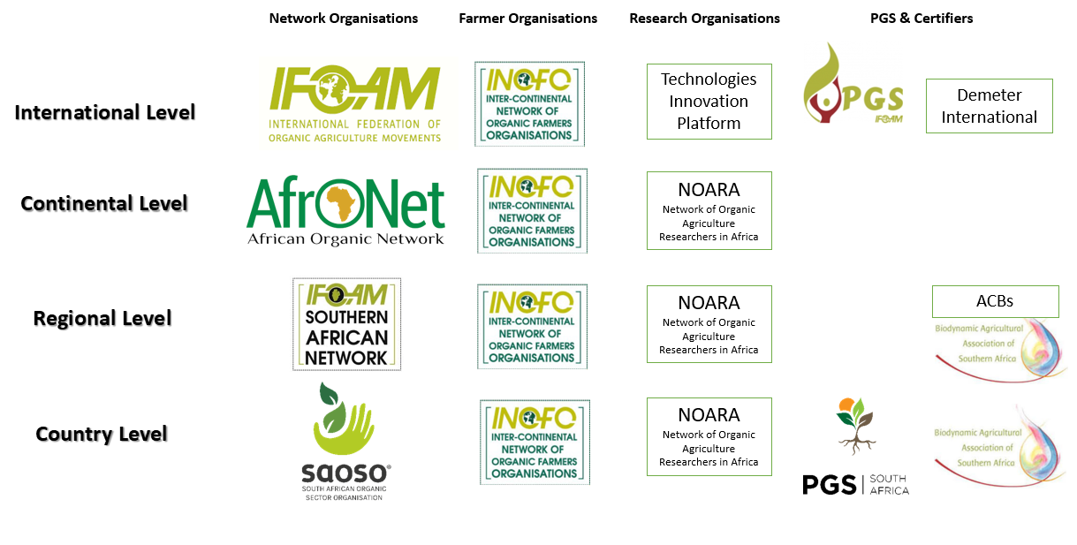
The Organic Movement

Slide 4
SAOSO is part of the IFOAM Family of Standards

Slide 5
What we do
SAOSO has five core objectives:
To develop a vibrant institution capacitated to respond efficiently and effectively to the needs of the diverse growing organic sector value chain
To establish a data base of relevant information, research and knowledge that will further the adoption of organic agriculture nationally
To address the production of organic food nationally and help advance producers’ access to market through the growth of the Participatory Guarantee Systems (PGS) and third-party certification to the SAOSO Standard for Organic Production and Processing
To develop strong networks diversifying the farmer base thus promoting cross pollination and the exchange of best practice – at a local, regional, national and international level
To promote and unite the organic agriculture sector through advocacy campaigns and lobbying efforts.

Slide 6
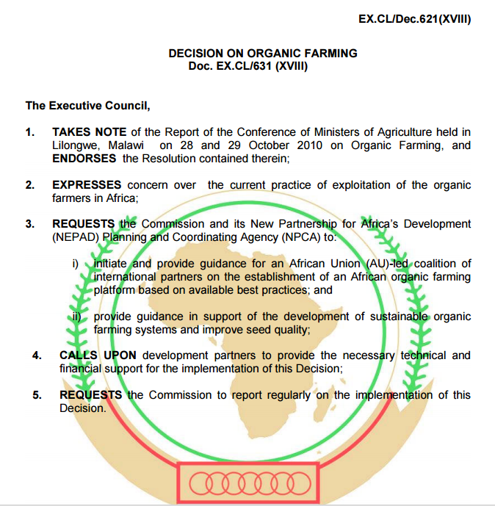
SAOSO’s work aligns with African Union’s Ecological Organic Agriculture (EOA) Initiative
The six inter-related pillars as expressed by the African Union’s Ecological Organic Agriculture strategic plan are the targeted focus for our work:
Research, training and extension
Information and communication
Value Chain and Market development
Networking and partnerships
Policy and Programme development
Institutional Capacity Development

Slide 7
SAOSO’s approach to achieving its objectives
Work hand in hand with Participatory Guarantee Systems South Africa (PGS SA) to encourage and support smallholder farmers entering the organic market
Promote the need for transparency, integrity, and ethics in the value chain, with producers aligned to the SAOSO Organic Standard for Production and Processing
SAOSO collaborates with organisations whose strategies are aligned. SAOSO aims to unite farmers, producers, retailers and consumers of organic products to collectively protect the future food freedom and natural ecology of South Africa

Slide 8
SAOSO’s Projects
Harmonisation of the SAOSO and SABS Standards to the latest version of the IFOAM norms and standards. Version 2 of the SAOSO Standard will see the inclusion of standards for wild harvesting, bee keeping and honey production, aquaculture and insect production.
SAOSO is the SA node of the Knowledge Hub for Organic Agriculture in South Africa. It is one of five hubs in Africa.
The focus of the programme has been the expansion of PGS in South Africa

Slide 9
Certification Landscape
First Party Claim - A verbal declaration is made by a farmer/producer directly to the consumer that their produce is produced in alignment with organic principles
Second Party Certification - The farmer/producer wants recognition that their production practices have been assessed by others and that they are in line with organic practices, processes and principles. The consumer wants assurance that the produce is grown organically. This is the realm of PGS.
Third Party Certification - Third-party certifi cation means that an independent organisation (typically referred to as an Accredited Certification Body or ACB or CB) has reviewed the production processes of a product and has independently verified that the final product complies with specific standards for safety, quality or performance.

Slide 10
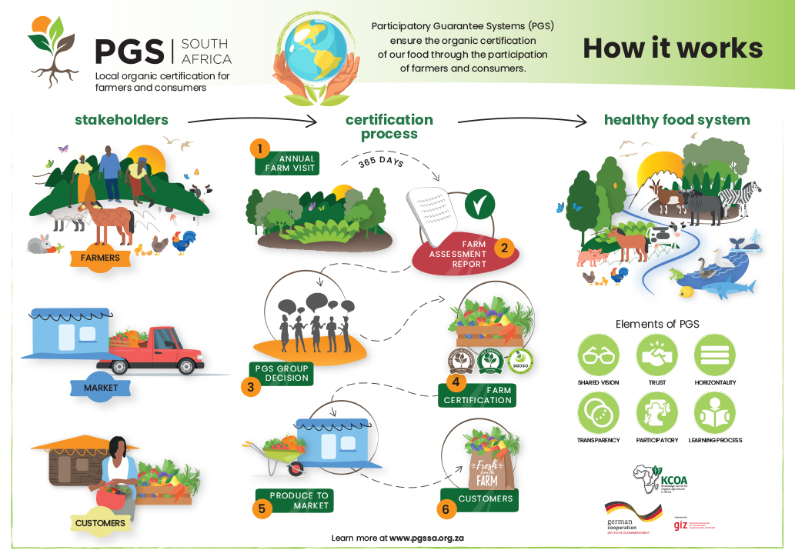

Slide 11
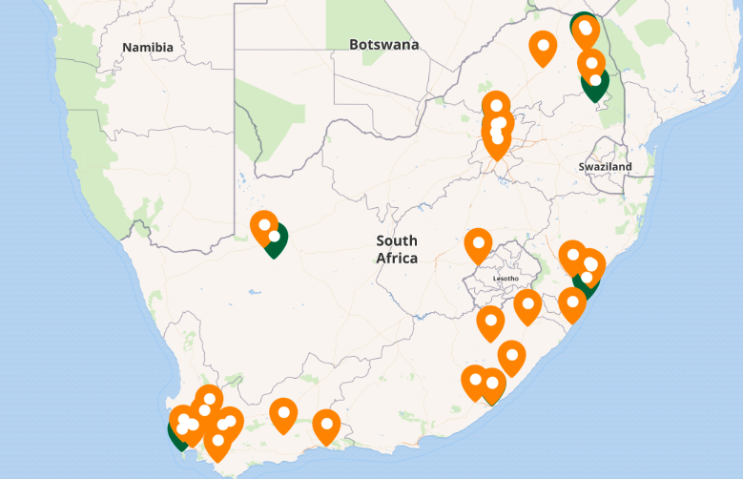
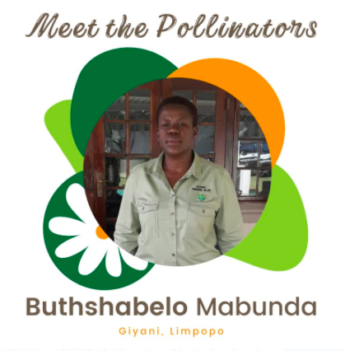
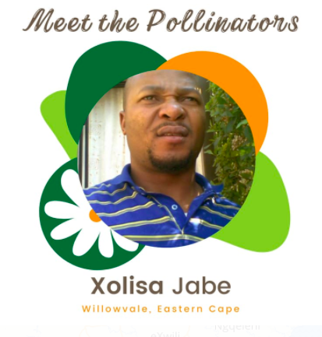
PGS Pollinators in South Africa
https://maphub.net/PGSSouthAfrica/eoa-pollinator-map

Slide 12
Other work that SAOSO has prioritised
Promoting the SAOSO certified logos and getting more producers certified to the SAOSO standard;
Setting up a trade desk to benefit producers and trade;
Developing the relationship with the Agricultural Research Council to further research around organic agriculture;
Working with ISAN to strengthen the network in Southern Africa;
Lobbying to allow for easier registration of organic inputs by the Registrar, Act 36;
Developing partnerships with like minded organisations to develop farmers who wish to farm organically.

Slide 13
SAOSO working in networks
SAOSO is the South African partner of the GIZ funded Knowledge Hub for Organic Agriculture
Is part of the Agroecology SA network – a coalition of civil society actors promoting alternatives in policy networks
Created the Agroecology Producers WhatsApp group of more than 150 farmers who share knowledge and information
Worked to establish the #Unpoison group which aims to stop the proliferation of harmful chemicals in SA. It consists of lawyers and academics positioned to support appeals to government to comply with pesticide policies
Is part of the IFOAM Southern African network

Slide 14
SAOSO Trademarked Organic Logos

Slide 15
PGS SA Organic Seals

Slide 16
Specific Comments on the Bill
Purpose and Background
1.2 Various deficiencies in the Act which necessitated the amendments were identified. A key deficiency was in the definition of management control system…when organic regulations were developed.
With reference to ‘organic regulations’ where do we stand? A document drafted in February, 2008 by the Department of Agriculture entitled AGRICULTURAL PRODUCT STANDARDS ACT, 1990 (ACT No. 119 OF 1990): REGULATIONS REGARDING CONTROL OVER THE SALE OF ORGANICALLY PRODUCED PRODUCTS IN THE REPUBLIC OF SOUTH AFRICA has never been passed. It is understood that these regulations were replaced by the SANS 1369: 2016 Organic Standard, which references Participatory Guarantee Systems under 3. Definitions

Slide 17
Specific Comments on the Bill
SABS SANS:1369 Extract on PGS
“3.18 participatory guarantee system/Participatory Guarantee Scheme/PGS
System among a group of smallholders who produce products for a local market, as follows:
the system shares a common objective with third-party certification systems that are run by accredited certification bodies by providing a credible guarantee to consumers who seek organic products;
PGSs are locally focused quality assurance systems that serve particular markets. They are built on a foundation of trust, social networks and knowledge exchange.
the system is especially adapted to local markets and short supply chains; and
NOTE PGSs enable the direct participation of producers, consumers and other stakeholders in the development and implementation of verification procedures and the review and decision process that is followed to recognize farmers as producers of organic food.
the system allows a much more intensive interaction between the farmer and the guarantee organization, and uses tools other than those that are used by third-party certification bodies to maintain integrity
NOTE 1: PGSs integrate capacity building and allow farmers and reviewers to help solve practical problems that will enable producers to comply with the standards.
NOTE 2: The direct involvement of farmers in the PGS process, and the fact that the process is owned by them and other stakeholders, encourage the farmers to take on more responsibility and results in their active involvement in the design of production and certification processes.”

Slide 18
Specific Comments on the Bill
Section 1 (a)
‘‘ ‘assignee’ means a person, undertaking, body, institution, association or board designated as such under section 2(3), which does not have direct or indirect interest in the product concerned’’
What is the definition of “indirect interest” Would other members of the PGS group be considered as having an indirect interest in the product?

Slide 19
Specific Comments on the Bill
Section 1 (b)
“ ‘audit’ means a systematic and functionally independent examination of the management control system in order to determine whether activities and related results comply with the claims associated with the product’’
Would the PGS audit process by other members of the PGS group be considered a “functionally independent examination”?

Slide 20
Specific Comments on the Bill
Section 1 (e)
“‘management control system’ means the [principles of procedure with regard to a product, from its primary production to its sale or export]” manner or method of production which may be claimed through the use of a name, word, expression, reference, particulars or indication in any manner, either by itself or in conjunction with any other verbal, written, printed, illustrated or visual material, in respect of the sale or export of a product;’’
PGS produce is labelled PGS Certified Organic or PGS organic in-conversion and it is generally recognised for the local market or short supply chains.

Slide 21
Specific Comments on the Bill
Section 2 (a)
‘‘The Minister may,…..
(i) designate as assignee a person, undertaking, body, institution, association, or board having a particular knowledge in respect of the product concerned; and
(ii) in addition to the designation referred to in subparagraph (i), designate as assignee one or more persons, undertakings, bodies, institutions, associations or boards having a particular knowledge in respect of the management control systems related to that product.’’
We ask that the Minister designate PGS South Africa as the body “having particular knowledge” and assign to them recognition as the knowledgeable body.

Slide 22
Email: info@pgssa.org.za
Web: www.pgssa.org.za
Email: info@saoso.org
Web: www.saoso.org

