Slide 1
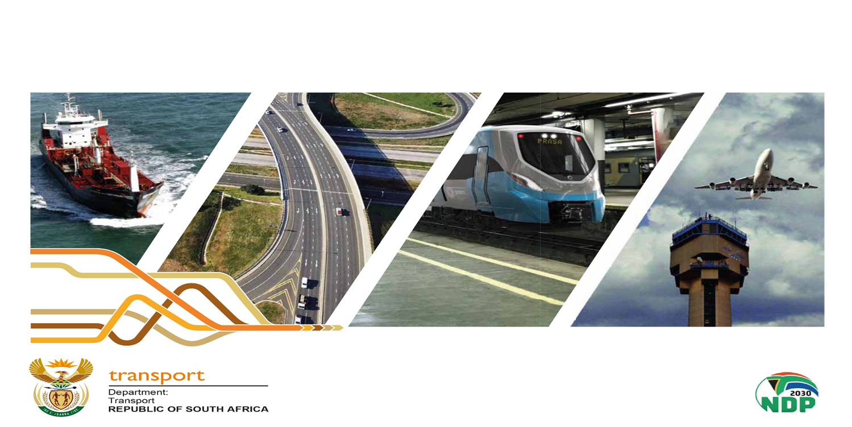
TRANSPORT APPEAL TRIBUNAL AMENDMENT BILL, 2020
PRESENTATION TO PORTFOLIO COMMITTEE ON THE RECEIVED COMMENTS AND RESPONSE BY THE DEPARTMENT OF TRANSPORT
01 NOVEMBER 2022

Slide 2
Contents
1. Background
2. Received comments & responses
3. Impact of clause 56 of the Rail Safety Bill on the TAT Amendment Bill
4. Conclusion

Slide 3
1. Background
The Amendment Bill was presented to PCOT on the 25 August 2021
Subsequently, the PCOT publicized the Amendment Bill for public comments with the closing date of 08 October 2021
On the 04 September 2021, the comments from the Western Cape Government – Ministry of Transport and Public Works - were received by the PCOT
On the 08 October 2021, the comments from the Gautrain Management Agency were received by the PCOT

Slide 4
1. Background (Cont…)
Furthermore, on the 07 December 2021, the PCOT considered the list of written submissions received
On 01 March 2022, the PCOT held a virtual meeting to deal with the received two (2) comments on the Amendment Bill
Consequently, the TAT Directorate responded to the received comments and forwarded its inputs to the DOT’s Legislation Directorate on the 04 July 2022

Slide 5
2. Received Comments and Department’s Response
Clause of Bill | Section of Act | Comments | Response
9 (GMA) | 16 | Our only substantive comment relates to clause 9 of the Amendment Bill, which empowers the Director-General to designate an officer of the Department of Transport to perform such investigation as the Tribunal may require, in order to decide on a matter. We recommend that the power of the Director-General, to so designate an officer of the Department of Transport, be subject to the natural rules of justice relating to management of conflict of interests and fair adjudication of disputes not being undermined by the involvement of a conflicted officer of the Department of Transport in a particular matter. | The Department disagrees with the proposal herein due to the following reasons: 1. The appointment of the designated officials to perform the work of the Tribunal by the Director-General is through the Public Service Act. It should be noted that the investigations that are contemplated are those required by the Tribunal, i.e. the TAT will still decide on whether investigations are required or not. Furthermore, the investigations and research are moreover to place the Tribunal in line with the developments in the Public Transport sector or industry. 2. Again, the Tribunal execute its mandate without fear, favour or prejudice as provided by Section 2 of the Act. No amount of interference is tolerated.

Slide 6
2. Received Comments and Department’s Response (Cont…)
Clause of Bill | Section of Act | Comments | Response
 |  | We, therefore, recommend that clause 9 be couched thus: “The Director-General must [, after consultation with the Tribunal,], subject to natural rules of justice, designate such officers in the Department of Transport as may be necessary to perform the administrative and secretarial work of the Tribunal and to perform any investigations required by the Tribunal that are necessary for, and prior to, taking its decisions. | 3. Therefore, no conflict of interest might arise as Tribunal officials provide supporting role and played no part in the adjudication processes. Agreed: it will be changed to – “ … by the Tribunal that are necessary for, and prior to, taking its decisions”. The Department will request the Parliamentary Law Adviser to make the change.

Slide 7
2. Received Comments and Department’s Response (Cont…)
Clause of Bill | Section of Act | Comments | Response
6 | 12 | We have also noted that, in the last line under clause 6, it will be more semantically correct to substitute the word “assuring” with the word “ensuring”. We, therefore, recommend accordingly. | Agreed: it will be changed to – “ensuring”. The Department will request the Parliamentary Law Adviser to make the change.

Slide 8
2. Received Comments and Department’s Response (Cont…)
Clause of Bill | Section of Act | Comments | Response
1 (WCMT) | 1 | The numbering of the sub-clauses in clause 1 is incorrect. Sub-clauses (g) to (m) flow incorrectly from sub-clause (a). Re-number sub-clauses (g) to (m) as sub-clauses (b) to (h). | Agreed: Sub-clause (a) will be followed by roman figures (i), (ii), (iii), (iv), (v), & (vi). Agreed: Sub-clause (g) to (m) to be changed to (b) to (h) respectively. The Department will request the Parliamentary Law Adviser to make the change

Slide 9
2. Received Comments and Department’s Response (Cont…)
Clause of Bill | Section of Act | Comments | Response
2(a) | 4 | “(1) The Tribunal consists of not more than nine, but not less than five members appointed by the Minister [after consultation with every member of the Executive Council in every province responsible for road transport matters]”. | The Department disagrees with the proposals herein and maintained its view of removing the consultation with the Executive Council in every province due to the following reasons: 1. It actually makes sense for the appointment of the Tribunal members not to include consultation of MECs because MECs are responsible for appointment of members of PREs while the Municipalities appoint members the MREs respectively. Separation of powers is thus maintained.

Slide 10
2. Received Comments and Department’s Response (Cont…)
Clause of Bill | Section of Act | Amendment | Purpose of amendment
 |  | The effect of the proposal in clause 2(a) of the Bill to remove the obligation of the Minister to consult MEC’s of each province will be to remove a critical layer of oversight by provincial stakeholders in the appointment process. This is not in line with the principles of oversight, transparency and cooperative government protected under the Constitution of the Republic of South Africa, 1996. | 2. Therefore, exclusion of the part dealing with the consultation of MECs will not only ensure independence of these structures but will also instill confidence to the public as the Tribunal is within the mandate of the National Government. 3. Further, the establishment of the NPTR by the Minister does not require consultation with MECs of each province as provided in section 20 of the National Land Transport Act, No. 5 of 2009 (NLTA), accordingly.

Slide 11
2. Received Comments and Department’s Response (Cont…)
Clause of Bill | Section of Act | Comments | Response
 |  | The following wording of clause 2(a) is proposed: “(1)(a) The Tribunal consists of not more than nine, but not less than five, members appointed by the Minister after consultation with every member of the Executive Council in every province responsible for road transport matters (b) The Minister may require members of the Executive Councils referred to in paragraph (a) to provide input on the appointment of members of the Tribunal within a specified time failing which the member of the Executive Council will be deemed not to have any input.” OR: | 4. Furthermore, during the nomination process, in terms of Section 3(a), (b) and (c) of the Act, the names of the nominees are Gazetted for public comments before being considered by the Minister. Simultaneously, the same Gazette is forwarded specifically to the offices of the HOD’s and MEC’s responsible for road transport matters for their attention and consideration in order to make comments, if any.

Slide 12
2. Received Comments and Department’s Response (Cont…)
Clause of Bill | Section of Act | Amendment | Purpose of amendment
 |  | “(1) The Tribunal consists of not more than five members appointed by the Minister after consultation with the Portfolio Committee responsible for transport matters.” | This process also compliments transparency and cooperative governance as protected under the Constitution.

Slide 13
2. Received Comments and Department’s Response (Cont…)
Clause of Bill | Section of Act | Comments | Response
3 | 7 | It is suggested that the word “consecutive” be inserted into clause 3 as follows: “(4)” Despite subsection (3), the Minister may, upon expiry of the term of office of a member of the Tribunal, extend the term of office of that member for a period not exceeding 12 consecutive months.” | Agreed: … consecutive months – to be inserted. The Department will request the Parliamentary Law Adviser to make the change

Slide 14
2. Received Comments and Department’s Response (Cont…)
Clause of Bill | Section of Act | Comments | Response
4 | 9 | It is suggested that section 9 (1) of the Act be retained. It is further suggested that clause 4 be amended by the insertion of a subsection (4) as follows: “(4) The Director-General, in consultation with the chairperson of the Tribunal, must determine the number of sittings of the Tribunal for the next financial year, the estimated number of hours per sitting and the estimated preparation time for sittings.” | The Department disagrees with this proposal herein due to the following reasons: 1. The administration of the Tribunal is through the Director-General, as provided in Section 16 of the Act. 2. The Tribunal has operational budget through the Department and it make financial sense for the Director-General to make financial decisions as the accounting officer of the Department.

Slide 15
2. Received Comments and Department’s Response (Cont…)
Clause of Bill | Section of Act | Comments | Response
 |  |  | 3. The Tribunal is not amongst the entities mentioned in the schedules under the Public Finance Management Act, No.1 of 2000, as it is housed / located within the Department. 4. Tribunal Secretariat receives the noted appeals on behalf of the Tribunal for processing.

Slide 16
2. Received Comments and Department’s Response (Cont…)
Clause of Bill | Section of Act | Comments | Response
 |  |  | 5. Tribunal members are appointed on a part-time basis and preside on the lodged appeals when invited by the Secretariat through working closely with the Office of the Chairperson or delegated member.

Slide 17
2. Received Comments and Department’s Response (Cont…)
Clause of Bill | Section of Act | Comments | Response
9 | 16 | It is strongly suggested that the requirement to consult the Tribunal be retained. | The Department disagrees with the proposal herein due to the following reasons: 1. The appointment of the designated officials to perform the work of the Tribunal by the Director-General is through the Public Service Act. It should be noted that the investigations that are contemplated are those required by the Tribunal, i.e. the TAT will still decide on whether investigations are required or not

Slide 18
2. Received Comments and Department’s Response (Cont…)
Clause of Bill | Section of Act | Comments | Response
 |  |  | Furthermore, the investigations and research are moreover to place the Tribunal in line with the developments in the Public Transport sector or industry. 2. Again, the Tribunal execute its mandate without fear, favour or prejudice as provided by Section 2 of the Act. No amount of interference is tolerated.

Slide 19
2. Received Comments and Department’s Response (Cont…)
Clause of Bill | Section of Act | Comments | Response
 |  |  | 3. Therefore, no conflict of interest might arise as Tribunal officials provide supporting role and played no part in the adjudication processes.

Slide 20
3. Impact of clause 56 of the Rail Safety (RS) Bill on the TAT Amendment Bill
The Memorandum on the Objects of the RS Bill provides as follows:
“Clauses 54 to 56 provide for an appeal mechanism against any decision by an employee of the Rail Safety Regulator (RSR) or made in the name of the RSR. The first level of appeal is to the CEO (in terms of clause 54), then to the Board or a Board appeals committee (in terms of clause 55) and ultimately to the Transport Appeal Tribunal (in terms of clause 56), established by section 3 of the Transport Appeal Tribunal Act, 1998 (Act No. 39 of 1998), which is to be amended by the Transport Appeal Tribunal Amendment Bill [B8–2020], which is currently being considered by Parliament.” (our emphasis)

Slide 21
4. Conclusion
To request PCOT to consider the responses made by the Department
PCOT to consider an emerging matter wrt clause 56 of the RS Bill
To process the Amendment Bill further in accordance with the procedure established in section 76 of the Constitution

Slide 22
The End
Thank You

