Slide 1
REQUEST FROM THE PORTFOLIO COMMITTEE ON SMALL BUSINESS DEVELOPMENT TO DISCUSS SOME OF THE RECENT DEVELOPMENTS IN THE CO-OPERATIVE BANKING ENVIRONMENT
Co-operative Banks Development Agency

Slide 2
CONTENTS
No. | Portfolio Committee Questions
1 | 2022/23 Cooperative Banking Institutions Indaba
2 | Cooperative Banking Sector Strategy
3 | Exclusion from participating in the Sefa Blended Finance
4 | Co-operatives Banks Act: Regulations in Terms of Section 86 clause 3.1
5 | Absence of a fully compliant and recognised Apex Body
6 | Status of the Cooperative Banks Act
7 | Any other latest development

Slide 3
2022/23 Cooperative Banking Institutions Indaba
Eastern Cape: 23 – 25 November 2022
Theme: “Role of the Cooperative Banking Sector in transforming the Financial Services Sector without limits in South Africa
* Access to financial infrastructure
* Support organisation for advocacy and training
Objective: To provide progress on work conducted towards implementation of the Cooperative Banking Strategy with the following pillars:
* Formation of a Secondary Cooperative Bank for scale
* Tiered licencing and proportional supervision
Notes:
Slide 7 OR 8

Slide 4
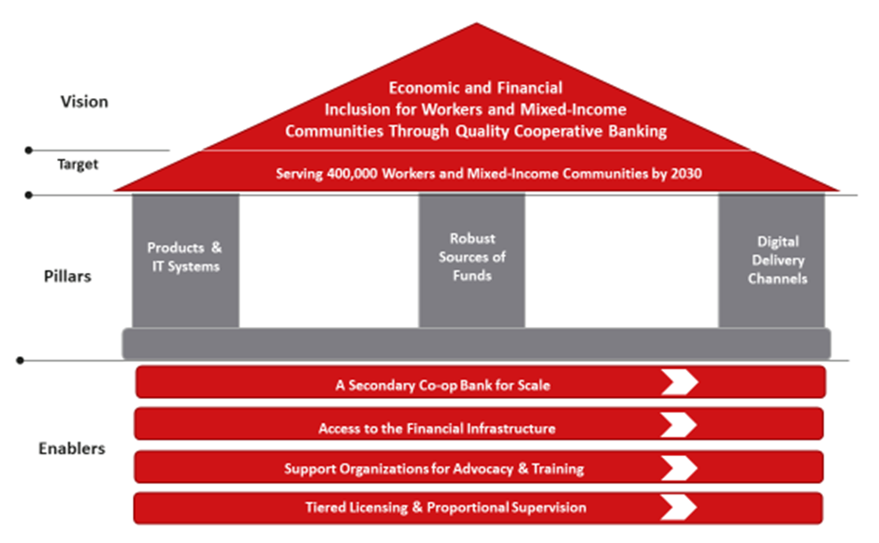
Cooperative Banking Sector Strategy-Sector led implementation

Slide 5
Exclusion from participating in the Sefa Blended Finance
CBI State of Readiness
Technology for reporting
Business case (loan product parameters)
Type of wholesale funding
Developmental
Concessionary (interest rate, deferred payments, sector specific loan products – farmers etc)
Possible stakeholders
Sefa
NEF
Regulators approval
CBDA – non financial support

Slide 6
Co-operatives Banks Act: Regulations in Terms of Section 86 clause 3.1
Co-operative Banks: Section 20 - Minister may issue Regulations
Co-operative Financial Institution (CFI): Section 44(b) - Prudential Authority
External credit is limited to maximum 15 per cent of total assets
Assets of a co-operative bank/CFI are primarily fixed assets (limited to 5% of total assets), loans (zero at start-up phase), retained earnings (zero at start-up), share capital etc.
Obstruct to assist with sustainability/growth
Quickest way vs Appropriate manner

Slide 7
Absence of a fully compliant and recognised Apex Body
Cooperative Banks Act makes no provision for registration of Apex bodies, within the cooperative banking space
Representative for CBIs registered - NACFISA
Representative deregistered for non-compliance
Support Organisation for CBIs registered – African Pioneers
2018
2022
2022

Slide 8
Status of the Cooperative Banks Act
Proposed amendments to the Co-operative Banks Act and the National Small Enterprise Act to enable the merger of SEDA/CBDA/SEFA will be finalised by mid-November as an attachment to the Business Model of the merged entity, for comments. The merger will take place by 31 December 2023.
After amending the Co-operative Banks Act, the Prudential Authority (SARB) will be the sole custodian of this Act. The financial and non-financial support of cooperative banking institutions will be “transferred” to the merged entity by amending the NSEA.

Slide 9
Any other latest development

Slide 10
THANK YOU
Questions and comments
www.treasury.gov.za/coopbank

