Slide 1
PORTFOLIO COMMITTEE ON TRANSPORT
Association for the Protection of Road Accident Victims (APRAV)
on cost saving proposals for the Road Accident Fund (RAF)
25 October 2022

Slide 2
OVERVIEW
OBJECTIVE OF THE PRESENTATION
APRAV
RAF IN NUMBERS
WHAT ARE THE KEY REALITIES?
HOW DID THE RAF GET INTO THIS POSITION?
3 COST SAVING EXAMPLES
POSSIBLE SOLUTIONS?
QUESTIONS

Slide 3
OBJECTIVES OF THE PRESENTATION
To share APRAV’s views on the current RAF realities
To make proposals on saving costs at the RAF (following a 3-year national RAF Solutions exercise)
To offer & provide any Industry support required to help make the RAF a Centre of Excellence again

Slide 4
APRAV
APRAV is a Human Rights Organisation that aims to protect the Constitutional rights of road crash victims
Formed in 2014
Prof Hennie Klopper lead a national RAF Solutions Initiative from 2018 to 2020 across 5 Task Teams: (a) Medical (b) Process (c) Settlement (d) RAF Act/Regulations (e) Financial

Slide 5
… key Constitutional Rights underpinned by the RAF Act
Section 9: Everyone is equal before the law
Section 10: Everyone has inherent dignity and must be respected & protected
Section 11: Everyone has the right to life
Section 12: Everyone has the right to bodily & psychological integrity
Section 24: Everyone has the right to an environment that is not harmful Section 27: Everyone has the right to have access to health care services
Section 33: Everyone has the right to administrative action that is lawful, reasonable & procedurally fair
Section 34: Everyone has the right to have any dispute resolved by a court
The RAF has a special & enhanced legal (Constitutional) duty, since it is ‘replacing the wrongdoer in any MVA on behalf of the State

Slide 6
Annual road crashes | 1 million | Internationally ranked 38th/40
Deaths per 100 000 vehicles | 134 | International norm: 7-14
Annual deaths | 14 000 to even 20 000 (5320 to 8000 pedestrians) | Source: Global Burden of Disease Study of 2015-2020
Injuries | 522 000 | 80% treated in state hospitals & 2 million indirectly affected
Serious injuries | 63 000
Number of pedestrians injured | 101 000
 |  | 68% from rural areas
Number of RAF claims p.a. | 92 000
Number of claims completed | 40 000 | ± 50 000 carried over every year
Number of claims outstanding | 305 000 to 400 000
Cost of MVA’s to fiscus | R34b p.a.
Cost of MVA’s to economy | R174b p.a. | 3,4% of GDP
Cost of MVA’s to average motorist | R4 800 p.a. or R400 p.m. | Aver of 25 000 kms p.a. & fuel consumption of 10 l/km
Cost to taxi owner | R19 000 p.a. or R1 600 p.m. | This cost is passed on to the commuter. Aver of 72 000 kms p.a. & fuel consumption of 7 km/l
Number of traffic officers | 18 000 | 100 000 required
Average claim in R | R138 000
% of claims > R500k | 5% | Whilst all the focus is on these claims
RAF IN NUMBERS
(Source: RAF Annual Reports as analysed by Prof. HB Klopper)

Slide 7
…the key statistics!
Our roads are the 3rd most dangerous in the world
The road death toll in SA is likely closer to 20 000 p/a & not 14 000 p/a
68% of all people affected by MVA’s are from rural areas
Only 44% of the annual RAF claims are completed
The total cost to the economy is Rb174 p/a & not the Rb34 Fuel Levy only
The country has only 18% of the Traffic Officers it requires

Slide 8
WHAT ARE THE KEY REALITIES?
Road safety impacts the liability of the RAF (need partnerships, i.e. Arrive Alive, RAF Buddy, etc.)
R3.3b Fuel Levy p/month is inadequate to service the current claim volume & costs
RAF only completing about 40 000 claims p.a. & escalating pool of outstanding claims
Escalating costs to determine the quantum of a claim (medical expert costs)
Escalating legal costs leaving matters uncontested and frivolous litigation (Auditor General; Medical Aids etc)
RAF ‘lost’ significant levels of expertise over the past 10 years
RAF is not optimally structured to deal with the work load or legal-administrative complexities
‘System’ has become dysfunctional - operational in-effective (i.e. HPCSA RAF 4 process)
Lack of a national & integrated strategy to focus on the underlying fundamental problems

Slide 9
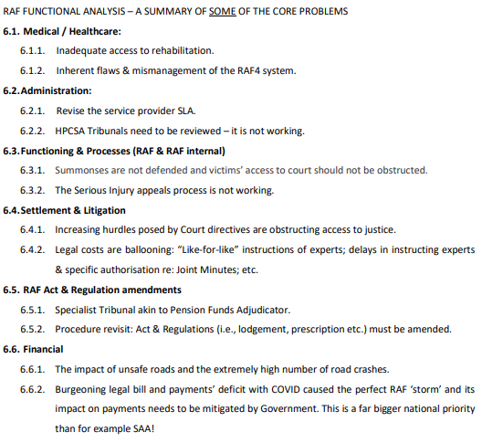
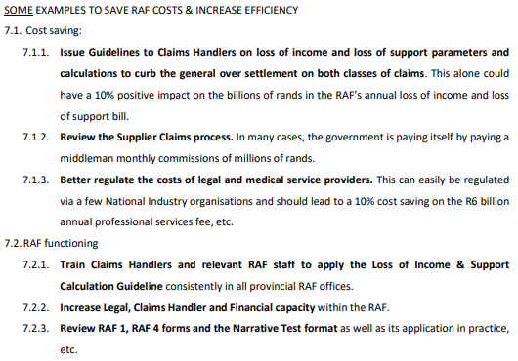
…underpinning analyses from the 5 Task Teams (only the tip of the iceberg of info)

Slide 10
HOW DID THE RAF GET INTO THIS POSITION? (short summery only)
RAF in 2022
RAF engaging in rule creation via litigation
Late payment interest of Rm237 p/a
Strong increase in Court cost findings
Overburden of High Courts
Uncontested claims by RAF (no panel of Attorneys & Experts)
Increase LOI settlement R (24%)
Backlog payments
(30 days to 180 days)
Unlawful ‘move’ to RABS
Unregulated cost of med. experts
Escalating legal cost - settle on the court steps
Non-adherence to the RAF Act from around 2012 by the RAF
RAF organisation didn’t adjust over time
(claim takes 55 months with 40 months waiting time)
Gradual eroding of pre-2008 RAF Excellence
Ever increasing road crashes

Slide 11
3 COST SAVING EXAMPLES
No RAF Attorneys & Medical Experts
RAF cancels panel of Attorneys & Medical Experts
Reportedly saving ± Rm180 p/m
Then COVID happened + no capacity was created quickly
Then, LOI claims start to over settle by about 24%.
Increase in payments of about Rm400 p/m
Net consequences is Rm400-Rm180=Rm220 increase in cost p/m
In October RAF issued Instruction that claims >R500k must now (again) appoint RAF Medical Experts
This is a step towards a solutions and can easily be aligned with an RAF Tribunal
Insurance as funding model for RAF
Opinion: National Insurance can replace the Fuel Levy as funding for RAF…
To match the current Fuel Levy: Cost will be ± R400 p/m p/road user + R1600 p/m for taxi owners
But Fuel Levy now is inadequate – need about 25% increase: Then the cost will be ± R500 p/m p/road user + R1920 p/m for taxi owners
But if the death toll is closer to 20 000 p/annum & not 14 000 another 30% increase will be required: Cost will be ± R650 p/m p/road user + R2 496 p/m for taxi owners
Conclusion: The Malamet Commission indicated in 1991 already, Insurance is too expensive & that lead to the creation of the Fuel Levy & RAF
Improve RAF functioning
Action 1: In house lawyers must properly evaluate claims as soon as they are received: Saving of ± Rm 220 p/m
Action 2: Improve Loss of Support Guidelines & effect more realistic settlements: Saving of Rm 100 p/m
Action 3: Get Professional medical bodies to better regulate experts' fees: Saving of Rm50 p/month
Action 5: Timeous & effective settlement of claims: Saving of Rm150 p/m in legal fees
Action 6: Timeous payment of accounts: Saving of Rm20 p/m on interest
A saving of ± Rm 500 p/month is doable by simply executing the RAF Act as intended

Slide 12
POSSIBLE SOLUTIONS?
RAF as a Centre of Excellence
(& all Constitutional Rights are still protected)
4. Consider 3rd Party Tribunal (based on CCMA + some adjustments)
More effective LOS settlements
Reduce unnecessary legal fees
Regulate Medical Expert fees
Strengthen Claims Handler capacity & competence
Contest claims effectively
Timeous settlement agreements
3. RAF to execute it’s legal mandate as per the RAF Act
2. Align RAF Act & RAF Regulations more effectively (some change needed)
1. Government to develop an integrated & cross-functional National Action Plan to make SA’s roads safer (& involve all stakeholders, including the Private Sector & the public)

Slide 13
QUESTIONS
This presentation is a very short summary of work done since 2014 and specifically 2018 to 2021 by the Solutions’ Task Teams. APRAV will gladly share our deep pool of factual analyses and solution’s research with the PCoT.
The RAF wheel needs not be reinvented, just improved
APRAV has no intention other than protect road user’s Constitutional rights & to assist to make the RAF a Centre of Excellence again.
Any questions?

