Slide 1
CSIR Annual Report 2021/22
Presentation to the
Parliamentary Portfolio Committee
on
Higher Education, Science and Innovation
Friday, 21 October 2022

Slide 2
Overview of the 2021/22 financial year
This year’s performance demonstrates a positive reflection of the decision to reposition the CSIR as an industry-focused institution.
The CSIR has achieved or exceeded more than 80% of its key performance indicators for the 2021/22 reporting year.
The work conducted has focused on achieving the balance of supporting the creation of a capable state, as well as contributing to industrial development in South Africa
The organisation maintained a continued long-standing unqualified audit status.
The CSIR has achieved a Level 1 B-BBEE rating, the best among public sector entities.
Transformation and increasing our science, engineering and technology (SET) base is a priority and we have seen encouraging progress in this area.
We continue to support youth employment through internships, and the YES and graduate-in-training programmes.
Our research programmes continue to be guided by various government strategies and frameworks and the South African Economic Reconstruction and Recovery Plan. This will remain high on the CSIR’s agenda.

Slide 3
Presentation outline
CSIR mandate and strategic focus
Key performance indicators
Human capital highlights
Financial sustainability and good governance
Research, development and innovation highlights

Slide 4
CSIR MANDATE AND STRATEGIC FOCUS

Slide 5
Our mandate
^{CSIR MANDATE}
“The objects of the CSIR are, through directed and particularly multidisciplinary research and technological innovation, to foster, in the national interest and in fields which in its opinion should receive preference, industrial and scientific development, either by itself or in co-operation with principals from the private or public sectors, and thereby to contribute to the improvement of the quality of life of the people of the Republic, and to perform any other functions that may be assigned to the CSIR by or under this Act.”
(Scientific Research Council Act, 1988 (Act 46 of 1988, amended by Act 27 of 2014)

Slide 6
Vision and mission
VISION
We are accelerators of socioeconomic prosperity in South Africa through leading innovation.
MISSION
Collaboratively innovate and localise technologies, while providing knowledge solutions for the inclusive and sustainable advancement of industry and society.

Slide 7
Our values
EXCELLENCE
We strive for excellence and quality in everything that we do. We always strive to deliver solutions that surpass the expectations of our stakeholders. We hold each other to the highest possible standard in research, development and innovation (RDI), as well as all other facets of CSIR business. We believe that excellence is a product of investing in the continuous development of our people, processes and ways of doing business.
PEOPLE-CENTRED
Our business is about touching the lives of people ─ our employees and business partners. We care about people. We respect each other’s diversity and conduct ourselves in a manner that upholds the dignity of every person. We believe in continuous personal development and encourage one another to seize opportunities for personal growth. We treat our stakeholders the way we like to be treated.
INTEGRITY
We act with integrity. We are honest and fair when dealing with one another and our business partners. We respect the trust that our colleagues and stakeholders place in us, and commit to ethical decision-making, delivery and governance.
COLLABORATION
We are keen to learn from one another and collaborate across the organisation and with external partners to ensure that our work has the best chance of innovating a better future for South Africans. We actively share our knowledge and expertise by design, formally and informally, so that we can realise large-scale impact.

Slide 8
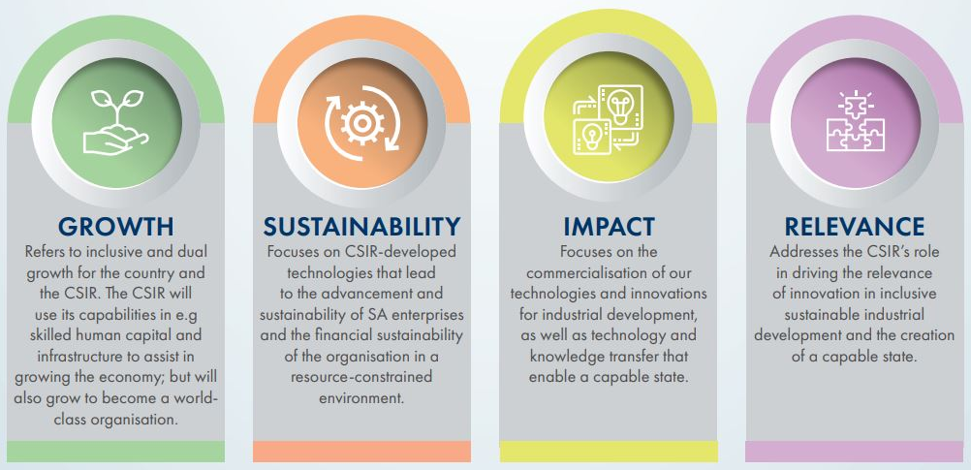
The CSIR strategic intent

Slide 9
Strategic objectives
Conduct research and development of transformative technologies
and accelerate their diffusion.
Improve the competitiveness of high-impact industries to support South Africa's re-industrialisation by collaboratively developing, localising and implementing technology.
Drive socioeconomic transformation through RDI that supports the development of a capable state.
Build and transform human capital and infrastructure.
Diversify income and maintain financial sustainability and good governance.

Slide 10
The pillars of the CSIR Strategy Positioned to drive South Africa’s industrialisation
Advanced Agri & Food
Innovate to strengthen primary production, agro-processing and advance rural economies
FUTURE PRODUCTION Chemicals
Establish state-of-the-art (bio)-chemistry to drive local pharmaceutical and the broader chemical industries
NextGen Health
Develop technologies to drive improved health outcomes and patient-centric healthcare delivery
Industry advancement clusters
FUTURE PRODUCTION Manufacturing
Strengthen the manufacturing value chain to enhance industry competitiveness
FUTURE PRODUCTION Mining
Support the growth and revitalisation of the mining industry
Defence and Security
Build resilient defence and security capabilities to strengthen national security technology capacity
SMART Places
Effect smarter resource use, sustainable economic growth and smart infrastructure and service developments
SMART Mobility
Enable South Africa to have an efficient, effective and integrated logistics sector
NextGen Enterprises and Institutions
Support the digitalisation of government, public institutions and private sectors
Industry and society enabling clusters
The clusters are technology industry convergences that represent the CSIR’s strategic focus.
They have been selected based on national priorities, potential for socioeconomic impact and the fourth industrial revolution.

Slide 11
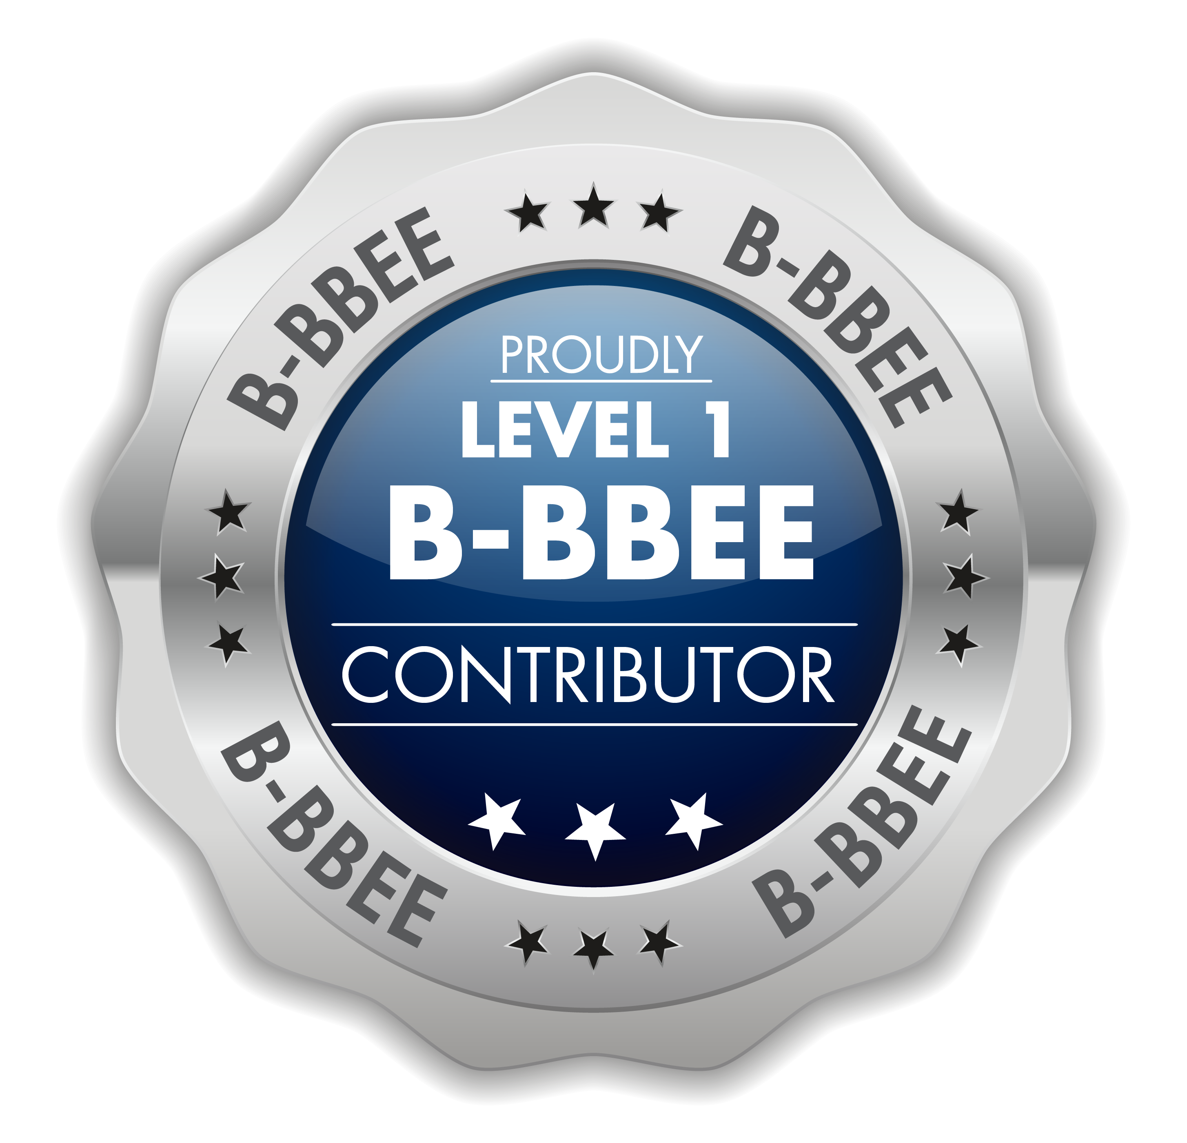
CSIR at a glance
Geographic profile
Pretoria; Johannesburg; Durban; Cape Town; and Stellenbosch
2 209
CSIR Total
Staff Base
1 644
Black South Africans
997
Female South Africans
1 551
Total SET base
1052
Black South Africans in SET base
CSIR Staff profile
607
Female South Africans in SET base
40
Employees
with disabilities
466
SET base with Master’s
318
SET base
with PhDs
99
SMMEs supported
31
Staff in exchange programmes
with industry
16
New patents
422.5
Publication
equivalents
55
Technology demonstrators
Our impact - output and outcomes
R2.65 billion
CSIR’s total income for 2021/22
Consecutive clean audit status

Slide 12
PERFORMANCE AGAINST SET TARGETS

Slide 13
KPI Performance Overview: 2019/20 – 2021/22
Priority Patents at 0%
Technology Demonstrators ↑ 49%
Licences ↑ 140%
Technologies Localised ↑ 100%
Joint Tech Agreements ↑ 9%
Capable State ↑ 28%
International Income ↑ 55%
Private Sector Income ↑ 32%
Ring-fenced grants ↑ 70%
PG ↓ 0.1%
Public Sector Income ↓ 24%
Total Income ↓ 4%
Publications ↓ 3%
SMMEs Supported ↓ 19%
Policies ↓ 8%
Standards ↓ 20%
Patents Granted ↓ 19%

Slide 14
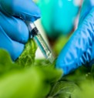
Conduct RDI of transformative technologies and accelerate their diffusion
60%
KPI | 2021/22 Target | 2021/22 Actual | Comments
KPI 1: Publication equivalents | 300 | 422.5 | Target exceeded
KPI 2: New priority patent applications filed | 9 | 7 | Target unachieved
KPI 3: New patents granted | 8 | 16 | Target exceeded
KPI 4: New technology demonstrators | 46 | 55 | Target exceeded
KPI 5: Number of technology licence agreements signed | 19 | 12 | Target unachieved
Plant-based recombinant protein expression system
CSIR researchers feature in this journal. Output published under publication equivalents

Slide 15
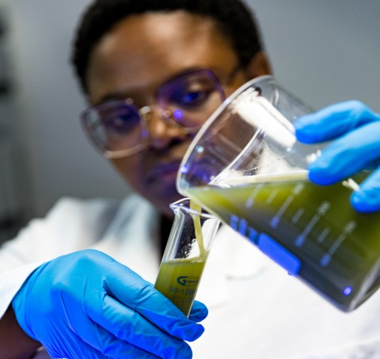
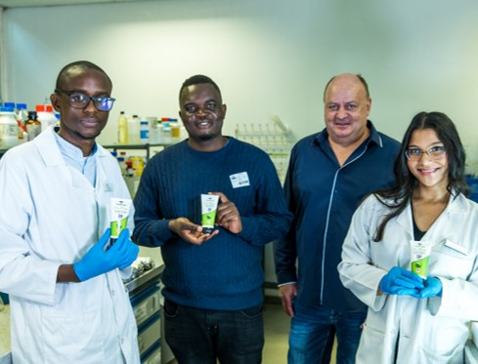
Collaboratively improve the competitiveness of high- impact industries to support SA’s re-industrialisation
100%
KPI | 2021/22 Target | 2021/22 Actual | Comments
KPI 6: Number of localised technologies | 11 | 14 | Target exceeded
KPI 7: Number of joint technology development agreements being implemented for industry | 22 | 25 | Target exceeded
KPI 8: Number of SMMEs supported | 75 | 99 | Target exceeded
Assisted an SMME to develop a shelf-stable vitamin-fortified natural okra beverage
South Africa’s Industrial Biocatalysis Hub has
started its operations at the CSIR.

Slide 16
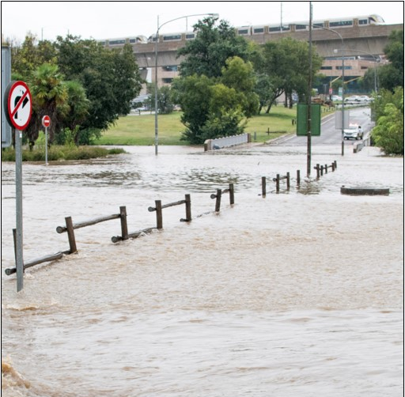
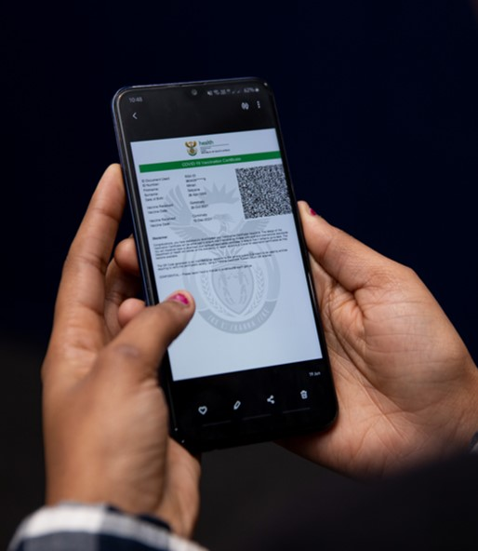
Drive socioeconomic transformation through RDI that supports the development of a capable state
100%
Key performance indicator | 2021/22 Target | 2021/22 Actual | Comments
KPI 9: Number of reports contributing to national policy development | 17 | 22 | Target exceeded
KPI 10: Number of standards delivered or contributed in support of the state | 9 | 8 | Target achieved within threshold
KPI 11: Number of projects implemented to increase the capability of the state | 40 | 86 | Target exceeded
Supporting South African metros to develop climate resilient cities
DoH and CSIR developed and implemented the country’s Covid-19
Vaccination Certificate System

Slide 17
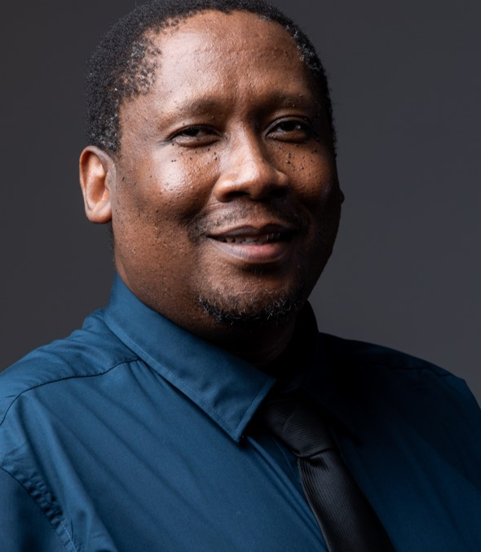
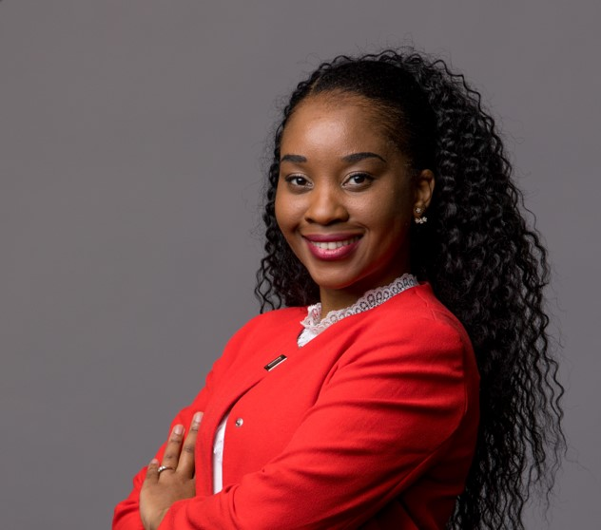
Build and transform human capital and infrastructure
75%
Key performance indicator | 2021/22 Target | 2021/22 Actual | Comments
KPI 12: Total SET staff | 1 497 | 1 551 | Target exceeded
KPI 13: Percentage of black SET staff | 66% | 67.8% | Target exceeded
KPI 14: Percentage of female SET staff | 37% | 39.1% | Target exceeded
KPI 15: Percentage of SET staff with a PhD | 23% | 20.5% | Target unachieved; however, there was an increased recruitment effort of senior executives and researchers towards the end of the FY
KPI 16: Total chief researchers | 17 | 15 | Target unachieved; a career ladder process has been concluded in Q4 to curb the regression
KPI 17: Percentage of black chief researchers | 17% | 13.3% | Target achieved
KPI 18: Percentage of female chief researchers | 24% | 13.3% | Target unachieved; a career ladder process has been concluded in Q4 to curb the regression
One of five newly appointed CSIR chief researchers
Increase in female SET staff

Slide 18
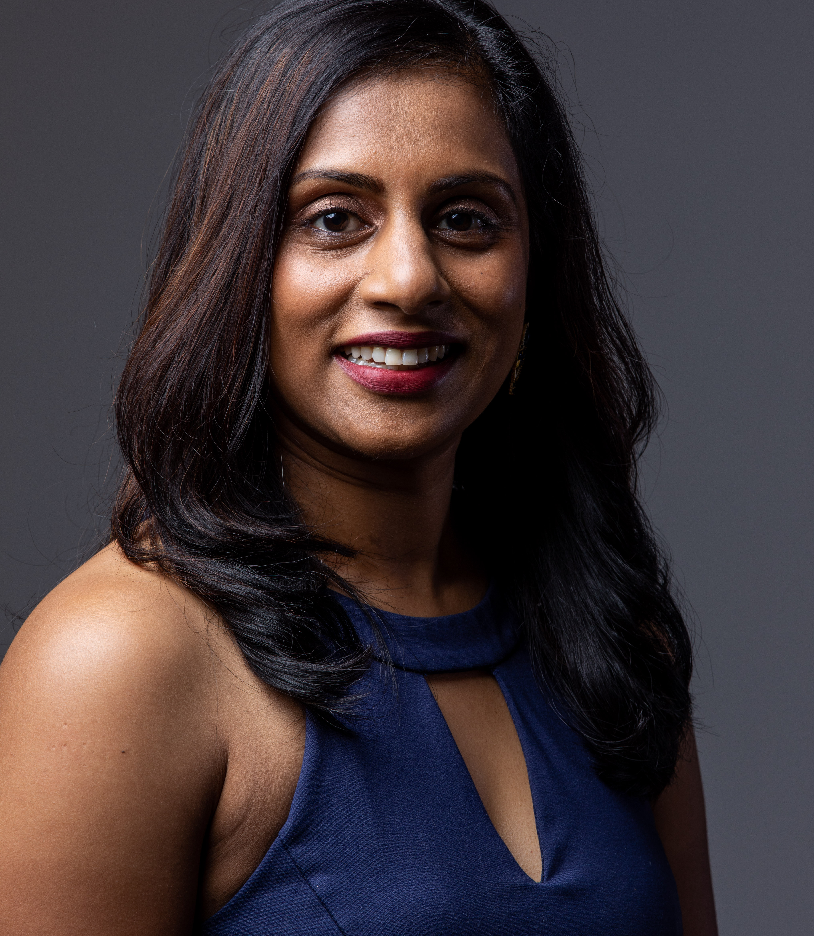
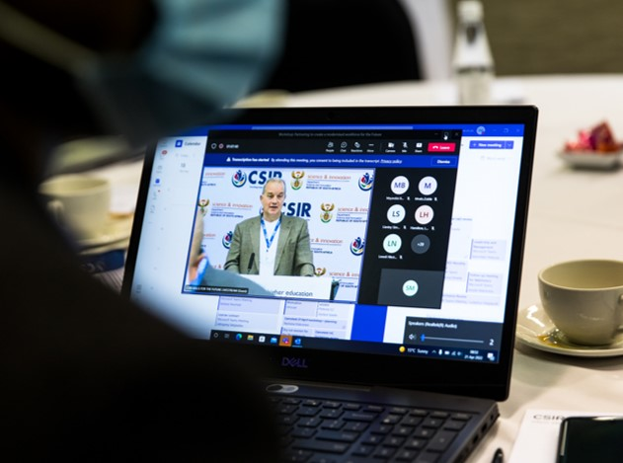
Build and transform human capital and infrastructure
Key performance indicator | 2021/22 Target | 2021/22 Actual | Comments
KPI 19: Total principal researchers | 193 | 188 | Target achieved
KPI 20: Percentage of black principal researchers | 35% | 34% | Target achieved
KPI 21: Percentage of female principal researchers | 22% | 19% | Target achieved
KPI 22: Number of exchange programmes with industry | 13 | 31 | Target exceeded
KPI 23: PPE Investment (Rm)* | 100 | 104 | Target exceeded
One of 28 newly appointed CSIR principal researchers
CSIR Learning Factory: Skills development and innovation in 4IR

Slide 19
Diversify income, maintain financial sustainability and good governance
87.5%
Key performance indicator | 2021/22 Target | 2021/22 Actual | Comments
KPI 24: Total income (Rm) | 2 869 | 2 654 | Target underachieved due to adverse economic conditions
KPI 25: Net profit (Rm) | -96.1 | 137 | Target exceeded
KPI 26: SA Public sector income (% Total Income) | 56% | 56% | Target achieved
KPI 27: SA Private sector income (% Total Income) | 9% | 9% | Target achieved
KPI 28: International contract income (% Total Income) | 6% | 8% | Target exceeded
KPI 29: B-BBEE Rating* | 2 | 1 | Target exceeded
KPI 30: Recordable incident rate* | 1,8 | 0,14 | Target exceeded
KPI 31: Audit opinion | Unqualified audit opinion | Unqualified audit opinion | Achieved
Maintained financial sustainability
Continued long-standing unqualified audit status

Slide 20
Performance against objectives
Strategic Objective | Description | 2021/22 Achieved (%) | 2020/21 Comparison (%)
SO1 | Conduct research, development and innovation of transformative technologies and accelerate their diffusion | 60 | 80
SO2 | Improve the competitiveness of high-impact industries to support South Africa’s re-industrialisation by collaboratively developing, localising and implementing technology | 100 | 66
SO3 | Drive the socioeconomic transformation through RD&I which supports the development of a capable state | 100 | 100
SO4 | Build and transform human capital and infrastructure | 75 | 83
SO5 | Diversify income, maintain financial sustainability and good governance | 87.5 | 75
Overall |  | 84.5 | 80.8

Slide 21
BUILD AND TRANSFORM HUMAN CAPITAL

Slide 22
Build and transform human capital
Strategic initiative
Focus and impact
Bursary programmes
Targeting undergraduate and postgraduate students to increase the pool of highly qualified individuals in STEM fields.
CSIR partnership with the DSI, NRF and SETAs.
488 students sponsored, with 153 at PhD level.
Graduates-in-Training programme
Holistic development of recent graduates to attain professional registration in their areas of expertise.
The programme had 17 new candidates appointed in March 2022.
A total number of 80 graduates have been supported since the inception of the programme in 2019/20, of which, 28 graduates have been appointed permanently in various clusters within the organisation.
Workplace-based learning programmes
Developed a Master Learning Factory to facilitate the development of skills through Work Integrated Learning, learnerships and candidacy, as well as influence the TVET Colleges curriculum in 4IR.
There are currently 86 interns supported within the CSIR and a total of 207 interns have been supported since the inception of the programme in 2018/19.
CSIR, DSI, DHET, NSF and SETAs partnership in advancing Skills of the Future through the Learning Factory.

Slide 23
Build and transform human capital
Strategic initiative
Focus and impact
YES initiative
Develop and impart skills, as well as create job opportunities for unemployed youth.
The CSIR was the first SOE to implement this programme.
The CSIR has 55 youths on board. The youths were placed at both the CSIR and its partnering SMMEs that are aligned with the organisation’s RD&I.
Since the inception of the programme in 2020, 145 unemployed youth have been supported by the CSIR.
Accelerated Researcher Development Programme
The CSIR regards its cohort of principal and chief researchers as an important indicator of the organisation’s capacity to fulfil its mandate and retain its status as a distinguished research organisation on the continent.
In 2021, the organisation welcomed the advancement of five new chief researchers (2 x black SA) and 28 principal researchers (17 x black SA, 10 x female SA).
Nine black South Africans are being supported for chief researcher under this programme.
Leadership and Management Development Programme
Training of junior, middle and senior leaders in key competencies that will assist the organisation to deliver on its strategy and values.
Leadership and management development programmes, formalised coaching and mentorship programmes have been introduced to support the efforts in talent management and succession planning rollouts.

Slide 24
FINANCIAL SUSTAINABILITY AND
GOOD GOVERNANCE

Slide 25
Financial sustainability
Financial performance
Financial performance
Income diversification remains a key objective for the CSIR
Income diversification is also expected to improve the CSIR’s profitability
Costs containment has been successful – Increase of 1.8%, well below inflation
Maintained financial sustainability
Improved liquidity and solvency
Increased margins on contract related income and yields on investment income
Challenges
Constraints imposed by national procurement legislation
Adverse economic climate and tight fiscal environment
Decline in national R&D investment
Cuts in Parliamentary Grant in nominal and real terms
Global geo political situation impacting on new opportunities

Slide 26
Good governance
Maintaining good governance, health and safety
Governance
Received a clean audit for the 2021/22 financial year
Achieved a Level 1 B-BBEE status against a Level 2 target driven by a combination of the YES programme, preferential procurement performance and optimised management of Enterprise Development
Continuously driving reduced irregular expenditure and eliminating fruitless and wasteful expenditure
Fully embedded CSIR Compliance function supporting ethics drive, fraud prevention and risk-based compliance assessment and mitigation support
Continued refinement of CSIR risk management practices aligned with best practice and within defined tolerances
Health and safety
Goal remains: zero harm, zero disabling injuries and zero fatalities
Achieved a recordable incident rate of < 0,14 through Safety Stand-downs, reinforcing the importance of safety in high-risk areas and implementation of structured SHEQ initiatives and communication
The CSIR is continuously monitoring its safety, health and environment risks and implementing appropriate response measures to address undesirable trends as and when identified

Slide 27
RESEARCH, DEVELOPMENT AND INNOVATION HIGHLIGHTS

Slide 28
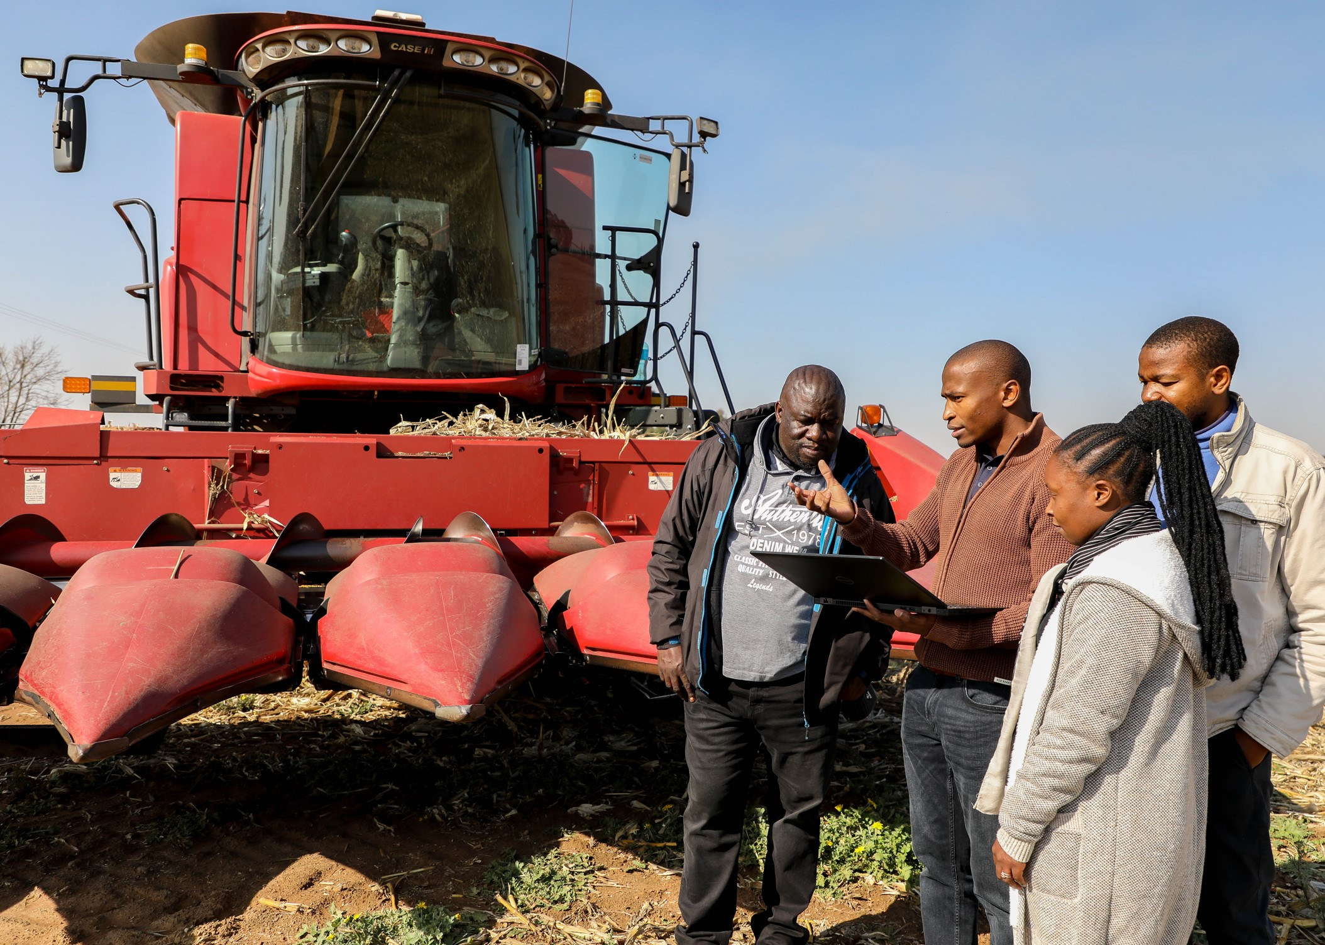
Conduct R&D of transformative technologies and accelerate their diffusion
Drone technology to support emerging farmers with precision farming
DESCRIPTION
Precision agriculture leverages capabilities in big data analytics, earth observation, internet of things and climate modelling to implement predictive tools that support precision agriculture.
OPPORTUNITY
The need to modernise and strengthen the agricultural sector, as well as improve global competitiveness; and
Harness advances in ICT and attain a digital advantage that will allow SA to participate effectively in 4IR.
2021/22 HIGHLIGHTS
The CSIR has partnered with FarmSol Holdings to digitally transform its maize farming extension services using unmanned aerial vehicles, satellite technologies and big data analytics.
The solutions under development will help emerging farmers with decision-making on crop health and growth.

Slide 29
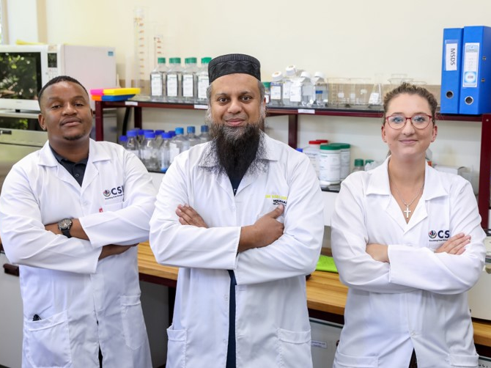
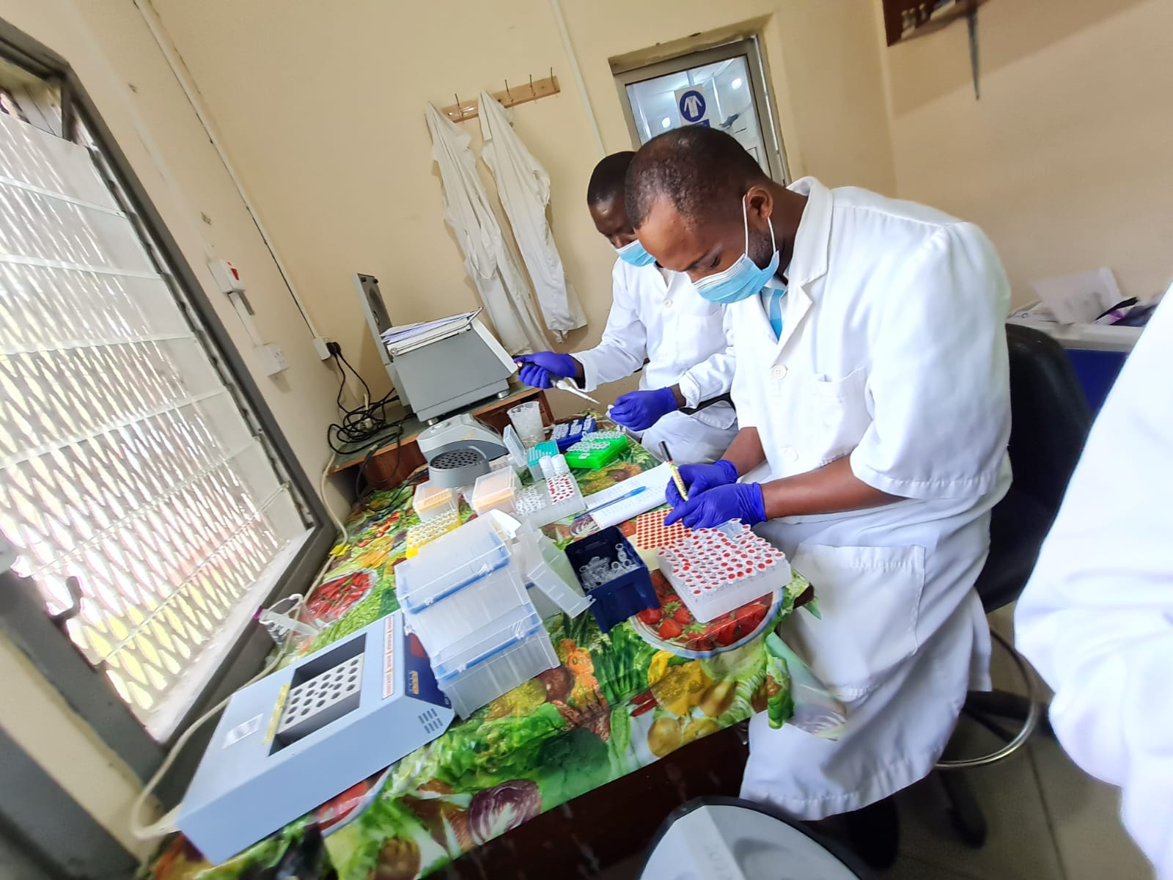
Research, development and innovation for and with the rest of Africa
New technology to detect viral diseases affecting the aquaculture industry
DESCRIPTION
Freshwater fish farming is an affordable and sustainable source of animal protein and a boost for the African economy. However, as production increases, the industry is affected by an escalating rate of diseases that cause economic and feedstock losses.
Two pathogens threaten the aquaculture freshwater fish farming industry in Africa.
OPPORTUNITY
The aquaculture industry – across the African continent – is set to benefit from novel diagnostic assays that are being developed by the CSIR to detect viral diseases caused by the infectious spleen and kidney necrosis virus and the tilapia lake virus.
2021/22 HIGHLIGHTS
The CSIR has collaborated with African counterparts for field trials of diagnostic assays and kits to detect pathogens that affect African aquaculture.
Field trials were expanded in several other countries to further demonstrate the technology for licensing and commercialisation.

Slide 30
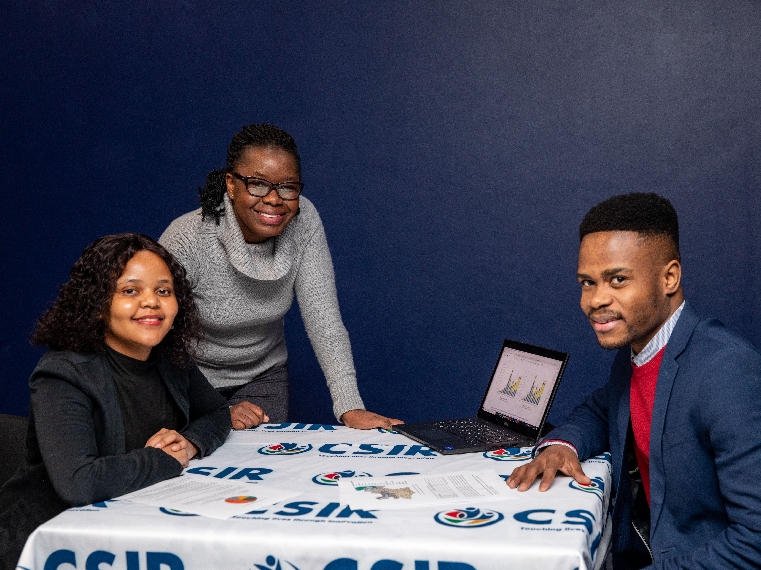
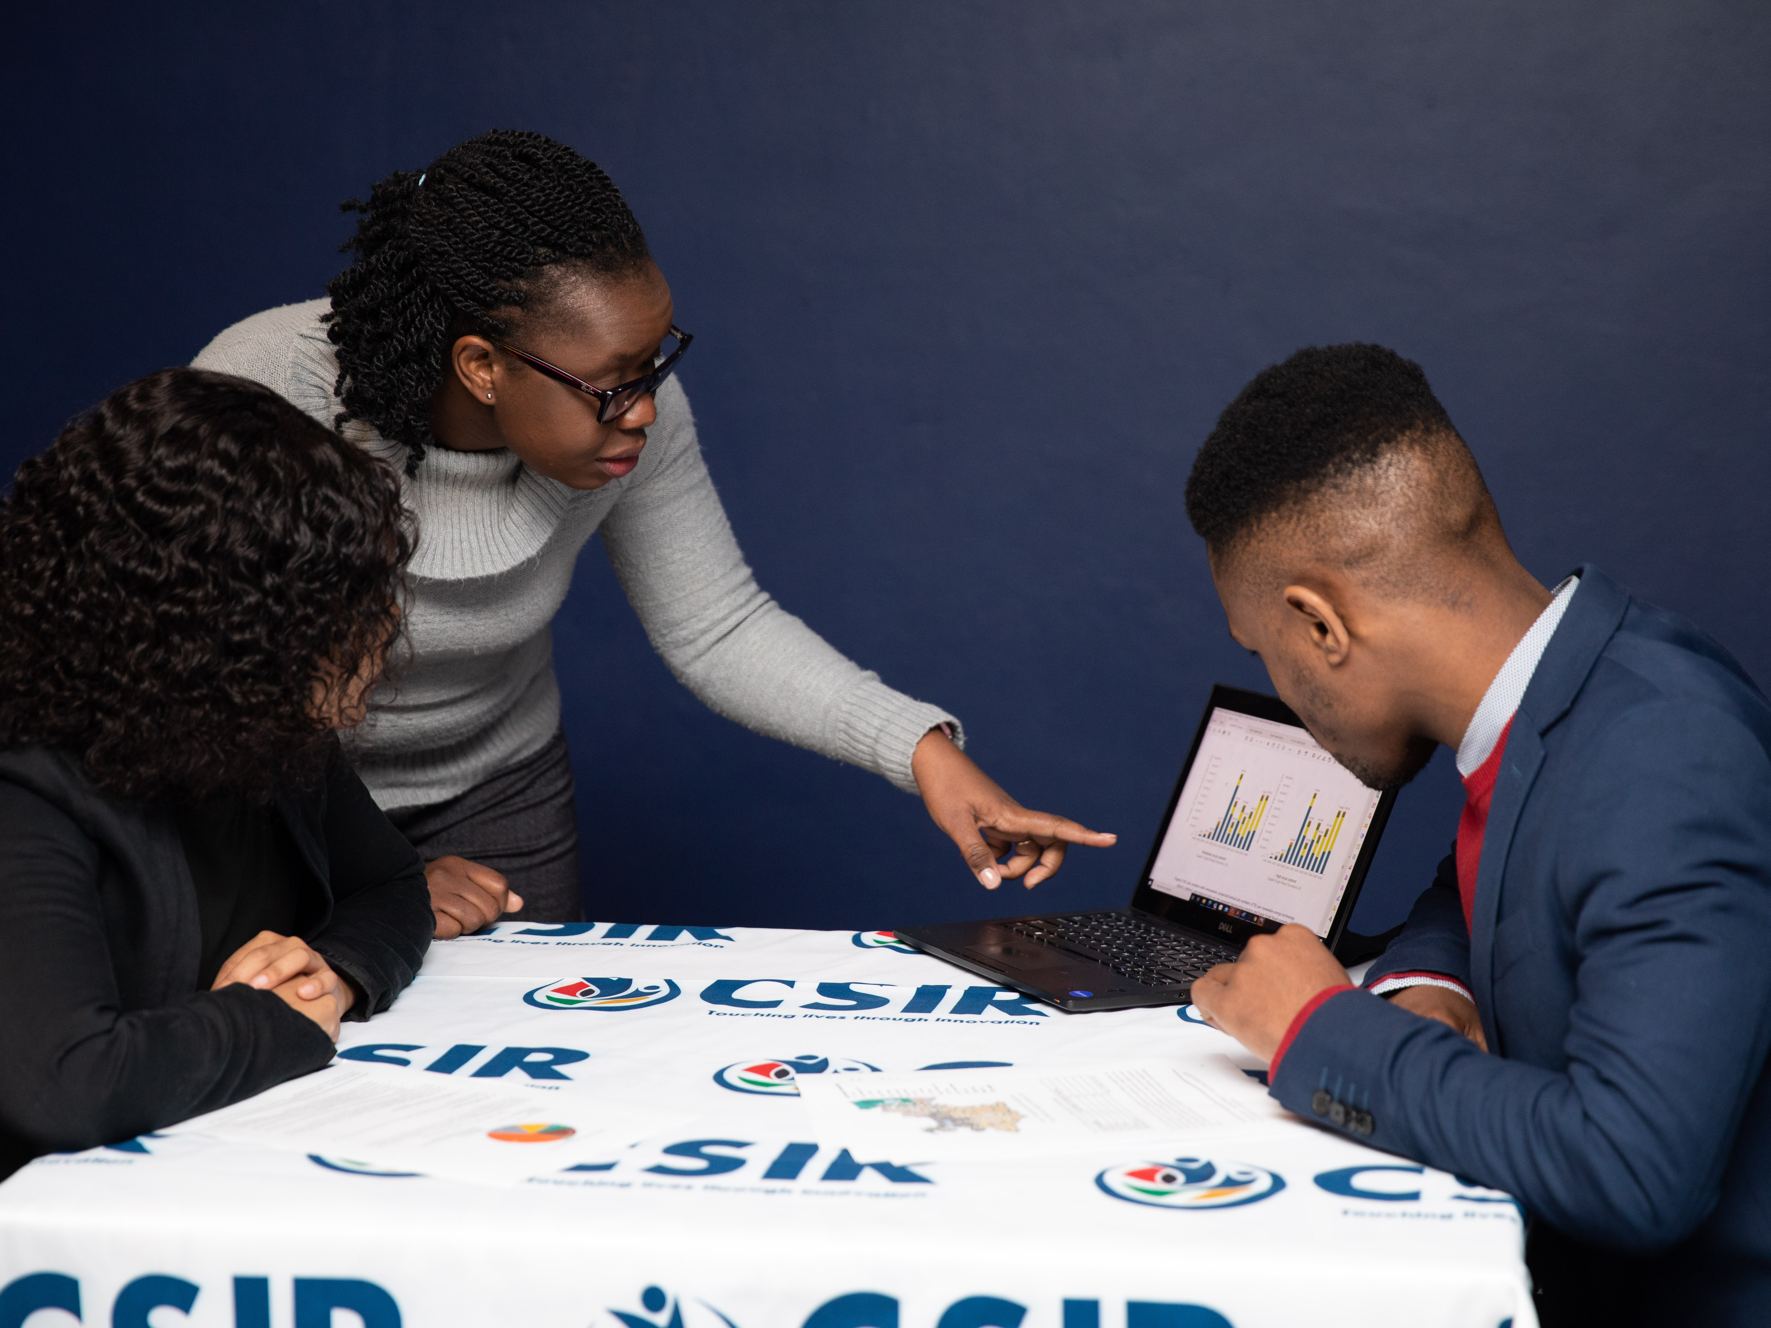
Build and transform human capital
Masterclasses for SMMEs in the field of energy
DESCRIPTION
The CSIR is implementing a programme aimed at empowering SMMEs ahead of South Africa's future energy technologies rollout.
OPPORTUNITY
The CSIR has also signed an agreement with the EWSETA to identify the skills requirement gap in the energy transition to renewable energy and provide specialised technical services to SMMEs in this field.
2021/22 HIGHLIGHTS
In the last year, 15 SMMEs benefitted from the collaboration between the Enterprise Development Programme of the South African Institute of Chartered Accountants and the CSIR to mentor entrepreneurs in the South African energy space.
As part of the collaboration, each SMME was paired with a CSIR technical expert, and numerous master classes and tailormade discussions were hosted to support them.
The CSIR has compiled a soon-to-be published handbook for SMMEs on renewable technology, in collaboration with EWSETA.

Slide 31
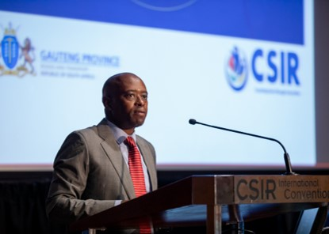
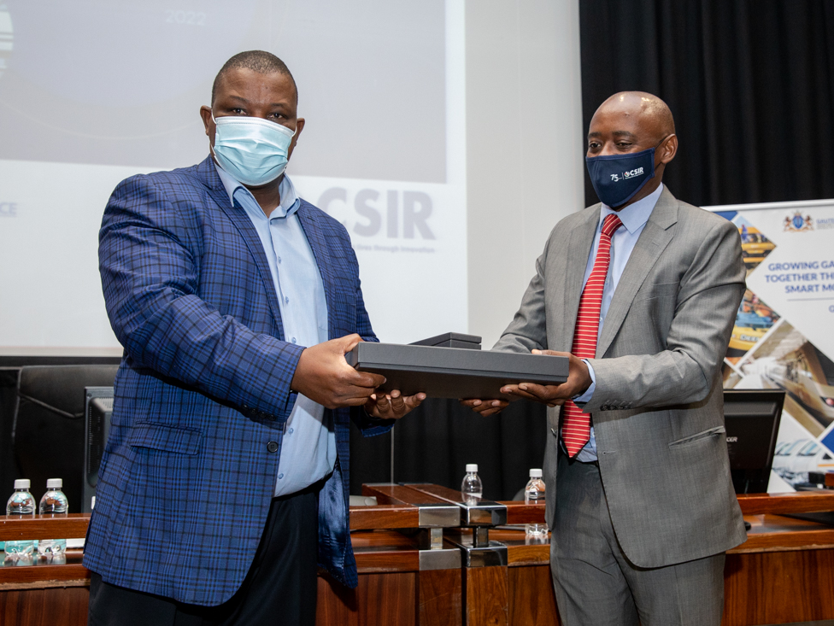
Drive socioeconomic transformation through RDI that supports the development of a capable state
Survey on Gauteng household travel patterns provides
valuable information to decision-makers
DESCRIPTION
The 2019/20 Gauteng household travel survey is a province-wide primary data collection project that is aimed at collecting and analysing information about household travel patterns. The 2019/20 survey was a collaborative project between the CSIR and the Gauteng Department of Roads and Transport.
OPPORTUNITY
Improved transport planning is important because transport continues to contribute significantly to the increased cost of living and, by extension, the cost of doing business in Gauteng.
The survey provides an improved understanding of the interaction between households and transport service delivery.
2021/22 HIGHLIGHTS
The survey found that about 60% of households spend more than the transport policy maximum of 10% of their income on public transport.

Slide 32
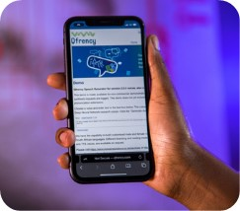
Conduct R&D of transformative technologies and accelerate their diffusion
CSIR-developed Qfrency text-to-speech technology released to the market
DESCRIPTION
The Qfrency text-to-speech technology consists of a text-to-speech engine and voices that enable a computer to create and reproduce synthesised speech from written text.
The text-to-speech voices can be used to read out text in South Africa’s 11 official language on a wide range of devices, such as cellphones, tablets and computers and on platform such as Windows, Android, iOS and MacOS and is suitable for use by industry, developers and individuals.
OPPORTUNITY
The current focus of commercialisation efforts is the business-to-business sector, specifically large-volume users such as call centres for telecommunications companies, adding speech channels to chat bots employed for self-service applications by large corporations, and adding speech modality to online learning platforms.
2021/22 HIGHLIGHTS
The CSIR signed a licence agreement with ReadSpeaker Holding BV, a global voice specialist, for the integration of South African languages text-to-speech into their offerings.
The new licence agreement will enable print-disabled and low literate users to access web-based content through text-to-speech technology.
The CSIR is engaging with major industry clients to sign up additional licencees.

Slide 33
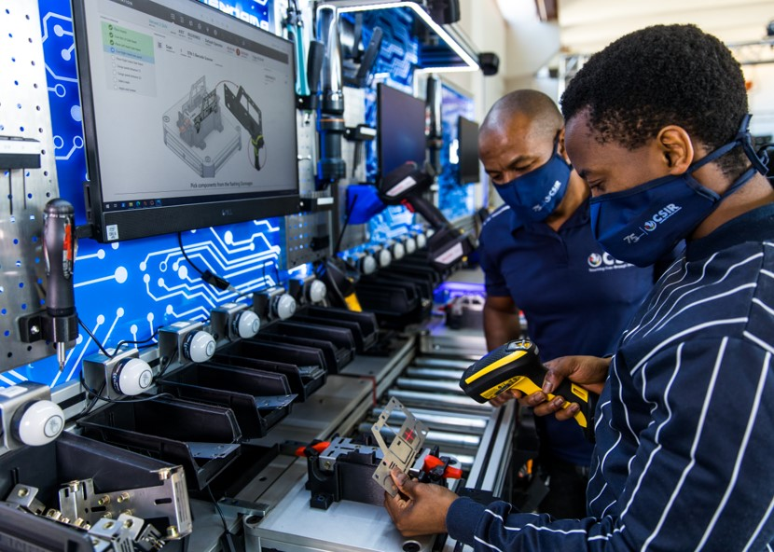
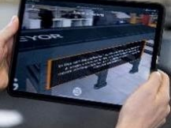
Investment in infrastructure
Learning factory established at the Eastcape Midlands Technical and Vocational Training College
DESCRIPTION
The Learning Factory is modular, customisable and mirrors an industrial operation; with appropriate, relevant curriculum.
Training is offered in various domains ─ e.g., augmented and virtual reality, digital twinning, robotics, human-centred automation, blockchain, artificial intelligence and digital transformation.
OPPORTUNITY
Infrastructure, skills development and technology adoption are still required for South Africa’s re-industrialisation and to reap the significant benefits of 4IR technologies.
2021/22 HIGHLIGHTS
The Eastern Cape became the first provincial site for a pilot learning factory.
The new learning factory is aimed at introducing students to the 4IR in their ecosystem.
The CSIR, in partnership with the merSETA, intends to establish more learning factories at TVET institutes around the country, with the target of at least two per province.

Slide 34
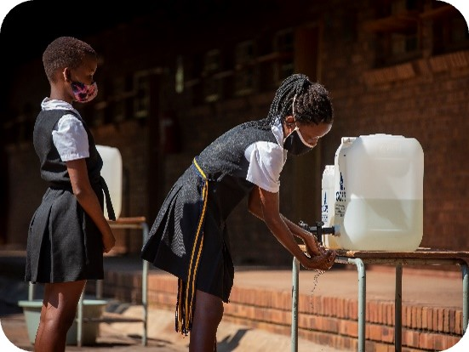
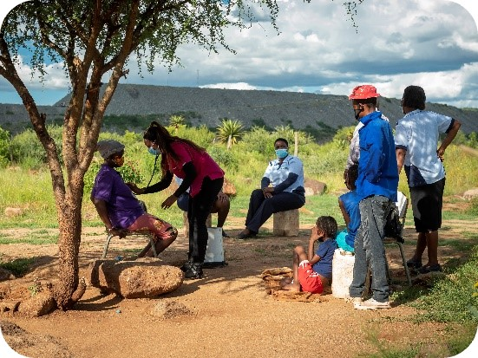
Impact Catalyst
Deliver socioeconomic change on a regional scale
DESCRIPTION
Establish inclusive, collaborative, cross-sectoral platforms, initiatives and partnerships to achieve systemic socioeconomic impact through public private partnerships.
The initiatives are designed to leverage collaboration for collective impact, be cross sectoral and selected for impact beyond the scale of individual participants.
OPPORTUNITY
The need for partnership between companies committed to socioeconomic change and government, to facilitate collaborative action through the implementation of initiatives for impact at scale; and
An open platform that invites participation by corporate South Africa and the public sector to build and execute socio-economic programmes in scope and scale that move the needle on the key local sustainable development challenges in South Africa.
2021/22 HIGHLIGHTS
The Impact Catalyst has partnered with more than 20 provincial partners to implement sustainable and scalable projects in five provinces.
Initiatives identified are strategically aligned with governmental strategy and resources.

Slide 35
Conclusion
Despite these huge gains and achievements, we have identified areas of improvement, which will receive focused attention in the current financial year. These include:
Ensuring that we have a strong pipeline of priority patent applications to support the growth in patents granted. More importantly, to ensure that we monetise the IP through licensing and other forms of commercialisation;
We are seeing improvements in terms of private sector contract R&D, however, the pace at which this is growing remains slow. Dedicated sector specific strategies for each cluster.
The growth and transformation of our principal and chief researcher pools remains a challenge. Despite the various initiatives we have put in place, progress is slow. As such, we have created a strategic fund to attract chief and principal researchers to the CSIR

Slide 36
THANK YOU

