Slide 1
Presentation to the Portfolio Committee on Higher Education, Science and Innovation
21 September 2022

Slide 2
Overview

Slide 3
TIA Act (No. 26 of 2008)
TIA established as an Agency to promote the development and exploitation, in the public interest, of discoveries, inventions, innovations and improvements.
TIA’s objective is to support the state in stimulating and intensifying technological innovation to improve economic growth and quality of life for all South Africans by developing and exploiting technological innovations.

Slide 4
VISION
Be a leading technology innovation agency that stimulates and supports technological innovation to improve the quality of life for all South Africans.
VALUES
Integrity
Innovation
Transparency
Excellence
Professionalism
Teamwork
MISSION
Facilitate the translation of South Africa’s knowledge resources into sustainable socio-economic opportunities.

Slide 5
Legislative Mandates
2020/21-2024/25 Medium-Term Strategic Framework goals:
Outcome 2: A long and healthy life for all South Africans.
Outcome 4: Decent employment through inclusive economic growth.
Outcome 5: A skilled and capable workforce to support an inclusive growth path.
Outcome 10: Protect and enhance our environmental assets and natural resources.
Economic Reconstruction and Recovery Plan
White Paper on Science, Technology and Innovation; Decadal Plan
Revitalising and modernising key sectors of the economy through improving economic competitiveness and productivity: agriculture, manufacturing and mining.
Leveraging off the circular economy and the digital economy as new sources of growth.
Innovation in support of health, specifically through the optimisation of health systems, improving the quality of healthcare and the digitisation of healthcare systems.
Energy sector innovation in support of decarbonising the economy.
Bio-economy Strategy
District Development Model

Slide 6
Organisational Performance

Slide 7
APP Output Performance
19/22 targets met (86%)
  7/9 support services targets met
  12/13 core mandate targets met
Significantly over-achieved against 4 targets:
  Products launched (37 vs. 22)
  Bio-based techs developed (36 vs. 15)
  Joint collaborations (34 vs. 15)
  Leveraged funds (R755.5m vs. R239m)

Slide 8
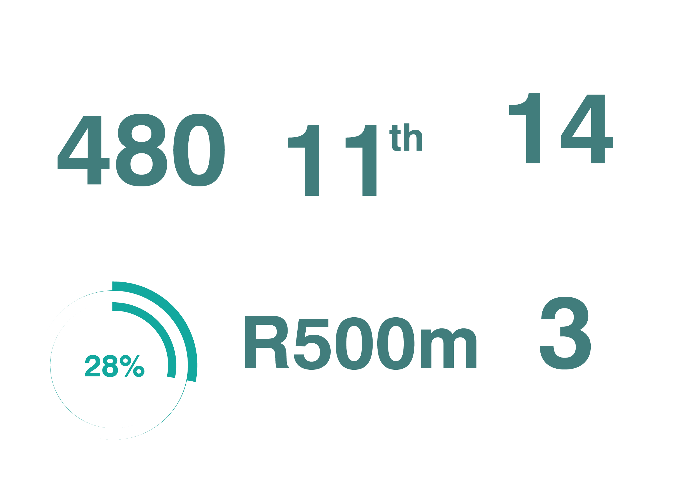
Highlights 2021/22

Slide 9


Distribution of beneficiaries
Publicly Funded IP
DSI target for TIA: 70% of budget to public-funded beneficiaries
2015-2020
2021/22

Slide 10


Distribution of beneficiaries (cont.)
62.9% Men
Gender
37.1% Women
62.2% Other
Youth
37.8% Youth

Slide 11
Outcome 1: Commercialised Innovations
Through this strategic thrust, TIA will intensify efforts to increase the rate of translation of locally developed technologies; exploit intellectual property from publicly funded institutions; ensure that these are commercialised in a manner that promotes economic growth and the competitiveness of industry; and respond to the imperatives of transformation and inclusive development.
Output Indicator | Target | Achieved | Deviation
Licensed or assigned technologies | 9 | 10 | +1
Collaborative projects involving industry or academia | 15 | 34 | +19
Successfully diffused technologies for inclusive development | 9 | 12 | +3
Products launched by start-ups or existing companies | 22 | 37 | +15
Leveraged funds | R239m | R746.5m | +R507.5m

Slide 12
Commercialisation Demographics

Slide 13
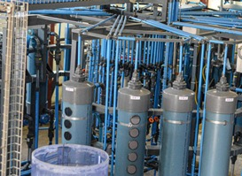
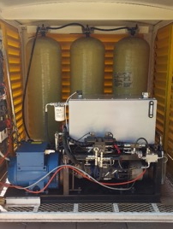
Output 1.1: Licensed or assigned technologies
Trailblazer
Leaper Innovate Green
Energies
KNeW tech treats
industrial effluent
and AMD.
Tech tested using tanker loads of mine water from mining operations as demonstrated interest in the tech.
License agreement with Nesafasi Water (100% black-owned) for pre-commercialisation of the tech via a demo plant to treat AMD drainage from several mines.
Compressed air energy storage system developed as an
alternative to other energy
storage technologies.
System has higher efficiency compared to batteries and a zero-carbon footprint, with water being the only by-product.
Technology licensed to Essential Water and Energy Services.

Slide 14

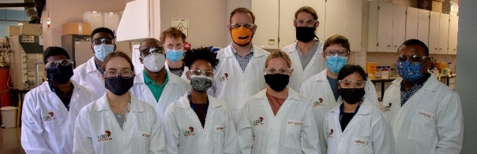
Output 1.2: Joint Collaboration with Industry
H3D and J&J
Jobox
Drug Discovery and Development Centre (H3D) pioneers drug discovery research through discovering novel medicines for diseases affecting African populations (malaria, TB, antibiotic-resistant microbial diseases).
Partnership with J&J to establish Satellite Centre for Global Health Discovery (R84m/5yrs) to fast track discovery and development of new antibiotics to limit anti-microbial resistance.
Jobox provides employers with access to the vetted, diverse and affordable talent, students with work experience opportunities.
Licensing agreement to UKZN for wide adoption of Jobox platform.

Slide 15
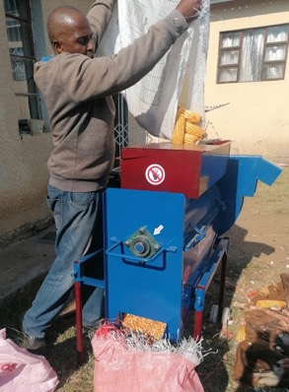

Output 1.3: Diffused Technologies
FibrePoynt KasiPoynt
Network
Nixtamalization
of Maize
FibrePoynt enabled the creation and incubation of a black-owned spin-off ISP to roll out KasiPoynt in a community, providing internet coverage to 120 homes.
Last mile connectivity- Jcaps.
Rolled out in 7 townships, expanding to a further 6.
7 jobs (mostly
black youth).
Entails the
removal of
toxins from
corn.
641 EC farmers
received training.
Threshing machines distributed to separate grain crops into grain/seeds and straw.

Slide 16
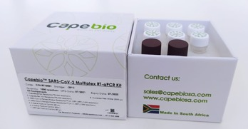

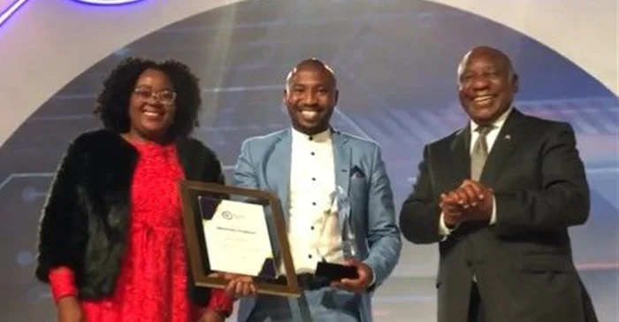
Output 1.4: Products Launched
CapeBio COVID-19
Test Kit
Hyrax Bioscience Exatype
Software Platform
SAHPRA granted
market
authorisation to
CapeBio to commercialise a COVID-19 PCR test kit.
Black Industrialists Excellence Award in the category 'Best Innovation & Technology’ to Daniel Ndima of CapeBio Technologies.
Hyrax Bioscience, a UWC spin-
out, has developed the Exatype
software platform which
enabled the scale-up of genomic
surveillance that led to the detection
of Omicron.
Platform automates the process of characterising variants through its capacity to analyse thousands of viral DNA sequences simultaneously.
Exatype used by African labs to analyse
>25 000 Sars-CoV-2 genomes.

Slide 17
Outcome 2: Delivering on the Bio-economy Strategy
Through this focus area, TIA’s efforts will be directed towards creating new bio-based products and processes and promote the creation of new enterprises that will ultimately lead to job creation.
Output Indicator | Target | Achieved | Deviation
Successfully demonstrated bio-based technologies | 15 | 36 | +21
Operational & functional Technology Platforms | 8 | 8 | 0
New Technology Platforms established in targeted regions | 1 | 1 | 0
Operational & functional Technology innovation Clusters | 8 | 7 | -1

Slide 18
Bio-economy Demographics

Slide 19

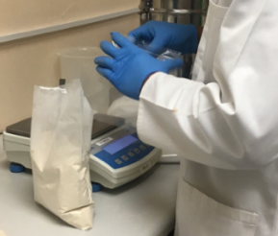
Output 2.1: Bio-based Technologies demonstrated
High-quality bromelain
made by Enzyme
Technologies
High-quality bromelain
enzyme is a complex
mixture of protease
enzymes.
Product is isolated and beneficiated from pineapple stems (agricultural waste).
Pharma grade bromelain developed to customer spec. in partnership with Gamwave.
Aims to manufacture botanical extracts, complementary medicines and food and beverage products.
Khepri Innovation
demonstrates new products
Bioconversion platform
developed using mass-
produced Diptera insect
species as a livestock feed
input.
Fish bait product developed
from waste insect meal as alternative fish bait for carp, cat fish, bream, tilapia and bass.
Illustrates successful beneficiation of organic waste of various sources into usable products.

Slide 20
Technology Platforms Programme
A network of 8 Technology Platforms providing access to cutting-edge biotech R&D capabilities
Agreement with J&J to establish H3D as a Global Public Health Discovery Center, focusing on antimicrobial/drug resistance research. Important for TB and HIV/AIDS treatment.
Tech transfer from Universiti Teknologi Malaysia to Sawubona Mycelium to enable the company to increase yields of commercially important bioactives harvested from mushrooms.

Slide 21

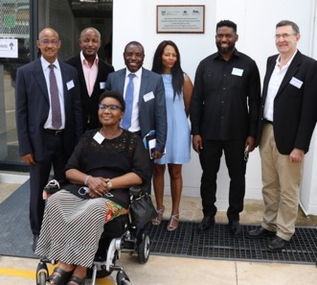
Technology Innovation Cluster Programme
Highlights
API+ Cluster was launched at CPT Pharma in collaboration with the DSI, NWU and industry partners. The Cluster aims to promote technology development and the commercialisation of Active Pharmaceutical Ingredients (APIs) used to manufacture medicines for human health, thereby decreasing the reliance on imports.
US$150k (R2.2m) funding secured for malaria drug process optimisation at CPT Pharma from Bill and Melinda Gates Foundation; partnership with Medicines for Malaria Venture.

Slide 22
Outcome 3: SMMEs Supported through Tech Stations
TIA aims to foster an enabling environment for innovation, with a specific focus on driving transformation and ensuring inclusion through the provision of science, engineering and technology and enterprise development services.
Output Indicator | Target | Achieved | Deviation
Technology Stations managed & supported | 18 | 18 | 0
New centres established & supported | 0 | 3 | +3
SET support provided to SMMEs | 3,500 | 3,167 | -333
HCD (postgrad students & post-docs) | 95 | 96 | +1
Knowledge & innovation products | 130 | 179 | +49

Slide 23
Innovation Enabling Demographics

Slide 24

Seed Fund
2021/22
82 projects supported (67% from HEIs and SCs, 33% from SMMEs).
28% are women-based projects and 23% are youth-based.
~R7m in co-funding leveraged from implementing partners.
64 knowledge innovation products produced (prototypes, IP, technology demonstrations).
Project example
Ithaka – a digital health platform of Aviro Health that
automates remote interactions between health care
workers and patients with chronic diseases remotely.
R16m in pre-series A funding raised to improve and
expand the Aviro Pocket Clinic.

Slide 25
Technology Stations Programme
443 SMMEs and 2,707 entrepreneurs and innovators supported (3,150 total).
Competitiveness improvements:
  541 products and protypes developed.
  49 enterprise solutions (product, processes or services) taken up in the market via new/maintained contracts resulting in retention/creation of jobs.
  1,249 tests or analysis performed for compliance to market standards or specifications.
Textile Hub established in partnership with Gauteng Dept of Economic Development (~R30m/5yrs).
i-GYM established at CUT for employees, students, learners, SMEs and community for ideation and prototyping.

Slide 26
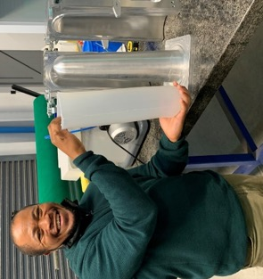
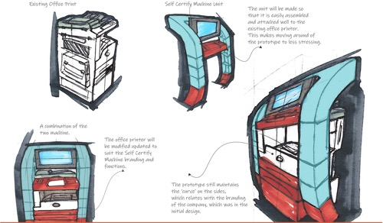
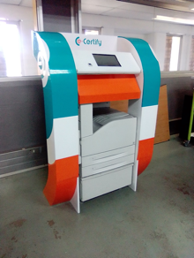
TSP Project Examples
Self-Service Document Certifying Machine
  e-Certify
    Prototype developed to verify, certify and use biometrics scans to authenticate documents.
    Aims to alleviate long queues at government institutions; reduce risk of document theft and fraud.
Silicone Prosthetic
Liner for Limb
Amputees
  Prosthetic
  Engineering
  Technologies
    Prosthetic liners
    improve amputee
    safety and comfort
    – cushioning between residual limb and prosthetic socket.
    The innovator, Luvuyo Sume, uses a prosthetic and was frustrated by range and price of imported silicone prosthetic liners.
    Prototype tool designed and made to manufacturing silicone prosthetic liners.

Slide 27
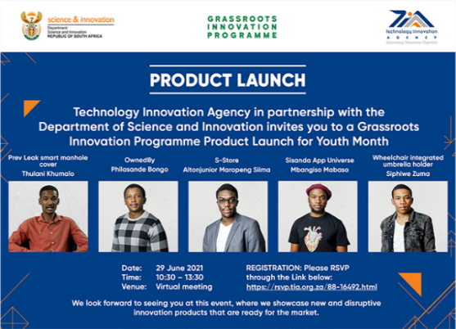
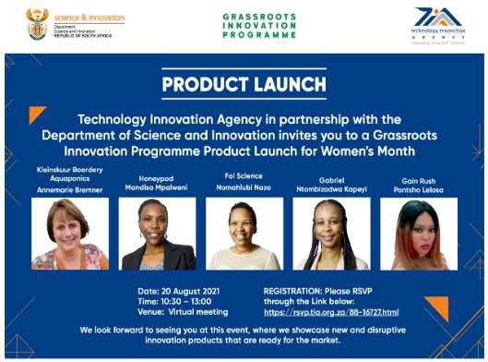
Grassroots Innovation Programme
Enrolled 110 innovators across all 9 provinces.
Leveraged additional funding of R19.8m (Insurance SETA and Department of Tourism).
26 innovation products produced.
15 new enterprises created.
Virtual product launches aligned with Women’s
Month and Youth Month.

Slide 28
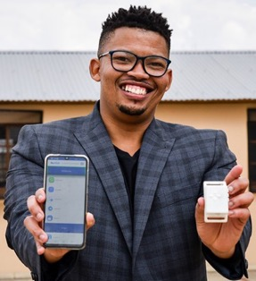
GIP Project Examples
  KA–DAH device (Tieho Tsiane)
    Helps visually impaired people to use apps without having to use a smartphone screen.
    Prototype tested with 10 visually impaired individual in Free State province.
    Additional R300k secured from SAB Foundation.
  Honeypod product range (Mandisa Mpalweni)
    Personal care, hair care and home care products made from indigenous SA botanicals.
    100% natural, non-toxic, mildly fragranced, hand crafted and environmentally friendly.
    Raw materials are ethically sourced.

Slide 29
Industry Matching Fund
Invested in 24 projects (50% from TIA’s de-risked project portfolio; >60% entail publicly funded IP.
9 projects commercialized.
~R500m leveraged at Fund level and ~R1bn at project level against R28m in TIA funds.
12 companies and 76 jobs created.
Achievements
SAB Foundation joined as a co-funding and business development partner (R28.6m).
SA SME Fund invested an additional R25m into the University Technology Fund.

Slide 30
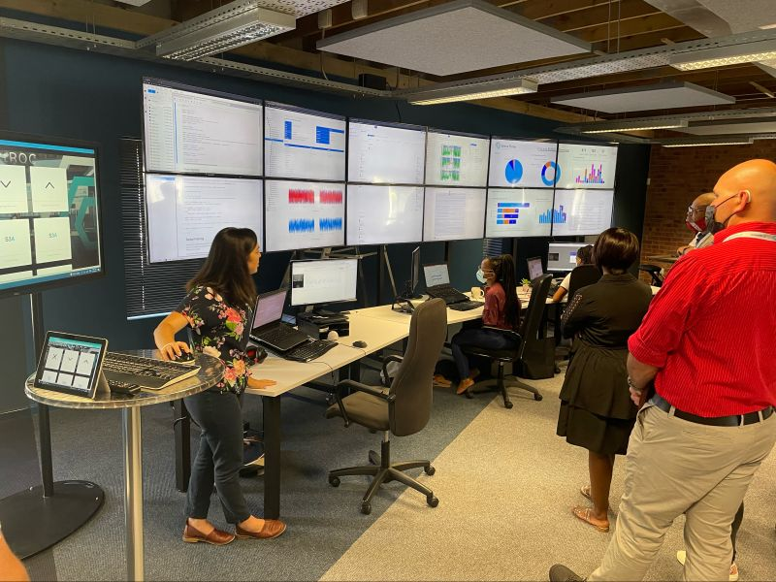
Innovation Fund
Innovation Fund established to enhance SA’s capacity to commercialise technological innovations. A pilot programme intended to run for a period of 3 years with a special allocation from Treasury through the DSI.
TIA received a total amount of R182.2m since the launch of the fund, and supported 14 projects towards commercialisation.
Stone Three Digital
Mineral processing efficiency improvement technology.
Expansion to new territories with international revenue generated.
Achieving profitability and has commenced repayment of loan.
48 jobs created.

Slide 31
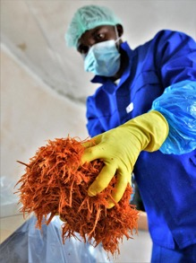
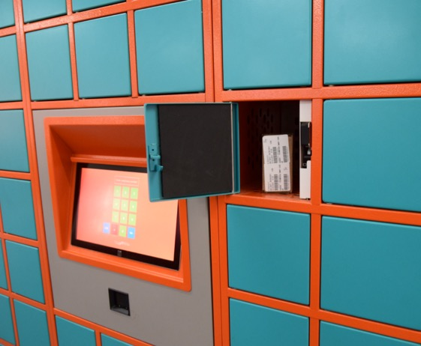
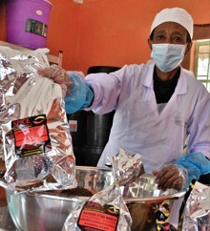
Technovera
Innovation Fund Project Examples
Setsong Tea Crafters
Chronic medication dispensing units/smart lockers.
Expansion to Namibian market.
100% black owned.
10 jobs.
Indigenous knowledge-based teas and health infusions from wild plants.
    Company sells 8 types of teas.
    20 permanent and 15 temporary jobs created.
    Sesong part of Food Lovers’ Market supplier network.

Slide 32
Administrative Indicators
7 targets achieved (78%)
  Includes 2 targets over-achieved on:
  Vacancy rate
  Enhanced learning opportunities through internships
2 Targets missed (22%)
  Turnaround Times
  Transformation initiatives through procurement

Slide 33
Audit Outcome

Slide 34

2021/22 Annual Report
Clean Audit
Positive Audit Outcome – Unqualified – Clean Audit Outcome

Slide 35
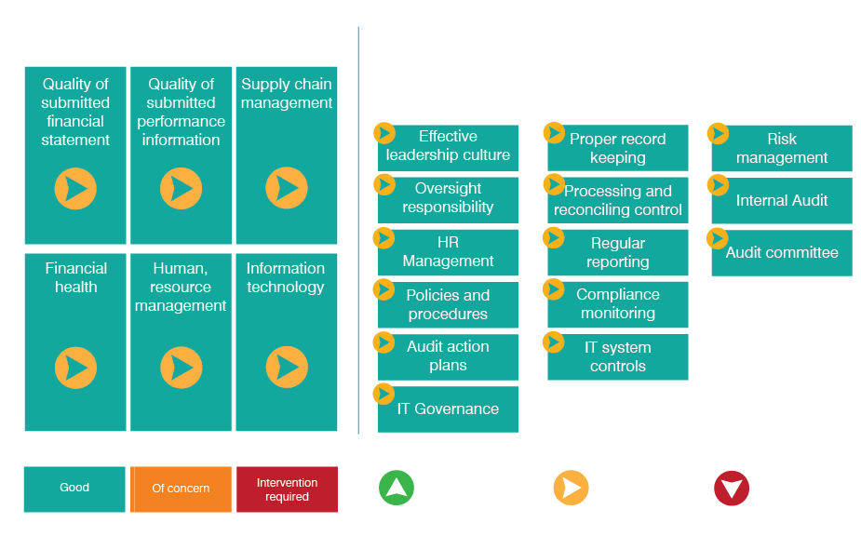
2021/22 Management Report

Slide 36
Annual Financial Statements

Slide 37
Revenue and Investment Expenditure
Amount (R’000)
Amount (R’000)

Slide 38
Efficiency Ratio

Slide 39
Thank you

