Slide 1
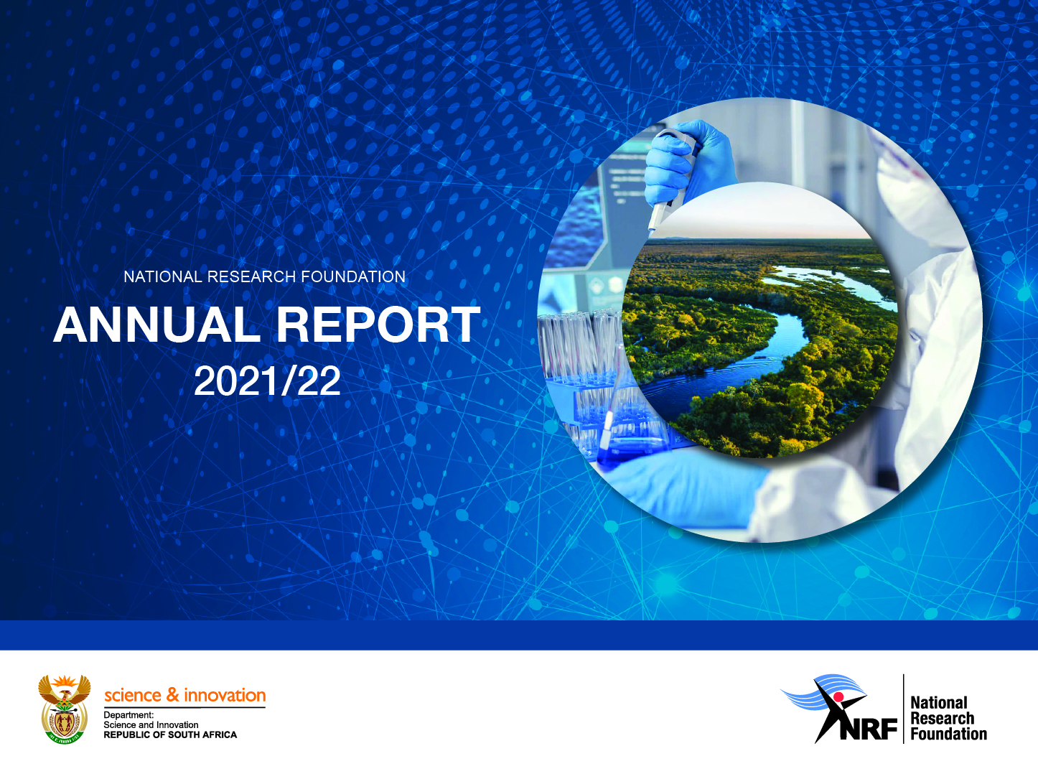
Presentation to the Parliamentary Portfolio Committee on Higher Education, Science and Innovation
21 October 2022

Slide 2

Recap on the mandate of the NRF
Recap on the mandate of the NRF
Strategic Context
Annual Performance 2021/22
Overview of Financial Performance 2021/22
Progress on NRF Strategy 2025
Highlights of Achievements
Current and Future Outlook

Slide 3
Recap on the mandate of the NRF
The Object of the NRF is to contribute to National Development by:
Supporting, promoting and advancing research and human capacity development, through funding and the provision of the necessary research infrastructure, in order to facilitate the creation of knowledge, innovation and development in all fields of science and technology, including humanities, social sciences and indigenous knowledge;
Developing, supporting and maintaining National Research Facilities;
Supporting and promoting public awareness of, and engagement with, science; and
Promoting the development and maintenance of the national science system and support of Government priorities.

Slide 4
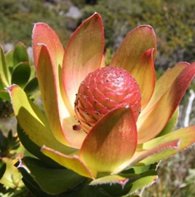
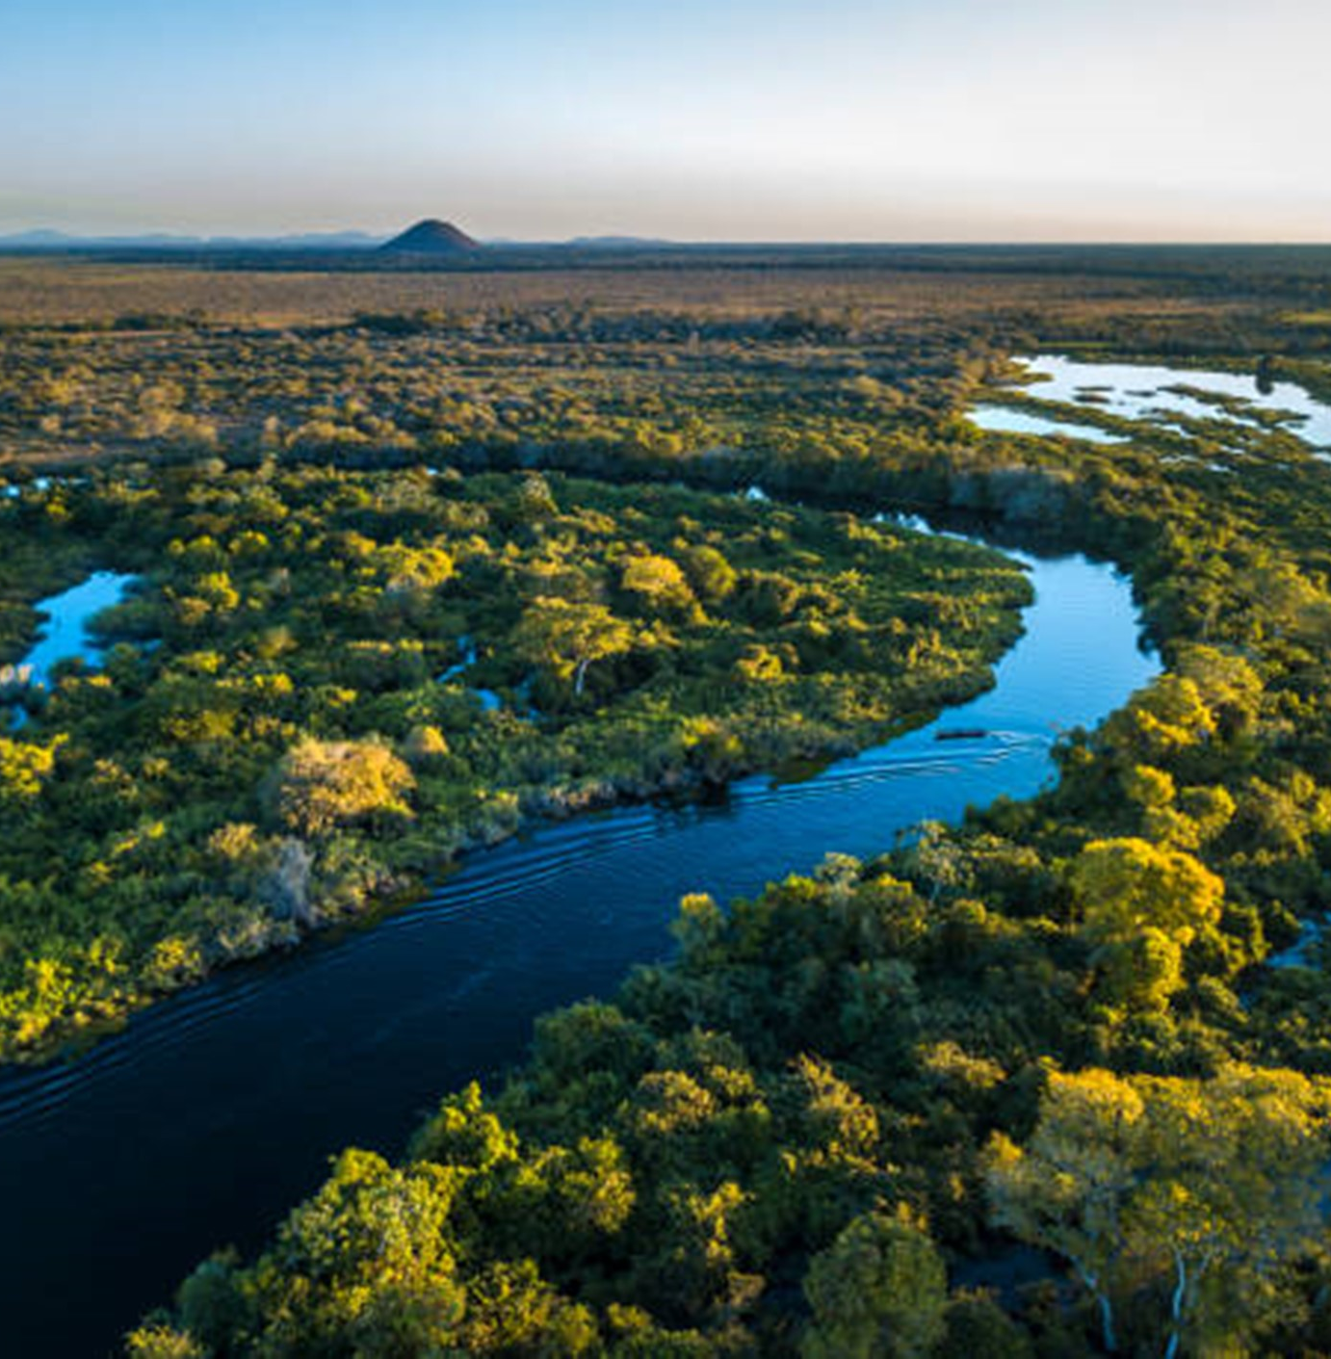
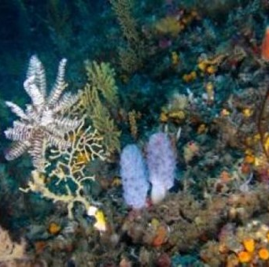
Strategic Context

Slide 5
Strategic Context
Positioning of the NRF
A transformed and agile knowledge organisation that shapes and influences all aspects of the research and knowledge enterprise, with unwavering commitment to transformation, innovation, impact, excellence and sustainability.
Key Focus Areas
Transformation: The imperative for a better future.
Impact and Innovation: A better society through knowledge.
Excellence: The foundation that sets the standard.
Sustainability: Building a better tomorrow today.

Slide 6
Contribution of the NRF to MTSF and DSI outcomes
MTSF Priorities for
2021 of relevance to
NRF
Improve competitiveness through Information Communication and Technology (ICT)-(Linked to Priority 2: Economic transformation and job creation).
DSI-led/ supported interventions/
indicators
across outcomes
NRF contribution
The NRF investments in SAIF, innovation and attraction of global and industry funding for research infrastructure and related HCD contribute to this outcome.
Status for 2021/22
Number of PhD students awarded bursaries through NRF and DSI.
Number of pipeline post-graduate student awarded bursaries through NRF and DSI.
Postgraduate student funding that aims at high throughput and progression of students.
NRF has developed a proposed Income Diversification Framework.
DSI-NRF Postgraduate Student Policy had its first cohort of students during the 2021 academic year. The NRF reports on funded students and students completing qualifications at honours, masters, and doctoral levels.
Increased expenditure in R&D.

Slide 7



Annual Performance 2021/22

Slide 8
Performance Against Targets in the APP for 2021/22
Output | Output indicators | Audited Actual 2019/20 | Audited Actual 2020/21 | Target 2021/22 | Actual 2021/22 | Deviation from planned target | Reason for deviation
PROGRAMME 1: ADMINISTRATION
A transformed leadership and management cohort | Proportion of employees from designated groups at Peromnes levels 1-7 | 52%% | 53% | 49% | 61.18% | 12.8% | Target exceeded.
Predictable and sustainable resourcing of the NRF mandate | Organisation Overheads as a proportion of total expenditure | 7.7% | 9.5% | <10% | 7.9% | 2.1% | Target achieved.
PROGRAMME 2: SCIENCE ENGAGEMENT
Support of the development of STEMI education | Number of learners, educators and students reached through school/HEI based initiatives (in support of the school and HEI curriculum). | - | - | 31 265 | 51 876 | 20 611 (67%) | Target exceeded. The use of online platforms facilitated larger reach for the initiatives

Slide 9
Performance Against Targets in the APP for 2021/22 (cont.)
Output | Output indicators | Audited Actual 2019/20 | Audited Actual 2020/21 | Target 2021/22 | Actual 2021/22 | Deviation from planned target | Reason for deviation
PROGRAMME 2: SCIENCE ENGAGEMENT
Support for Engaged Research | Number of NRF grant holders and National Facility scientists undertaking/supporting science engagement and engaged science. | - | - | 240 | 572 | 332 (138%) | Target exceeded. More opportunities for science engagement activities spared on by the ongoing pandemic and online platforms
Enabling public access to research and science engagement infrastructure | Number of NRF supported public Science engagement interventions at research and science engagement infrastructure across the NSI. | - | - | 10 | 10 | 0 | Target Achieved
Building science engagement capacity and capability | Number of scientist/journalists that use indigenous languages used in science communication | - | - | 320 | 156 | -164 (-51%) | Target not achieved This is a developing area of focus for the NRF, where this target proved to be a stretch target.

Slide 10
Performance Against Targets in the APP for 2021/22 (cont.)
Output | Output indicators | Audited Actual 2019/20 | Audited Actual 2020/21 | Target 2021/22 | Actual 2021/22 | Deviation from planned target | Reason for deviation
PROGRAMME 3: RESEARCH AND INNOVATION SUPPORT AND ADVANCEMENT
Funded postgraduate students | Number of NRF-funded postgraduate students | 11 167 | 11 093 | 7 414 | 7 732 | 318 (4%) | Target exceeded. Reprioritisation of funds during the year and the active management of grants resulted in better take up of awards.
Funded researchers | Number of NRF-funded researchers | 3 985 | 3 000 | 4 521 | 3 201 | -1 320 (-29%) | Target not achieved. Fewer applications for various instruments that fund mobility such as Knowledge Interchange and Collaborations (KIC), the Conference Fund and Incentive Funding and lower uptake of Postdoctoral fellowships, BAAP and nGAP development grants, Research Equipment due the ongoing pandemic and restricted international travel.

Slide 11
Performance Against Targets in the APP for 2021/22 (cont.)
Output | Output indicators | Audited Actual 2019/20 | Audited Actual 2020/21 | Target 2021/22 | Actual 2021/22 | Deviation from planned target | Reason for deviation
PROGRAMME 3: RESEARCH AND INNOVATION SUPPORT AND ADVANCEMENT
The knowledge produced by NRF supported researchers | Number of peer-reviewed publications produced by NRF-funded researchers (including from NNEP, NEP and SREP) | - | 8 150 | 9 250 | 9 116 | -134 (-1.4%) | Target not achieved. As a result of COVID-19 restrictions, researchers undertook fewer field trips and attended fewer international conferences and workshops, thus produced fewer number of papers.

Slide 12
Performance Against Targets in the APP for 2021/22 (cont.)
Output | Output indicators | Audited Actual 2019/20 | Audited Actual 2020/21 | Target 2021/22 | Actual 2021/22 | Deviation from planned target | Reason for deviation
PROGRAMME 4: NATIONAL RESEARCH INFRASTRUCTURE PLATFORMS
Diversity of student cohorts accessing RIPs | Proportion South African postgraduate students from designated groups who are users of NFs. | - | - | 76% | 76% | 0 | Target achieved
Diversity of researchers accessing RIPs | Proportion South African researchers from designated groups who are users of NFs | - | - | 39% | 11% | -28% | Target not achieved. NFs business rules and systems not designed to collect data on citizenship and racial designations of researchers and students users of RIPs.

Slide 13
Performance Against Targets in the APP for 2021/22 (cont.)
Output | Output indicators | Audited Actual 2019/20 | Audited Actual 2020/21 | Planned Target 2021/22 | Actual Achievement 2021/22 | Deviation from planned target | Reason for deviation
PROGRAMME 4: NATIONAL RESEARCH INFRASTRUCTURE PLATFORMS
Socio- Economic contribution of NFs | Foreign income (Rand million) derived from NFs activities or operations | - | - | 63.8 | 80.7 | 16.9 (26%) | Target exceeded. Increase in production and sales to meet demand and raise funds for capital projects.
 | Number of employees from rural towns adjacent to NFs operating sites that are employed by the NFs | - | - | 265 | 271 | 6 (2%) | Target exceeded. By maintaining current permanent jobs and using flexible employment opportunities.
Knowledge produced for societal benefit | Number of patient doses generated from radioisotopes produced by NRF- iThemba LABS | - | - | 167 500 | 171 713 | 4 213 (2.5%) | Target exceeded. The actual achievement is demand driven and depended on changes in market conditions

Slide 14
Performance Against Targets in the APP for 2021/22 (cont.)
Output | Output indicators | Audited Actual 2019/20 | Audited Actual 2020/21 | Target 2021/22 | Actual 2021/22 | Deviation from planned target | Reason for deviation
PROGRAMME 4: NATIONAL RESEARCH INFRASTRUCTURE PLATFORMS
Knowledge produced for societal benefit | Number of recognised publications by NFs | 640 | - | 445 | 689 | 244 (55%) | Target exceeded. Researchers appear to have used the time made available by COVID -19 restrictions to focus on publishing.
Successful establishment of scientific infrastructure by NFs | Number of MeerKAT+ antenna foundations, and related Infrastructure completed by NRF- SARAO | - | - | 10 | 18 | 8 (80%) | Target exceeded. Accelerated schedule to complete 24 antenna foundations in total.
 | Progress on implementation of the SAIF Project by NRF-iThemba LABS | - | - | 75% | 75% | - | Target achieved
 | Number of SALT Gen 1.5 subprojects being implemented by NRF-SAAO | - | - | 4 | 3 | -1 (25%) | The Board of SALT the commissioning company decided to suspend the one project for the time being.

Slide 15



Financial Overview 2021/22

Slide 16
Financial Overview for the Year ending 31 March 2022
Statement of Financial Performance | 2022 Actual R’000 | 2022 Budget R’000 | Variance | 2021 Actual R’000
Total Income | 4,466,375 | 4,930,375 | (9%) | 3,574,207
Total Expenditure | 4,231,522 | 4,595,821 | (8%) | 3,670,117
Net unspent funds/(deficit) | 234,853 | 334,554 |  | (95,910)
Transfers to/(from) Accumulated Fund (incl. capex transfers) | (227,579) | (334,554) |  | 99,071
Accumulated surplus/(deficit) | 7,274 | - |  | 3,161
* Actual is lower than Budget due to decrease in the Science Missions contract, lower grants take-up and contract carry forward to next year.
Statement of Financial Position | 2022 R’000 | 2021 R’000
Current assets | 1,798,390 | 1,705,023
Non-Current assets | 2,712,537 | 2,580,748
Current liabilities | (1,698,124) | (1,707,822)
Net assets | 2,812,803 | 2,577,949
Statement of Cash Flow | 2022 R’000 | 2021 R’000
Net cash flow from operating activities | 348,326 | 167,695
Net cash flow from investing activities | (483,779) | (196,154)
Net cash flow from financing activities | - | -
Net increase/(decrease) in cash and cash equivalents | (135,453) | (28,459)

Slide 17
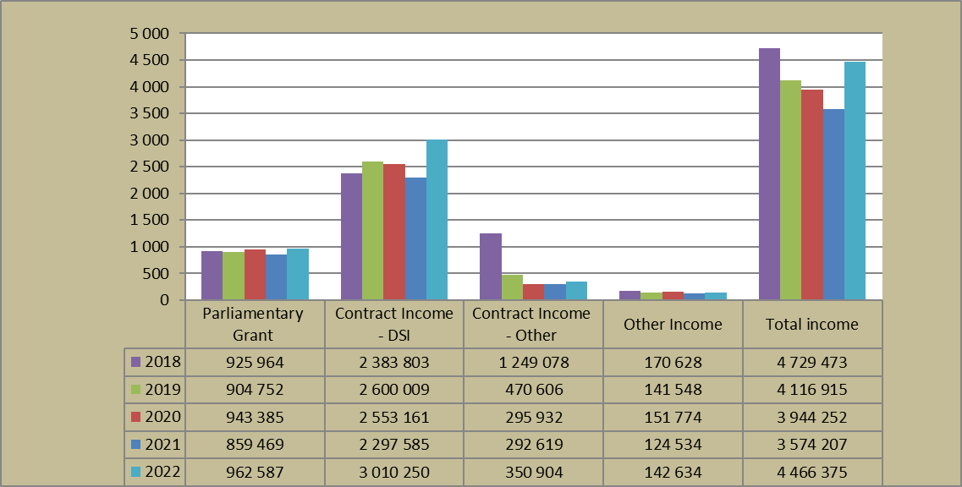
Financial Overview - Income Trends
Parliamentary Grant (PG) is declining in real terms and below inflationary adjustment year-on-year.
PG and DSI Contract income increase attributed to recovery of COVID-19 budget cut of R763 m.
Other Contract income – Additional funds received from DHET for the Scare Skills Development Fund.
Other income – Isotope export sales increased as markets opened & increased interest income due to higher interest rate.

Slide 18
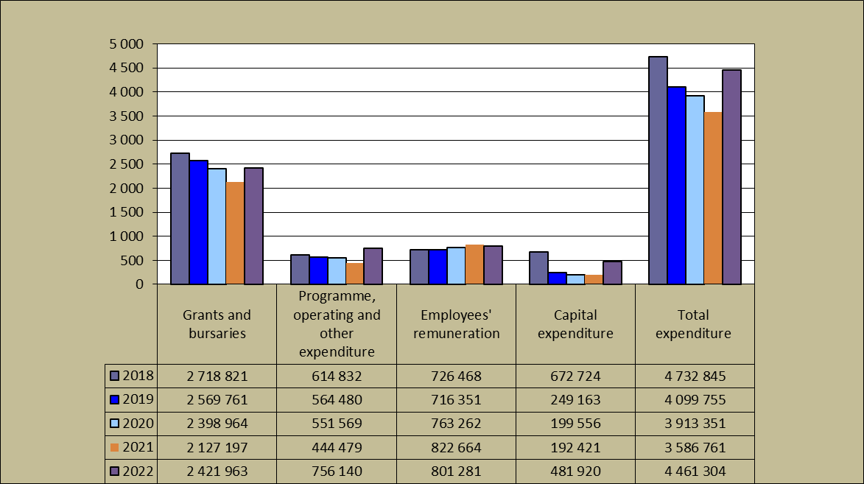
Financial Overview - Expenditure Trends
Increased grant and bursaries due to NEP programme as funding is received every second year, i.e. 2021/22, and the recovery of COVID-19 spending lags within bursaries and scholarships.
Operating expenditure increase is aligned to return to stable level of operations and includes RSA’s membership contribution to SKAO.
Salaries – decreased due to the impact of the temporary moratorium on the filling of vacancies.
Capex – increased as spending aligned to the delivery on the SAIF 70Mev cyclotron and the MeerKAT extension project ramped up.

Slide 19
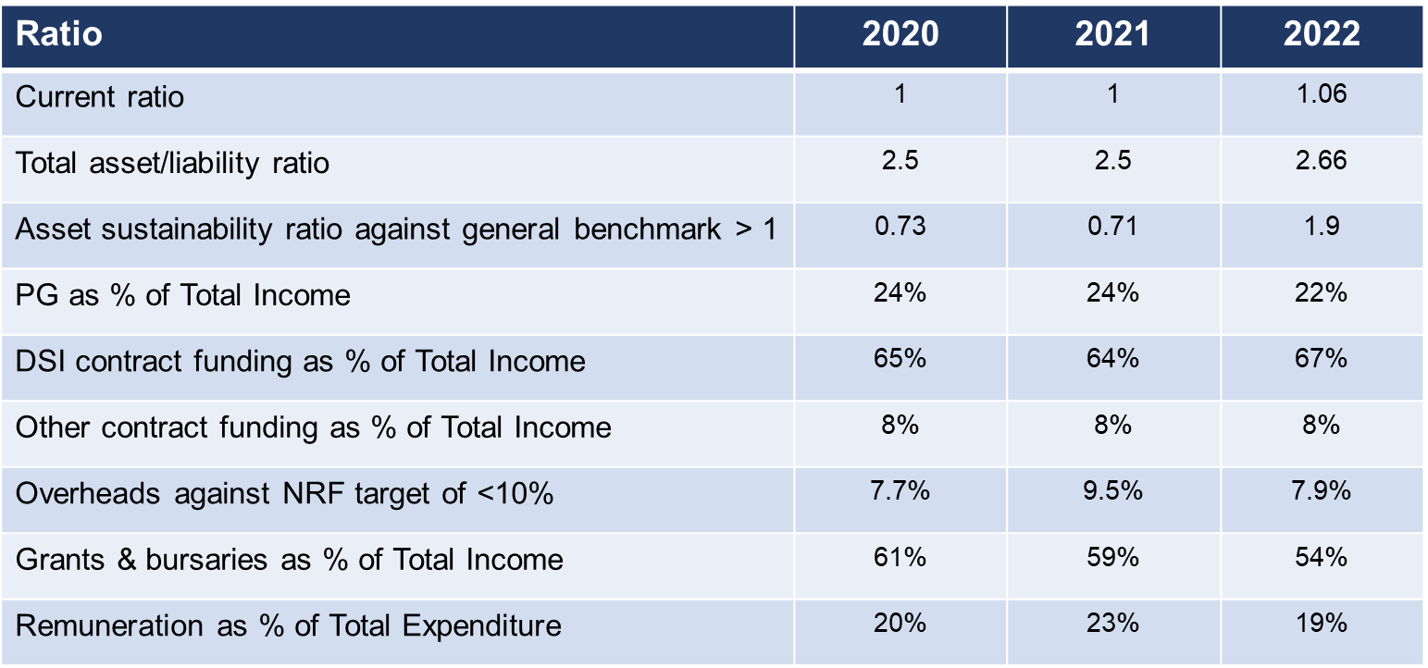
Key Ratios

Slide 20
Governance and Audit Outcome
Unqualified Audit with a Clean Award.
Good internal controls implemented by management (AGSA Management Report).
Healthy going concern position.
Irregular Expenditure – None.
Fruitless and wasteful expenditure – None.

Slide 21
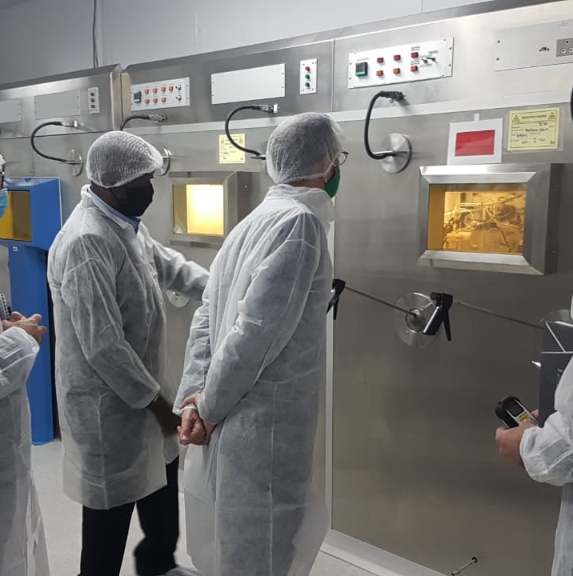
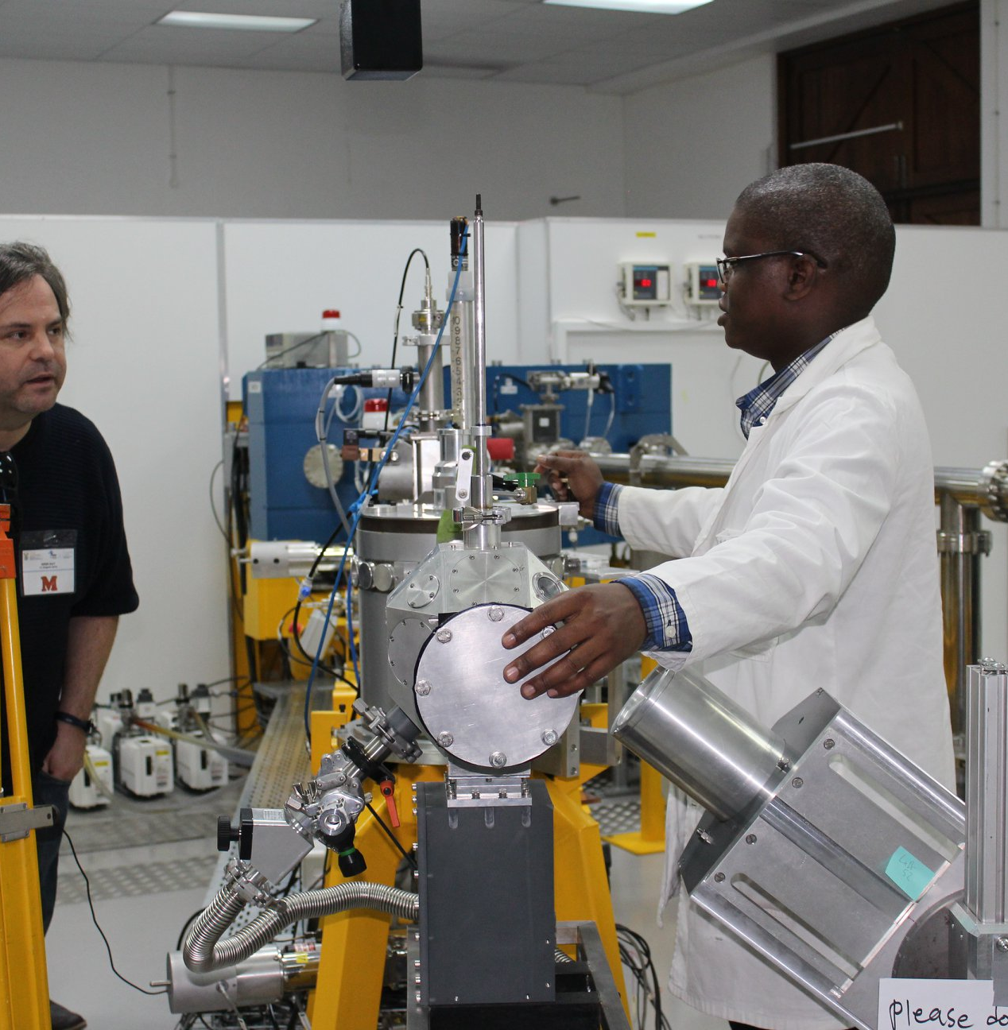
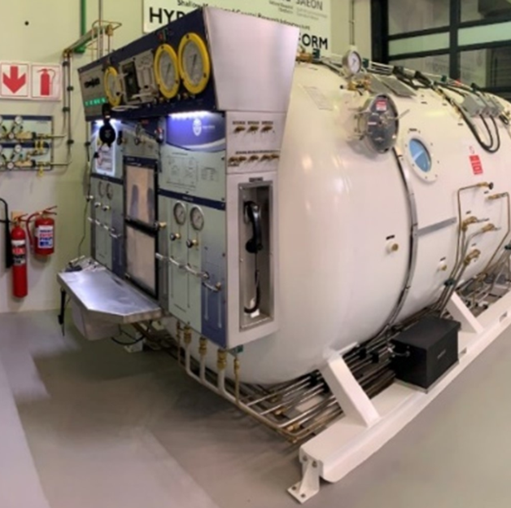
Progress on NRF Strategy 2025

Slide 22
NRF Strategy 2025 Outcomes, Indicators and Targets
Outcome | Outcome indicator | Five year target | YTD Progress
A transformed , internationally competitive and sustainable research workforce | Profile of NRF-funded post-graduate students who have completed their studies | Black 80% Women 55% | Black 80% [2020] Women 61% [2020]
 | Profile of NRF-funded researchers producing research outputs | Black 48% Women 42% | Black 46% Women 40%
Enhanced impact of the research enterprise | Entrenchment of knowledge and societal impacts in excellent research supported by the NRF | Portfolio of excellent research supported by the NRF justified with sound ex-ante and ex-post Knowledge and Societal Impact | Research Impact Framework and Implementation Plan has been developed. Methods and Capability for ex-post evaluations outstanding.
 | Inclusive support of all domains of science | Balanced portfolio of NRF research investments across the knowledge domains | Research Agenda deferred to follow STI Decadal Plan.
 | Evidence-based decision-making to enhance the impact of the research enterprise | Improved organisational and NSI analytics and its use in strategic decision-making | A draft RDIP Needs Analysis Report was developed at the end of 2021/22. The development of RDIP is underway with DSI funding.

Slide 23
NRF Strategy 2025 Outcomes, Indicators and Targets (cont.)
Outcome | Outcome indicator | Five year target | YTD Progress
Enhanced impact of science engagement (SE) | Engaged science entrenched in the research enterprise | A fully integrated science engagement programme which meets the needs of the diverse NRF engagement chain | Approved Engaged Research Framework and SAASTA Business Plan.
A transformed organisation that lives its culture and values | Representation of designated groups in leadership, management, and supervisory (P1-7 occupational levels) | Women 38% Black 55% (Towards mirroring the NRF Employment Equity Plan targets) | Women 30% Black 49%
 | Inclusive, enabling and learning organisation | Improvement on baseline survey’s results | The first formal organisational culture survey was completed in May 2021 to provide baseline results for the NRF culture.
 | A co-created culture enhancing high performance and service excellence | Improvement on baseline survey’s results

Slide 24


Highlight of Achievements
Harnessing Africa partnerships on Science Technology and Innovation: the NRF hosted the Global Research Council (GRC) Africa Regional meeting in November 2021.
Seamless grants management system: NRF Connect grants management platform was launched in December 2021 and went live on 15 March 2022.

Slide 25
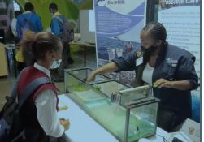

Highlight of Achievements
Science engagement interventions
The 2021 National Science Week with the theme Making It Possible through Science attracted 45 institutions, hosted 53 webinars, 24 recorded exhibits, 13 documentaries and four live exhibitions.
Rising Star and Sida Tsoatsoas: NRF-SAAO’s & SARAO’s first Locally Produced Digital Planetarium Film, Rising Star, has been added to the ESO Astronomy full-dome content database and is now available for international downloads. It celebrates African indigenous knowledge systems and traditional folklore.

Slide 26
Highlight of Achievements
Collaborative Human Capacity Development
SA-Germany (DFG) International Research Training Groups: The first cohort of students under this programme has been selected and were registered at the beginning of the 2022 academic year.
The NRF and Sasol launched a first-of-its-kind joint programme in support of collaborative research grants in Science and Engineering that will contribute to South Africa’s energy transition and green economy. The R54m initiative has granted 26 joint programmes between academia and industry.
NRF and National Student Financial Aid Scheme (NSFAS) Partnership: NRF announced its partnership with NSFAS in March 2022. The collaboration seeks to increase access to funding opportunities for postgraduate students.

Slide 27

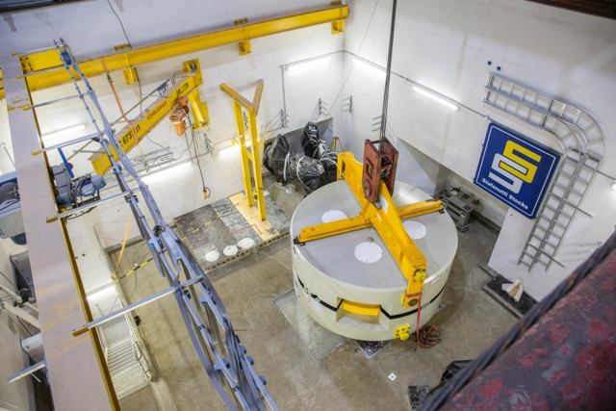
Highlight of Achievements
Impact of the research enterprise
1 000 hours of the MeerKAT data release reveals new cosmic puzzles: An announced of a comprehensive overview paper for the MeerKAT Galaxy Cluster Legacy Survey (MGCLS).
Research infrastructure
South African Isotope Facility (SAIF): A strategic investment aimed at significant change of the landscape of accelerator-based physics research in South Africa and on the African continent. The delivery the two magnet yokes of the newly acquired C70 MeV cyclotron and Installation of some beam line components in the vaults represented a major achievement in 2022

Slide 28
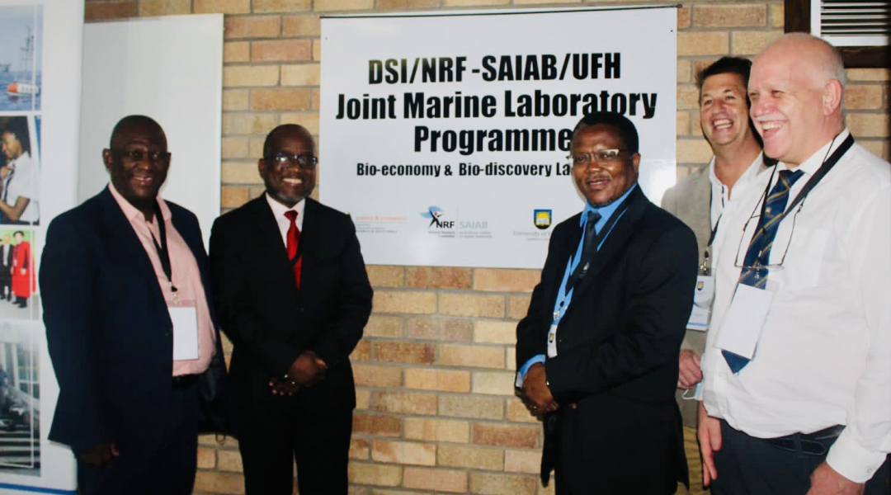
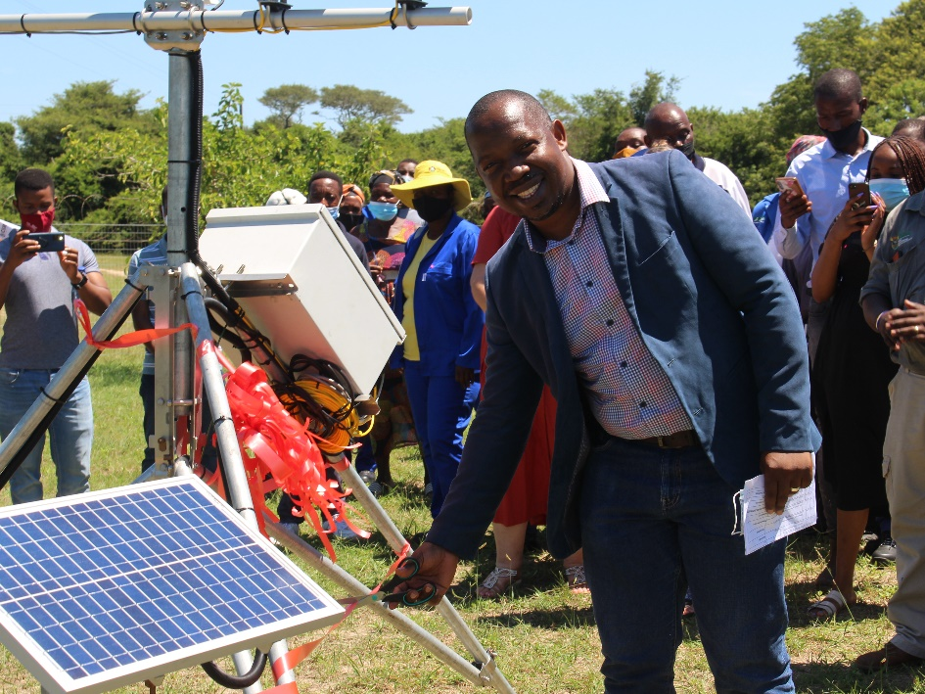
Highlight of Achievements
Through the ACEP Phuhlisa Programme, NRF-SAIAB has established a ground-breaking Joint Marine Laboratories Programme (JMLP) at four HDIs- University of Fort Hare, Walter Sisulu University, University of the Western Cape and University of Zululand. JML was launched in March 2022 at Fort Hare University, bringing cutting edge marine research equipment to Fort Hare.
Inkosi Nxumalo of the Mabasa Traditional Council “unveiling” the first EFTEON automatic weather station in the Northern Maputaland EFTEON landscape.

Slide 29
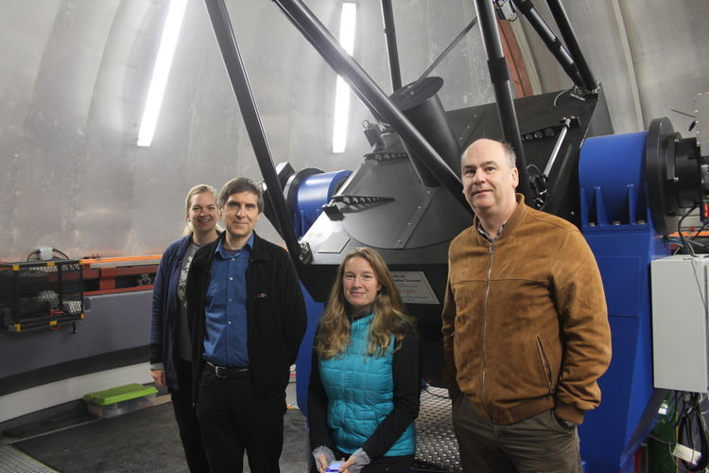
Highlight of Achievements
Infrastructure development to advance knowledge
South Africa’s Hosting of Hazardous Asteroid Tracking Telescope: ATLAS telescope, in collaboration with NASA, has undergone a successful installation and commissioning campaign at the NRF-SAAO site in Sutherland.
New spectrograph (Mookodi) commissioned in Sutherland. Milestone in the Intelligent Observatory initiative: fully autonomous spectroscopic observations demonstrated.

Slide 30
Current and Future Outlook
During the next MTEF period, the organisation will continue to deliver on the following key priorities:
Innovation and impact within the research enterprise and the NSI;
Partnerships with industry;
Science Engagement that enables impact; and
A culture that enhances high-performance.

Slide 31
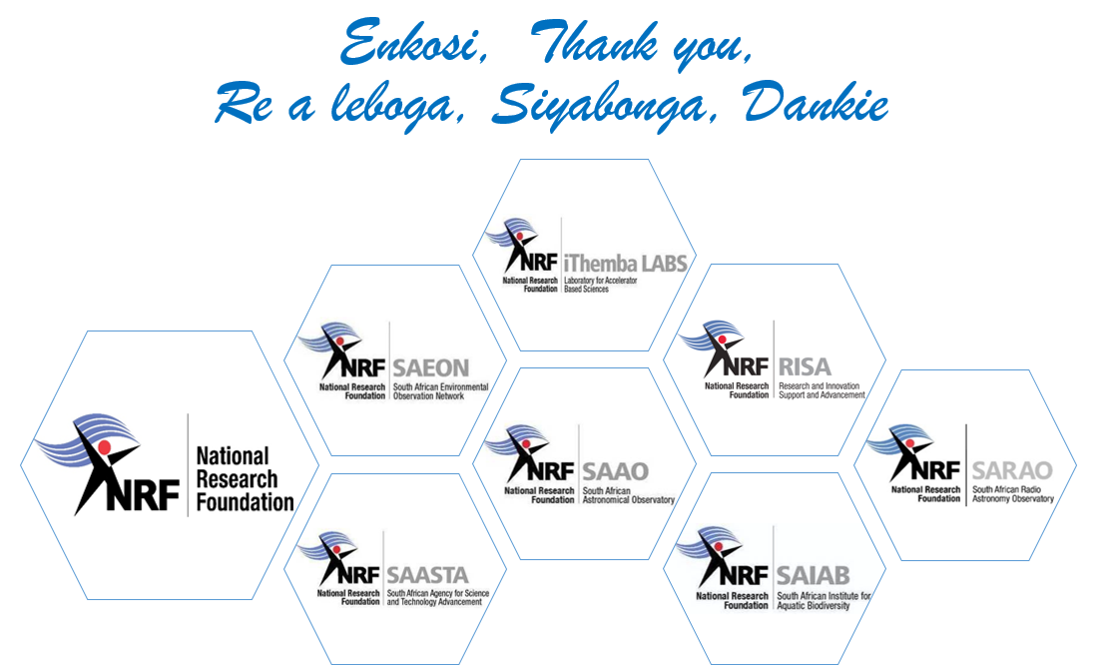
Current and Future Outlook

