Slide 1
PRESENTATION TO THE PORTFOLIO COMMITTEE ON JUSTICE AND CORRECTIONAL SERVICES
2021/22 Annual Report
Date: 20 October 2022

Slide 2
Overview of the Presentation
Introductory remarks
Overview of 2021/22 performance information
2021/22 Audit and financial information
2023 MTEF funding requirements
Report of the Audit Committee
Overview of 2022/23 Quarter 1 performance information
2022/23 Quarter 1 expenditure

Slide 3
Part 1: Acting Public Protector
Adv Kholeka Gcaleka

Slide 4
Introductory Remarks (1)
We are thankful for the opportunity to present the Public Protector South Africa (PPSA) Annual Report for 2021/22.
It has been a challenging four months since one was entrusted with the demanding responsibility of leading the PPSA, an institution that ranks amongst the vanguards of our democracy and an important avenue for justice to the less privileged.
If one’s interactions with stakeholders in the past few months is anything to go by, it would appear that, as far as some quarters in society are concerned, and owing to some of the challenges we have contended with, the institution was viewed as being fluid.

Slide 5
Introductory Remarks (2)
However, the team of 368 dedicated women and men who swell the ranks of the institution are proving equal to the task and remain hard at work in an effort to keep the office stable while continuing to focus on the job at hand. It is the collective effort of these women and men who are a composition of this institution and not, for instance, I, as an individual.
We are hopeful for the future, as work is underway to ensure high level institutional functionality underpinned by the values of independence and impartiality, now more than ever, as enshrined in the Constitution. This is to ensure that even in handling the most contentious matters, we do so without fear, favour or prejudice, to uphold the integrity of the institution.

Slide 6
Introductory Remarks (3)
With all said and done, we remain on course with Vision 2023 in that we have, in the main, touched the lives of the most marginalized and continue to receive high volumes of complaints.
Relying on a portion of the R362.7million we were allocated for the reporting period, we embarked on an awareness drive, including, engagements with the Executive in provinces to give effect to section 182(4) of the Constitution, in terms of which this institution is enjoined to be accessible to all persons and communities.

Slide 7
Introductory Remarks (4)
Data coming out of this report suggests that we have spent a lot of time on matters that should not have streamed into our case load in the first place. Investigators dealt with nearly 800 complaints that fell out of our remit and referred a further 1 405 to other competent forums.
We have, as a result developed and implemented a Mobile Complaints Management Application, which we hope will help us cut back on the time we spend on non-jurisdictional matters. It advises, guides and refers the public to internal complaints handling systems and mechanisms at institutional level by facilitating remote access to relevant information and contact details of the various state institutions at all three spheres of government, as well as other organs of state.

Slide 8
Introductory Remarks (5)
The application, which went live on 31 March 2022, is currently being rolled out free of charge on Google Play Store. For the time being, it is only downloadable on Android devices. It will soon be available for Apple gadgets.
Honourable Members, we report that, for the third time in a row, we managed to obtain a clean audit opinion. This calls on us to continue effecting internal governance reforms to lead the path on good governance.
One of the boxes the institution must tick in order to receive a clean bill of health from the Auditor-General is performance against set targets.

Slide 9
Introductory Remarks (6)
This report demonstrates that our organisational performance continues on an upward trend in terms of quantity. Now the focus is on improving the quality and impact of our reports, to strike a balance.
All praise must go to the PPSA team under the capable leadership of the Chief Executive Officer, Ms Thandi Sibanyoni and the Executive Management. Without their collective effort and dedication, these achievements would not have been possible. Their endeavours are living proof that if we join hands and rally behind a common vision, we can continue to inspire hope amongst the people of South Africa.
These are the achievements notwithstanding the reduction in 2020 of 125 in the total number of posts on the approved establishment of the Public Protector, leaving us with 200 approved posts that are still unfunded. Of the total number of 260 investigative posts in the organisation on all levels, we experienced a high vacancy rate of 9,23%, resulting in 236 posts being filled.

Slide 10
Introductory Remarks (7)
The total comparative caseload for the 2021-22 year reflects that we dealt with 8823 cases, which is slightly less than the previous year (9299), but translates to a significantly higher workload contrary to the global standard of between 10-25 cases per investigator in similar institutions, compared to an average of more than 40 cases per PPSA investigator.
In the same vein, one wishes to highlight the efforts we are making to improve our efficiency. We closed our books with a sizable surplus. We are not proud of this. It is for this reason that we will see to it that resources do not return to the fiscus when we have pressing matters to address.

Slide 11
Introductory Remarks (8)
These include the security question in our offices, e-library services for research which we have to improve on, training and capacity-building, strengthening our employee wellness programme, especially under the current climate, improving our ICT systems and filling key positions such as those of the Chief Operations Officer, the Chief Financial Officer, Manager: Knowledge Management and Legal Research and investigation posts. We have already undertaken a drive to attract the most capable skills in this regard.
As I conclude, we wish to inform Honourable Members, that this presentation coincides with the commemoration of the PPSA’s 27th anniversary. To mark this milestone in our existence as an institution, we shine the spotlight on Good Governance under the banner of what we call Good Governance Month. We have done so since 2010.

Slide 12
Introductory Remarks (9)
This year is no different. In the week leading up to the end of the month, we will engage in a series of activities through which we will seek to ensure that issues of Good Governance take central stage starting within PPSA and extending to the public discourse.
These activities will include an engagement with organised business on issues of ethics in relation to improper conduct in state affairs, collaborative work with Community Based Organisations and the approval of the ethics policy, followed by the signing of a pledge by the PPSA workforce, committing to carry out our responsibilities with integrity and ethics.
With that said we wish to thank the organs of state which take the opportunity to assist our institution to fulfil its constitutional mandate by responding to allegations put to them and further implementing our remedial action. The implementation of our remedial action, which remains a challenge, is important for Governance Reforms in our country and is a step towards combating corruption, thus a critical contribution to economic growth.

Slide 13
Introductory Remarks (10)
It is for this reason that we have also sent communication to the Speaker of the National Assembly, highlighting to her the mammoth task that awaits the legislature, as a result of the State Capture Report issued by Adv Madonsela, to expedite the amendments to the Executive Members Ethics Act.
In addition, we will soon request meetings with all the political parties represented in the National Assembly to discuss matters of common interest. We believe they are a critical stakeholder and have a key role to play in a number of areas in our work, including the enforcement of remedial action through oversight.
We are further thankful for the unwavering support of stakeholders, including the public we serve and the legislature we account to. As we set off to take our services to all corners of our beautiful country, we depend on this formidable support.

Slide 14
Part 2: Chief Executive Officer
Ms Thandi Sibanyoni

Slide 15
2. Overview of the 2021/22 Performance based on approved and tabled Annual Performance Plan

Slide 16
2021/22 Institutional Performance

Slide 17
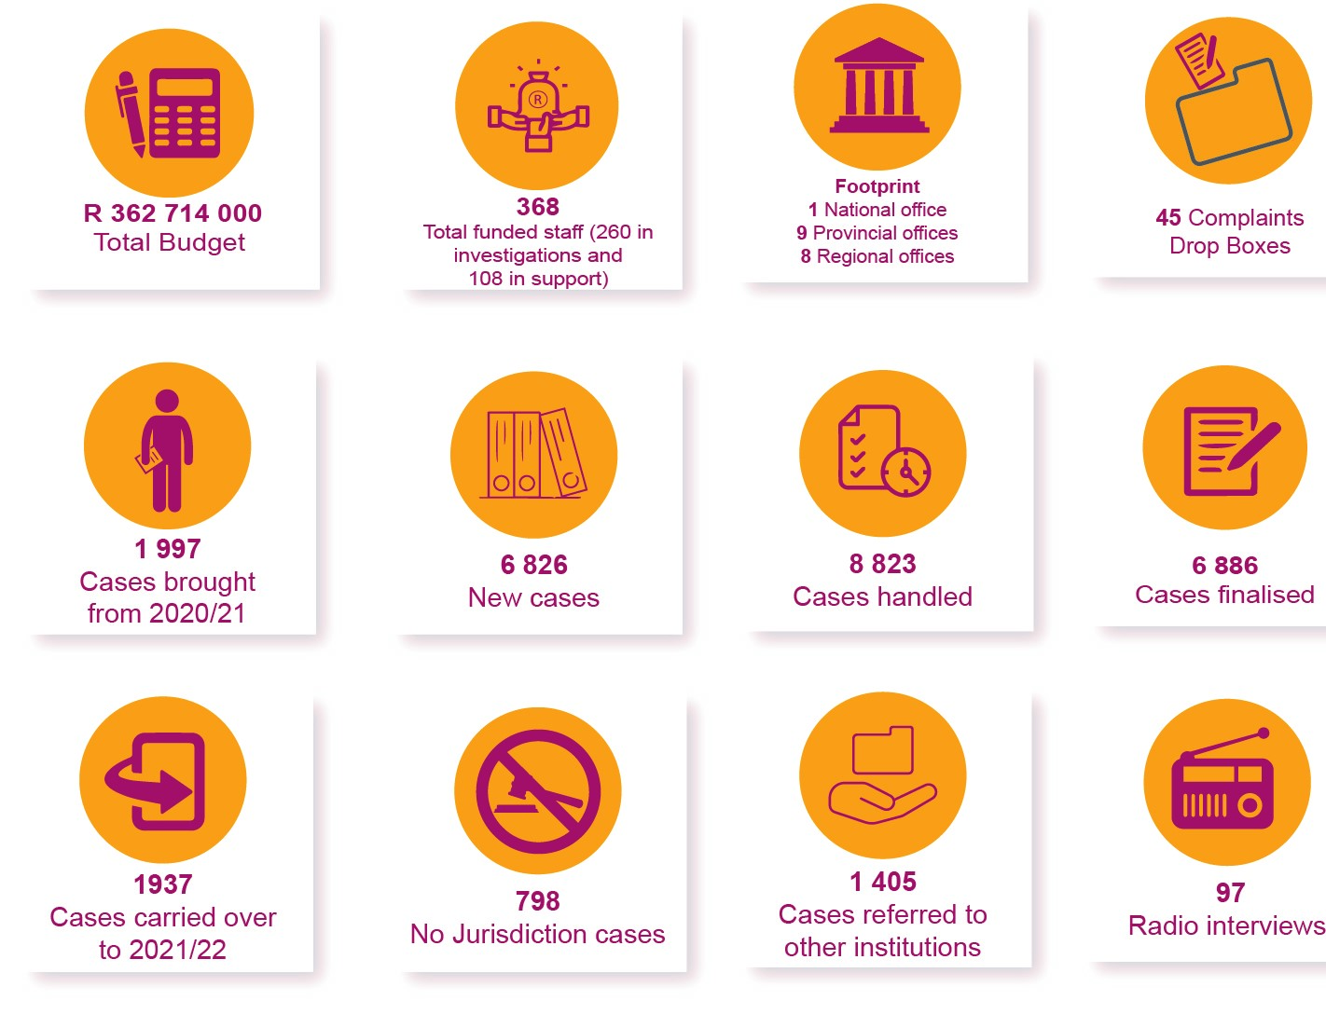
2021/22 Year at a Glance

Slide 18
Summary: 2021/22 Institutional Performance

Slide 19
Comparison of Institutional Performance over the last three years

Slide 20
Administration (1)
Output Indicator | Planned Annual Target | 2021/22 Actual Achievement | Comments
Obtain clean audit annually | Maintain a clean audit opinion | ACHIEVED PPSA maintained a clean audit opinion from AGSA | N/A

Slide 21
Investigations (1)
Output Indicator | Planned Annual Target | 2021/22 Actual Achievement | Comments
Number of investigation reports finalised | Finalise 50 investigation reports by 31 March 2022 | EXCEEDED A total of 112 investigation reports were finalised | 62 more reports were finalised. More cases were finalised during the period under review as a result of effective project management of investigations and enhanced Quality Assurance through the weekly Quality Assurance Committee sessions.

Slide 22
Investigations (2)
Output Indicator | Planned Annual Target | 2021/22 Actual Achievement | Comments
Percentage of 2 years and older cases finalised | Finalise 80% of 2 years and older cases (except GGI very complex matters) by 31 March 2022 | NOT ACHIEVED 65% (262/404) of two years and older cases were finalised | 15% of 2 years and older cases were not finalised. Two (2) years older cases were project managed, however the target could not be achieved due to high caseload in relation to staff complement, reliance on state organs to provide information/ documents, requests for extensions by respondents (state organs) and complexity of other matters investigated
Investigation and finalisation of systemic investigations/ interventions | Finalise 1 systemic investigation by 31 March 2022. Identify and investigate 2 systemic investigations /interventions | EXCEEDED 2 systemic investigations/ interventions were identified 2 systemic investigations were finalised | 1 additional systemic Investigation, carried over from the prior year, was finalized.

Slide 23
Investigations (3)
Output Indicator | Planned Annual Target | 2021/22 Actual Achievement | Comments
Percentage of adherence to turnaround times in finalisation of cases | Finalise 80% of cases within the following turnaround times: ER: 6 months SD: 12 months GGI: 24 months GGI (very complex): 36 months by 31 March 2022 | EXCEEDED 85% (3189/3732) of cases were finalised within turnaround times | 5% more cases were finalised within turnaround times. Project management applied by the investigation team in dealing with cases, with close oversight by executive authority through file inspections and quarterly dashboard the ensured achievement of the target.
Number of bilateral meetings held with organs of state on systemic challenges | 10 bilateral meetings held with organs of state on systemic challenges by 31 March 2021 | EXCEEDED 12 bilateral meetings were held with organs of state on systemic challenges | 2 more bilateral meetings were held with organs of state on systemic challenges by the Eastern Cape and Mpumalanga Province as they identified challenges in organs of state that needed to be addressed.

Slide 24
Stakeholder Management (1)
Output Indicator | Planned Annual Target | 2021/22 Actual Achievement | Comments
Number of activities executed in the implementation plan of an Integrated Access and Stakeholder Management Strategy | Execute 42 activities in the implementation plan of an Integrated Access and Stakeholder Management Strategy by 31 March 2022 (42 = 36 radio interviews + 5 national events and 1 Good Governance Week) | EXCEEDED 103 activities were executed in the implementation plan of an Integrated Access and Stakeholder Management Strategy - 97 radio Interviews were conducted 5 National events were conducted 1 Good Governance Week | 61 more radio interviews were conducted in the implementation plan of an Integrated Access and Stakeholder Management Strategy. Strengthened relations with community radio stations resulted in free radio slots being allocated to PPSA.

Slide 25
2021/22 Human Resource Management

Slide 26
Appointments and terminations
Number of employees appointed = 28
Number of employees that exited PPSA = 24
Vacancy rate = 7.18%

Slide 27
Reasons for staff leaving PPSA in the last 3 years
Reasons for termination of service | 2019/20 | 2020/21 | 2021/22
Death | 0 | 1 | 2
Resignation | 13 | 6 | 16
Expiry of contract | 2 | 0 | 0
Dismissal – operational changes | 0 | 0 | 0
Dismissal – misconduct | 0 | 3 | 2
Dismissal – inefficiency | 1 | 0 | 1
Discharged due to ill-health | 0 | 0 | 1
Retirement | 1 | 3 | 2
Other (Promotions) | 9 | 15 | 0
Total | 26 | 28 | 24

Slide 28
Personnel expenditure per programme
 | Programme | Personnel | Percentage of
 |  | expenditure | personnel
 |  | (R’000) | expenditure
 | Administration | 55 670 | 23%
 | Investigations | 180 200 | 73%
 | Stakeholder | 10 128 | 4%
 | Management
 | Total | 245 998 | 100%

Slide 29
Part 3: Acting Chief Financial Officer
Mr Tshiamo Senosi

Slide 30
3. 2021/22 Audit and Financial information

Slide 31
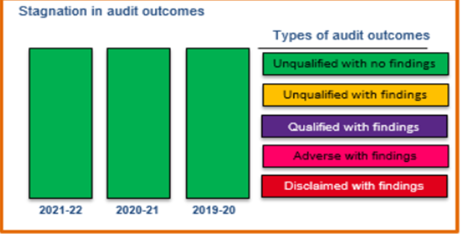
PPSA Audit Opinion 2021/22

Slide 32
2021/22 Key Highlights
PPSA maintained clean audit status in the 2019-20 and 2021-22 financial years.
Non-material audit findings remained at 21 for the period under review.
Bailout of R30,8 million from the Department of Justice and Constitutional Development in the month of November 2021. However, the total amount could not be spent as it was received late.
Reported a surplus of R35.1 million compared to R14.7 million of previous financial year. The R5 million that could not be spent is due to positions that were vacated and not yet filled.
PPSA was given approval by National Treasury to maintain the surplus. We have plans to utilise money on projects such as the ones on ICT.
PPSA’s financial viability was assessed and found to be good by AGSA.

Slide 33
2021/22 Expenditure Overview
Revenue | R'000
Total Revenue | 374 743
Expenditure by programme and Economic classification
Expenditure by programme | R'000
Administration | 146 586
Investigations | 181 344
Complaints and Stakeholder Management | 11 672
Total Expenditure | 339 601
Expenditure by Major Economic classification | R'000
Compensation of employees | 245 998
Administrative expenses | 87 481
Depreciation and amortisation | 4 858
Finance costs | 1 149
Loss on disposal of assets | 43
Acturial gains and losses | 71
Total expenditure by economic classification | 339 601
Surplus for the year | 35 142
Revenue is inclusive of transfers from the Department of Justice and Constitutional Development, income received for parking and recovery of bursaries, Interest received from investment as well as services in kind.
Total expenditure amounts to R339.6 million.
Expenditure on the Investigations branch amounts to R181.3 million, representing 53% of the total expenditure incurred, this represents CoE in the main.

Slide 34
2021/22 Personnel cost and vacancies
 | Total Expenditure for PPSA (R’000) | Personnel Expenditure (R’000) | Personnel exp. as a % of total exp. (R’000) | No. of employees | 2021/2022 Vacancies
Administration | 146 586 | 55 670 | 38% | 78 | 12
Investigations | 181 344 | 180 200 | 99% | 236 | 24
Stakeholder Management | 11 672 | 10 128 | 87% | 18 | 0
CoE expenditure in 2021/22 amounted to 72% of the total expenditure (i.e. R245 998 of 339 601)

Slide 35
Irregular Expenditure
Irregular expenditure incurred in 2021/22 is
R 40 299.00

Slide 36
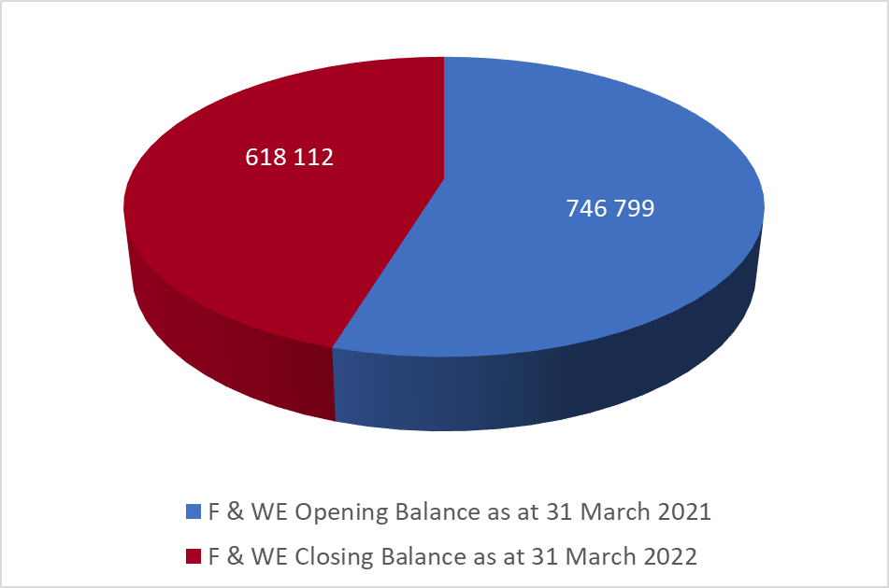
Fruitless and Wasteful Expenditure
Fruitless and wasteful expenditure incurred in 2021/22 is R52 166.00

Slide 37
4. 2022/23 MTEF funding requirements

Slide 38
2023 MTEF funding requirements
Description | 2022/23 | 2023/24 | 2024/25
 | R'000 | R'000 | R'000
Funding of critical positions (x 23) | 10 200 | 12 000 | 15 309
Section 194 expenses | 7 000 | 0.00 | 0.00
Security (provincial and regional offices | 6 127 | 6 446 | 6 774
PABX | 900 | 100 | 100
Total | 24 227 | 18 546 | 22 183

Slide 39
2023 MTEF funding requirements (1)
Funding of critical positions
There are 23 critical posts that must be filled in by the PPSA and the estimated cost for them is R10.2 million as from August 2022-March 2023. Annualized the amount is R15 309 375 - this estimate is expected to increase over the MTEF period. Recruitment has since been expanded to ensure diversity of skills among investigators which would in turn ensure quality and prompt investigation
Section 194 Expenses
On 09 June 2022, the Public Protector, Adv. Busisiwe Mkhwebane was placed on suspension by the President of the Republic of South Africa, to pave way for the section 194 Parliamentary Committee Enquiry. The Constitutional Court ruling stated that the Public Protector is entitled to legal representation. The Legal costs and travel cost must be paid by the PPSA, which was not budgeted for. The estimated cost is R 7,0 million.

Slide 40
2023 MTEF funding requirements (2)
Security
PPSA is currently not compliant with the requirements of section 2 of the Control of Access to Public Premises and Vehicles Act 53 of 1985, which requires the deployment of security officers to conduct access control. As a minimum, given the current financial situation PPSA, should have two security officers in each office to manage access control.
PPSA does not have physical security at the 16 of its 17 offices across the country - only Head Office has physical security services. As part of mitigation, a videofied alarm system was installed in the 16 offices - the contract is for 3 years.
Ideally, physical security guards are required at all offices. The absence of physical guards poses threats to PPSA staff members, Complainants, Stakeholders and assets.

Slide 41
2023 MTEF funding requirements (3)
PABX
Currently 6 out of 17 offices have new PABX system being installed with new telephone management systems due to relocation of offices.

Slide 42
5. Governance
Audit Committee Activities

Slide 43
The Audit Committee members
Name | Date appointed | No. of meetings attended (2021/2022)
Ms Princess Mangoma (Chairperson of the Audit Committee) | Started: 01 March 2018 Reappointed: 01 March 2021 | 10
Mr Stanley Ngobeni | Started: 01 March 2018 Reappointed: 04 March 2021 | 10
Mr Luyanda Mangquku | 01 December 2019 | 8

Slide 44
The Audit Committee Reviewed, Amongst Others
The effectiveness of the internal control system and provided independent advise thereon;
The risk management activities of PPSA and considered the Risk Management Committee reports at their meetings;
The adequacy, reliability and accuracy of the financial information as presented at its quarterly meetings and captured in the annual financial statements;
Monitored the implementation of AGSA audit action plans and internal audit recommendations;
The institution’s compliance with legal and regulatory provisions through the review of compliance reports; and
Provided guidance to and reviewed the work of the internal audit function, and considered 25 internal audit reports during the reporting period;
Management continues to implement the recommendations of the audit committee

Slide 45
6. 2022/23 Quarter 1 Institutional Performance

Slide 46
SUMMARY OF 2022/23 QUARTER 1 PERFORMANCE

Slide 47
ADMINISTRATION
Annual Target | Quarter 1 Target | Actual Performance | Comments
Maintain clean audit annually | N/A | N/A | N/A
100% implementation of a Case Management Application by 31 March 2023 | 6% implementation of the Case Management Application (Testing and piloting at Head Office) | ACHIEVED The Case Management Application was implemented at 6%. (Testing and piloting at Head Office) | N/A

Slide 48
INVESTIGATIONS (1)
Annual Target | Quarter 1 Target | Actual Performance | Comments
Finalise 80 investigation reports by 31 March 2023 | Finalise 17 investigation reports by the end of the quarter | ACHIEVED 17 investigation reports were finalised | N/A

Slide 49
INVESTIGATIONS (2)
Annual Target | Quarter 1 Target | Actual Performance | Comments
Finalise 80% of cases within the following turnaround times: ER: 6 months SD: 12 months GGI: 24 months GGI (very complex): 36 months by the end of the quarter | Finalise 80% of cases within the following turnaround times: ER: 6 months SD: 12 months GGI: 24 months GGI (very complex): 36 months by the end of the quarter | NOT ACHIEVED 70% (684/978) of cases finalised within the turnaround times | Reason for variance The target was not achieved due to the high number of backlog matters that the institution had to focus on while having to prevent a further backlog on current matters. The capacity of PPSA is also inadequate in relation to its caseload. Plans to address the non-achievement Plans to address the non-achievement is to continue to projectise backlog and pre-backlog matters while identifying matters to be resolved through alternative dispute resolution mechanisms.

Slide 50
INVESTIGATIONS (3)
Annual Target | Quarter 1 Target | Actual Performance | Comments
Finalise 3 systemic investigations by 31 March 2023 | N/A | N/A | N/A
Hold 10 bilateral dialogues with an organ of state on systemic challenges by 31 March 2023 | Hold 2 dialogues with an organ of state on systemic challenges by the end of the quarter | EXCEEEDED 3 bilateral dialogues held with organs of state on systemic challenges | Systemic challenges were identified at various provinces based on the nature and number of complaints received during this quarter which have an impact on service delivery. This resulted in more bilateral engagements with the affected state organ to address the gaps identified and measures to resolve the challenges.

Slide 51
INVESTIGATIONS (4)
Annual Target | Quarter 1 Target | Actual Performance | Comments
Number of quarterly reports on the implementation of remedial action submitted to Parliament | Submit 1 quarterly report on the implementation of remedial action to Parliament by the end of the quarter | ACHIEVED 1 Quarterly report on the implementation of remedial action was submitted to Parliament on 30 June 2022. | N/A

Slide 52
STAKEHOLDER MANAGEMENT
Annual Target | Quarter 1 Target | Actual Performance | Comments
Execute 117 activities in the implementation plan of an Integrated Access and Stakeholder Management Strategy by 31 March 2023 (117 = 108 public awareness sessions+ 5 National events + 1 Good Governance Week + 3 collaborations with Community-Based Organisations on advocacy matters at the grassroots level) | Execute the following activities in the implementation plan of an Integrated Access and Stakeholder Management Strategy by the end of the quarter: 1 national event, conduct 27 public awareness sessions, 3 CBOs identified for collaboration on advocacy matters at the grassroots level by 2023) | NOT ACHIEVED Youth Month commemoration simulcast held on 28 June 2022 21 Public Awareness Sessions conducted: 14 CBOs were identified | Reason for variance The need to process approvals to deviate from the normal bidding processes to procure services of local radio stations. Plans to address the non-achievement Approval of deviations will to done during the quarters preceding the actual events.

Slide 53
7. 2022/23 Quarter 1 Expenditure

Slide 54
Revenue vs Expenditure
Income | YTD
Transfers from DOJ | 83 607 000
Interest Income | 686 639
Revenue: Service in kind | -
Other income | 28 850
Total revenue | 84 322 489
Expenditure
Compensation of employees | 62 978 344
Goods and services | 14 340 775
Depreciation | 949 474
Total Expenditure | 78 268 592
Preliminary surplus/(deficit) | 6 053 896
The revenue as at the 30th of June 2022 amounted to R84.3 million which comprised of R83.6 million in transfers, R687k in interest earned from the bank and other income amounting to R28.8k.
The total expenditure amount to R78,3 million. Expenditure on CoE amount to R63 million and Goods and services of R 14,3 million.
The preliminary surplus as at the end 30 June 2022 is R6,1 million.

Slide 55
Expenditure - Summary
Description | Original budget | Expenditure | Commitments/Projections | Variance | Expenditure %
Staff costs | 269 882 126 | 62 978 344 | 206 903 782 | 0 | 23%
General expenses (Goods and services) | 86 677 874 | 14 340 775 | 15 960 820 | 56 376 280 | 17%
Depreciation and amortisation | 4 358 000 | 949 474 | - | 3 408 527 | 22%
Total | 360 918 000 | 78 268 592 | 222 864 602 | 59 784 807 | 22%
The original approved budget of PPSA amounts to R360,9 million.
As at 30 June 2022 PPSA’s spending on employee costs amount to R63 million (23%), Goods and Services R14,3 million (17%). The total expenditure trend of 22% is below average by 3% - on a straight line projection, the spending should be at 25%.

Slide 56
THANK YOU, NGIYATHOKOZA, ENKOSI, NGIYABONGA, KE A LEBOGA, KE A LEBOHA, KE A LEBOGA, NDI A LIVHUHA, NDZA KHENSA, DANKIE

