Slide 1
BORDER SAFEGUARDING SITUATION UPDATE 20 OCTOBER 2022
Lt Gen S.L. Sangweni
Chief Joint Operations

Slide 2
AIM
To brief the Joint Standing Committee on Defence and Military Veterans (JSCDMV) on the current situation of the Border Safeguarding Operation (OP CORONA).

Slide 3
SCOPE
BACKGROUND
CONCEPT
OBJECTIVES
AREA OF OPERATIONS (AOO)
OPTIMISATION
INITIATIVES
PROPOSED GOVT CONTRIBUTION
TECHNOLOGY USAGE
SUCCESSES
CHALLENGES
BORDER MANAGEMENT AGENCY (BMA)
CONCLUSION

Slide 4
BACKGROUND
OP CORONA is executed as part of the SANDF mandate “to defend the territorial integrity” of the Republic of South Africa.
Operation CORONA (OP CORONA) is the Codename for the SANDF Border Safeguarding Operation
The Area of Operations (AOO) is the area that runs parallel to the international borderline and extends 10 km inland from the international borderline. Border areas (towns, villages, in the close vicinity of the borderline but stretching/located outside of the 10km zone) are regarded as an extended land and air AOO as these areas has influence, effect, and or affected by the illegal cross border movement and cross border criminality.

Slide 5
CONCEPT
The SANDF Force Elements are permanently deployed for Border Safeguarding for 365 days of the year.
Border Safeguarding involves the land, air and maritime borderline domains, as well as the Cyber Space domain.
Border Safeguarding is the responsibility of the SANDF to protect the borderline outside of the Port of Entry/Border Post/Border Gate as well as the maritime territorial waters.
The SANDF elements deployed on the borderline continue working hard, with commitment, dedication and zeal to achieve the set objectives despite the serious capacity challenges the DOD is faced with.

Slide 6
OBJECTIVES
The set objectives of Op CORONA (Border Safeguarding) is to:
Prevent the illegal cross border movements of persons, contraband, livestock, weapons, drugs and vehicles across our international borderline.
Apprehend undocumented persons, criminals, illegal livestock, illegal weapons, drugs, contraband and stolen vehicles.
Create a Deterrence to any possible illegal cross border movement and or threat of foreign aggression across our international borderline.

Slide 7
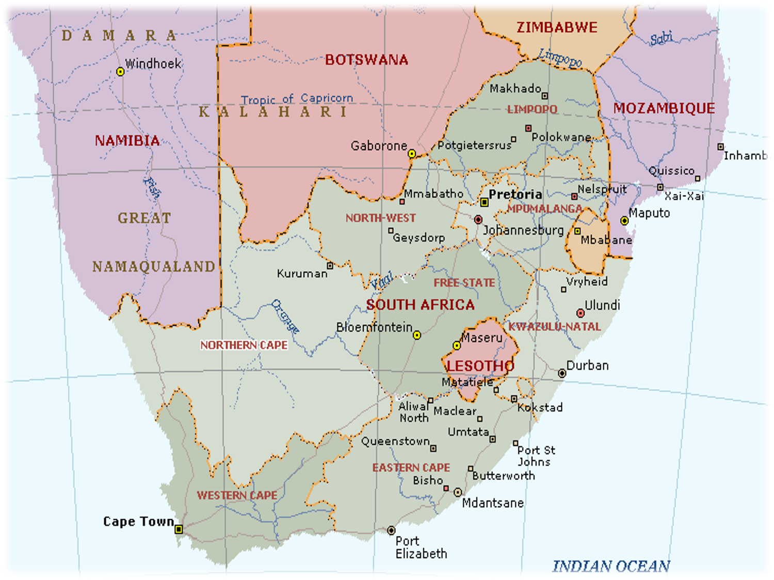
AREA OF OPERATIONS (AOO)
FORCE DISPOSITION
BN HQ (MUSINA)
4 X Coys
BN HQ (MACADAMIA)
3 X Coys
COY HQ (GOPANE)
1 X Coy
COY HQ (LOUISVALE)
1 X Coy
BN HQ (PONGOLA)
3 X Coys
BN HQ (LADYBRAND)
2 X Coys (incl Horses & Motor Bikes)
COY HQ (MALUTI)
1 X Coy

Slide 8
DEVELOPMENTS AND FUTURE PLANS
Increase of Force Levels (sub-units) in the short term on land borderline deployment is highly unlikely.
The Maritime borderline domain in 2023 will be highly improved and the domination of the territorial waters will be effected. This is due to the acquisition of 3 new vessels (IMMPV) in the Medium Term. The 1st IMMPV will be operationally deployed by early 2023.
Work is underway to bring in technology in the form of sensors and radars as a force multiplier in the medium term.

Slide 9
OPTIMISATION (1/2)
Areas of optimisation to mitigate the capability short comings (mobility, equipment, infrastructure, personnel):
Maintain and improve existing coordination, collaboration and cooperation with other national and local govt departments role-players and stakeholders (SAPS, BMA, DFFE, etc).
Maintain and improve coordination, collaboration and cooperation with local traditional leadership, community forums, business leaders, farming communities as well as identified private security companies.
Maintain and improve cooperation, coordination and collaboration with counterparts across the borderline conducting borderline security/control bmo regular meetings, sharing of info, conducting joint/combined operations.

Slide 10
OPTIMISATION (2/2)
Work is underway to increase the deployment and utilisation of technology through acquiring of new technology systems.
Application of innovations intended to dominate the AOO.
Improve the conditions of the Ops Base facilities including the Forward Operating Bases (FOBs) and Temporary Bases (TBs).
Increased effort and contribution by govt towards improving the condition of the borderline infrastructure (proper and suitable fence, patrol roads).

Slide 11
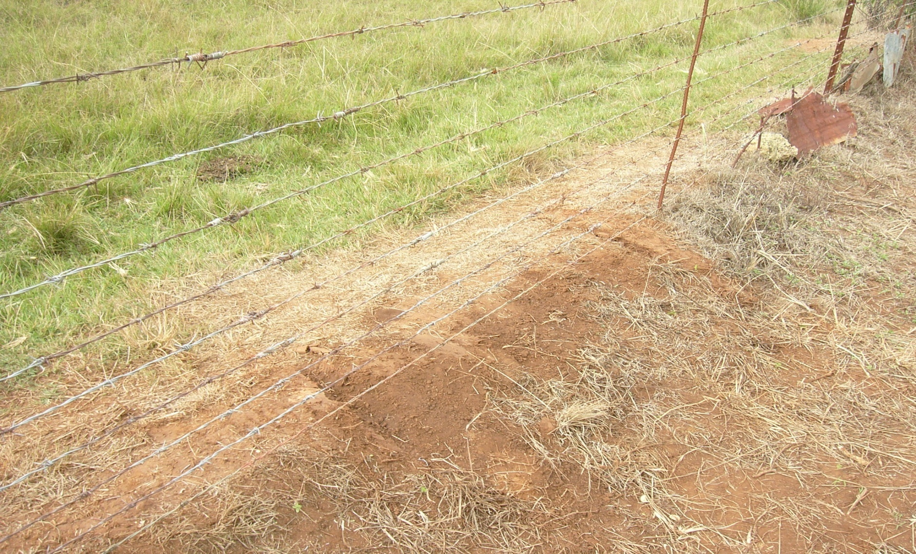
LAND BORDERLINE FENCE
POOR QUALITY BORDERLINE FENCE

Slide 12
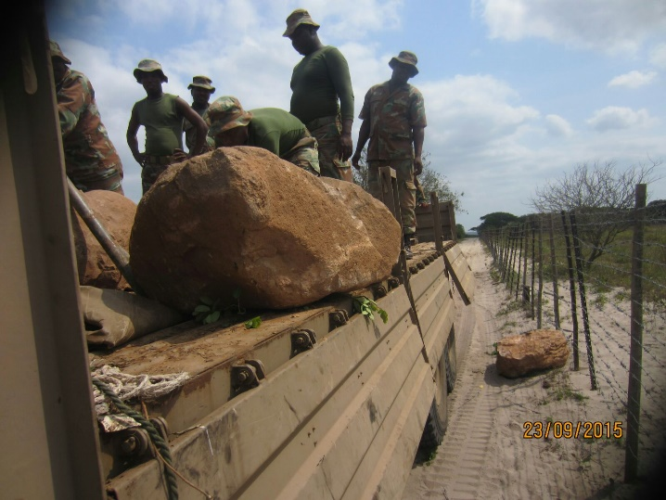
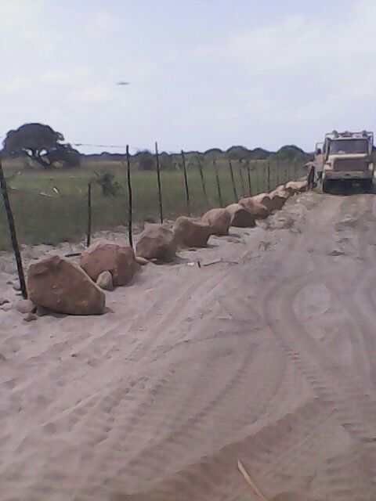
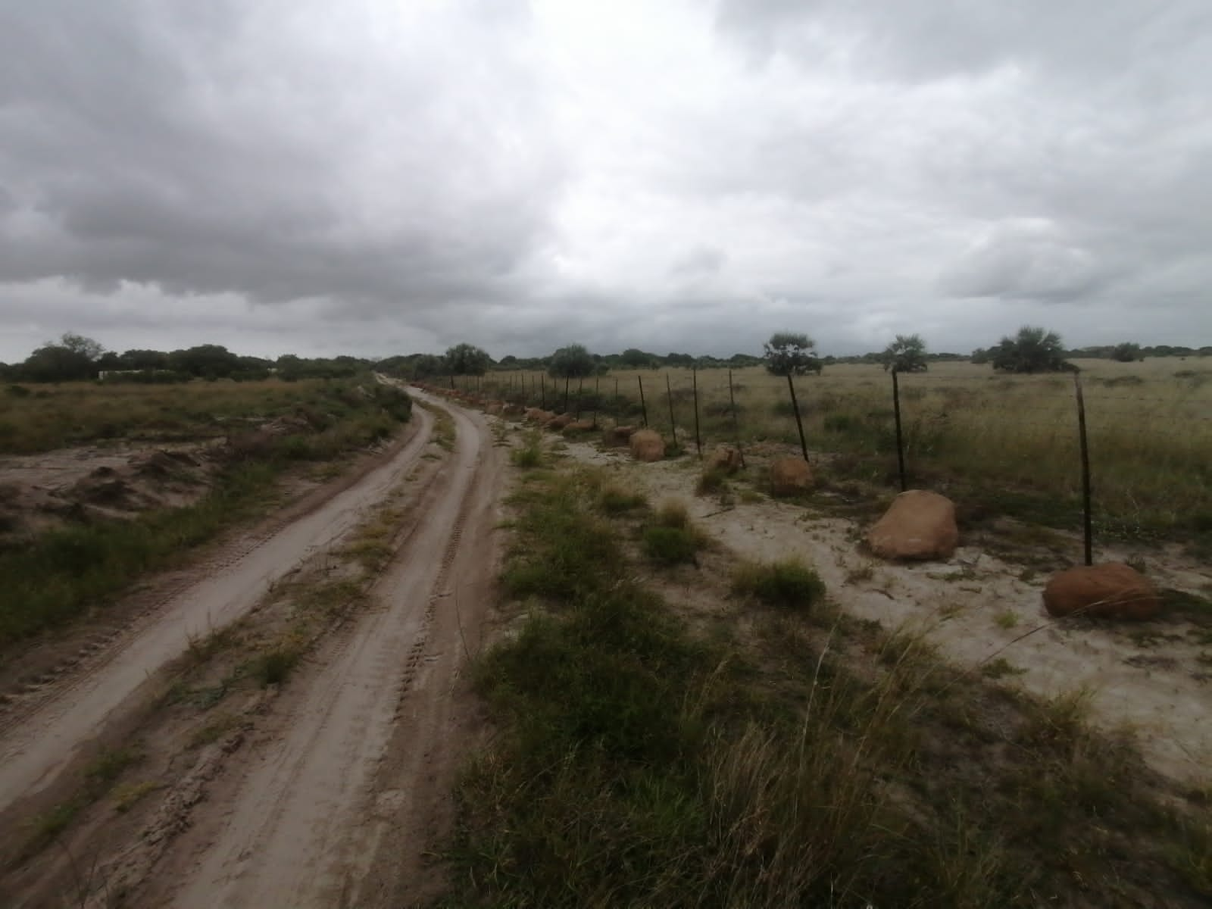
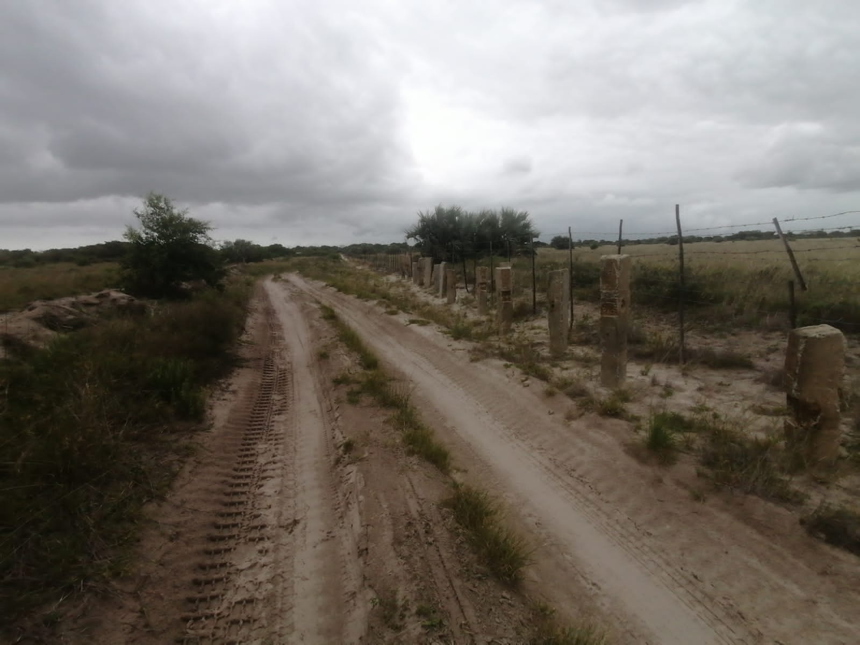
INITIATIVES & INNOVATIONS (1/2)
SANDF commanders at all levels will continue being innovative and coming up with initiatives to mitigate the capability short comings:

Slide 13
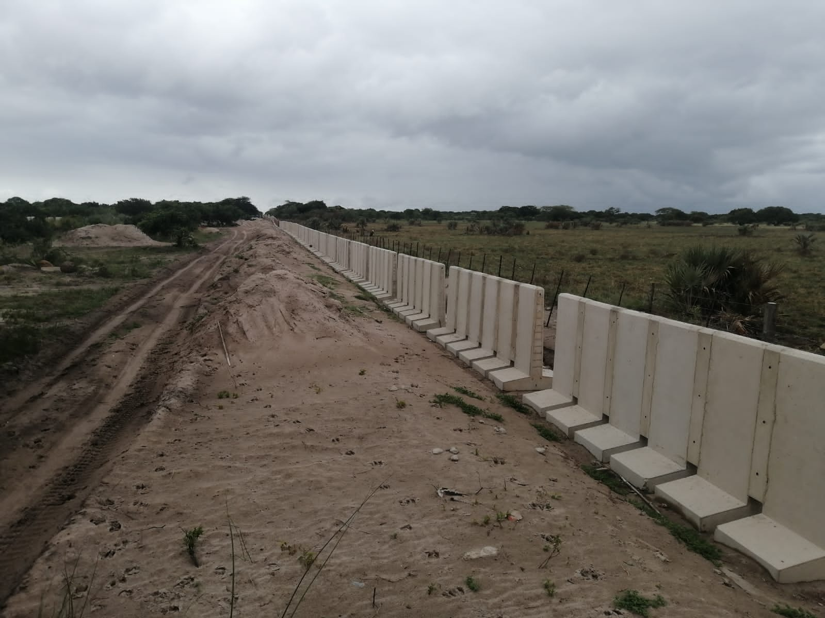
INITIATIVES AND INNOVATIONS (2/2)
KZN/MOZAMBIQUE BORDERLINE: JERSEY BARRIER OBSTACLES

Slide 14
TECHNOLOGY USAGE
Technology has been utilised in Border Safeguarding for a number of years to date, and continue being utilised periodically in the form of UAVs deployed as part of the Battlefield Surveillance Force Elements/ capability.
New technology systems in the form of sensors and radars are being acquired for deployment on the borderline by next year 2023.

Slide 15
PROPOSED GOVT CONTRIBUTION
DOD proposes for the involvement and contribution by other govt departments for a dedicated whole of govt effort to address the lack of adequate capabilities in the protection of our borderline bmo:-
Opening up/establishment of patrol roads along the entire stretch of the borderline.
Consideration to establish a servitude area/restricted zone along the entire stretch of the borderline.
Adoption of the KZN provincial govt initiative of placing/installing barricades (Jersey barriers) to make it difficult for vehicles to drive through across the borderline.

Slide 16
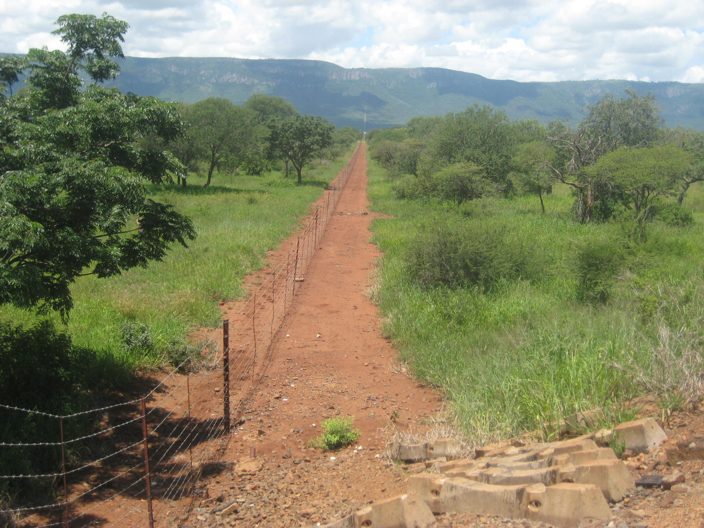
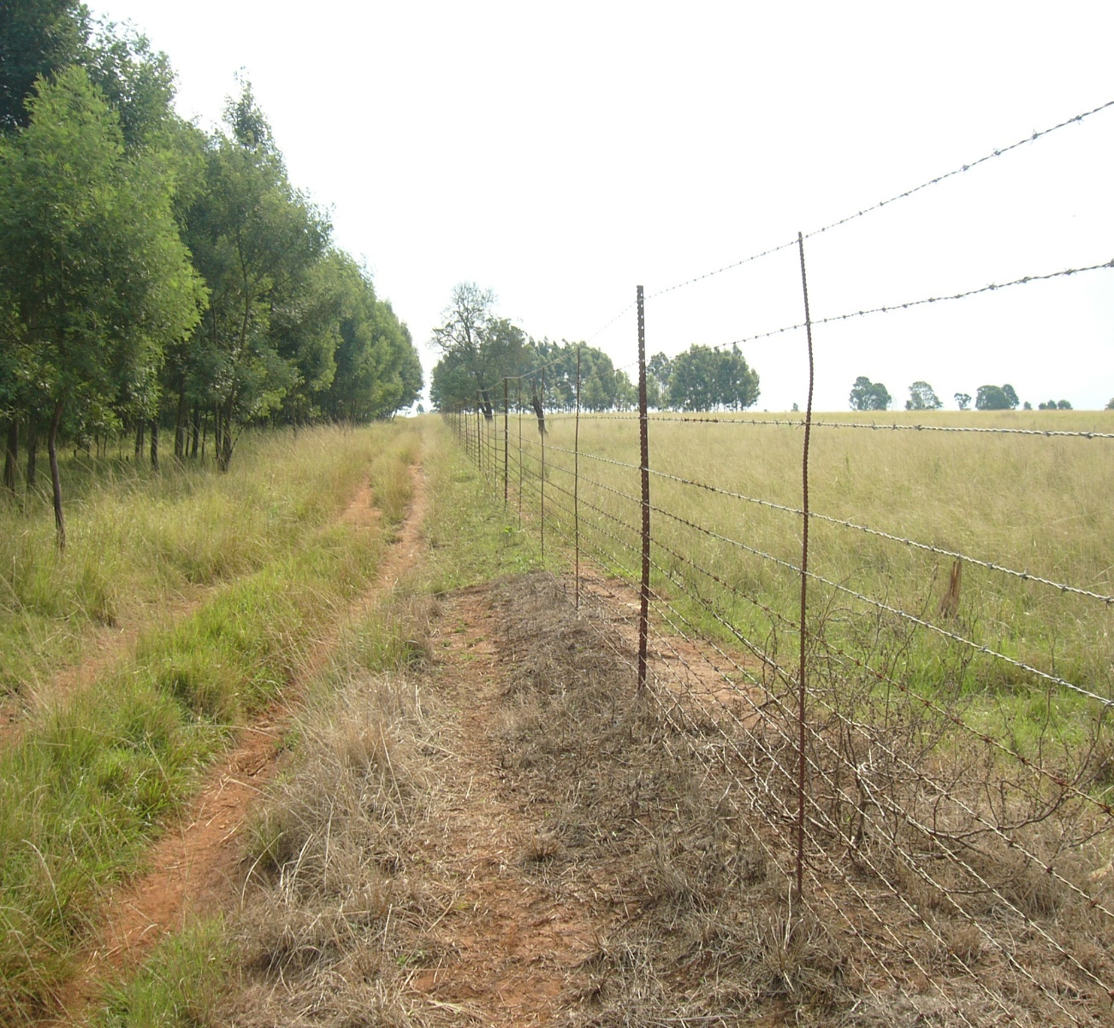
BORDERLINE SERVITUDE & PATROL ROADS

Slide 17
SUCCESSES (1/2)
1st QUARTER: APRIL TO JUNE 2022

Slide 18
SUCCESSES (2/2)
2nd QUARTER: JULY TO SEPTEMBER 2022

Slide 19
CHALLENGES
Lack of adequate mobility (land, air, sea) and transport capabilities.
Facilities for soldiers in deployment area not up to the required standard and affects the morale of deployed soldiers.
Cumbersome and lengthy procurement process negatively affects the required sustainment and support to the deployed soldiers. Continuous and adequate logistical supply support is a critical enabler in the conduct of operations.
Poor borderline infrastructure (border fence, patrol roads, access routes) is a serious impediment to exercising full control of the deployment area.
Legislative impediments.

Slide 20
COOPERATION WITH BMA
The Implementation Protocol between the DOD and the BMA to regulate/guide the cooperation and working together at the borders was drafted, agreed upon, signed and is operational.
Cooperation between the DOD and the BMA is currently in place, with cordial relations and no challenges thus far.

Slide 21
CONCLUSION
SANDF Force Elements deployed on the borderline will continue working hard, with commitment, dedication and zeal to achieve the set objectives and continue making a deference despite the serious capacity challenges the DOD is faced with.
Commanders and soldiers entrusted with the Border Safeguarding effort will continue coming up with innovations and initiatives in order to dominate the borderline AOO.
Work is underway to bring in technology in the form of sensors and radars as a force multiplier in the medium term.
Consideration for a more robust approach wherein the govt should own a portion of land stretching along the borderline (servitude, restricted zone) which will be exclusively under control of the security cluster.

Slide 22
QUESTIONS!
REMARKS!!
INPUTS!!!

