Slide 1
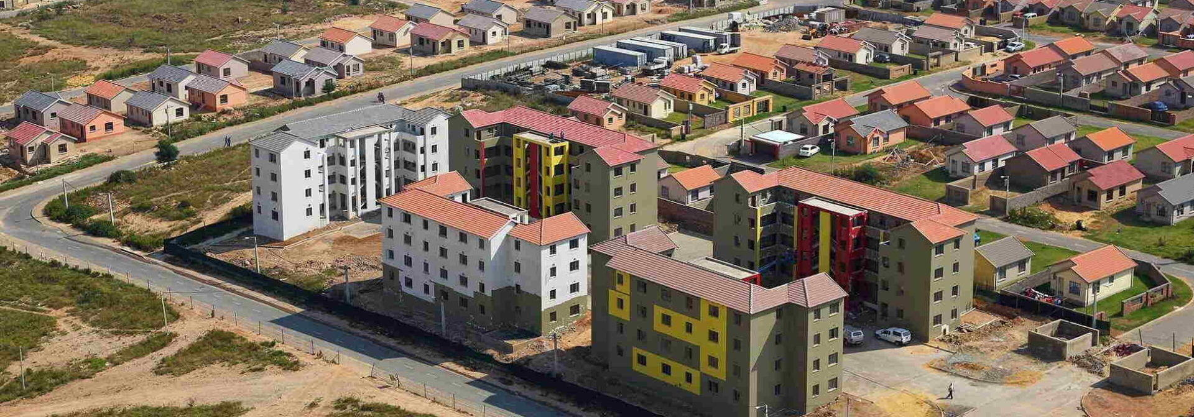

ANNUAL REPORT
Presentation
2021/22 FY

Slide 2
TABLE OF CONTENTS
Item | Content | Slide no
1. | Purpose | 3
2. | Executive overview and Highlights | 4-5
3. | HDA Performance Overview and Highlights | 6-8
4. | MTSF Targets and Performance to date | 9
5. | Detailed performance tables | 10- 20
6. | Audit Outcomes and Audit action plan | 21-25
7. | Financial Overview | 26-30
8. | Recommendations | 31

Slide 3
PURPOSE
To brief the Portfolio Committee on Human Settlements on the Annual Report of the Housing Development Agency for the 2021/22 Financial Year

Slide 4
EXECUTIVE OVERVIEW AND HIGHLIGHTS - 2021/22
During the period under review the former Minister of Human Settlements appointed Mr. Neville Chainee as Administrator effective 17 February 2021. Mr Chainee was replaced by Dr Mahapa as the Administrator in July 2021.
The Audit and Risk Committee remained the only functional committee to support the organisation under the leadership of the Administrator.
The Board was appointed by Honourable Minister Kubayi in November 2021
Mr. Stephen Poya was appointed as Acting 17th of February in 2021 to 27th August 2021
Ms Daphney Ngoasheng was appointed Acting CEO from 27th August 2021 to 31st May 2022
The Board with the support of the Minister expedited the appointment of the CEO and CFO who resumed their duties in June and July 2022 respectively
Since the appointment of the CEO and CFO the following has been done:
7. Disciplinary matters with Executives concluded
8. Organisational Structure finalised and submitted for Minister’s review
9. Moratorium on position lifted to enable filing of critical positions
10. Irregular Expenditure Register being developed and condonation process underway
11. Improvement in Organisational Performance in Q1 – 61% Performance
12. Weekly project tracking done and updated on the project tracking tool to identify blockages and required actions

Slide 5
EXECUTIVE OVERVIEW AND HIGHLIGHTS - 2021/22
The HDA developed a new strategy with a focus on its role as a developer of choice for the public sector that is structured on the 6 strategic pillars of the HDA :
Mandate | Clarification of the mandate and the HDA fully implementing its mandate and put in measures that will lead to a much bigger role as a fully-fledged property developer
Governance | Implementation of concerted initiatives to progressively enhance compliance with the applicable regulatory and governance frameworks for the HDA,
Sustainability | A business and funding model will be implemented that will support both the primary and secondary mandate and balances the need for the public mandate and the need for financial sustainability,
People and Structure | The strategic path chosen by the HDA requires a systematic and deliberate reorganisation to ensure that the HDA has the right fit in terms of people and structure.
Processes and Systems | The HDA strategic outlook requires that the organisation embraces processes and systems that fit the digital era.
Perception Management | The HDA will need to implement change management programme that is both inward and outward looking.

Slide 6
DETAILED ORGANISATIONAL PERFORMANCE
PROGRAMME | TOTAL NUMBER OF KPI’S | TOTAL TARGETS ACHIEVED | TOTAL TARGETS NOT ACHIEVED
PROGRAMME 1: TOTALS | 9 | 1 | 8
Administration | 9 | 1 | 8
PROGRAMME 2: TOTALS | 5 | 2 | 3
Land Assembly and PHSHDAs | 5 | 2 | 3
PROGRAMME 3: TOTALS | 19 | 7 | 12
3.1 Informal Settlements Upgrading | 4 | 2 | 2
3.2 Catalytic Projects and Revitalisation Distressed Mining Communities | 3 | 2 | 1
3.3 Regions | 13 | 3 | 10
PROGRAMME 4: TOTALS | 1 | 0 | 1
Planning , Monitoring and Evaluation and IGR | 1 | 0 | 1
HDA Totals | 34 | 10 | 24
HDA OVERALL PERFORMANCE |  | 29,41% | 70,59%

Slide 7
OVERALL ORGANISATIONAL PERFORMANCE TREND Q1-Q4

Slide 8



HDA ANNUAL PERFORMANCE MICRO-INDICATORS 2021/22
TARGET
ACHIEVED
5020 housing units
2451 housing units
1500 Hectares of land acquired in PHSHDA’s
1765,5591 Hectares Acquired
(PHSHDAs) was declared on the 15th of May 2020
47 Integrated implementation
programmes for PDAs prepared
40 Development Plans for PHSHDA completed
2806 Service Sites
(PHSHDAs) was declared on the 15th of May 2020
5598 Service Sites
1456 Title Deeds
1566 Title Deeds
(PHSHDAs) was declared on the 15th of May 2020

Slide 9
MTSF TARGETS IN PROGRESS
MTSF TARGET ( Sectoral Targets) | HDA TARGET | PROGRESS TO DATE
94 priority development areas declared for human settlements development | 94 priority development areas declared for human settlements development | The 136 Priority Human Settlements and Housing Development Areas (PHSHDAs) were declared on the 15th of May 2020
Development Plans for all 94 priority developed areas, categorised and prioritised with budgets & finance options | Development Plans for all 94 priority developed areas, categorised and prioritised with budgets & finance options | 59 Development Plans for PHSHDA completed
100% hectares rezoned (acquired in 2014-2019 within PHDA’s ) | 100% hectares rezoned (acquired in 2014-2019 PHDA’s) | 32% of acquired land during 2014-2019 rezoned falling within the PHSHDAs
470 000 housing units | 67 669 Housing Units Delivered | 12 779 Housing units delivered
300 000 serviced sites | 51 146 Serviced sites delivered | 9715 serviced sites delivered
Total number of title deeds registered - Post- 2019: 300 000 | 39 002 Title deeds Registered | 9521 Title deeds Registered

Slide 10
Programme 1: Administration
PROGRAMME 1: ADMINISTRATION
Outcome | Output | Output Indicators | Audited Actual Performance 2019/20 | Audited Actual Performance 2020/21 | Planned Annual Target 2021/22 | **Actual Achievement 2021/22 | Deviation from Planned Target to Actual Achievement 2021/22 | Reasons for Deviation | POE Submitted
Functional, Efﬁcient and Integrated Governance | Unqualiﬁed audits | 1.1.1 Unqualiﬁed audit outcome with no material ﬁndings | Qualiﬁed audit opinion for the 2018/ 19 ﬁnancial year | Unqualiﬁed audit report for 2019/20 | Unqualiﬁed audit outcome with no material ﬁndings | Not Achieved Qualiﬁed audit opinion for the 2020/21 ﬁnancial year | Unqualiﬁed audit outcome with no material ﬁndings | The HDA has received a qualiﬁed audit opinion for the 2020/21 FY. Management is implementing the Audit Action Plan. | External Audit Action Plan 2020/21 Management Report 2020/21 Audit Action Plan 2020/21
 | Transformation and Empowerment of designated groups | 1.1.2 Percentage of annual HDA procurement spend, targeted at businesses owned by BBBEE Levels 1 - 4 | 50% of annual HDA procurement spend, targeted at businesses owned by BBBEE Levels 1 - 4 | 50% of annual HDA procurement spend, targeted at businesses owned by BBBEE Levels 1 - 4 | 60% of annual HDA procurement spend, targeted at businesses owned by BBBEE Levels 1 - 4 | Achieved 70,07%of annual HDA procurement spend, targeted at businesses owned by BBBEE Levels 1 - 4 | +10,07% of annual HDA procurement spend, targeted at businesses owned by BBBEE Levels 1 - 4 | Positive variance is due to the implementation of the pre-qualiﬁcation in line with the approved T&E Policy | CSD Reports/ BEE Certiﬁcates
 |  | 1.1.3 Percentage of annual HDA procurement spend targeted at businesses owned by Women | 33.5% of annual HDA procurement spend, targeted at businesses owned by Women | 35% of annual HDA procurement spend, targeted at businesses owned by Women | 35% of annual HDA procurement spend, targeted at businesses owned by Women | Not Achieved 8,12% of annual HDA procurement spend, targeted at businesses owned by Women | -26,88% of annual HDA procurement spend, targeted at businesses owned by Women | Negative variance - due to non- implementation of projects earmarked for designated groups. A policy has been approved to enable focus targeted focus on designated groups | CSD Reports/ BEE Certiﬁcates
 |  | 1.1.4 Percentage of annual HDA procurement spend, targeted at businesses owned by Youth | 46% of annual HDA procurement spend, targeted at businesses owned by Youth | 15% of annual HDA procurement spend, targeted at businesses owned by Youth | 15% of annual HDA procurement spend, targeted at businesses owned by Youth | Not Achieved 2,92% of annual HDA procurement spend, targeted at businesses owned by Youth | -12,08% of annual HDA procurement spend, targeted at businesses owned by Youth | Negative variance - due to non- implementation of projects earmarked for designated groups | CSD Reports/ BEE Certiﬁcates

Slide 11
Programme 1: Administration
PROGRAMME 1: ADMINISTRATION
Outcome | Output | Output Indicators | Audited Actual Performance 2019/20 | Audited Actual Performance 2020/21 | Planned Annual Target 2021/22 | **Actual Achievement 2021/22 | Deviation from Planned Target to Actual Achievement 2021/22 | Reasons for Deviation | POE Submitted
 |  | 1.1.5 Percentage of annual HDA procurement spend targeted at businesses owned by Persons with disabilities | 0% of annual HDA procurement spend, targeted at businesses owned by Persons with disabilities | 5% of annual HDA procurement spend, targeted at businesses owned by Persons with disabilities | 5% of annual HDA procurement spend, targeted at businesses owned by Persons with disabilities | Not Achieved 0,53% of annual HDA procurement spend, targeted at businesses owned by Persons with disabilities | -4,47% of annual HDA procurement spend, targeted at businesses owned by Persons with disabilities | Negative variance - due to non-implementation of projects earmarked for designated groups. A policy has been approved to enable focus targeted focus on designated groups. | CSD Reports/ BEE Certiﬁcates
 |  | 1.1.6 Percentage of annual HDA procurement spend targeted at businesses owned by Military Veterans | 0.56% of annual HDA procurement spend, targeted at businesses owned by Military Veterans | 5% of annual HDA procurement spend, targeted at businesses owned by Military Veterans | 5% of annual HDA procurement spend, targeted at businesses owned by Military Veterans | Not Achieved 0,27% of annual HDA procurement spend, targeted at businesses owned by Military Veterans | -4,73% of annual HDA procurement spend, targeted at businesses owned by Military Veterans | Negative variance - due to non-implementation of projects earmarked for designated groups. A policy has been approved to enable focus targeted focus on designated groups. | CSD Reports/ BEE Certiﬁcates
 |  | 1.1.7 Percentage implementation of the approved internal audit plan | New Indicator | 100% implementation of Internal Audit plan against the annual coverage plan 2020/2021 | 100% implementation of the approved internal audit plan | Not Achieved 75% Implementation of the approved internal audit plan | -25% implementation of the approved internal audit plan | Partial Implementation of the approved internal audit. | Signed off Report by the Audit & Risk Manager Internal Audit Plan
 |  | 1.1.8 Percentage implementation of anti-fraud and corruption plan | New Indicator | 100% implementation of anti-fraud and corruption plan | 100% implementation of anti-fraud and corruption plan | Not Achieved 0% implementation of anti-fraud and corruption plan | -100% implementation of anti-fraud and corruption plan | Anti-Fraud & Corruption Plan was approved and partially implemented as the plan speciﬁed as whistle blower report as evidence of implementation. However, in the period under review there was no whistleblower report. | Minutes extract from ARC meeting Fraud Prevention Plan Whistleblowing Report

Slide 12
Programme 1: Administration
PROGRAMME 1: ADMINISTRATION
Outcome | Output | Output Indicators | Audited Actual Performance 2019/20 | Audited Actual Performance 2020/21 | Planned Annual Target 2021/22 | **Actual Achievement 2021/22 | Deviation from Planned Target to Actual Achievement 2021/22 | Reasons for Deviation | POE Submitted
PROGRAMME 2: LAND MANAGEMENT AND PRIORITY HUMAN SETTLEMENTS HOUSING DEVELOPMENT AREASc
Outcome | Output | Output Indicators | Audited Actual Performance 2019/20 | Audited Actual Performance 2020/21 | Planned Annual Target 2021/22 | **Actual Achievement 2021/22 | Deviation from Planned Target to Actual Achievement 2021/22 | Reasons for Deviation | POE Submitted
 | Integrated implementation programmes PDAs prepared | 2.1.1. Number of integrated implementation programmes for PDAs prepared | New Indicator | New Indicator | 47 Integrated implementation programmes for PDAs prepared | Not Achieved 40 integrated implementation programmes for PDAs prepared | -7 integrated implementation programmes for PDAs prepared | Procurement delays and Budget constraint (insufﬁcient funds), and lack of joint planning with the municipalities where PDA's are located | Implementation Programmes
 | Well-located land acquired within PHSHDAs | 2.1.2 Number of hectares of well- located land acquired within PHSHDAs | New Indicator | 1500 hectares of well-located acquired within PHSHDAs | 1500 hectares of well-located acquired within PHSHDAs | Achieved 1765,5591 ha of well-located land acquired within PHSHDAs | +265,5591 ha of well- located land | Land has been released by the Department of Public Works through the rapid release programme which has assisted in the achievement of the target. | Agreements of Sale Power of Attorney
 | Land rezoned, townships established, and all related development approvals acquired | 2.1.3 Percentage of the 1884.6870ha of land acquired during 2014 – 2019 falling within PHSHDAs rezoned | New Indicator | 10% of the land acquired during 2014 – 2019 falling within PHSHDAs rezoned | 30% of the 1884.6870ha of land acquired during 2014 – 2019 falling within PHSHDAs rezoned | Not Achieved 0% of the 1884.6870ha of land acquired during 2014 – 2019 falling within PHSHDAs rezoned | -30% of the 1884.6870ha of land acquired during 2014 – 2019 falling | Delays in the approval of land rezoning applications by Municipal planning tribunals. | Not Applicable
Programme 2: Land Management Priority Human Settlements Housing Development Areas

Slide 13
Programme 2: Land Management Priority Human Settlements Housing Development Areas
PROGRAMME 2: LAND MANAGEMENT AND PRIORITY HUMAN SETTLEMENTS HOUSING DEVELOPMENT AREAS
Outcome | Output | Output Indicators | Audited Actual Performance 2019/20 | Audited Actual Performance 2020/21 | Planned Annual Target 2021/22 | **Actual Achievement 2021/22 | Deviation from Planned Target to Actual Achievement 2021/22 | Reasons for Deviation | POE Submitted
 |  | 2.1.4 Number of hectares of land rezoned for Human Settlements development | 5 parcels of land facilitated for rezoning | 1000 hectares of land rezoned for Human Settlements development | 1000 hectares of land rezoned for Human Settlements development | Not Achieved 607,1939 hectares of land rezoned for Human Settlements development | -392,8061 ha hectares of land rezoned for Human Settlements development | Delays in the approval of the applications for rezoning due to relevant Municipal Tribunals not convening. | Letters of approval from the relevant municipalities
 | Well-located land acquired or released for human settlement development | 2.1.5 Number of hectares of well- located land acquired or released for human settlements development | 3514, 5428 hectares of Land acquired or released for Human Settlements | 1500 of hectares of well-located land acquired or released for human settlements development | 750 of hectares of well-located land acquired or released for human settlements development | Achieved 3243.447 ha of well- located land acquired or released for human settlements development | +2493.447 ha of well-located land acquired or released for human settlements development | The target was exceeded due to the acquisition of properties above the targets for all the quarters. | Agreements of Sale

Slide 14
Programme 3.1 Programme Planning and Design
PROGRAMME: 3.1 PROGRAMME PLANNING AND DESIGN
Outcome | Output | Output Indicators | Audited Actual Performance 2019/20 | Audited Actual Performance 2020/21 | Planned Annual Target 2021/22 | **Actual Achievemen t 2021/22 | Deviation from Planned Target to Actual Achievement 2021/22 | Reasons for Deviation | POE Submitted
Integrated and sustainable human settlements and Security of Tenure | Adequate housing and improved living conditions in informal settlements | 3.1.1 Number of Informal settlements supported for upgrading to phase 3 | 369 Informal settlements assessed and categorized | 143 of Informal settlements supported for upgrading to phase 3 | 375 of Informal settlements supported for upgrading to phase 3 | Not Achieved 204 informal Settlements supported for upgrading to phase 3 | -171 informal Settlements supported for upgrading to phase 3 | The Agency is still in discussions with GDHS to be appointed as an implementing agent to undertake assessment of bulk infrastructure for the informal settlements Programme. This has caused the delay in the implantation of the programme. | Progress Reports Funding Agreements Project Implementation Plans Inception Reports Service Level Agreements
 |  | 3.1.2 Number of Informal Settlements upgraded to phase 3 (end to end) | New Indicator | New Indicator | 4 of Informal Settlements upgraded to phase 3 (end to end) | Achieved 5 Informal Settlements upgraded to phase 3 (end to end) | + 1 Informal Settlements upgraded to phase 3 (end to end) | HDA has entered into a tripartite agreement with GDHS and GPF, which has assisted the HDA in exceeding the set target | Progress Reports Service Level Agreements
 | Adequate housing and improved living conditions in Emergency housing areas Selected Inner cities Selected catalytic/mega projects | 3.1.3 Number of Informal settlements assisted with the relocation and emergency interventions | New Indicator | New Indicator | 2 of Informal settlements assisted with relocation and emergency interventions | Achieved 4 Relocation commences in settlements | +2Relocation assistance provided in 3 informal settlements | Relocation and /or emergency interventions were planned for Khutsong and Makhuduthamaga. Support was provided to Khutsong Intervention (relocation due to sinkholes). In addition, the HDA provided relocation assistance work in Western Cape for relocation services for a property held by PRASA and leading to the overachievement on this target. | Implementation Protocol Execution Plan

Slide 15
Programme 3.2 Catalytic Projects and Distressed Mining Communities
PROGRAMME 3.2 : SUB PROGRAMME: REGIONAL COORDINATION AND HUMAN SETTLEMENTS IMPLEMENTATION SUPPORT SERVICES
Outcome | Output | Output Indicators | Audited Actual Performance 2019/20 | Audited Actual Performance 2020/21 | Planned Annual Target 2021/22 | **Actual Achievement 2021/22 | Deviation from Planned Target to Actual Achievement 2021/22 | Reasons for Deviation | POE Submitted
Integrated and sustainable human settlements and Security of Tenure | Adequate housing and improved living conditions in selected catalytic/mega projects | 3.2.1 Number of catalytic projects provided with implementation support | 50 Catalytic Projects provided with Implementation support | 50 Catalytic Projects provided with Implementation support | 50 Catalytic Projects provided with Implementation support | Achieved 50 Catalytic Projects provided with Implementation support | None | Not Applicable | Reports on the 50 projects
 |  | 3.2.2 Number of Catalytic projects assisted in raising capital for the infrastructure required for the projects | New Indicator | New Indicator | 6 of Catalytic projects assisted to raise capital for the infrastructure required for the projects | Not Achieved Business cases and business plans, including ﬁnancials for the projects and sub-projects not completed | 6 of Catalytic projects assisted to raise capital for the infrastructure required for the projects | Insufﬁcient human resources due to moratorium on recruitment | Not Applicable
 | Adequate housing and improved living conditions in distressed mining communities | 3.2.3 Number of municipalities provided with technical and implementation support6 for distressed mining communities | 22 of municipalities provided with technical and implementation support for distressed mining communities | 23 of municipalities provided with technical and implementation support for distressed mining communities | 23 of municipalities provided with technical and implementation support for distressed mining communities | Achieved 23 municipalities were provided with technical and implementation support. The target was thus achieved | None | None | Project Pipelines Development Plans Technical implementation Support

Slide 16
Programme 3.3 Regional Co-ordination
PROGRAMME 3.3 : PROGRAMME PLANNING AND DESIGN AND REGIONAL COORDINATION AND HUMAN SETTLEMENT IMPLEMENTATION SUPPORT SERVICES
Outcome | Output | Output Indicators | Audited Actual Performance 2019/20 | Audited Actual Performance 2020/21 | Planned Annual Target 2021/22 | **Actual Achievement 2021/22 | Deviation from Planned Target to Actual Achievement 2021/22 | Reasons for Deviation | POE Submitted
Integrated and sustainable human settlements and Security of Tenure | Housing Units delivered by HDA | 3.3.1 HDA Strategic Projects: Number of units completed15 | New Indicator | New Indicator | 780 of units completed | Not Achieved 0 wall plates completed | 780 of units completed | The service provider has been appointed, the inception report has been initiated, engineering reports, designs etc. are being prepared by the relevant authorities. | Not Applicable
 |  | 3.3.2 Region A: Number of IBT housing units delivered i.r.o. projects implemented by the HDA16 | 4356 of IBT housing units delivered i.r.o. projects implemented by the HDA | 2283 of IBT housing units delivered i.r.o. projects implemented by the HDA | 2787 of IBT housing units delivered i.r.o. projects implemented by the HDA | Not Achieved 1685 IBT housing units delivered i.r.o. projects implemented by the HDA | -1102 IBT housing units not delivered i.r.o. projects implemented by the HDA | During the year under review there has been the withdrawal of mandates i.e., WC (Masiphumelelo) and other projects in the EC. | Signed Practical completion certiﬁcates Happy Letters
 |  | 3.3.3 Region B: Number of Housing Units Delivered i.r.o. projects implemented by HDA | 1191 of Housing Units Delivered i.r.o. projects implemented by HDA | 1138 of Housing Units Delivered i.r.o. projects implemented by HDA | 1463 of Housing Units Delivered i.r.o. projects implemented by HDA | Not Achieved 766 of Housing Units Delivered i.r.o. projects implemented by HDA | -697 of Housing Units Delivered i.r.o. projects not implemented by HDA | Limpopo Poor performance of contractors due to poor cash ﬂow and planning (2) Contractors withdrawing units allocated to them due to several reasons beyond HDA's control on Military veterans. Gauteng - Financial capacity of Kwazenzele & Munsieville contractors has contributed to not achieving set target. | Quality assurance certiﬁcates Happy letters

Slide 17
Programme 3.3 Regional Co-ordination
PROGRAMME 3.3 : PROGRAMME PLANNING AND DESIGN AND REGIONAL COORDINATION AND HUMAN SETTLEMENT IMPLEMENTATION SUPPORT SERVICES
Outcome | Output | Output Indicators | Audited Actual Performance 2019/20 | Audited Actual Performance 2020/21 | Planned Annual Target 2021/22 | **Actual Achievement 2021/22 | Deviation from Planned Target to Actual Achievement 2021/22 | Reasons for Deviation | POE Submitted
 | Serviced sites delivered | 3.3.4 Region A: Number of serviced sites delivered i.r.o. projects implemented by HDA8 | 2440 of serviced sites delivered i.r.o. projects implemented by HDA | 3872 of serviced sites delivered i.r.o. projects implemented by HDA | 2513 of serviced sites delivered i.r.o. projects implemented by HDA | Achieved 2596 of serviced sites delivered i.r.o. projects implemented by HDA | +83 of serviced sites not delivered i.r.o. projects implemented by HDA | Serviced sites were implemented in EC, NC and WC. In the WC the Masiphulelele project was withdrawn therefore serviced sites were not delivered in Masiphumelele. However, the HDA team ensured that other projects such as the Boystown project are implemented to achieve the set target. | Engineer completion certiﬁcate
 |  | 3.3.5 Region B: Number of serviced sites delivered i.r.o. projects implemented by HDA19 | 1400 of serviced sites delivered i.r.o. projects implemented by HDA | 884 of serviced sites delivered i.r.o. projects implemented by HDA | 1389 of serviced sites delivered i.r.o. projects implemented by HDA | Not Achieved 210 of serviced sites delivered i.r.o. projects implemented by HDA | -1179 serviced sites delivered i.r.o. projects implemented by HDA | Gauteng - The delay in the approval of designs for Alexandra X52 has had effect target not being met. Furthermore, the consolidation of the stand to 1 erf where the 144 units had impact on the achievement of the target | Engineering certiﬁcate
 |  |  |  |  |  |  |  | Limpopo – (1) Disruptive community protests affecting construction on sites..
 |  |  |  |  |  |  |  | North West - Project frustrations through the lack of sufﬁcient bulk infrastructure and poor public support
 |  | 3.3.6 Region C: Number of serviced sites delivered i.r.o. projects implemented by HDA | New Indicator | New Indicator | 500 serviced sites delivered i.r.o. projects implemented by HDA | Not Achieved 0 of serviced sites delivered i.r.o. projects implemented by HDA | -500 serviced sites delivered i.r.o. projects implemented by HDA | Kwa-Zulu Natal- Delay in SPLUMA applications approvals for the service sites programmes | Not Applicable

Slide 18
Programme 3.3 Regional Co-ordination
PROGRAMME 3.3 : PROGRAMME PLANNING AND DESIGN AND REGIONAL COORDINATION AND HUMAN SETTLEMENT IMPLEMENTATION SUPPORT SERVICES
Outcome | Output | Output Indicators | Audited Actual Performance 2019/20 | Audited Actual Performance 2020/21 | Planned Annual Target 2021/22 | **Actual Achievement 2021/22 | Deviation from Planned Target to Actual Achievement 2021/22 | Reasons for Deviation | POE Submitted
 | TRUs delivered as requested | 3.3.7 Region B: Number of serviced sites delivered i.r.o. projects implemented by HDA | New Indicator | New Indicator | 1554 Number of serviced sites delivered i.r.o. projects implemented by HDA | Not Achieved 0 serviced sites delivered i.r.o. projects implemented by HDA | -1554 serviced sites delivered i.r.o. projects implemented by HDA | The HDA continues to encounter non-response of correspondences by relevant Municipality. | Not Applicable
 | Projects managed by HDA delivered against all milestones, as per signed IPs and MTOPs | 3.3.8 Region A: Number of HS Projects managed by the HDA | New Indicator | New Indicator | 40 HS Projects managed by the HDA | Achieved 53 HS Projects managed by the HDA | +13 HS Projects managed by the HDA | The HDA established and maintained good relationships with Provinces that make up Region A, which has resulted to further work being allocated to the HDA. | Funding Agreements Implementation Protocol Memorandum of Agreement
 |  | 3.3.9 Region A: Percentage completion of milestones of all projects managed by the HDA | New Indicator | New Indicator | 100% completion of milestones of all projects managed by the HDA | Not Achieved 0% completion of milestones of all projects managed by the HDA | 0% completion of milestones of all projects managed by the HDA | The milestones were not completed to achieve 100% completion | Not Applicable

Slide 19
Programme 3.3 Regional Co-ordination
PROGRAMME 3.3 : PROGRAMME PLANNING AND DESIGN AND REGIONAL COORDINATION AND HUMAN SETTLEMENT IMPLEMENTATION SUPPORT SERVICES
Outcome | Output | Output Indicators | Audited Actual Performance 2019/20 | Audited Actual Performance 2020/21 | Planned Annual Target 2021/22 | **Actual Achievement 2021/22 | Deviation from Planned Target to Actual Achievement 2021/22 | Reasons for Deviation | POE Submitted
 |  | 3.3.10 Region C: Number of HS Projects managed by the HDA | New Indicator | New Indicator | 62 HS Projects managed by the HDA | Not Achieved 32 HS Projects managed by the HDA | -31 HS Projects managed by the HDA | Kwa-Zulu Natal – (1) Delay in SPLUMA applications approvals for the Serviced Sites Programme. | Memorandum of Agreement Instructions to Perform Work
 |  |  |  |  |  |  |  | (2) Programme delays on the ﬁnalisation of the implementation protocol with Alfred Duma LM, | MTOP Service level agreement
 |  | 3.3.11 Region C: Percentage completion of bucket eradication project implemented by the HDA | New Indicator | New Indicator | 100% completion of bucket eradication projects implemented by the HDA | Not Achieved 0% (Clocolan) 0% (Ficksburg) completion of bucket eradication projects implemented by the HDA | -100% completion of bucket eradication projects implemented by the HDA | Project has been withdrawn due to the separation of the Department of Human Settlements And Water and Sanitation. The project has been handed back to the Department of Water and Sanitation.
 | HDA Projects packaged for implement ation | 3.3.12 Number of HDA strategic Projects packaged for development | New Indicator | New Indicator | 3 projects (Ellofspark, Queenstown and Hartebees- fontein) strategic Projects packaged for development | Not Achieved 0 Finalise submissions of WULA, Development Planning and related studies applications | -3 Finalise submissions of WULA, Development Planning and related studies applications | Hartebeespoort and Queenstown project approved by BAC, SCM ﬁnalising appointments and Contracts. Partial funding allocated to commence with the projects.
 |  | 3.3.13 Number of Title deeds registered | 403 Title Deeds Registered | 7058 Title Deeds Registered | 1456 Title Deeds Registered | Achieved 1566 Title Deeds Registered | +110 Title Deeds Registered | The targeted has been exceeded due to the responsiveness of the deed's ofﬁce in timeously processing documents lodged by conveyancers. | Conveyancer Certiﬁcates/letters

Slide 20
Programme 4 Planning , Monitoring and Evaluation and IGR
PROGRAMME 4: PLANNING, MONITORING AND EVALUATION AND IGR
Outcome | Output | Output Indicators | Audited Actual Performance 2019/20 | Audited Actual Performance 2020/21 | Planned Annual Target 2021/22 | **Actual Achievement 2021/22 | Deviation from Planned Target to Actual Achievement 2021/22 | Reasons for Deviation | POE Submitted
Integrated and | HS Projects | 4.1.1 Percentage | New Indicator | New Indicator | 100% of spatial | Not Achieved | -7% of spatial | In the ﬁrst quarter of | Desktop
sustainable | managed or | of spatial |  |  | transformation | 93% of spatial | transformation | the ﬁnancial year | analysis,
human | developed by HDA | transformation |  |  | planning, analysis, | transformation | planning, analysis, | only 2 of the 6 | Meeting
settlements | reﬂects spatial | planning, analysis |  |  | and | planning, analysis | and | logged requests have | minutes.
and Security of | transformation | and implementation |  |  | implementation | and implementation | implementation | not been achieved
Tenure | principles | support provided |  |  | support provided | support provided | support provided
 |  | on projects / |  |  | on projects / | on projects / | on projects /
 |  | programs within |  |  | programs within 10 | programs within | programs within
 |  | 10 working days |  |  | working days | 10 working days | 10 working days

Slide 21

2021/22 AUDIT OUTCOME
AUDIT OPINION:
Qualified Opinion
BASIS OF OPINION:
Project Obligations
Project Receivables, Land inventory, Property Plant and Equipment
Irregular, Fruitless & Wasteful Expenditure
PRE DETERMINED
OBJECTIVE:
Unmodified Opinion

Slide 22
AUDIT ACTION PLAN – 2021/22
No. | FINDING – Audit Report | ROOT CAUSE | ACTION PLAN | DATE
1. | Project Obligation - No sufficient audit evidence that project obligations have been correctly accounted for. The entity did not have adequate systems to maintain records of project obligations. | No adequate record keeping processes in place. | Review the invoicing process to the provincial departments. Meeting with provincial departments to align GRAP and MCS reporting while adhering to DoRA and the PFMA. Confirmations on a monthly basis with the provincial departments. | 31 December 2022
2. | Project Receivables – The entity did not recognise project receivables in accordance with GRAP 1. Project receivables are recorded when the project agreement is concluded. The entity has no right to receive the asset as a result of past events as the entity has not done any activity. | No adequate record keeping processes in place. | Review the invoicing process to the provincial departments. Meeting with provincial departments to align GRAP and MCS reporting while adhering to DoRA and the PFMA. Confirmations on a monthly basis with the provincial departments. | 31 December 2022
3. | Land Inventory – Management did not state inventory at lower of cost and current replacement cost. | Land valuations at year end were not performed | 1. Land valuations to be performed for the third and fourth quarter and record in accordance with GRAP 1. | 31 December 2022

Slide 23
AUDIT ACTION PLAN 2021/22
No. | FINDING – Audit Report | ROOT CAUSE | ACTION PLAN | DATE
4. | Property. Plant & Equipment – No audit evidence obtained due to the office relocation. Physical assets could not be confirmed. The condition of the assets could not be assessed for impairment and was unable to determine the impact on the net carrying amount of PPE. | 1. Lack of review of assets on an annual basis. 2. Inadequate record keeping to support financial reporting. | Review of the asset register to ensure all assets are accounted for. Perform an annual impairment test on the asset register. | 30 September 2022 15 March 2023
5. | Irregular expenditure – No adequate systems in place for identifying and recording all irregular expenditure | Lack of internal controls within SCM Lack of capacity in SCM Develop a proper irregular expenditure register | Strengthen internal controls within SCM and finance to detect irregular expenditure. All SCM and finance officials to undergo training Appointment of Senior Manager SCM and other key vacancies within SCM | 30 September 2022 30 November 2022
6. | Statement of Budget vs Actual – The approved budget was not used for reporting in the statement of comparison between budget and actual. | Lack of review of the statement of Budget vs Actual | Adequate review to be performed to ensure the approved budget is linked to the APP. | 28 February 2023

Slide 24
AUDIT ACTION PLAN 2021/22

Slide 25
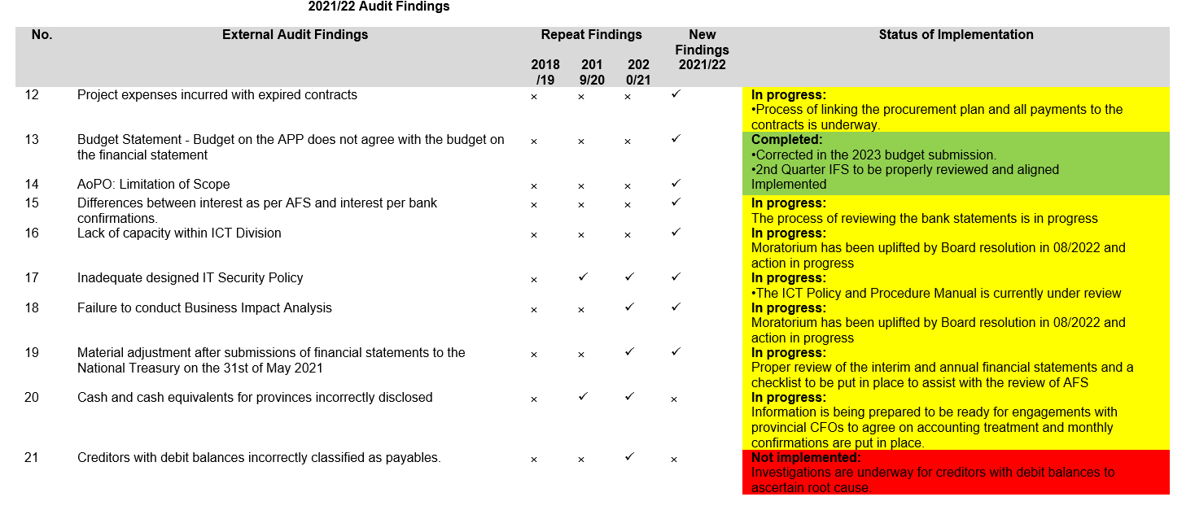
AUDIT ACTION PLAN 2021/22

Slide 26
IRREGULAR EXPENDITURE
51% (81 out of 157) transactions from 2017/2018 to 2020/2021 financial years completed and ready to be tabled at the Condonation Committee in line with the Irregular Expenditure framework.
Currently finalising the remaining 2019/2020 IE transactions;
First batch of 2019/2020 IE reports ready to be handed to the CEO;
Proper IE Register being developed.
Stages of condonation process to be followed:
  Stage 1 – Assessment / Investigation report finalized
  Stage 2 – Condonation Committee considers the matter and makes recommendation for consequence management
  Stage 3 – Report to EXCO, ARC, REMCO and Board
  Stage 4 – Consequence Management
  Stage 5 – Condonation report to National Treasury

Slide 27
STATEMENT OF FINANCIAL POSITION
Notes
Land parcels acquisition by the HDA, representing land owned by the Entity, has not changed in the past 3 years.
Receivables from non-exchange transactions increased due to a prepayment of R47 million for land held on behalf of BCMM.
Land inventory consists of land held by the HDA on behalf of other provinces/municipalities.
Project Receivables consist of invoices raised, based on funding agreements signed, but not honoured by the provincial departments.
Significant portion of R1,9 billion cash is held on behalf of provincial departments with the obligation of the corresponding project, these funds remained unspent as at 31 March 2022.
Payables from exchange transactions – consists of normal creditors not paid at year-end. Year-end payables significantly declined compared with the prior year due to the timeous payment of service providers.
Project payables – consists of contractors or project-related creditors not paid at year-end.
Cash held by the HDA on behalf of provincial departments has increased triple fold over the 3 years.
Project Obligations – consist of funds received from provinces for projects to be implemented by the HDA. A significant portion of the money transferred to the HDA was received during the 4th Quarter of R856 million(excluding value creation projects).

Slide 28
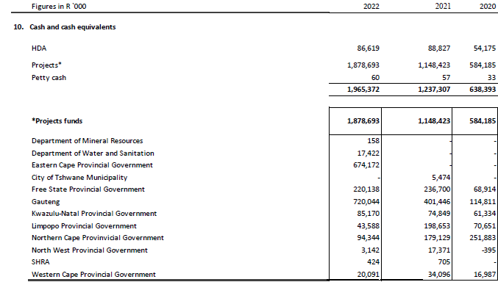
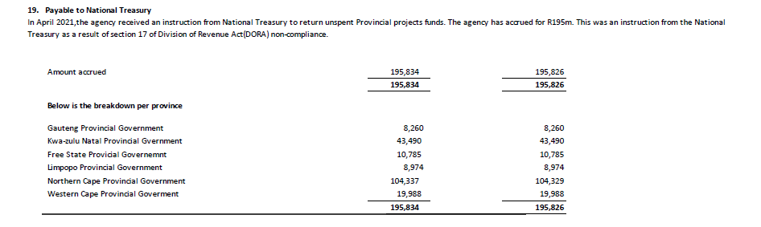
SUMMARY OF PROJECT FINANCES – CASH
FS: Balance is due to additional cash received from Free State for land acquisition.
EC Cape unspent moneys relate to UISP. The HDA is preparing request to have the funds rolled-over based on commitments.
Gauteng: A portion of chemical toilet funds remained unspent at year end, including moneys received from municipalities.
KZN: Funds remaining at year-end were for implementation of catalytic projects.
Limpopo: A significant decline is due to funds refunded to Limpopo Coghsta (R85 million).
NC: Of the R94 million, R65 million was returned to the province as per AGSA request.
NW: Balance at year-end was mainly due to the interest earned.
Declaration of surplus funds have been made to the National Treasury in 2019/20 FY, however funds were not paid over. The HDA still holds an amount of R195 million that was provided to be returned to National Treasury.
Declaration of surplus funds for 2021/22 FY is underway.

Slide 29
STATEMENT OF FINANCIAL PERFORMANCE
Revenue from non-exchange transactions – represent the grant allocation received from NDHS.
Revenue from exchange transactions – consists mainly of conditional grant from provinces (MTOPs) for project operations. Management fees earned has increased significantly by more than 100%. This is money earned by the HDA for services when implementing projects.
Other income – included rental income earned.
Operating expenses – significant increase due to travel & accommodation, legal fees and consultants. This is due to increase in projects including catalytic projects, litigations and temporary staff.
Technical & project services – Includes costs related to catalytic projects.
Employee costs – increase is due to new appointments made before the moratorium was put in place.

Slide 30
COMPARISON OF ACTUALS AND BUDGET
Notes
Provinces conditional grant – R231 million was gazetted by the provincial departments for transfer to HDA, but only R99 million was received during the FY for project operations.
Project management fees – R69 million was budgeted based on the signed funding agreements. Due to delays /slow implementation of projects by the HDA, only R38 million was earned.
Expenditure - Overall expenditure was less than the budget. Operating expenses are increasing at an alarming rate and an exercise to review the costs allocation process is underway to ensure project costs are not paid from the operational grant.

Slide 31
Recommendation
For the Portfolio Committee on Human Settlements to consider and note the Annual Report of the Housing Development Agency for the 2021/22 financial year.

