Slide 1
Eskom Presentation to SCOPA
2019 Oversight Visit Recommendations
FY2022/23 Quarter 2 Report
Date: 19 October 2022

Slide 2
Table of Content
1.
Recommendations: 6.1 – 6.23
2.
Supplier Referrals from SIU

Slide 3
Table of Content
1.
Recommendations: 6.1 – 6.23
2.
Supplier Referrals from SIU

Slide 4
Nine Successful Implemented Recommendations
(1/2)
6.1
Contracts must be managed properly by suitably skilled and qualified people to ensure that expiring contracts are identified timeously and that the appointment of contractors is made through an open market process.
√
6.2
There must be no restrictions for Eskom to employ suitably qualified and skilled employees and contractors to ensure that the Medupi and Kusile projects are completed on time and are operated at maximum efficiency.
√
Compulsory DOIs must be made by all senior managers and directors, at the very least annually, and declarations must be enforced immediately in instances where they have not been done in order to avoid employees and directors and their family members doing business with Eskom.
6.6
√
All previous employees who have left the employ of Eskom and who have been implicated in malfeasance of any sort must, in collaboration with law enforcement agencies such as the NPA and the Hawks, have criminal charges instituted against them.
6.11
√
Before payments to suppliers are made, proper controls must be implemented through documented checks and balances. This is to ensure that payments are made for value received and are not advance payments for which non- commensurate value or, worse, no value is received.
6.12
√
6.15
The issue of responsibility of contractors for defects must be followed up, and the contractors must be held responsible for costs, where necessary.
√
6.17
Retention bonds must be used against contractors as a recourse for delays and substandard work that has been performed.
√

Slide 5
Successful Implemented Recommendations
(2/2)
6.18
There must be stability of project managers at Kusile to avoid delays.
√
6.22
Contractors must be held accountable for substandard work
√

Slide 6
Progress on Implementation of Recommendations
Proper document management systems
(6.3)
Document and records management in line with Eskom Procedure 32-6: Documentation Management Policy and supporting document management standards are ongoing and will be monitored through ISO 9001:2015 periodic audits
A new Eskom system is also being implemented, which will further enhance document management at sites.
Employment of skilled personnel in the Supply Chain Management Unit
(6.4)
The Chief Procurement Officer and two Executive Managers were appointed, one being the head of the Supplier Development, Localisation and Industrialisation (SDL&I) Unit and the other being in core procurement.
40 employees have been appointed within the Supply Chain Management Department and 25 placements in the pipeline.
In progress with closing of identified skills gaps by offering procurement training sessions through the Eskom Academy of Learning and government institutions to ensure that the current staff members across the business are upskilled
Vetted of Senior Executives and Supply Chain Management Unit (6.5)
Eskom’s vetting programme is in progress, focusing on Senior Executives, Supply Chain Management (commercial), National Key points, Security, Assurance and Forensic and Primary Energy areas.
The State Security Agency (SSA) continues to support Eskom to prioritise and provide feedback on vetting investigations
Establishment of the Eskom Vetting Field Work Unit is in progress as SSA is under great pressure from the high demand for vetting and its shortage of resources
The SIU is also engaged to assist with the financial profiling of individuals cited in investigations

Slide 7
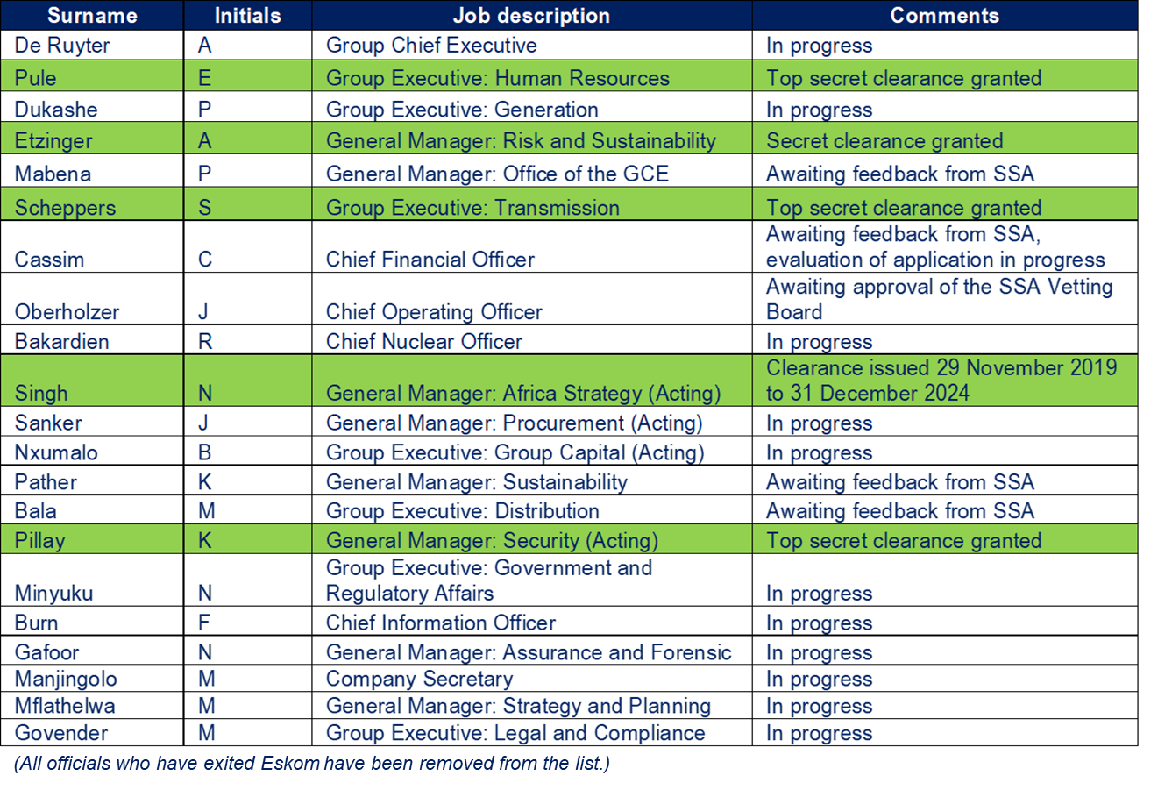
Recommendation 6.5: Vetted Senior Executives and Supply Chain Management Unit as at 30 June 2022

Slide 8
Recommendation 6.7: Update on Internal Investigations
Internal Investigations
Lifestyle Audit
As at 1 July 2022, Eskom had an opening balance of 270 active cases
38 new active cases were added during this quarter
69 of the active case were completed
239 cases are in various stages of progress under investigation both internally and externally.
Completed the first phase of 383 mandatory lifestyle audits on executives and senior managers, and their partners where applicable.
34 high-risk cases were handed over to the SIU for further investigation.
16 referrals were closed, and One case was closed on the basis that the employee was dismissed on unrelated charges
11 resulted in referrals to Eskom for disciplinary action
The remaining six cases are still under investigation.
Regarding the 11 disciplinary referral cases made to Eskom, the status is as follows:
7 executives were found guilty, and sanctions were imposed, ranging from 6 or 12 months written warnings to suspension for 14 days.
2 executive was found not guilty.
1 executive resigned on 30 November 2018, before the disciplinary case was referred to Eskom.
1 executive retired from Eskom on 31 March 2020, before the disciplinary case was referred to Eskom.
Data-analytics testing in 2020 revealed that 3 812 employees at M, P, S, G, and T band grading levels, including FTCs, had not declared their business-related interests
A total of 3799 exceptions were referred to Management and IR for assessment of consequence management actions.
Of the 3799 exceptions, 3651 has been dealt with and closed as at 30 September 2022 and 148 are still awaiting action while 13 employees resigned before action could be taken against them

Slide 9
Recommendation 6.8: - Recovery of Financial Losses
(1/9)
ABB
In December 2020 , ABB repaid approximately R1,5 billion to Eskom.
Eskom is working with the SIU to set aside the R2,2 billion control and instrumentation contract that had been irregularly awarded to ABB. Court papers in this regard are being finalised.
Eskom will ensure a seamless transition between the setting aside of the contract and the execution of a new contract between Eskom and ABB
Eskom will also institute supplier disciplinary proceedings against ABB in due course.
SIU vs Tegeta; Eskom and Others (Case No. 90171/2018)
Application for equitable relief in which the SIU seeks an order that Tegeta repay Eskom an amount of approximately R734 million, which was paid to Tegeta for supply of reject coal
Tegeta is under business rescue, and Eskom submitted a claim of approximately R359 million against the business rescue practitioners (BRPs) for post-business-rescue penalties
The underlying Tegeta coal supply agreement was set aside in terms of a court order handed down on 4 March 2020.
The SIU has instituted proceedings against Tegeta and the BRPs for just and equitable relief to repay the sum of approximately R734 million to Eskom
The BRPs have opposed the relief sought. Eskom filed a notice to abide in June 2021.
This matter is being driven by the SIU and remains ongoing.

Slide 10
Recommendation 6.8: - Recovery of Financial Losses
(2/9)
NDPP v Kurt Robert Knoop NO and 15 Others (Case No. 62604/2021): Optimum Coal Mine
An application for the preservation of all Tegeta’s shares in Optimum Coal Mine and the business of Optimum Coal Mine was instituted by the NDPP in terms of the Prevention of Organized Crime Act, 121 of 1998. Eskom is supporting the NDPP in this process.
The application was heard on 8 March 2022. Judgement was handed down in favour of the NDPP, on 23 March 2022,
The National Union of Mineworkers and the BRPs have appealed this order.
Templar Capital Ltd (Templar Capital) and Liberty Coal (Pty) Ltd (Liberty Coal) filed an application for leave to intervene in the application and be allowed to argue their own appeal.
The above applications were argued on 15 June 2022, and judgment was reserved
On 4 July 2022, the NDPP filed an application in terms of the Prevention of Organised Crimes Act for a forfeiture order in respect of all claims held by Templar Capital against Optimum.
The forfeiture application is presently under consideration
Eskom will be engaging with the NDPP and SIU on the next steps to ensure that Eskom is able to apply for equitable relief as a victim of crime
On 22 August 2022, the BRPs launched an application in the High Court in terms of which they seek an order declaring that the operation and execution of the judgement and preservation order granted in favour of the NDPP on 23 March 2022 be suspended pending the outcome of their appeal to the Supreme Court of Appeal
Eskom is engaging with the NDPP and SIU on the next steps to ensure that Eskom can apply for equitable relief as a victim of crime.

Slide 11
Recommendation 6.8: - Recovery of Financial Losses
(3/9)
Impulse International
Impulse International instituted action against Eskom for claims of approximately R61 million and Eskom Rotek Industries (ERI) for claims of approximately R22 million in respect of payment for contracts suspended by Eskom and ERI.
Eskom litigation: Eskom has filed a special plea, plea, and counterclaim and is continuing in its efforts to have the contracts with Impulse declared void, unlawful, and unenforceable.
ERI litigation: a court date is yet to be set by Impulse International, as it is dominus litis in the matter.
SIU/National Prosecuting Authority (NPA) process: the SIU has considered instituting civil proceedings. However, it has decided that civil proceedings will be futile, based on the following:
SARS has a judgment (and preferent claim) of R200 million against Impulse International, but has only found R16 million, to date, to execute against. SARS is continuing in its endeavours to recover further funds
The Asset Forfeiture Unit (AFU) has progressed with its forfeiture application against the directors of Impulse International and related parties
The matter has been referred to the NPA for criminal prosecution, and the SIU will support the NPA in this regard
T-Systems South Africa (T-Systems)
An investigation was undertaken to determine whether the contract between TSSA and Eskom was managed in accordance with Eskom’s policies and procedures. The investigation report identified instances where due process was not followed, resulting in potential wasteful expenditure to Eskom.
An assessment is underway regarding the wasteful expenditure incurred, following which appropriate legal action will be instituted..

Slide 12
Recommendation 6.8: - Recovery of Financial Losses
(4/9)
PwC Task Order SM003: Capital Scrubbing
On 16 March 2021, Eskom filed an application for an order declaring the award of a contract to PwC unlawful, unconstitutional, and invalid, for reviewing and setting aside the award, for reviewing and setting aside the contract concluded with PwC following the award, and for claiming repayment of R108 million paid by Eskom to PwC.
PwC is opposing the application, and pleadings are underway.
Eskom has amended the court record it had initially filed and wrote to the Deputy Judge President requesting the matter to be transferred to the Commercial Court. The matter has been certified as a commercial matter. The parties are awaiting allocation of the judge from the Deputy Judge President.
AfricaWide Consulting
Eskom awarded a contract to AfricaWide without undertaking an open and competitive tender process. The original contract value was modified to R17 million without National Treasury approval, and Eskom intends pursuing R17 million in recovery.
AfricaWide is in liquidation and final liquidators were appointed on 8 February 2022. The liquidators report confirms that there are no assets in Africawide’s estate.
In light of the above, Eskom is reviewing its position regarding civil recovery.

Slide 13
Recommendation 6.8: - Recovery of Financial Losses
(5/9)
Trillian Management Consulting (Pty) Ltd
On 2 October 2019, Eskom obtained an interim enforcement order directing Trillian and Mr Eric Wood to repay the sum of R595m to Eskom which had been paid on the pretext of Trillian being a supplier development and localisation partner to McKinsey.
Trillian and Mr Wood did not honour this order, and Eskom instituted liquidation proceedings.
SARS intervened as a party to the liquidation proceedings, claiming that Trillian owed it approximately R600 million in unpaid taxes. SARS has a preferent claim in this regard.
Accordingly, Eskom has submitted a claim for R595 million to the liquidators, but has not contested the SARS preferent claim.
Eskom’s taxed bill of costs for bringing the liquidation application has been submitted to the liquidators, who have indicated that there are no funds to settle the bill at this stage, but that it will be included in the first liquidation and distribution account.
The hearing of the liquidation enquiry, during which the liquidators and Mr Wood presented evidence, commenced on 20 January 2022
The liquidators stayed the enquiry process until further notice, and the Commissioner will be requested to postpone the enquiry while the liquidators consider the status of pending litigation and further steps to be taken. Eskom has been engaging SARS to understand the next steps in order to ensure that its interests are protected.
If reinstated, Eskom will continue participating in the insolvency enquiry to the extent that this will facilitate the tracing and recovery of funds. Eskom is also actively monitoring and assisting the NPA and related authorities to secure criminal convictions in this matter, which may give rise to further opportunities for victim recovery proceedings against the implicated parties.

Slide 14
Recommendation 6.8: - Recovery of Financial Losses
(6/9)
Econ Oil and Energy (Pty) Ltd (Econ Oil) – Overcharging
On 14 December 2020, Eskom received an interim forensics report on the quantification of possible overcharging by Econ Oil in the amount of approximately R1,2 billion over a five-year period (2012 to 2017).
On 17 December 2020, Eskom instituted arbitration proceedings against Econ Oil to recover this sum.
Econ Oil is opposing the application and has served its plea and a special defence based on prescription. In the dispute on whether the issue of prescription had to be heard separately or together with the merits, the arbitrator ruled in Eskom’s favour that the issue of prescription would be heard together with the merits. On 17 September 2021, Econ Oil filed a notice of appeal against the arbitrator’s ruling on separation. The appeal has since been dismissed.
A timetable for submission of pleadings has been agreed to
Econ Oil Bid Corp 4786
On 25 February 2021, Econ Oil launched an application against Eskom at the South Gauteng High Court to review and set aside the Eskom Board’s decision of March 2020 to approve the cancellation of Bid Corp 4786 for the procurement of fuel oil or, alternatively, to review and set aside the decision of the Eskom Board to cancel Bid Corp 4786. Eskom is opposing the review application.
In light of the review instituted by Eskom against Econ Oil on the same set of facts, the parties agreed to await the judgment before deciding on how to proceed further with Econ Oil’s review against Eskom. Despite an undertaking to respond within 10 days following judgment in Eskom’s review application. Econ Oil has not responded on the way forward on this matter.
The matter remains pending

Slide 15
Recommendation 6.8: - Recovery of Financial Losses
(7/9)
Former Eskom Directors and Executives implicated in State Capture
Eskom is pursuing civil action for R3.8 billion against a number of former Eskom directors and executives to recover large sums of money lost by Eskom as a result of State Capture and the involvement of the former executives in it.
In August 2020, combined summons and particulars of claim were issued against 12 defendants, with the SIU cited as co-plaintiff.
Of the 12 defendants, Eskom is only pursuing claims against 7 former Eskom executives and directors, based on breach of fiduciary duties and breach of contract.
Eskom had the matter placed under judicial case management, and the first meeting was held on 13 September 2021 to deal with the defendants’ objections and delays. It was resolved that a day would be set aside to ventilate the issues to be dealt with in terms of the interlocutory applications, after which the remainder of the issues would be dealt with.
There has been difficulty securing a date with the judge, and efforts to do so are ongoing.
An executor has yet to be appointed for the estate of the late Dr Ngubane
Monies irregularly spent on behalf of Directors and Executives for Legal Fees
Eskom instituted an action to recover monies advanced regarding legal fees to five former directors and executives; and has recovered R27 000,00 from one director.
Another director (owing R500 000,00) entered into a payment arrangement, although he has defaulted on that arrangement. However, he has advised that he wishes to settle this matter.
Three directors (owing R706 000,00; R595 000,00; and R201 000,00 respectively) are defending the action.
Default judgment has been applied for against one director and one executive. A trial date for the claims against two directors, and the estate of the late director has been applied for.
As per the directives issued by the Deputy Judge President (DJP), all amendments to the pleadings were filed by 31 May 2022. Eskom’s attorneys are in the process of preparing a discovery affidavit to be filed.
Once the formalities have been concluded, the parties can again approach the DJP for direction on the way forward. Eskom has been seeking an audience with the DJP for such direction, but has been unsuccessful thus far

Slide 16
Recommendation 6.8: - Recovery of Financial Losses
(8/9)
Eskom Pension and Provident Fund (EPPF) v Brain Molefe, Eskom Holdings SOC Ltd, and the Commissioner for the South African Revenue Service
1
On 25 January 2018, the High Court handed down judgment declaring the agreement concluded between Eskom and Mr Molefe, placing him on early retirement, invalid. Mr Molefe was ordered to pay back all amounts paid to him in terms of this agreement, amounting to R31,5 million (plus interest still to be calculated). No agreement could be reached on the quantum payable.
On 4 July 2022, the High Court handed down judgment as follows:
Mr Molefe is to pay the EPPF the difference between the pension benefits paid to him and the lump sum pension benefits payment he had transferred from the Transnet Retirement Fund to the EPPF (inclusive of accruals up to 31 October 2019).
The EPPF is required to calculate the difference between these amounts and inform Mr Molefe of the calculation. Mr Molefe is required to pay this amount within 10 days of receipt of the calculation.
The EPPF is to pay Eskom the employer and employee contributions made on behalf of Mr Molefe (with interest calculated until 30 October 2019).
The EPPF is to pay Eskom Mr Molefe’s performance bonus contributions (inclusive of interest accrued by the EPPF on such contributions), less the EPPF’s administration costs.
The EPPF is to pay Eskom the amount of R30 103 915,62 (with interest calculated until 30 October 2019), being the amount paid for his future pensionable service until age 55 and the waiving of penalties, in order for Mr Molefe to be placed on early retirement.
People and Governance Committee on 23 and 24 August 2022 on the EPPF’s proposal. Both Committee’s rejected the proposal and a letter confirming Eskom’s position has been sent to the EPPF

Slide 17
Recommendation 6.8: - Recovery of Financial Losses
(9/9)
Eskom Pension and Provident Fund (EPPF) v Brain Molefe, Eskom Holdings SOC Ltd, and the Commissioner for the South African Revenue Service
On 22 August 2022, the EPPF filed a conditionally cross appeal i.e., the appeal is subject to the granting of leave to appeal to Mr Molefe. In the application the EPPF seeks the following:
That the interest payable on the amount of R30 103 915.62 should only start running from 25 January 2018, (being the date of the judgement which found the payment to have been unlawful and not as at the date of payment by Eskom to the Fund) and not from 30 October 2019.
The interest rate on all capital amounts to be paid to Eskom to be changed from mora interest to fund interest.
The payment to Eskom be subject to the EPPF receiving all amounts owed to it by Mr Molefe.
Mr Molefe’s application for leave to appeal was heard and judgment was reserved. The judgment is expected to be delivered on 11 October 2022.
2
Wilge Residential Development Project and former general manager (GM) for Facilities
Following an investigation into various allegations of fraud, corruption, and misconduct relating to the Wilge Housing Project, disciplinary proceedings were instituted against the GM for Facilities, for his failure to perform his duties, causing significant financial losses to Eskom. He was subsequently dismissed, and a decision was taken to recoup losses attributable to his conduct from him.
Investigations have been concluded, and in addition to Mr Mamorare, there are potentially other individuals from whom funds can be recovered, however this is subject to further assessment from a civil litigation perspective. The value of the claim is being determined; however, initial estimates reflect approximately R840 million as fruitless and wasteful expenditure.

Slide 18
Recommendation 6.9: Consequence Management
Item 6.9 “Consequence management must be followed through where wrongdoing has been proven, and quarterly reports in this regard should be submitted to SCOPA ”.
Overview of disciplinary action following from investigations
As at year-to-date (YTD) 30 September 2022, Eskom Industrial Relations Department (IR) had registered 389 employees who had undergone disciplinary processes.
Of these, 361 were completed, and 28 are in progress.
The completed disciplinary cases resulted in 183 employees terminating Eskom employment through resignation, abscondment (157), and retirement (26) during the disciplinary processes, with a further 41 being dismissed because of fraud and corruption.

Slide 19
Recommendation 6.10: Update on Internal Audit Unit
14 specialist resources, with the associated budget, were approved and recruitment of candidates has been completed to fill all these specialist positions. Below is a list of the positions:
Specialist resources
Status of recruitment
1
Forensic
Investigation
5 Senior Advisor
1 Assistant Officer
Appointed and concluded
Appointed and concluded
Internal
Audit
Appointed and concluded
Appointed and concluded
Appointed and concluded
Appointed and concluded
Appointed and concluded
Appointed and concluded
2
3 Senior Advisor with knowledge of supply chain management and experience
1 Senior Advisor with treasury skills
1 Quantity Surveyor to assist with audits for major projects
1 Senior Advisor dedicated to running commercial data analytics
1 Chief Advisor: Technical Auditing who will also assist with major technical investigations
1 Chief Advisor: Auditing with IT security skills
The Forensic and Anti-corruption (“Forensic”) section’s management team has a full complement. There are however 3 vacancies resulting from natural attrition. Recruitment for these positions is underway
The Forensic team continue to deal with high number of cases reported including a significant backlog
Approval was received to appoint fixed-term contractors to deal with the high number of cases received the backlog. Recruitment process for these positions has commenced and 3 investigators will be starting on 1 October 2022

Slide 20
Recommendation 6.11: Institution of Criminal Charges against the employee implicated with wrongdoing
(1/2)
Status as at 30 September 2022
South African Police Service (SAPS)
131 criminal cases had been opened with the South African Police Service (SAPS) for further investigation
13 of the above 131 have been through the criminal proceedings provided for under the Criminal Procedure Act.
The above numbers include the following matters, which are under investigation by the specialised units of the SAPS:
Impulse, Tegeta/Brakfontein, McKinsey/Trillian, and Dongfang
SIU is conducting investigations on, inter alia, maladministration in the affairs of Eskom and any losses or prejudice suffered by Eskom as a result, in relation to:
Medupi, Kusile, Ingula, high-voltage transmission projects associated with Medupi, Kusile and Ingula Pumped-Storage Scheme,
Appointment of McKinsey, Trillian and Regiment;
Contracting for the procurement of coal, coal transportation services, diesel; Cloud computing services; software licences, and support services;
Engineering and project management consulting services in respect of Contract No. 4600061859 and Contract No. 4600062636 and payments made in respect thereof
Any undisclosed or unauthorised interest that employees, officials, and/or Eskom’s agents may have had in contractors, suppliers, or service providers bidding for work or doing business with Eskom
Special Investigation Unit (SIU)

Slide 21
Recommendation 6.11: Institution of Criminal Charges against the employee implicated with wrongdoing
(2/2)
Status as at 30 September 2022
Eskom has established a task team (the State Capture Task Team) to manage potential legal, business, financial, and reputational risks following the findings and recommendations in the report issued by the Judicial Commission of Inquiry into State Capture, Corruption and Fraud in the Public Sector, including Organs of State.
Through its dedicated State Capture Task Team, Eskom has prepared, and is implementing, an action plan to address the findings in the report.
The plan was approved by Eskom’s Board on 14 July 2022 and submitted to the Department of Public Enterprises (DPE) on 17 July 2022.
Eskom has also been working closely with the DPE, other state-owned enterprises (SOEs), and law enforcement agencies to ensure that it either directly addresses the recommendations or, where recommendations such as criminal prosecutions that are not within its control occur, supports law enforcement agencies in taking appropriate action against delinquent suppliers, former employees, former executives, former Board members, and associated perpetrators.
The State Capture Commission of Inquiry investigation
Employees resigning while implicated with wrongdoing
183 employees terminating Eskom employment through resignation, abscondment (157), and retirement (26) during the disciplinary processes, with a further 41 being dismissed because of fraud and corruption.

Slide 22
Recommendation 6.13: Managing the extension of existing contracts that are due to expire
Divisions are provided with a contract expiry report, advising of all contracts which are about to expire in zero to 12 months in order to commence with the process of establishing a new contract well in advance before the expiry of preceding contracts.
Embedded triggers to enable early detection of the potential risk of having to run projects through deviations or continuous expansion of contracts due to poor planning.
In instances where expansion or scope variation is inevitable, the variation is approved by the relevant delegated authority to eliminate any elements of possible manipulation then reported to National Treasury in accordance with the newly enacted PFMA Instruction Note No. 03 of 2021/2022.
In compliance with the newly enacted PFMA Instruction Note No. 03 of 2021/2022, all such transactions are reported to the National Treasury and the Auditor-General of South Africa (AGSA) in accordance with the prescribed reporting rhythm, with deviations and procurement by other means having to be reported within 14 days of approval and expansions and variations having to be reported on a monthly basis.
In accordance with Ministerial Equity Conditions, procurement planning is being entrenched across the divisions as well as the monitoring of contract performance against the project budgets to reduce contract variations and expansions.
Lastly, establishment of the Contract Management Offices across the Division is underway which will ensure proper management of contracts.

Slide 23
Recommendation 6.14: Correction of Defects Identified at Medupi and Kusile Power Stations
Major plant defects at Medupi and Kusile are tracked under the Eskom Operations Recovery New Build (9 Point Plan). Major plant defects are defined as plant system or equipment defects that result in or has the potential to, significantly reduce the Energy Availability Factor of multiple units at the new build power plants and where the available contractual defect resolution remedies have not been effective
The five (5) major plant defects at Medupi and Kusile include the following:
Medupi and Kusile Pulse Jet Fabric Filter Plant (PJFF) poor performance due to inadequate pulsing system and flue gas flow entry.
Medupi and Kusile Gas Air Heater (GAH) mechanical performance, erosion, and operational performance in terms of ash carry over and outlet temperature stratification
Medupi and Kusile Furnace Exit Gas Temperature resulting in excessive Reheater Spray Water flow
Medupi and Kusile Milling plant defects;
Medupi and Kusile Air and Flue Gas ducting erosion
Eskom is making steady progress in developing and implementing effective technical solutions to the major plant defects at Medupi and Kusile Power Stations
At Medupi, the energy availability factor (EAF), excluding the impact unit 4 that is currently offline for repairs, has improved from 64% to 85%, since the effective correction of the major plant defects
The completion of the first phase of the effective correction of the major plant defects at Medupi and Kusile is forecast for 2023
Additional plant defect corrections, undertaken by Eskom in-house with or without third party involvement, is forecast for completion after 2027, depending on the extent of technical solutions and unit outage availability as per the Eskom outage plan.
The costs of executing the major defects correction plan are managed within the current Eskom Board approved Medupi and Kusile project budgets

Slide 24
Recommendation 6.16: Coal Quality Management
Coal quality audits were conducted with various service providers in FY2023 Q2 (July to September 2022)
All major non-conformances (NCs) are addressed, and a corrective action plan is submitted within the 24-hour timeline.
Service providers | July 2022 |  | August 2022 |  | September 2022
 | Non-conformances | Status | Non-conformances | Status | Non-conformances | Status
Laboratory 1 |  |  | 6 Major NCs issued. | Follow up audit conducted and all 6 NCs were closed. | 6 Major NCs were issued. | 6 NCs are still open, remedial actions, root cause analysis and corrective actions submitted to Eskom, and will be verified and closed during the follow up audit.
Laboratory 2 |  |  |  |  | 6 Major NCs were issued. | Follow up audit conducted and all 15 NCs from Q1 audit were closed.
 |  |  |  |  |  | All 6 NCs- Corrective action plan submitted to Eskom
Laboratory 3 |  |  |  |  | 5 NCs from Q1 audit | Follow up audit was conducted, and 3NCs were closed.
 |  |  |  |  |  | 2 Major NCs still open as Eskom was not satisfied with the implemented corrective actions.
Laboratory 4 |  |  |  |  | 06 NCs from Q1 audit | Follow up audit conducted, and all 06 Major NCs were closed
Laboratory 5 |  |  |  |  | 1 Major NC recorded from Q1 audit. | Follow up audit conducted, and 01 Major NC was closed
Laboratory 6 |  |  |  |  | 06 Major NCs were recorded in Q1. | Follow up audit was conducted, and 4 Major NCs were verified and closed.
 |  |  |  |  |  | The other 2 Major NCs are still open.
Additional technologies are being investigated to test coal when received at the power station by truck

Slide 25
Recommendation 6.19: Weighbridges and offloading facilities
(1/2)
Weighbridges and offloading facilities at Kusile Power Station
The first three phases have now been completed (with the third phase comprising civil works for permanent weighbridges, the inspection building, and the control room).
Outstanding phases are the coal hopper civil construction (Phase 4) and west access road (Phase 5). The coal hopper contract was awarded on 11 February 2022 and Construction is under way, with mass earthworks (excavations) for the hopper structure completed.
The next activity of construction piles resumed in August 2022 and to date,103 piles have been done
Construction completion for the hopper structure is forecast to be the end of 2023. The west access road (Phase 5) will be executed in the same time frame.
Installation of the 4 additional weighbridges in the coal stockyard has been completed and the weighbridges are operational. A total of six weighbridges have been installed in the stockyard and all are operational
The installation of the additional feed conveyor in the coal stockyard is complete and in operation

Slide 26
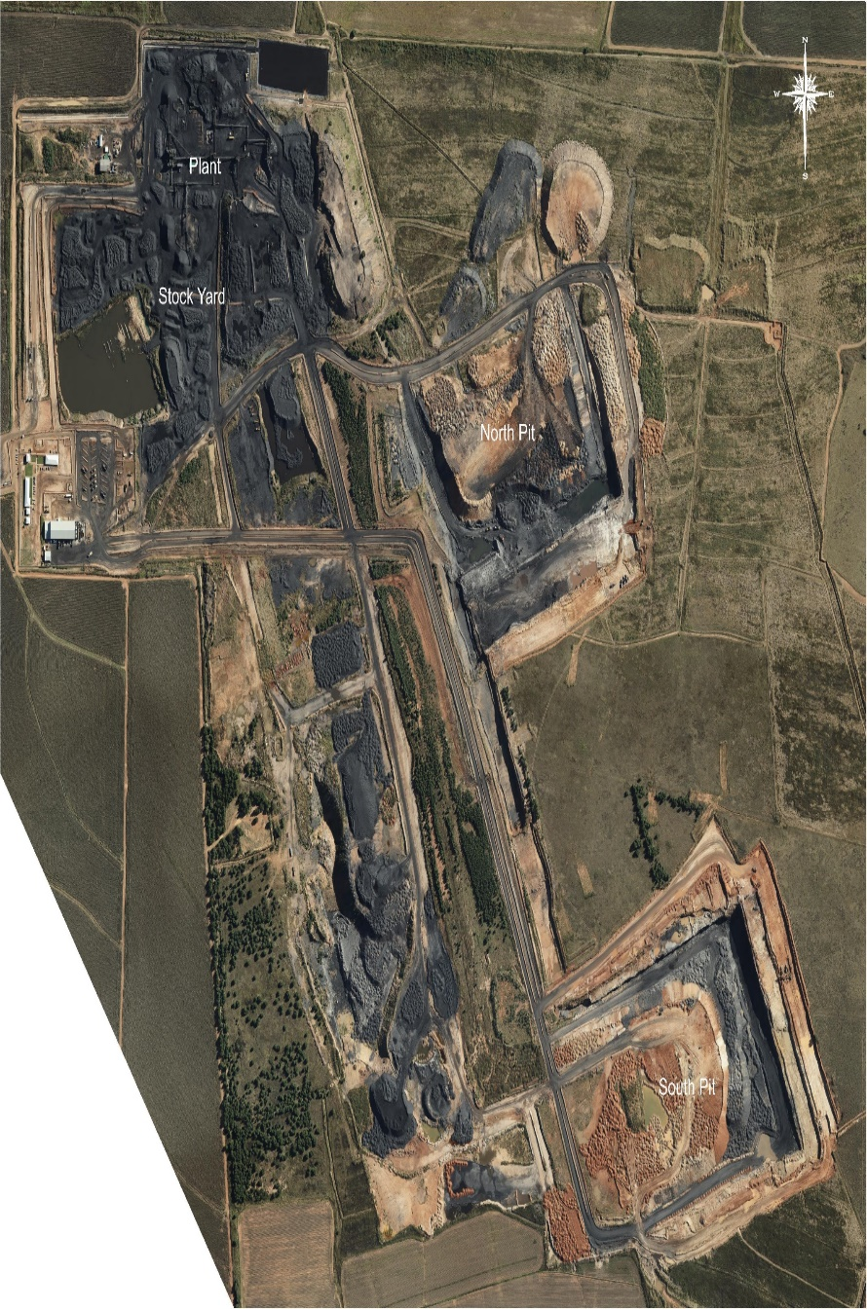
Recommendation 6.19 - Construction of weighbridges and offloading facilities at Kusile Power Station (Progress on New Largo coalfield project)
(2/2)
Negotiations between Eskom and Seriti for the New Largo Pit D, Pit H, Pit F and the New Largo main mine for coal supply to Kusile are advancing.
It is anticipated that the contracts will be entered into, in tranches, for the different blocks of coal set out above, which will eventually see at least half of Kusile’s coal requirement being supplied by conveyor.
The first of a suite of coal supply agreements (CSAs) for a three-year supply from Pit D to Kusile Power Station has been concluded by the parties.
The parties are currently in negotiations for the second tranche, namely, the long term 10-year CSA from New Largo Pit D, and are targeting conclusion of this tranche by December 2022
Current engagements with Seriti, based on the revised production schedule from the New Largo plan, indicate that Mini-Pit D will be the first to be contracted during 2022, followed by the New Largo main mine, expected during the course of Q1 of 2024.
Eskom requested Seriti to develop a business case to build, operate, and maintain the conveyor belt under the already existing New Largo Coal environmental approvals, including the possible off-site offloading facility to minimise the number of trucks coming into the station.
Seriti presented a revised business case of building a conveyor belt to connect its beneficiation plant with the Kusile coal stockyard conveyor belts
The signing of the long term Pit D coal supply agreement by 31 December 2022 will then allow Seriti to build a conveyor, which will be commissioned 18 months after the signing of the coal supply agreement. The conveyor is anticipated to be in operation by 30 June 2024.
The delay in concluding a coal supply agreement with Eskom, Seriti has advised that it has earmarked the New Largo coal for supply to the export market and has advised Eskom of its intention to supply a middlings product from the coal beneficiation process to Eskom.

Slide 27
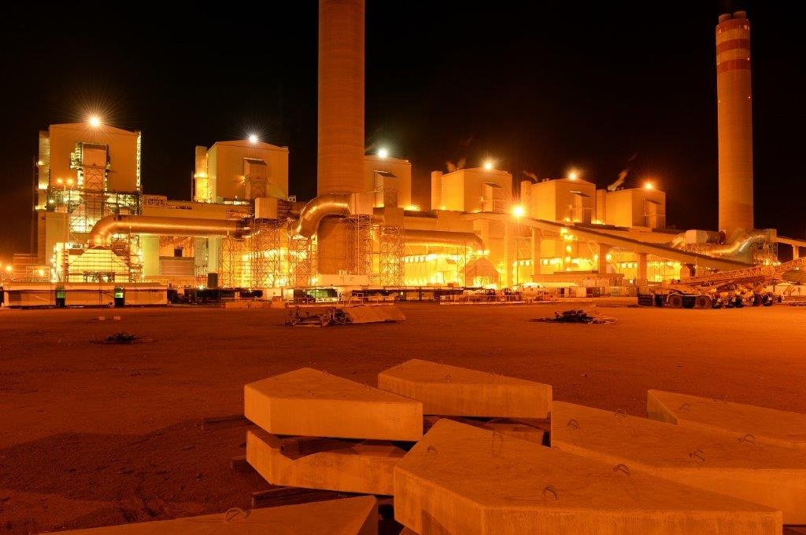
Recommendation 6.20: Negotiations on “Take-or-Pay System”
As at the end of August 2022, the Medupi take-or-pay penalty amounted to R9,7 billion. For FY2023, no Medupi take-or-pay penalties have been paid.
Eskom previously tried to renegotiate the contract but was unsuccessful. Given the location of the power station, Eskom does not have other supply options at a more competitive price than the current agreement
In August 2020, Eskom wrote a formal letter to Exxaro, requesting the renegotiation of the take-or-pay contractual clause to make it applicable on an annual basis instead of the current monthly applicability. Exxaro responded formally in November 2021, declining Eskom’s request for renegotiation
Eskom explored the use of the coal in the Mpumalanga area, but due to the high inherent sulphur quality of the coal and the cost to transfer the coal to Mpumalanga, the option was found to be unsuitable.
The construction of the Medupi coal strategic stockyard was completed in August 2019, and the stockyard was at 17,3 Mt as at 31 August 2022.
Eskom will, thus, incur further take-or-pay penalties if Medupi Power Station cannot burn the minimum contractual volumes

Slide 28
Recommendation 6.21: The production of gypsum
Request for proposals was issued to the market for the disposal of gypsum at Kusile Power Station on 3 August 2020
The Gypsum enquiry closed on 30 October 2020 after an extension of the closure date was granted
The transaction is currently with Audit and Forensic for assurance after an anonymous complaint or request was received. The assurance report will provide guidance on whether the process followed in the tendering process is compliant or not.
If compliant, a mandate to negotiate will be sought from the delegated committee for the negotiations and conclusion of the contract with the successful bidder
Due to delays in the conclusion of the investigation by Audit and Forensic, the anticipated conclusion of the transaction has been delayed to October 2022.
The successful bidder will have to construct a separation plant in order to extract gypsum from the system

Slide 29
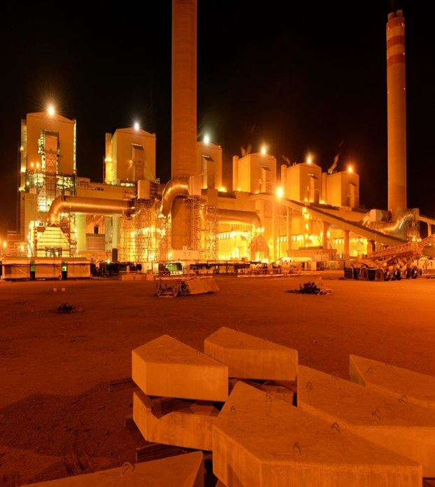
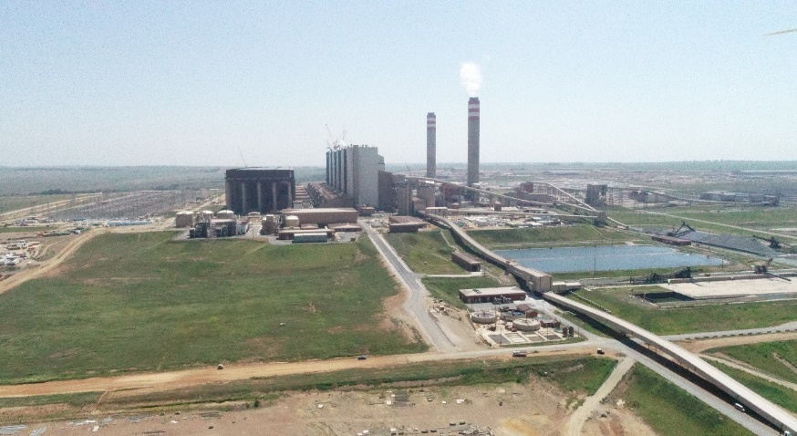
Recommendation 6.23: Medupi and Kusile Power Stations must be completed at the revised times
(1/2)
The remaining investment/cost to complete Medupi is R18.95 billion.
All six units are in full commercial operation (CO), connected to the national grid, and supplying energy.
The last unit achieved CO on 31 July 2021.
The current focus is on completion of the remaining balance-of-plant scope and conclusion of all commercial claims to ensure proper project close-out. The target for full project completion is November 2023.
Following a catastrophic hydrogen explosion in Medupi U4 in 2021, the unit is out of operation and is anticipated to return to service in September 2024.
Completion of Medupi Station
The remaining investment/cost to complete Kusile is R14 billion.
Four units are in full commercial operation (CO), connected to the national grid, and supplying energy.
The fourth unit, unit 4, achieved CO on 31 May 2022.
Construction and commissioning activities are in progress on the remaining two units, unit 5 and 6, respectively.
CO of Unit 5 and Unit 6 is targeted for December 2023 and May 2024, respectively.
The target for full project completion is May 2026
Completion of Kusile Power Station

Slide 30
Recommendation 6.23: Medupi and Kusile Power Stations must be completed at the revised times
(2/2)
The current Eskom Board approved business cases for Medupi and Kusile remain valid. To date, no additional cost has been incurred in the completion of Medupi and Kusile.
The costs of executing the major defects correction plan are managed within the current Eskom Board approved Medupi and Kusile project budgets
The liable parties/contractors are held to account within the provisions of the relevant contracts and are fully responsible for the related major plant defect costs
The outcome of the current corruption investigations at Kusile, some commercial challenges and the past COVID-19 pandemic impacts are risks that are negatively impacting the Kusile business case
From inception to date (ITD) project budget values, project expenditures and the investment/cost to complete the remaining scope of works at Medupi and Kusile, all costs exclude interest during construction (IDC):
Project | Eskom Board approved Budget, as at April-June 2020 (excl. IDC) | Project Expenditure, as at Aug 2022 (excl. IDC) | Remaining Investment/Cost (excl. IDC)
Medupi | R145.00 billion | R126.05 billion | R18.95 billion
Kusile | R161.40 billion | R147.40 billion | R14.00 billion
The above Medupi budget does not include the cost of installing the Flue Gas Desulphurisation (FGD) plant. The Medupi FGD plant is expected to cost between R35bn and R40bn, and will be commissioned by 2027/28
The FGD has already been installed at Kusile, and the above Kusile budget include FGD costs.

Slide 31
Table of Content
1.
Recommendations: 6.1 – 6.23
2.
Supplier Referrals from SIU

Slide 32
Eskom Presentation to SCOPA
Feedback on SIU Referrals
FY2023 Report
Date: 19 October 2022

Slide 33
SIU Supplier Referrals: Overview
During May 2022, Eskom was requested to respond to an enquiry on progress on the 99 SIU supplier referrals for administrative action. Eskom received the same list from National Treasury during August 2022, in which NT stated that the suppliers have transacted with Eskom during the 2021/22 financial year.
Upon analysis of the 99 referrals, only 55 matters were supplier related, with 44 employee transgressions linked to the suppliers on the list. Of the 55, only 42 suppliers are registered on the Eskom Vendor Master Data.
Of 42 Vendors, 6 transacted with Eskom during the 2021/22 financial year
Two transacted while its directors were Eskom Employees.
Four of the suppliers had Eskom Employees as directors until 2016.
Eskom has not received a complete and accurate list of SIU referrals. Eskom received four different lists containing SIU referrals (of which “list of 99” is one). The list totals 156 suppliers, of which 84 are common across all lists.
SIU referrals are focused on undisclosed or unauthorized interests of Eskom Employees but lacks sufficient evidence to ensure administrative action against suppliers that is procedurally fair.
Eskom and SIU are working together to ensure completeness of the referrals and to address the issues impacting on our ability to conclude on the restriction process. This includes a meeting held on 20 July 2022.

Slide 34
Status Update
To address the risk of doing business with Suppliers having directors who are Eskom Employees, while restriction process is underway:
84 suppliers that were common on all SIU lists were referred for blocking on Eskom’s Vendor Database.
Temporary blocks were placed on 72 suppliers (12 were not Eskom Vendors).
Blocking on Eskom Vendor Database prevents placement of new orders and payments
Two suppliers who transacted with Eskom while having Eskom Employees as directors are currently being investigated.
Eskom and SIU are working together and will engage again at the end of October 2022.
In alignment with NT Instruction Note 03 of 2021/2022, Eskom’s Supplier Review Process is implemented, and Supplier Review Committee constituted, to process supplier referrals.

Slide 35
Conclusion

