Slide 1
COPYRIGHT IN THE AGE OF TECHNOLOGY AND INTERNET: Presented to parliament of the republic of south africa, 18 oct. 2022
Prof Malebakeng Forere

Slide 2
Outline
1. INTRODUCTION: TECH, INTERNET & IP
1.1 Advancements in technology
1.2 Impact of tech and internet on copyright
Recap of Prof Dean’s presentation: content of rights
2. RESPONSES TO INTERNET & TECH DISRUPTIONS ON COPYRIGHT: INTERNATIONAL TREATIES
2.1 WIPO Copyright Treaty (WCT)
- new rights for copyright owners
- infringement and exceptions
- Safeguarding rights online: obligations for States’ parties
2.2 WIPO Performances and Phonograms Treaty (WPPT)*
3. SOUTH AFRICA AND INTERNATIONAL ORGANISATIONS/TREATIES AND TRADING PARTNERS
3.1 Interdependence of markets
3.2 Nature of IP, enforcement & reciprocity
3.3 EU-EPAs/US-AGOA, S301
Notes:
For the next session on Performers’ Bill

Slide 3
Terms
Digital technologies
Enablers which aid in the transmission and use of protected works in digital form over interactive works.
Technological Measures
Technologies/devices, which in their normal use can prevent unauthorized activity, e.g encryption; passcodes; no copying/saving functionality
Internet Treaties 1996:
WIPO Copyright Treaty (WCT)
WIPO Performances and Phonograms Treaty (WPPT)

Slide 4
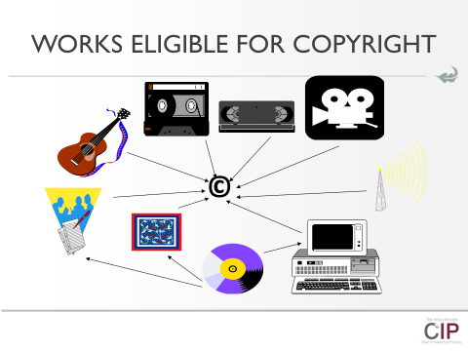
TECH, INTERNET AND IP
Re-cap on Prof Dean’s presentation on protected works:
Notes:
Use of Prof Dean’s slide (fair dealing or fair use)

Slide 5
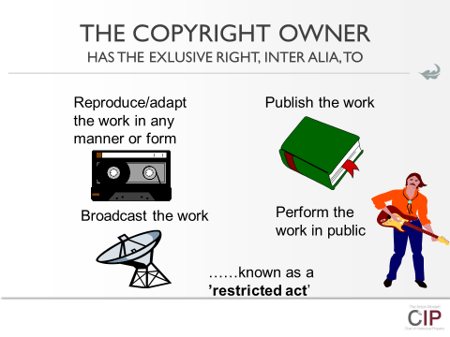
Tech, internet and ip
Re-cap on Prof Dean’s presentation on Exclusive/Restricted Rights
Notes:
Use of Prof Dean’s slide (fair dealing or fair use

Slide 6
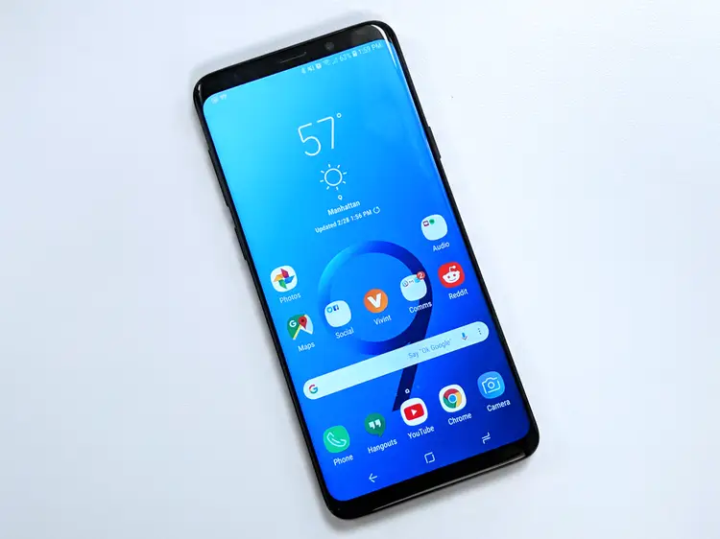
Tech, internet & IP
Notes:
Reproduction is rampant with excellent quality
Adaptation is a norm
Communication to the public is the 21st century mode of consumption
Broadcast (tv and radio) is endangered

Slide 7
Tech, internet and IP
Reproduction is rampant with excellent quality
who wants to buy a book while Google has it or can copy for free from the library with excellent quality?
why buy CD or DVD while you can copy or share with peers?
Adaptation is a norm
why not using that novel for a movie?
why not translating that Harry Potter book in isiZulu?
Communication to the public >>>the right of making available is the 21st century mode of consumption
Broadcast (tv and radio) is endangered with the making available
- who still go to the cinemas or watch monotonous tv programs?
- who still buys stacks of CDs or DVD? By the way, where would you buy them? Look n Listen and Musica gone?
- by the way downloads (i-tunes) are very old fashioned!!!!

Slide 8
RESPONSE TO DISRUPTIONS: wct
NEW RIGHTS
NATURE OF WORKS | NEW RIGHTS
Authors of literary & artistic works | Right of distribution, Art. 6 - Authorise the making available of their work through sale or any transfer of ownership
Authors of (i) computer programs; (ii) cinematographic works; and (iii) works embodied in phonograms | Rental right, Art 7 right of authorizing commercial rental to the public of the originals or copies of their works
authors of literary and artistic works | Communication to the public, Art 8 authorizing any communication to the public of their works, by wire or wireless means, including the making available to the public of their works in such a way that members of the public may access these works from a place and at a time individually chosen by them
Notes:
NB: databases are regarded as literary works within the meaning of Bern Convention

Slide 9
Exceptions to restricted rights
Three step test: Art: 10
Contracting Parties may, in their national legislation, provide for limitations of or exceptions to the rights granted to authors of literary and artistic works under this Treaty in certain special cases that do not conflict with a normal exploitation of the work and do not unreasonably prejudice the legitimate interests of the author.

Slide 10
Safeguarding rights online: TPMs
Purpose
A means of enforcing IP policy
Protection of right owners
Assurance of authenticity and quality control
Notes:
Self-help (TPMs)

Slide 11
Safeguarding rights online: TPMs
WIPO Internet Treaties, 1996:
The WIPO Copyright Treaty (WCT)
The WIPO Performances and Phonograms Treaty (WPPT)
Obligations under the treaties: Art. 11 of WCT
Provision of adequate legal protection
Effective remedies for circumvention of the technologies

Slide 12
Safeguarding rights online: TPMs
Art. 11 of WCT:
“Contracting Parties shall provide adequate legal protection and effective legal remedies against the circumvention of effective technological measures that are used by authors in connection with the exercise of their rights under this Treaty or the Berne Convention and that restrict acts, in respect of their works, which are not authorized by the authors concerned or permitted by law."

Slide 13
Safeguarding rights online: TPMs
Challenge for legislature:
Recall section 12 of Copyright Act
Consider obligations imposed by Art 10 WCT and the nature of TPMs
How do you ensure fair dealing and/or fair use in light of TPMs?

Slide 14
Safeguarding rights: Information rights management
Obligations to states parties:
Effective legal remedies against any person knowingly performing any of the following acts knowing,
- induce, enable, facilitate or conceal an infringement of any right
i) to remove or alter any electronic rights management information without authority; ii) to distribute, import for distribution, broadcast or communicate to the public, without authority, works or copies of works knowing that electronic rights management information has been removed or altered without authority.

Slide 15
Challenges for the legislature
scope of copyright protection in the digital environment
responsibility of online service providers (active vs passive hosts)
rights of performers in the digital environment (e.g. YouTube singing stars)
protection of databases
peer-to-peer file sharing systems such (e.g. Napster)
4th Industrial Revolution and AI: Copyright for works created by AI (SA Scandal in Patents – DABUS)

Slide 16
Why does it matter????
Interdependence of markets and FDI
Nature of IP, enforcement & reciprocity
EU-EPAs/US-AGOA, S301

