Slide 1
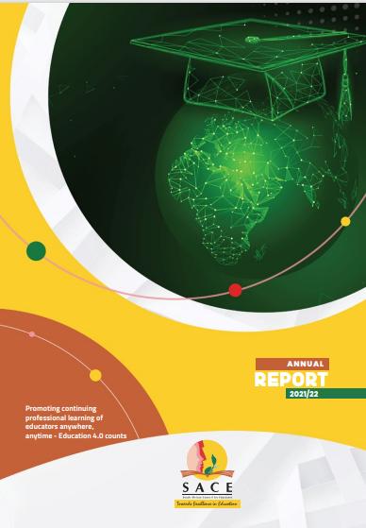

ANNUAL REPORT PRESENTATION TO THE PORTFOLIO COMMITTEE ON BASIC EDUCATION
18 October 2022

Slide 2


Slide 3

PRESENTATION OUTLINE
PART A
General Information
PART B
Performance Information
PART C
Governance
PART D
Human Resource Management
PART E
Financial Information

Slide 4

PURPOSE
TO REPORT ON:
the programme and financial achievements and challenges of the entity for the 2021/22 financial year.
the performance of Council against the planned targets of the pre-determined objectives in the Annual Performance Plan for the financial year 2021/22.
the Council’s expenditure for the Financial Year 2021/22.

Slide 5

PART A
GENERAL

Slide 6
LEGISLATIVE AND POLICY ENVIRONMENT
SACE ACT, 2000
The objects of the SACE Act are:
(a) to provide for the registration of educators;
(b) to promote the professional development of educators; and
(c) to set, maintain and protect ethical and professional standards for educators, by means of the functioning of the council.

Slide 7
OTHER SUPPORTING LEGISLATION AND POLICIES
NDP: Vision 2030
NPFTED, 2007
National Policy Framework for Teacher Education and Development South Africa
ISPFTED, 2011
Integrated Strategic Planning Framework for Teacher Education and Development in South Africa, 2011–2025
Employment of Educators Act, 1998
National Qualifications Framework Act, 2008
South African Schools Act, 1996
The Revised Policy On The Minimum Requirements For Teacher Education Qualifications, 2015
Policy on Minimum Requirements for Programmes Leading to Qualifications in Higher Education for Early Childhood Development Educators, 2017
Relevant Education Labour Relations Council Resolutions
Children’s Act, Equality Act
Criminal Law (Sexual Offences and Related Matters) Act, As Amended 2021

Slide 8
VISION 2025
Inspiring a Credible Teaching Profession
MISSION
To protect the integrity of the teaching profession through the maintenance of the professional and ethical standards.

Slide 9
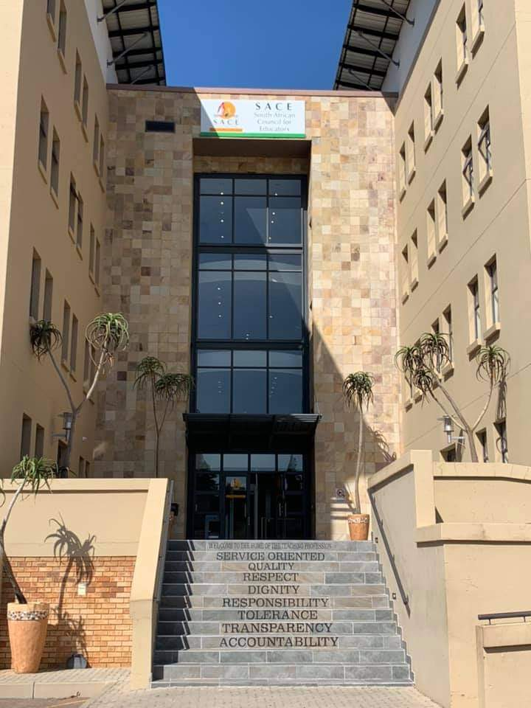
SACE VALUES

Slide 10
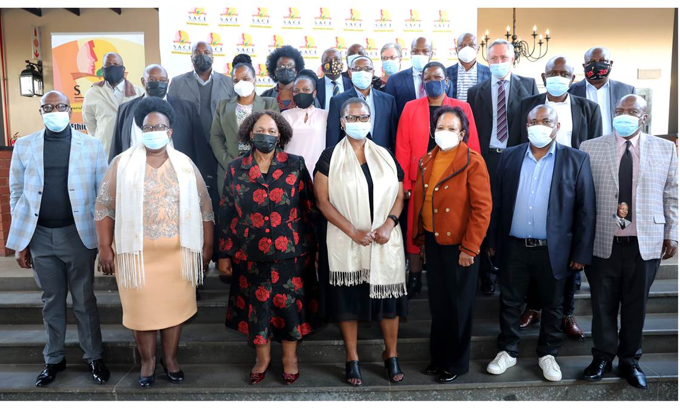

REPORTING PERIOD OVERVIEW
This Annual report signals the second year of implementing Council’s 2020 – 2025 strategic plan
Moving towards the strategic plan mid-term review in 2022/2023.
The financial year also marks the first reporting cycle for the public entity’s Accounting Authority (AA), appointed and inaugurated by the Minister of Basic Education in August 2021, for the 2021–2025 term of office.

Slide 11
REPORTING PERIOD OVERVIEW….
Overall, 43 326 newly qualified educators, were registered during the period under review. More ethical misconduct ethical.
Council had a total of 1327 educator misconduct cases to be processed for the period of 2021/2022 with a total budget to R4m.
1327 reported cases are made up of 563 case rolled over to the 2021/2022 financial year from previous years, and 764 new cases received for the 2021/2022 financial year.
614 investigations versus 86 disciplinary hearings were conducted, with a total of 19 educators struck off from the roll of educators indefinitely and 5 struck off for a particular period.
26 804 educators benefited from the development and support on participation in the CPTD system and various professional matters.
Policy advisory brief on Safety and Security in schools, promoting reading in the profession through the SACE virtual library, analysis of educator misconduct cases were some of the research activities undertaken.
The SACE Programme on SACE women in school leadership and management was established to focus on the struggles and success of women in education.
Council continues is finalising the new office for Northern Cape, with Upington as the possible area for the office location. The remaining two provinces will follow in the next financial year.

Slide 12
REPORTING PERIOD OVERVIEW….
Surplus was reduced from R16m in 2020/2021 to R3m in 2021/2022. This is a reduction of the 2021/2022 surplus by R13m (81.25%).
Council received an unqualified audit report with some misstatements.

Slide 13

PART B
PERFORMANCE INFORMATION

Slide 14
PROGRAMME BUDGET STRUCTURE
Programme | Sub-programmes
1. Administration | 1.1 Executive and Governance 1.2 Planning, Monitoring & Evaluation and Reporting 1.3 Corporate Services 1.4 Communication and Stakeholder Relations 1.5 Financial Management 1.6 Information and Communication Technology
2. Professional Registration | 2.1 Registration of Teachers 2.2 Registration of student educators
3. Ethical Standards | 3.1 Investigations 3.2 Disciplinary Hearings 3.3 Sanctioning
4. Professional Development | 4.1 Continuing Professional Teacher Development Management 4.2 Member Support 4.3 Quality Management
5. Professional Teaching Standards | 5.1 Initial Teacher Education 5.2 Newly Qualified Educators 5.3 Practicing Educators
6. Research | 6.1 Research Reports 6.2 Data Management 6.3 Research Dissemination 6.4 Virtual Library

Slide 15
SUMMARY OF YEAR-ON-YEAR PERFORMANCE
Overall, 23 (77%) out of the 30 Annual Performance Plan indicators were achieved in 2021/22 as compared to 14 (52%) out of 27 in 2020/21.
The 2021/22 performance increased by 12% as compared to 2020/2021.

Slide 16
SUMMARY OF OUTPUT PERFORMANCE INDICATORS NOT ACHIEVED
Performance Indicator | Annual Target | Annual Output | Reason for Deviation
Percentage of invoices paid within 30 days | 100% | 91% | Not achieved due to delays in dispute resolution
Percentage of Digitized system in a year | 60% | 40% | Slow turnaround time of service providers
Percentage of educators applying through the online system for professional registration | 50% | 28% (12 310/43 326 x 100) | The Online Registration system currently only accommodates first time applicants and most of the Professionally qualified applicants especially in the last quarter were those that were updating therefore they could not apply through the Online system.

Slide 17
SUMMARY OF OUTPUT PERFORMANCE INDICATORS NOT ACHIEVED
Performance Indicator | Annual Target | Annual Output | Reason for Deviation
Percentage of investigations on new cases finalised | 80% | 44.4% (339/764 x 100) | This indicator depends largely on availability of learners who are the dominant witnesses to obtain information regarding each filed case of misconduct against teachers. Due to closure of schools for a greater part of the year, very little could be done during that period. This is also owing to the focus placed on roll-over cases in indicator 3.1.2.
Percentage of investigations on roll-over cases finalised | 80% | 49% (275/563 x 100) | -31%

Slide 18
SUMMARY OF OUTPUT PERFORMANCE INDICATORS NOT ACHIEVED
Performance Indicator | Annual Target | Annual Output | Reasons for Deviation
Percentage of disciplinary hearings on new cases finalized | 50% | 24% (40/162 x 100) | Every case which gets finalised depends on substantive evidence obtained to secure a conviction. Much of the evidence require by Council is the sworn testimony of child witnesses. these remained unavailable to Council as schools remained closed, whereat children and the accused educators can only be secured to dispense with cases. On that basis this drastically affected what Council could achieve despite having started the year with hope of closing as many cases as possible and even revising them drastically owing to the changes in the new normal environment did not help to finalise more cases.

Slide 19
SUMMARY OF OUTPUT PERFORMANCE INDICATORS NOT ACHIEVED
Performance Indicator | Annual Target | Annual Output | Reasons for Deviation
Percentage of selected practicing signed-up educators verified for the continuing professional development uptake | 30% | 11% (2 288 /20 908 x 100) | During the 2021-2022 Financial year many of the providers moved aways from face to face to online activities, therefore given prevailing inequalities in various schools and communities educators could not access the system due to data and connectivity problems.
Percentage of signed-up final-year initial teacher education students | 55% | 0% | The request was made to universities, unfortunately responses were not coming through from some universities and in terms of TDI the denominator should be drawn in total population of final year students. The Council is currently engaging all relevant structures to allay fears surrounding the data sharing.

Slide 20

PROGRAMME 1 ADMINISTRATION

Slide 21
PROGRAMME 1 ADMINISTRATION
Purpose of the Programme
The purpose of this programme is to implement and manage the policy directives and priorities of the Council to ensure the functional proficiency of SACE through appropriate support services.
Outcome:
Efficient and effective governance
Sub-Programme
Executive and Governance
Planning, Monitoring & Evaluation and Reporting
Corporate Services
Communication and Stakeholder Relations
Financial Management
Information and Communication Technology

Slide 22
PROGRAMME 1: ADMINISTRATION
Key Performance Indicators, Planned Targets And Actual Achievements
KEY PERFORMANCE INDICATOR | PLANNED TARGET 2021/22 | ACTUAL ACHIEVEMENT 2021/22 | DEVIATION FROM PLANNED TARGET TO ACTUAL ACHIEVEMENT 2021/22
Number of Council and EXCO meetings | 12 | 17 | +5
Number of quarterly performance reports submitted to DBE | 4 | 4 | 0
Percentage of employees assessed through performance development system | 100% | 100% | 0
Percentage of trained employees | 30% | 31% | +1
Number of SACE promotion and advocacy activities on the selected core mandates | 4 | 4 | 4

Slide 23
PROGRAMME 1 ADMINISTRATION
Key performance Indicators, Planned Targets and Actual Achievements
KEY PERFORMANCE INDICATOR | PLANNED TARGET 2021/22 | ACTUAL ACHIEVEMENT 2021/22 | DEVIATION FROM PLANNED TARGET TO ACTUAL ACHIEVEMENT 2021/22
Percentage of invoices paid within 30 days | 100% | 91% | -9%
Percentage of Digitised system in a year | 60% | 40% | -20%

Slide 24
PROGRAMME 2
PROFESSIONAL REGISTRATION

Slide 25
PROGRAMME 2: PROFESSIONAL REGISTRATION
Purpose of the programme:
The purpose of this programme is to register qualified educators and create sub-registers for special categories; maintain and update the educator database, and enhance the quality of the registration of teachers by introducing standards.
Outcome:
Fit-to-Practice Registered Educators
Sub-Programmes:
Registration of Educators
Registration of Student Educators

Slide 26
PROGRAMME 2: PROFESSIONAL REGISTRATION
Key performance Indicators, Planned Targets and Actual Achievements
KEY PERFORMANCE INDICATOR | PLANNED TARGET 2021/22 | ACTUAL ACHIEVEMENT 2021/22 | DEVIATION FROM PLANNED TARGET TO ACTUAL ACHIEVEMENT 2021/22
Number of educators | 25 000 | 43 326 | 18326
Percentage of educators applying through the online system for professional registration | 50% | 28% (12 310/43 326 x 100) | -22%
Creation of additional Specified categories for student educators. | Pilot five-year registration of first year student educators with 12 Universities | Performance indicator was reviewed and removed from the APP. | Performance indicator was reviewed and removed from the APP.

Slide 27
REGISTRATION HIGHLIGHTS AND CHALLENGES…
The following categories were registered, provisionally registered or conditionally registered following their screening of conduct through the SAPS and Department of Justice and Constitutional Development’s National Register of Sexual Offenders:
  43 326 Newly Qualified Teachers (Professionally qualified with BED or PGCE and first qualification
  32 634 Final Year Student Teachers (Provisionally Registered)
  3541 ECD Practitioners with NQF Level 4 Qualifications
  2952 ECD Practitioners with NQF Level 5 Qualifications
  3270 Academically Qualified but Professionally Unqualified (conditional Registration with PGCE Requirement)
The analysis of the SACE annual professional registration data is important in contributing to the education sector’s discussions around teacher supply and demand in terms of:
  absolute shortage projections of 50 000 to 70 000 by 2030,
  quality and substance in specific subjects/areas of focus in need,
  Inadequate numbers of created teaching posts due to budgetary constraints,
  number of newly qualified professionally registered teachers taking up posts in the schooling system or the country,
  needs in the ECD sector, special needs education, three stream model, focus schools and rural schools.

Slide 28
REGISTRATION HIGHLIGHTS AND CHALLENGES…
18 326 more newly qualified educators were registered as compared to 25 000 in 2021/2022 because most of them could not update their provisional to full registration status due to cancellations in their graduation and 2020 academic year that overlapped into the first quarter of 2021.
With the introduction of the POPI Act in July 2021, Council found itself in a position where it could not receive student teachers' information from Higher Education Institutions. Hence one indicator was dropped from the APP. It should be noted that this indicator was developed before the approval of the POPIA.
While the registration processes and turn around time improved significantly, there are still isolated incidents of delayed registration finalisation due to:
  use of fraudulent agencies,
  incomplete forms and online registration transactions and
  more focus on walk-ins.

Slide 29
PROGRAMME 3
PROFESSIONAL ETHICS

Slide 30
PROGRAMME 3 PROFESSIONAL ETHICS
Purpose of the Programme
The purpose of this programme is to promote and maintain ethical standards in the profession.
Outcome:
Maintained Ethical Standards
Sub-Programme
Investigations
Disciplinary Hearings
Sanctions

Slide 31
PROGRAMME 3: ETHICAL STANDARDS
Key Performance Indicators, Planned Targets And Actual Achievements
KEY PERFORMANCE INDICATOR | PLANNED TARGET 2021/22 | ACTUAL ACHIEVEMENT 2021/22 | DEVIATION FROM PLANNED TARGET TO ACTUAL ACHIEVEMENT 2021/22
Percentage of investigations on new cases finalised | 80% | 44.4% (339/764 x 100) | -35,6%
Percentage of investigations on roll-over cases finalised | 80% | 49% (275/563 x 100) | -31%
Percentage of disciplinary hearings on new cases finalized | 50% | 24% (40/162 x 100) | -26%
Percentage of disciplinary hearings on roll-over cases finalised | 60% | 78% (68/87 x 100) | +18%
Number of analysis reports produced on sanctioned educators | 2 | 5 | +3

Slide 32
SUMMARY OF PROCESSED CASES
PROCESSED CASES IN 2021/2022 |  |  |  | TOTAL
Total Number of Cases Rolled Over From 2020/21 to 2021/22 | 563 | New Cases Received in 2021/22 | 764 | 1 327
Investigations conducted from the rolled over cases | 275 (48.89%) | Investigations Conducted from the new cases received in 2021/2022 | 339 (44,3%) | 614 (46,2%)
Rolled over cases closed after investigations from the 2020/21 rolled over cases and withdrawn cases | 169 | Cases closed after investigations from the 2020/21 newly reported cases | 141 | 310
Rolled over investigated cases forwarded to disciplinary hearing process | 106 | New cases forwarded to disciplinary hearing after investigations | 198 | 304

Slide 33
SUMMARY OF PROCESSED CASES
PROCESSED |  |  |  | TOTAL
Rolled over investigated cases forwarded to disciplinary hearing process | 106 | New cases forwarded to disciplinary hearing after investigations | 198 | 304
Cases withdrawn from the 106 cases forwarded to disciplinary hearings | 5 | Cases withdrawn from the 198 cases forwarded to disciplinary hearings | 0 | 5
Educators not found guilty from the 106 cases forwarded to disciplinary hearings | 6 | Educators not found guilty from the 198 cases forwarded to disciplinary hearings | 5 | 11
Disciplinary Hearings Concluded from the 2020/21 rolled over cases with guilty verdict | 70 | Disciplinary Hearings with guilty verdicts concluded from the 2021/22 reported cases. | 16 | 102
Cases that could not be processed for the disciplinary hearing from 106 investigated cases | 36 | Cases that could not be processed for the disciplinary hearing from 198 investigated cases | 177 | 213

Slide 34
SANCTIONS
 | Sanctions from the 70 Disciplinary Hearings Concluded from the 2020/21 rolled over cases with guilty verdict | Sanctions from the 16 Disciplinary Hearings Concluded from the 2020/21 rolled over cases with guilty verdict
Total number of educators whose names have been removed from the roll indefinitely. | 15 | 04
Total number of educators whose names have been removed from the roll for a specified period. | 03 | 02
Total number of educators whose names have been removed for a certain period, but the removal is suspended for a certain period, including fines. | 52 | 10
TOTAL | 70 | 16

Slide 35
HIGHLIGHTS AND CHALLENGES
Unprecedented huge caseload during the period under review:
  In 2021/2022 764 new cases of educator misconduct cases reported as compared to 443 in 2020/2021 – Increase by 321 (41.9%)
  Plus 563 cases rolled over from the previous financial year/s
  A total of 1 374 caseload that is not in sync with R4m available/ allocated budget, 7 staff members and limited contracted panellists
Top 5 Reported Cases in 2021/2022
  Assault / Corporal Punishment – 248 out of 764 (32.46%)
  Sexual Misconduct – 191 out of 764 (25%)
  Verbal Abuse / Intimidation / Victimisation – 127 out of 764 (16.62%)
  Fraud / Mismanagement of Funds / Theft – 75 out of 764 (9.8%)
  Use of Improper Language / Alcoholism – 44 out of 764 (5.7%)
Other areas include Racism (10 out of 764), Threatening to Kill and Murder (2 out of 764) and others.

Slide 36
HIGHLIGHTS AND CHALLENGES….
SACE does not have control over reported cases and period of reporting – Reactive Case Management Approach
Continued case dumping to SACE by the Provincial Education Departments at the end of the financial year
Prioritisation of sexual misconduct and assault/corporal punishment
Dependent on parents' cooperation and availability of children as witnesses
Inevitable recuring carry-over of cases to the new financial years

Slide 37
PROGRAMME 4
PROFESSIONAL DEVELOPMENT

Slide 38
PROGRAMME 4 PROFESSIONAL DEVELOPMENT
Programme Purpose:
To ensure that educators engage in life-long learning to improve their professional competence
Outcome: Improved Teacher Competence
Sub-Programmes:
Sub-Programmes
Continuing Professional Teacher Development Management System
Member Support
Quality Management

Slide 39
PROGRAMME 4 PROFESSIONAL DEVELOPMENT
Key performance indicators planned targets and actual achievements
KEY PERFORMANCE INDICATOR | PLANNED TARGET 2021/22 | ACTUAL ACHIEVEMENT 2021/22 | DEVIATION FROM PLANNED TARGET TO ACTUAL ACHIEVEMENT 2021/22
Percentage of selected practicing signed-up educators verified for the continuing professional development uptake | 30% | 11% (2 288/20 908 x 100) | -19%
Percentage of signed-up final-year initial teacher education students | 55% | 0% | -55%
Number of educators supported on professional matters | 20 000 | 26 804 | +6 804
Percentage of professional development providers approved | 75% | 100% (64/64 x 100) | +25%
Percentage of professional development activities endorsed | 85% | 100% (1062/1062 x100) | +15%
Percentage of endorsed activities monitored | 10% | 100% (50/50 x 100) | +90%

Slide 40
PROGRAMME 4 HIGHLIGHTS AND CHALLENGES
Notwithstanding the Programme performance information misstatements in Programme 4, the performance audit opinion shifted from disclaimer in 2020/2021 to qualification in 2021/2022.
In October 2021 (third quarter of the financial year) we reported the implementation of the remedial action plan for Programme 4 to the Portfolio committee following the programme performance information disclaimer audit opinion
In real terms, the remedial action plan commenced in October 2021 with more impact on last quarter of the financial year.
While Programme 4 achieved more numbers than any other years, it fell short in terms of management focusing more on performance information at number counting and verifying levels only and not quality assuring the teachers’ self-completed data in the collected records and attendance registers.

Slide 41
PROGRAMME 4 HIGHLIGHTS AND CHALLENGES
The required additional remedial work for Programme 4’s 2021/22 audit findings is in progress in terms of:
  Consequence management on not rewarding failure of the concerned management;
  Dedicated data clean up, information management and quality assurance systems and processes, as well as capacity building sessions in the area;
  Mandatory Monitoring and Evaluation part and full qualifications by Programme Managers;
  Heighten systems and processes for credible and reliable performance information in line with the DPME / National Treasury Frameworks;

Slide 42
PROGRAMME 4 HIGHLIGHTS AND CHALLENGES
  Mandatory Monthly and quarterly performance information review sessions by management;
  Quarterly Executive Committee performance oversight and accountability sessions;
  Strengthened role of Internal Audit Unit in certifying quarterly performance information;
  Use of the audit lessons to review the APP 2022/23 and develop the 2023/24 APP
  Quarterly Bi-lateral meetings with the DBE Branch T on SACE mandates, quarterly performance reports and the CPTD system.
  Organisational Job evaluation process that will assist to review management in the programme and others; and
  SACE review and repositioning programme that will also inform the job review process, as well as the positioning of management according to their internal capacity and quality effectiveness.

Slide 43
PROGRAMME 4 HIGHLIGHTS AND CHALLENGES
26 804 educators across the provinces, were capacitated and supported on participation in the CPTD system, as well as various professional matters.
From the 26 804, 14 567 were supported online through SACE’s Mondays and Wednesdays online webinars that take place through direct invitations to educators as part of promoting learning anywhere, anytime, while 12 237 took place face-to-face in collaboration with education districts located in the rural areas;
Also, 5% of selected educators (2880) were given support in reporting their participation in the Continuing Professional Teacher Development Management System (CPTD MS), and Developing Professional Development Portfolios; and
1062 professional development activities and programmes were endorsed, and 64 providers approved. However, the spread of these programmes and providers continue to be in big cities only.

Slide 44
PROGRAMME 5
PROFESSIONAL DEVELOPMENT

Slide 45
PROGRAMME 5: PROFESSIONAL TEACHING STANDARDS
Programme Purpose
To Improve and maintain the status and image of the teaching profession and ensure the quality of initial teacher education and ongoing professional development through quality assurance mechanisms and standards.
Outcome: Improved Professionalism
Sub-Programmes
Initial Teacher Education
Newly Qualified Educators
Practising Educators

Slide 46

PROGRAMME 5: PROFESSIONAL TEACHING STANDARDS
Key performance indicators, planned targets and actual achievements
KEY PERFORMANCE INDICATOR | PLANNED TARGET 2021/22 | ACTUAL ACHIEVEMENT 2021/22
Development of the teacher professionalisation policy | Approved Teacher Professionalisation policy | Approved Policy
Policy framework registering student educators from year one | Approved policy framework registering student educators from first year of study | Approved Policy
Development of a Professional Certification Framework and Policy for educators registering with Council | Draft professional certification framework and policy consulted on | Draft framework and policy Consultation reports
Development of the teacher designation | Teacher Designation Communication Strategy and Plans implemented | Report on teacher designation communication strategy implementation
Development of re-certification framework | Extensive consultation | Consultation report
rofessional Teaching Standards - DRAFT FOR CONSULTATION WITH
TEACHERS & SUBJECT AND PHASE SPECI
ALISTS
50

Slide 47
PROGRAMME 6
PROFESSIONAL DEVELOPMENT

Slide 48
PROGRAMME 6: PROFESSIONAL RESEARCH
Purpose of the programme:
To enhance research coordination within SACE in order to strengthen its advisory role and service that is informed by policy, research, and consultative processes. This programme also aims to promote research on professional matters and any other educational matter relevant to SACE and the educational landscape.
Outcome:
Improved advisory role
Sub-Programmes:
Research Reports,
Data Management,
Research Dissemination,
Virtual Library

Slide 49
PROGRAMME 6: RESEARCH
Key performance indicators, planned targets and actual achievements
KEY PERFORMANCE INDICATOR | PLANNED TARGET 2021/22 | ACTUAL ACHIEVEMENT 2021/22 | DEVIATION FROM PLANNED TARGET TO ACTUAL ACHIEVEMENT 2021/22
Number of Research reports produced | 3 | 3 | 0
Number of statistical reports produced on the status of the profession | 2 | 2 | 0
Number of SACE journal Magazines produced | 2 | 2 | 0
Percentage of visits by educators to the virtual library | 10% | 11% | +1%
50

Slide 50
PROGRAMME 6:NARRATIVE HIGHLIGHTS
Given the number of SACE-endorsed professional development programmes and activities, Council conducted a research study the uptake of the endorsed professional development activities by teachers and their relevance and effectiveness in schools.
Analysis of sexual misconduct cases received in the 2020/2021 financial year
Analysis of the randomly sampled educators who are signed up in the CPTD information system and would be further supported in their professional development journey and in utilising the system.
For both, analysis gaps were identified in the data-capturing processes of the Council, which could not provide a clear picture of the state of the profession.
Produced policy brief to the Minister on Teachers’ Safety and Security in Schools.
Continue with supporting teachers’ reading through the SACE virtual library which has 50 000 titles.
Conceptualization of a model to work collaboratively with districts. A pilot has been implemented with 10 out of the 12 districts in KZN.
Conceptualization of a programme on women in leadership and management,. The DBE EMGD Directorate has been supportive in many of the SACE sessions for the capacitation and empowerment of these women.

Slide 51



PROGRAMME 6:NARRATIVE HIGHLIGHTS
These women school leaders have started a process of writing a book by women for women in the teaching profession with the support of KZN Women Authors Forum.
It covers gender-based violence on women in the profession, their struggles and strategies to overcome them, as well as their successes.

Slide 52
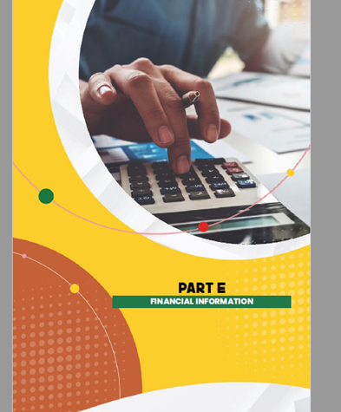
PART E
FINANCIAL INFORMATION

Slide 53
STATEMENT OF FINANCIAL POSITION AS AT 31 MARCH 2022

Slide 54

NOTES: FINANCIAL POSITION
Total assets increased by 10% -
  property, plant and equipment
  Receivables from exchange transactions
Non-current assets increased by 22%
  acquisition of eastern cape; western cape and free state offices
Current liabilities decrease of 105%
  Change of policy on leave management
Accumulated surplus increase of 2%
  Unspent CPTD grant
  Unspent operating expenses
Financial position of SACE is favorable – going concern.

Slide 55
STATEMENT OF FINANCIAL PERFORMANCE

Slide 56

NOTES: FINANCIAL PERFORMANCE
Revenue from Operating Transactions increased by 58%
  Increase in registration-related revenue
An increase of 46% on CPTD subsidy spending
  improved contacts and interaction with the educators
Total Revenue increase of 14%
  CPTD spending
  Increased registration activities
Personnel Expenditure increased by 20%
  Inflation-related increase and filling of vacant posts
  Change of leave policy

Slide 57

NOTES: FINANCIAL PERFORMANCE CONT…
Operating Expenditure increased by 58%
  Adjustment of business operation
  Improved interaction with the educators and ultimately improved delivery
Total Expenditure increased by 31%
  Improved operation activities
  Improvement in surplus by 381%
SACE operated within its approved budget
Surplus of R3.3 million realized
  Approval has been obtained to retain surplus for contingency and improving operating infrastructure.
  Improvement of 381% from the previous year

Slide 58
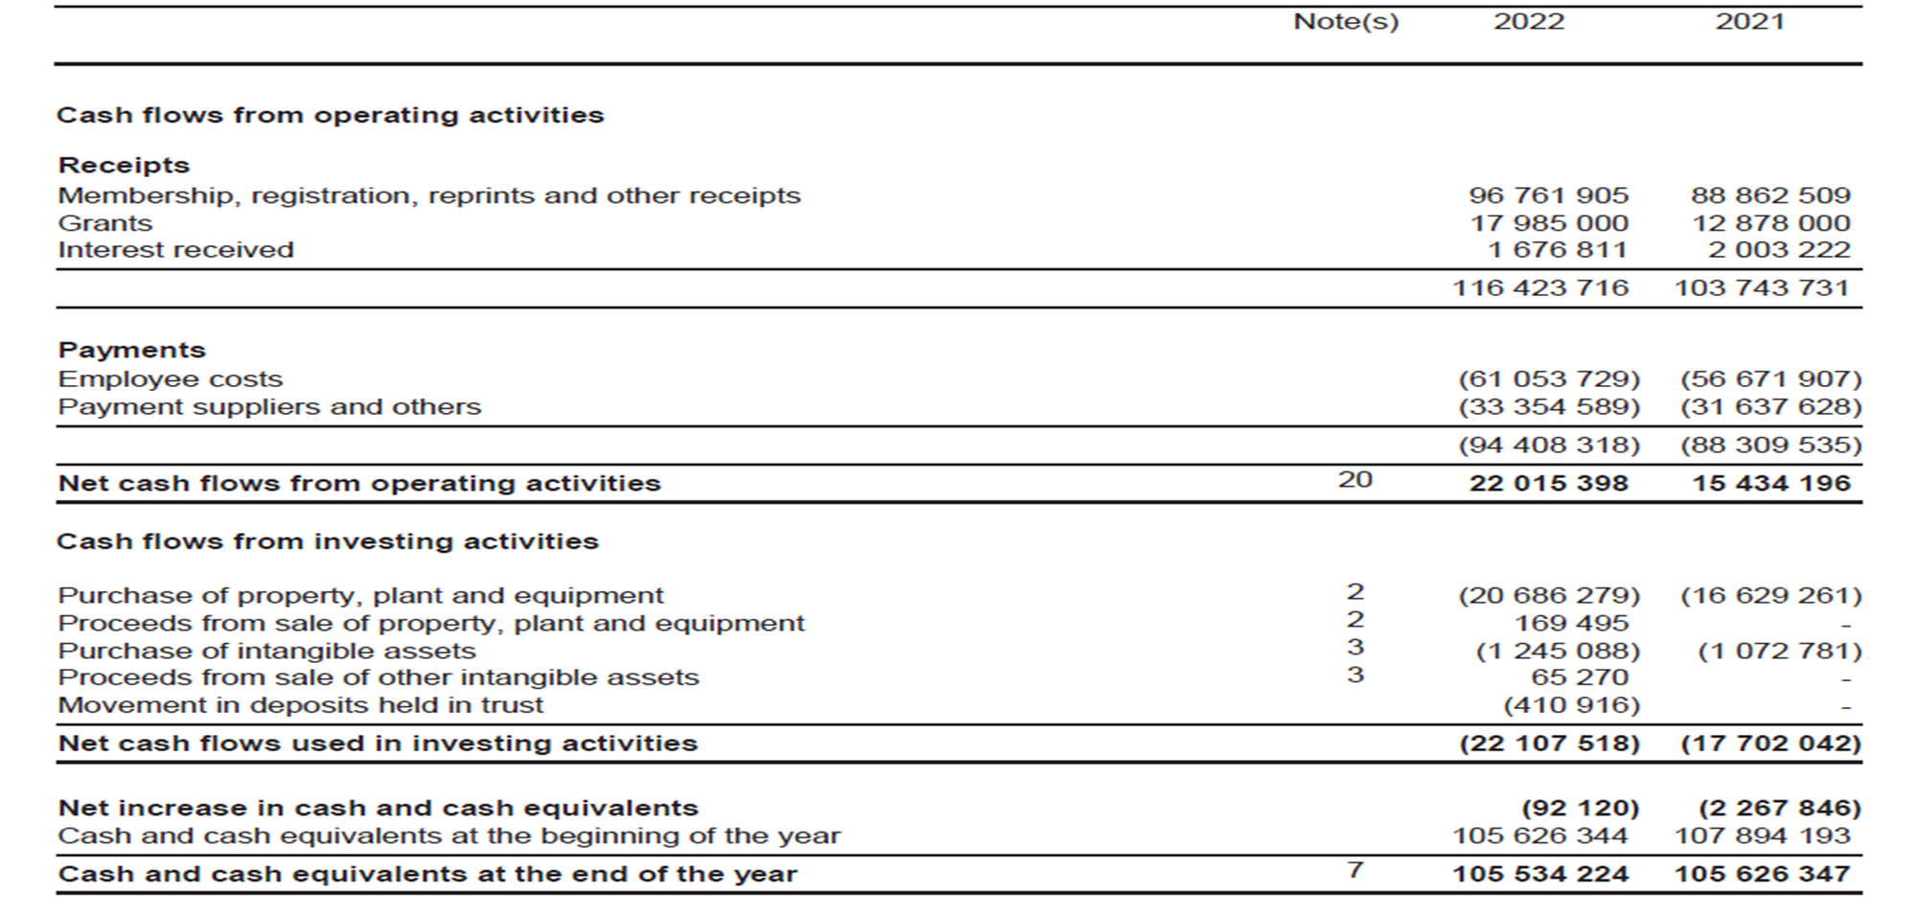
CASH FLOW STATEMENT

Slide 59

NOTES: CASH FLOW
Cash inflow into SACE increased by 12%
  increase in CPTD subsidy spending
  increase of collection of subscription and registration fees
Net cash flows from operations increased by 43% - increase in revenue(inflow).
Cash and Cash equivalents on the 31st March 2022 remained at R106 mil – necessary approval has been obtained.

Slide 60

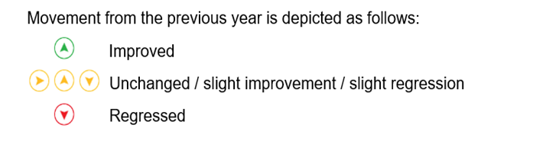

AUDITORS REPORT
SACE received unqualified audit opinion for 2021/22.
Improvement was made in terms of compliance to legislations and relevant standards.
Material misstatements were raised on reported performance information regarding Professional Development for the following indicators:
    4.2.1 Number of educators supported on professional matters;
    4.3.1 Percentage of Professional Development providers approved; and
    4.3.2 Percentage of Professional Development activities endorsed.
    Remedial actions being implemented in line with the information highlighted in Programme 4 slides.
Programme | Pages in annual performance report | Opinion | Movement
Programme 4– Professional Development | 43 – 49 | Qualified

