Slide 1
COPYRIGHT
Prof Owen Dean
Chair of Intellectual Property Law
Stellenbosch University

Slide 2
DEFINITION OF COPYRIGHT
Copyright is the exclusive right in relation to a work embodying intellectual property (i.e., the product of the intellect) to do, or to authorise others to do, certain acts in relation to that work, which acts represent in the case of each type of work the manners in which that work can be exploited for personal gain or profit
Dean: Handbook of South African Copyright Law p 1 – 1
Published by Juta & Co.

Slide 3
RATIONALE OF COPYRIGHT
‘to promote the progress of useful arts, by securing for limited times to authors ….the exclusive rights to their respective writings…’
Article 1s 8 clause 8 of the Constitution of the USA.

Slide 4
WORKS ELIGIBLE FOR COPYRIGHT
©

Slide 5

DEFINITION OF LITERARY WORK
“Literary work” includes, irrespective of literary quality and in whatever mode or form expressed –
Novels, stories and poetical works
Dramatic works, stage directions, cinematograph film scenarios and broadcasting scripts
Textbooks, treatises, histories, biographies, essays and articles

Slide 6
DEFINITION OF LITERARY WORK (continued)
Encyclopaedias and dictionaries
Letters, reports and memoranda
Lectures, addresses and sermons
Tables and compilations, but excludes computer programmes

Slide 7
DEFINITION OF MUSICAL WORK
A work consisting of music, exclusive of any words or action intended to be sung, spoken or performed with the music

Slide 8
DEFINITION OF ARTISTIC WORK
“Irrespective of the artistic quality thereof –
  Paintings, sculptures, drawings, engravings and photographs
  Works of architecture, being either buildings or models of buildings
  Works of craftsmanship not falling within either paragraphs mentioned above

Slide 9
DEFINITION OF CINEMATOGRAPH FILM
‘Any fixation or storage
by any means whatsoever on film or any other material
of data, signals or a sequence of images
capable, when used in conjunction with any other mechanical, electronic or other device, of being seen as a moving picture and of reproduction,
and includes the sounds embodied in a sound-track associated with the film, but shall not include a computer programme’

Slide 10
DEFINITION OF SOUND RECORDING
‘Any fixation or storage
of sounds, or data or signals representing sounds,
capable of being reproduced,
but does not include a sound-track associated with a cinematograph film’

Slide 11
DEFINITION OF COMPUTER PROGRAMME
A set of instructions
fixed or stored in any manner
and which, when used directly or indirectly in a computer,
directs its operation to bring about a result

Slide 12
DEFINITION OF BROADCAST
A telecommunications service of transmissions
consisting of sounds, images, signs or signals,
which takes place by means of electromagnetic waves,
and is intended for reception by the public.

Slide 13
DEFINITION OF PROGRAMME-CARRYING SIGNAL
A signal embodying a program which is emitted and passes through a satellite

Slide 14
DEFINITION OF PUBLISED EDITION
The first print
by whatever process
of a particular typographical arrangement
of a literary or musical work

Slide 15
AUTHOR
Person first making or creating a literary, musical or artistic work
Person responsible for composition of a photograph
Person making the arrangements for making a sound recording
First person emitting a signal, or first broadcaster, of respectively a broadcast or a programme carrying signal

Slide 16
AUTHOR (continued)
Publisher of a published edition
Person who exercised control over the making of a computer programme
Person making arrangements for the making of a cinematograph film

Slide 17
SUBSISTENCE OF COPYRIGHT
Reduced to material form
Original
Author domiciled, or resides in, or the work first published in, SA or in a Berne Convention country
Registration not possible

Slide 18
INITIAL OWNERSHIP OF COPYRIGHT
Person Making or creating a work
(author)
Employer Of author under contract of service
Commissioner Of making a photograph/ portrait/ film/ recording/ gravure
State Work made under its direction or control

Slide 19

TERM OF COPYRIGHT
LITERARY WORK, MUSICAL WORK
OR ARTISTIC WORK
Until fifty years from the death of the author; provided that, if before the death of the author, there has been no exploitation of the work, copyright subsists for fifty years from the year in which exploitation first takes place

Slide 20

TERM OF COPYRIGHT (continued)
CINEMATOGRAPH FILM, PHOTOGRAPH OR COMPUTER PROGRAMME
Until fifty years after the work is lawfully made available to the public, or failing such an event within fifty years from the making of the work, fifty years from when the work was made.

Slide 21

TERM OF COPYRIGHT (continued)
SOUND RECORDING, BROADCAST, PROGRAMME-CARRYING SIGNAL
Until fifty years after the first publication of the sound recording, or after the transmission of a broadcast or programme carrying signal, respectively

Slide 22
THE COPYRIGHT OWNER
HAS THE EXLUSIVE RIGHT, INTER ALIA, TO
Reproduce/adapt the work in any manner or form
Publish the work
Broadcast the work
Perform the work in public
……known as a ’restricted act’

Slide 23
REPRODUCTION/ADAPTATION
Both are copies – dependant on the degree of change from original
Reproduction is generally a replication or conversion of the work
Adaptation generally amounts to creating a new original work based on another - translation

Slide 24
SIMILARITY/COPYING
Similarity necessary. If not due to copying, does not constitute copyright infringement by reproduction/adaptation

Slide 25
IDEA/EXPRESSION DICHOTOMY
Ideas and information not protected
Material expression of ideas is subject of protection

Slide 28
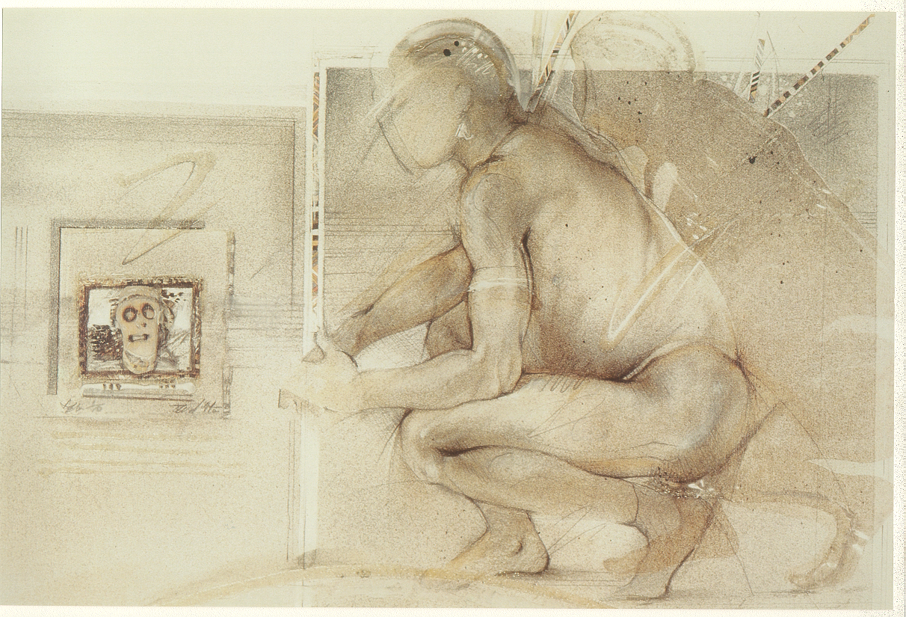

Slide 30


Slide 31


Slide 32


Slide 33
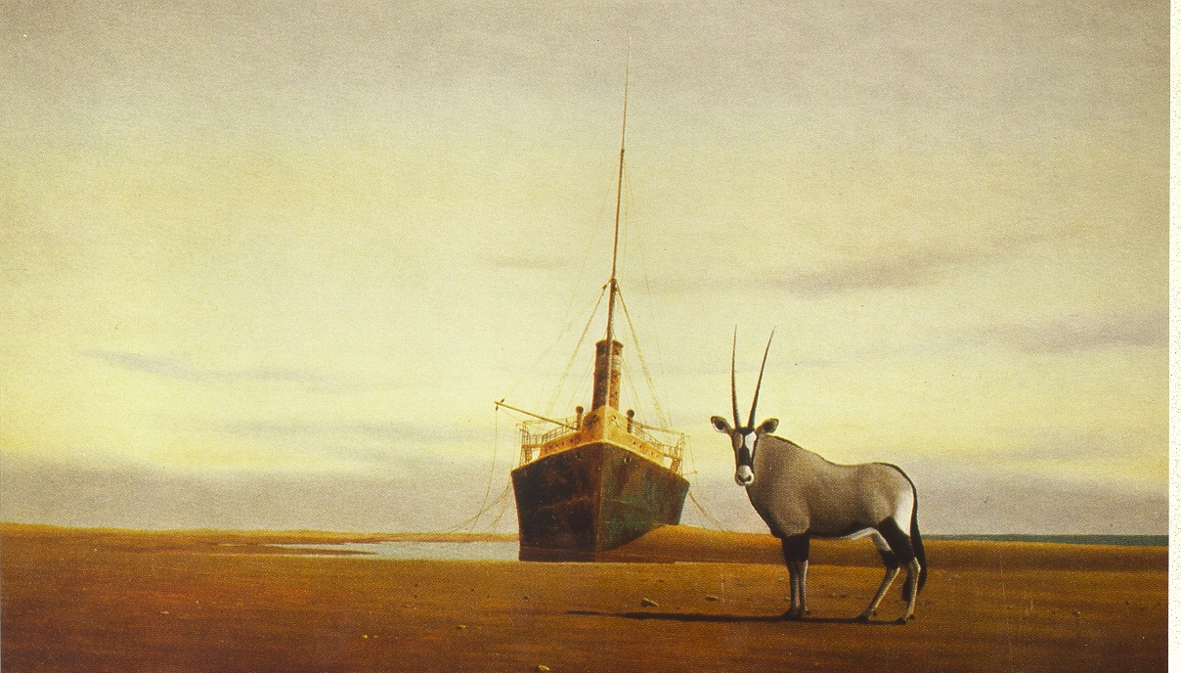

Slide 35
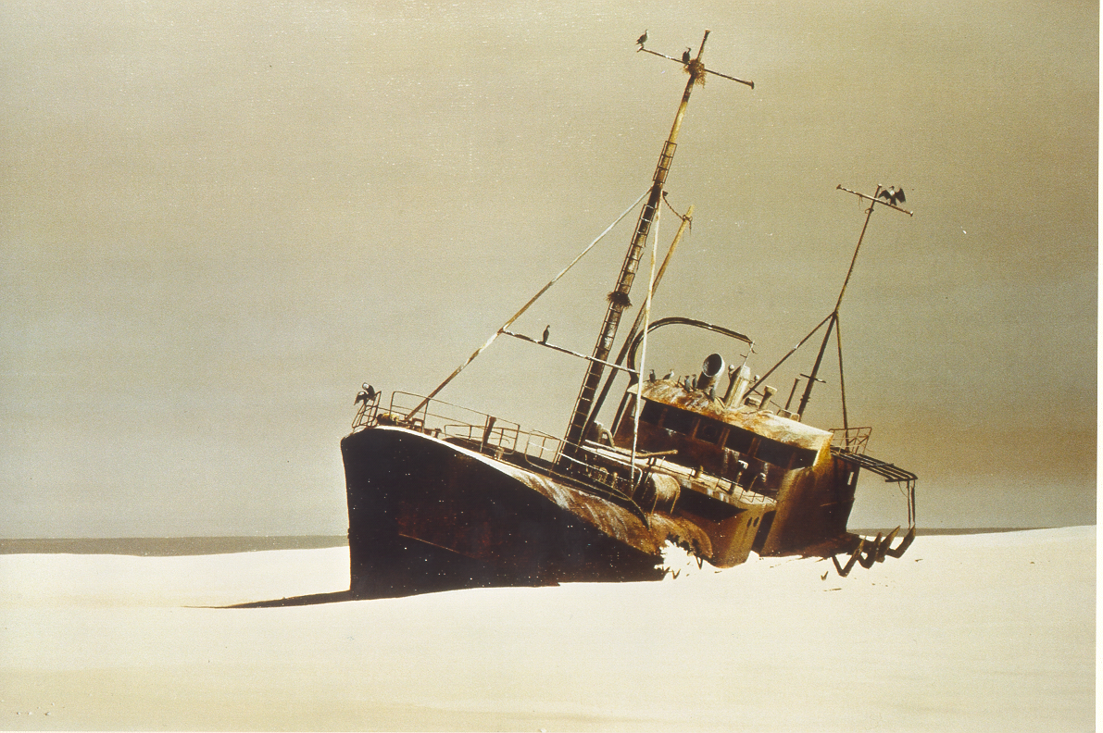

Slide 38

AUTHOR’S MORAL
RIGHTS
In addition to copyright the author has a
Right of Paternity
Right of Integrity
irrespective of whether he/she is the copyright owner
Enforced as though a restricted act

Slide 39
PRIMARY INFRINGEMENT
Person performs one of the ‘restricted acts’
Without the permission of the copyright owner
In relation to any substantial part of the work
Lack of guilty knowledge is no excuse

Slide 40
CRIMINAL COPYRIGHT INFRINGEMENT
Copyright infringement can be a criminal offence
Guilty knowledge is a prerequisite
Stiff penalties

Slide 41
CONSEQUENCES OF COPYRIGHT INFRINGEMENT
CIVIL PROCEEDINGS
Interdict (injunction)
Damages
  Loss of profit, or
  a reasonable royalty, plus
  punitive damage where:
    the infringement is flagrant
    undue benefit to the infringer

Slide 42

CONSEQUENCES OF COPYRIGHT INFRINGEMENT
CRIMINAL PROCEEDINGS
For each article to which the offence relates
  R5 000/R10 000 fine and/or
  3/5 years imprisonment

Slide 43
CERTAIN EXCEPTIONS

Slide 44
EXCEPTIONS EXEMPT INFRINGEMENT
Prima facie infringing act.
Exception excuses infringement
Private property rights weighed against
the public interest

Slide 45
‘THREE STEP TEST’
Only in certain exceptional cases
Not in conflict with normal exploitation of the work
Not unreasonably prejudicial to the legitimate interests of the copyright owner –
Berne Convention and TRIPS Agreement.

Slide 46
FAIR DEALING/FAIR USE
Fair dealing involves listing a closed number of defined exceptions
Fair use entails giving the court a discretion to determine that a particular activity should be exempted
The former creates certainty but is rigid
The latter creates uncertainty but is flexible.

Slide 47
TRANSFER OF COPYRIGHT
* Assignment
* Licence
* Will
The subject is a ‘bundle of rights’

Slide 48
ASSIGNMENT/LICENSING

Slide 49
CONSIDERATION FOR TRANSFER
Lump sum
Royalties.

Slide 50
GENERAL
Works are ‘orphan’ where copyright ownership is unknown
No specific provision made
‘droite de suite’ (ARR) provides for the author (not the copyright owner) to benefit from resale of original version of artistic works.
Not currently provided for

Slide 51
END

