Slide 1
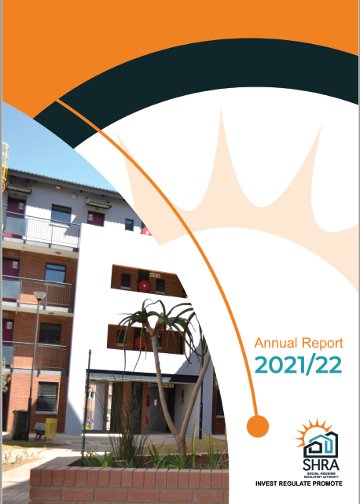
Social Housing Regulatory Authority (SHRA)
Presentation to the
Portfolio Committee on
Human Settlements

Slide 2
PURPOSE
To brief the Portfolio Committee on Human Settlements on the Annual Report of the Social Housing Regulatory Authority for the 2021/22 financial year

Slide 3
CONTENTS
1
EXECUTIVE OVERVIEW & HIGHLIGHTS
2
PERFORMANCE OVERVIEW
3
AUDIT OUTCOME
4
FINANCIAL OVERVIEW
5
RECOMMENDATION

Slide 4
EXECUTIVE OVERVIEW
SHRA’s performance achievement was 61% (19/31) for the 2021/22 year. Regular monitoring of in-year performance with remedial action plans to improve levels of performance are being implemented.
Expenditure on the Consolidated Capital Grant as part of the Project Development and Funding Programme increased from R587 227 628 in the previous financial year to R744 790 731 in the period under review against R713 146 000 allocation received (104% spent against receipts).
2 771 units were completed in 2021/22 and a total of 7 637 units completed (42% of the revised 18 000 MTSF target).
There are 90 accredited institutions on the SHRA Accreditation Register, eight (8) of which are fully accredited, and 82 are conditionally accredited. Thirty-six (36) have stock under management or approved projects and seventeen (17) have projects in the pipeline.
Indexation of the grant quantum and income bands (R1 850 – R22 000 gross household income) were approved in the year for implementation in the 2022/23 financial year.

Slide 5
EXECUTIVE OVERVIEW (Continued)
Inclusion of six (6) Social Housing projects in the Infrastructure Fund. An additional R305 million for the Social Housing Programme (SHP) with the Budget Facility for Infrastructure (BFI) was approved over the MTEF.
The last quarter of the year under review was the last quarter for the implementation of the Covid 19 Rent Relief Fund. By the end of March 2022, a total amount of R2 069 172 was disbursed (0.7% of the R300m allocation). Policy changes will support the motivation for optimal utilisation and the retention of cash surplus.
There were two (2) findings raised in 2021/22 relating to minuting of bid specification meetings and terms of reference. These supply chain matters have already been resolved.
Five (5) audit findings raised during 2020/21 - three (3) fully and two (2) partially addressed during the period under review with the most important the appointment of the SHRA Council on 26 November 2021.
Of the 31 performance indicators, 11 indicators related to transformation, eight (8) of these were achieved. The remedial action plans to target designated groups and support transformed entities will be implemented in the ensuing financial year.
Staff vacancy rate as of March 2022 was 19.64% with a headcount of 45 full time staff.
Commencement of an organisational design and review undertaken in the year.

Slide 6
HIGHLIGHTS: UNITS APPROVED, COMPLETED & REGULATED
Units Completed over the MTSF 2019-24:
7 637 units (42%) and 10 363 units remaining in the next two years to meet target
Approximately 14 000 units have been approved and not yet completed and these require focus to increase the numbers of units completed
Total Units under regulation (2021/22) = 42 553 units
This represents an 8% increase from the start of the MTSF and a 4.7% increase from the prior year 2020/21
6

Slide 8
PERFORMANCE OVERVIEW
SHRA had 31 targets planned for the 2021/22 financial year:
19 targets were achieved.
12 targets were not achieved.
Overall, the Entity achieved 61% of the planned targets.
ANNUAL PERFORMANCE RATE 2016/17-2021/22

Slide 9
PROGRAMME 1: ADMINISTRATION
Outcome 1 | Functional, efficient and integrated government
Performance indicator | 2021/22 Annual Target | Actual Performance | Comments on non-achievement
Percentage implementation of the approved Internal Audit Plan | 100% implementation of the approved Internal Audit Plan | 82% implementation of the approved Internal Audit Plan | As a result of the transitional arrangements due to the change in the service provider of the outsourced internal audit services function, certain planned activities were not performed in line with the initial internal audit plan and other internal audit reviews were performed by the new incumbent that were not part of the internal audit plan that led to the non-achievement of an 18% negative variance. This has been rectified with the appointment of an internal audit service provider that will be in place throughout the ensuing financial year ending 2022/23.
Statutory tabling and reporting requirements | 100% compliance with statutory reporting requirements and prescripts | 100% compliance with statutory reporting requirements and prescripts | No variance
Percentage adherence to the Anti-Fraud and Corruption Policy | 100% adherence to the Anti-Fraud and Corruption Policy | 100% adherence to the Anti-Fraud and Corruption Policy | No variance
Percentage implementation of the approved Risk Management Plan | 100% implementation of the approved Risk Management Plan | 100% implementation of the approved Risk Management Plan | No variance

Slide 10
PROGRAMME 1: ADMINISTRATION
Outcome 1 | Functional, efficient and integrated government
Performance indicator | 2021/22 Annual Target | Actual Performance | Comments on non-achievement
Percentage implementation of the annual stakeholder management plan | 80% implementation of the annual stakeholder management plan | 83.01% implementation of the annual stakeholder management plan | The achievement was due to planned initiatives being successfully rolled out. These included media releases, interviews, driving the SHRA’s digital and media campaign, conducting information sessions. Going forward the SHRA will continue to expand its stakeholder and marketing drive.
Affordable rental housing policy framework | Affordable rental housing policy position developed | Affordable rental housing policy position developed but not approved by Council | The draft Affordable rental housing policy framework has progressed, and a National led process has been initiated, further consultation with other entities is required prior to being endorsed by the Council.
Outcome 6 | A transformed Social Housing Sector
Percentage procurement spend to majority black-owned service providers | 75% procurement spend to majority black-owned or controlled service providers | 81% procurement spend to majority black-owned service providers | Focus placed on the Appointment of B-BBEE level 1 and 2 service providers has yielded positive results in terms of procurement spend towards designated groups to exceed operational expenditure.
Percentage procurement spend on designated groups | 40% procurement spend on designated groups | 38% procurement spend on designated groups | Procurement spend in terms of designated groups in aggregate have remained consistent year on year. Majority of the actual negative achievement arose from women owned enterprises. Procurement sourcing strategies will be developed in the ensuing year.

Slide 11
PROGRAMME 2: COMPLIANCE, ACCREDITATION AND REGULATION
Outcome 5 | An effectively regulated and sustainable social housing sector
Performance indicator | 2021/22 Annual Target | Actual Performance | Comments on non-achievement
Percentage of reporting Social Housing Institutions (SHIs) and Other Delivery Agents (ODAs) meeting 3 or more out of 5 of the primary performance benchmarks | 61% of reporting SHIs and ODAs meeting 3 or more performance benchmarks | 43.75% (14 out of 32) of reporting SHIs and ODAs achieved 3 or more performance benchmarks | Negative variance of 17.25% . The reporting benchmarks include metrics such as rent collections, vacancy rates, cost to income ratio. In terms of rental collections 47% of the institutions had rent collections lower than 90%. Vacancies are becoming a structural problem with considerable financial implications. Sixteen (16) or 50% of the entities have a vacancy rate greater than 5%. Externalities have jeopardised the sustainability of social housing institutions and delivery agents. Improvements to the Residential Rent Relief framework, would allow institutions that are in financial distress and have suffered losses and experience sustainability challenges due to external factors despite, having done everything in their power to stay afloat. Work towards a sector wide coordinated approach to dealing with rental boycotts has commenced.

Slide 12
PROGRAMME 2: COMPLIANCE, ACCREDITATION AND REGULATION
Outcome 5 | An effectively regulated and sustainable social housing sector
Performance indicator | 2021/22 Annual Target | Actual Performance | Comments on non-achievement
Number of additional fully accredited SHIs | 2 additional fully accredited SHIs | 0 additional fully accredited SHIs. | Negative variance of 2. There were no entities that progressed from conditionally to fully accredited status over the period. It was found that greater training and familiarity in understanding the social housing programme and the process of accreditation. Applicants, particularly designated groups, struggle to access land, to develop and manage a project which is a requirement for full accreditation. A review of the accreditation processes and interventions to improve on the incubation of applicants. Partnerships through joint implementation with the Housing Development Agency (HDA) is intended to assist conditionally accredited SHIs struggling to obtain land to develop their first social housing project.
Number of additional conditionally accredited SHIs with accredited projects | 5 additional conditionally accredited SHIs with accredited projects | 1 additional conditionally accredited SHIs with accredited projects | Negative variance of 4. Only one conditionally accredited SHI project (Siyanakhela Imizi) was accredited. Projects have been mainly approved during the year by other delivery agents. The SHRA observed a reduction in projects submitted for accreditation during this reporting period. It is SHRA opinion that applicants have been holding back their project applications pending the application of pending adjustments to the grant quantum and income bands. The Accreditation unit will in the next financial year, use a proactive approach to attract and improve on the chances of conditionally accredited institutions to progress towards full accreditation.

Slide 13
PROGRAMME 2: COMPLIANCE, ACCREDITATION AND REGULATION
Outcome 5 | An effectively regulated and sustainable social housing sector
Performance indicator | 2021/22 Annual Target | Actual Performance | Comments on non-achievement
Number of subsidised housing units' tenancy audits conducted | 3 300 subsidised housing units' tenancy audits conducted | 4 532 subsidised housing units’ tenancy audits conducted. | Positive variance of 1 232 units. Overachievement was a result of advanced planning. A total of fourteen (14) projects and 4 532 tenancy audits were conducted. This was 1 2332 more than the annual target.
Number of subsidised housing projects’ tenant satisfaction surveys conducted | 10 subsidised housing projects’ tenant satisfaction surveys conducted audits conducted | 11 subsidised housing projects’ tenant satisfaction surveys conducted | Positive variance of 1. A total of 26 projects were identified as part of the survey pilot. Poor response rates resulted in only 11 projects being considered as part of the reported achievement. Going forward the SHRA will assess the process and applicability of the findings to guide best practice towards achieving the regulatory require for good tenant management practice.
Number of subsidised housing projects’ safety and security audits conducted | 15 subsidised housing projects’ safety and security audits conducted | 22 subsidised housing projects’ safety and security audits have been conducted. | Positive variance of 7. Early initiation with the safety and security audits allowed 7 additional projects to be included in the year. The identified findings will continue to inform the remedial actions and/or intervention to be planned and implemented.

Slide 14
PROGRAMME 2: COMPLIANCE, ACCREDITATION AND REGULATION
Outcome 6 | A transformed social housing sector value chain
Performance indicator | 2021/22 Annual Target | Actual Performance | Comments on non-achievement
Percentage of new project accreditation applicants that are black majority owned or controlled | 85% of new project accreditation applicants that are black majority owned or controlled | 80% of new project accreditation applicants that are black majority owned or controlled | A negative variance of 5%. Project accreditation applicants are now required to submit transformation plans addressing their current transformation profiles. The Inclusive Growth policy approved in January 2022 guides on how each programme should contribute towards meeting this objective.
Percentage of new project accreditation applicants that are majority owned or controlled by the designated groups | 40% of new project accreditation applicants that are majority owned or controlled by the designated groups | 28% of new project accreditation applicants that are majority owned or controlled by the designated groups | Negative variance of 12%. Project accreditation applications have mostly come from entities that have limited majority representation by women, youth, people with disabilities. Some of the challenges faced by the available institutions bringing projects by designated groups arises because of access to land and finance. Measures to open opportunities for designated groups to access land and finance including the submission of transformation plans addressing changes to their transformation profiles to improve chances of project success and achievement of the target have been identified and will be actioned.

Slide 15
PROGRAMME 3: SECTOR DEVELOPMENT & TRANSFORMATION
Outcome 3 | Enhanced performance of delivery agents and projects
Performance indicator | 2021/22 Annual Target | Actual Performance | Comments on non-achievement
Number of incubation programme participants receiving project accreditation | 2 incubation programme participants receiving project accreditation | 0 incubation programme participants receiving project accreditation | Negative variance of 2. This was due to no project in from any of the participants in the multi-year programme ready for accreditation. A review of the accreditation approach and support needed has been put in place to improve the success rate of the incubation programme.
Percentage achievement of the SHI intervention plan | 75% achievement of the SHI intervention plan | 100% achievement of the SHI intervention plan | Positive variance of 25%. Two of the identified interventions have been successfully implemented resulting in the maintenance of the accreditation level.

Slide 16
PROGRAMME 3: SECTOR DEVELOPMENT & TRANSFORMATION
Outcome 3 | Enhanced performance of delivery agents and projects
Performance indicator | 2021/22 Annual Target | Actual Performance | Comments on non-achievement
Percentage achievement of the social housing projects’ intervention plan | 75% achievement of the social housing projects’ intervention plan | 0% of the social housing projects’ intervention plan | Negative variance of 75%. No project has reached readiness for accreditation. The time taken from identification, implementation of the interventions can span over multiple years. Going forward a review of the processes and institutional investment support is required
Outcome 4 | Increased capacity of municipalities and provinces to deliver social housing
Number of provinces that achieve at least 80% of the criteria for supporting a functional Social Housing Programme | 7 provinces that achieve at least 80% of the criteria for supporting a functional Social Housing Programme | 7 provinces that achieve at least 80% of the criteria for supporting a functional Social Housing Programme | No variance.

Slide 17
PROGRAMME 3: SECTOR DEVELOPMENT & TRANSFORMATION
Outcome 4 | Increased capacity of municipalities and provinces to deliver social housing
Performance indicator | 2021/22 Annual Target | Actual Performance | Comments on non-achievement
Number of projects from municipalities in the municipal support programme accredited | 2 projects from municipalities in the municipal support programme accredited | 2 projects from municipalities in the municipal support programme accredited | No variance.
Outcome 6 | A transformed social housing sector value chain
Percentage of Institutional Investment Grant (IIG) recipients that are majority black-owned or controlled | 85% of IIG recipients that are majority black-owned or controlled | 94% of Institutional Investment Grant (IIG) recipients that are majority black-owned or controlled | Positive variance of 9%. There was a total of 31 Grant Recipients who were required to report on the extent of ownership or control. Only one of the thirty-one (31) grant recipients was a level 4 contributor.

Slide 18
PROGRAMME 3: SECTOR DEVELOPMENT & TRANSFORMATION
Outcome 6 | A transformed social housing sector value chain
Performance indicator | 2021/22 Annual Target | Actual Performance | Comments on non-achievement
Percentage of Institutional Investment Grant (IIG) recipients that are from the designated groups | 40% of Institutional Investment Grant (IIG) recipients that are from the designated groups | 48% of Institutional Investment Grant (IIG) recipients that are from the designated groups | Positive variance of 8%. A total of 131 executive and non-executive board members across all the 31 IIG recipients. Out of these recipients, a total of 61 executive and non-executive board members are classified as a being from the designated group made up of 39 women, 22 youth and one 1 Military Veteran
Percentage of participants in the incubation programme that are women or youth owned or controlled | 33% (2/6) of participants in the incubation programme that are women or youth owned or controlled | 77% of participants in the incubation programme are women or youth-owned or controlled | Positive variance of 44%. Out of a total of 9 Incubation Participants that was made up of Social Housing Institutions (not for profit), Seven (7) institutions had controlling interests by board members that were controlled by women and/or youth

Slide 19
PROGRAMME 4: PROJECT DEVELOPMENT & FUNDING
Outcome 2 | Quality affordable social housing for rental delivered in strategically located areas
Performance indicator | 2021/22 Annual Target | Actual Performance | Comments on non-achievement
Number of social housing units completed | 3 500social housing units completed | 2 771social housing units completed | Negative variance of 729 units. This is due to majority of projects are stuck at planning due to a myriad of reasons not limited to statutory approvals and largely securing debt funding. The PD&F unit in the next FY will work closely with municipalities and grant recipients to fast-track statutory approvals through the PSCs. The programme has also seen several interested financiers to provide debt and equity which will move projects from planning to break ground and commence with construction.
Number of social housing units delivered | 4 000 social housing units delivered (tenanted). | 2 057 Social housing units delivered (tenanted). | Negative variance of 1 943 units. This is due to the challenges faced by the programme are that there are units to be tenanted however they are awaiting statutory approvals such as occupational certificates. Performance against approximately 1 500 of these units will be accounted for in the next financial year. Over and above this, with the country opening up economically, job creation and economic activity will allow take up of units by prospective qualifying tenants.
Percentage expenditure of the approved annual Consolidated Capital Grant cash flow projection | 95% expenditure of the approved annual Consolidated Capital Grant cash flow projection | 97% expenditure of the approved annual Consolidated Capital Grant cash flow projection | Positive variance of 18.68%. The PD&F unit has in assessing projects on the pipeline pursued applicants to ensure transformation. However, the SHRA must exercise caution with the recent High Court outcome regarding Government’s procurement on BBBEE procurement requirements

Slide 20
PROGRAMME 4: PROJECT DEVELOPMENT & FUNDING
Outcome 6 | A transformed social housing sector value chain
Performance indicator | 2021/22 Annual Target | Actual Performance | Comments on non-achievement
Percentage of CCG awarded to black majority owned or controlled enterprises | 75% of CCG awarded to black majority-owned or controlled enterprises | 93.68% of CCG awarded to black majority owned or controlled enterprises | Positive variance of 18.68%. The PD&F unit has in assessing projects on the pipeline pursued applicants to ensure transformation. However, the SHRA must exercise caution with the recent High Court outcome regarding Government’s procurement on BBBEE procurement requirements
Percentage spent by grant recipients on black owned main contractors and professional teams | 50% spent by grant recipients on black owned main contractors and professional teams | 78.98% of project value spent by grant recipients on black majority owned main contractors and professional teams | A positive variance of 28.98%. The Portfolio Managers play an active oversight role in the appointment of Contractors and Professional Teams to ensuring CIDB grading Transformation, job creating in the value chain.
Percentage of CCG awarded to enterprises that are majority owned or controlled by the designated groups | 30% of CCG awarded to enterprises that are majority owned or controlled by the designated groups | 57.76% of CCG awarded to enterprises that are majority owned or controlled by the designated groups | Positive variance of 27.76%. The PD&F unit had assessed projects on the pipeline and pursued applicants to ensure that the designated group is part of the applicant’s ownership and management structure.

Slide 21
PROGRAMME 4: PROJECT DEVELOPMENT & FUNDING
Outcome 6 | A transformed social housing sector value chain
Performance indicator | 2021/22 Annual Target | Actual Performance | Comments on non-achievement
Percentage spent by grant recipients on main contractors and professional teams that are from the designated groups | 20% spent by grant recipients on main contractors and professional teams that are from the designated groups | 23.19% spent by grant recipients on main contractors and professional teams that are from the designated groups | A positive variance of 3.19%. The Portfolio Managers played an active oversight role in the appointment of Contractors and Professional Teams to ensuring CIDB grading and Transformation

Slide 22
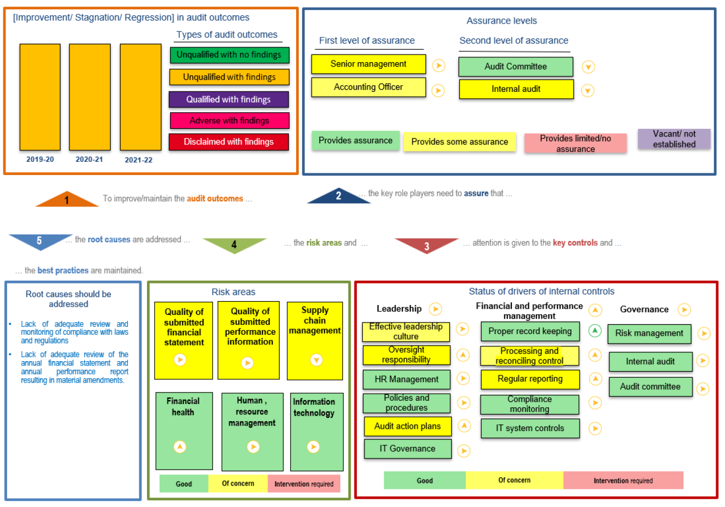
SUMMARY OF AUDIT OUTCOMES

Slide 23
AUDIT OUTCOME 2021/22
Area | Description
Audit Opinion | Unqualified Audit Opinion with emphasis of matter
Emphasis of matter | Internal control deficiencies identified during the audit resulted in the following Non-compliance with relevant laws and regulations Material amendments made to the financial statements. Material amendments made to the annual performance report
Annual Financial Statements | Material misstatements in the submitted financial statements that were identified by the external auditors. The entity subsequently corrected the financial statements, resulting in an unqualified audit opinion being issued.
Compliance with Legislation | 55(1)(b) of the PFMA – preparation of financial statements and annual performance report submitted for audit being free of material error
Predetermined objectives | External auditor did not raise any material findings on the usefulness and reliability of the reported performance information

Slide 24
AUDIT OUTCOME 2021/22 (Continued)
Area | Description
Fruitless and wasteful expenditure | None identified in the current financial year
Irregular expenditure | The irregular expenditure identified in the current financial year relates to: Irregular expenditure resulting from non-compliance to Section 9 of the Social Housing Act, 2008 (Act No.16 of 2008), due to an interim Council being in place for two consecutive financial year. The irregular expenditure is a consequence of: Transactions being processed following resolutions taken by the Interim Council with regards to CCG project approvals and Ensuing disbursements, payroll related approvals remuneration paid and other costs incurred for the Interim Council. In cases of procurement within the threshold of more than R2 000 but not exceeding R30 000, three written quotations were not obtained per the provisions of PFMA Instruction Note 2 of 2021/22

Slide 25
MITIGATION MEASURE TO IMPROVE AUDIT OUTCOME
Irregular Expenditure
Obtain Council ratification of previous resolutions taken by the interim Council for condonation
The Supply Chain Management policy has been amended and approved by Council to align with the revised thresholds
Misstatements in the AFS
Strengthen management review and include internal audit review of unaudited financial statements prior to release
AUDIT FINDINGS 2021/22
2 external audit findings, related to non-compliance were raised in 2021/22 :
Mitigation Measures
1
Minutes of the bid specification meeting are not compiled
Bid specifications meeting minutes are prepared
2
Relating to bid specifications Terms of Reference
Bid specifications terms of reference in place

Slide 26
GRANT EXPENDITURE
CCG Expenditure for 2021/22 R744.8m (104% of allocation received) and an increase of 27% from
2020/21 = R 587.2m expenditure .
IIG Expenditure for 2021/22: R 9.12m (40% against budget allocation) a further decrease of R1.4m from the prior year’s R10.5m expenditure (47% of R22.4m allocation in 2020/21)

Slide 27
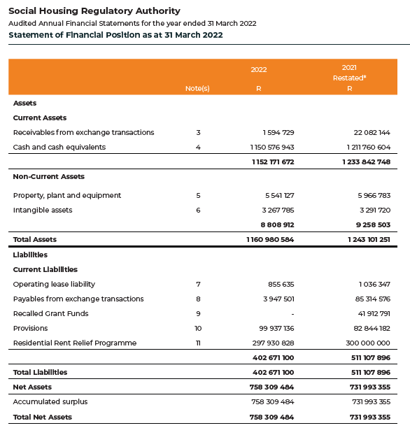
STATEMENT OF FINANCIAL POSITION
Cash & Cash Equivalents stand at R1.152bn a decrease of R61.1m
Total Liabilities have decreased to R402.67m end March 2022 from R511.1m in 2021.
Accumulated Surplus as at year end was R758.31m, an increase of R26.32m from the prior years restated balance of R731.99m

Slide 28
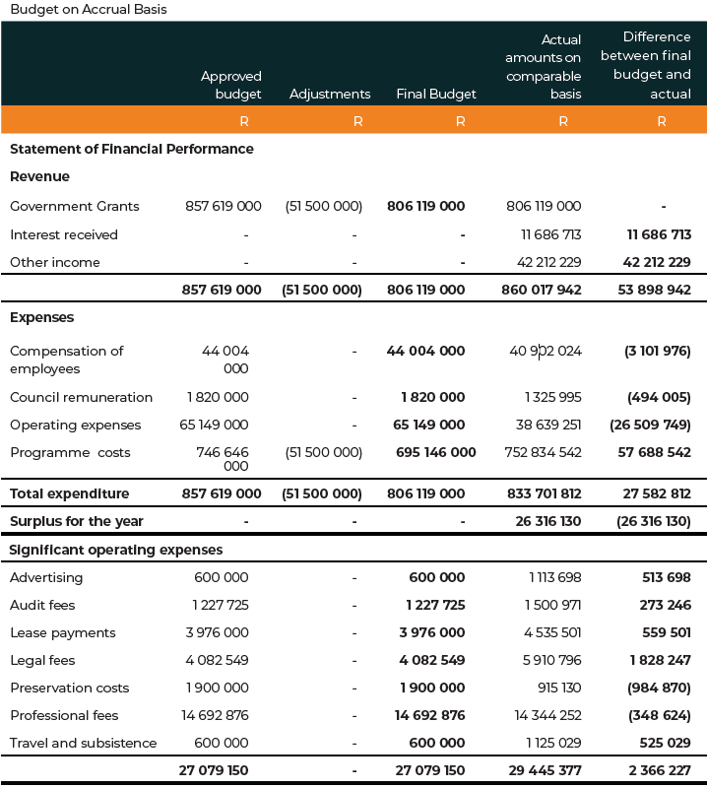
STATEMENT OF FINANCIAL PERFORMANCE

Slide 29
RECOMMENDATION
For the Portfolio Committee on Human Settlements to consider and note the Annual Report of the Social Housing Regulatory Authority for the 2021/22 financial year

