Slide 1
2022 Integrated Report Company presentation
PCOT – October 2022

Slide 2
Our vision and mission
Ensuring our national road transport system delivers a better South Africa for all.
VISION
Our purpose is to deliver a safe, efficient, reliable and resilient national road transport system for the benefit of all the people of South Africa.
MISSION

Slide 3
Principal tasks and objectives

Slide 4
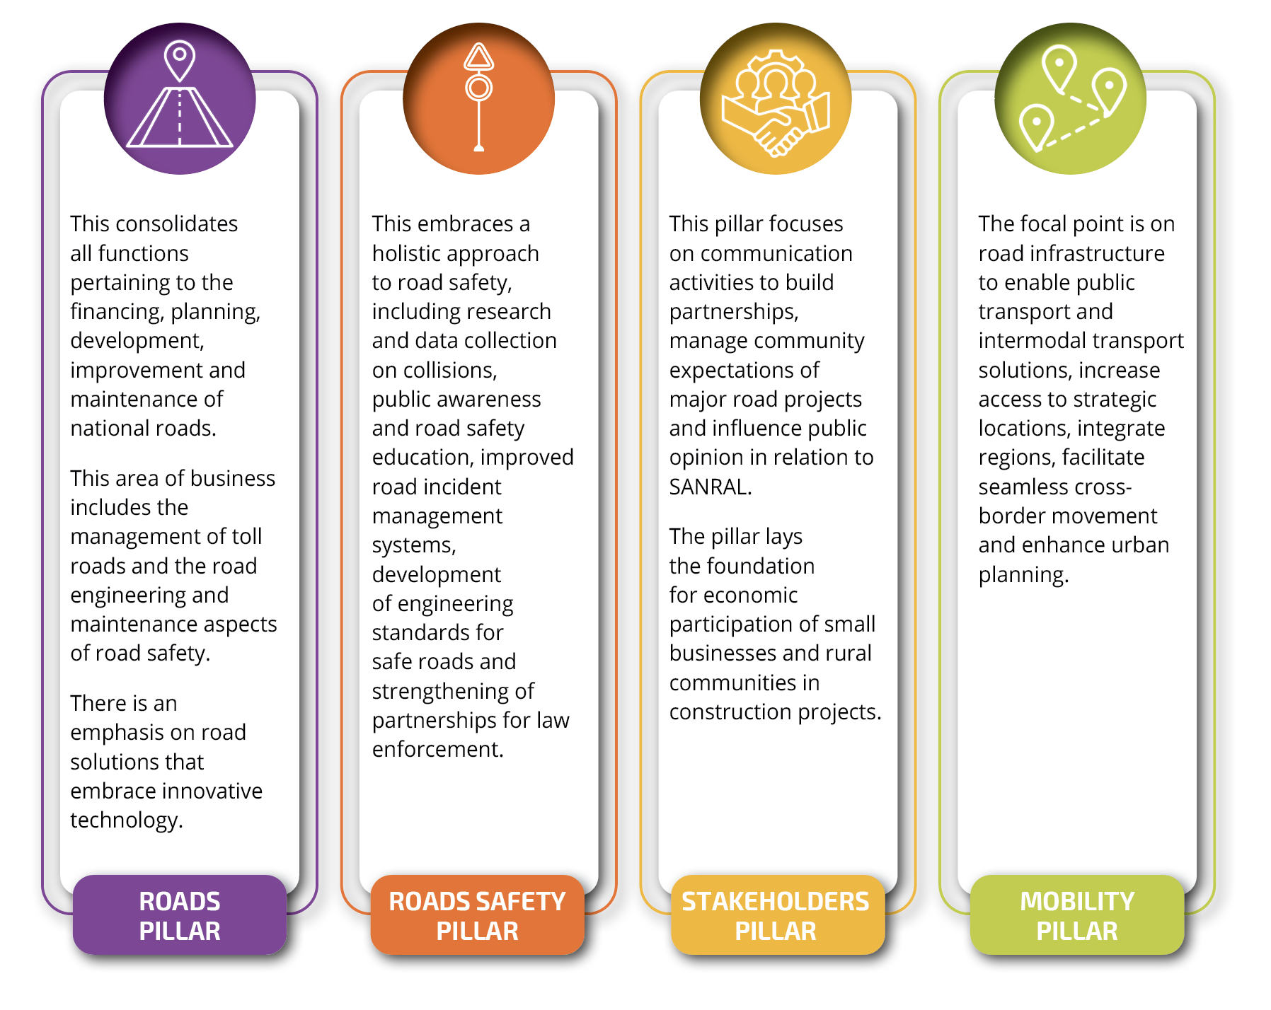
Business pillars
SANRAL’s long-term strategy,
Horizon 2030, defines four business pillars that serve to integrate its operations and activities across the Agency and deliver different forms of value, as set out in the graphic

Slide 5
Integrated Report 2022 | Table of contents
VOLUME 2
Section 3: Corporate Governance
Section 4: Consolidated Financial Statements
VOLUME 1
Chairperson’s Report
CEO’s Report
Section 1: Company Overview
Section 2: Capitals and Performance (SANRAL’s IR has been set up as per capitals used/affected - King IV’s recommended practice has been adopted).

Slide 6
Manufactured capital (p27 - 61)
7% managed by SANRAL
6% managed by concession
National road network = 22,266km
Non-toll = 87%
Built and maintained by annual grant from treasury
Toll roads = 13%
Expenditure on road development, improvement, strengthening and maintenance declined for the third consecutive year = the total amount spent, R11.8bn, was 7.8% lower than the previous year
42% was allocated to capital projects while the balance secured routine and periodic maintenance.

Slide 7
Pavement condition (p39)
Road roughness Under 4.2m/km
95.94%
Rut depth Less than 20mm
98.34%
Macro-texture over 0.4mm
99.37%
Ensures a smooth ride and limits wear and tear
Safeguards against accumulation of water and risk of aquaplaning
Ensures friction for safer wet weather travel at speeds exceeding 60km/h

Slide 8
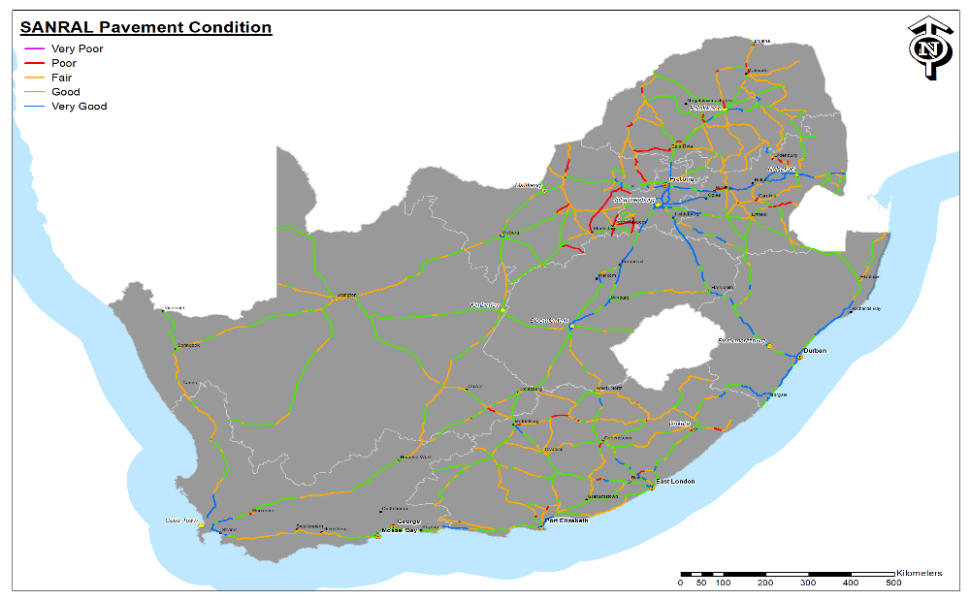
Pavement condition (p39)
Type | Year | V-Good | Good | Fair | Poor | V-Poor
Length (km) | 2022 | 2,627 | 8,906 | 8,862 | 1,781 | 89
% | 2022 | 11.8% | 40% | 39.8% | 8.0% | 0.4%

Slide 9
Funding capital (p67 - 79)
Spending on
non-toll roads
R9.112 bn
Spending on
SANRAL toll roads
R2.747 bn

Slide 10
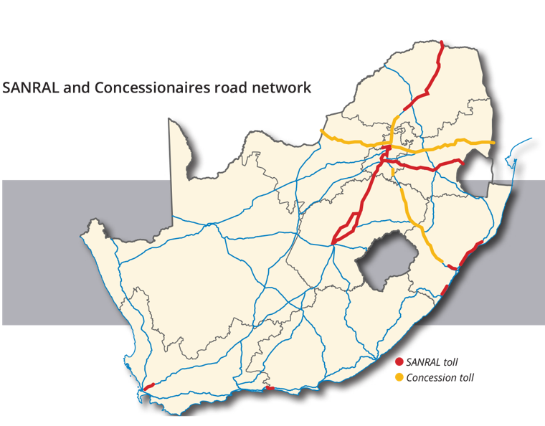
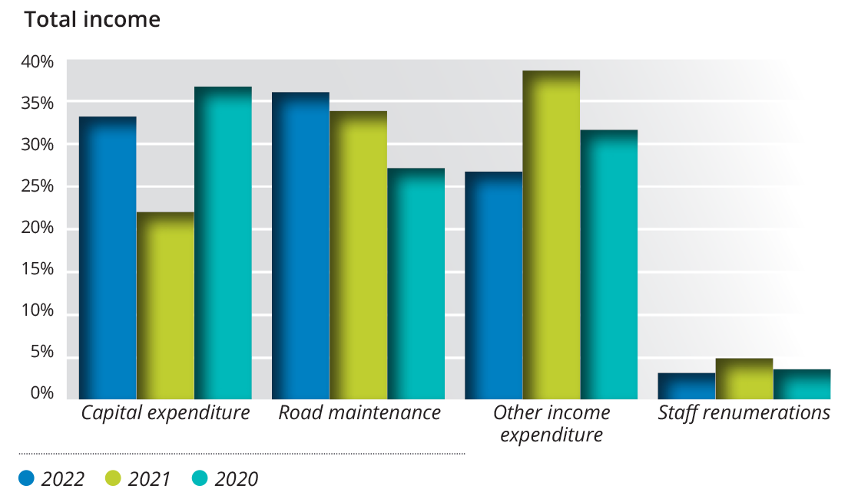
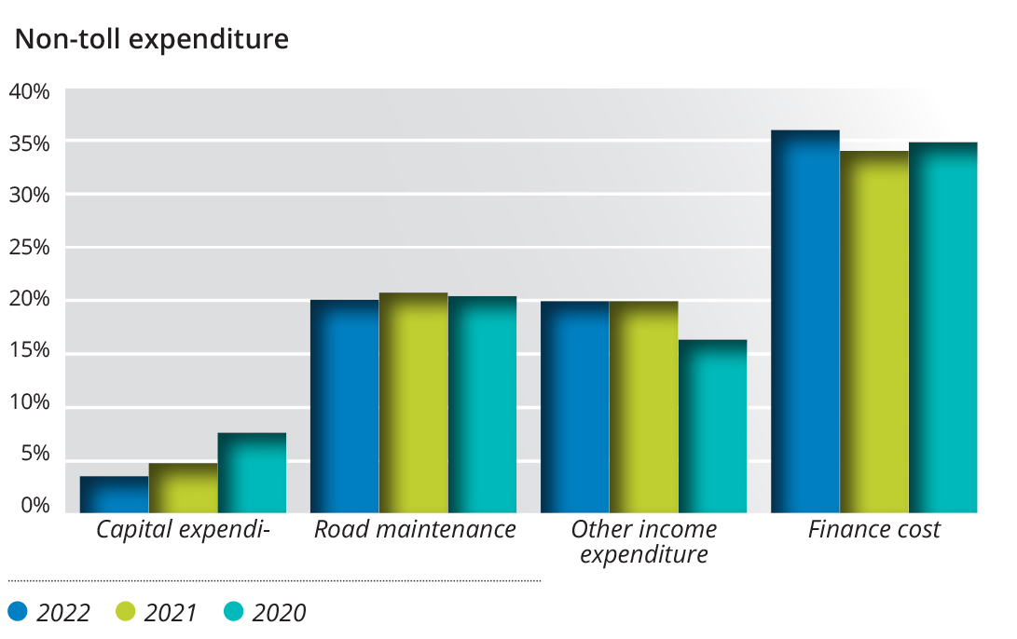
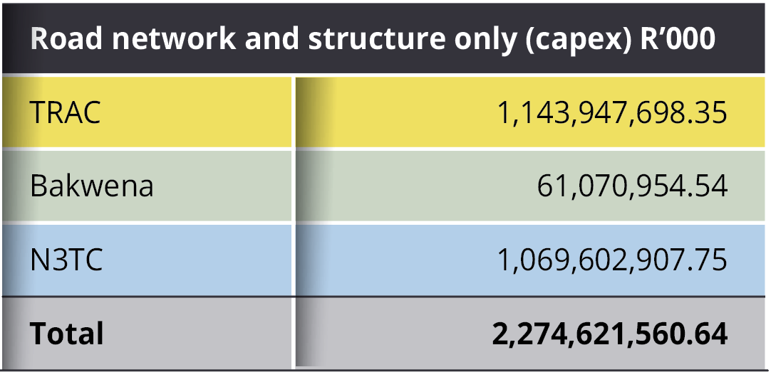
Non-Toll expenditure
Toll expenditure

Slide 11
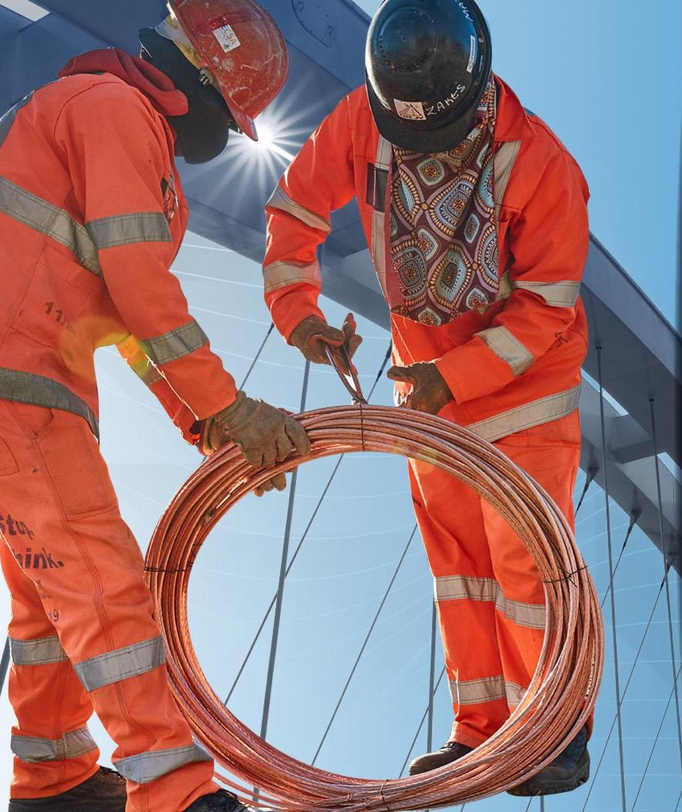
Intellectual capital (p98 - 118)
Value-added services
Account-based ticketing
The SANRAL mobile app
Average speed over distance
Parking
Automated electronic toll payment
Geotechnical solutions
Geometric design solutions
Innovative design

Slide 12
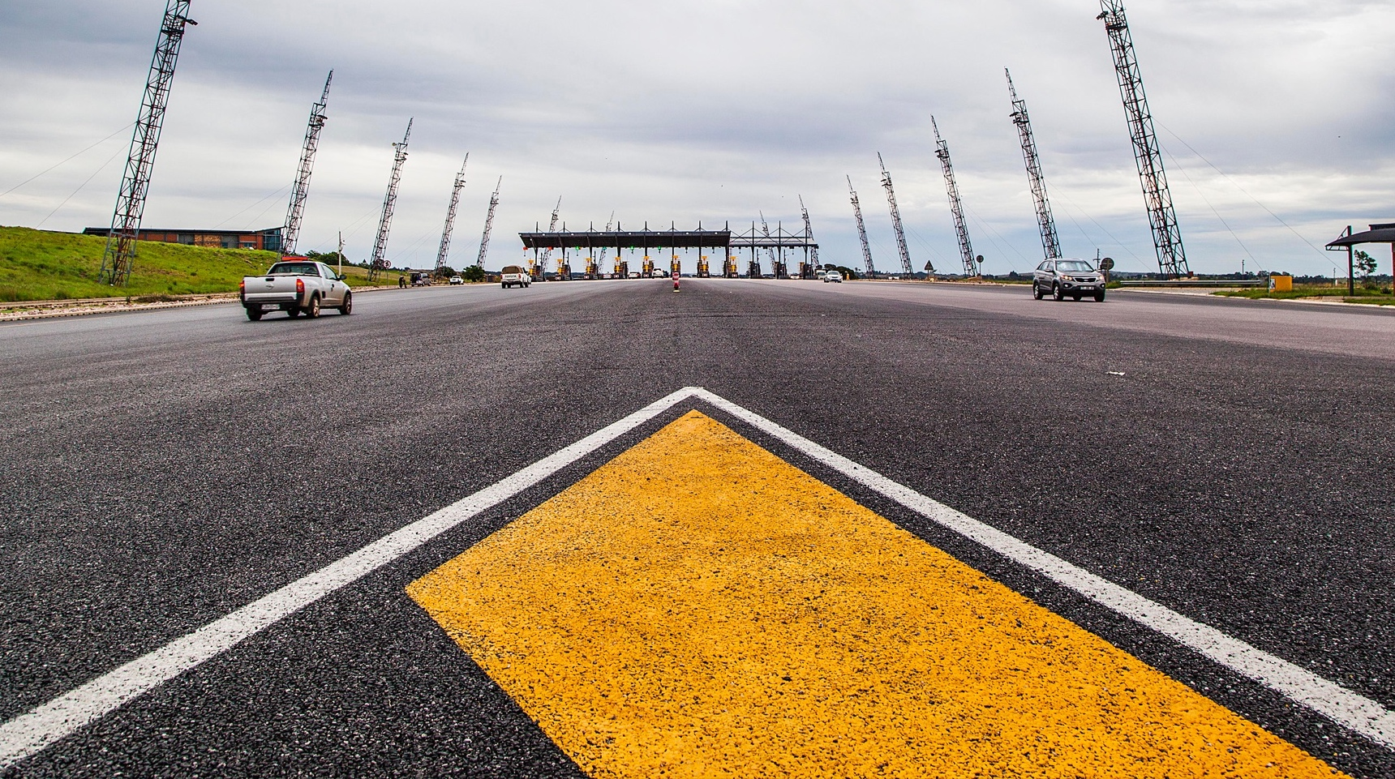
Social and relationship capital (p123- 127)
Value of work performed by SMMEs
Percentage contracts by black-owned companies
Percentage of value of work by black-owned companies
R2.330 bn
88.05%
89.6%
Work
opportunities for
Training for
Road safety education for
Community development projects worth
9129
individuals
613
individuals
525,504
individuals
R31.201m

Slide 13
Concessionaire work by SMMEs (p113)
Concessionaires building small businesses and creating jobs

Slide 14
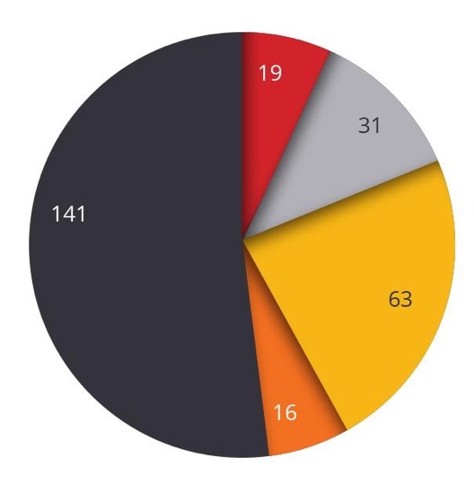
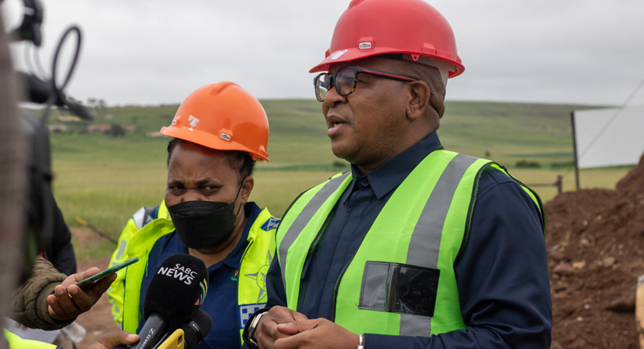
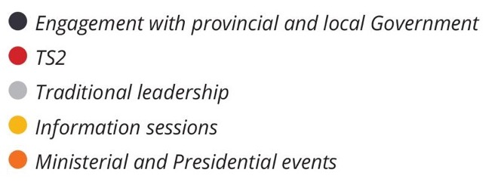
Communications, stakeholder engagement and community involvement
SANRAL convened a total of 270 stakeholder engagements, activations and events.
Ministerial events:
The Minister of Transport, Fikile Mbalula conducted site visits to oversee developments along flagship road infrastructure and associated community development projects carried out by SANRAL nationally.
SANRAL public events 2021/22

Slide 15
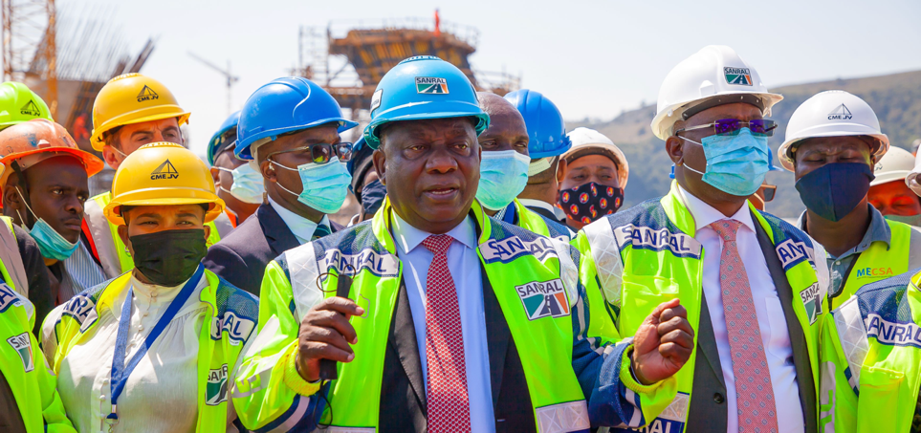
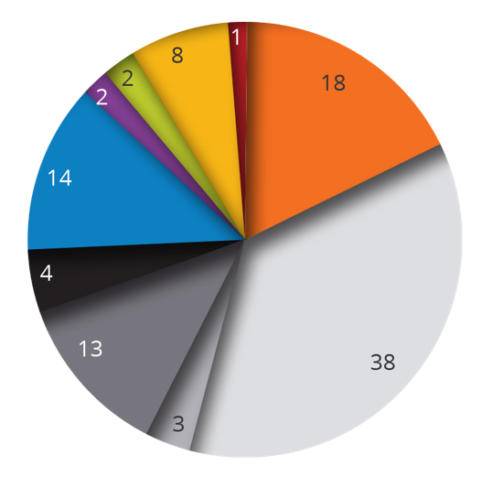
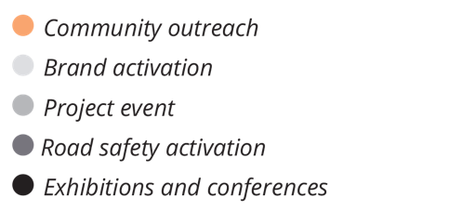
Communications, stakeholder engagement and community involvement
Presidential oversight visits:
President Cyril Ramaphosa undertook site inspections of SANRAL’s flagship projects, which are aligned with the country’s strategic infrastructure projects (SIPS).
Event breakdown

Slide 16
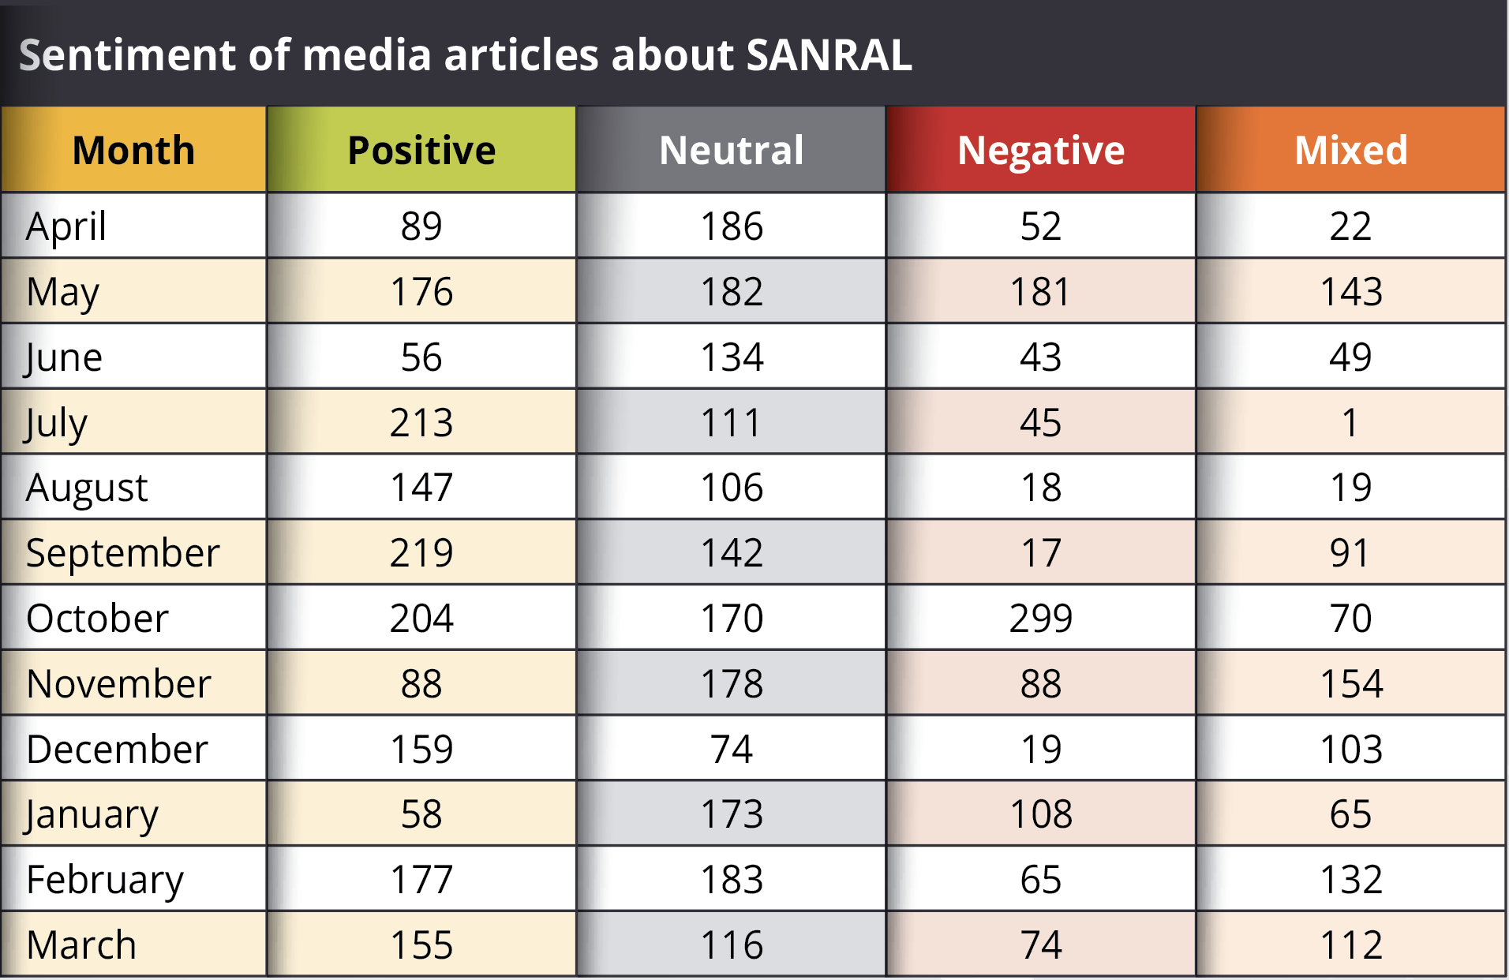
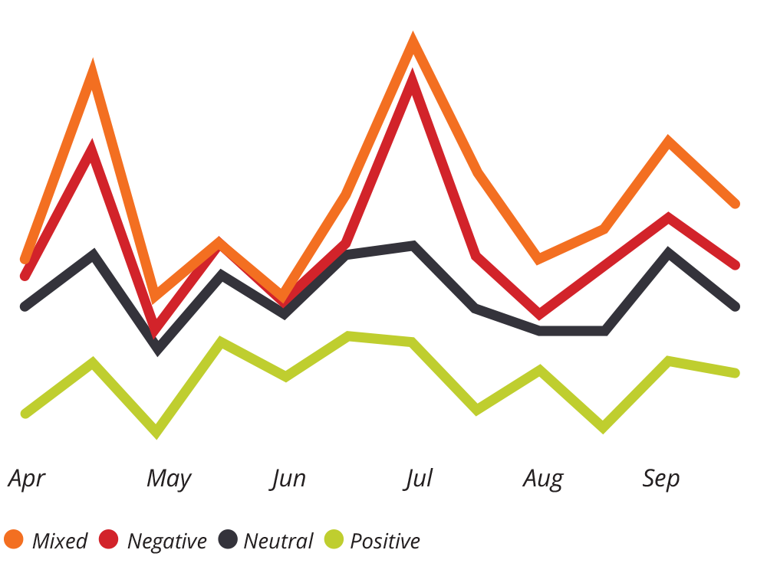
Media relations and media tone

Slide 17
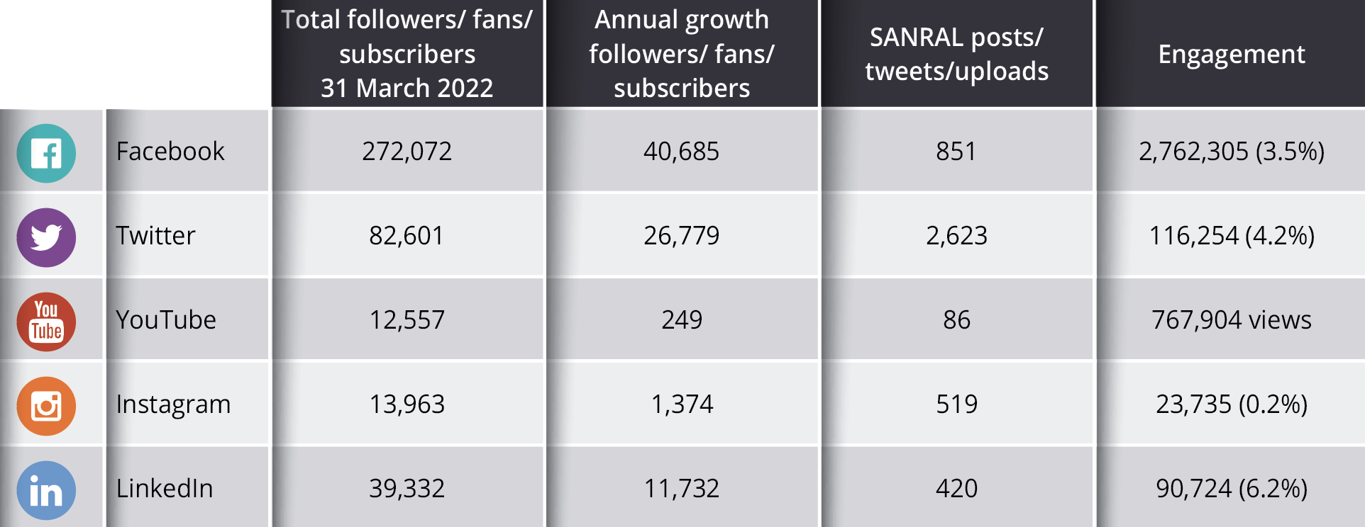
Social media (p200)

Slide 18
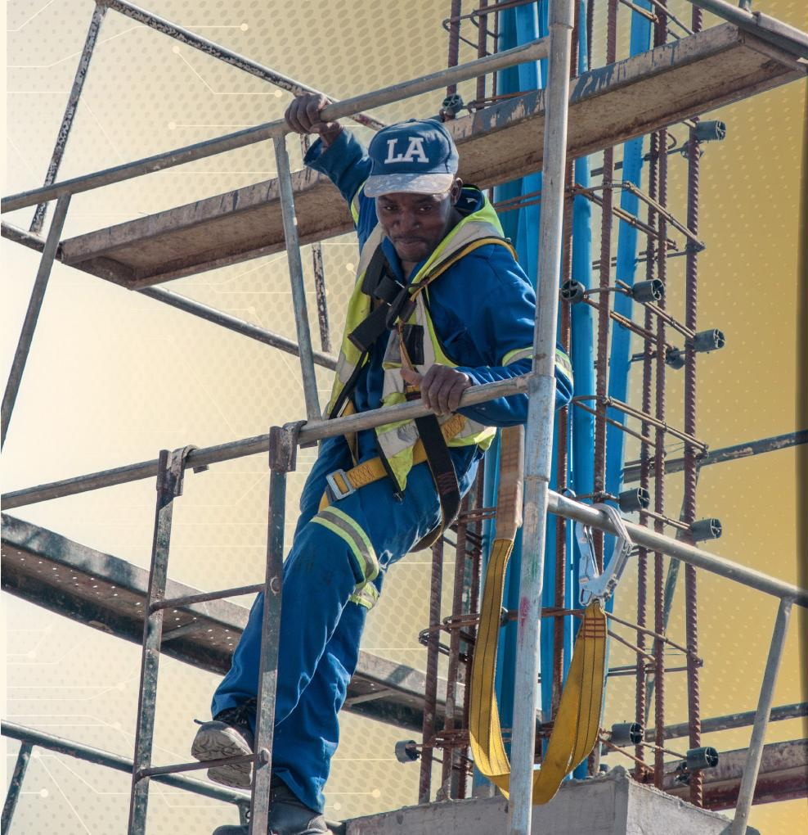
Human capital (p174)
The bulk of SANRAL’s work falls within the realm of:
Planning;
Specialised contracting; and
project management.
All of which are professional engineers with in-depth knowledge of:
road systems management;
road design; and
construction.
Operational work is undertaken mainly by contracted engineering and construction companies.
Senior managers, experienced professionals and middle managers account for 64% of the total number of employees.

Slide 19
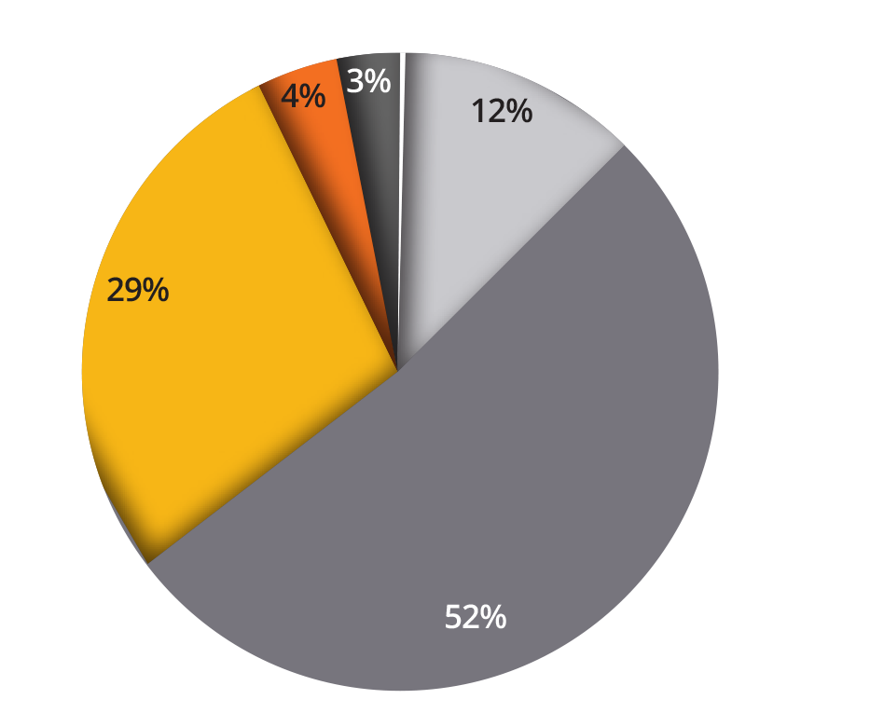
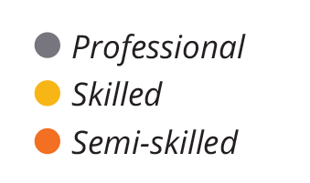
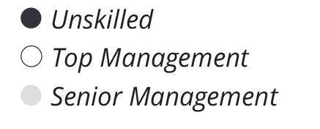
Employees by occupational category (p162)

Slide 20
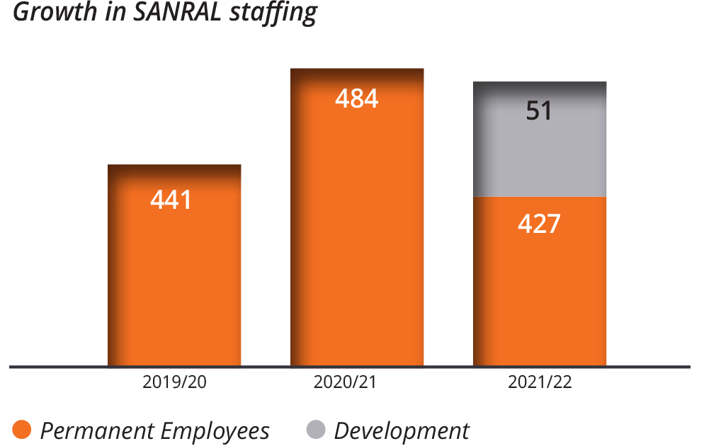
Growth in SANRAL staffing
Growth and diversity
SANRAL’s staff complement has decreased substantially, from 13.22% growth in 2020/21 to 9.6% growth in this reporting year.
This was due to the impending structural and operational model review changes, which have imposed recruitment restrictions to allow the transition process to take place.
The total number of employees as of 31 March 2022 was 427 nationally and the total number of development appointments (candidates and interns) was 51, bringing the combined headcount to 478.

Slide 21
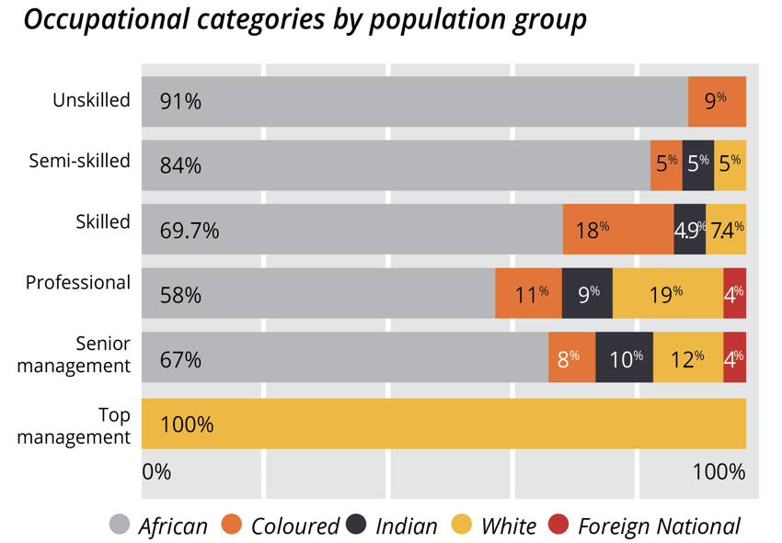
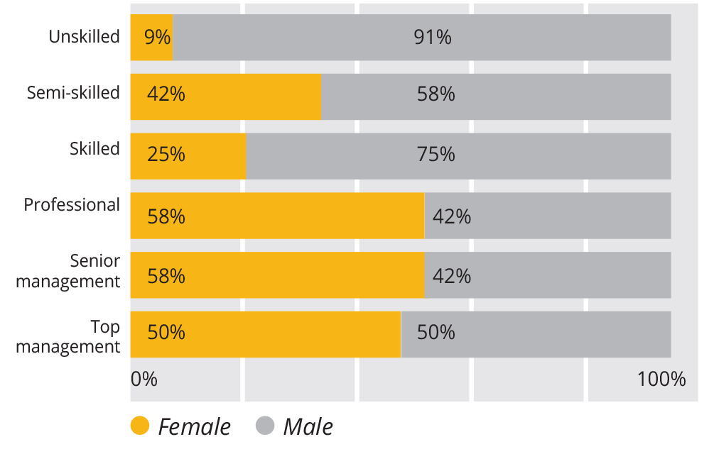
Workforce profile
Gender ratio in occupational categories

Slide 22
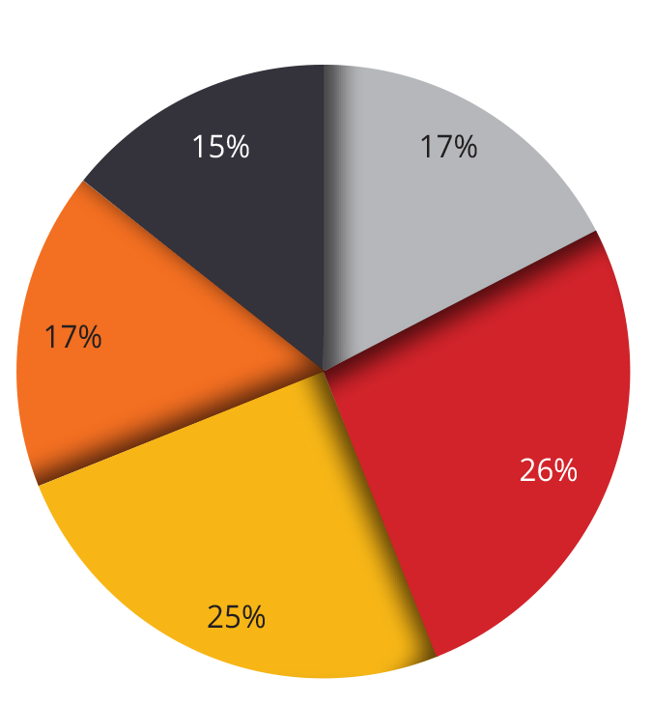
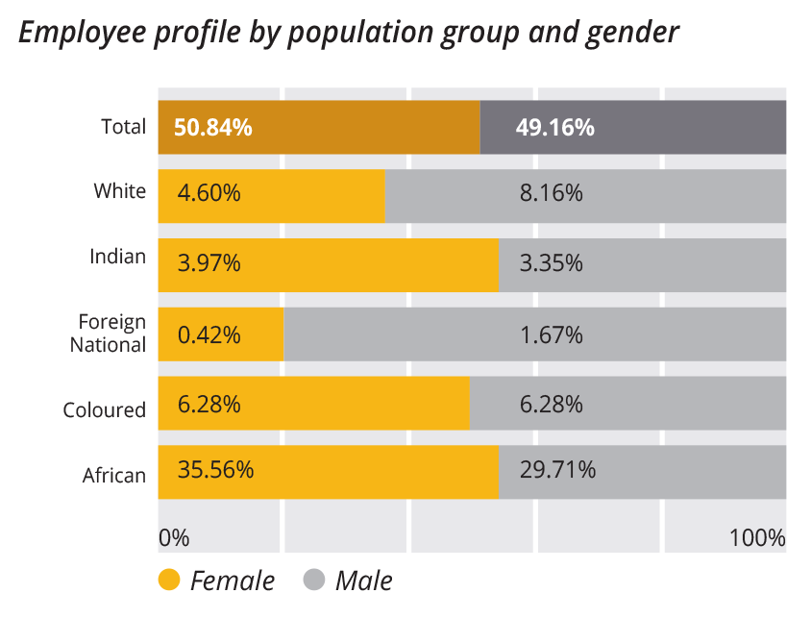
Workforce profile
Employee distribution across offices

Slide 23
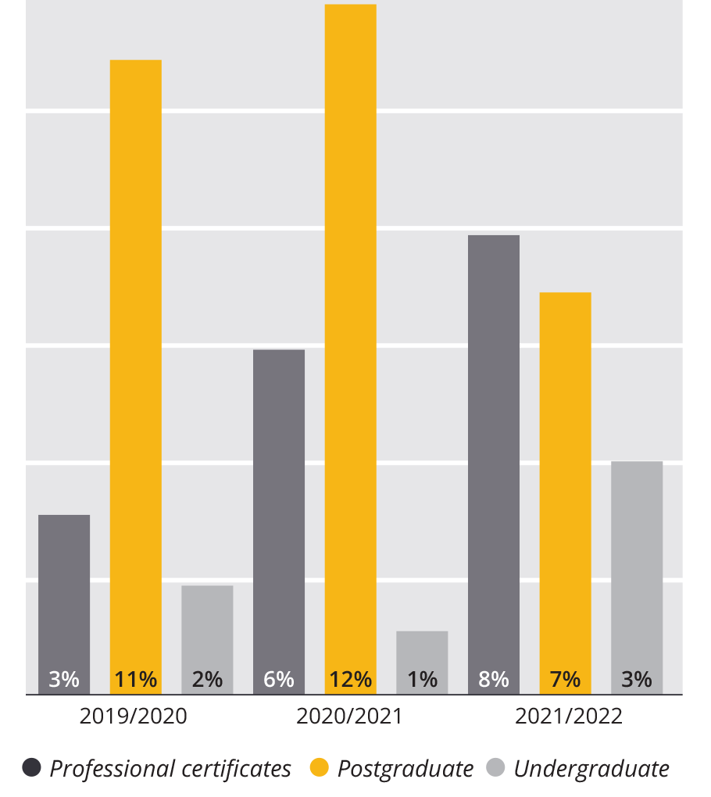
Employee development (p179)
Completed qualifications 2019/20 - 2021/22
SANRAL encourages the development of employee skills and knowledge throughout their careers. Avenues for personal growth range from:
on-the-job learning to e-learning;
participation in short courses;
Workshops;
study for diplomas;
degrees at undergraduate; and
postgraduate levels.
A total of 278 employees were trained during the
period under review, at an investment of
R3,060,070.70.
A total of 115 employees, including 23 new applicants,
were awarded bursaries for tertiary studies during
2021/22. More than half of the bursary recipients
(64%) were engaged in postgraduate studies.

Slide 24
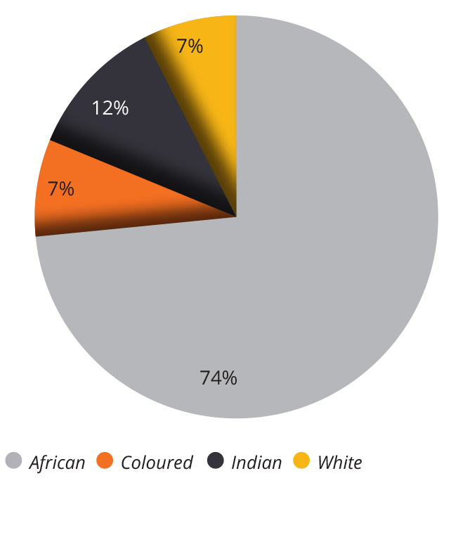
Employee development
2021/22 Internal bursary recipients by course of study
2021/22 internal bursary recipients by population group
2021/22 internal bursary recipients by gender
52%
48%

Slide 25
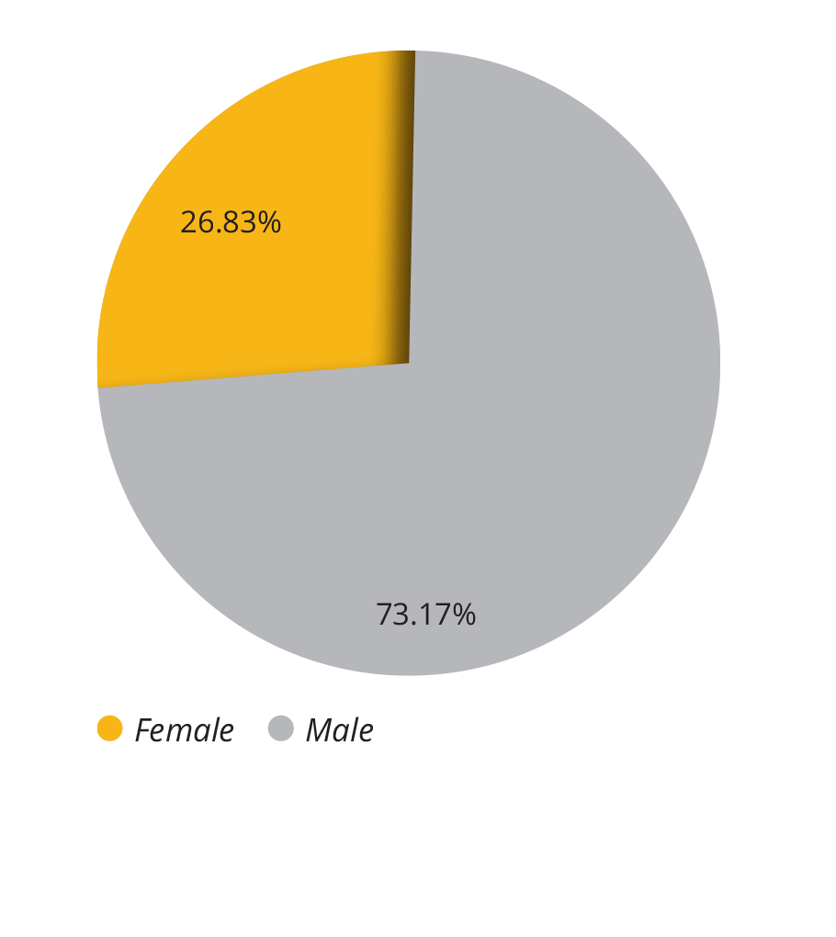
Employee development page 181
The SANRAL graduate development programme
The graduate development programme has evolved over a period of 13 years. Initially established to provide training to civil engineering graduates via secondments on a case-to-case basis, the programme is now structured, with increasing focus on inclusivity and transformation.
Gender composition of 2022 candidate engineers at TEA

Slide 26
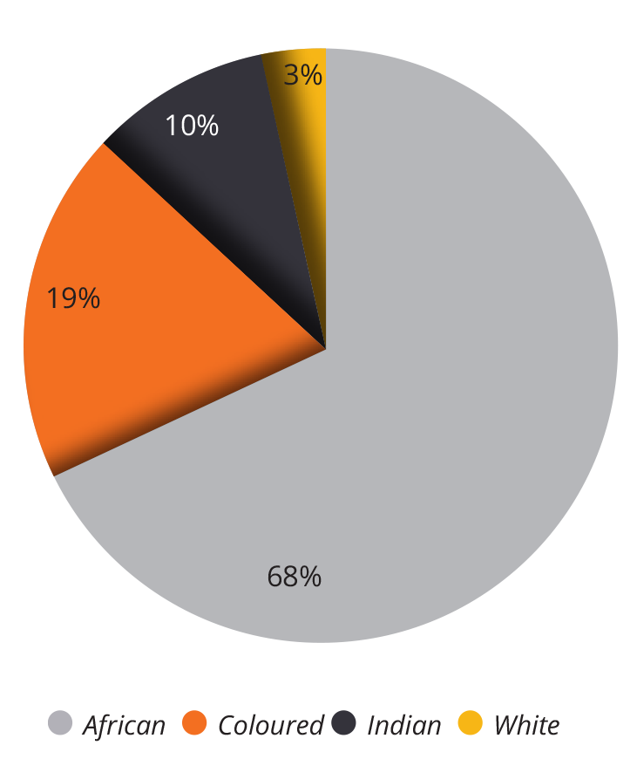
Employee development - Continued
The Technical Excellence Academy (TEA)
and the extended graduate training programme is a facility that assists graduates in fulfilling practical experience and work-integrated learning that is aligned to their careers and required by professional registration bodies, such as the Engineering Council of South Africa (ECSA) and the South African Council for the Quantity Surveying Profession (SACQSP).
Composition of 2022 TEA candidate engineers by population group

Slide 27
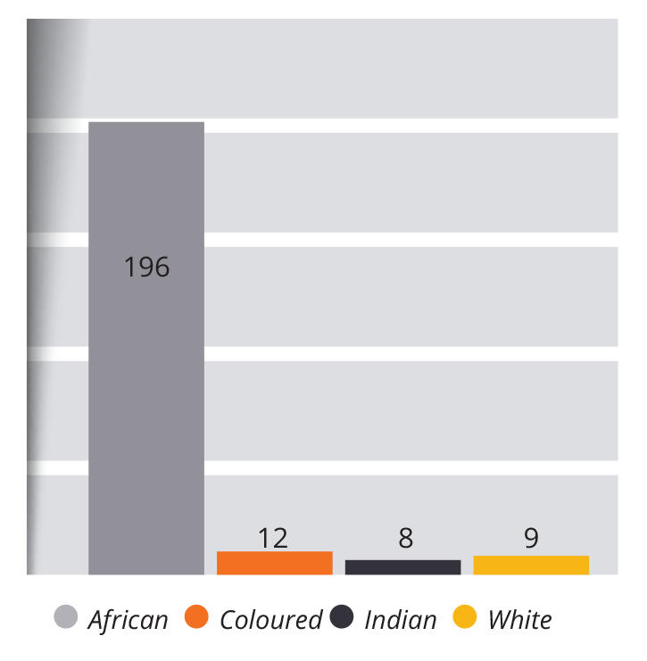
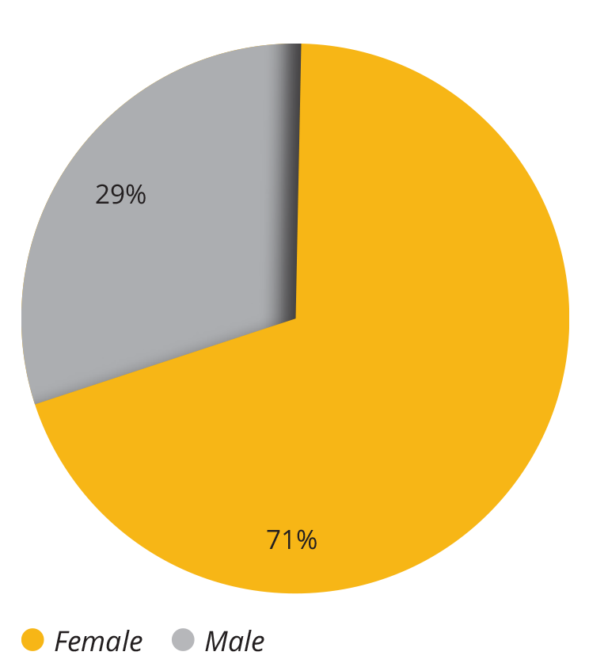
Scholarships and external bursaries (p165)
Scholarships
In 2021/22, scholarships were awarded to 225 learners,71% of whom were girls.
The annual number of scholarships has varied only slightly in recent years.
Investment in this reporting period amounted to R6,311,140,74.
Scholarships by population groups 2021/22
Scholarships awarded in 2021/22 by gender

Slide 28
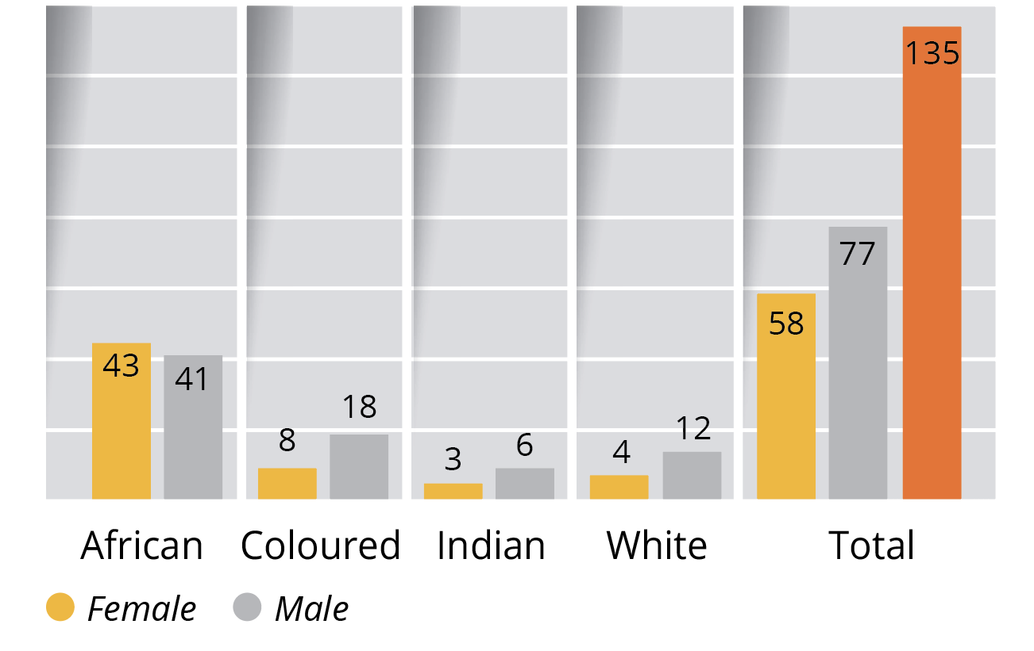
External bursaries
The new policy provisions allowed SANRAL to expand the scope of bursary fields to include students in computer science, mechatronics, human resources, law, electrical engineering, accounting, supply chain and quantity surveying.
Further changes to the programme include student access to the Wellness Programme. Future plans include access to tutoring services, as well as Code 08 learner’s and driver’s licence support.
This year, more awards were allocated to women.
SANRAL awarded external bursaries to 135 students for both postgraduate and undergraduate qualifications, 16 tertiary institutions with a focus on applicants from rural areas and disadvantaged communities.
External bursaries awarded in 2021/22

Slide 29
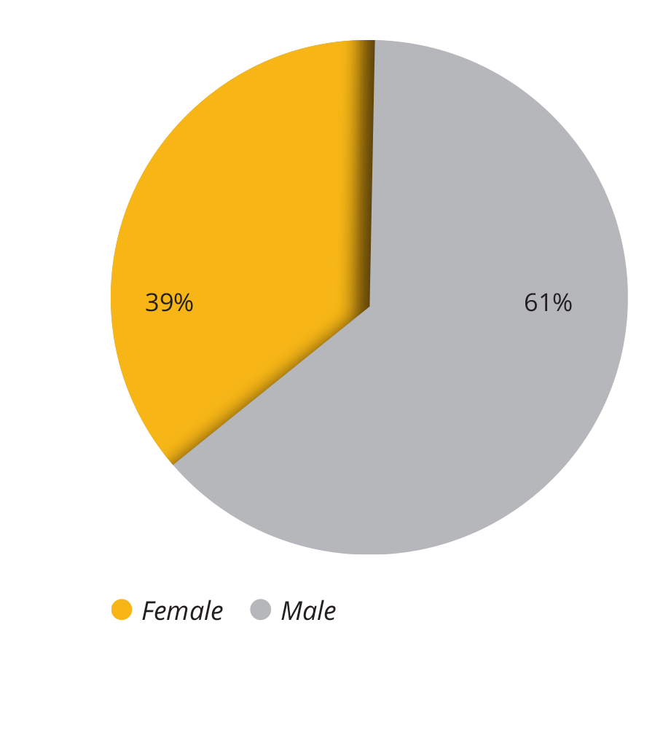
Internships (p167)
The regional offices facilitate student placement in Work Integrated Learning (WIL) programmes through road construction and maintenance contracts.
The intern signs a WIL contract with the training provider (consultant), who provides the necessary training guided by the student’s logbook as designed for their respective discipline. Work integrated Learning is open for all disciplines and runs for either 6, 12, or 18 months.
Interns on SANRAL contracts by gender

Slide 30
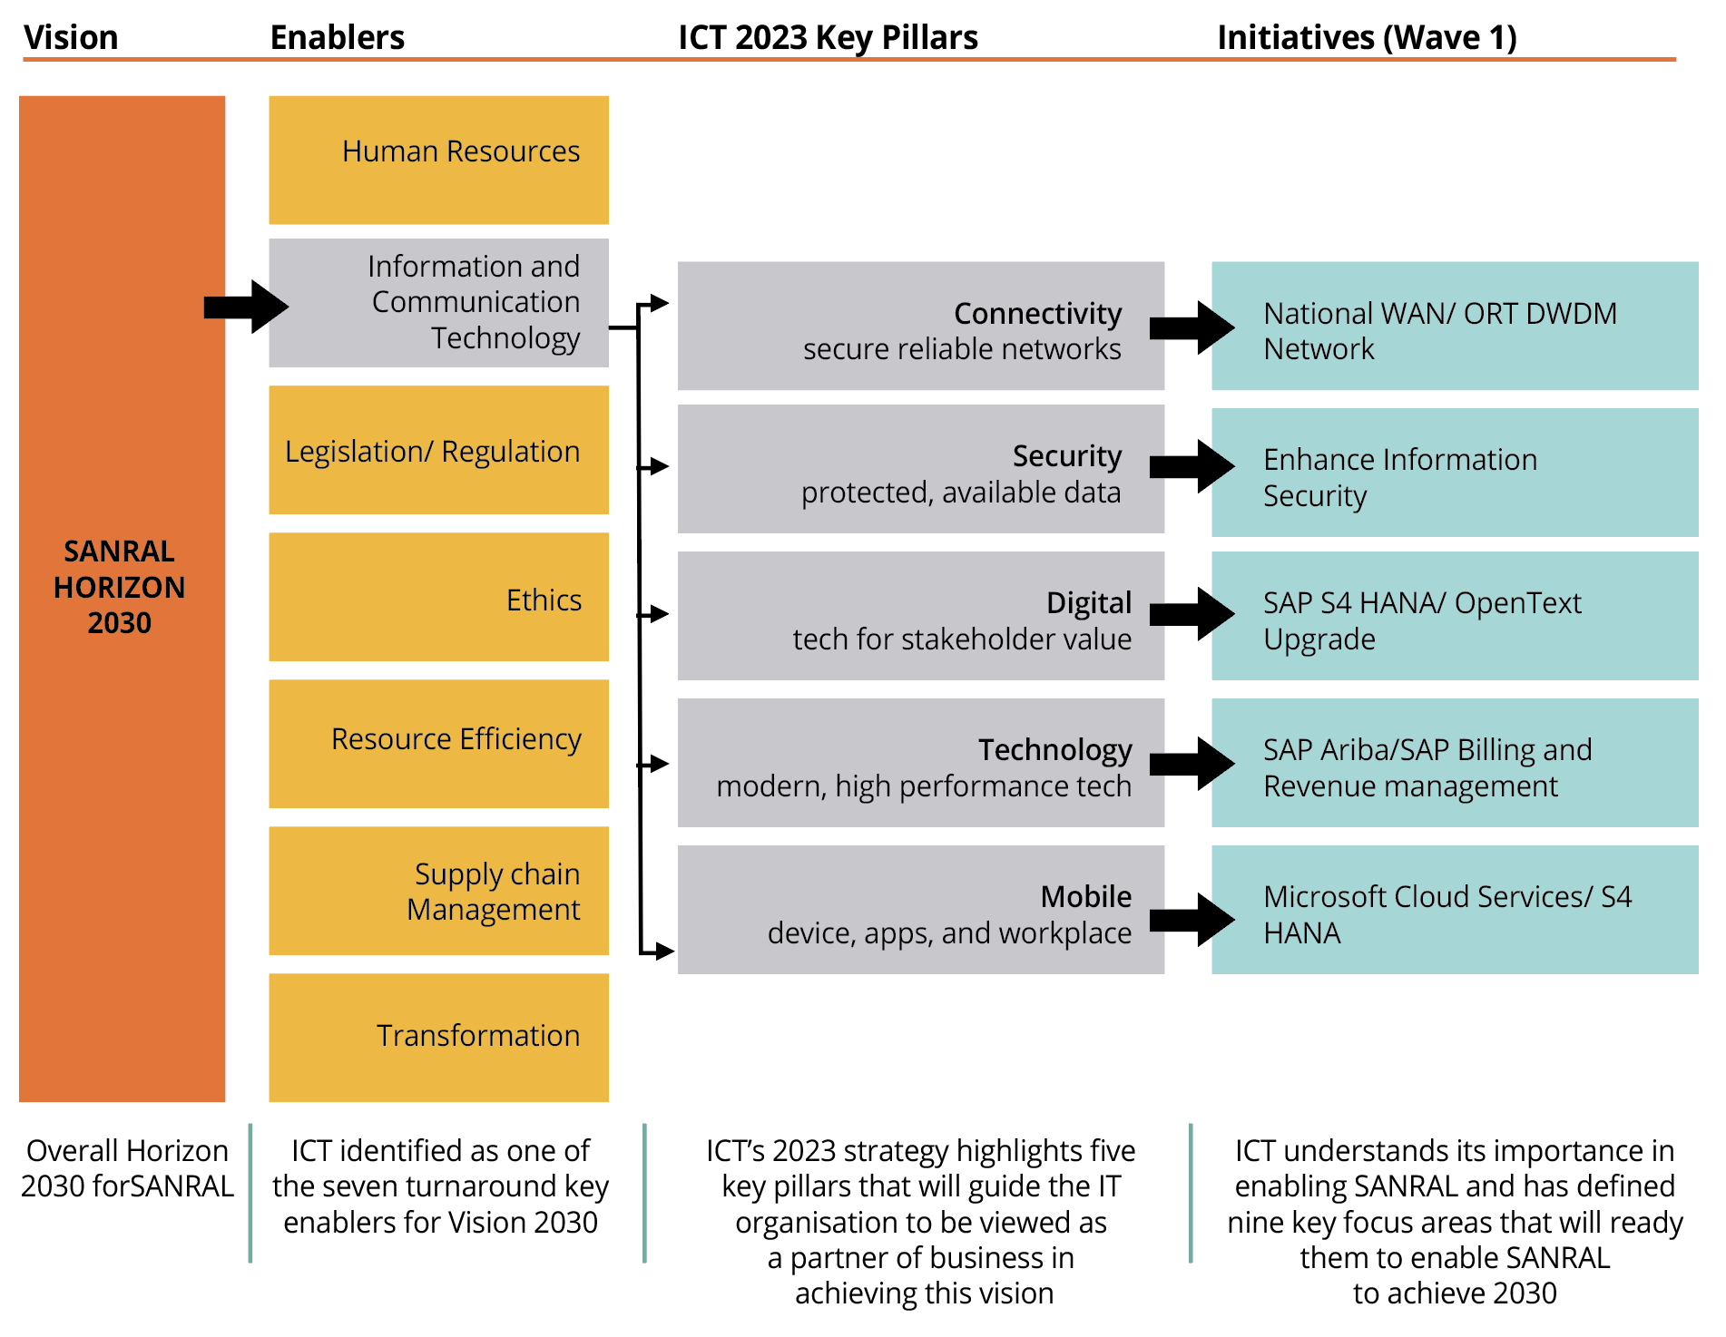
Information Technology – (p200)
Snapshot: Five-Year ICT strategy 2023 (p201)
The strategy has identified five key pillars to support the nine key focus areas in enabling SANRAL to realise its Horizon 2030 strategic objectives.

Slide 31
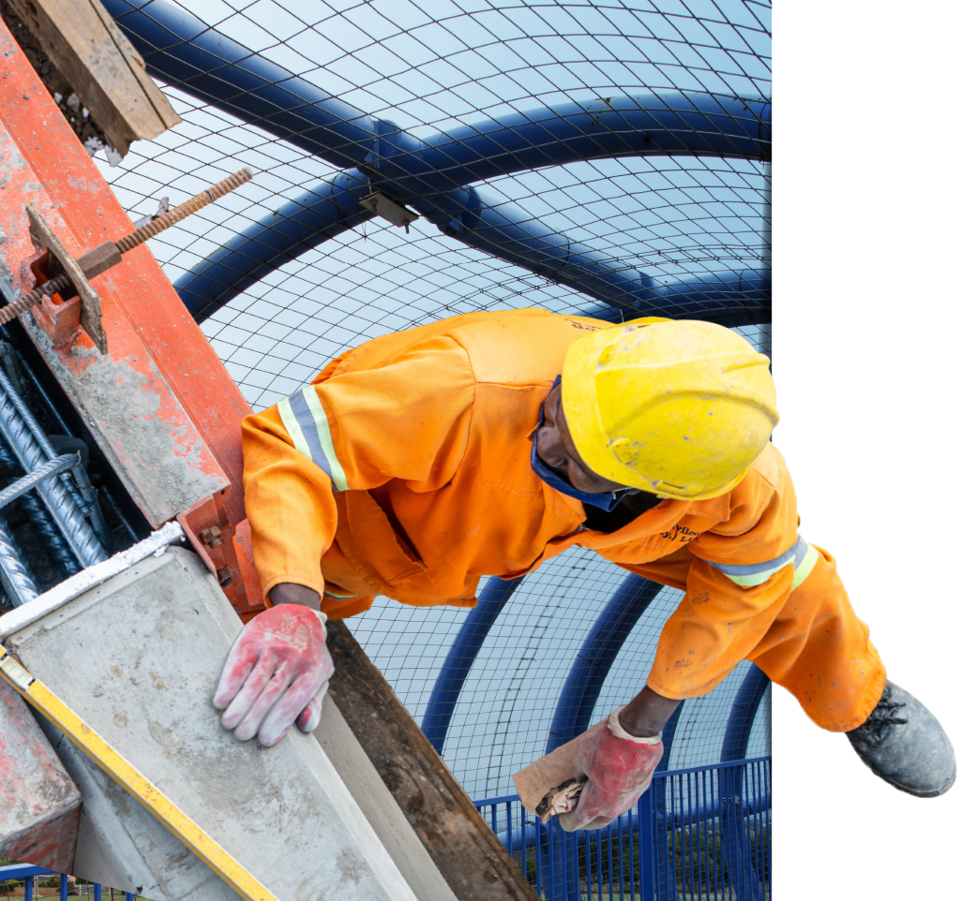
Annual Financial Statements 2021/22
Volume 2 Section 3

Slide 32
Summary: Corporate performance 2021/22 (Volume 2 p30-32)
Outcome | Outputs | Total Output Indicators | Targets Achieved | Reason for Non-achievement of Target
Optimally maintained national road network | Management of national roads | 4 | 4 | Not applicable
 | Maintenance of national road network | 4 | 2 | Underperformance due to delays in award of new reseal contracts, along with the 3- month ramp-up period after award resulted in very limited actual expenditure from projects procured in terms of latest SANRAL procurement requirements. Underperformance due to delays in award of new CAPEX contracts, along with the 3- month rampup period after award resulted in very limited actual expenditure from projects procured in terms of latest SANRAL procurement requirements.

Slide 33
Summary: Corporate performance 2021/22 (Volume 2 p30-32)
Outcome | Outputs | Total Output Indicators | Targets Achieved | Reason for Non-achievement of Target
 | Transformation of the industry | 2 | 1 | The annual target for SMME was not met for the year. Due to delays in award of new contracts, along with the 3-month ramp-up mobilisation period after award to enable SANRAL 14-point procedures to be followed, resulted in very limited actual expenditure (and thus SMME opportunities) from projects procured in terms of latest SANRAL procurement requirements where more than 80% has been awarded 51% or more Black-owned entities.
 | Community Development Project | 1 | 0 | Procurement delays.

Slide 34
Summary: Corporate performance 2021/22 Continued
Outcome | Outputs | Total Output Indicators | Targets Achieved | Reason for Non-achievement of Target
Jobs created on projects (Full Time Equivalent) | Creation of jobs | 1 | 0 | *The annual target for job creation was not met for the year.
Creating Delivery capacity for the country | Internships | 1 | 1 | Not applicable
 | Provision of bursaries | 1 | 1 | Not applicable
 | Provision of scholarships | 1 | 1 | Not applicable
*Deviation note: Delays in award of new contracts, along with the 3-month ramp-up mobilisation period after award to enable SANRAL 14-point procedures to be followed, resulted in very limited actual expenditure from projects procured in terms of latest SANRAL procurement requirements where more than 80% has been awarded 51% or more Black-owned entities. Intermittent court challenges resulted in several other evaluations being held in abeyance pending the finalisation of the court cases. Some of these court cases were only finalised as late as July/August 2021 whilst others are still pending.

Slide 35
Summary: Corporate performance 2021/22 Continued
Outcome | Outputs | Total Output Indicators | Targets Achieved | Reason for Non-achievement of Target
Safer Roads | Provision and management of safe road infrastructure | 2 | 1 | Not applicable
 | Improved public road safety education and awareness | 1 | 1 | Not applicable

Slide 36
Summary: Corporate performance 2021/22 Continued
Outcome | Outputs | Total Output Indicators | Targets Achieved | Reason for Non-achievement of Target
Improved SANRAL reputation | Improvement and management of reputation | 1 | 1 | Not applicable
 | Constructive engagement with stakeholders | 1 | 1 | Not applicable
Total |  | 20 | 14 (70%)

Slide 37
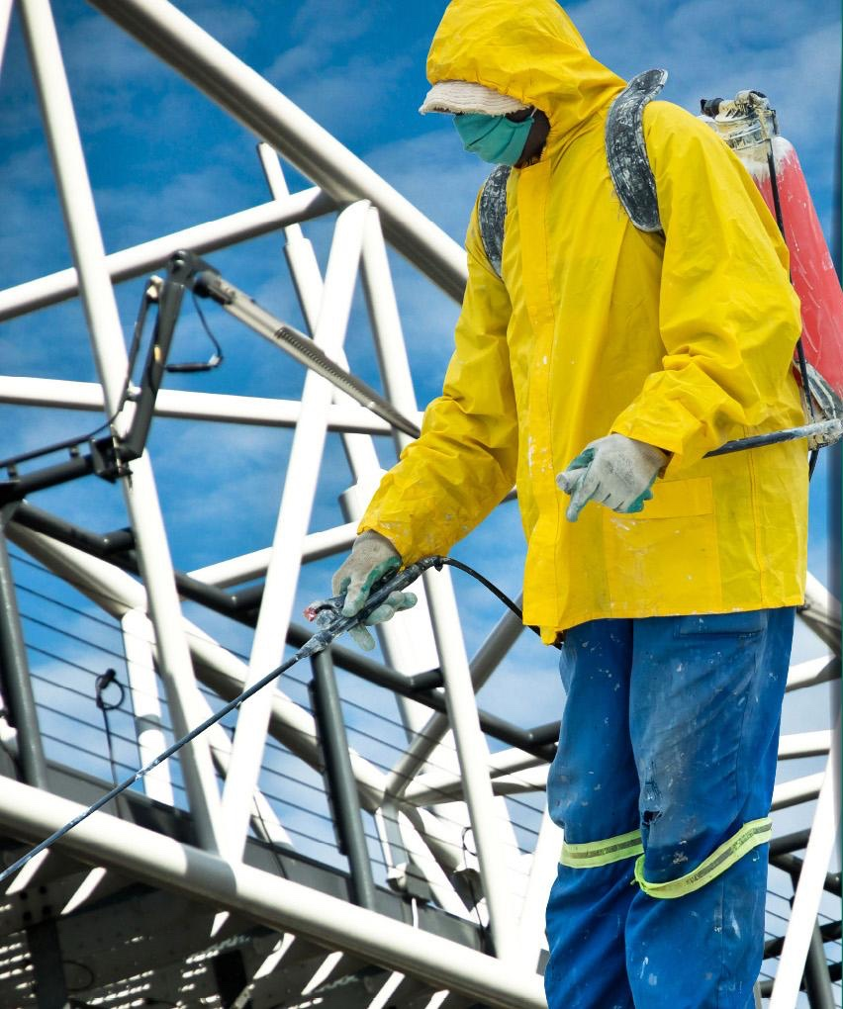
Annual Financial Statements 2021/22
Volume 2 Section 4

Slide 38
Statement of financial position (Vol 2 p87)
R’million |  | 2022 | 2021
Assets
 | Non-current Assets | 519,017 | 448,891
 | Current Assets | 45,469 | 31,604
 | Non-current assets held for sale | 13,349 | 0.014
Total Assets |  | 564,553 | 480,509
R’million |  | 2022 | 2021
Equity |  | 408,382 | 340,152
Liabilities |  |  | 140,357
 | Non-current liabilities | 127,786 | 118,469
 | Current Liabilities | 28,385 | 21,887
Total Equity and Liabilities |  | 564,553 | 480,509

Slide 39
Statement of profit and loss (Vol 2 p88)
R’million |  | 2022 | 2021
 | Revenue | 14,804 | 12,604
 | Other income and other gains | 1,985 | 1,580
 | Operating expenses | (13,744) | (11,234)
Operating Profit |  |  | 2,698
 | Investment income | 1,787 | 1,420
 | Fair value adj for investment property | (0,070) | (0,047)
 | Finance Cost | (4,316) | (3,690)
Profit for the year |  |  | 0,381
 | Remeasurement on net defined benefit policy | (0,0005) | 0,004
 | Revaluations | 67,882 | 8,271
Total comprehensive income for the year |  | 68,230 | 8,656

Slide 40
Statement of cash flows (Vol 2 p90)
R’million |  | 2022 | 2021
Cash generated from operations |  | 13,007 | 15,967
 | Interest income | 1,659 | 1,386
 | Finance cost paid | (3,772) | (3,501)
Net cash from operating Activities |  | 10,895 | 13,853
Net cash from investing activities |  | (6,394) | (0,205)
Net cash from financing activities |  | 7,409 | (0,841)
 | Cash at beginning of year | 29,340 | 16,534
Total Cash and Cash Equivalents |  | 41,249 | 29,340

Slide 41
Audit report 2021/22 (Vol 2 p61)
Unqualified opinion
Key Audit Matter | Outcome
Re-valuation of road network and road structures | AGSA was satisfied that the revaluation of road network and road structures is appropriate, reasonable, is fairly valued and appropriately disclosed in the annual financial statements.
Expected credit losses on toll debtors | AGSA was satisfied that the expected credit losses on e-toll and other receivables were reasonable, in line with their expectations and appropriately disclosed in the annual financial statements in accordance with IFRS.
Gauteng Freeway Improvement Project (GFIP) / e-toll revenue | AGSA was satisfied that e-toll revenue was recognised and accounted for in line with the requirements of IFRS 15 and appropriately disclosed in the annual financial statements.

Slide 42
Audit report 2021/22 (Vol 2 p61) Continued
Material uncertainty relating to going concern / financial sustainability
The AGSA draws attention to the dependence of SANRAL “on positive developments to resolve the e-toll impasse by Cabinet” as the accumulated loss and SANRAL’s funding strategy indicates a material uncertainty on SANRAL’s ability to continue as a going concern. It refers to Note 44 to the financial statements.
Note 44 emphasises the following to support the going concern principle:
Total assets exceeding total liabilities by R408.382 billion
Current assets exceeds current liabilities by R17.084 billion
Significant cash holding of R41.249 billion
Ability to raise funding through capital market under the available government guarantee
Continued government support by un-earmarking of funds to cover revenue shortfall on toll

Slide 43
Emphasis of matter
Description | Reference
Material Impairments – trade and other receivables Expected credit losses (impairment) of R10.1 billion were recognised R9.6 billion of this impairment relates to e-toll receivables. | Note 11
Irregular expenditure Irregular expenditure of R487.136 million was incurred in the current year, due to non-compliance with prescribed procurement prescripts. Included is R415.101 m for non-compliance with tender pre-qualification criteria on a single tender. The tenderer was evaluated further and should have been disqualified for not submitting bank rating / confirmation letter. No new applications for condonations were submitted to National Treasury in the year by the Loss Control Committee. | Note 43

Slide 44
Irregular expenditure (Vol 2 p156)
Financial Year (R'000) | 2012 | 2013 | 2014 | 2015 | 2016 | 2017 | 2018 | 2019 | 2020 | 2021 | 2022
Current year expenditure from old irregular contracts | 2,099,702 | 2,441,283 | 1,432,795 | 1,499,411 | 1,151,537 | 281,718 | 226,900 | 116,085 | 65,148 | 94,073 | 72,035
Current year new irregular expenditure | 0 | 864,428 | 106,827 | 106,827 | 4,758 | 143,231 | 106,707 | 303,100 | 277,000 | 81,210 | 415,101
Total expenditure for the year | 2,101,714 | 3,307,724 | 1,541,636 | 1,608,253 | 1,158,311 | 426,966 | 335,625 | 421,204 | 344,168 | 177,304 | 487,136

Slide 45
Thank you
www.nra.co.za
THE SOUTH AFRICAN NATIONAL ROADS AGENCY SOC LTD (SANRAL)
Head Office
48 Tambotie Avenue, Val de Grace, Pretoria
PO Box 415, Pretoria, 0001 South Africa
Tel: +27 (0) 12 844 8000
Fax: +27(0) 12 844 8200
www.sanral.co.za
Registration Number:
1998/009584/30
RP173/2021
Tel: +27 (0) 12 844 8000
info@nra.co.za
Contact Details for SANRAL’s Fraud Hotline/
Tip-Offs Anonymous
Toll-Free Phone No: 0800 204 558
Toll-Free Fax No: 0800 007 788
E-mail: sanral@tip-offs.com
Postal address:
Tip-Offs Anonymous,
Freepost DN 298, Umhlanga Rocks 4320

