Slide 1
PRESENTATION TO THE PUBLIC WORKS AND INFRASTRUCTURE PORTFOLIO COMMITTEE
COUNCIL FOR THE BUILT ENVIRONMENT
2021/22 ANNUAL REPORT
13 October 2022
Mr Msizi Myeza
Chief Executive Officer

Slide 2
CBE DELEGATION
Dr Sitsabo Dlamini Council Chairperson
Ms Maphefo Mogodi Council Deputy Chairperson
Mr Msizi Myeza Chief Executive Officer
Mr Phuti Manamela Acting Chief Operations Officer
Ms Sarie Treeby Acting Chief Financial Officer
Mr Sisa Jikeka Acting Chief Shared Service officer

Slide 3
Contents
Purpose
CBE Mandate
Vision and Mission
DPWI Built Environment Organogram
CBE Programmes
Part A: Performance Information
Part B: Financial Report
Governance Matters
Human Resources
Part C: Councils for the Built Environment Professions

Slide 4
Purpose
To present the CBE’s Performance for the 2021/22 financial year, as per the commitments made in the 2021/22 Annual Performance Plan.

Slide 5
CBE’S MANADATE
The central mandate of the Council for the Built Environment (CBE) is the transformation of the built environment sector.
National strategy
Give direction
Mentor
Lead
Set standards
Scope categories of registration
Set frameworks for concurrent functions of Councils
Ensure consistent application of policies and standards
Conduct appeals
Monitor transformation trends
Regulate
Facilitate platforms
for integration of interdependent services
Combine collective efforts
Six built environment professions
National/Country
Representing demographics
4IR and beyond
Transformation
Coordinate
Recommendations
on built environment
issues
Conduct research
Analyse and forecast trends
Repository of data
Inform national policy
Provide thought-leadership
Strategy facilitation services
Advise

Slide 6
VISIONS AND MISSION STATEMENTS
VISION
An intelligent, inclusive, adaptive and thriving Built Environment by 2035
MISSION
Lead, regulate, advise and coordinate professions and their councils to meet the National Built Environment and Transformation Future of the industry
VALUES
Quality is non-negotiable
Professionalism in all that we do
Future orientated
All-round inclusiveness
.

Slide 7
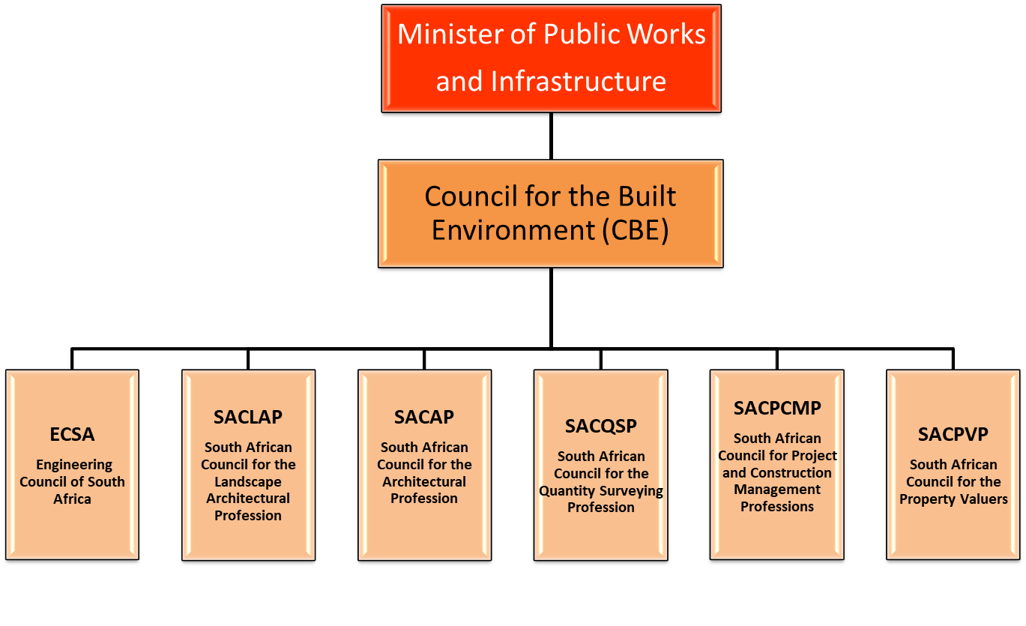
DPWI Built Environment Organogram

Slide 8
CBE Programmes
Impact Statement | Outcomes | Programmes
Well-regulated and inclusive Built Environment Professions that contribute to national priorities and ambitions | Optimum Functioning CBE | Administration
 | Transformed Built Environment | Transformation
 | Skilled Built Environment Professionals | Skills and Capacity Development
 | Informed decision making that impacts the current and future operational requirements of the industry | Research and Advisory
 | Promote and protect public interest in the Built Environment. | Regulation and Public Protection

Slide 9
PART A
PERFORMANCE INFORMATION

Slide 11
Analysis of Annual Performance for 2022/2022
Programme | Total Targets | Targets Achieved | Targets Not achieved
Programme 1: Administration | 5 | 4 | 1
Programme 2: Transformation | 4 | 3 | 1
Programme 3: Skills and Capacity Development | 3 | 3 | 0
Programme 4: Research and Advisory | 3 | 3 | 0
Programme 5: Regulation and Public Protection | 3 | 3 | 0
Total | 19 | 17 | 2

Slide 12
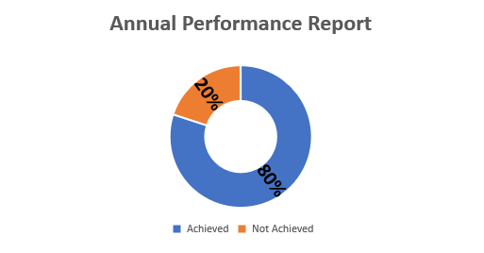
Programme: 1 Administration
Narrative Summary:
The Programme had five(5) annual targets for the financial year 2021/22. Four (4) targets were fully achieved and one (1) was not achieved.
The key challenge for non-achievement relates to the following:
There was a delay in procuring the service provider. Further research to verify/classify the director of the recommended service provider was requested by one of the Council Committees. The appointment was only signed in March 2022.
Annual Targets
Total Targets | Targets Achieved | Targets Not achieved
5 | 4 | 1

Slide 13
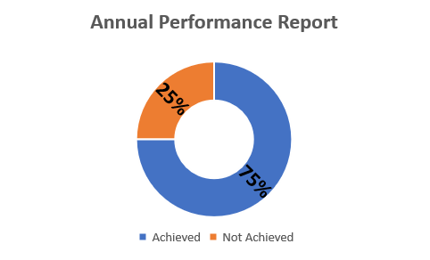
Programme: 2 Transformation
Narrative Summary:
The Programme had four(4) annual targets for the financial year 2021/22. Three (3) targets were fully achieved and one (1) was not achieved.
The key challenge for non-achievement relates to the following:
The strategy was not hundred percent implemented. Some of the identified transformation interventions were not fully undertaken.
Annual Targets
Total Targets | Targets Achieved | Targets Not achieved
4 | 3 | 1

Slide 14
Programme 1: Administration
Performance Highlights
CBE obtained a clean audit for the 2021/22 financial year
An enhanced CBE procedures manual for quality assurance was produced
Hundred percent of the revised organisational structure action plan identified priorities for the 2021/22 financial year were implemented
There were four marketing communication activities to raise the profile of the CBE in the provinces of KwaZulu-Natal, Limpopo, Eastern Cape and Mpumalanga
The CBE’s revenue was increased by 1% of the grant and levies received by
31 March 2022

Slide 15
Programme 2 : Transformation
Highlights
Ten baseline /analysis reports were developed
Three functional databases of women-owned Built Environment Professionals and Built Environment companies were sourced
One annual online event and five sector collaborative engagements
CBE submitted inputs on the procurement bill recommending a differentiation between procurement of built environment professionals and procurement of goods
CBE convened stakeholders to investigate the resuscitation of the Roster System in procuring Built Environment professional services

Slide 16
Programme: 3 Skills and Capacity Development
Annual Targets
Total Targets | Targets Achieved | Targets Not achieved
3 | 3 | 0
Narrative Summary:
The Programme had three (3) annual targets for the financial year 2021/22. All three (3) targets were fully achieved.

Slide 17
Programme 3: Skills and Capacity Development Highlights
Thirty-two workplaces were monitored and evaluated in implementing the Structured Candidacy Programme
Eighty-seven Built Environment career awareness initiatives were conducted for school learners across nine provinces
Oversight report on the CBEP’ accreditation of Built Environment Academic programmes and institutions was developed

Slide 18
Programme 4: Research and Advisory
Narrative Summary:
The Programme had three (3) annual targets for the financial year 2021/22. All three (3) targets were fully achieved.
Annual Targets
Total Targets | Targets Achieved | Targets Not achieved
3 | 3 | 0

Slide 19
Programme 4: Research and Advisory
Highlights
Twenty-seven research papers aligned to the CBE Research Agenda were published on the Built Environment Research Hub
Four research discussion papers were developed in line with the CBE Research Agenda
Two Built Environment advisory reports were developed and submitted to the Minister of DPWI on:
      The Role of Built Environment Professions in the Effective Implementation of the FIDPM
      Built Environment Skills Requirements to Support the Implementation of the DDM

Slide 20
Programme 5: Regulation and Public Protection
Annual Targets
Total Targets | Targets Achieved | Targets Not achieved
3 | 3 | 0
Narrative Summary:
The Programme had three (3) annual targets for the financial year 2021/22. All three (3) targets were fully achieved.

Slide 21
Programme 5: Regulation and Public Protection Highlights
Hundred percent of the recommended Built Environment Legislative Updates action plan was implemented
Hundred percent of lodged appeals were finalised within the statutory 60 days from the date of lodgement. A total of six appeals were finalised in the 2021/22 financial year
Corporate Governance assessment of six Councils for the Built Environment Professions (CBEP) on compliance with the provisions of the adopted Governance Framework was developed

Slide 22
PART B
FINANCIAL INFORMATION

Slide 23
Financial Information
 | 2021/22 |  |  | 2020/21
Source of Revenue | Estimate | Actual Amount Collected | (Over) / Under Collection | Estimate | Actual Amount Collected | (Over) / Under Collection
Government grant from DPWI | R’000 | R’000 | R’000 | R’000 | R’000 | R’000
 | 53 528 | 53 528 | - | 48 813 | 48 813 | -
Levies | 2 308 | 1 711 | 597 | - | 2 075 | (2 075)
Interest | 553 | 584 | (31) | 445 | 481 | (36)
Other operating income | 1 | 241 | (240) | 469 | 730 | (261)
Total | 56 390 | 56 064 | 326 | 49 727 | 52 099 | (2 372)

Slide 24
Financial Information
 | 2021/22 |  |  | 2020/21
Programme | Budget | Actual Expenditure | (Over)/Under Expenditure | Budget | Actual Expenditure | (Over)/Under Expenditure
Programme 1: Administration | 52 271 | 50 279 | 1 992 | 47 133 | 50 388 | (3 255)
Programme 2: Transformation | 571 | 805 | (234) | 186 | 49 | 137
Programme 3: Skills and Capacity Development | 2 084 | 2 064 | 20 | 1 718 | 1 165 | 553
Programme 4: Research and Advisory | 648 | 21 | 627 | 24 | 14 | 10
Programme 5: Regulation and Public Protection | 816 | 616 | 200 | 666 | 652 | 14
Total | 56 390 | 53 785 | 2 605 | 49 727 | 52 268 | (2 541)
Assets (additions) | - | 1 662 | (1 662) | - | 993 | (993)
Total including assets (additions) | 56 390 | 55 447 | 943 | 49 727 | 53 261 | (3 534)

Slide 25
Audit Outcome Matters
Audit Opinion:
Unqualified Audit Opinion with no material findings
Annual Financial Statements:
Timeously submitted financial statements free from material misstatements
No new irregular expenditure was identified
Compliance with Legislation:
No instances of material non-compliance with selected specific requirements of applicable legislation
Internal Control:
No significant deficiencies in internal control were identified
Performance Information – Programme 3:
No material findings raised on reliability

Slide 26
Audit Outcome
Year | Audit Opinion | Performance
2021/22 | Clean audit | 89%
2020/21 | Clean audit | 87%
2019/20 | Clean audit | 63%
2018/19 | Clean audit | 86%
2017/18 | Clean audit | 90%

Slide 27
Governance Matters
The following challenges confronted the CBE during the financial year of reporting:
Nine Council Members resigned
Council did not quorate in the fourth quarter
(c) Resignation of the CEO and COO at the end of June 2021

Slide 28
HUMAN RESOURCE MANAGEMENT

Slide 29
Employment Vacancies, Equity & Staff turnover
Disability
1
Women in Executive Management 63%
Resignations
2 - CEO and COO in June 2021
Suspension
1 - Company Secretary
New Appointments
2 - CEO and COO November 2021

Slide 30



Employment Vacancies, Equity & Staff turnover
FILLED POSTS BY GENDER
FILLED POSTS BY RACE
25 | African
6 | White
1 | Coloured
2 | Indian
23 (68%)
34
11(32%

Slide 31
PART C
COUNCILS FOR THE BUILT ENVIRONMENT PROFESSIONS

Slide 32
Professional Registration Statistics
CBEP | 2017/18 | 2018/19 | 2019/20 | 2020/21 | 2021/22 | Percentage increase / decrease by 2022
SACAP | 8 426 | 8 592 | 9 134 | 8 728 | 13 405 | 53%
SACLAP | 223 | 236 | 261 | 305 | 310 | 2%
ECSA | 30 235 | 35 640 | 31 948 | 35 750 | 31 854 | (11%)
SACPVP | 1 319 | 1 419 | 1 405 | 1 443 | 984 | (32%)
SACPMP | 2 668 | 2 723 | 2 705 | 7 069 | 7 266 | 3%
SACQSP | 2 192 | 2 271 | 2 294 | 2 409 | 2 507 | 4%
Total | 45 063 | 50 881 | 47 747 | 55 704 | 56 326 | 1.12%

Slide 35
Candidate Registration Statistics
CBEP | 2018/19 | 2019/20 | 2020/21 | 2021/22 | Percentage of increase / decrease by 2022
SACAP | 3062 | 2 725 | 3 062 | 4 162 | 36%
SACLAP | 93 | 113 | 98 | 89 | (9)
ECSA | 22 227 | 23 782 | 26 049 | 24 555 | (6%)
SACPVP | 656 | 481 | 451 | 711 | 58%
SACPMP | 4 120 | 4 662 | 4 353 | 3 694 | (15%)
SACQSP | 2151 | 1 836 | 2 045 | 2 212 | 8%
Total | 31 637 | 33 599 | 36 058 | 35 423 | (2%)

Slide 38
Continuing Professional Development
CBEP | CBEP Percentage of Registered Professionals who Comply with CPD Requirements
SACLAP | 80%
ECSA | 36.3%
SACPVP | 65%
SACPCMP | 16%
SACQSP | 52%
SACAP compliance rate is:
Professional Architects – 44%
Professional Senior Architectural Technologists – 43%
Professional Architectural Technologists – 35%
Professional Architectural Draughtspersons – 31%

Slide 39
Agreements and Partnerships
CBEP | Agreements
SACAP | Internationally, SACAP signed a MoU with Canberra Accord
SACLAP | N/A
ECSA | ECSA is a signatory to three accords: Washington Accord Sydney Accord Dublin Accord ECSA is a member of three Competency Agreements: International Professional Engineers Agreement (IPEA) International Engineering Technologists Agreement (IETA) Agreement for International Engineering Technicians (AIET)
SACPVP | Member of the International Valuation Standards Council (IVSC)
SACPCMP | N/A
SACQSP | Signed a new Mutual Recognition of Professional Competence Agreement with the Royal Institute of Chartered Surveyors (RICS)

Slide 40
Agreements and Partnerships Cont’d
SACLAP is currently exploring possibilities of linkages with the organisations such as the International Federation of Landscape Associations (IFLA) and World Urban Parks Association (WUPA).
ECSA retained its International Engineering Alliance (IEA) membership. South Africa is undergoing a routine review and the outcome was presented at the IEA meeting in
June 2022.

Slide 41
Agreements and Partnerships Cont’d
In 2021/22 SACPVP completed the Monitoring Framework to assist in ensuring compliance with municipal valuation standards
      The standards have been developed in collaboration with the Local Government Sector Education and Training Authority (LGSETA) to improve the standard of valuation reporting for municipal rating purposes
      These standards were compared and adapted to the International Association of Assessing Officers (IAAO) standards as well as the IVS to ensure international harmonisation of standards on municipal roll valuations.

Slide 42
Complaints
CBEP | No Received | No Completed | No in Progress | No Withdrawn
SACAP | 34 | 0 | 34 | 0
SACLAP | 1 | 1 | 0 | 0
ECSA | 5 new complaints received | 0 | 13 pre-existing complaints | 0
SACPVP | 33 | 3 | 27 | 3
SACPMP | 3 | 0 | 3 | 0
SACQSP | 4 | 2 | 2 | 0
Total | 80 | 6 | 79 | 3

Slide 43
Voluntary Associations
CBEP | Number of VAs recognised | Number of VAs not recognised
SACAP | 13 | 0
SACLAP | 3 | 3
ECSA | 48 | 0
SACPVP | 2 | 1
SACPCMP | 11 | 3
SACQSP | 1 | 0

Slide 44
THANK YOU

