Slide 1
Presentation to the Portfolio Committee on Small Business Development
Date: 12 October 2022

Slide 2
Presentation outline
sefa Overview
Performance Highlights – FY2021/22
Loan Portfolio Performance
Financial Performance
Performance Against Pre-Determined Objectives
Human Capital Management
Governance
Key Organisational Challenges
Key Organisational Priorities / Focus
Case Studies

Slide 3
sefa Overview

Slide 4
Vision, Mission & Values
To be the leading catalyst for the development of sustainable Small Medium and Micro Enterprises and Co-operative Enterprises through finance.
Vision
To provide simple access to finance in an efficient and sustainable manner to SMMEs and Co-operatives throughout South Africa by:
providing loan and credit facilities to SMMEs and Co-operative enterprises;
providing credit guarantees to SMMEs and Co-operative Enterprises;
Supporting the institutional strengthening of financial intermediaries so that they can effectively assist SMMEs and co-operatives;
creating strategic partnerships with a range of institutions for sustainable SMME and Co-operative enterprise development and support;
developing, through partnerships, innovative finance products, tools and channels to catalyse increased market participation in the provision of affordable finance.
Monitoring the effectiveness and impact of our financing, credit guarantee and capacity development activities.
Mission
Increase access and provision of finance to SMMEs & Co-operatives and contribute towards job creation
Build an effective and efficient sefa that is sustainable, and performance driven
Objective
Kuyasheshwa!
Passion for development
Integrity
Transparency
Innovation
Values

Slide 5
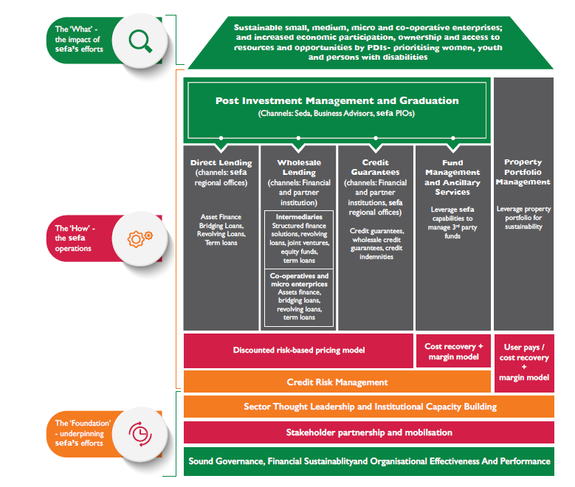
Operating Model, Distribution Channels & Products

Slide 6
Qualifying Criteria & sefa’s Target Market
Loan Criteria
Be a South African citizen or a permanent resident.
Be a registered entity, including sole traders with a fixed physical address.
Be within the required legal contractual capacity.
Be domiciled in South Africa.
Be compliant with generally accepted corporate governance practices appropriate to the client’s legal status.
Have a written proposal or business plan that meets sefa’s loan application criteria.
Demonstrate the character and ability to repay the loan.
Provide personal and/or credit references.
Be the majority shareholder and the owner-manager of the business.
Provide relevant securities/collateral; and
Have a valid Tax Clearance Certificate.
Target Market
sefa’s loan financing programmes primarily focus on black entrepreneurs, women, youth, entrepreneurs with disabilities, enterprises in rural communities and townships, and Military Veteran entrepreneurs. These programmes are aligned with the New Growth Path (NGP), Industrial Policy Action (IPAP) and the National Development Plan (NDP).
sefa funds qualifying business ventures primarily in the following sectors:
services (including retail, wholesale and tourism).
manufacturing (including agro-processing).
agriculture (specifically land reform beneficiaries and contract-farming activities).
construction (small construction contractors).
mining (specifically small-scale miners); and
green industries (renewable energy, waste, and recycling management).

Slide 7
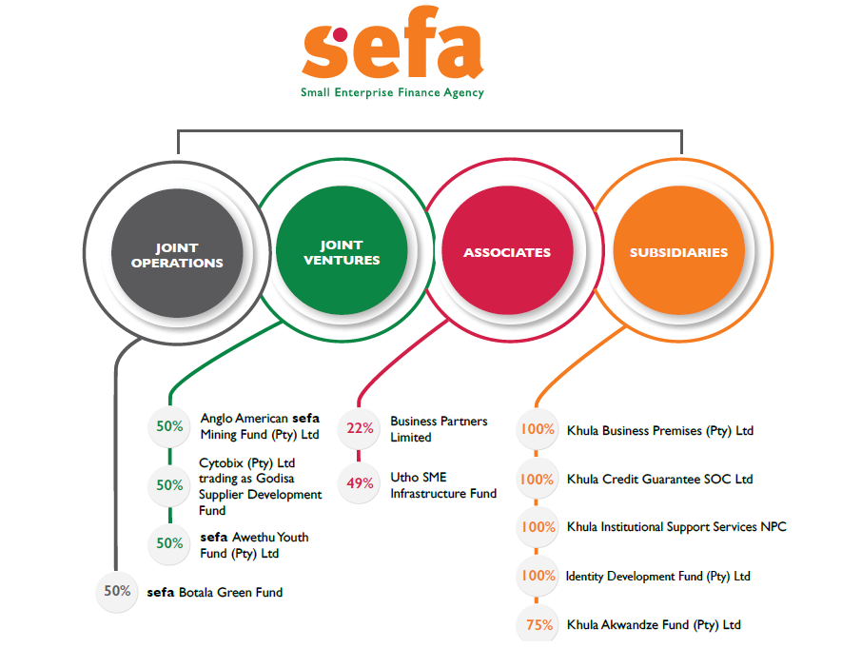
Group Structure

Slide 8
Performance Highlights – FY2021/22

Slide 9
Performance Highlights (2021/22)
Loan Book Performance
Developmental Impact
(Disbursements)
R990 million
R494 million
R2.5 billion
R2.3 billion
R2 billion
Disbursements
Black-Owned Enterprises
Women-Owned Enterprises
Youth-Owned Enterprises
Approvals
76 129
96 589
R977 million
R665 million
SMMEs and Co-operatives financed
Jobs facilitated
R37.8 million
People with disabilities
Enterprises in rural towns and villages
Township-based enterprises

Slide 10
Geographic Spread - Funding Activities – FY2021/22

Slide 11
Geographic Spread - Funding Activities – FY2021/22

Slide 12
Geographic Spread - Funding Activities – FY2021/22

Slide 13
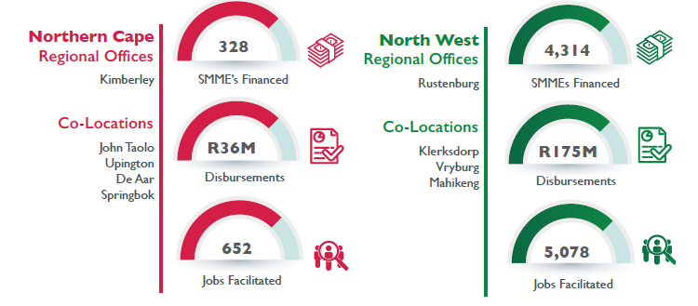
Geographic Spread - Funding Activities – FY2021/22 (cont.)

Slide 14
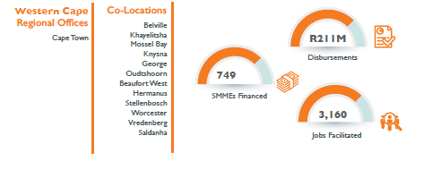
Geographic Spread - Funding Activities – FY2021/22 (cont.)

Slide 15
Historical Funding Activities: FY2016/17 to FY2021/22
Over the past six financial years, sefa approved loans to the value of R8 billion across various loan channels.
Disbursed into the South African economy, loans to the value of R8.8 billion over the same period.

Slide 16
Historical Funding Activities: FY2016/17 to FY2021/22
sefa financed over 385 thousand SMMEs and Co-operatives over the past six financial years. This financial support helped these enterprises to create and preserve over 482 thousand jobs.

Slide 17
Developmental Impact: FY2016/17 to FY2021/22
Over the past six financial years, sefa disbursed just under R7billion to enterprises owned by black entrepreneurs. Women-owned businesses received funding support to the value of R3.3 billion over the same period.

Slide 18
Developmental Impact: FY2016/17 to FY2021/22
Youth-owned businesses received loans to tune of R1.6 billion over the past six financial years. Whilst enterprises operating in the townships received financial support to the value of R1.3 billion over the same period.

Slide 19
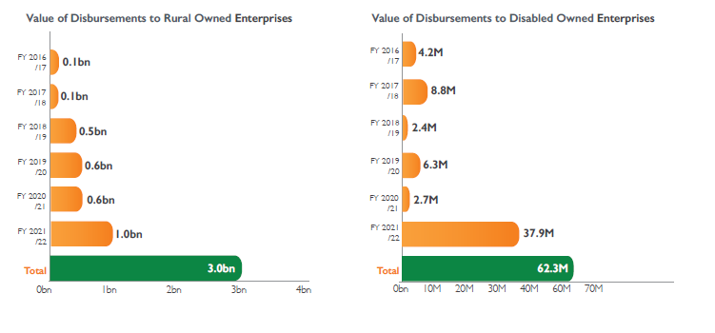
Developmental Impact: FY2016/17 to FY2021/22
sefa provided financial support amounting to R3 billion to businesses operating in the rural towns and villages over the past six financial years.
Entrepreneurs with disabilities received financial support from sefa to the tune of R62 million over the same period.
This gap has been addressed hence the significant growth in disbursement over the past financial year to these businesses.

Slide 20
Loan Portfolio Performance

Slide 21
sefa Loan Portfolio – Overview (2021/22)
The loan portfolio grew by 38% year-on-year due to the implementation of the Economic Recovery Programmes.
There has also been an increase in strategic partnerships within the Wholesale Lending channel that contributed to the portfolio growth (17 new intermediaries on-boarded).

Slide 22
sefa Loan Portfolio – Total Collections (2021/22)
The effects of COVID-19 pandemic continued to have an adverse impact on sefa clients.
This is evident in their repayment patterns as seen in the overall collections.
This challenge is mostly seen in businesses operating in manufacturing, logistics, fuel retailers as well as tourism and hospitality sector.
However, the collections target of 85% was exceeded (actual achieved 87%).

Slide 23
Financial Performance

Slide 24
sefa Financial Performance as at 31 March 2022- highlights
Unqualified audit opinions since sefa’s inception 1 April 2012 (10 years running).
sefa’s financial position showed an improvement which was supported by the increased size of the loan book and the increase in cash and cash equivalents.
The net loans and advances have increased by R640 million to a carrying amount of R1.5 billion at year end.
The improvement in the cost-to-income ratio was a result of:
growth in revenue achieved of 43%
interest earned on cash balances
operational cost savings realised during the year when compared to budget.
Net profit after tax for the Group for the year was R98.3 million, showing a reduction of R454 million on the previous year’s losses. It is important to note however that the Group made a loss before tax of R171 million (2021: R283 million). A provision for tax was raised in the prior year for allocations received from DSBD and this provision was reversed in the current year after the relevant tax legislation was amended.

Slide 25
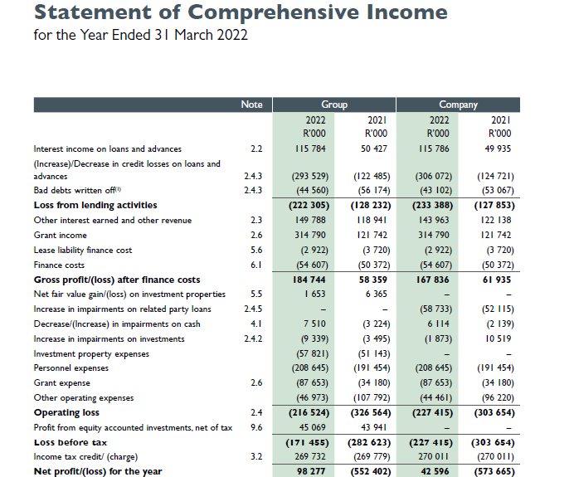
sefa Financial Performance as at 31 March 2022

Slide 26
Income Analysis
Interest on loans and advances increased from the previous year by R65 million due to the increased loan book size in the current year and lower interest earned in the previous year as six months loan repayment moratoriums were provided to some clients.
Rental income earned from the property portfolio increased by R7.1 million in the current year relative to the previous year. The prior year amount was lower due to the six months rental payment holidays that were provided to some tenants as part of COVID-19 relief.
Interest on cash and cash equivalents has increased by R28 million from the previous year due to higher average cash balances held during the 2022 financial year.
This was driven mainly by the various funding allocations received under the economic recovery programmes from the Department of Small Business Development and Tourism Equity Funds (TEF) from the Department of Tourism.
sefa’s share of net profits from equity-accounted investments was slightly higher by R1.1 million in the current year compared to the previous year.

Slide 27
Expense Analysis
Savings in operating costs when compared to budgets were realised during the year, with a bulk of the savings derived from lower technical reserves movement (R95 million) due to lower take-ups in KCG, lower consulting expenses (R7 million) and depreciation (R6 million).
Operating expenditure (excluding grant expenses, impairments and bad debts written off) decreased by R61 million year on year.
A significant portion of the decrease was as a result of income taxation penalty provision (R27 million) raised in the prior year, which was reversed in the current financial year resulting in a R54 million positive movement.
Overall impairments write-off and bad debt provisions on loans and advances have increased by a net amount of R339 million from the previous year due to the growth in the loan portfolio.

Slide 28
Performance Against Predetermined Objectives

Slide 29
Performance Against Predetermined Objectives

Slide 30
Performance Against Predetermined Objectives (cont.)

Slide 31
Analysis of Performance Against Predetermined Objectives
Under the Customer perspective, there has been a significant improvement in respect of performance achieved in FY2022 compared to the prior year. The cumulative average performance increased from 58% to 76%.
Cumulative percentage performance on the Financial Perspective, increased with 6% with all the 5 indicators achieving 100% and above.
The organisational business processes, the turnaround times were only introduced in the balanced scorecard during the period under review, and both Direct Lending and Wholesale Lending met the set targets for the year.
People, Learning and Growth Perspective – cumulative average performance increased from 89% to 91%. There has been a significant improvement in the Employee Satisfaction Index in the current period relative to the previous financial year. This was driven mainly by interventions aimed at supporting both personal and professional growth of employees.
Summary of performance of key indicators FY2022
Percentage performance | Number of Indicators | Percentage Achieved
100% and above | 13 | 57%
Between 75% and 99% | 5 | 22%
Below 75% | 5 | 21%
Total | 23

Slide 32
Human Capital Management

Slide 33
Human Capital Management
Performance Achievements at a Glance:
HCM focused on the filling of strategic and critical vacancies during the reporting period in compliance with the moratorium on recruitment posed by the planned sefa/Seda/CBDA merger.
The implementation of the first round of the sefa Management Development Programme (MDP) was completed.
The Employee Engagement Survey was conducted, and the engagement score was 63%; this was an increase from the previous FY2020/21 survey index score of 49.5%.
Employee engagement interventions such as Youth Day, Women’s Day and Men’s Health virtual events were conducted as part of the sefa employee engagement initiatives. The Culture Transformation Project also continued with the implementation of the EXCO Culture Redefinition Session, which sought to unpack the existing culture challenges whilst mapping out a new culture and values-based behaviours for the organisation.
To support employee wellness, a comprehensive wellness programme was introduced to support employees during COVID-19 as well as the new hybrid work organisation.

Slide 34
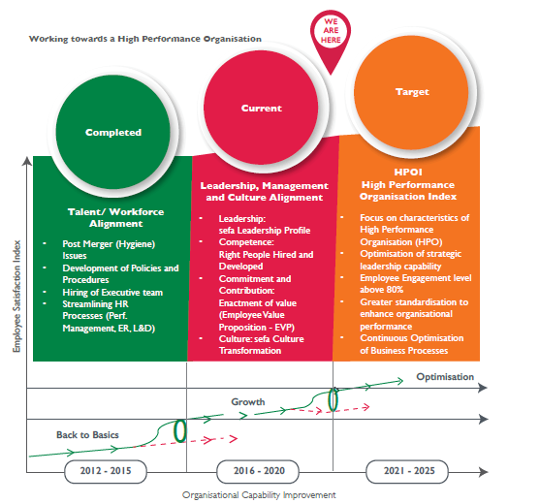
Human Capital Management (cont.)
sefa’s journey towards the achievement of an HPO status started in 2014. The organisation is currently in the growth phase of the HPO journey.
The 2021/22 strategic work plan execution focused on transitioning through the growth phase of the HPO journey by focusing on leadership and culture transformation interventions.

Slide 35
Governance

Slide 36
Governance
The Board fulfils inter alia, the following roles and functions:
Reports to the Executive Authority and the Shareholder on the direction, governance and performance of the company, including any matter that needs reporting or disclosure in the terms of legal requirements;
Represented by the Chairperson of Board or her delegate, reports to the Parliamentary Portfolio Committee on Small Business Development.
Reviews and approves strategic plans, budgets, quarterly and annual performance plans as proposed by management.
Reviews and approves policies.
Reviews processes for the identification and management of business risk and processes for compliance with key regulatory and legal requirements.
Provides oversight on organisational performance against targets and objectives.
Stable internal control environment with an effective Internal Audit and Independent Risk Management Function.
Unqualified audit opinion since establishment (10 years).

Slide 37
Key Organisational Challenges
Challenges:
Low growth economic environment impacting on the performance of SMME sector, in particular, sefa clients, leading to increase in impairments and defaults.
sefa/Seda/CBDA merger – creating organisational uncertainty, increased resignation of key employees, which has adverse impact on organisational performance.
Khula Credit Guarantee – owing to low uptake of the approved facilities, and delays in the implementation of the TREP.
Application funding readiness of clients, impacting on loan approvals turnaround times.

Slide 38
Key Organisational Priorities / Focus
Build a Sustainable Loan Book
Expansion of credit (e.g., Microfinance)
Investment and building of sustainable black-owned financial intermediary base
Building clients sustainability (PIM and business support services)
Decreasing impairments
Crowding-in the private sector resources
Improving performance on key development indicators (Enterprises owned by Youth, Women, People with disabilities, and Townships)
Improving the cost structure
Cost efficiency (funding model, right-sizing, etc.)
Systems development and
Digitisation
Turn around strategy for the property portfolio
Enhancing organisational capabilities across sefa value chain (Lending, Post Investment, Back-Office)
Building the sefa brand and increasing sefa visibility
Key market segments,
Increasing investment in marketing and client outreach,
Building partnerships (SMMEs ecosystem)
Governance
Establishing KCG as a fully operating subsidiary of sefa.
Pro-actively develop capacity to manage the merger.
Install project management capacity to drive key organisational projects.

Slide 39
Thank you

Slide 40
Case Studies

Slide 41
New Partnerships (SME WL)
Amadlelo Agri (Pty) Ltd
Amadlelo Agri (Pty) Ltd was established in 2004 by 70 commercial dairy farmers in the Eastern Cape and KwaZulu-Natal. The aim was to take under- or unutilised community land and develop it to its full potential and to train local community members in farming and management practices. Amadlelo has undergone substantial transformation since its establishment and is now 72% black owned (inclusive of 8% farmworker ownership) with 28% shareholding by white
commercial farmers.
For over a decade, the collaborative efforts of Amadlelo have been at the forefront in transforming the dairy industry and unlocking the land potential of black communities in the Eastern Cape and KwaZulu-Natal. Amadlelo’s first dairy enterprise was established in 2007 in partnership with the University of Fort Hare also creating a training platform for emerging farmers and research capabilities. Six more dairy enterprises, operating in rural areas and on communal land have since been successfully established.
It expanded its footprint within the agricultural sector to include fruit (macadamia), livestock (piggery) production and agro-processing in the form of milk processing. sefa’s facility will be utilised for working capital within the Amadlelo Agri value chain (on-lending to farms and other related entities) in line with sefa’s credit policy.

Slide 42
New Partnerships (SME WL) (cont.)
Outsource Finance (Pty) Ltd
Outsource Finance (Pty) Ltd (OF) is a black majority owned company that was established in 2012. The company is registered with and regulated by the National Credit Regulator (NCR), certificate number NCRCP13946. OF provides retail financial services to small, medium and micro enterprises in South Africa including some government institutions in the office automation space. Their products on offer include operating lease and full maintenance lease on equipment specialising in office automation. sefa’s facility of R30 million will be utilised for on-lending for equipment finance to its target market in line with sefa’s
credit policy.
Mincap (Pty) Ltd
Mincap (Pty) Ltd is a diversified financial services company founded in 2008. The business has several business offerings or services, and are outlined as follows: debt collection, SME finance, capital raising and investments amongst other activities. In 2017, Mincap began providing working capital financing to SMEs as a response to an overwhelming call in the market for invoice discounting and purchase order financing. sefa’s facility will be utilised for invoice discounting and purchase order financing mainly in the public sector and other sectors not prohibited by sefa’s credit policy.
sefa’s facility of R30 million will be utilised for on-lending and ultimately to grow their invoice discounting and purchase order financing loan book portfolio in line with sefa’s credit policy.

Slide 43
Alternative Finance Solutions T/A Bizcash (KCG)
A portfolio credit guarantee of R75 million for Bizcash was approved in FY2021/22. The purpose of this portfolio credit
guarantee is to encourage and facilitate the provision of funding to SMMEs via the purchase of transferable instruments in the form of invoices, purchase orders and contracts by offering to absorb 80% of Bizcash’s irrecoverable loss in the event of
a default.
Bizcash’s main working capital product offering includes the following:
Bizcash Selective Invoice Discounting, Disclosed/Undisclosed (1 to 6 months).
It is a process whereby businesses can convert existing sales invoices into cash as opposed to waiting 30 or 60 days to get paid.
Bizcash Business Loan (1 to 12 months).
Applicants can apply online at Bizcash for their required loan amount and get the funding that is needed to invest in growing the business.
Bizcash Term Loan (1 to 24 months).
This is flexible working capital facility, repaid in regular monthly payments with either fixed or floating interest rates over a set period.
Bizcash Overdraft (on demand, followed by annual renewal).
A facility for now and later access to funds during cashflow crunches, servicing interest only on what has been taken out, making deposits anytime at no charge.
Bizcash Supply Chain Finance (1 to 6 months).
A revolutionary online cash flow solution that bridges the buyer–supplier business relationship, by assisting buyers to pay their suppliers cash on delivery, while simultaneously offering buyers extended terms and flexible repayment amounts.

Slide 44
The Automotive Aftermarket Programme (KCG)
The Automotive Aftermarket Programme (AA): R187.5 million
ABSA has been appointed as a partner bank to implement the AA programme. Due to a late start few applications have been disbursed towards the end of Q4 of FY2021/22. The major challenge came from clients whose funding needs changed or who declined the offers that had been presented by the bank.
ABSA offers applicants a maximum of R500 000 with a grant of 20% but limited to R100 000 per client.
The AA Programme is aimed at:
Supporting qualified motor body repairers (panel beaters) to operate accredited small /independent
panel beaters (motor body repairers) centres;
Supporting qualified motor mechanics to operate authorised service centres;
Supporting the small/independent auto-spares shops to serve as distributors of automotive aftermarket spare
parts centres; and
Supporting in the formalisation of informal fitment centres into formal fitment centres.

Slide 45
Browns Group (Pty) Ltd – Direct Lending
Browns Group (Pty) Ltd (“Browns Foods”) is 100% youth black woman-owned business. It is owned by Mrs Mabel Philisile Akinlabi who has a communications media background and a passion for the food industry. The business began operating in December 2020. It is located in Newport Business Park, Unit 9 Quartz Dr, Kya Sand in close proximity to Cosmo City.
The business focuses on manufacturing corndogs for freezers and delis. The product is a hot dog on a stick that is coated in a thick layer of cornmeal (yellow maize meal) butter and deep fried. The client was assisted with funds amounting to R12,511,718.40 through a Small Enterprise Manufacturing Support Programme. 57 jobs were maintained as a result of this funding.

Slide 46
GS United – Direct Lending
GS United is a black female-owned company based in Barrydale, Western Cape. Its business activities consist of fruit farming (apricots and plums) and running a free-range piggery. This business initially started as a construction business focusing on low-cost housing and gradually diversified into
the farming sector.
The entrepreneur focus was primarily on exporting fruit globally – having clients in Asia, Europe and
USA. However, due to COVID-19 she was unable to export as borders were closed. She decided to purchase her own packaging plant to de-risk the business dependency on export market by also supplying fruit to local retailers.
The entrepreneur approached sefa for funding to purchase a fruit packaging plant under the Business Viability Programme. A facility amounting to R15 million was approved. 209 jobs were created as a result of this facility.

Slide 47
Triton Pharmaceuticals (Pty) Ltd – Direct Lending
Triton Pharmaceuticals (Pty) Ltd was started in the year 2009 by entrepreneurs Daniel Dinezulu Mpande (51%) and Colin Levy (49%). The business manufactures tablets, capsules, lotions, creams and liquids in any dosage or quantity and is based in Midrand, Johannesburg.
The business is well-established and has grown over the years into a well-respected manufacturing business serving clients such as Clicks Pharmacies, Spar Pharmacies, Netcare, Shoprite (Medirite), Tony Ferguson,
Adcock Ingram and the Link Pharmacy.
A 15 million facility was provided to the client, as a result of which the business created 72 jobs and sustained 160.

