Slide 1

ANNUAL PERFORMANCE INFORMATION FOR THE
2021/22 FINANCIAL YEAR
PRESENTATION TO THE PORTFOLIO COMMITTEE ON PUBLIC SERVICE AND ADMINISTRATION, OCTOBER 2022

Slide 2
Purpose
The purpose of the presentation to the Portfolio Committee on Public Service and Administration is to present the financial and non-financial performance information of the National School of Government for the 2021/22 financial year.
The annual performance information marks the second year of implementing the five-year strategic plan (2020-2025).

Slide 3
Outline of the Presentation
1.
Strategy
2. Performance
3.
Finance
4.
Human Resources
5.
Corporate Governance

Slide 4






Mandate of the NSG
OFFER QUALIFICATIONS
FOSTER COLLABORATION
THREE SPHERES OF GOVERNMENT, LEGISLATIVE SECTOR,
ORGANS OF STATE
SUPPORT DEVELOPMENT (INSTITUTIONAL)
NSG MANDATE
CONDUCT TRAINING, EXAMINATIONS OR TESTS
(PRE-REQUISITES)
Provide education & training (individual)
Section 195 of the Constitution of the Republic of South Africa, 1996
Public Service Act, 1994
Public Administration Management Act, 2014

Slide 5
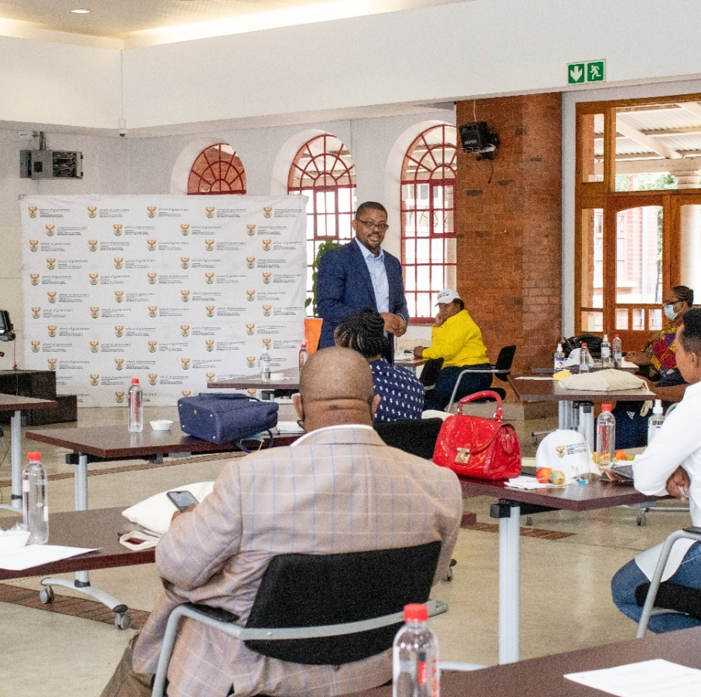
Our 5-year strategy
VISION
Build an Ethical and Capable Public Sector in Service of the People.
MISSION
To Empower Public Servants to be Responsive to Citizen Needs and Government Priorities
through Education, Training and
Development interventions.

Slide 6
Strategic Outcomes
A functional integrated institution (NSG) supporting the delivery of ETD interventions
Competent public servants who are empowered to do their jobs
Sustainable partnerships and collaboration to support ETD interventions
Quality ETD practitioners
Responsive ETD Interventions

Slide 8
Audited Performance Per Programme
Programme 1: Administration
The programme had a total of 6 planned targets for the financial year, all (6) targets were achieved for the period under review which translated to 100% achievement.
Programme 2: Public Sector Organisational and Staff Development
The programme had a total of (22) planned targets for the financial year, (20) targets were achieved, wherein (2) targets were not achieved for the period under review which translated to 91% achievement.

Slide 9

Highlights of performance
A total of 86 687 learners trained against annual target of 38 460 (225% achievement)
Revenue generated to the amount of R98,7 m (83%) of the annual target
Nyukela programme - total of 9874 learners enrolled for the course and 6168 successfully completing
Ethics in the public service course had a total enrolment of 38 006, with 30 185 completing the course (79% achievement)
12 online courses were developed to expand the eLearning platform and 11 skills assessments completed with public sector institutions.

Slide 10
Highlights of performance
The post-graduate qualification of the NSG was developed and will undergo accreditation process in the next financial year to ensure implementation in the subsequent years.
The National Framework towards the Implementation of Professionalisation of the Public Sector was finalised by the high-level Ministerial Advisory Panel, the recommendations presented to MPSA in January 2022
The NSG signed a Memorandum of Understanding with the Ghana Institute of Management and Public Administration (GIMPA).
The NSG held 3 thought leadership Seminars with the focus on EU case study project and cooperation with partners, successful publication of a book on case studies (NSG supported by EU) led to the round table discussion at the IASIA conference (with case study project participants) and a workshop on research and teaching case studies
10

Slide 11
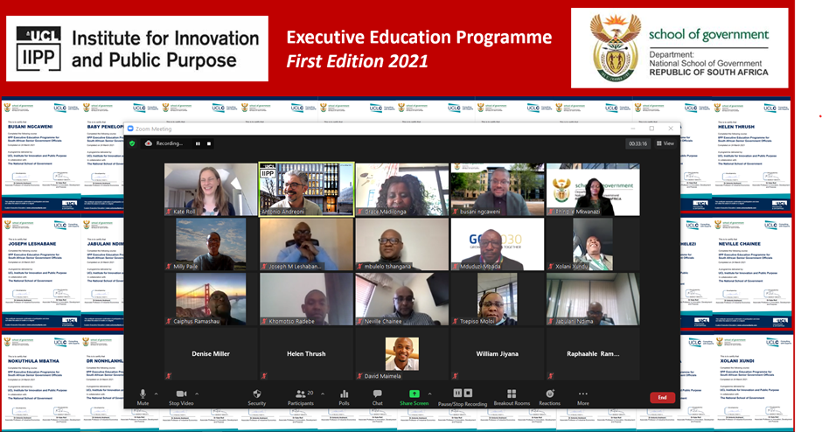
Highlights of performance
11

Slide 12
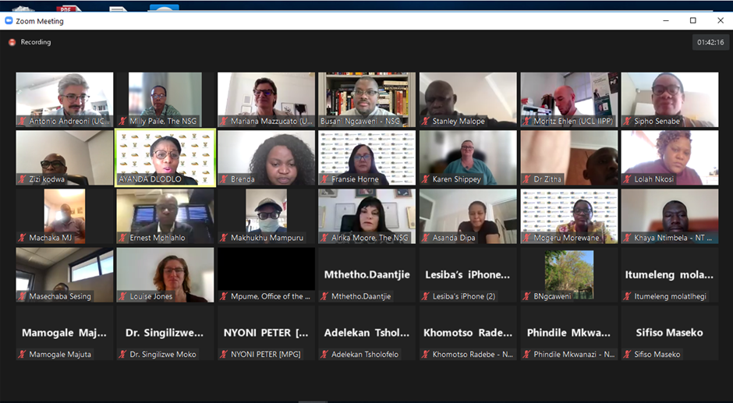
Highlights of performance
12

Slide 13
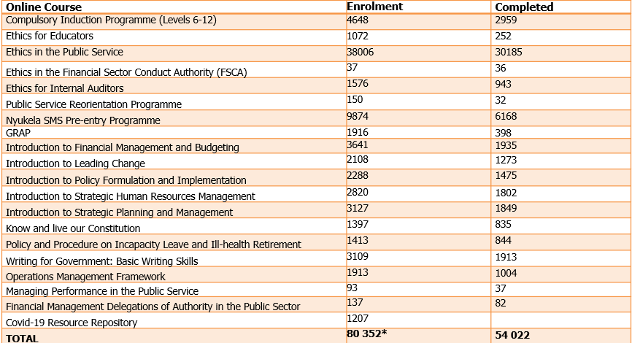
Highlights of performance

Slide 14
Highlights of performance
There is a higher number of learners enrolling for no-cost open eLearning courses as compared to paid courses
The no-cost open eLearning courses are self- paced, efficient, there is no physical interaction and the learner can immediately register.

Slide 15
















Our Partners
GIMPA

Slide 16

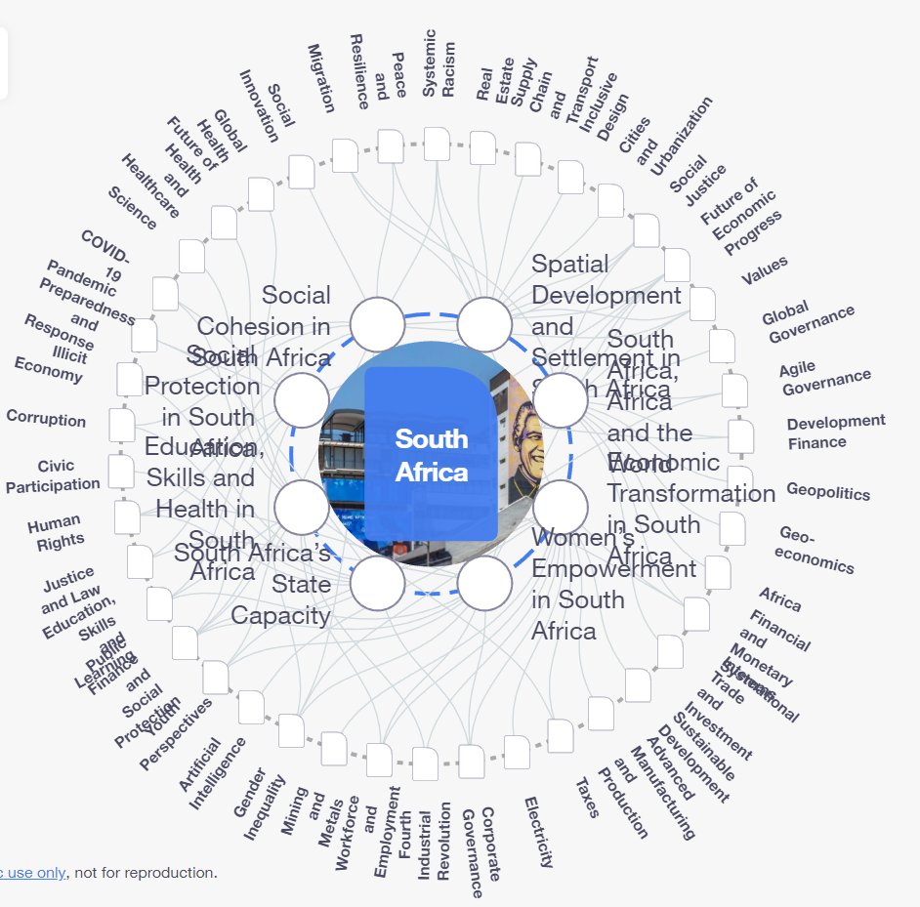
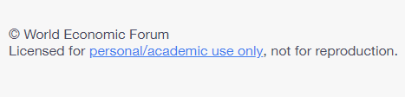
WEF and Knowledge Cooperation

Slide 17



Building depth & expanding reach through HEIs

Slide 18
Programme 1: Targets Achieved
Output Indicator | Planned Target 2021/22 | Actual Achievement 2021/22 | Comment on deviations | Reasons for deviation
Total quality management Plan developed | Total quality management plan developed by March 2022 | Total Quality Management plan developed by March 2022 | None | None
Number of mapped business processes in line with operations management plan implemented | 3 Mapped business processes in line with operations management plan implemented by March 2022 | 6 business process mapped in line with operations management plan by March 2022 | 3 Mapped business processes | A value chain review was undertaken which required new process mapping for all operations
Number of ICT business solutions projects enabling NSG operations | 6 ICT business solutions enabling operations implemented by March 2022 | 6 ICT business solutions enabling operations implemented by March 2022 | None | None

Slide 19
Programme 1: Targets Achieved
Output Indicator | Planned Target 2021/22 | Actual Achievement 2021/22 | Comment on deviations | Reasons for deviation
Percentage of NSG brand and marketing strategy implemented | 30% of the NSG brand and marketing strategy implemented by March 2022 | 50% of the NSG brand and marketing strategy implemented by March 2022 | 20% of the NSG brand and marketing strategy | Two of the four objectives in the brand and marketing strategy were implemented
Number of communication interventions promoting NSG offerings in the public sector | 12 communication interventions promoting NSG offerings in the public sector by March 2022 | 34 communication interventions promoting NSG offering in the public sector undertaken by March 2022 | 22 communication interventions | The need to support branding and promote NSG offering to the public sector
Percentage of material audit findings resolved by the end of financial year | 100% of material audit findings resolved by March 2022 2 Material audit findings issued by AGSA | 100% of material audit findings resolved by March 2022 | None | None

Slide 20
Programme 2: Targets Achieved
Output Indicator | Planned Target 2021/22 | Actual Achievement 2021/22 | Comment on deviations | Reasons for deviation
Knowledge management strategy to support ETD interventions implemented | 4 areas of good practice in the public sector documented to support ETD interventions by March 2022 | 4 areas of good practice in the public sector documented to support ETD by March 2022 | None | None
Number of research projects informing ETD interventions developed | 4 research reports informing ETD interventions developed by March 2022 | 4 research reports informing ETD interventions developed by March 2022 | None | None
Percentage of business development interventions resulting in opportunities for the uptake of NSG offerings | 50% of business development interventions resulting in opportunities for the uptake of the NSG offerings by March 2022 | 50% (23/46) business development interventions resulting in opportunities for the uptake of the NSG offerings by March 2022 | None | None

Slide 21
Programme 2: Targets Achieved
Output Indicator | Planned Target 2021/22 | Actual Achievement 2021/22 | Comment on deviations | Reasons for deviation
Number of skills assessment reports completed on training needs for relevant ETD interventions | 5 skills assessments reports informing ETD needs completed by March 2022 | 11 skills assessment reports informing ETD needs completed by March 2022 | 6 skills assessment reports | The provincial dynamics in the Department of Social Development necessitated more skills assessments to be completed
Annual report on the analysis of Workplace and Sector Skills Plans to inform ETD interventions developed | Annual Report on the analysis of Workplace and Sector Skills Plans to inform ETD interventions developed by March 2022 | Annual Report on the analysis of Workplace and Sector Skills Plans to inform ETD interventions developed by March 2022 | None | None
Number of courses/ programmes/ interventions responsive to identified skills gaps and government priorities developed/ reviewed | 8 courses/ programmes /interventions responsive to identified skills gaps and government priorities developed/ reviewed by March 2022 | 8 courses/ programmes /interventions responsive to identified skills gaps and government priorities developed/ reviewed by March 2022 | None | None

Slide 22
Programme 2: Targets Achieved
Output Indicator | Planned Target 2021/22 | Actual Achievement 2021/22 | Comment on deviations | Reasons for deviation
Number of impact evaluations studies conducted | 6 impact evaluation studies conducted by March 2022 | 6 impact evaluation studies conducted by March 2022 | None | None
Number of impact evaluations studies conducted | 6 reports on the impact evaluation studies conducted | 6 reports on the impact evaluation studies conducted by March 2022 | None | None
Professionalise 2 functional areas of public servants through partnership with professional bodies | National implementation framework on professionalisation of the public service developed by March 2022 | National implementation framework on professionalisation of the public service developed by March 2022 | None | None
Post graduate qualification developed for the NSG | Post-Graduate qualification developed for the NSG by March 2022 | Post-Graduate qualification developed for the NSG by March 2022 | None | None
Percentage of partnerships facilitated to support ETD interventions | 20% partnerships facilitated to support interventions by March 2022 | 55% (28/51) partnerships facilitated to supported interventions by March 2022 | 35% | Some partnership agreements were due for implementation since signing in the previous financial years

Slide 23
Programme 2: Targets Achieved
Output Indicator | Planned Target 2021/22 | Actual Achievement 2021/22 | Comment on deviations | Reasons for deviation
Number of thought leadership seminars/platforms in partnership with public and private sectors hosted | 5 Thought leadership platforms /seminars hosted by March 2022 | 8 thought leadership platforms/ seminar hosted by March 2022 | 3 platforms | The hosting of further thought leadership platforms emanated from cooperation and collaboration with partners.
Performance Management Systems for ETD practitioners established | Framework for performance management system for ETD practitioners developed by March 2022 | Framework for performance management system for ETD practitioners developed by March 2022 | None | None
NSG status as an accredited training provider maintained | Accreditation processes facilitated and managed to maintain the status of the NSG as an accredited training provider by March 2022 | Accreditation processes facilitated and managed to maintain the status of the NSG as an accredited training provider by March 2022 | None | None
Number of programmes/ courses quality assured by the NSG Quality Assurance Committee | 8 programmes/ courses quality assured by the NSG Quality Assurance Committee by March 2022 | 8 programmes/ courses quality assured by the NSG Quality Assurance Committee by March 2022 | None | None

Slide 24
Programme 2: Targets Achieved
Output Indicator | Planned Target 2021/22 | Actual Achievement 2021/22 | Comment on deviations | Reasons for deviation
Compulsory in-service training framework approved and programmes implemented | 4 compulsory programmes implemented by March 2022 | 9 compulsory programmes Implemented by March 2022 | 5 compulsory programmes | The reduced Covid-19 restrictions led to more virtual and face to face training being conducted and implementing more compulsory programmes
Number of learners trained on compulsory and demand- led ETD interventions | 38 460 learners trained on compulsory and demand-led ETD interventions by March 2022 | 86 687 learners trained on compulsory and demand- led ETD interventions by March 2022 | 48 227 learners | Increased face to face bookings due to the relaxed Covid-19 regulations

Slide 25
Programme 2: Targets Achieved
Output Indicator | Planned Target 2021/22 | Actual Achievement 2021/22 | Comment on deviations | Reasons for deviation
Number of provincial departments of education trained (ToT) by NSG to roll out training on handling diversity and dealing with all forms of discrimination to teachers and School Management Teams | 4 provincial departments of education trained (ToT) to roll out training to teachers and School Management Teams by March 2022 | 5 provincial departments of education trained (ToT) to roll out training to teachers and School Management Teams by March 2022 (Limpopo, Mpumalanga, Northern Cape, North West, Western Cape) | 1 provincial education department trained and School Management Team | An additional department was able to avail itself for the training session.
Comprehensive methodology for a perception survey to determine satisfaction with the NSG’s ETD interventions in response to government priorities and performance improvement in the public sector developed | Perception survey in national and provincial government to determine the learner satisfaction on NSG’s ETD interventions undertaken by March 2022 | Perception survey in national and provincial government to determine the learner satisfaction on NSG’s ETD interventions completed by March 2022 | None | None

Slide 26
Programme 2: Targets Achieved
Output Indicator | Planned Target 2021/22 | Actual Achievement 2021/22 | Comment on deviations | Reasons for deviation
Number of active online learning ETD interventions | 36 active online learning ETD interventions available by March 2022 | 43 active online learning ETD (excluding blended and virtual) by March 2022 | All NSG ETD interventions are either delivered online or have an online component. | In responding to the increased demand, All NSG ETD interventions are either delivered online or have an online component.
Number of online courses developed | 2 online courses developed by March 2022 | 12 online courses developed by March 2022 | 7 online ETD

Slide 27
Programme 2: Targets Not Achieved
Performance Indicator | Planned Target 2021/22 | Actual Achievement 2021/22 | Comment on deviations | Reasons for deviation
Amount of revenue generated and other funding sources in TTA as part of the cost-recovery | R118,5m in revenue and other funding sources generated (cumulative) by March 2022 | R98.7 in revenue and other funding sources generated by March 2022 | R19.8 | The difference in revenue generated is due to the lower online tariffs as opposed to face to face tariffs.
Percentage of senior managers in the public service trained on how to deal with all forms of discrimination | 30% of senior managers in the public service trained on how to deal with all forms of discrimination by March 2022 | No training in the financial year under review by March 2022 | 30% SMS | Despite DPSA issuing Circular 11 of 2021, and continual calls to HRD coordinators, launch session, no uptake on course was received.

Slide 28
Financial Performance - VOTE
 | Annual Budget 2021/22 | Adjusted Budget | April to March Pro-rata budget 2021/22 | April to March Actual Expenditure | April to March Variance budget compared to actual (over)/under | April to March Expenditure as % of pro-rata budget
 | R'000 | R'000 | R'000 | R'000 | R'000 | %
Administration | 110,874 | 110,874 | 110,874 | 104,079 | 6,795 | 93,9%
Public Sector Organisational and Staff Development | 103,423 | 103,423 | 103,423 | 103,423 | - | 100,0%
Total Vote Expenditure | 214,297 | 214,297 | 214,297 | 207,502 | 6,795 | 96,8%
Compensation of Employees | 59,694 | 59,671 | 59,671 | 56,880 | 2,791 | 95,3%
Goods and services | 47,621 | 47,621 | 47,621 | 44,935 | 2,686 | 94,4%
Households | 196 | 219 | 219 | 219 | - | 100,0%
Payments for capital assets | 3,363 | 3,363 | 3,363 | 2,045 | 1,318 | 60,8%
Transfers NSG | 103,423 | 103,423 | 103,423 | 103,423 | - | 100,0%
Total Vote Expenditure | 214,297 | 214,297 | 214,297 | 207,502 | 6,795 | 96,8%
Donor EU | 10,468 | 10,468 | 10,468 | 7,682 | 2,786 | 73,3%
Grand Total | 224,765 | 224,765 | 224,765 | 215,184 | 6,795 | 96,8%

Slide 29
Financial Performance – TRADING ACCOUNT
 | Annual Budget 2021/22 | Adjusted Budget | April to March Pro-rata budget 2021/22 | April to March Actual Expenditure | April to March Variance budget compared to actual (over)/under | April to March Expenditure as % of pro-rata budget
 |  | R'000 | R'000 | R'000 | R'000 | %
Training related revenue (course Fees) | 118,588 | 118,588 | 118,588 | 97,609 | 20,979 | 82%
Transfers NSG | 103,423 | 103,423 | 103,423 | 103,423 | - | 100,0%
Other Revenue (Interest) | 3,400 | 3,400 | 3,400 | 6,259 | -2,859 | 184%
Total Revenue | 225,411 | 225,411 | 225,411 | 207,291 | 18,120 | 92%
Compensation of Employees | 106,624 | 106,624 | 106,624 | 92,736 | -13,888 | 87%
Goods and services | 118,787 | 118,787 | 118,787 | 89,186 | -29,601 | 75%
Payments for capital assets |  |  | - | -1,925 | 1,925 | 0,0%
Total Trade Expenditure | 225,411 | 225,411 | 225,411 | 183,847 | 41,564 | 82%
Suplus/(Deficit) | - | - | - | 23,444 | -23,444 | -

Slide 30
Human Resource Information
The NSG has a total of 229 posts on the organisational structure
204 posts filled and 25 vacant, vacancy rate is therefore 10.9%
Of the 25 vacant posts, 6 posts are SMS whilst 19 are non SMS posts
The vacant posts are due to the repositioning of the NSG and budget ceiling on compensation of employees
Demographic Profile
African | 82.4%
White | 7.8%
Coloured | 5.4%
Indian | 4.4%
Employment Equity
NSG has fair representation of gender; females (58.8%), females SMS (51.2%). Youth (19.1%) and PWD (2.4%)

Slide 31
Corporate Governance
Following the internal and external audits, the NSG has once again achieved a CLEAN AUDIT (Vote) and UNQUALIFIED AUDIT (Trade).
The NSG follows an integrated approach towards risk management and has adopted the Public Sector Risk Management Framework in developing the approved Enterprise Risk Management Framework. The Framework outlines the risk management approach followed by the Department in identifying strategic, operational and emerging risks.
The NSG has an approved Fraud and Anti-Corruption Policy that has a zero-tolerance to fraud, corruption and other irregularities. The policy and the fraud and ethics implementation plan are the tools used as a response framework for combating fraud and corruption within the Department.

Slide 32
Progress Report on PC Recommendations

Slide 33
Progress report on PC Recommendations
No | RECOMMENDATION | RESPONSE
9.1 | The School should develop a fully-fledged Funding Model to maintain self-generated income through the Training Trading Account. The NSG should provide the Committee with an update by November 2022. | The National School of Government is engaging with the National Treasury on its Funding and Sustainability Model. A discussion document has been developed and will be submitted to the FOSAD Cluster and Cabinet before the end of the financial year 2022/23. This discussion document is part of the Repositioning of the National School of Government.
9.2 | The NSG should move with speed towards the execution of the National Implementation Framework on the Professionalisation of the public service once Cabinet approves it. The NSG together with the Department of Public Service and Administration should ensure that all government departments and entities abide by the Framework. | After public comments were received and considered by the High-Level Ministerial Panel, NSG, PSC and DPSA, the revised Framework on the Professionalisation of the Public Sector was presented again to the FOSAD MANCO on 09 May 2022. The revised Framework was also shared with the National Planning Commission and SALGA for further inputs and they have submitted their inputs. The Framework was also given to the Department of Justice and Constitutional Development for vetting. The Framework has been finalised and it was presented to the Joint Cabinet Committee on 03 August 2022. The Framework will again be presented to the Joint Cabinet Committee and Cabinet in October 2022 for approval. Lead government departments and agencies are requested to have implementation plans by end of the financial year.

Slide 34
Progress report on PC Recommendations
No | RECOMMENDATION | RESPONSE
9.3 | The NSG should provide its trainees with qualification (certificates) after having enrolled and completed training courses, even as balance must be struck between education and training being certification driven, more so than imparting impactful knowledge to the public servants. | The NSG issues competence certificates to all qualifying learners within a reasonable period. Qualifying learners are those who meet admission requirements for enrolment to accredited programmes and courses, and who are found competent following assessment and moderation of their assignments and successful verification by Education Training Quality Assurance bodies. Attendance and completion certificates are issued, on average, within two weeks from the last date of training.
9.4 | The NSG should conduct impact evaluation of its training programmes to measure the efficacy and application of knowledge with the aim of improving performance. | Since 2013, the NSG has been conducting more in-depth evaluation studies, i.e., the Application of Learning Studies (ALS) / Outcome evaluations and impact evaluations (started in 2020/2021) of the identified training programmes (this is usually done at least 6 months to a year after the training has taken place). The aim of these evaluations is to determine whether the training programmes offered by the NSG are aligned to the needs of the public service, whether there are any changes in behaviours of individuals because of the training as well as the subsequent changes in the workplace. In effect, these evaluations are measuring the impact of the training at an individual and unit level by following the cohort of officials who attended the training programmes in order to measure their performance against the programmes they had attended.

Slide 35
Progress report on PC Recommendations
No | RECOMMENDATION | RESPONSE
9.4 | Continuing…. | To date, twenty-eight (28) of these Application of Learning Evaluations and six impact evaluations have been conducted by the NSG which focused on training programmes offered by the NSG. The findings revealed behavioural changes in individuals, especially, in incidences where the correct target group of participants (i.e. the correct level) was sent to a training intervention and the work environment of these participants is conducive for the implementation of their newly acquired knowledge and skills. In many instances, systemic changes as well as improvements in operational procedures in Departments are realised. It was also found during the two of the Application of Learning studies / Impact evaluations that in instances where negative audit opinions were made against a particular department in specific functional areas, the deficiencies get addressed once officials responsible for those functional areas attended the relevant training programmes at the NSG. Some of the evaluations revealed that in incidences where departments sent the correct officials to attend the training programme and they were supportive to these officials, positive outcomes had been realised, which resulted in a return on expectations by the employers and the officials.

Slide 36
Progress report on PC Recommendations
No | RECOMMENDATION | RESPONSE
9.4 | Continuing… | Two of the impact evaluations that were conducted during the 2021/2022 financial year (i.e., Gender Mainstreaming in the Public Service Programme and The Art of Facilitating Participatory Community Engagement Programme) yield excellent results/findings, as impact could be measured at a personal level of those participants who attended the training interventions (i.e. behavioural changes occurred). Impact also occurred at their unit and departmental levels (due to a conducive environment for application of their newly acquired knowledge and skills). The majority of these participants also indicated that they applied their new knowledge in their communities as well as in their family lives. These findings prove that if the conditions are favourable for the implementation of newly acquired knowledge and skills gained by the participants who attend the NSG training interventions, impact at various levels will occur. The NSG is conducting six new impact evaluations from 2022/2023 – 2023/2024.

Slide 37
Progress report on PC Recommendations
No | RECOMMENDATION | RESPONSE
9.5 | The NSG should create more awareness campaigns on the Nyukela programme annually in order to attract young people employed in both public and private sector aspiring to consider public service as career of choice. | The National School of Government has implemented paid social media advertising campaigns to expand the reach of the young people employed in both public and private sectors. In addition to paid advertising, the NSG also uses its social media platforms to market the Nyukela course. The weekly DPSA Vacancy Circular includes information directing all senior management post applicants to enrol for Nyukela Programme which further assists to market the course. Other efforts are exhibitions at conferences and government departments open days that attract young people. The NSG website is also used to support the Nyukela advertising campaign.
9.6 | The School should offer mostly accredited courses so that full recognition is afforded to employees being trained, so that they have opportunities for development and promotion. | The National School of Government is in the process of signing the Service Level Agreement (SLA) with the Quality Council for Trades and Occupations to ensure that the School delivers registered qualifications on the Occupational Qualifications Sub-Framework. In addition, the NSG has started engagements with the Minister of Higher Education Science & Innovation regarding this matter. A follow up meeting is scheduled for 10 October 2022 with the Department of Higher Education & Training to discuss the possibility of declaring the NSG as a College to deliver accredited higher education qualifications. Plans are already in place for the NSG to revise and align some of its programmes into full qualifications.

Slide 38
Progress report on PC Recommendations
No | RECOMMENDATION | RESPONSE
9.7 | The School should consider, where possible, to offer most of its training courses through e-Learning platforms, as part of modernising its business and saving costs on the logistics such as venues. The School has to devise a strategy to attract public servants to enrol for online courses. The School has to approach all data network companies to donate data for NSG courses to be offered on a zero rated basis. Zero rated data for training courses will assist the School to attract more public servants to enrol for training and development interventions that will assist government officials to learn, serve and grow. The Committee was of the firm view that virtual learning platforms will reduce logistical costs of the NSG and other government departments. | Since the COVID-19 pandemic required social distancing, the majority of new ETD interventions developed for rollout by the NSG have an online component. eLearning works in a cross-functional team to make NSG offerings available on its eLearning platform, growing online learning opportunities. Online training, by definition, requires that participants have access to computers and data. While the NSG adheres to design and development principles to promote the accessibility of online learning materials, the School cannot provide the hardware, software and data necessary for participation in the context of implementation. The uptake of eLearning has increased significantly since social distancing was imposed to curb the spread of COVID-19.

Slide 39
Progress report on PC Recommendations
No | RECOMMENDATION | RESPONSE
9.8 | Due to global warming, the School was urged to conceptualise courses on climate change in order to empower the public service to respond to natural disasters. | The National School of Government developed the Our Planet Our Home: Promoting the Green Economy to Balance Inclusive Growth and Sustainability – blended interactive learning course with several application of learning activities. The course focuses on the following: Climate change and the Green Economy – setting the context for the course by clarifying key terms and green economy concepts and challenges. It also outlines policy responses and mainstreaming imperatives. Transiting to a greener economy – engaging with the contestations, debates, and perspectives around the green economy. It also deals with the use of natural resources, and Public Service delivery and implementation within the Green Economy. Policy and regulatory compliance are discussed as an important aspect of transitioning to a greener economy. Applying responsive policies to promote sustainability, service delivery and inclusive growth – dealing with the practical aspects of the Green Economy in relation to service delivery. Learners should be able to demonstrate an understanding of the options and opportunities available for the practical implementation of climate sensitive and environmentally sound approaches in their areas of work.

Slide 40
Thank you
The NSG:
Learn: expanding learning opportunities for public servants to master state craft
Serve: building the capacity (and culture) of public servants to serve society effectively
Grow: helping public servants to combine learning and service (experience) to grow professionally

